Slide 1
Chapter 3
Vectors

Slide 2
Vectors
Vector quantities
  Physical quantities that have both numerical and directional properties
Mathematical operations of vectors in this chapter
  Addition
  Subtraction
Introduction

Slide 3
Coordinate Systems
Used to describe the position of a point in space
Common coordinate systems are:
  Cartesian
  Polar
Section 3.1

Slide 4
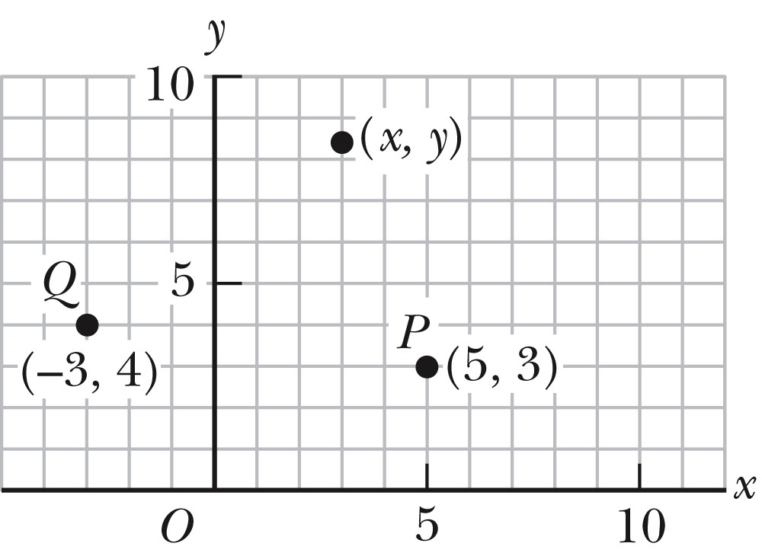
Cartesian Coordinate System
Also called rectangular coordinate system
x- and y- axes intersect at the origin
Points are labeled (x,y)
Section 3.1

Slide 5
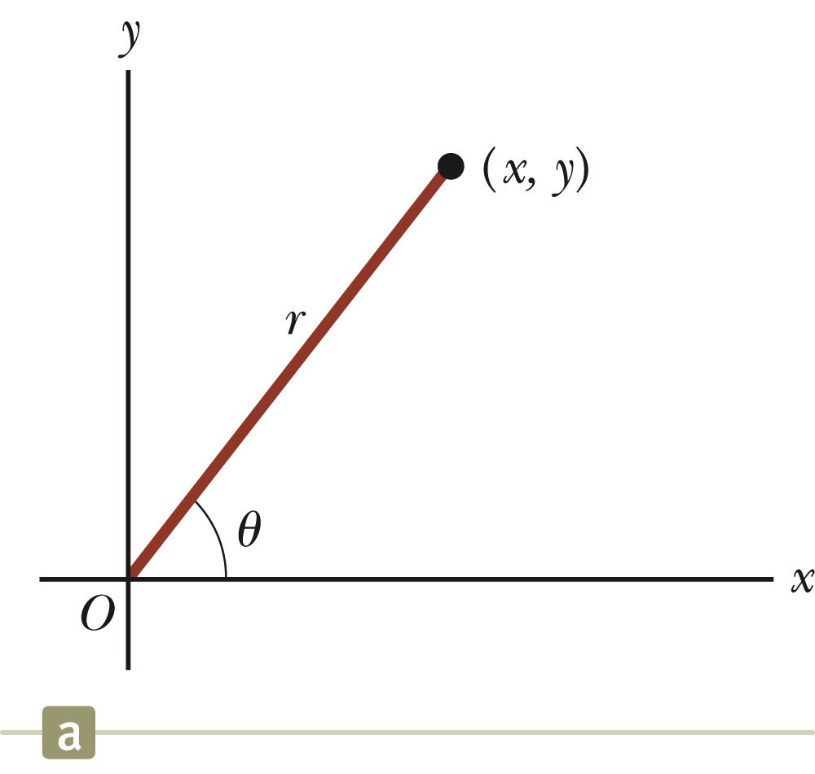
Polar Coordinate System
Origin and reference line are noted
Point is distance r from the origin in the direction of angle θ, ccw from reference line
  The reference line is often the x-axis.
Points are labeled (r,θ)
Section 3.1

Slide 6
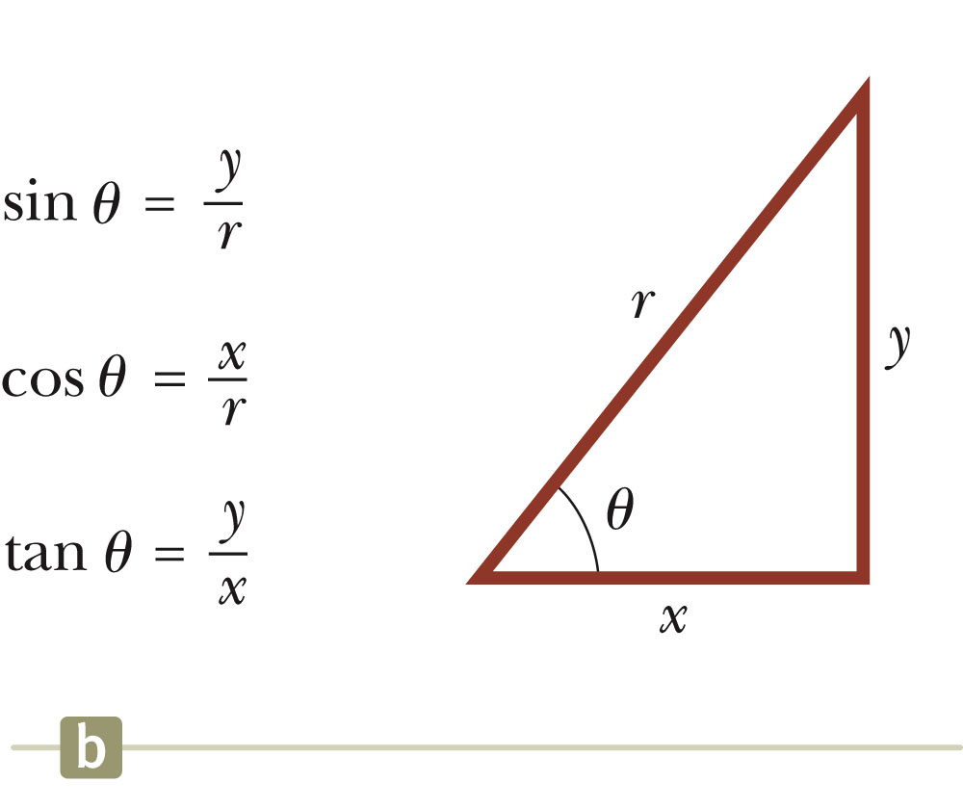
Polar to Cartesian Coordinates
Based on forming a right triangle from r and θ
x = r cos θ
y = r sin θ
If the Cartesian coordinates are known:
Section 3.1

Slide 7
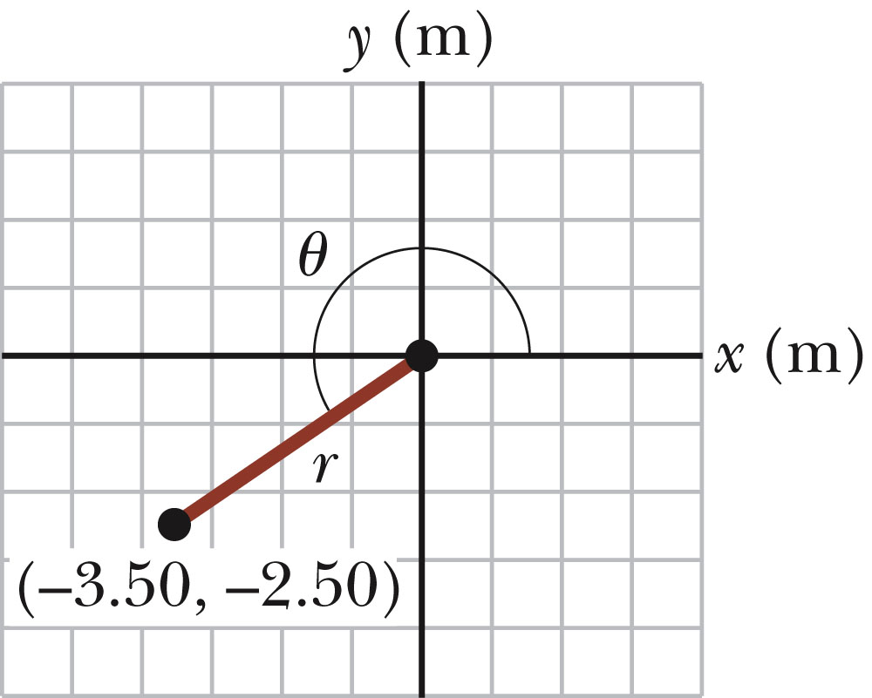
Example 3.1
The Cartesian coordinates of a point in the xy plane are (x,y) = (-3.50, -2.50) m, as shown in the figure. Find the polar coordinates of this point.
Solution: From Equation 3.4,
and from Equation 3.3,
Section 3.1

Slide 8
Vectors and Scalars
A scalar quantity is completely specified by a single value with an appropriate unit and has no direction.
  Many are always positive
  Some may be positive or negative
  Rules for ordinary arithmetic are used to manipulate scalar quantities.
A vector quantity is completely described by a number and appropriate units plus a direction.
Section 3.2

Slide 9
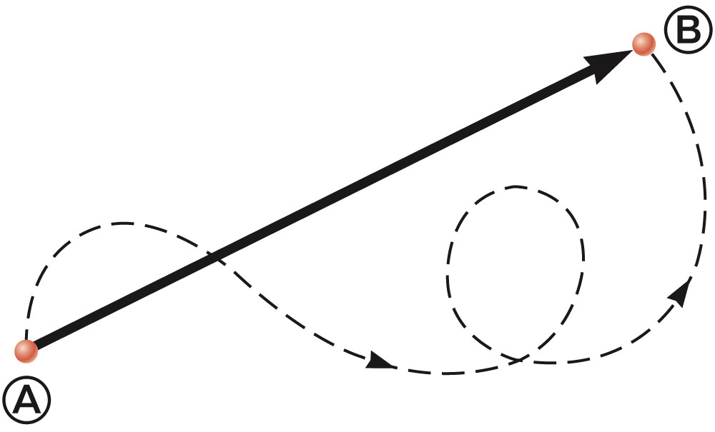
Vector Example
A particle travels from A to B along the path shown by the broken line.
  This is the distance traveled and is a scalar.
The displacement is the solid line from A to B
  The displacement is independent of the path taken between the two points.
  Displacement is a vector.
Section 3.2

Slide 10
Vector Notation
Text uses bold with arrow to denote a vector:
Also used for printing is simple bold print: A
When dealing with just the magnitude of a vector in print, an italic letter will be used: A or | |
  The magnitude of the vector has physical units.
  The magnitude of a vector is always a positive number.
When handwritten, use an arrow:
Section 3.2

Slide 11
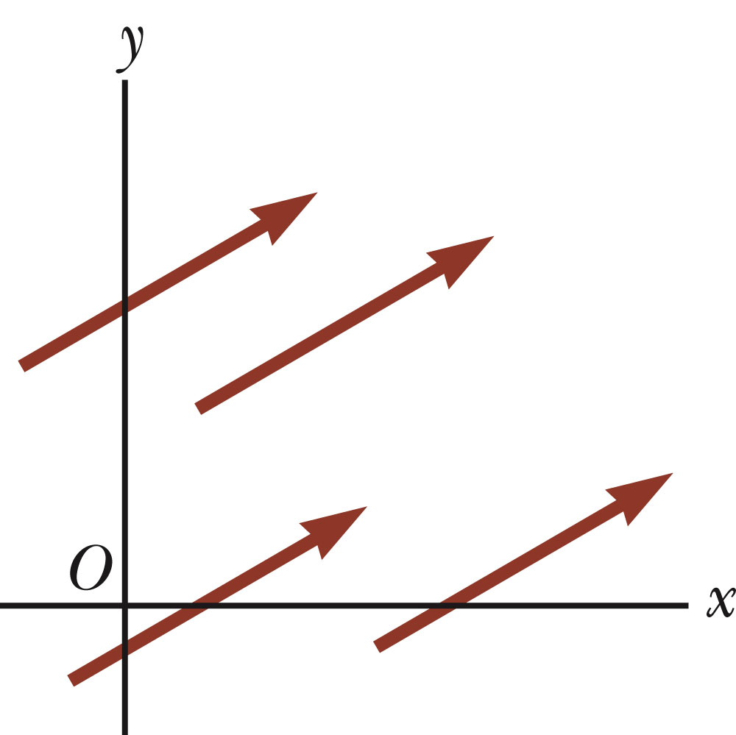
Equality of Two Vectors
Two vectors are equal if they have the same magnitude and the same direction.
if A = B and they point along parallel lines
All of the vectors shown are equal.
Allows a vector to be moved to a position parallel to itself
Section 3.3

Slide 12
Adding Vectors
Vector addition is very different from adding scalar quantities.
When adding vectors, their directions must be taken into account.
Units must be the same
Graphical Methods
  Use scale drawings
Algebraic Methods
  More convenient
Section 3.3

Slide 13
Adding Vectors Graphically
Choose a scale.
Draw the first vector, , with the appropriate length and in the direction specified, with respect to a coordinate system.
Draw the next vector with the appropriate length and in the direction specified, with respect to a coordinate system whose origin is the end of vector and parallel to the coordinate system used for .
Section 3.3

Slide 14
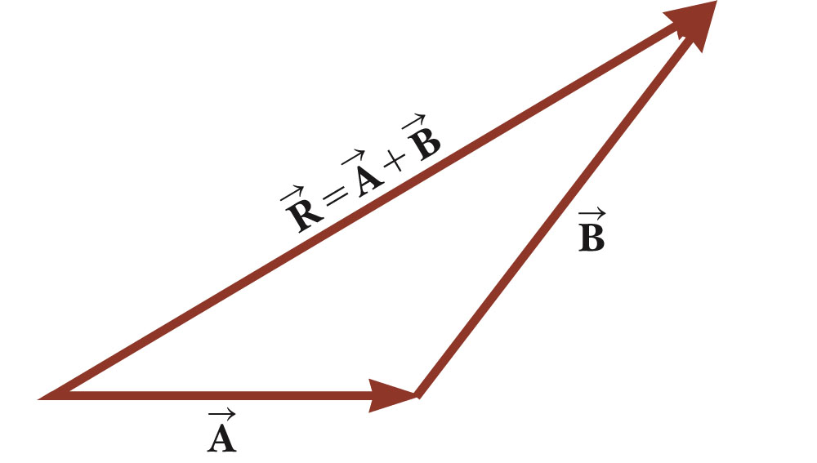
Adding Vectors Graphically, cont.
Continue drawing the vectors “tip-to-tail” or “head-to-tail”.
The resultant is drawn from the origin of the first vector to the end of the last vector.
Measure the length of the resultant and its angle.
  Use the scale factor to convert length to actual magnitude.
Section 3.3

Slide 15
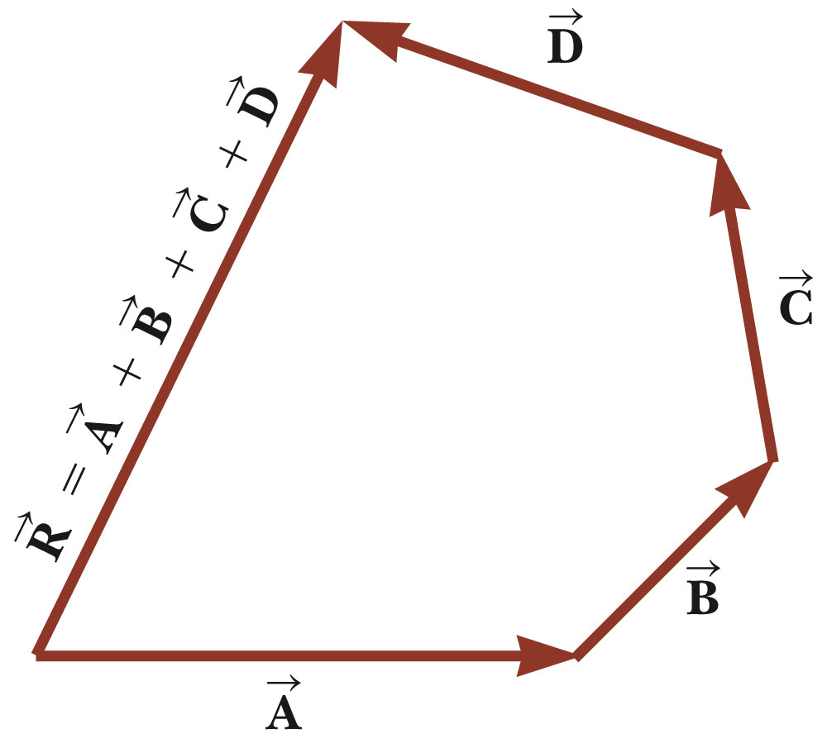
Adding Vectors Graphically, final
When you have many vectors, just keep repeating the process until all are included.
The resultant is still drawn from the tail of the first vector to the tip of the last vector.
Section 3.3

Slide 16
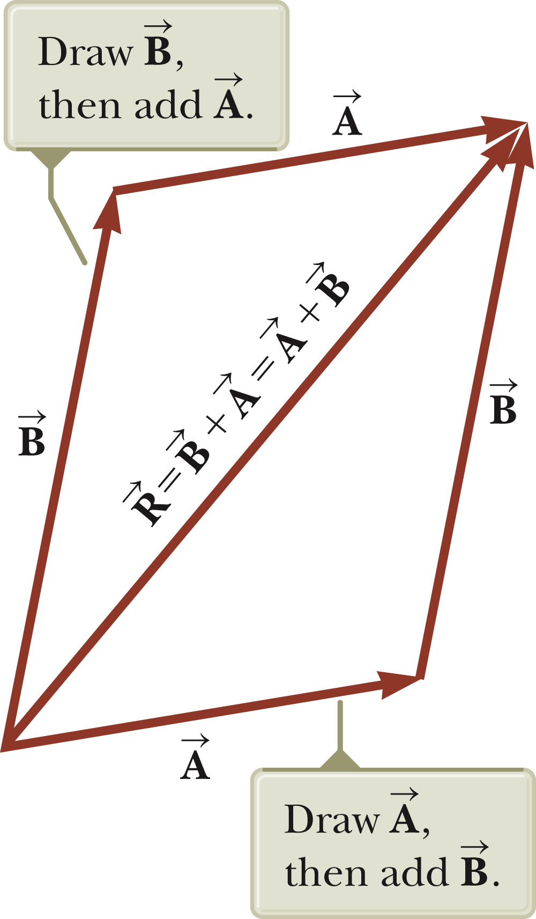
Adding Vectors, Rules
When two vectors are added, the sum is independent of the order of the addition.
  This is the Commutative Law of Addition.
Section 3.3

Slide 17
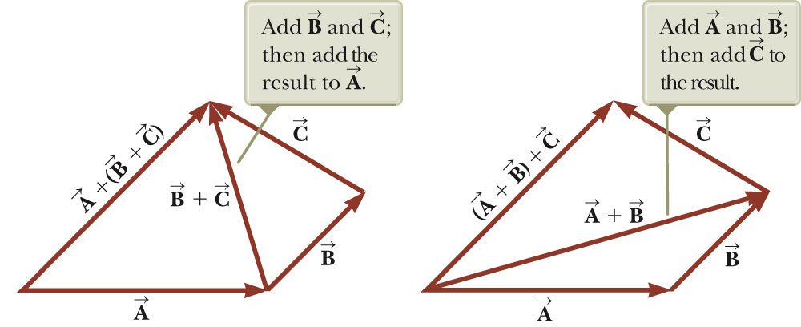
Adding Vectors, Rules cont.
When adding three or more vectors, their sum is independent of the way in which the individual vectors are grouped.
  This is called the Associative Property of Addition.
Section 3.3

Slide 18
Adding Vectors, Rules final
When adding vectors, all of the vectors must have the same units.
All of the vectors must be of the same type of quantity.
  For example, you cannot add a displacement to a velocity.
Section 3.3

Slide 19
Negative of a Vector
The negative of a vector is defined as the vector that, when added to the original vector, gives a resultant of zero.
  Represented as
The negative of the vector will have the same magnitude, but point in the opposite direction.
Section 3.3

Slide 20
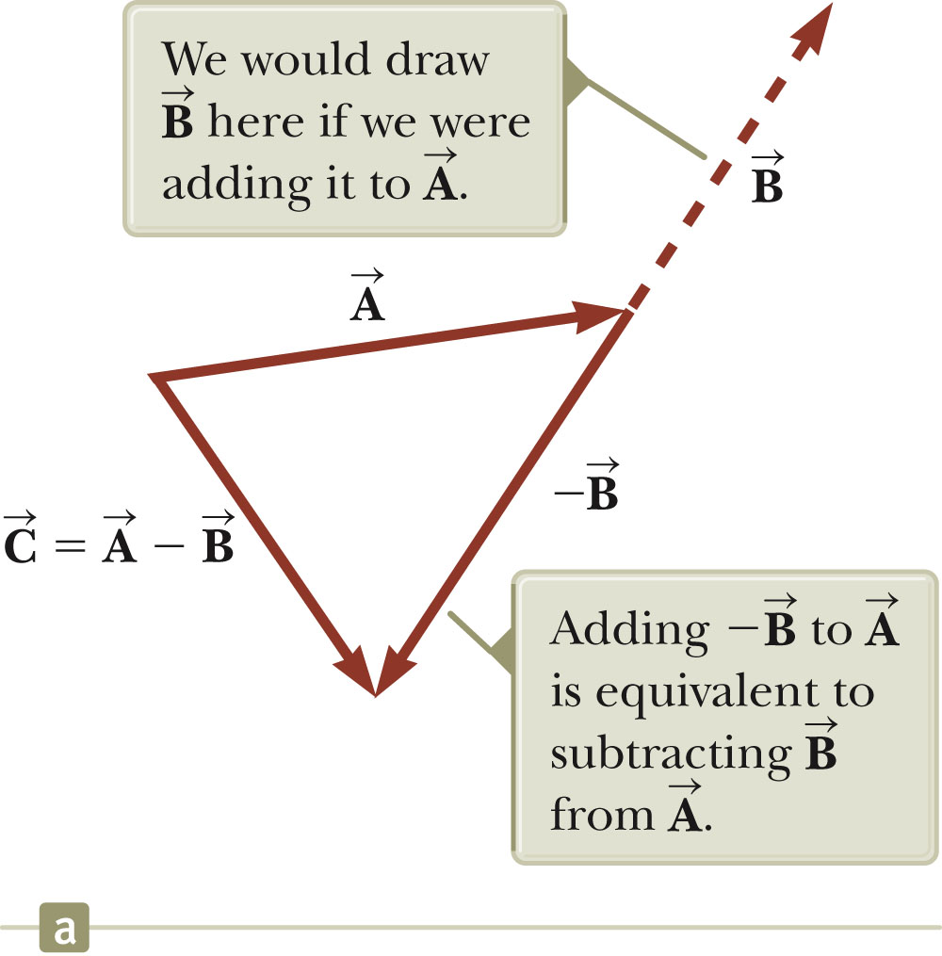
Subtracting Vectors
Special case of vector addition:
If , then use
Continue with standard vector addition procedure.
Section 3.3

Slide 21
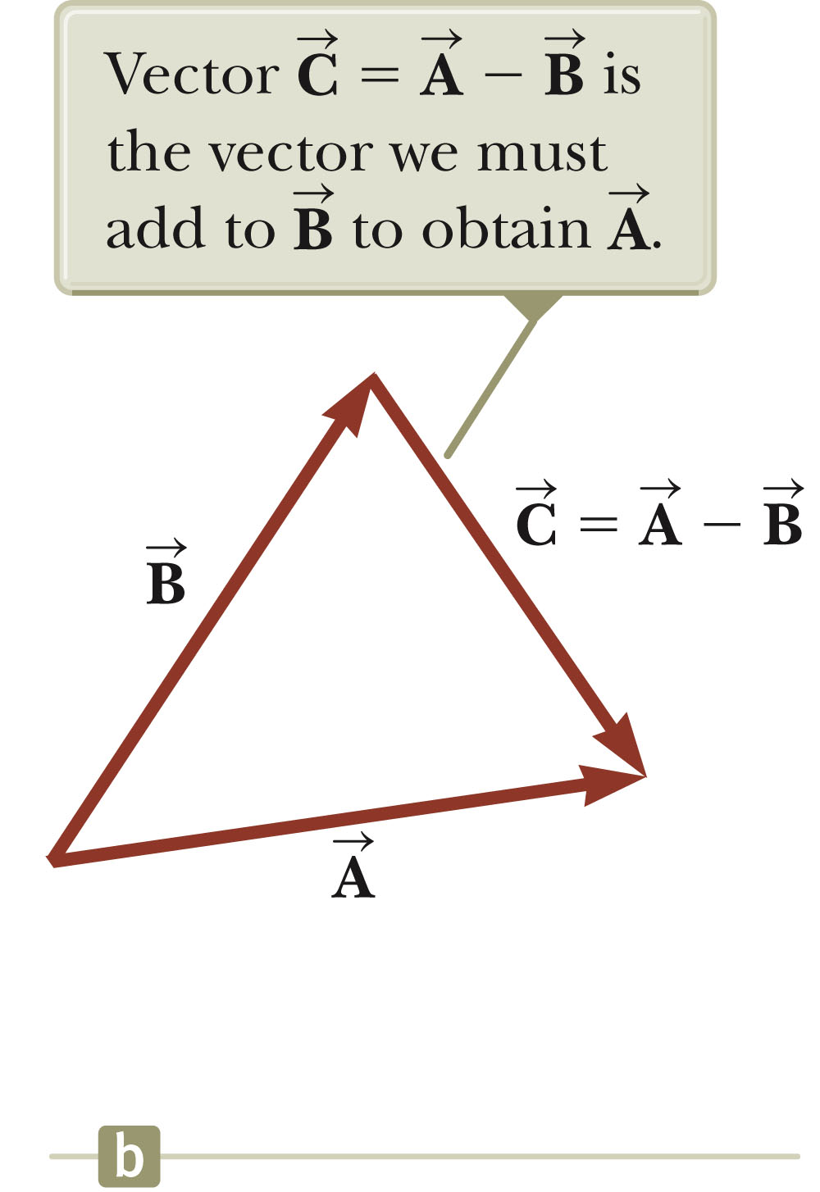
Subtracting Vectors, Method 2
Another way to look at subtraction is to find the vector that, added to the second vector gives you the first vector.
  As shown, the resultant vector points from the tip of the second to the tip of the first.
Section 3.3

Slide 22
Multiplying or Dividing a Vector by a Scalar
The result of the multiplication or division of a vector by a scalar is a vector.
The magnitude of the vector is multiplied or divided by the scalar.
If the scalar is positive, the direction of the result is the same as of the original vector.
If the scalar is negative, the direction of the result is opposite that of the original vector.
Section 3.3

Slide 23
Component Method of Adding Vectors
Graphical addition is not recommended when:
  High accuracy is required
  If you have a three-dimensional problem
Component method is an alternative method
  It uses projections of vectors along coordinate axes
Section 3.4

Slide 24
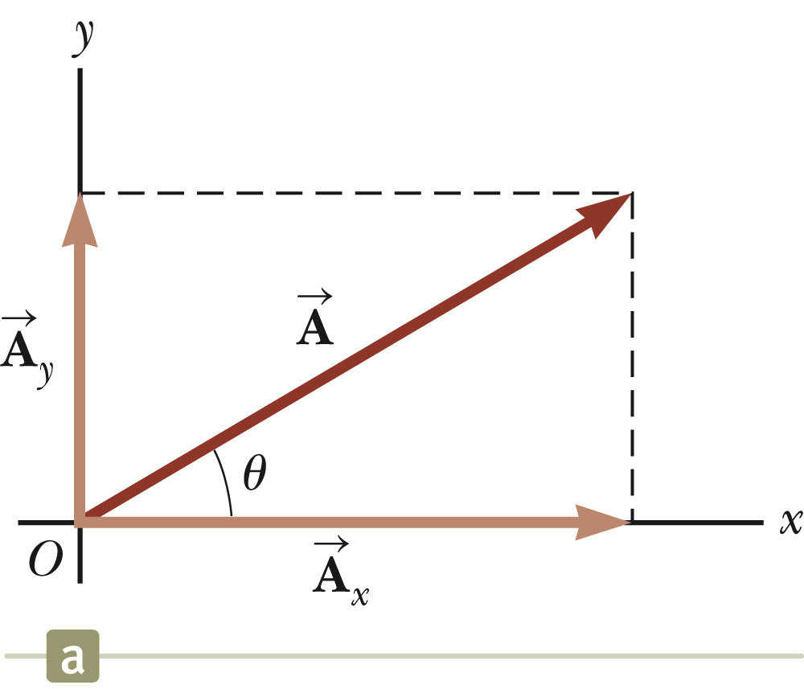
Components of a Vector, Introduction
A component is a projection of a vector along an axis.
  Any vector can be completely described by its components.
It is useful to use rectangular components.
  These are the projections of the vector along the x- and y-axes.
Section 3.4

Slide 25
Vector Component Terminology
are the component vectors of .
  They are vectors and follow all the rules for vectors.
A_{x} and A_{y} are scalars, and will be referred to as the components of .
Section 3.4

Slide 26
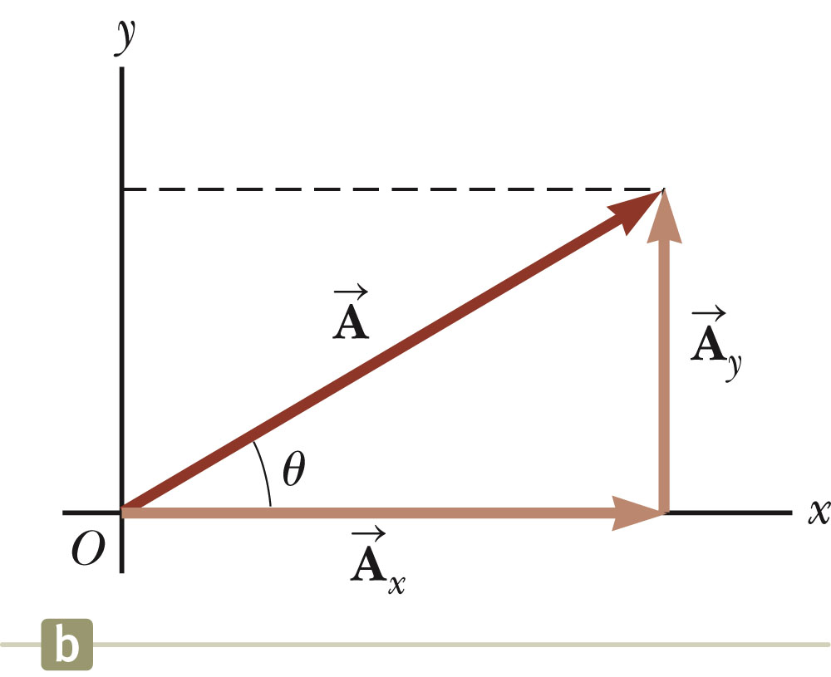
Components of a Vector
Assume you are given a vector
It can be expressed in terms of two other vectors, and
These three vectors form a right triangle.
Section 3.4

Slide 27
Components of a Vector, 2
The y-component is moved to the end of the x-component.
This is due to the fact that any vector can be moved parallel to itself without being affected.
  This completes the triangle.
Section 3.4

Slide 28
Components of a Vector, 3
The x-component of a vector is the projection along the x-axis.
The y-component of a vector is the projection along the y-axis.
This assumes the angle θ is measured with respect to the x-axis.
  If not, do not use these equations, use the sides of the triangle directly.
Section 3.4

Slide 29
Components of a Vector, 4
The components are the legs of the right triangle whose hypotenuse is the length of A.
  May still have to find θ with respect to the positive x-axis
In a problem, a vector may be specified by its components or its magnitude and direction.
Section 3.4

Slide 30
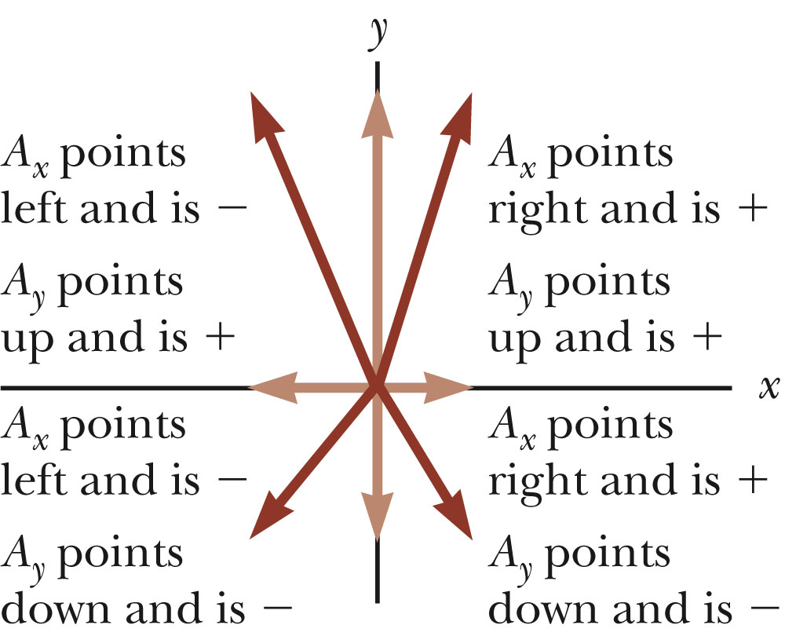
Components of a Vector, final
The components can be positive or negative and will have the same units as the original vector.
The signs of the components will depend on the angle.
Section 3.4

Slide 31
Unit Vectors
A unit vector is a dimensionless vector with a magnitude of exactly 1.
Unit vectors are used to specify a direction and have no other physical significance.
Section 3.4

Slide 32
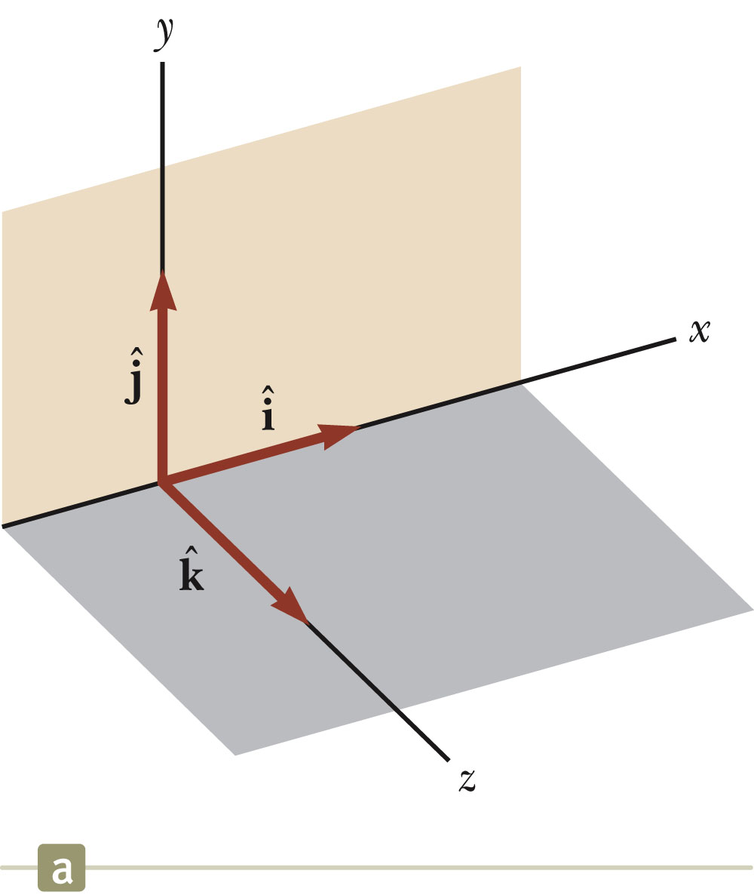
Unit Vectors, cont.
The symbols
represent unit vectors
They form a set of mutually perpendicular vectors in a right-handed coordinate system
The magnitude of each unit vector is 1
Section 3.4

Slide 33
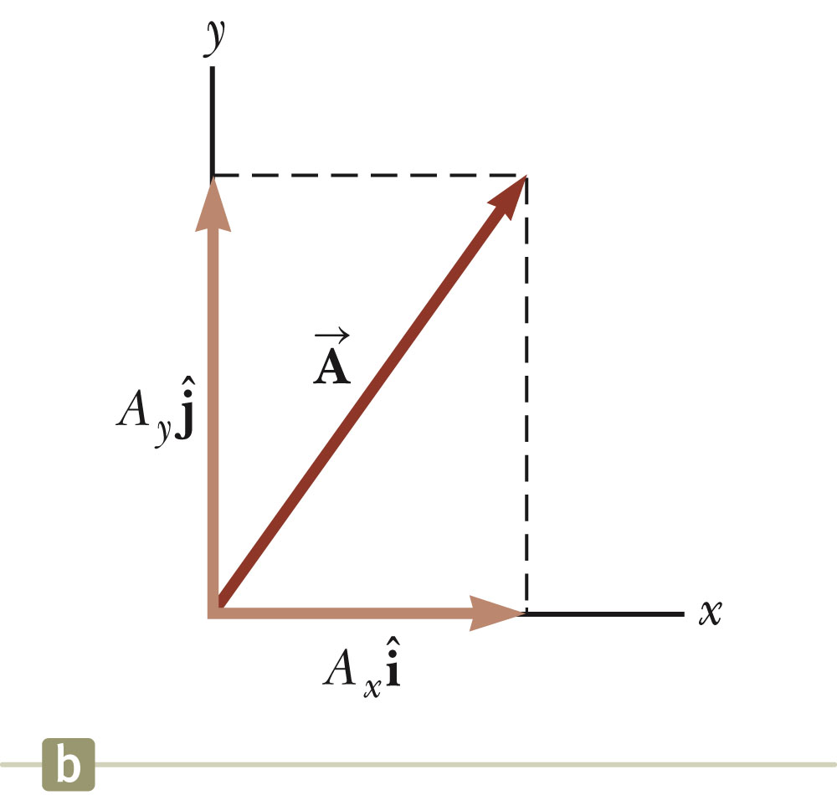
Unit Vectors in Vector Notation
A_{x} is the same as A_{x} and A_{y} is the same as A_{y} etc.
The complete vector can be expressed as:
Section 3.4

Slide 34
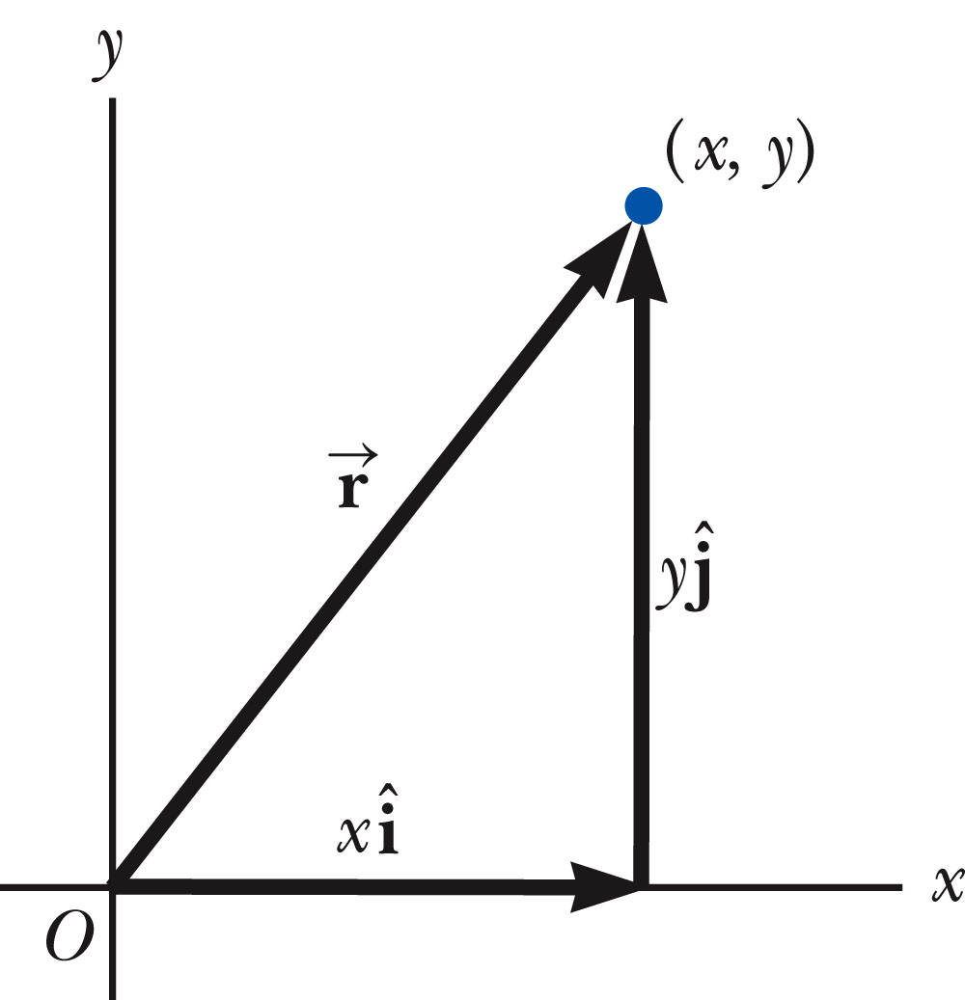
Position Vector, Example
A point lies in the xy plane and has Cartesian coordinates of (x, y).
The point can be specified by the position vector.
This gives the components of the vector and its coordinates.
Section 3.4

Slide 35
Adding Vectors Using Unit Vectors
Using
Then
So R_{x} = A_{x} + B_{x} and R_{y} = A_{y} + B_{y}
Section 3.4

Slide 36
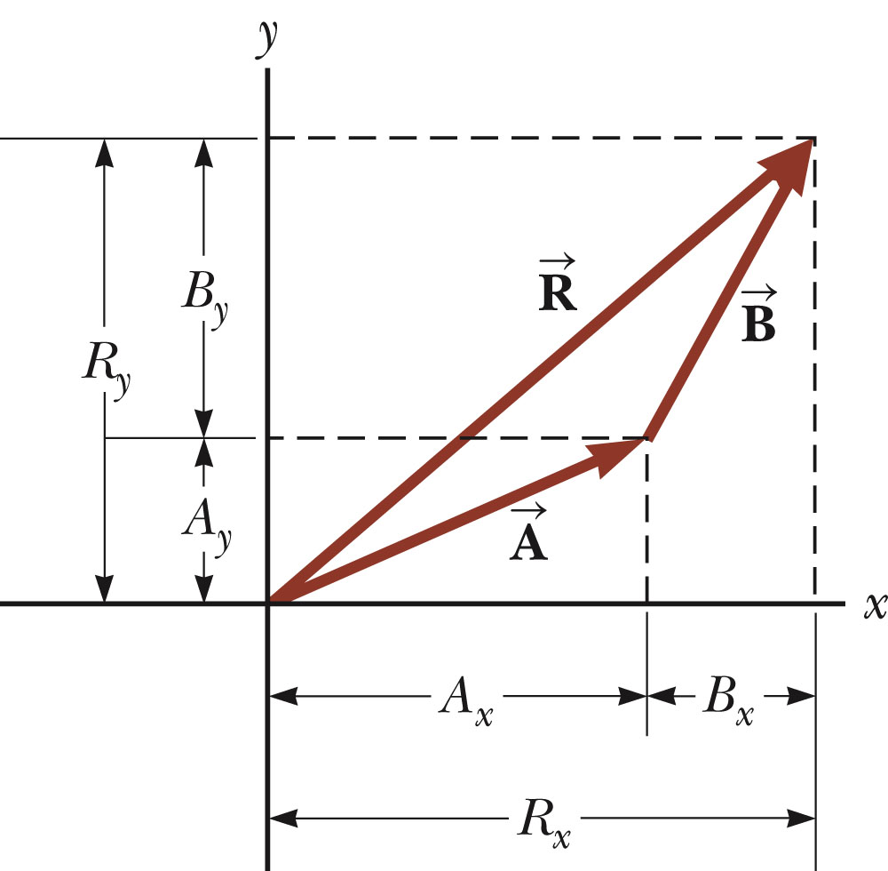
Adding Vectors with Unit Vectors
Note the relationships among the components of the resultant and the components of the original vectors.
R_{x} = A_{x} + B_{x}
R_{y} = A_{y} + B_{y}
Section 3.4

Slide 37
Three-Dimensional Extension
Using
Then
So R_{x}= A_{x}+B_{x}, R_{y}= A_{y}+B_{y}, and R_{z} = A_{z}+B_{z}
Section 3.4

Slide 38
Adding Three or More Vectors
The same method can be extended to adding three or more vectors.
Assume
And
Section 3.4

Slide 39
Example 3.5 – Taking a Hike
A hiker begins a trip by first walking 25.0 km southeast from her car. She stops and sets up her tent for the night. On the second day, she walks 40.0 km in a direction 60.0° north of east, at which point she discovers a forest ranger’s tower.
Section 3.4

Slide 40
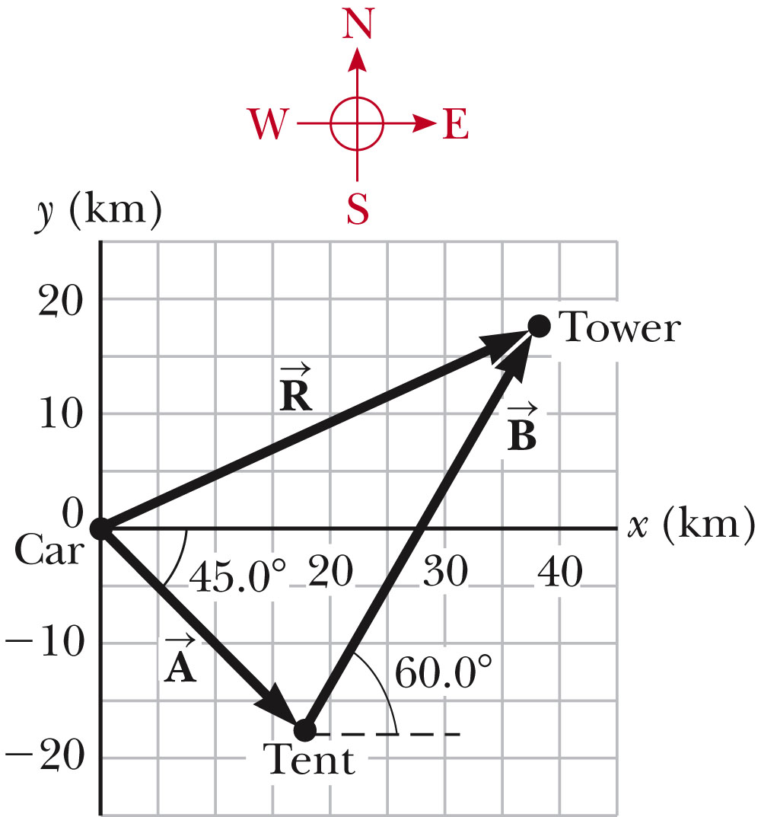
Example 3.5 – Solution, Conceptualize and Categorize
Conceptualize the problem by drawing a sketch as in the figure.
Denote the displacement vectors on the first and second days by and respectively.
Use the car as the origin of coordinates.
The vectors are shown in the figure.
Drawing the resultant , we can now categorize this problem as an addition of two vectors.
Section 3.4

Slide 41
Example 3.5 – Solution, Analysis
Analyze this problem by using our new knowledge of vector components.
The first displacement has a magnitude of 25.0 km and is directed 45.0° below the positive x axis.
Its components are:
Section 3.4

Slide 42
Example 3.5 – Solution, Analysis 2
The second displacement has a magnitude of 40.0 km and is 60.0° north of east.
Its components are:
Section 3.4

Slide 43
Example 3.5 – Solution, Analysis 3
The negative value of A_{y} indicates that the hiker walks in the negative y direction on the first day.
The signs of A_{x} and A_{y} also are evident from the figure.
The signs of the components of B are also confirmed by the diagram.
Section 3.4

Slide 44
Example 3.5 – Analysis, 4
Determine the components of the hiker’s resultant displacement for the trip.
  Find an expression for the resultant in terms of unit vectors.
The resultant displacement for the trip has components given by
  R_{x} = A_{x} + B_{x} = 17.7 km + 20.0 km = 37.7 km
  R_{y} = A_{y} + B_{y} = -17.7 km + 34.6 km = 16.9 km
In unit vector form
Section 3.4

Slide 45
Example 3.5 – Solution, Finalize
The resultant vector has a magnitude of 41.3 km and is directed 24.1° north of east.
The units of are km, which is reasonable for a displacement.
From the graphical representation , estimate that the final position of the hiker is at about (38 km, 17 km) which is consistent with the components of the resultant.
Section 3.4

Slide 46
Example 3.5 – Solution, Finalize, cont.
Both components of the resultant are positive, putting the final position in the first quadrant of the coordinate system.
  This is also consistent with the figure.
Section 3.4

