Slide 1
Chapter 4
Motion in Two Dimensions

Slide 2
Kinematics in Two Dimensions
In this chapter, we explore the kinematics of a particle moving in two dimensions.
Knowing the basics of two-dimensional motion will allow us—in future chapters—
to examine a variety of motions ranging from the motion of satellites in orbit to
the motion of electrons in a uniform electric field.
Will study the vector nature of position, velocity and acceleration in greater detail
Will treat projectile motion and uniform circular motion as special cases of motion in two dimensions.
Discuss the concept of relative motion which shows why observers in different frames of reference may measure different positions and velocities for a given particle.
Introduction

Slide 3
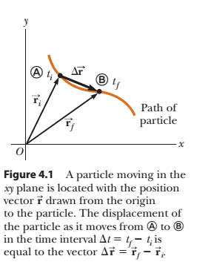
4.1 The Position, Velocity, and Acceleration Vectors
In Chapter 2, we found that the motion of a particle along a straight line is completely known if its position is known as a function of time.
Let us now extend this idea to two-dimensional motion of a particle in the xy plane.
the position of the particle is described by its position vector , drawn from the origin of some coordinate system to the location of the particle in the xy plane

Slide 4
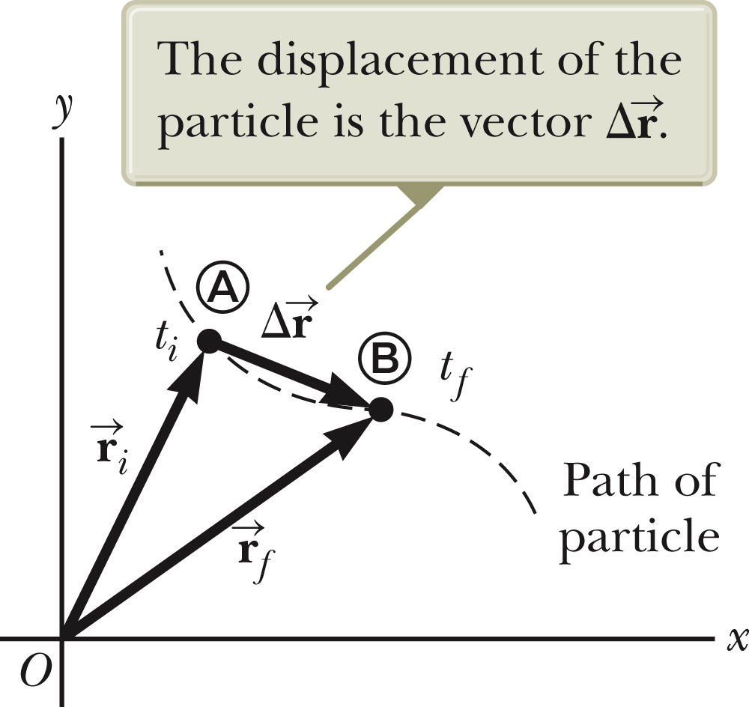


Position and Displacement
The position of an object is described by its position vector, .
The displacement of the object is defined as the change in its position.
Section 4.1

Slide 5
General Motion Ideas
In two- or three-dimensional kinematics, everything is the same as in one-dimensional motion except that we must now use full vector notation.
  Positive and negative signs are no longer sufficient to determine the direction.
Section 4.1

Slide 6
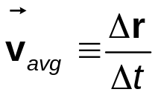
Average Velocity
The average velocity is the ratio of the displacement to the time interval for the displacement.
The direction of the average velocity is the direction of the displacement vector.
The average velocity between points is independent of the path taken.
  This is because it is dependent on the displacement, which is also independent of the path.
Section 4.1

Slide 7
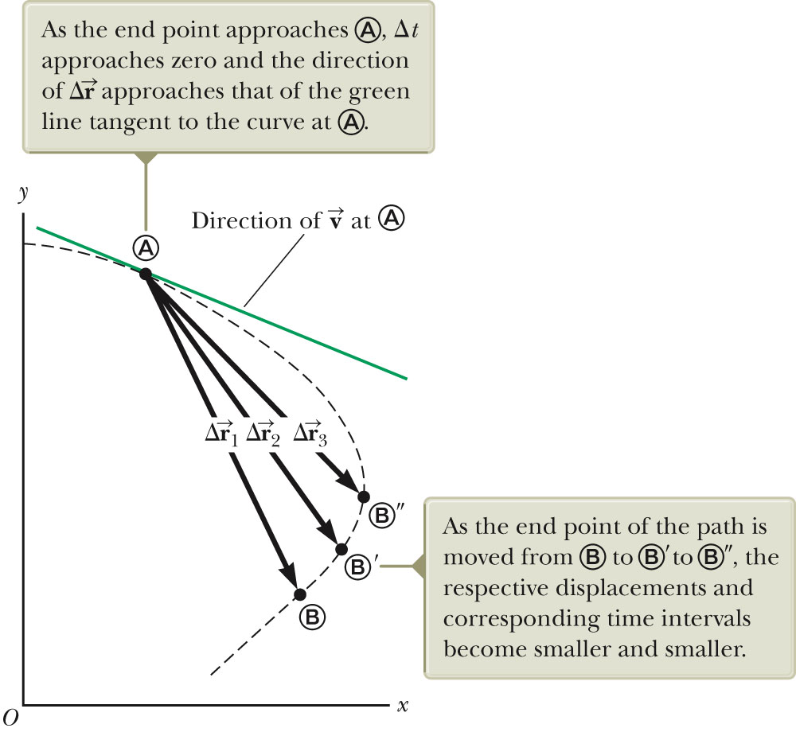
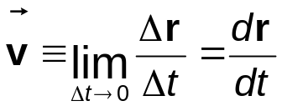
Instantaneous Velocity
As the time interval over which we observe the motion becomes smaller and smaller—that is, as B is moved to and then to , and
so on—the direction of the displacement approaches that of the line tangent to
the path at A
The instantaneous velocity is the limit of the average velocity as Δt approaches zero.
  As the time interval becomes smaller, the direction of the displacement approaches that of the line tangent to the curve.
Section 4.1

Slide 8
Instantaneous Velocity, cont
The direction of the instantaneous velocity vector at any point in a particle’s path is along a line tangent to the path at that point and in the direction of motion.
The magnitude of the instantaneous velocity vector is the speed.
  The speed is a scalar quantity.
Section 4.1

Slide 9
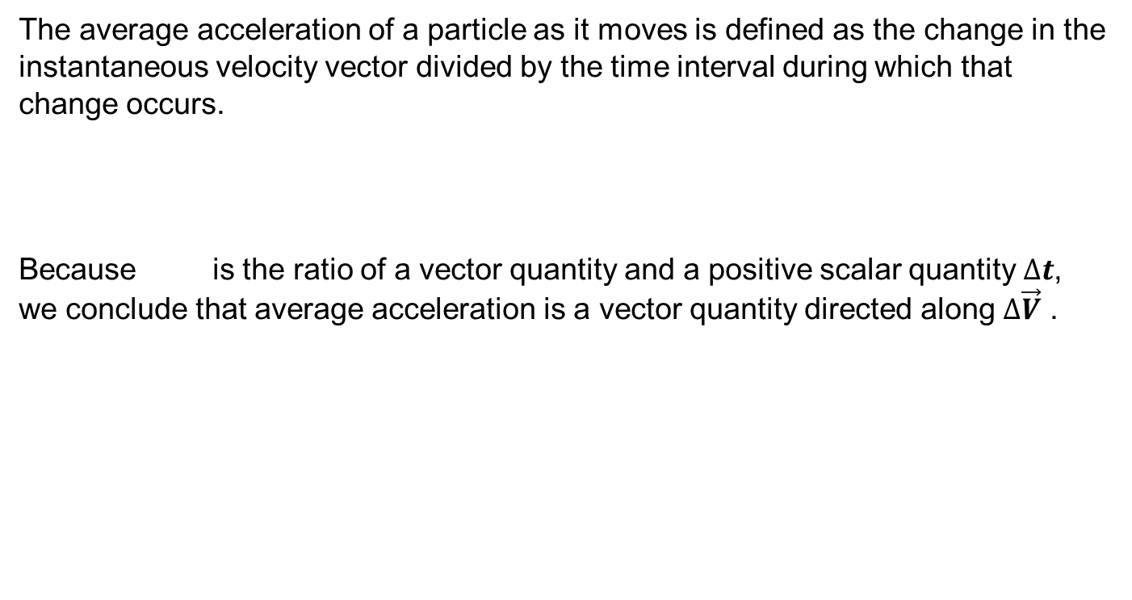
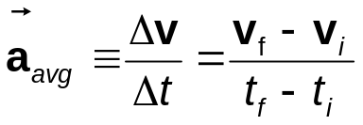

Average Acceleration
Section 4.1

Slide 10
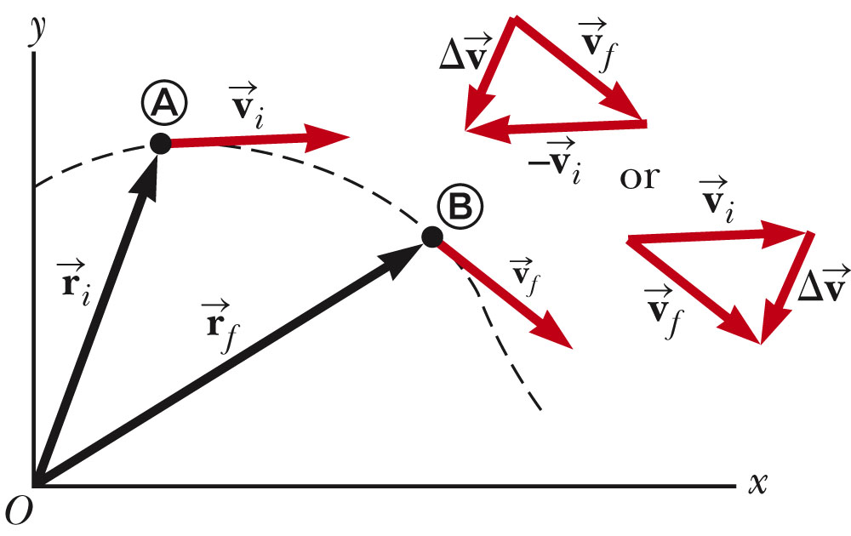


Average Acceleration, cont
As a particle moves, the direction of the change in velocity is found by vector subtraction.
The average acceleration is a vector quantity directed along .
Section 4.1

Slide 11

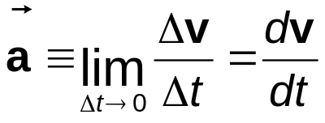
Instantaneous Acceleration
The instantaneous acceleration is the limiting value of the ratio as Δt approaches zero.
  The instantaneous equals the derivative of the velocity vector with respect to time.
Section 4.1

Slide 12
Producing An Acceleration
Various changes in a particle’s motion may produce an acceleration.
  The magnitude of the velocity vector may change.
  The direction of the velocity vector may change.
    Even if the magnitude remains constant
  Both may change simultaneously
Section 4.1

Slide 13
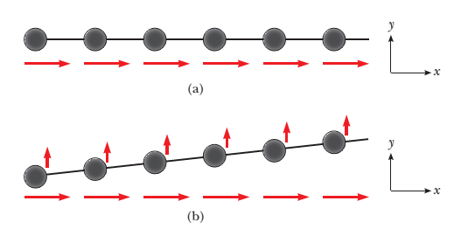
4.2 Two-Dimensional Motion with constant acceleration
Let us now consider two-dimensional motion during which the acceleration of a particle remains constant in both magnitude and direction.
Imagine an air hockey puck moving in a straight line along a perfectly level, friction-free surface of an air hockey table.
Because there are no forces on the puck in the horizontal plane, it moves with constant velocity in the x direction. Now suppose you blow a puff of air on the puck as it passes your position, with the force from your puff of air exactly in
the y direction.
Because the force from this puff of air has no component in the x direction, it causes no acceleration in the x direction.
Section 4.2

Slide 14
4.2 Two-Dimensional Motion with constant acceleration
It only causes a momentary acceleration in the y direction, causing the puck to have a constant y component of velocity once the force from the puff of air is removed. After your puff of air on the puck, its velocity component in the x direction is unchanged, as shown in Figure 4.4b.
The generalization of this simple experiment is that motion in two
dimensions can be modeled as two independent motions in each of the two perpendicular directions associated with the x and y axes. That is, any influence in the y direction does not affect the motion in the x direction and vice versa.

Slide 15

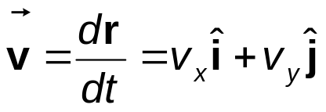

Kinematic Equations, 2
Position vector for a particle moving in the xy plane.
4.6
The velocity vector can be found from the position vector.
  4.7
  Since acceleration is constant, we can also find an expression for the velocity as a function of time:
Section 4.2

Slide 16
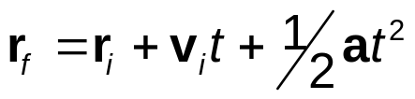
Kinematic Equations, 3
The position vector can also be expressed as a function of time:
  This indicates that the position vector is the sum of three other vectors:
    The initial position vector
    The displacement resulting from the initial velocity
    The displacement resulting from the acceleration
Section 4.2

Slide 17
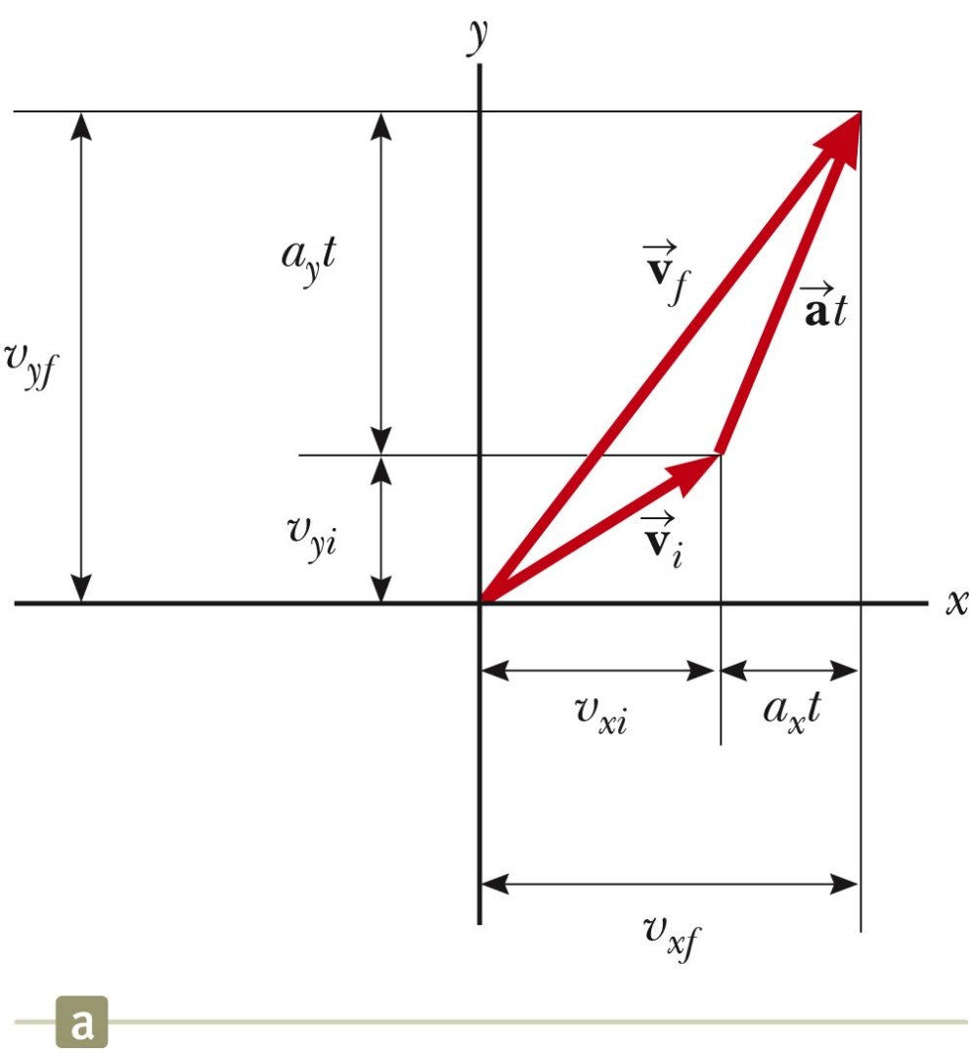



Kinematic Equations, Graphical Representation of Final Velocity
The velocity vector can be represented by its components.
is generally not along the direction of either or
Section 4.2

Slide 18
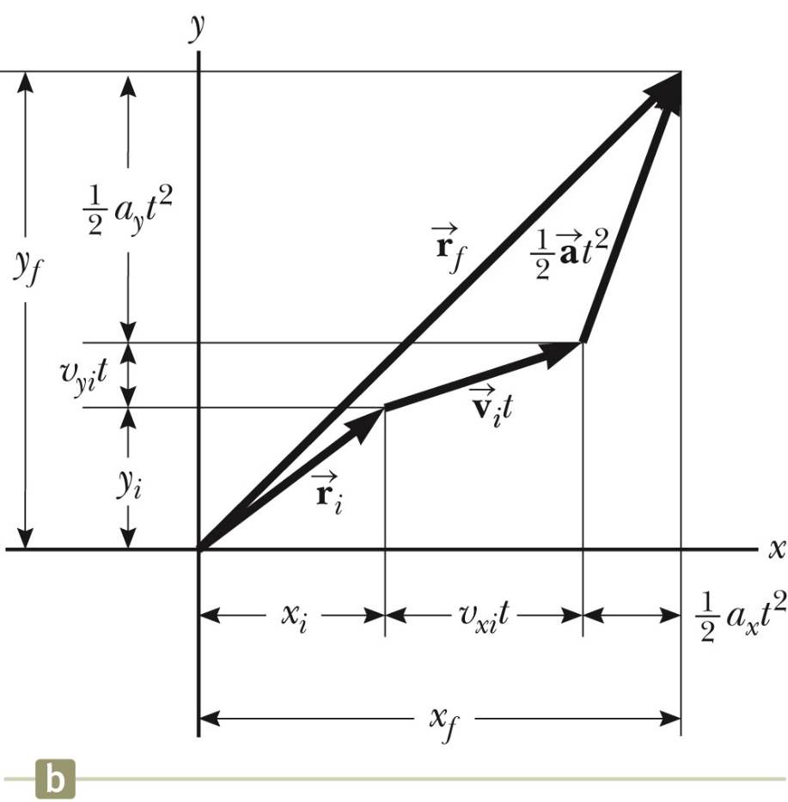


Kinematic Equations, Graphical Representation of Final Position
The vector representation of the position vector
is generally not along the same direction as , or
and are generally not in the same direction
Section 4.2

Slide 19
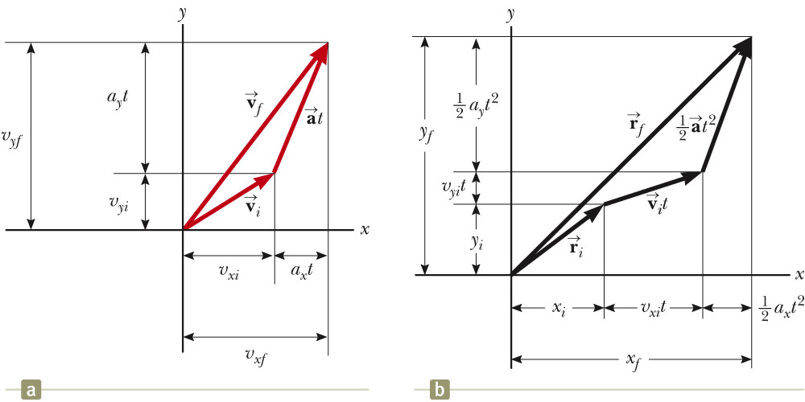
Graphical Representation Summary
Various starting positions and initial velocities can be chosen.
Note the relationships between changes made in either the position or velocity and the resulting effect on the other.
Section 4.2

Slide 20
Projectile Motion
Projectile motion is a generalization of purely vertical motion (falling objects) we
studied in chapter 2.
An object may move in both the x and y directions simultaneously.
The form of two-dimensional motion we will deal with is called projectile motion.
Projectile motions can be approached using the method of vector components.
We can analyze the motion by studying its vertical and horizontal components
separately
Section 4.3

Slide 21
Assumptions of Projectile Motion
The free-fall acceleration is constant over the range of motion.
  It is directed downward.
  This is the same as assuming a flat Earth over the range of the motion.
  It is reasonable as long as the range is small compared to the radius of the Earth.
The effect of air friction is negligible.
With these assumptions, an object in projectile motion will follow a parabolic path.
  This path is called the trajectory.
Section 4.3

Slide 22
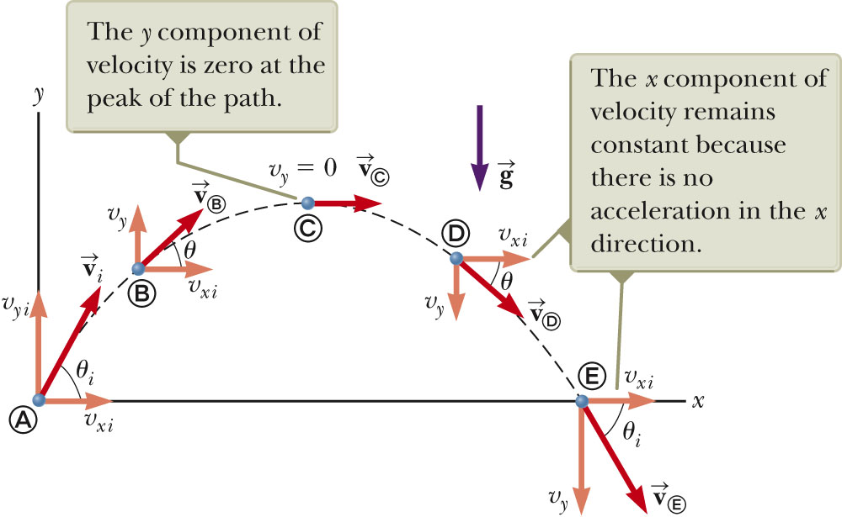
Projectile Motion Diagram
Section 4.3

Slide 23
Acceleration at the Highest Point
The vertical velocity is zero at the top.
The acceleration is not zero anywhere along the trajectory.
  If the projectile experienced zero acceleration at the highest point, its velocity at the point would not change.
    The projectile would move with a constant horizontal velocity from that point on.
Section 4.3

Slide 24
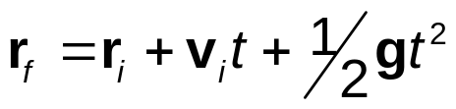
Analyzing Projectile Motion
Consider the motion as the superposition of the motions in the x- and y-directions.
The actual position at any time is given by:
The initial velocity can be expressed in terms of its components.
  v_{xi} = v_{i} cos θ and v_{yi} = v_{i} sin θ
The x-direction has constant velocity.
  a_{x} = 0
The y-direction is free fall.
  a_{y} = -g
Section 4.3

Slide 25
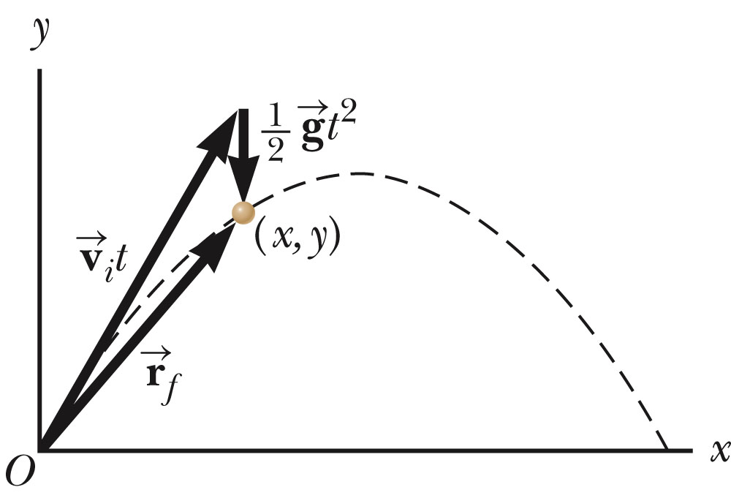
Projectile Motion Vectors
The final position is the vector sum of the initial position, the position resulting from the initial velocity and the position resulting from the acceleration.
Section 4.3

Slide 26
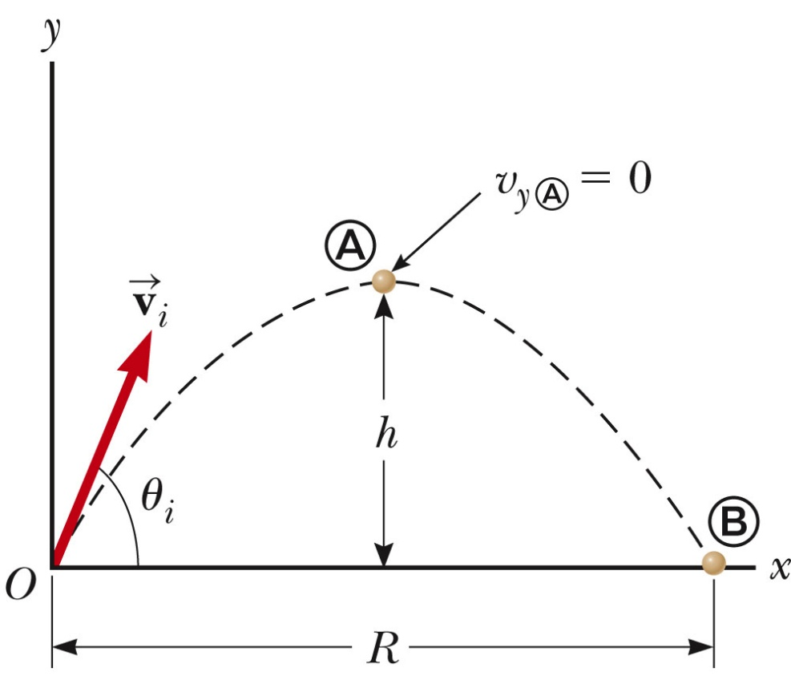
Range and Maximum Height of a Projectile
When analyzing projectile motion, two characteristics are of special interes.t
The range, R, is the horizontal distance of the projectile.
The maximum height the projectile reaches is h.
Section 4.3

Slide 27
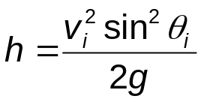
Height of a Projectile, equation
The maximum height of the projectile can be found in terms of the initial velocity vector:
This equation is valid only for symmetric motion.
Section 4.3

Slide 28
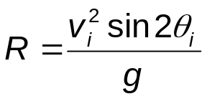
Range of a Projectile, equation
The range of a projectile can be expressed in terms of the initial velocity vector:
This is valid only for symmetric trajectory.
Section 4.3

Slide 29
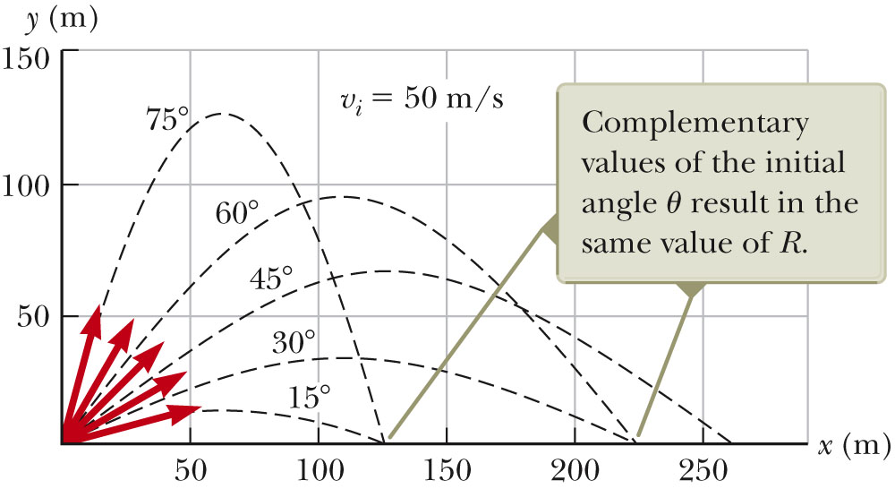
More About the Range of a Projectile
Section 4.3

Slide 30
Range of a Projectile, final
The maximum range occurs at θ_{i} = 45º .
Complementary angles will produce the same range.
  The maximum height will be different for the two angles.
  The times of the flight will be different for the two angles.
Section 4.3

Slide 31
Projectile Motion – Problem Solving Hints
Conceptualize
  Establish the mental representation of the projectile moving along its trajectory.
Categorize
  Confirm air resistance is neglected.
  Select a coordinate system with x in the horizontal and y in the vertical direction.
Analyze
  If the initial velocity is given, resolve it into x and y components.
  Treat the horizontal and vertical motions independently.
Section 4.3

Slide 32
Projectile Motion – Problem Solving Hints, cont.
Analysis, cont.
  Analyze the horizontal motion with the particle-under-constant-velocity model.
  Analyze the vertical motion with the particle-under-constant-acceleration model.
  Remember that both directions share the same time.
Finalize
  Check to see if your answers are consistent with the mental and pictorial representations.
  Check to see if your results are realistic.
Section 4.3

Slide 33
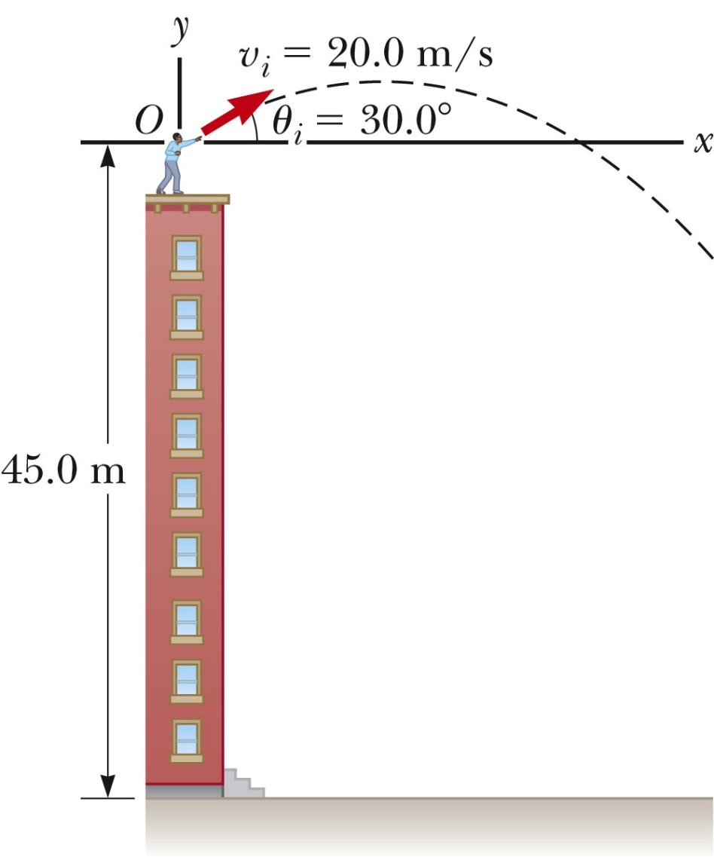
Non-Symmetric Projectile Motion
Follow the general rules for projectile motion.
Break the y-direction into parts.
  up and down or
  symmetrical back to initial height and then the rest of the height
Apply the problem solving process to determine and solve the necessary equations.
May be non-symmetric in other ways
Section 4.3

Slide 34
Uniform Circular Motion
Uniform circular motion occurs when an object moves in a circular path with a constant speed.
The associated analysis model is a particle in uniform circular motion.
An acceleration exists since the direction of the motion is changing .
  This change in velocity is related to an acceleration.
The constant-magnitude velocity vector is always tangent to the path of the object.
Section 4.4

Slide 35

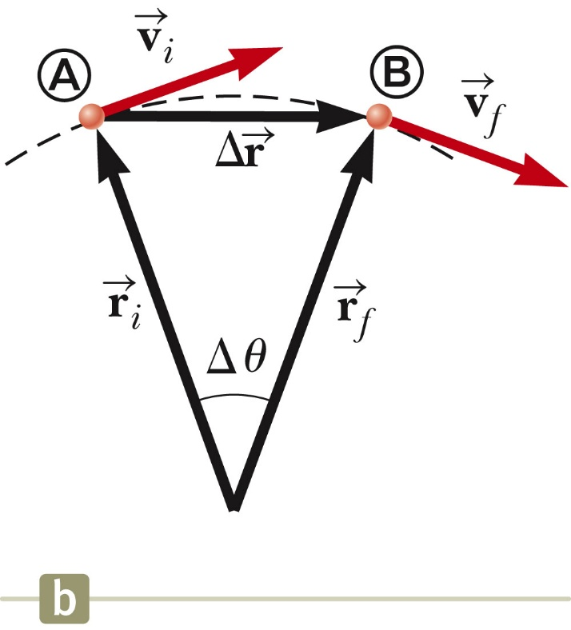
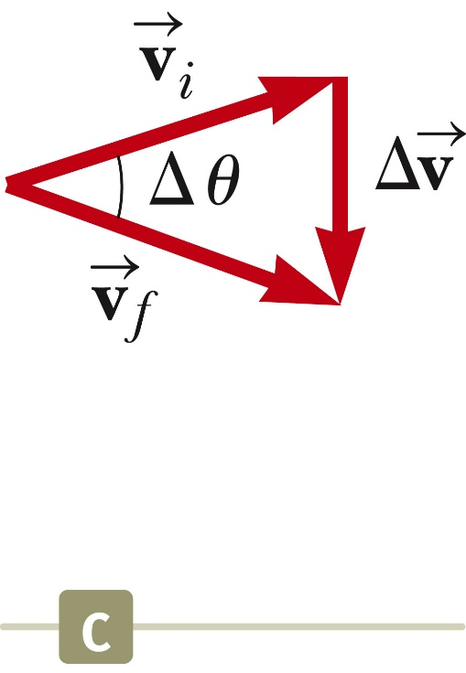
Changing Velocity in Uniform Circular Motion
The change in the velocity vector is due to the change in direction.
The direction of the change in velocity is toward the center of the circle.
The vector diagram shows
Section 4.4

Slide 36
Centripetal Acceleration
The acceleration is always perpendicular to the path of the motion.
The acceleration always points toward the center of the circle of motion.
This acceleration is called the centripetal acceleration.
Section 4.4

Slide 37
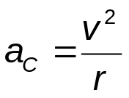
Centripetal Acceleration, cont
The magnitude of the centripetal acceleration vector is given by
The direction of the centripetal acceleration vector is always changing, to stay directed toward the center of the circle of motion.
Section 4.4

Slide 38
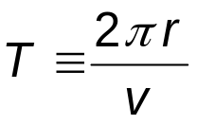
Period
The period, T, is the time required for one complete revolution.
The speed of the particle would be the circumference of the circle of motion divided by the period.
Therefore, the period is defined as
Section 4.4

Slide 39
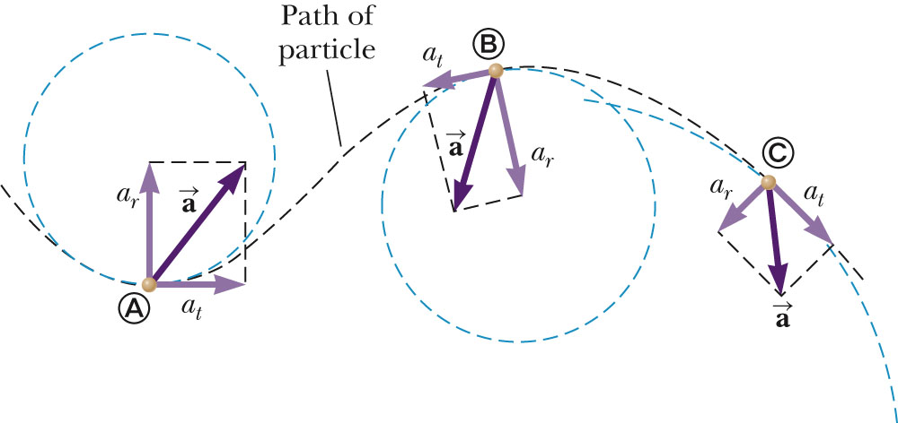
Tangential Acceleration
The magnitude of the velocity could also be changing.
In this case, there would be a tangential acceleration.
The motion would be under the influence of both tangential and centripetal accelerations.
  Note the changing acceleration vectors
Section 4.5

Slide 40
Total Acceleration
The tangential acceleration causes the change in the speed of the particle.
The radial acceleration comes from a change in the direction of the velocity vector.
Section 4.5

Slide 41
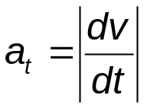
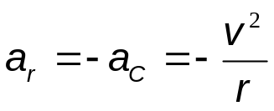
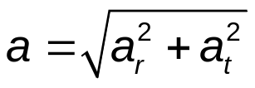
Total Acceleration, equations
The tangential acceleration:
The radial acceleration:
The total acceleration:
  Magnitude
  Direction
    Same as velocity vector if v is increasing, opposite if v is decreasing
Section 4.5

Slide 42
Relative Velocity
Two observers moving relative to each other generally do not agree on the outcome of an experiment.
However, the observations seen by each are related to one another.
A frame of reference can described by a Cartesian coordinate system for which an observer is at rest with respect to the origin.
Section 4.6

Slide 43
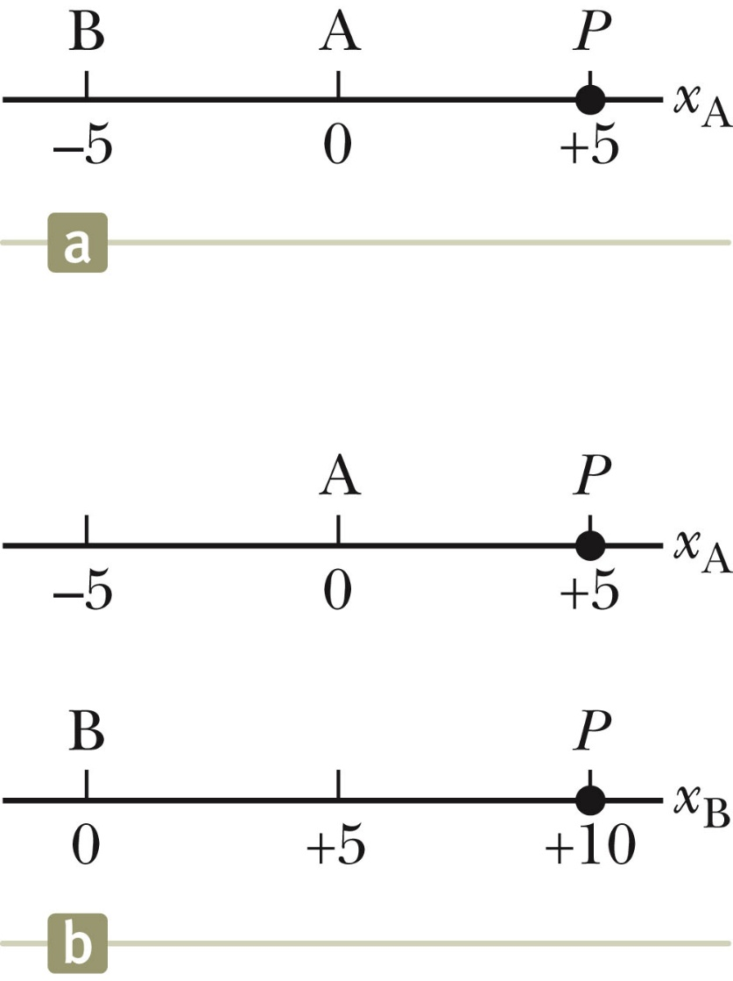
Different Measurements, example
Observer A measures point P at +5 m from the origin
Observer B measures point P at +10 m from the origin
The difference is due to the different frames of reference being used.
Section 4.6

Slide 44
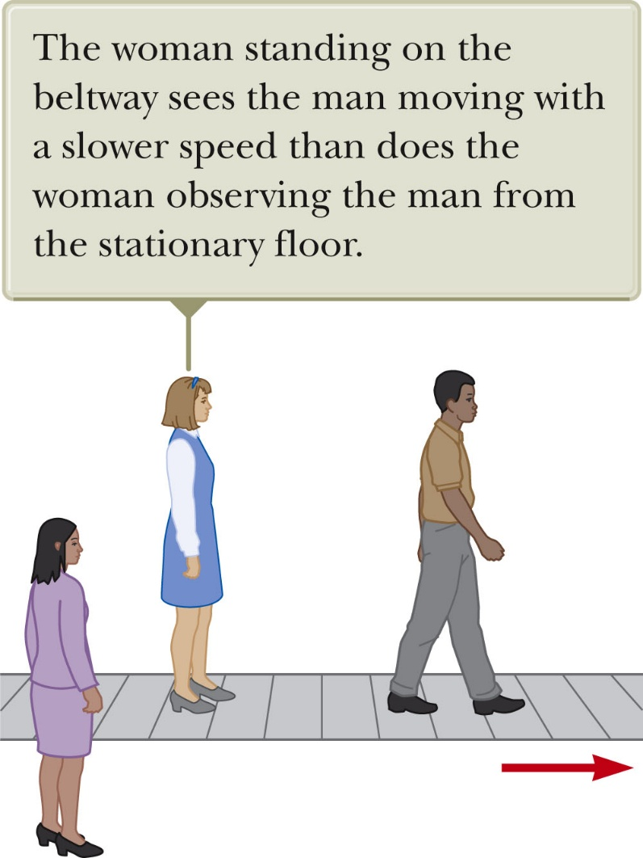
Different Measurements, another example
The man is walking on the moving beltway.
The woman on the beltway sees the man walking at his normal walking speed.
The stationary woman sees the man walking at a much higher speed.
  The combination of the speed of the beltway and the walking.
The difference is due to the relative velocity of their frames of reference.
Section 4.6

Slide 45
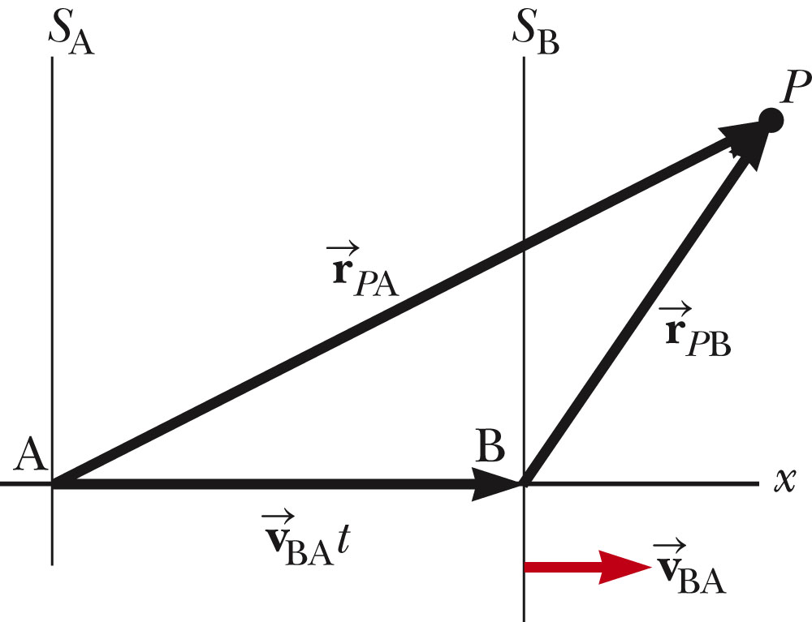


Relative Velocity, generalized
Reference frame S_{A} is stationary
Reference frame S_{B} is moving to the right relative to S_{A} at
  This also means that S_{A} moves at – relative to S_{B}
Define time t = 0 as that time when the origins coincide
Section 4.6

Slide 46

Notation
The first subscript represents what is being observed.
The second subscript represents who is doing the observing.
Example
  The velocity of B (and attached to frame S_{B}) as measured by observer A
Section 4.6

Slide 47




Relative Velocity, equations
The positions as seen from the two reference frames are related through the velocity
The derivative of the position equation will give the velocity equation
    is the velocity of the particle P measured by observer A
    is the velocity of the particle P measured by observer B
These are called the Galilean transformation equations.
Section 4.6

Slide 48
Acceleration in Different Frames of Reference
The derivative of the velocity equation will give the acceleration equation.
The acceleration of the particle measured by an observer in one frame of reference is the same as that measured by any other observer moving at a constant velocity relative to the first frame.
Section 4.6

Slide 49
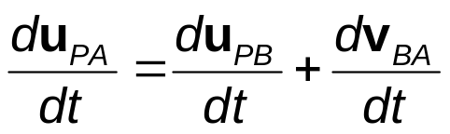


Acceleration, cont.
Calculating the acceleration gives
Since
Therefore,
Section 4.6

