Slide 1
Chapter 5
The Laws of Motion

Slide 2
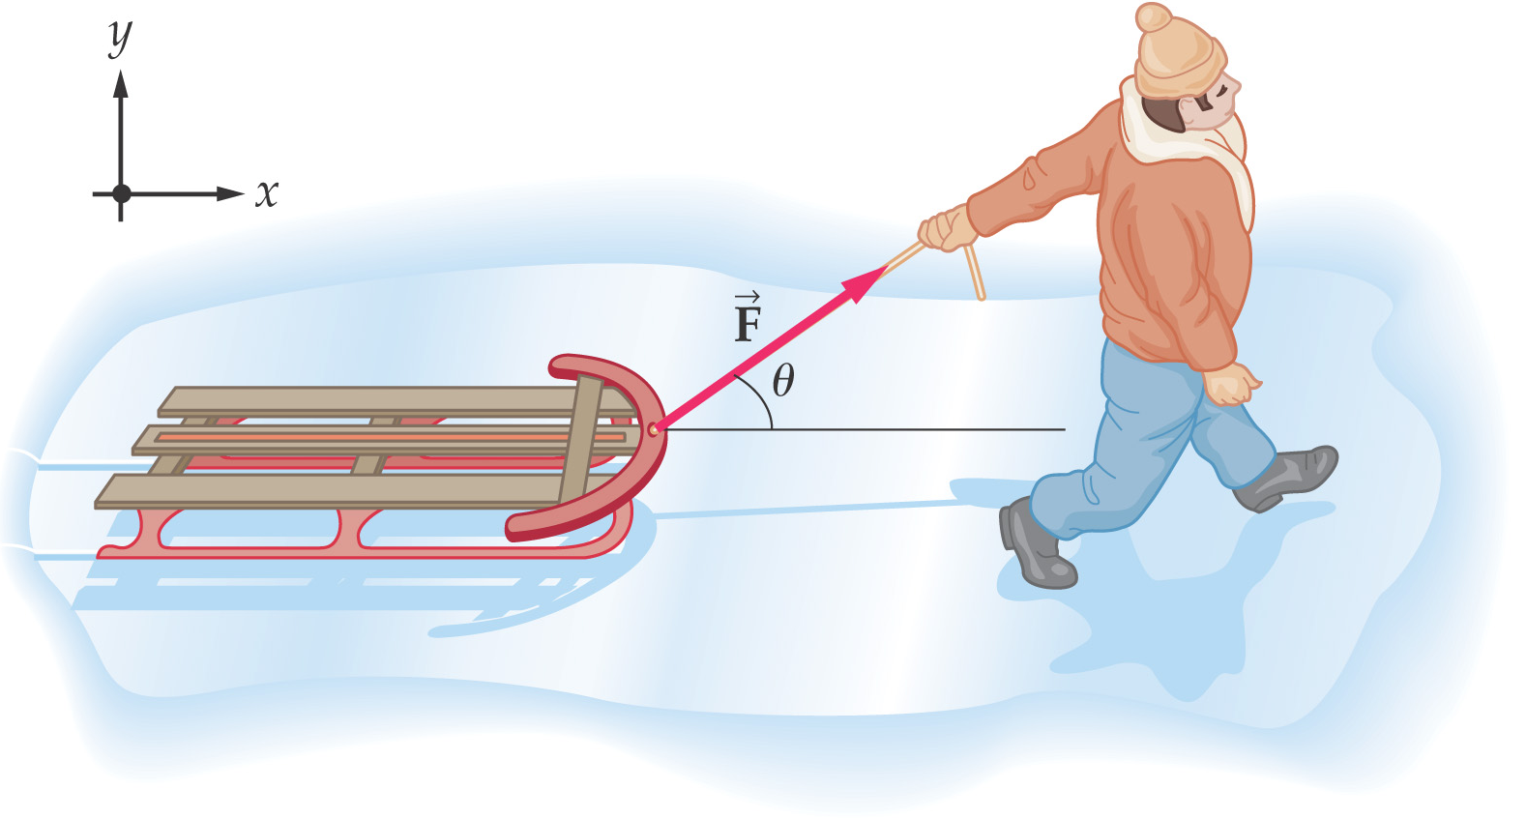
The Laws of Motion
In chapter 2 and 4 the full description of an object motion was done in terms of its position, velocity, and acceleration.
There was no consideration of what might influence that motion.
Now we considering what might influence that motion i.e. second important part of mechanics “Dynamics”
What might cause one object to remain at rest and another object to accelerate?
Two main factors need to be addressed to answer questions about why the motion of an object will change.
  Forces acting on the object
  The mass of the object
Dynamics describes the relationship between the motion of objects in our everyday world and the forces acting on them
Introduction

Slide 3
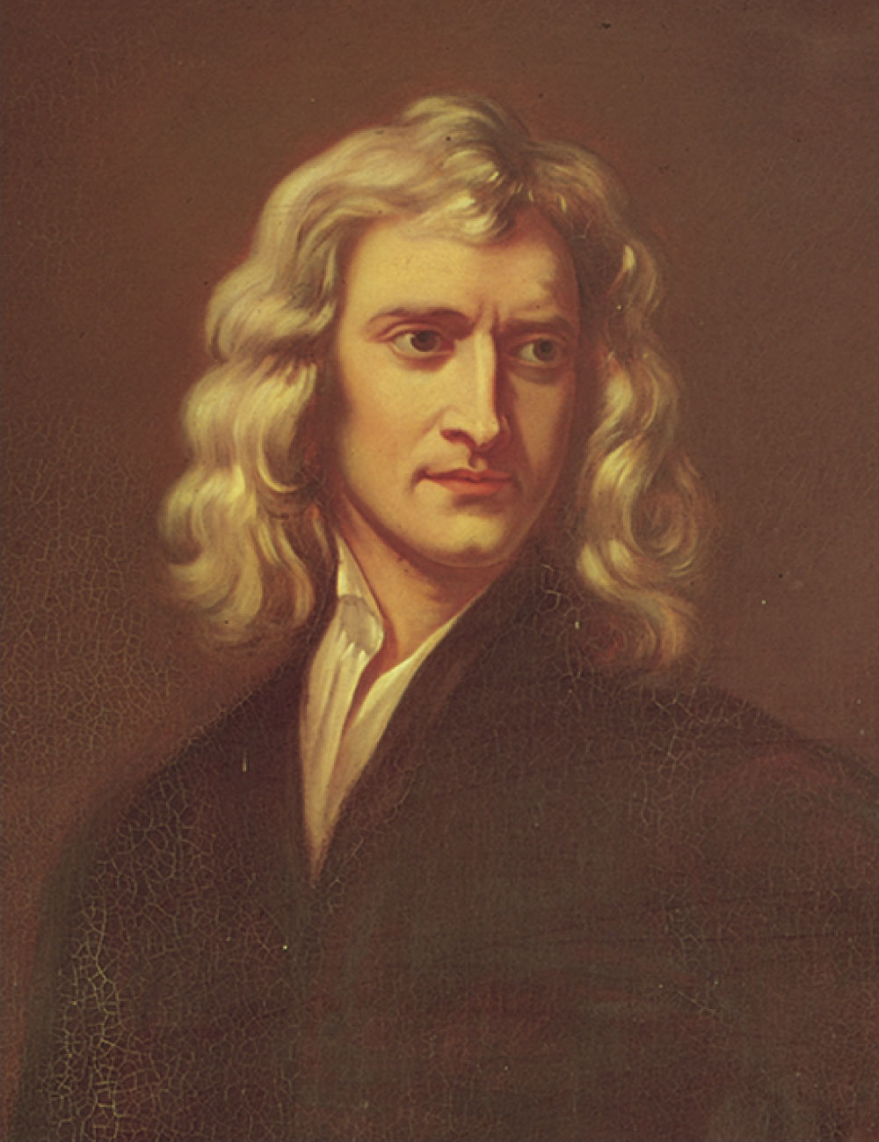
Sir Isaac Newton
1642 – 1727
Formulated basic laws of mechanics
Discovered Law of Universal Gravitation
Invented form of calculus
Many observations dealing with light and optics
Section 5.1

Slide 4
5.1 The Concept of Force
Forces in everyday experience
  Push on an object to move it
  Throw or kick a ball
  In these examples the word force refer to an interaction with an object by means of muscular activity and some change in the object’s velocity.
  Forces do not always cause the motion when your sitting, a gravitational force acts in your body and yet you remain stationary.
  May push on an object and not be able to move it
Forces are what cause any change in the velocity of an object.
  Newton’s definition
  A force is that which causes an acceleration
Section 5.1

Slide 5
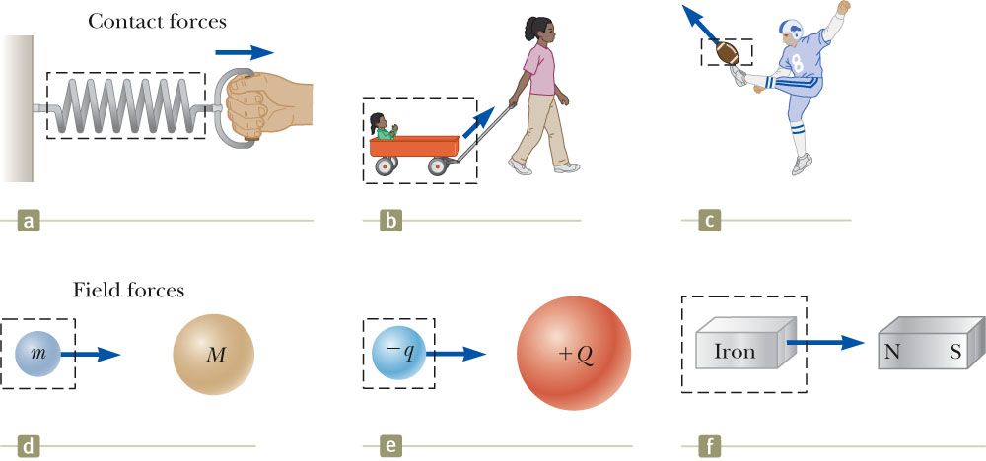
Classes of Forces
Contact forces involve physical contact between two objects
  Examples a, b, c
Field forces does not involve physical contact between two objects they act through empty space
  No physical contact is required
  Examples d, e, f
Section 5.1

Slide 6
Fundamental Forces
Gravitational force
  Between objects
Electromagnetic forces
  Between electric charges
Nuclear force
  Between subatomic particles
Weak forces
  Arise in certain radioactive decay processes
Note: These are all field forces.
Section 5.1

Slide 7
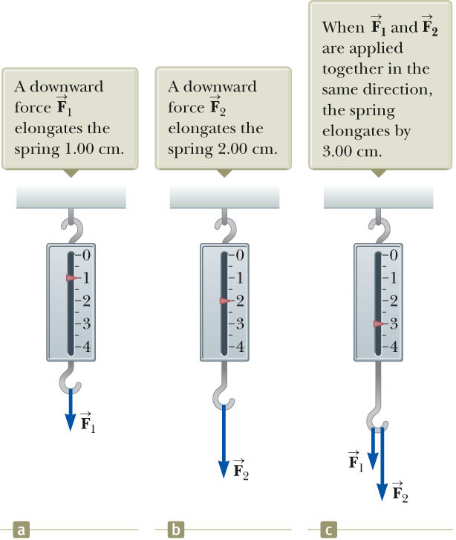
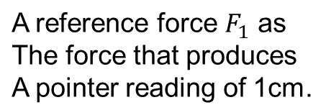
More About Forces
A spring can be used to calibrate the magnitude of a force.
Doubling the force causes double the reading on the spring.
When both forces are applied, the reading is three times the initial reading.
Section 5.1

Slide 8
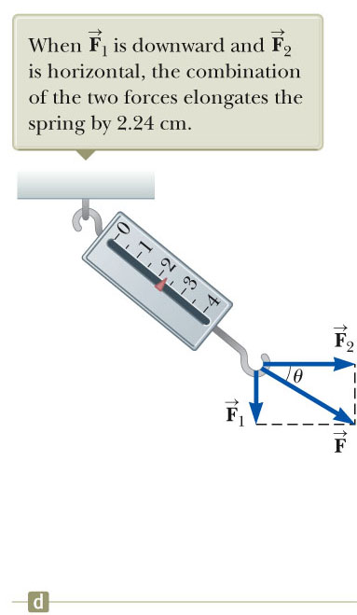
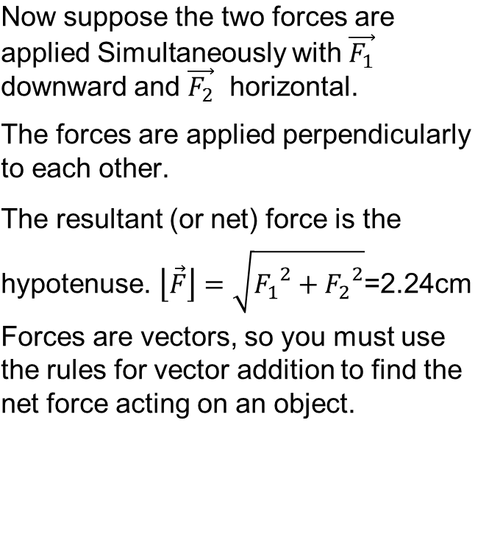
Vector Nature of Forces
Section 5.1

Slide 9
Newton’s First Law
If an object does not interact with other objects, it is possible to identify a reference frame in which the object has zero acceleration.
  This is also called the law of inertia.
  It defines a special set of reference frames called inertial frames.
    We call this an inertial frame of reference.
Section 5.2

Slide 10
Inertial Frames
Any reference frame that moves with constant velocity relative to an inertial frame is itself an inertial frame.
If you accelerate relative to an object in an inertial frame, you are observing the object from a non-inertial reference frame.
A reference frame that moves with constant velocity relative to the distant stars is the best approximation of an inertial frame.
  We can consider the Earth to be such an inertial frame, although it has a small centripetal acceleration associated with its motion.
Section 5.2

Slide 11
Newton’s First Law – Alternative Statement
In the absence of external forces, when viewed from an inertial reference frame, an object at rest remains at rest and an object in motion continues in motion with a constant velocity.
  Newton’s First Law describes what happens in the absence of a force.
    Does not describe zero net force
  Also tells us that when no force acts on an object, the acceleration of the object is zero
  Can conclude that any isolated object is either at rest or moving at a constant velocity
The First Law also allows the definition of force as that which causes a change in the motion of an object.
Section 5.2

Slide 12
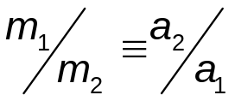
Inertia and Mass
The tendency of an object to resist any attempt to change its velocity is called inertia.
Mass is that property of an object that specifies how much resistance an object exhibits to changes in its velocity.
Masses can be defined in terms of the accelerations produced by a given force acting on them:
  The magnitude of the acceleration acting on an object is inversely proportional to its mass.
Section 5.3

Slide 13
More About Mass
Mass is an inherent property of an object.
Mass is independent of the object’s surroundings.
Mass is independent of the method used to measure it.
Mass is a scalar quantity.
  Obeys the rules of ordinary arithmetic
The SI unit of mass is kg.
Section 5.3

Slide 14
Mass vs. Weight
Mass and weight are two different quantities.
Weight is equal to the magnitude of the gravitational force exerted on the object.
  Weight will vary with location.
Example:
  w_{earth} = 180 lb; w_{moon} ~ 30 lb
  m_{earth} = 2 kg; m_{moon} = 2 kg
Section 5.3

Slide 15
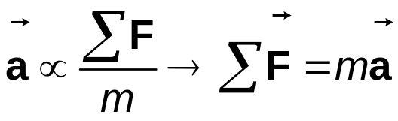
Newton’s Second Law
When viewed from an inertial reference frame, the acceleration of an object is directly proportional to the net force acting on it and inversely proportional to its mass.
  Force is the cause of changes in motion, as measured by the acceleration.
    Remember, an object can have motion in the absence of forces.
    Do not interpret force as the cause of motion.
Algebraically,
  With a proportionality constant of 1 and speeds much lower than the speed of light.
Section 5.4

Slide 16
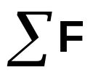
More About Newton’s Second Law
is the net force
  This is the vector sum of all the forces acting on the object.
    May also be called the total force, resultant force, or the unbalanced force.
Newton’s Second Law can be expressed in terms of components:
  ΣF_{x} = m a_{x}
  ΣF_{y} = m a_{y}
  ΣF_{z} = m a_{z}
Remember that ma is not a force.
  The sum of the forces is equated to this product of the mass of the object and its acceleration.
Section 5.4

Slide 17
Units of Force
The SI unit of force is the newton (N).
  1 N = 1 kg·m / s²
The US Customary unit of force is a pound (lb).
  1 lb = 1 slug·ft / s²
1 N ~ ¼ lb
Section 5.4

Slide 18


Gravitational Force
The gravitational force, , is the force that the earth exerts on an object.
This force is directed toward the center of the earth.
From Newton’s Second Law:
Its magnitude is called the weight of the object.
  Weight = F_{g}= mg
Section 5.5

Slide 19
More About Weight
Because it is dependent on g, the weight varies with location.
  g, and therefore the weight, is less at higher altitudes.
  This can be extended to other planets, but the value of g varies from planet to planet, so the object’s weight will vary from planet to planet.
Weight is not an inherent property of the object.
  The weight is a property of a system of items: the object and the Earth.
Note about units:
  Kilogram is not a unit of weight.
  1 kg = 2.2 lb is an equivalence valid only on the Earth’s surface.
Section 5.5

Slide 20
Gravitational Mass vs. Inertial Mass
In Newton’s Laws, the mass is the inertial mass and measures the resistance to a change in the object’s motion in response to an external force.
∑F=ma
In the gravitational force, the mass is determining the gravitational attraction between the object and the Earth.
Fg=mg
Experiments show that gravitational mass and inertial mass have the same value.
Section 5.5

Slide 21




Newton’s Third Law
If two objects interact, the force exerted by object 1 on object 2 is equal in magnitude and opposite in direction to the force exerted by object 2 on object 1.
  Note on notation: is the force exerted by A on B.
Section 5.6

Slide 22
Newton’s Third Law, Alternative Statement
The action force is equal in magnitude to the reaction force and opposite in direction.
  One of the forces is the action force, the other is the reaction force.
  It doesn’t matter which is considered the action and which the reaction.
  The action and reaction forces must act on different objects and be of the same type.
Section 5.6

Slide 23
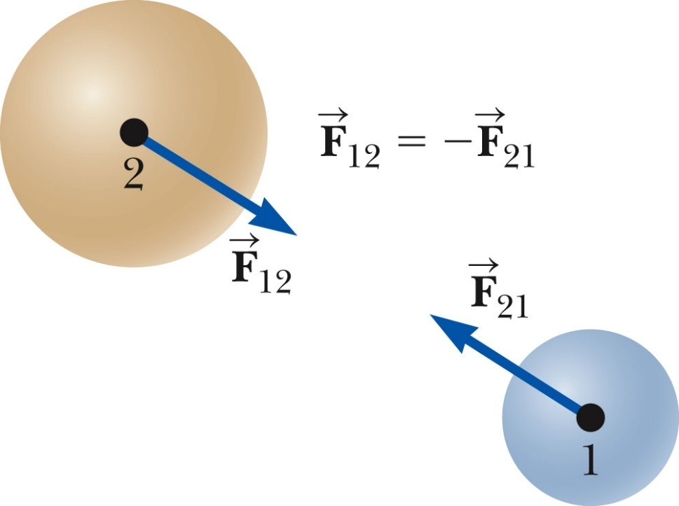
Action-Reaction Examples, 1
The force exerted by object 1 on object 2 is equal in magnitude and opposite in direction to exerted by object 2 on object 1.
Section 5.6

Slide 24
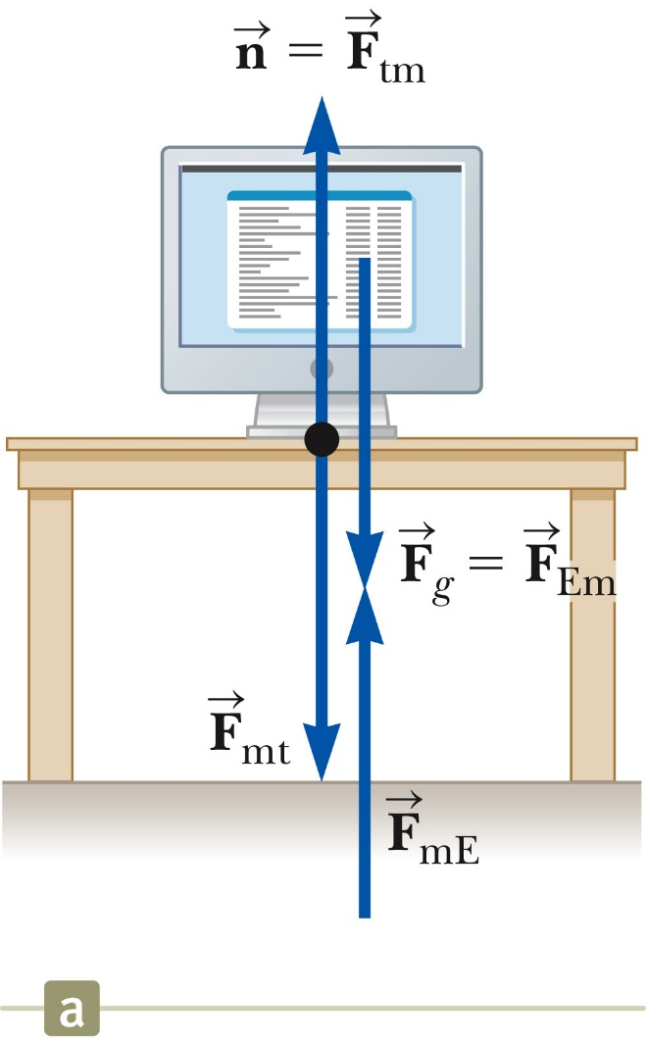
Action-Reaction Examples, 2
The normal force (table on monitor) is the reaction of the force the monitor exerts on the table.
  Normal means perpendicular, in this case
The action (Earth on monitor) force is equal in magnitude and opposite in direction to the reaction force, the force the monitor exerts on the Earth.
Section 5.6

Slide 25
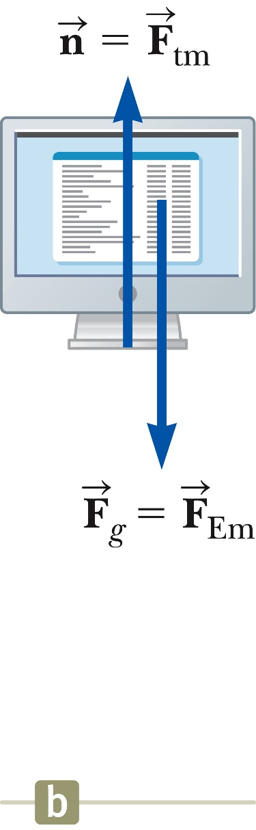
Forces on the Object
In a free body diagram, you want the forces acting on a particular object.
  Model the object as a particle
The normal force and the force of gravity are the forces that act on the monitor.
Section 5.6

Slide 26
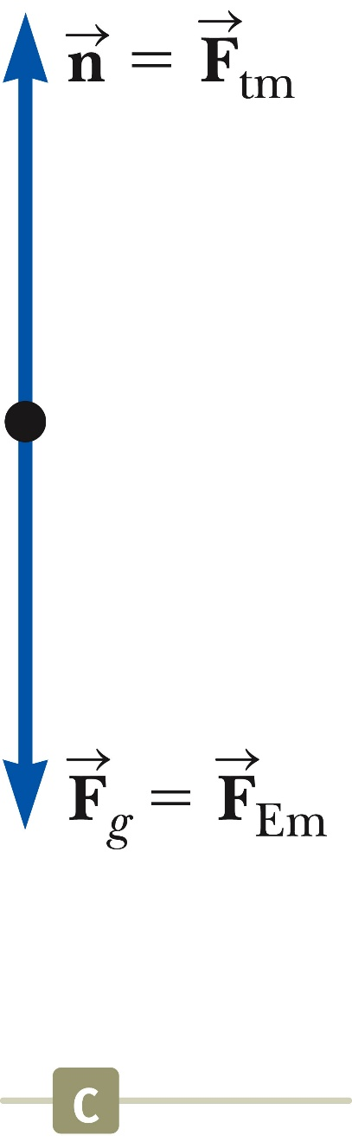
Free Body Diagram
The most important step in solving problems involving Newton’s Laws is to draw the free body diagram.
Be sure to include only the forces acting on the object of interest.
Include any field forces acting on the object.
Do not assume the normal force equals the weight.
Section 5.6

Slide 27
Free Body Diagrams and the Particle Model
The particle model is used by representing the object as a dot in the free body diagram.
The forces that act on the object are shown as being applied to the dot.
The free body helps isolate only those forces acting on the object and eliminate the other forces from the analysis.
Section 5.6

Slide 28
Analysis Models Using Newton’s Second Law
Assumptions
  Objects can be modeled as particles.
  Interested only in the external forces acting on the object
    Can neglect reaction forces
  Initially dealing with frictionless surfaces
  Masses of strings or ropes are negligible.
    The force the rope exerts is away from the object and parallel to the rope.
    When a rope attached to an object is pulling it, the magnitude of that force is the tension in the rope.
Section 5.7

Slide 29
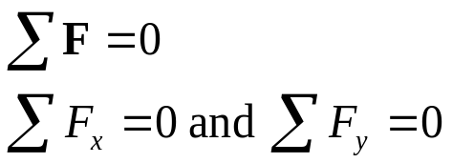
Analysis Model: The Particle in Equilibrium
If the acceleration of an object that can be modeled as a particle is zero, the object is said to be in equilibrium.
  The model is the particle in equilibrium model.
Mathematically, the net force acting on the object is zero.
Section 5.7

Slide 30
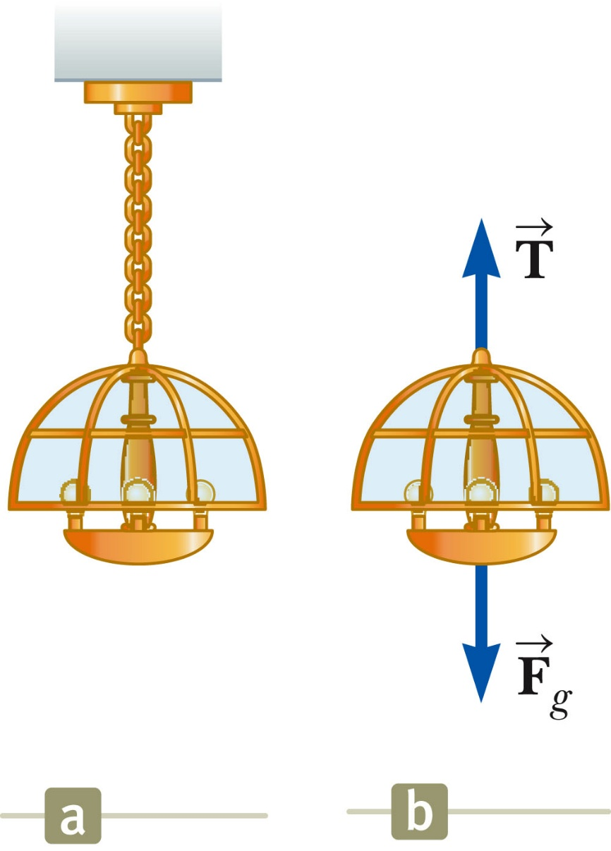

Equilibrium, Example
A lamp is suspended from a chain of negligible mass.
The forces acting on the lamp are:
  the downward force of gravity
  the upward tension in the chain
Applying equilibrium gives
Section 5.7

Slide 31
Analysis Model: The Particle Under a Net Force
If an object that can be modeled as a particle experiences an acceleration, there must be a nonzero net force acting on it.
  Model is particle under a net force model .
Draw a free-body diagram.
Apply Newton’s Second Law in component form.
Section 5.7

Slide 32
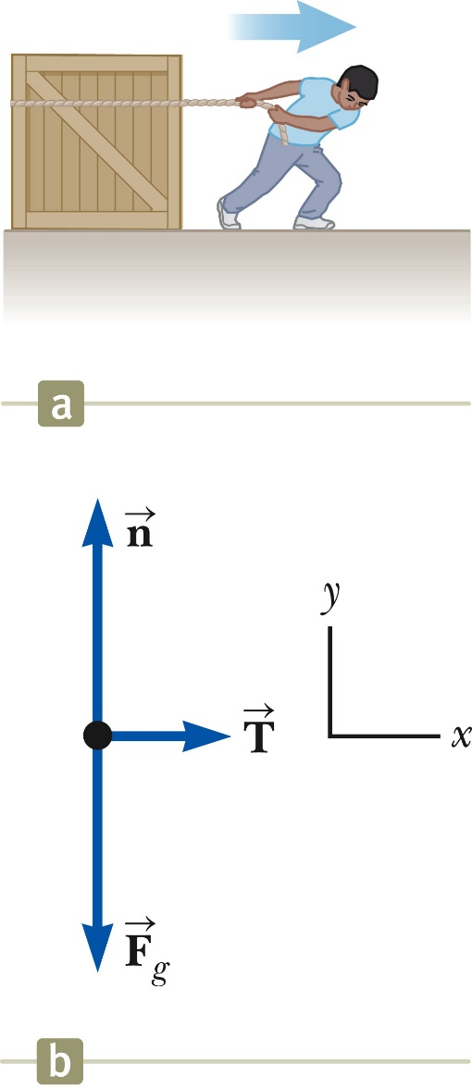



Newton’s Second Law, Example 1
Forces acting on the crate:
  A tension, acting through the rope, is the magnitude of force
  The gravitational force,
  The normal force, , exerted by the floor
Section 5.7

Slide 33


Newton’s Second Law, Example 1, cont.
Apply Newton’s Second Law in component form:
Solve for the unknown(s)
If the tension is constant, then a is constant and the kinematic equations can be used to more fully describe the motion of the crate.

Slide 34
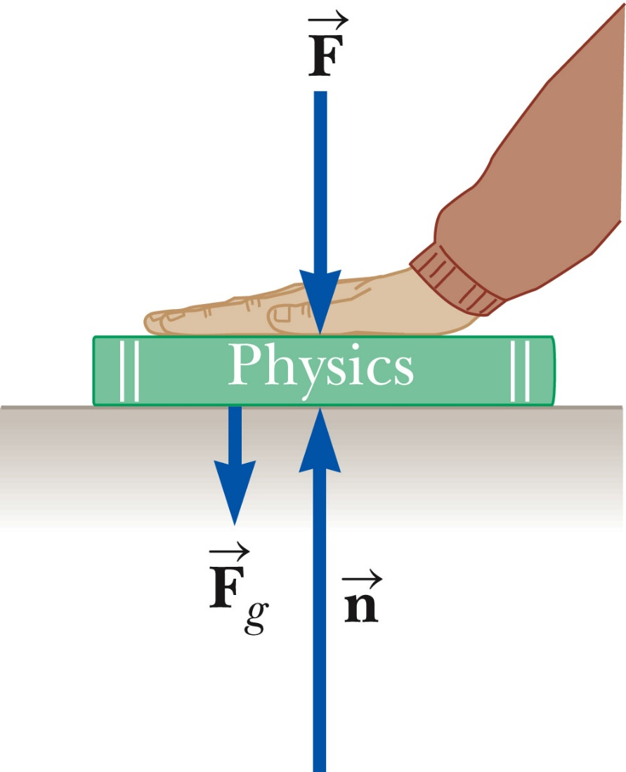
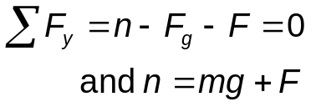

Note About the Normal Force
The normal force is not always equal to the gravitational force of the object.
For example, in this case
may also be less than
Section 5.7

Slide 35
Problem-Solving Hints – Applying Newton’s Laws
Conceptualize
  Draw a diagram
  Choose a convenient coordinate system for each object
Categorize
  Is the model a particle in equilibrium?
    If so, ΣF = 0
  Is the model a particle under a net force?
    If so, ΣF = m a
Section 5.7

Slide 36
Problem-Solving Hints – Applying Newton’s Laws, cont.
Analyze
  Draw free-body diagrams for each object
  Include only forces acting on the object
  Find components along the coordinate axes
  Be sure units are consistent
  Apply the appropriate equation(s) in component form
  Solve for the unknown(s)
Finalize
  Check your results for consistency with your free-body diagram
  Check extreme values
Section 5.7

Slide 37
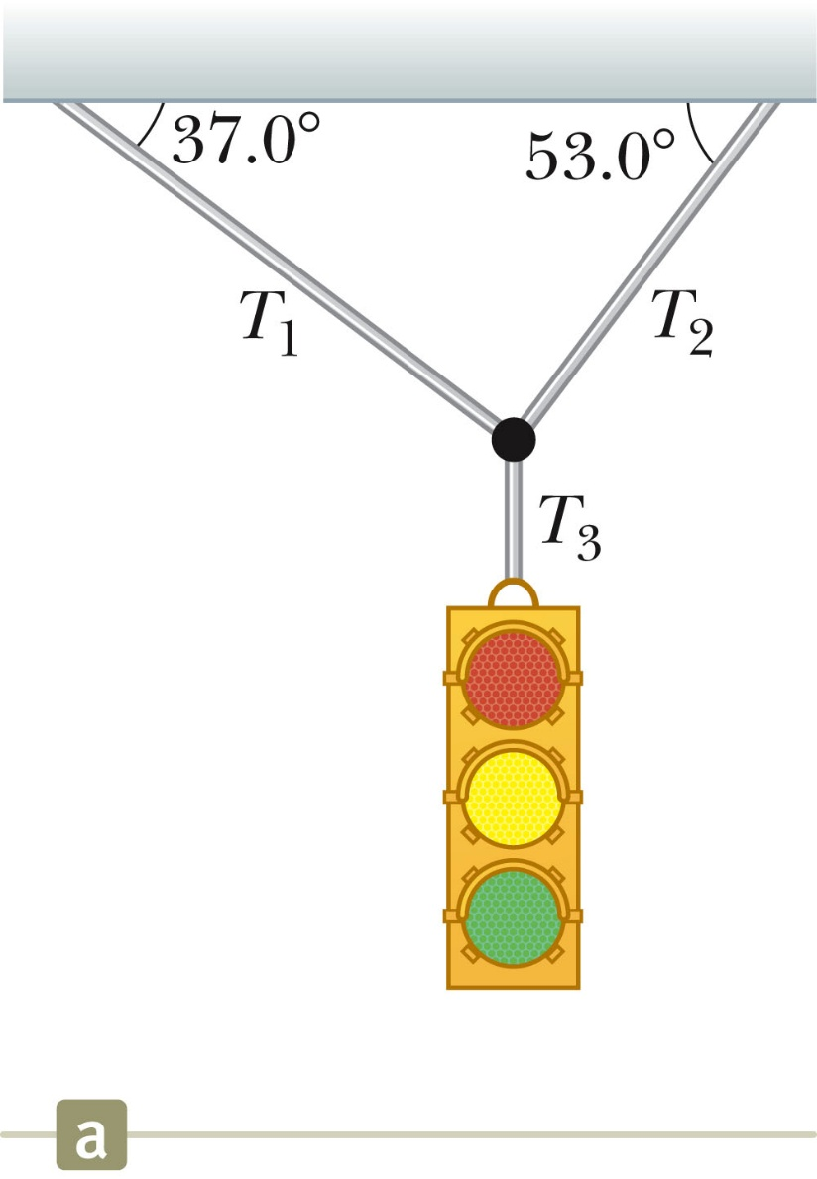
Equilibrium, Example 2
Example 5.4
Conceptualize the traffic light
  Assume cables don’t break
  Nothing is moving
Categorize as an equilibrium problem
  No movement, so acceleration is zero
  Model as a particle in equilibrium
Section 5.7

Slide 38
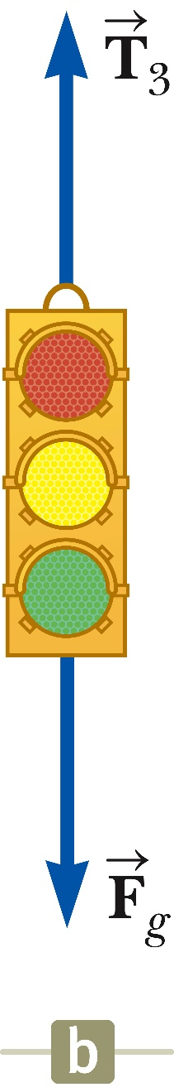
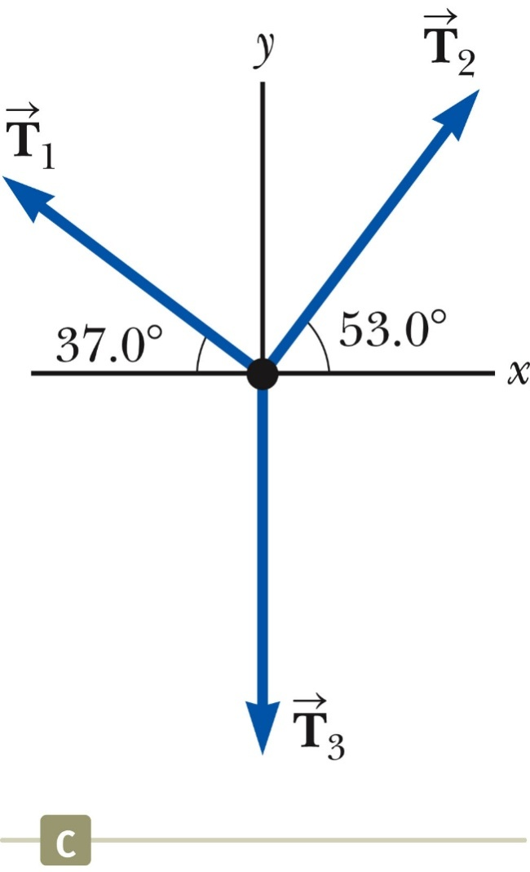
Equilibrium, Example 2, cont.
Analyze
  Construct a diagram for the forces acting on the light
  Construct a free body diagram for the knot where the three cables are joined
    The knot is a convenient point to choose since all the forces of interest act along lines passing through the knot.
  Apply equilibrium equations to the knot
Section 5.7

Slide 39
Equilibrium, Example 2, final
Analyze, cont.
  Find T₃ from applying equilibrium in the y-direction to the light
  Find T₁ and T₂ from applying equilibrium in the x- and y-directions to the knot
Finalize
  Think about different situations and see if the results are reasonable.
Section 5.7

Slide 40
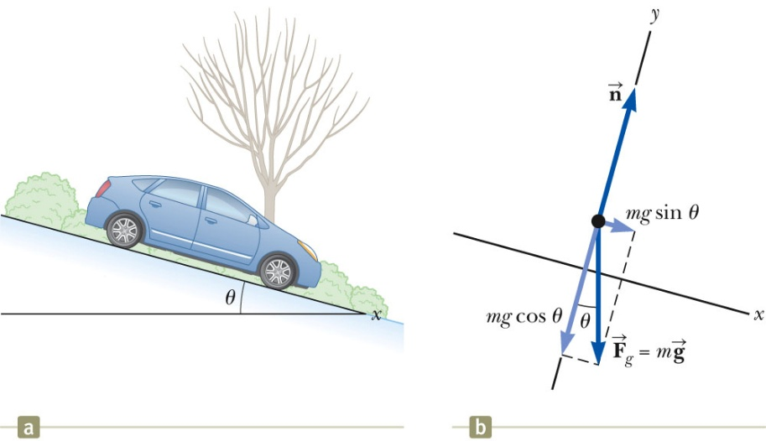
Inclined Planes
Categorize as a particle under a net force since it accelerates.
Forces acting on the object:
  The normal force acts perpendicular to the plane.
  The gravitational force acts straight down.
Choose the coordinate system with x along the incline and y perpendicular to the incline.
Replace the force of gravity with its components.
Apply the model of a particle under a net force to the x-direction and a particle in equilibrium to the y-direction.
Section 5.7

Slide 41
Multiple Objects
When two or more objects are connected or in contact, Newton’s laws may be applied to the system as a whole and/or to each individual object.
Whichever you use to solve the problem, the other approach can be used as a check.
Section 5.7

Slide 42
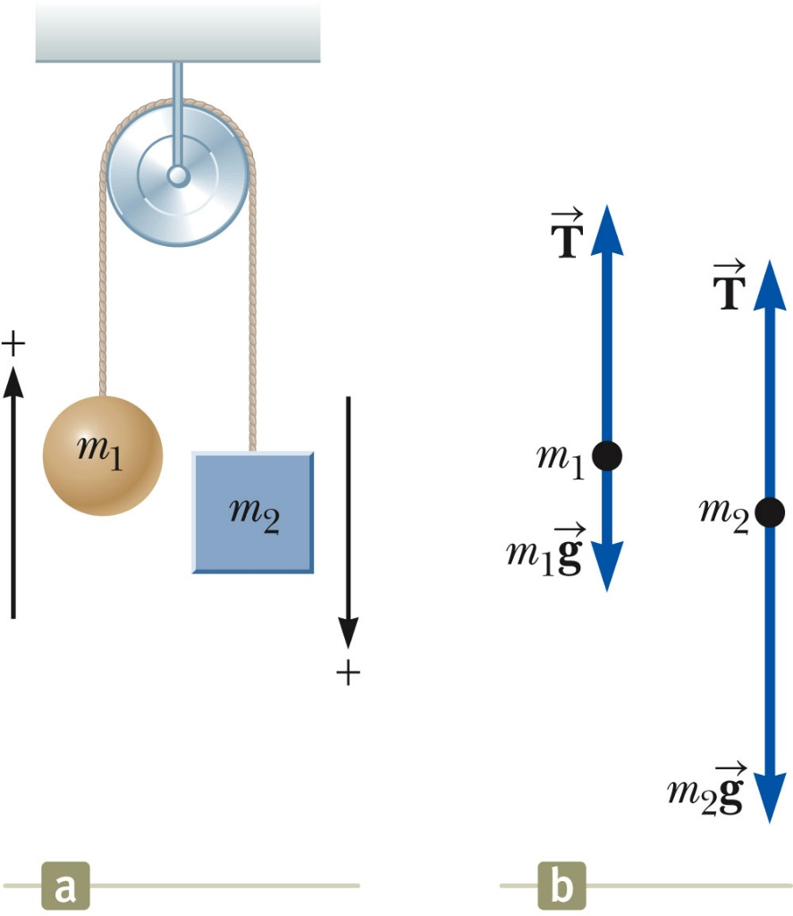
Multiple Objects, Example – Atwood’s Machine
Forces acting on the objects:
  Tension (same for both objects, one string)
  Gravitational force
Each object has the same acceleration since they are connected.
Draw the free-body diagrams
Apply Newton’s Laws
Solve for the unknown(s)
Section 5.7

Slide 43
Exploring the Atwood’s Machine
Vary the masses and observe the values of the tension and acceleration.
  Note the acceleration is the same for both objects
  The tension is the same on both sides of the pulley as long as you assume a massless, frictionless pulley.
What if?
  The mass of both objects is the same?
  One of the masses is much larger than the other?
Section 5.7

Slide 44
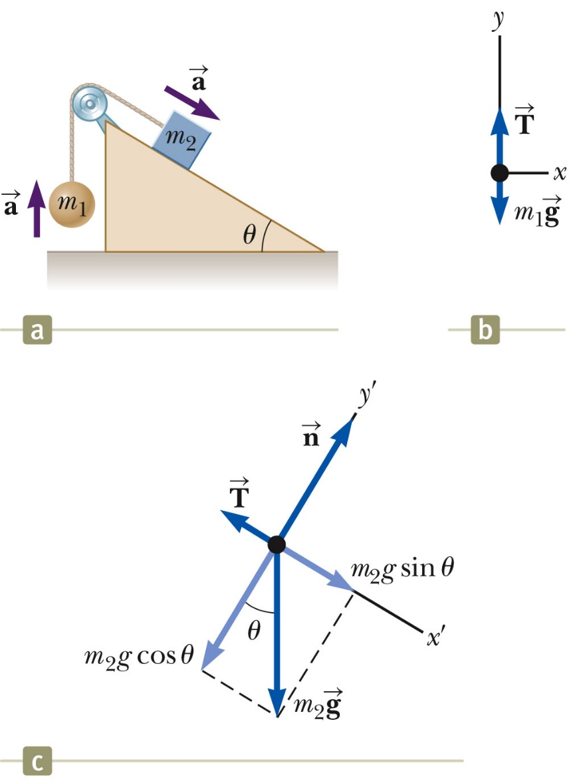
Multiple Objects, Example 2
Draw the free-body diagram for each object
  One cord, so tension is the same for both objects
  Connected, so acceleration is the same for both objects
Categorize as particles under a net force
Apply Newton’s Laws
Solve for the unknown(s)
Section 5.7

Slide 45
Forces of Friction
When an object is in motion on a surface or through a viscous medium, there will be a resistance to the motion.
  This is due to the interactions between the object and its environment.
This resistance is called the force of friction.

Slide 46
Forces of Friction, cont.
Friction is proportional to the normal force.
  ƒ_{s} ≤ µ_{s} n and ƒ_{k}= µ_{k} n
    μ is the coefficient of friction
  These equations relate the magnitudes of the forces; they are not vector equations.
  For static friction, the equals sign is valid only at impeding motion, the surfaces are on the verge of slipping.
  Use the inequality for static friction if the surfaces are not on the verge of slipping.
Section 5.8

Slide 47
Forces of Friction, final
The coefficient of friction depends on the surfaces in contact.
The force of static friction is generally greater than the force of kinetic friction.
The direction of the frictional force is opposite the direction of motion and parallel to the surfaces in contact.
The coefficients of friction are nearly independent of the area of contact.

Slide 48
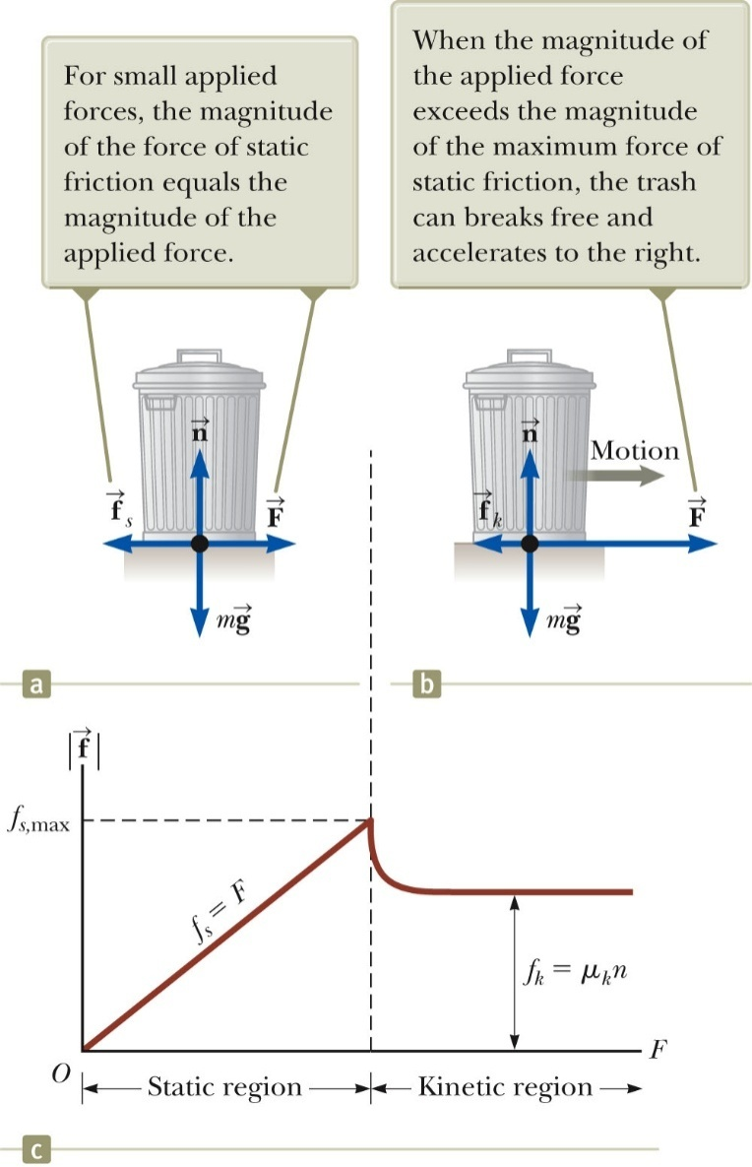


Static Friction
Static friction acts to keep the object from moving.
As long as the object is not moving, ƒ_{s} = F
If increases, so does
If decreases, so does
ƒ_{s} ≤ µ_{s} n
  Remember, the equality holds when the surfaces are on the verge of slipping.
Section 5.8

Slide 49

Kinetic Friction
The force of kinetic friction acts when the object is in motion.
Although µ_{k} can vary with speed, we shall neglect any such variations.
ƒ_{k} = µ_{k} n
Section 5.8

Slide 50
Explore Forces of Friction
Vary the applied force
Note the value of the frictional force
  Compare the values
Note what happens when the can starts to move
Section 5.8

Slide 51
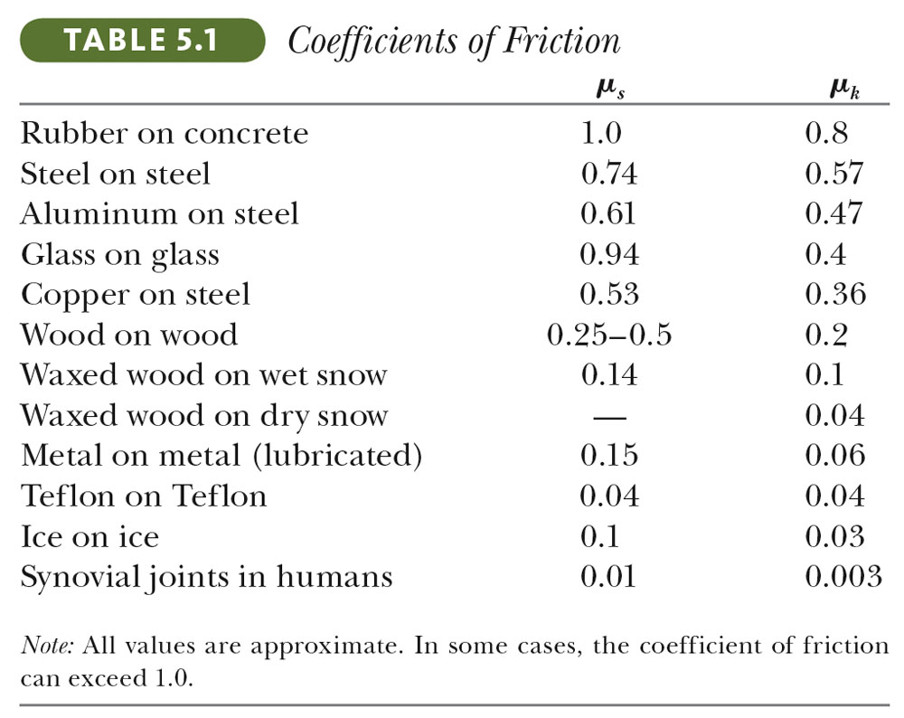
Some Coefficients of Friction
Section 5.8

Slide 52

Friction in Newton’s Laws Problems
Friction is a force, so it simply is included in the in Newton’s Laws.
The rules of friction allow you to determine the direction and magnitude of the force of friction.
Section 5.8

Slide 53
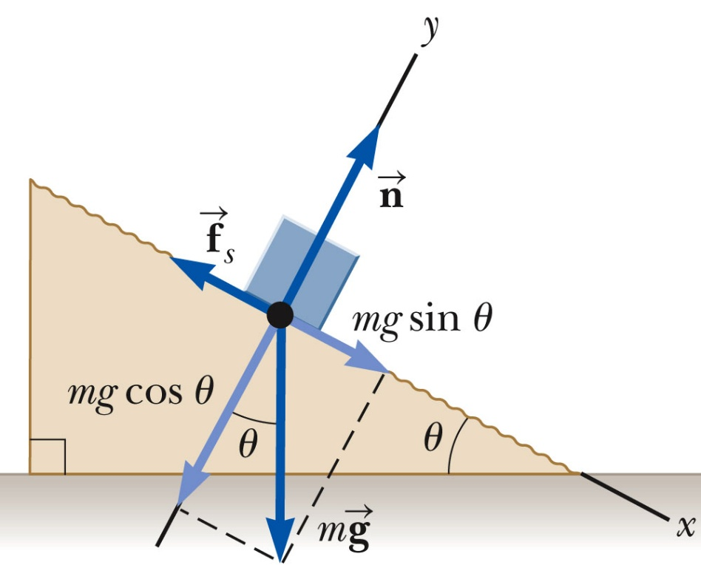
Friction Example, 1
The block is sliding down the plane, so friction acts up the plane.
This setup can be used to experimentally determine the coefficient of friction.
µ = tan θ
  For µ_{s}, use the angle where the block just slips.
  For µ_{k}, use the angle where the block slides down at a constant speed.
Section 5.8

Slide 54
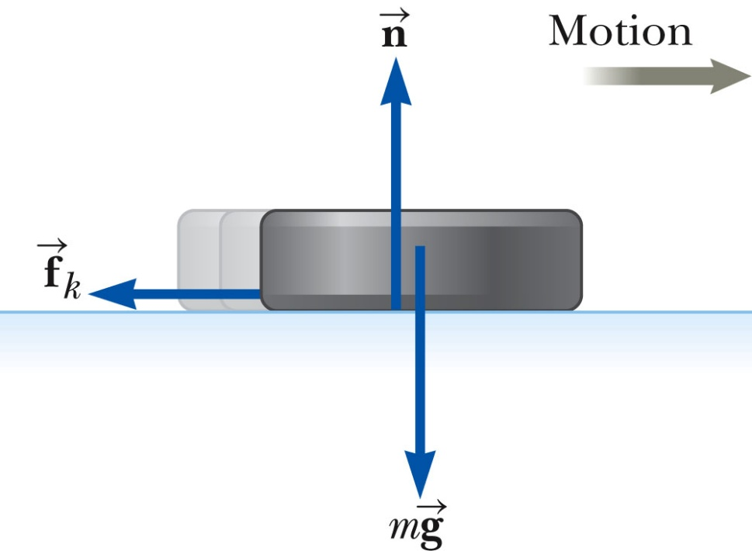
Friction, Example 2
Draw the free-body diagram, including the force of kinetic friction.
  Opposes the motion
  Is parallel to the surfaces in contact
Continue with the solution as with any Newton’s Law problem.
This example gives information about the motion which can be used to find the acceleration to use in Newton’s Laws.
Section 5.8

Slide 55
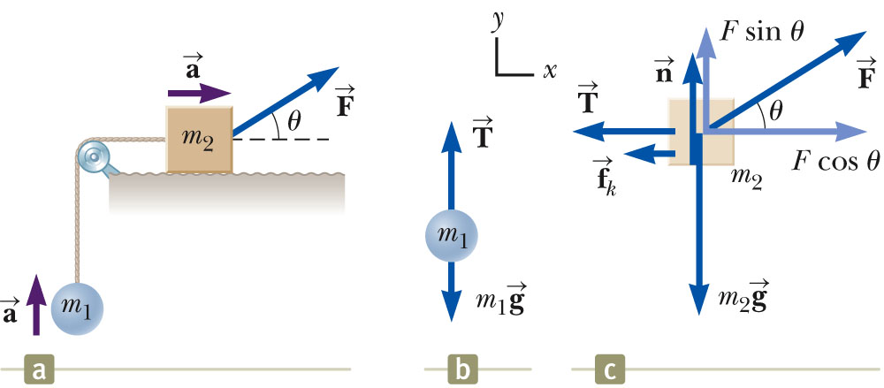
Friction, Example 3
Friction acts only on the object in contact with another surface.
Draw the free-body diagrams.
Apply Newton’s Laws as in any other multiple object system problem.
Section 5.8

Slide 56

Analysis Model Summary
Particle under a net force
  If a particle experiences a non-zero net force, its acceleration is related to the force by Newton’s Second Law.
  May also include using a particle under constant acceleration model to relate force and kinematic information.
Particle in equilibrium
  If a particle maintains a constant velocity (including a value of zero), the forces on the particle balance and Newton’s Second Law becomes.
Section 5.8

