Slide 1
Chapter 2
Motion in One Dimension

Slide 2
Kinematics
Describes motion while ignoring the external agents that might have caused or modified the motion
For now, will consider motion in one dimension
  Along a straight line
Motion represents a continual change in an object’s position.
Introduction

Slide 3
Types of Motion
Translational
  An example is a car traveling on a highway.
Rotational
  An example is the Earth’s spin on its axis.
Vibrational
  An example is the back-and-forth movement of a pendulum.
Introduction

Slide 4
Particle Model
We will use the particle model.
  A particle is a point-like object; has mass but infinitesimal size
Introduction

Slide 5
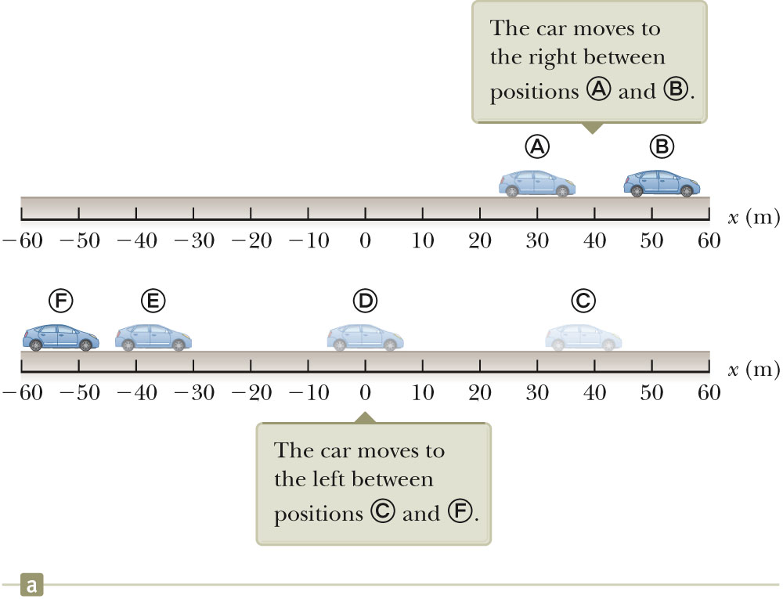
Position
The object’s position is its location with respect to a chosen reference point.
  Consider the point to be the origin of a coordinate system.
Only interested in the car’s translational motion, so model as a particle
Section 2.1

Slide 6
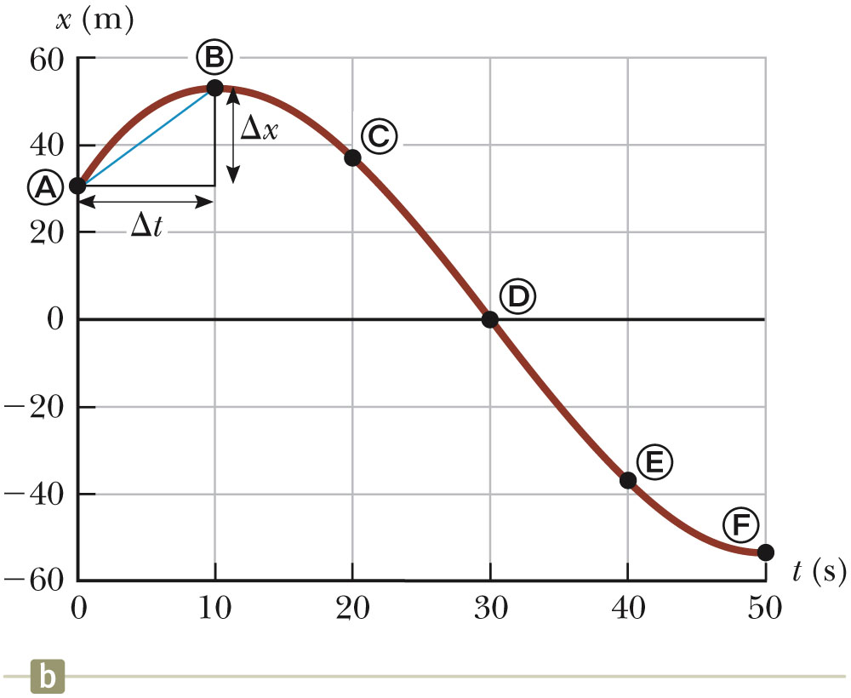
Position-Time Graph
The position-time graph shows the motion of the particle (car).
The smooth curve is a guess as to what happened between the data points.
Section 2.1

Slide 7
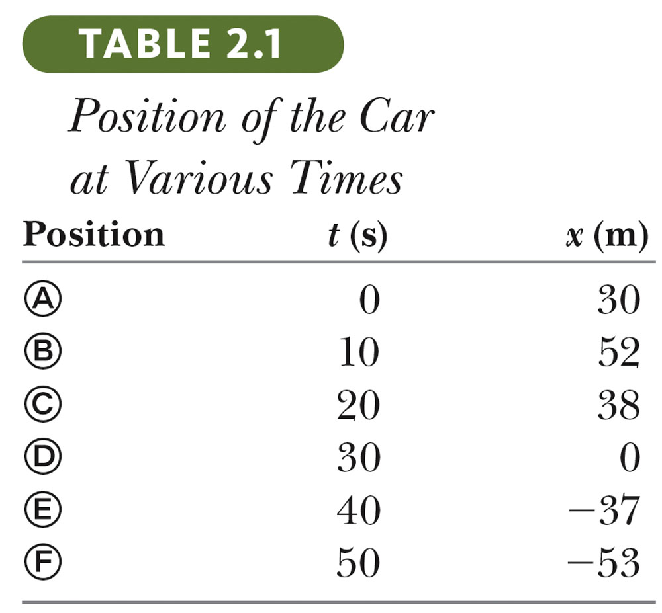
Data Table
The table gives the actual data collected during the motion of the object (car).
Positive is defined as being to the right.
Section 2.1

Slide 8
Representations of the Motion of Car
Various representations include:
  Pictorial
  Graphical
  Tablular
  Mathematical
    The goal in many problems
Using alternative representations is often an excellent strategy for understanding the situation of a given problem.
  For example, compare the different representations of the motion.
Section 2.1

Slide 9
Alternative Representations
Using alternative representations is often an excellent strategy for understanding a problem.
  For example, the car problem used multiple representations.
    Pictorial representation
    Graphical representation
    Tabular representation
Goal is often a mathematical representation
Section 2.1

Slide 10
Displacement
Displacement is defined as the change in position during some time interval.
  Represented as Δx
  Δx ≡ x_{f} - x_{i}
  SI units are meters (m)
  Δx can be positive or negative
Different than distance
  Distance is the length of a path followed by a particle.
Section 2.1

Slide 11

Distance vs. Displacement – An Example
Assume a player moves from one end of the court to the other and back.
Distance is twice the length of the court
  Distance is always positive
Displacement is zero
  Δx = x_{f} – x_{i} = 0 since x_{f} = x_{i}
Section 2.1

Slide 12
Vectors and Scalars
Vector quantities need both magnitude (size or numerical value) and direction to completely describe them.
  Will use + and – signs to indicate vector directions in this chapter
Scalar quantities are completely described by magnitude only.
Section 2.1

Slide 13
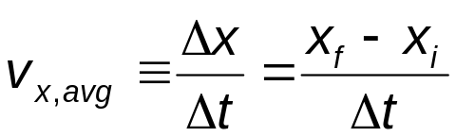
Average Velocity
The average velocity is rate at which the displacement occurs.
  The x indicates motion along the x-axis.
The dimensions are length / time [L/T]
The SI units are m/s
Is also the slope of the line in the position – time graph
Section 2.1

Slide 14
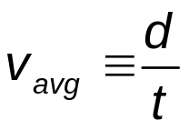
Average Speed
Speed is a scalar quantity.
  Has the same units as velocity
  Defined as total distance / total time:
The speed has no direction and is always expressed as a positive number.
Neither average velocity nor average speed gives details about the trip described.
Section 2.1

Slide 15
Average Speed and Average Velocity
The average speed is not the magnitude of the average velocity.
  For example, a runner ends at her starting point.
  Her displacement is zero.
  Therefore, her velocity is zero.
  However, the distance traveled is not zero, so the speed is not zero.
Section 2.1

Slide 16
Instantaneous Velocity
The limit of the average velocity as the time interval becomes infinitesimally short, or as the time interval approaches zero.
The instantaneous velocity indicates what is happening at every point of time.
Section 2.2

Slide 17
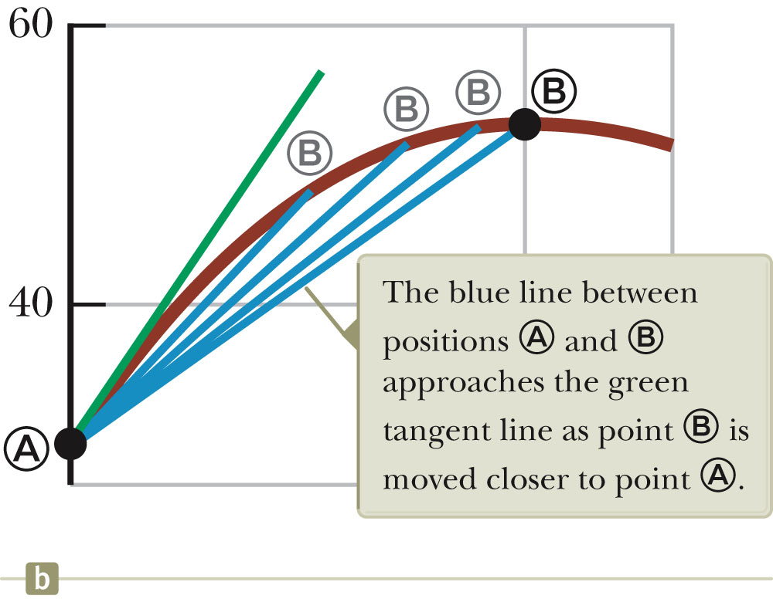
Instantaneous Velocity, graph
The instantaneous velocity is the slope of the line tangent to the x vs. t curve.
  This would be the green line.
The light blue lines show that as Δt gets smaller, they approach the green line.
Section 2.2

Slide 18
A Note About Slopes
The slope of a graph of physical data represents the ratio of change in the quantity represented on the vertical axis to the change in the quantity represented by the horizontal axis.
The slope has units
  Unless both axes have the same units
Section 2.2

Slide 19
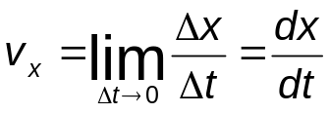
Instantaneous Velocity, equations
The general equation for instantaneous velocity is:
The instantaneous velocity can be positive, negative, or zero.
Section 2.2

Slide 20
Instantaneous Speed
The instantaneous speed is the magnitude of the instantaneous velocity.
The instantaneous speed has no direction associated with it.
Section 2.2

Slide 21
Vocabulary Note
“Velocity” and “speed” will indicate instantaneous values.
Average will be used when the average velocity or average speed is indicated.
Section 2.2

Slide 22
Analysis Models
Analysis models are an important technique in the solution to problems.
An analysis model is a description of:
  The behavior of some physical entity, or
  The interaction between the entity and the environment.
Try to identify the fundamental details of the problem and attempt to recognize which of the types of problems you have already solved could be used as a model for the new problem.
Section 2.3

Slide 23
Analysis Models, cont
Based on four simplification models
  Particle model
  System model
  Rigid object
  Wave
Problem approach
  Identify the analysis model that is appropriate for the problem.
  The model tells you which equation to use for the mathematical representation.
Section 2.3

Slide 24
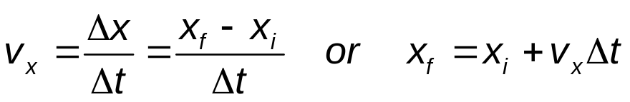
Model: A Particle Under Constant Velocity
Constant velocity indicates the instantaneous velocity at any instant during a time interval is the same as the average velocity during that time interval.
  v_{x} = v_{x, avg}
  The mathematical representation of this situation is the equation.
  Common practice is to let t_{i} = 0 and the equation becomes: x_{f} = x_{i} + v_{x} t (for constant v_{x})
Section 2.3

Slide 25
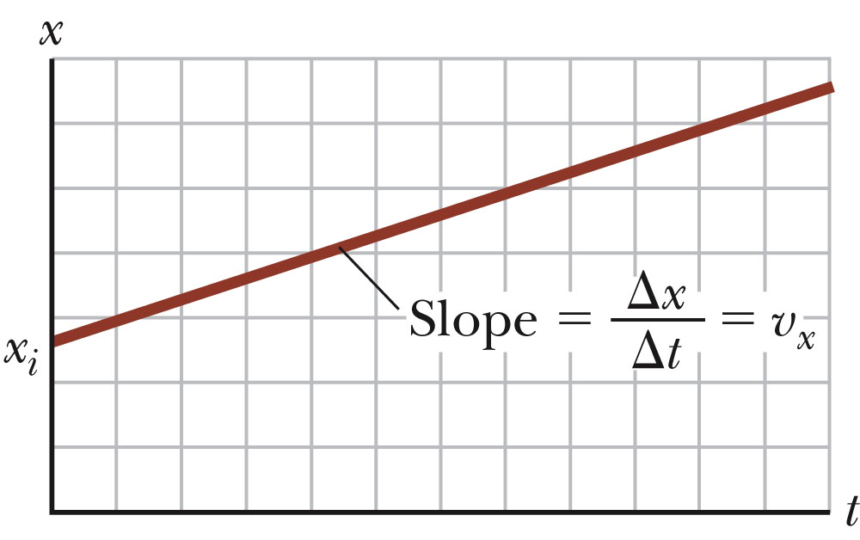
Particle Under Constant Velocity, Graph
The graph represents the motion of a particle under constant velocity.
The slope of the graph is the value of the constant velocity.
The y-intercept is x_{i.}
Section 2.3

Slide 26
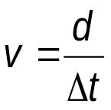
Model: A Particle Under Constant Speed
A particle under constant velocity moves with a constant speed along a straight line.
A particle can also move with a constant speed along a curved path.
This can be represented with a model of a particle under constant speed.
The primary equation is the same as for average speed, with the average speed replaced by the constant speed.
Section 2.3

Slide 27
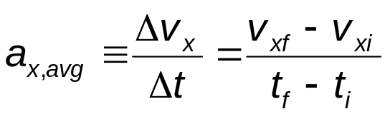
Average Acceleration
Acceleration is the rate of change of the velocity.
Dimensions are L/T²
SI units are m/s²
In one dimension, positive and negative can be used to indicate direction.
Section 2.4

Slide 28
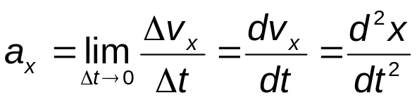
Instantaneous Acceleration
The instantaneous acceleration is the limit of the average acceleration as Δt approaches 0.
The term acceleration will mean instantaneous acceleration.
  If average acceleration is wanted, the word average will be included.
Section 2.4

Slide 29
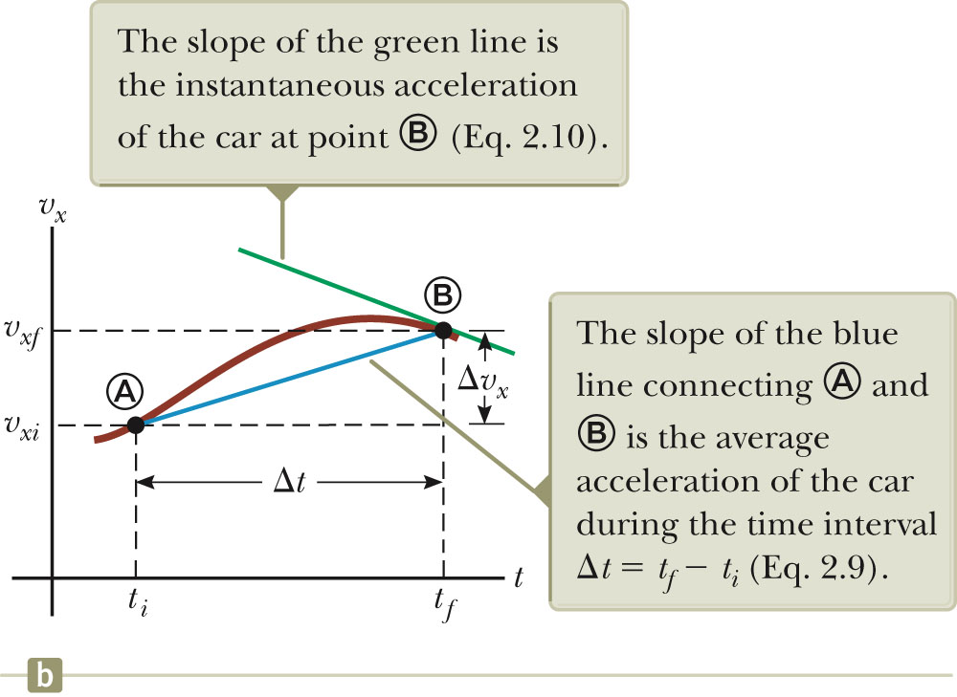
Instantaneous Acceleration – graph
The slope of the velocity-time graph is the acceleration.
The green line represents the instantaneous acceleration.
The blue line is the average acceleration.
Section 2.4

Slide 30
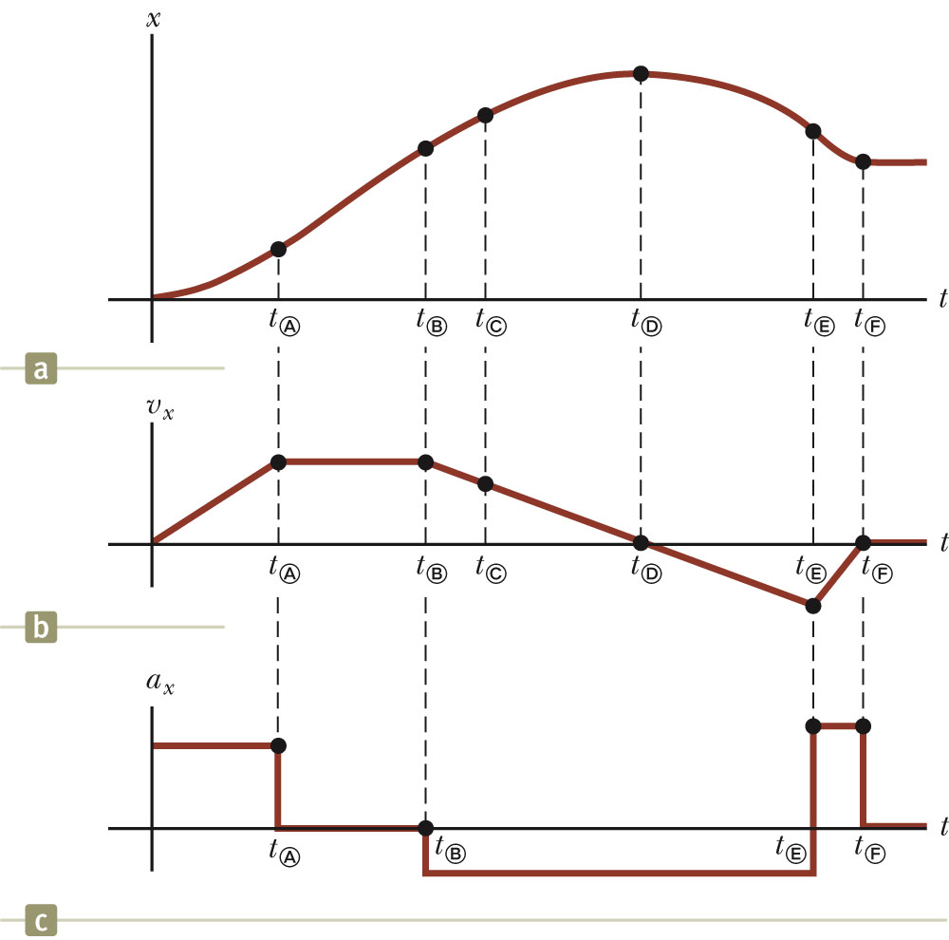
Graphical Comparison
Given the displacement-time graph (a)
The velocity-time graph is found by measuring the slope of the position-time graph at every instant.
The acceleration-time graph is found by measuring the slope of the velocity-time graph at every instant.
Section 2.4

Slide 31
Acceleration and Velocity, Directions
When an object’s velocity and acceleration are in the same direction, the object is speeding up.
When an object’s velocity and acceleration are in the opposite direction, the object is slowing down.
Section 2.4

Slide 32
Acceleration and Force
The acceleration of an object is related to the total force exerted on the object.
  The force is proportional to the acceleration, F_{x} ∝ a_{x .}
  Assume the velocity and acceleration are in the same direction.
    The force is in the same direction as the velocity and the object speeds up.
  Assume the velocity and acceleration are in opposite directions.
    The force is in the opposite direction as the velocity and the object slows down.
Section 2.4

Slide 33
Notes About Acceleration
Negative acceleration does not necessarily mean the object is slowing down.
  If the acceleration and velocity are both negative, the object is speeding up.
The word deceleration has the connotation of slowing down.
  This word will not be used in the text.
Section 2.4

Slide 34
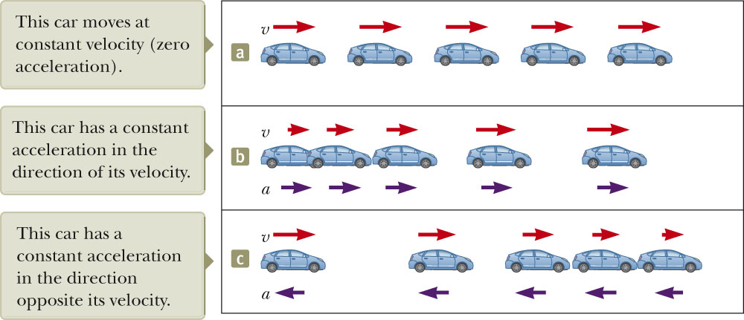
Motion Diagrams
A motion diagram can be formed by imagining the stroboscope photograph of a moving object.
Red arrows represent velocity.
Purple arrows represent acceleration.
Section 2.5

Slide 35
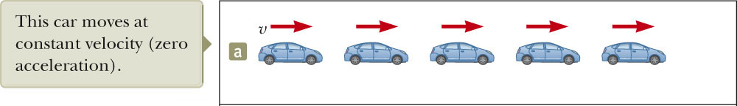
Constant Velocity
Images are equally spaced.
The car is moving with constant positive velocity (shown by red arrows maintaining the same size).
Acceleration equals zero.
Section 2.5

Slide 36
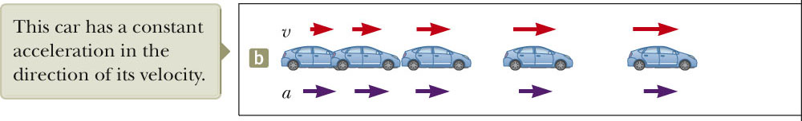
Acceleration and Velocity, 3
Images become farther apart as time increases.
Velocity and acceleration are in the same direction.
Acceleration is uniform (violet arrows maintain the same length).
Velocity is increasing (red arrows are getting longer).
This shows positive acceleration and positive velocity.
Section 2.5

Slide 37
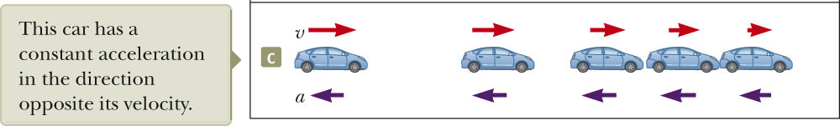
Acceleration and Velocity, 4
Images become closer together as time increases.
Acceleration and velocity are in opposite directions.
Acceleration is uniform (violet arrows maintain the same length).
Velocity is decreasing (red arrows are getting shorter).
Positive velocity and negative acceleration.
Section 2.5

Slide 38
Acceleration and Velocity, final
In all the previous cases, the acceleration was constant.
  Shown by the violet arrows all maintaining the same length
The diagrams represent motion of a particle under constant acceleration.
A particle under constant acceleration is another useful analysis model.
Section 2.5

Slide 39
Kinematic Equations
The kinematic equations can be used with any particle under uniform acceleration.
The kinematic equations may be used to solve any problem involving one-dimensional motion with a constant acceleration.
You may need to use two of the equations to solve one problem.
Many times there is more than one way to solve a problem.
Section 2.6

Slide 40

Kinematic Equations, 1
For constant a_{x},
Can determine an object’s velocity at any time t when we know its initial velocity and its acceleration
  Assumes t_{i} = 0 and t_{f} = t
Does not give any information about displacement
Section 2.6

Slide 41
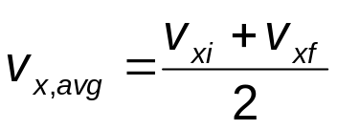
Kinematic Equations, 2
For constant acceleration,
The average velocity can be expressed as the arithmetic mean of the initial and final velocities.
  This applies only in situations where the acceleration is constant.
Section 2.6

Slide 42
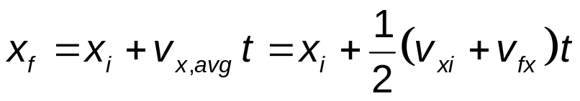
Kinematic Equations, 3
For constant acceleration,
This gives you the position of the particle in terms of time and velocities.
Doesn’t give you the acceleration
Section 2.6

Slide 43
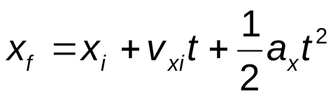
Kinematic Equations, 4
For constant acceleration,
Gives final position in terms of velocity and acceleration
Doesn’t tell you about final velocity
Section 2.6

Slide 44

Kinematic Equations, 5
For constant a,
Gives final velocity in terms of acceleration and displacement
Does not give any information about the time
Section 2.6

Slide 45
When a = 0
When the acceleration is zero,
  v_{xf} = v_{xi} = v_{x}
  x_{f} = x_{i} + v_{x} t
The constant acceleration model reduces to the constant velocity model.
Section 2.6

Slide 46
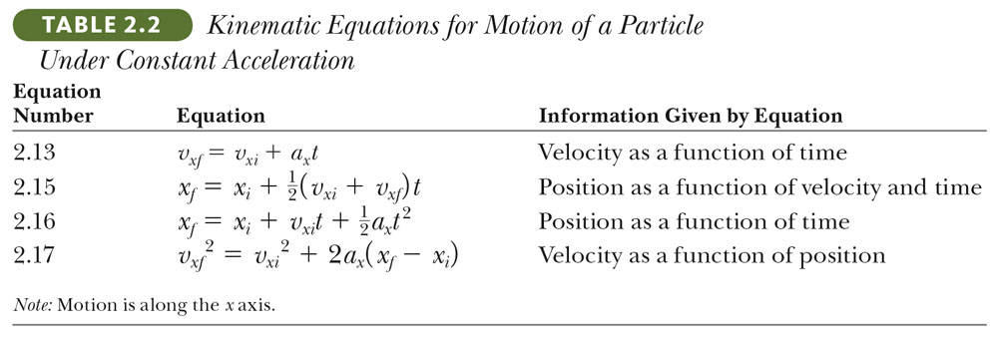
Kinematic Equations – summary
Section 2.6

Slide 47
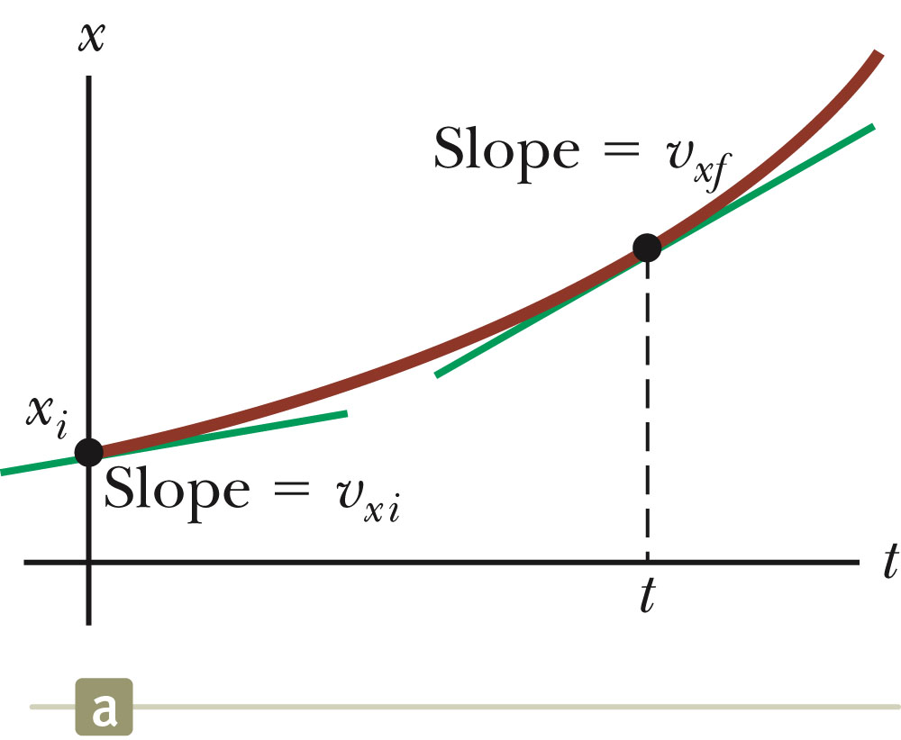
Graphical Look at Motion: Displacement – Time curve
The slope of the curve is the velocity.
The curved line indicates the velocity is changing.
  Therefore, there is an acceleration.
Section 2.6

Slide 48
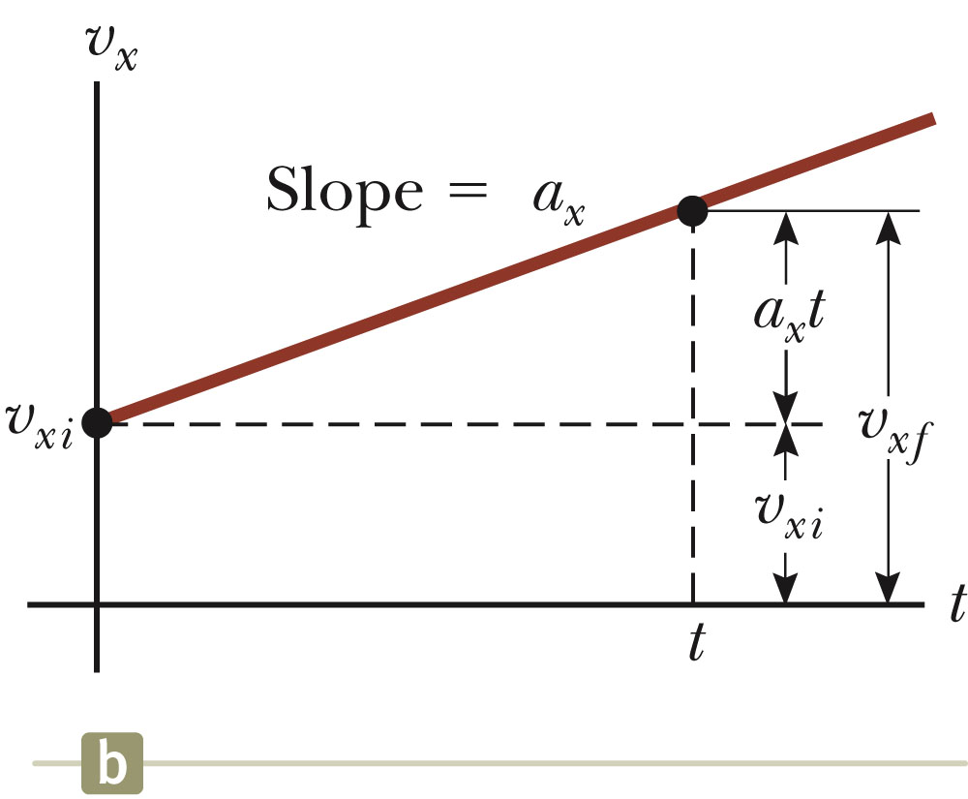
Graphical Look at Motion: Velocity – Time curve
The slope gives the acceleration.
The straight line indicates a constant acceleration.
Section 2.6

Slide 49
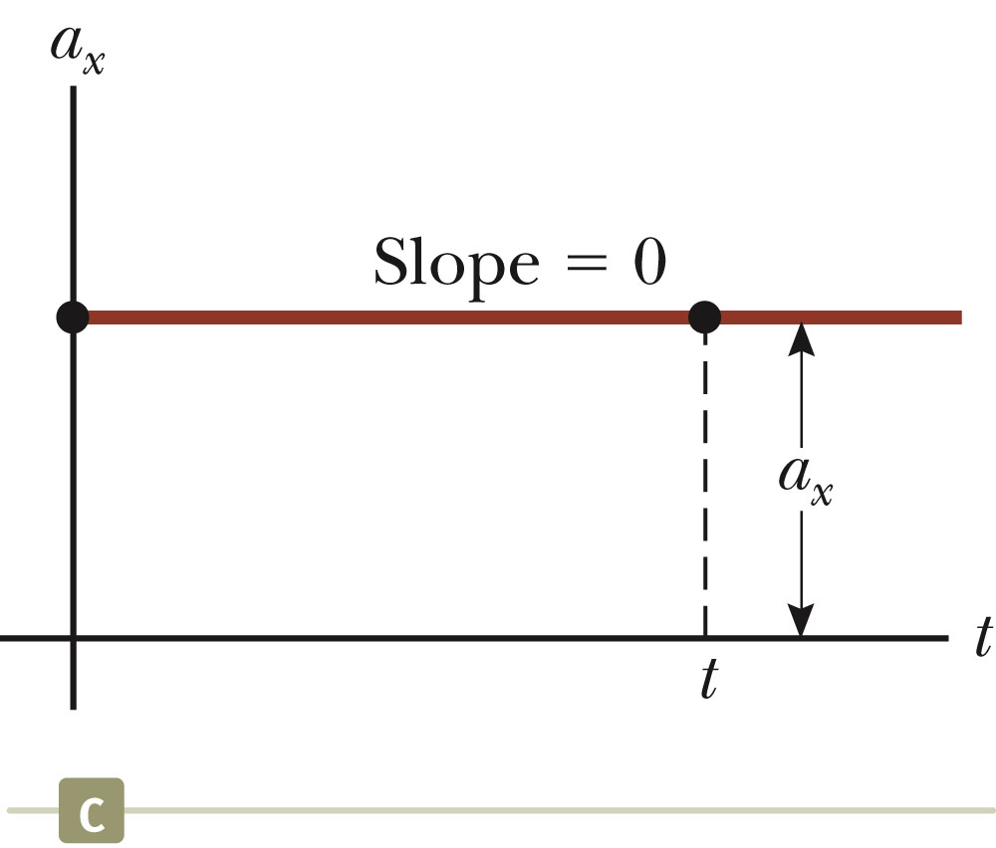
Graphical Look at Motion: Acceleration – Time curve
The zero slope indicates a constant acceleration.
Section 2.6

Slide 50
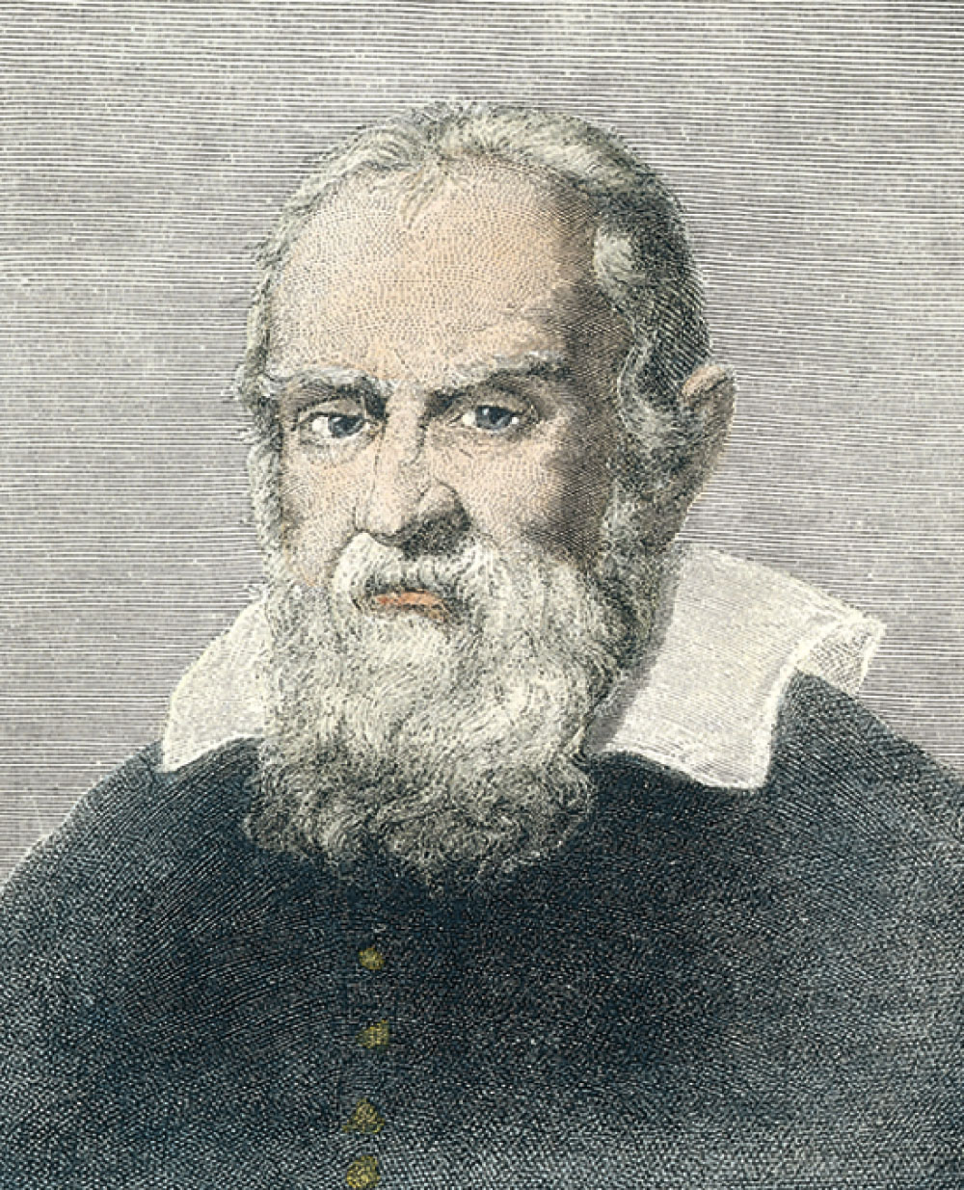
Galileo Galilei
1564 – 1642
Italian physicist and astronomer
Formulated laws of motion for objects in free fall
Supported heliocentric universe
Section 2.7

Slide 51
Freely Falling Objects
A freely falling object is any object moving freely under the influence of gravity alone.
It does not depend upon the initial motion of the object.
  Dropped – released from rest
  Thrown downward
  Thrown upward
Section 2.7

Slide 52
Acceleration of Freely Falling Object
The acceleration of an object in free fall is directed downward, regardless of the initial motion.
The magnitude of free fall acceleration is g = 9.80 m/s².
  g decreases with increasing altitude
  g varies with latitude
  9.80 m/s² is the average at the Earth’s surface
  The italicized g will be used for the acceleration due to gravity.
    Not to be confused with g for grams
Section 2.7

Slide 53
Acceleration of Free Fall, cont.
We will neglect air resistance.
Free fall motion is constantly accelerated motion in one dimension.
  Use model of a particle under constant acceleration
Let upward be positive
Use the kinematic equations
  With a_{y} = -g = -9.80 m/s²
  Note displacement is in the vertical direction
Section 2.7

Slide 54
Free Fall – An Object Dropped
Initial velocity is zero
Let up be positive
Use the kinematic equations
  Generally use y instead of x since vertical
Acceleration is
  a_{y} = -g = -9.80 m/s²
v_{o}= 0
a = -g
Section 2.7

Slide 55
Free Fall – An Object Thrown Downward
a_{y} = -g = -9.80 m/s²
Initial velocity ≠ 0
  With upward being positive, initial velocity will be negative.
v_{o}≠ 0
a = -g
Section 2.7

Slide 56
Free Fall – Object Thrown Upward
Initial velocity is upward, so positive
The instantaneous velocity at the maximum height is zero.
a_{y} = -g = -9.80 m/s² everywhere in the motion
v = 0
v_{o}≠ 0
a = -g
Section 2.7

Slide 57
Thrown upward, cont.
The motion may be symmetrical.
  Then t_{up} = t_{down}
  Then v = -v_{o}
The motion may not be symmetrical.
  Break the motion into various parts.
    Generally up and down
Section 2.7

Slide 58
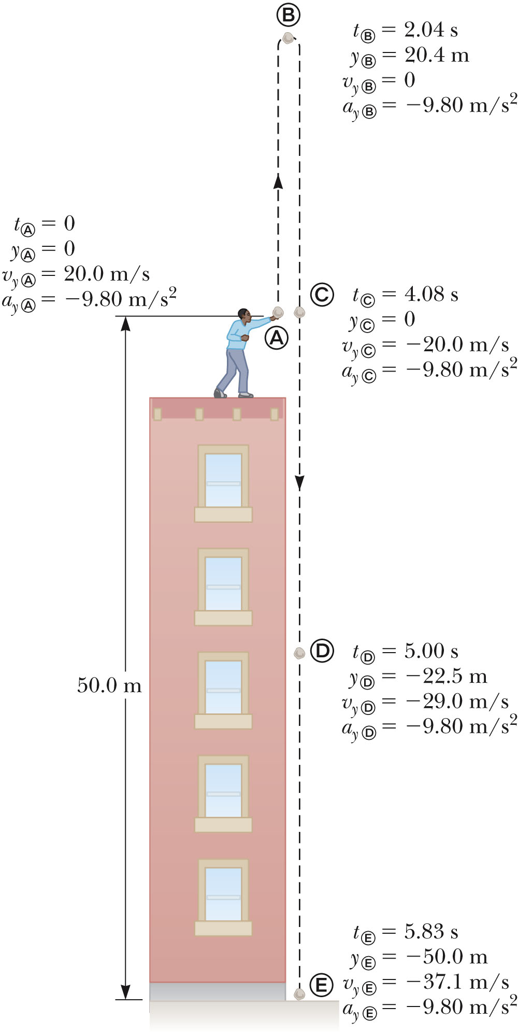
Free Fall Example
Initial velocity at A is upward (+) and acceleration is -g (-9.8 m/s²).
At B, the velocity is 0 and the acceleration is -g (-9.8 m/s²).
At C, the velocity has the same magnitude as at A, but is in the opposite direction.
The displacement is –50.0 m (it ends up 50.0 m below its starting point).
Section 2.7

Slide 59
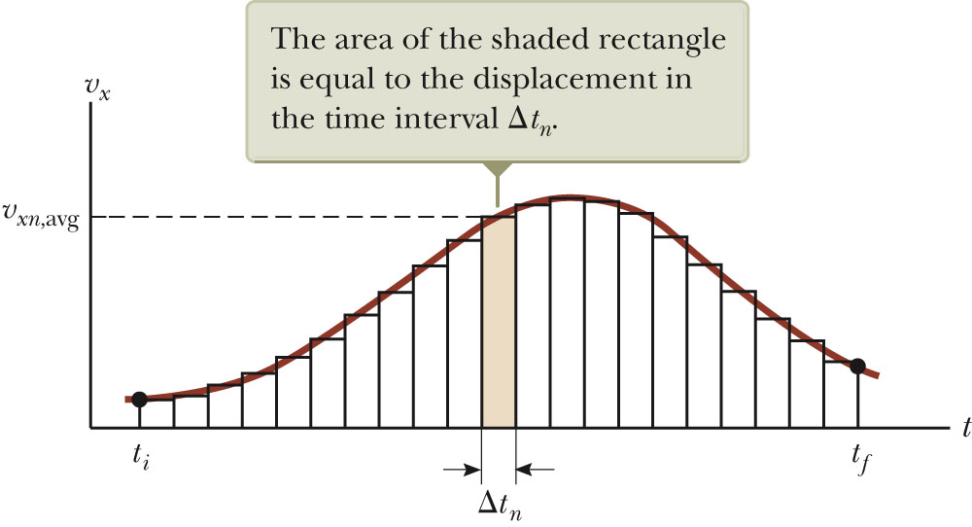
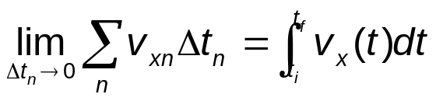
Kinematic Equations from Calculus
Displacement equals the area under the velocity – time curve
The limit of the sum is a definite integral.
Section 2.8

Slide 60
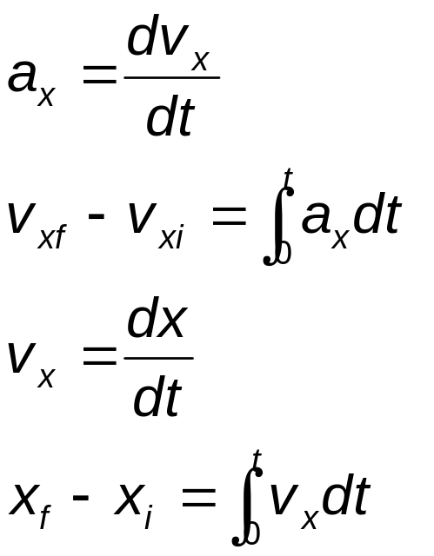
Kinematic Equations – General Calculus Form
Section 2.8

Slide 61

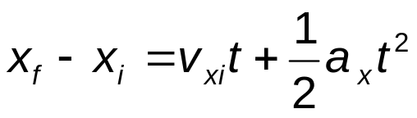
Kinematic Equations – From Integration
The integration form of v_{f} – v_{i} gives
The integration form of x_{f} – x_{i} gives
Section 2.8

Slide 62
General Problem Solving Strategy
In addition to basic physics concepts, a valuable skill is the ability to solve complicated problems.
Steps in a general problem solving approach:
  Conceptualize
  Categorize
  Analyze
  Finalize
Section 2.8

Slide 63
Problem Solving – Conceptualize
Think about and understand the situation.
Make a quick drawing of the situation.
Gather the numerical information.
  Include algebraic meanings of phrases.
Focus on the expected result.
  Think about units.
Think about what a reasonable answer should be.
Section 2.8

Slide 64
Problem Solving – Categorize
Simplify the problem.
  Can you ignore air resistance?
  Model objects as particles
Classify the type of problem.
  Substitution
  Analysis
Try to identify similar problems you have already solved.
  What analysis model would be useful?
Section 2.8

Slide 65
Problem Solving – Analyze
Select the relevant equation(s) to apply.
Solve for the unknown variable.
Substitute appropriate numbers.
Calculate the results.
  Include units
Round the result to the appropriate number of significant figures.
Section 2.8

Slide 66
Problem Solving – Finalize
Check your result.
  Does it have the correct units?
  Does it agree with your conceptualized ideas?
Look at limiting situations to be sure the results are reasonable.
Compare the result with those of similar problems.
Section 2.8

Slide 67
Problem Solving – Some Final Ideas
When solving complex problems, you may need to identify sub-problems and apply the problem-solving strategy to each sub-part.
These steps can be a guide for solving problems in this course.
Section 2.8

