Slide 1

KCL and KVL
Engr. Muhammad Waqas

Slide 2
Some Confusion from Previous Lectures
Electric circuit has many elements like resistor, capacitor, inductor, battery etc.
Circuit analysis is the process by which voltage or current is measured across the element.
In a complete circuit there are two types of elements found
  active elements.
    The active elements generate energy. Batteries, generators, operational amplifiers etc are active elements.
  passive elements.
    The passive elements cannot generate energy, they drop energy. Resistor, capacitor, inductor etc are passive elements because they takes energy from circuit.

Slide 3
Some Confusion from Previous Lectures
In a complete circuit voltage or current source are most active elements which deliver power in the circuit.
Two type of source
  Independent source
  Dependent source.

Slide 4
Circuit Definitions
Node – any point where 2 or more circuit elements are connected together
  Wires usually have negligible resistance
  Each node has one voltage (w.r.t. ground)
Branch – a circuit element between two nodes
Loop – a collection of branches that form a closed path returning to the same node without going through any other nodes or branches twice

Slide 5
Example
How many nodes, branches & loops?
R₁
+
Vo
-
+
-
Vs
Is
R₂
R₃

Slide 6
Example
Three nodes
R₁
+
Vo
-
+
-
Vs
Is
R₂
R₃

Slide 7
Example
5 Branches
R₁
+
Vo
-
+
-
Vs
Is
R₂
R₃

Slide 8
Example
Three Loops, if starting at node A
A
B
R₁
+
Vo
-
+
-
Vs
Is
R₂
R₃
C

Slide 9
Kirchoff’s Voltage Law (KVL)
The algebraic sum of voltages around each loop is zero
  Beginning with one node, add voltages across each branch in the loop (if you encounter a + sign first) and subtract voltages (if you encounter a – sign first)
Σ voltage drops - Σ voltage rises = 0
Or Σ voltage drops = Σ voltage rises

Slide 10
Kirchhoff’s Voltage Law
Using sum of the drops = 0
“b”
•
+
v₂
-
-
v₅
+
Blue path, starting at “a”
- v₇ + v₁₀ – v₉ + v₈ = 0
-
-
-
v₁
v₄
v₆
+
+
+
v₃
v₇
Red path, starting at “b”
+v₂ – v₅ – v₆ – v₈ + v₉ – v₁₁
– v₁₂ + v₁ = 0
-
+
+
-
•
“a”
+
-
+
v₁₂
v₁₀
v₈
+
Yellow path, starting at “b”
+ v₂ – v₅ – v₆ – v₇ + v₁₀ – v₁₁
- v₁₂ + v₁ = 0
-
-
+
v₁₁
-
-
v₉
+
11

Slide 11
Example
Kirchoff’s Voltage Law around 1st Loop
A
I₁
+ I₁R₁ -
B
R₁
I₂
+
Vo
-
+
I₂R₂
-
+
-
Vs
Is
R₂
R₃
C
Assign current variables and directions
Use Ohm’s law to assign voltages and polarities consistent with
passive devices (current enters at the + side)

Slide 12
Example
Kirchoff’s Voltage Law around 1st Loop
A
I₁
+ I₁R₁ -
B
R₁
I₂
+
Vo
-
+
I₂R₂
-
+
-
Vs
Is
R₂
R₃
C
Starting at node A, add the 1st voltage drop: + I₁R₁

Slide 13
Example
Kirchoff’s Voltage Law around 1st Loop
A
I₁
+ I₁R₁ -
B
R₁
+
Vo
-
I₂
+
I₂R₂
-
+
-
Vs
Is
R₂
R₃
C
Add the voltage drop from B to C through R₂: + I₁R₁ + I₂R₂

Slide 14
Example
Kirchoff’s Voltage Law around 1st Loop
A
I₁
+ I₁R₁ -
B
R₁
I₂
+
Vo
-
+
I₂R₂
-
+
-
Vs
Is
R₂
R₃
C
Subtract the voltage rise from C to A through Vs: + I₁R₁ + I₂R₂ – Vs = 0
Notice that the sign of each term matches the polarity encountered 1st

Slide 15
Circuit Analysis
When given a circuit with sources and resistors having fixed values, you can use Kirchoff’s two laws and Ohm’s law to determine all branch voltages and currents
+ V_{AB} -
A
I
7Ω
B
+
V_{BC}
-
+
12 v
-
3Ω
C

Slide 16
Circuit Analysis
By Ohm’s law: V_{AB} = I·7Ω and V_{BC} = I·3Ω
By KVL: V_{AB} + V_{BC} – 12 v = 0
Substituting: I·7Ω + I·3Ω -12 v = 0
Solving: I = 1.2 A
+ V_{AB} -
A
I
7Ω
B
+
V_{BC}
-
+
12 v
-
3Ω
C

Slide 17
Circuit Analysis
Since V_{AB} = I·7Ω and V_{BC} = I·3Ω
And I = 1.2 A
So V_{AB} = 8.4 v and V_{BC} = 3.6 v
+ V_{AB} -
A
I
7Ω
B
+
V_{BC}
-
+
12 v
-
3Ω
C

Slide 18
Series Resistors
KVL: +I·10Ω – 12 v = 0, So I = 1.2 A
From the viewpoint of the source, the 7 and 3 ohm resistors in series are equivalent to the 10 ohms
I
+
I·10Ω
-
+
12 v
-
10Ω

Slide 19
Series Resistors
To the rest of the circuit, series resistors can be replaced by an equivalent resistance equal to the sum of all resistors
Series resistors (same current through all)
I
. . .
I
Σ Rseries

Slide 20
Kirchoff’s Current Law (KCL)
The algebraic sum of currents entering a node is zero
  Add each branch current entering the node and subtract each branch current leaving the node
Σ currents in - Σ currents out = 0
Or Σ currents in = Σ currents out

Slide 21
Example
Kirchoff’s Current Law at B
B
A
I₁
R₁
I₂
+
Vo
-
I₃
+
-
Vs
Is
R₂
R₃
C
Assign current variables and directions
Add currents in, subtract currents out: I₁ – I₂ – I₃ + Is = 0

Slide 22
Circuit Analysis
A
+
V_{AB}
-
+ +
- -
10 A
I₁
I₂
8Ω
4Ω
B
By KVL: - I₁∙ 8Ω + I₂∙ 4Ω = 0
Solving: I₂ = 2 ∙ I₁
By KCL: 10A = I₁ + I₂
Substituting: 10A = I₁ + 2 ∙ I₁ = 3 ∙ I₁
So I₁ = 3.33 A and I₂ = 6.67 A
And V_{AB} = 26.33 volts

Slide 23
Circuit Analysis
A
+
V_{AB}
-
10 A
2.667Ω
B
By Ohm’s Law: V_{AB} = 10 A ∙ 2.667 Ω
So V_{AB} = 26.67 volts
Replacing two parallel resistors (8 and 4 Ω)
by one equivalent one produces the same
result from the viewpoint of the rest of the
circuit.

Slide 24
Parallel Resistors
The equivalent resistance for any number of resistors in parallel (i.e. they have the same voltage across each resistor):
1
Req =
1/R₁ + 1/R₂ + ∙∙∙ + 1/R_{N}
For two parallel resistors:
Req = R₁∙R₂/(R₁+R₂)

Slide 25
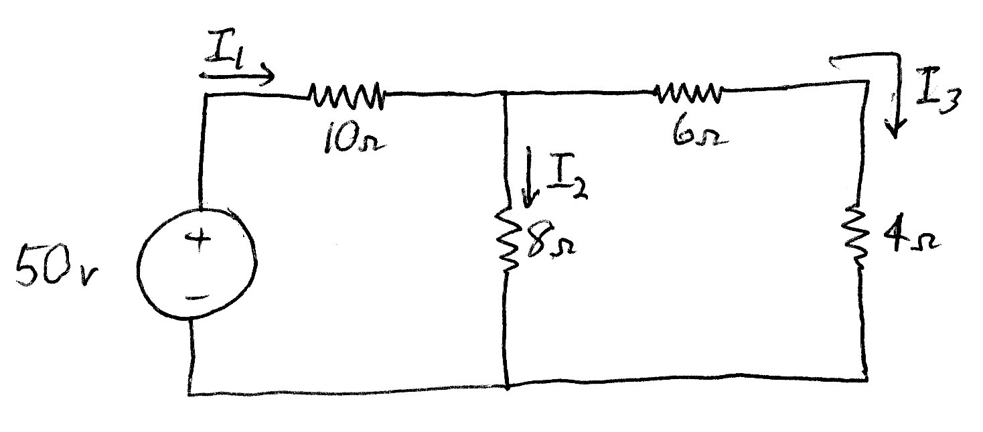
Example Circuit
Solve for the currents through each resistor
And the voltages across each resistor

Slide 26
Example Circuit
+ I₁∙10Ω -
+ I₃∙6Ω -
+
I₃∙4Ω
-
+
I₂∙8Ω
-
Using Ohm’s law, add polarities and
expressions for each resistor voltage

Slide 27
Example Circuit
+ I₁∙10Ω -
+ I₃∙6Ω -
+
I₃∙4Ω
-
+
I₂∙8Ω
-
Write 1st Kirchoff’s voltage law equation
-50 v + I₁∙10Ω + I₂∙8Ω = 0

Slide 28
Example Circuit
+ I₁∙10Ω -
+ I₃∙6Ω -
+
I₃∙4Ω
-
+
I₂∙8Ω
-
Write 2nd Kirchoff’s voltage law equation
-I₂∙8Ω + I₃∙6Ω + I₃∙4Ω = 0
or I₂ = I₃ ∙(6+4)/8 = 1.25 ∙ I₃

Slide 29
Example Circuit
A
Write Kirchoff’s current law equation at A
+I₁ – I₂ - I₃ = 0

Slide 30
Example Circuit
We now have 3 equations in 3 unknowns, so we can solve for the currents through each resistor, that are used to find the voltage across each resistor
Since I₁ - I₂ - I₃ = 0, I₁ = I₂ + I₃
Substituting into the 1st KVL equation
-50 v + (I₂ + I₃)∙10Ω + I₂∙8Ω = 0
or I₂∙18 Ω + I₃∙ 10 Ω = 50 volts

Slide 31
Example Circuit
But from the 2nd KVL equation, I₂ = 1.25∙I₃
Substituting into 1st KVL equation:
(1.25 ∙ I₃)∙18 Ω + I₃ ∙ 10 Ω = 50 volts
Or: I₃ ∙ 22.5 Ω + I₃ ∙ 10 Ω = 50 volts
Or: I₃∙ 32.5 Ω = 50 volts
Or: I₃ = 50 volts/32.5 Ω
Or: I₃ = 1.538 amps

Slide 32
Example Circuit
Since I₃ = 1.538 amps
I₂ = 1.25∙I₃ = 1.923 amps
Since I₁ = I₂ + I_{3,} I₁ = 3.461 amps
The voltages across the resistors:
  I₁∙10Ω = 34.61 volts
  I₂∙8Ω = 15.38 volts
  I₃∙6Ω = 9.23 volts
  I₃∙4Ω = 6.15 volts

Slide 33
Example Circuit
Solve for the currents through each resistor
And the voltages across each resistor using
Series and parallel simplification.

Slide 34
Example Circuit
The 6 and 4 ohm resistors are in series, so
are combined into 6+4 = 10Ω

Slide 35
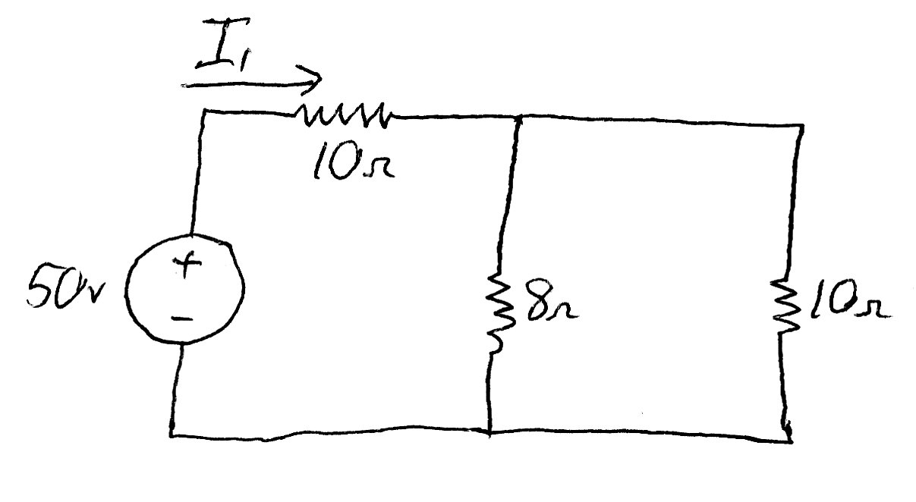
Example Circuit
The 8 and 10 ohm resistors are in parallel, so
are combined into 8∙10/(8+10) =14.4 Ω

Slide 36
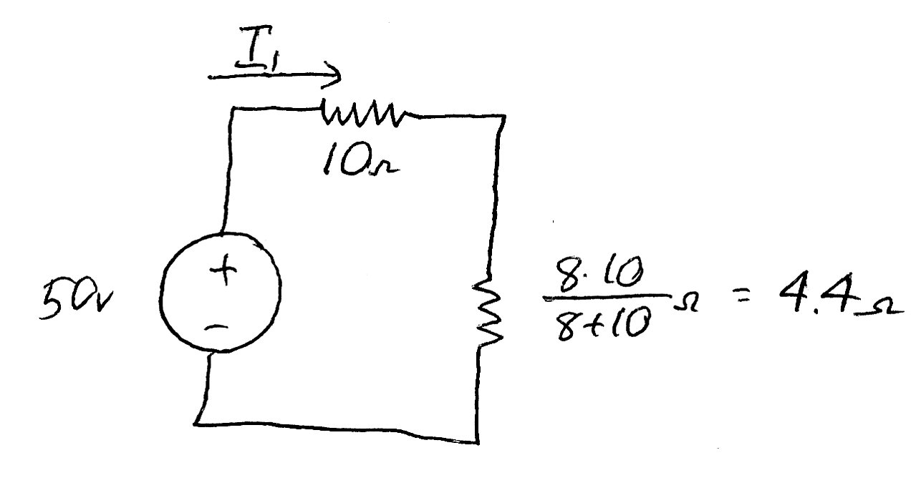
Example Circuit
The 10 and 4.4 ohm resistors are in series, so
are combined into 10+4 = 14.4Ω

Slide 37
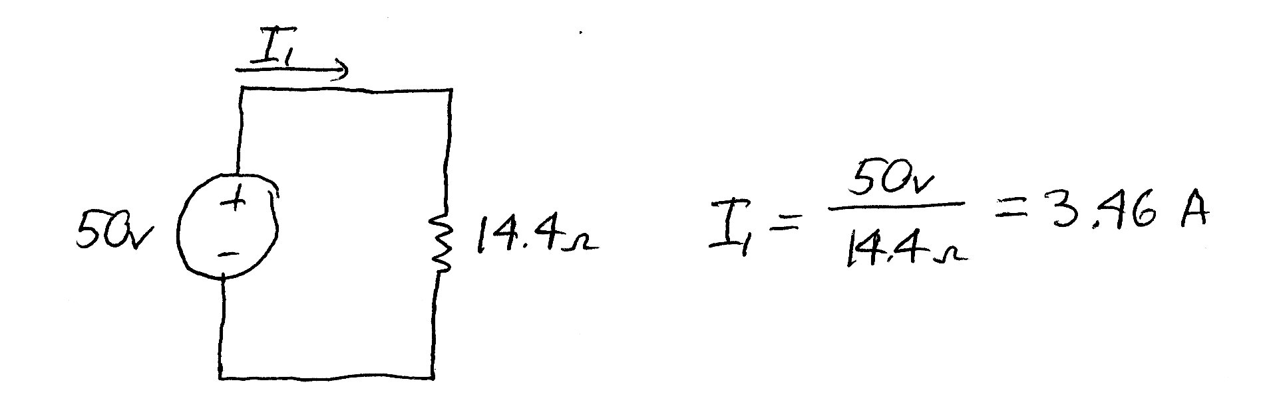
Example Circuit
+
I₁∙14.4Ω
-
Writing KVL, I₁∙14.4Ω – 50 v = 0
Or I₁ = 50 v / 14.4Ω = 3.46 A

Slide 38
Example Circuit
+34.6 v -
+
15.4 v
-
If I₁ = 3.46 A, then I₁∙10 Ω = 34.6 v
So the voltage across the 8 Ω = 15.4 v

Slide 39
Example Circuit
+ 34.6 v -
+
15.4 v
-
If I₂∙8 Ω = 15.4 v, then I₂ = 15.4/8 = 1.93 A
By KCL, I₁-I₂-I₃=0, so I₃ = I₁–I₂ = 1.53 A

