Slide 1
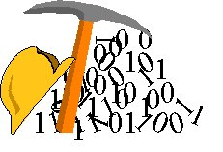
Superposition theorem
Engr. Muhammad Waqas

Slide 2
Superposition Principle
Because the circuit is linear we can find the response of the circuit to each source acting alone, and then add them up to find the response of the circuit to all sources acting together. This is known as the superposition principle.
The superposition principle states that the voltage across (or the current through) an element in a linear circuit is the algebraic sum of the voltages across (or currents through) that element due to each independent source acting alone.

Slide 3
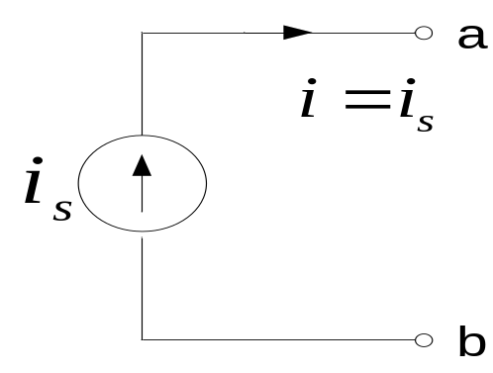

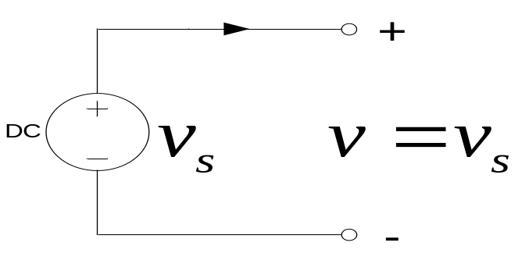

Turning sources off
Current source:
We replace it by a current source where
An open-circuit
Voltage source:
We replace it by a voltage source where
i
An short-circuit

Slide 4
Steps in Applying the Superposition Principle
Turn off all independent sources except one. Find the output (voltage or current) due to the active source.
Repeat step 1 for each of the other independent sources.
Find the total output by adding algebraically all of the results found in steps 1 & 2 above.
In some cases, but certainly not all, superposition can simplify the analysis.

Slide 5
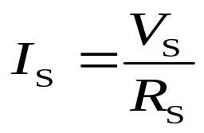

Source conversions
Summary
Any voltage source with an internal resistance can be converted to an equivalent current source and vice-versa by applying Ohm’s law to the source. The source resistance, R_{S}, is the same for both.
To convert a voltage source to a current source,
To convert a current source to a voltage source,

Slide 6
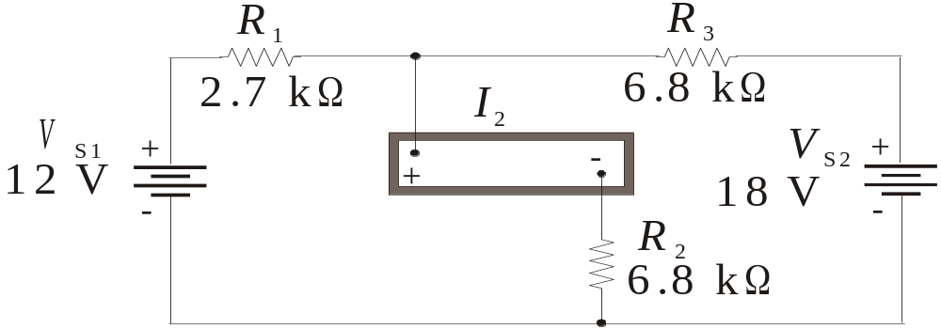
Superposition theorem
Summary
The superposition theorem is a way to determine currents and voltages in a linear circuit that has multiple sources by taking one source at a time and algebraically summing the results.
Example:
What does the ammeter read for I₂? (See next slide for the method and the answer).

Slide 7
Summary
Summary
What does the ammeter read for I₂?
1.56 mA
Set up a table of pertinent information and solve for each quantity listed:
Source 1: R_{T(S1)}= I₁= I₂=
6.10 kΩ
1.97 mA
0.98 mA
Source 2 R_{T(S2)}= I₃= I₂=
8.73 kΩ
2.06 mA
0.58 mA
Both sources I₂=
1.56 mA
The total current is the algebraic sum.

Slide 8
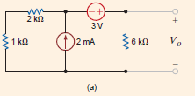

Slide 9
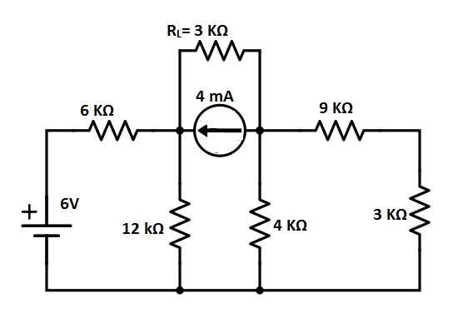

Slide 10
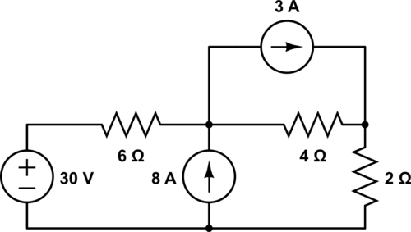

Slide 11
