Slide 1
Transistors and BJTs
Engr. Muhammad Waqas

Slide 2
Transistors
Semiconductors: ability to change from conductor to insulator
Can either allow current or prohibit current to flow
Useful as a switch, but also as an amplifier
Essential part of many technological advances

Slide 3
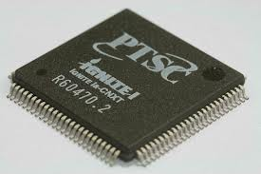
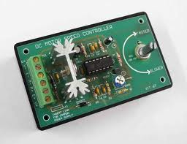

Purpose
  To amplify and switch electronic signals on or off (high or low)
Modern Electronics
Microprocessor
Motor Controllers
Cell Phones
Notes:
http://www.cultofmac.com/218357/fingerprint-detecting-iphone-5s-to-release-in-july-new-99-iphone-5-will-come-in-multiple-colors-new-casing/

Slide 4
A Brief History
Guglielmo Marconi invents radio in 1895
Problem: For long distance travel, signal must be amplified
Lee De Forest improves on Fleming’s original vacuum tube to amplify signals
Made use of third electrode
Too bulky for most applications

Slide 5
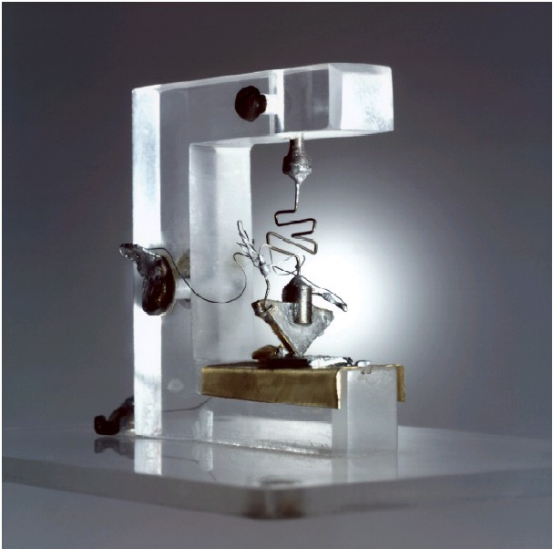

The Transistor is Born
Bell Labs (1947): Bardeen, Brattain, and Shockley
Originally made of germanium
Current transistors made of doped silicon

Slide 6
How Transistors Work
Doping: adding small amounts of other elements to create additional protons or electrons
P-Type: dopants lack a fourth valence electron (Boron, Aluminum)
N-Type: dopants have an additional (5th) valence electron (Phosphorus, Arsenic)
Importance: Current only flows from P to N

Slide 7
Introduction
The transistor is the main building block “element” of electronics. It is a semiconductor device and it comes in two general types:
  the Bipolar Junction Transistor (BJT)
  the Field Effect Transistor (FET).
The BJT is a three terminal device and it comes in two different types.
  The npn BJT and the pnp BJT.
  The BJT is fabricated with three separately doped regions.
  The npn device has one p region between two n regions and the pnp device has one n region between two p regions.

Slide 8
BJTs
The BJT has two junctions (boundaries between the n and the p regions). These junctions are similar to the junctions we saw in the diodes and thus they may be forward biased or reverse biased.
The three terminals of the BJT are called
  the Base (B),
  the Collector (C)
  the Emitter (E).

Slide 9
The BJT – Bipolar Junction Transistor
The Two Types of BJT Transistors:
npn
pnp
n
p
n
p
n
p
E
C
E
C
Cross Section
C
Cross Section
C
B
B
B
B
Schematic Symbol
Schematic Symbol
E
E
Collector doping is usually ~ 10⁶
Base doping is slightly higher ~ 10⁷ – 10⁸
Emitter doping is much higher ~ 10¹⁵

Slide 10
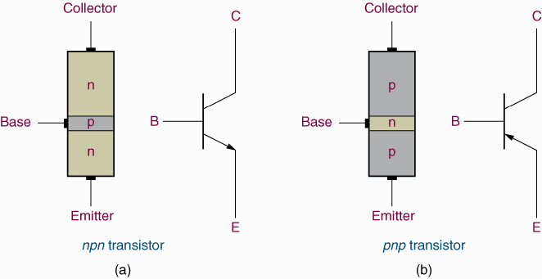
Introduction to BJT
a three-terminal component – Emitter, Collector and Base.
(a) npn transistor which has an n – type emitter and collector and a p – type base, and
(b) pnp transistor which consist of p – type emitter and collector and an n – type base.

Slide 11
The arrow on the schematic symbol
represents:
(1) the emitter terminal.
The terminal opposite the emitter is the collector and the center terminal is the
base.
(2) the direction of the arrow is always point towards the n – type of the material.
(3) the direction of the emitter current (conventional).

Slide 12
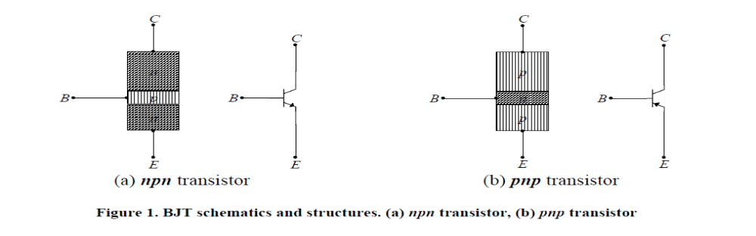
BJTs

Slide 13
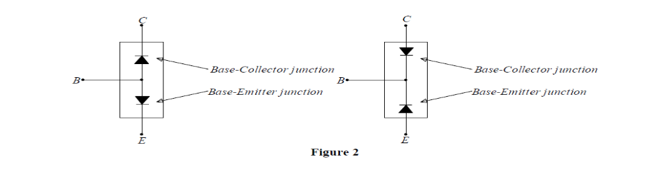
BJTs

Slide 14
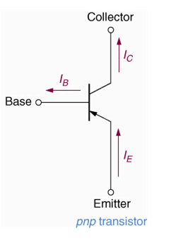
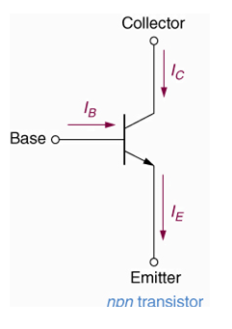
Transistor Currents
I_{E}, I_{C} and I_{B} – emitter, collector and base currents.
I_{E} > I_{C} >> I_{B}
(mA) (μA)
I_{E} ≈ I_{C}
Current directions of the npn transistor are opposite those for the pnp transistor.
The direction of I_{E} is always opposite that of I_{B} and I_{C}.

Slide 15
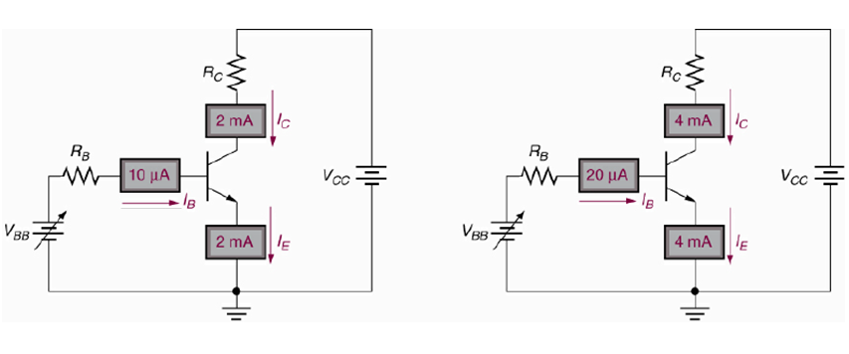
BJT - Current-controlled device
The values of the collector and emitter currents are determined primarily by the value of the base current.
The small increase in base current (from 10 μA to 20 μA) produces a larger increase in I_{C} and in I_{E} (from 2 mA to 4 mA).
β = 200

Slide 16
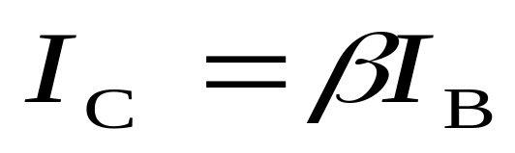
BJT - Current-controlled device
The value of I_{C} is normally some multiple of the value of I_{B}.
β - forward current gain, of the device.

Slide 17
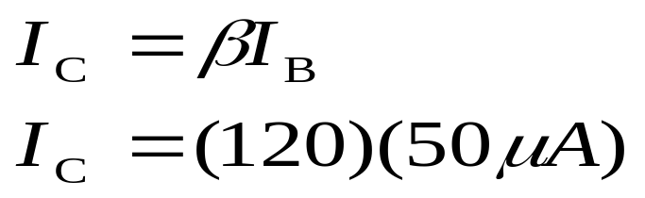
Example:
Assume that a transistor has values of I_{B} = 50 μA and β = 120. The collector current for the transistor is
Solution:
I_{C} = 6 mA

Slide 18
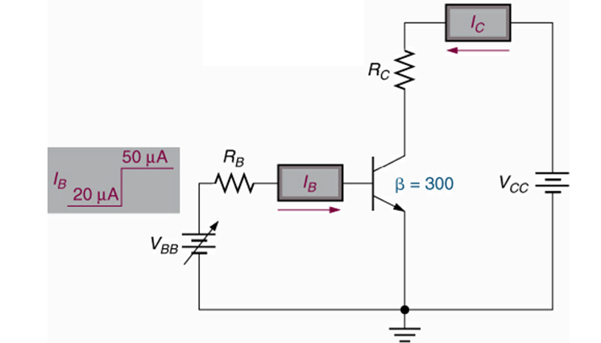
Example
Determine the values of collector current for the values of the base current shown below.

Slide 19
Solution
The base current has an initial value of 20 μA. The beta rating of the component is 300. The initial value of the collector current is found as
mA
When I_{B} increases to 50 μA, the collector current increases to
mA
Thus, a 30 μA change in base current causes a 9 mA change in collector current.

Slide 20
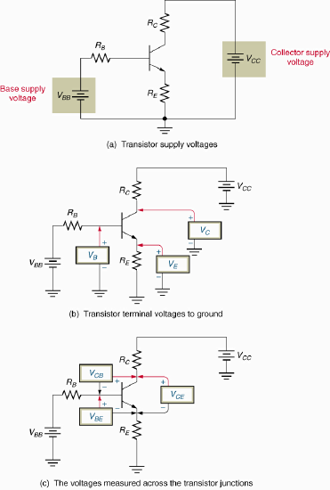
Transistor Voltages
V_{CC} and V_{BB} are dc voltage sources that are used to bias the transistor.
Some circuits also contain a dc biasing source in the emitter circuit labeled V_{EE}.

Slide 21
Transistor Voltages
V_{C}, V_{B} and V_{E} are transistor terminal voltages.
Each voltage is measured from the identified transistor terminal to ground.

Slide 22
Transistor Voltages
V_{CE}, V_{CB}, and V_{BE} are measured across the identified transistor terminals.

Slide 23
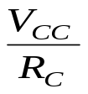
Transistor Operation
Base-emitter junction | Collector-base junction | Operating region | BJT Characteristics
Reverse biased | Reverse biased | Cutoff | I_{B} = I_{C} = I_{E} = 0, V_{CE} = V_{CC}
Forward biased | Reverse biased | Active | I_{C} = β_{DC}I_{B}
Forward biased | Forward biased | Saturation | I_{C} = I_{C(sat)} =
*Breakdown

Slide 24
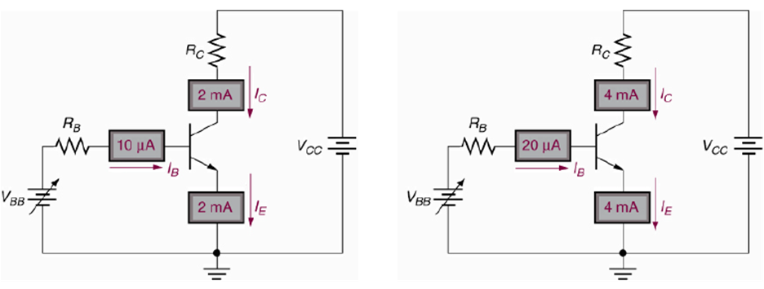
Transistor Currents and Voltages
The transistor is a current-controlled device.
In many applications, the base current is varied to produce variations in I_{C} and I_{E}
i.e. a small change in I_{B} results in a large change in the other terminal currents.

Slide 25
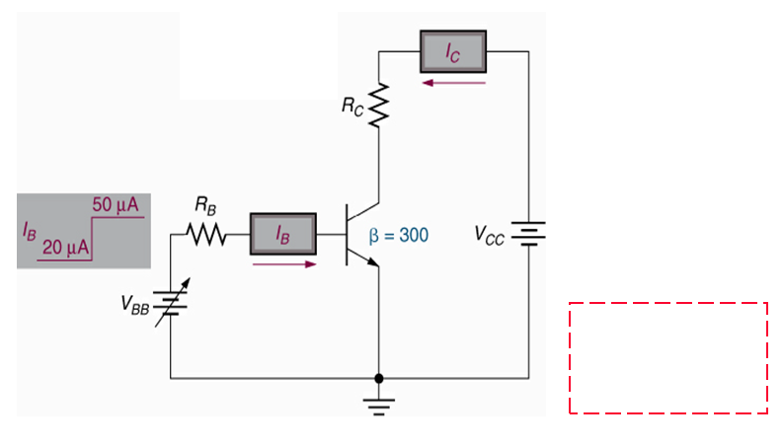
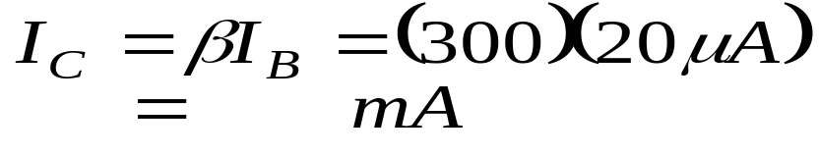
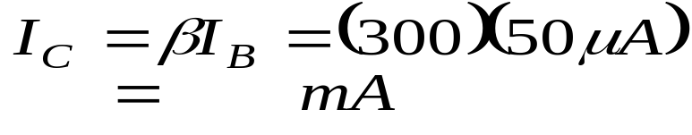
Example Once Again
Determine the values of collector current for the values of the base current shown below.
Solution
The initial value of the collector current
When I_{B} increases to 50 μA, the collector current is
ΔI_{B} = 30 μA,
ΔI_{C} = 9 mA,

Slide 26
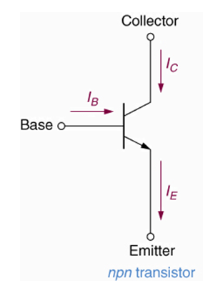
Transistor Currents and Voltages
The Relationship Among I_{E}, I_{C} and I_{B}
Kirchhoff’s current law: the current leaving a component must be equal to the current entering the component.
I_{E} = I_{B} + I_{C}
I_{B} is normally much less that I_{C},
I_{C} ≅ I_{E}
The current relationships shown
above hold true for both the npn
and pnp transistors.

Slide 27
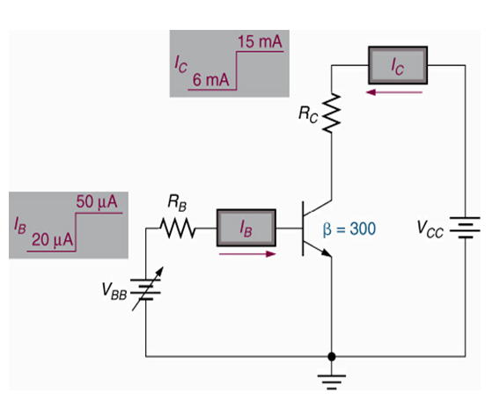
Transistor Currents and Voltages
I_{B} = 20 μA, I_{C} = 6 mA
∴ I_{E} = 6mA + 20 μA
= 6.02 mA
≈ I_{C}
I_{B} = 50 μA, I_{C} = 15 mA
I_{E} = 15.05 mA

Slide 28
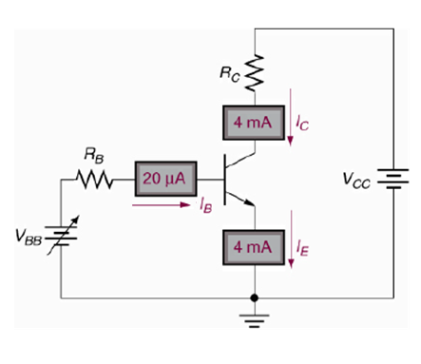
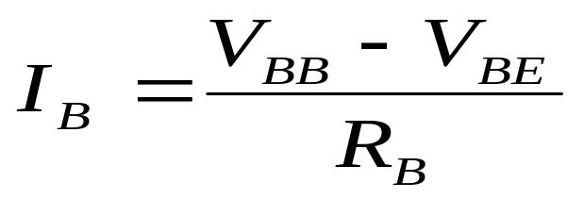
Transistor Currents & Voltages
The BE junction is forward biased,
V_{BE} ≈ 0.7 V.
Emitter is at ground. The voltage across R_{B} is
V_{R(B)} = V_{BB} − V_{BE} --(1)
Also, from Ohm’s Law,
V_{R(B)} = I_{B}R_{B} --(2)
Let (1) = (2)
I_{B}R_{B} = V_{BB} − V_{BE}
Solving for I_{B}:

Slide 29
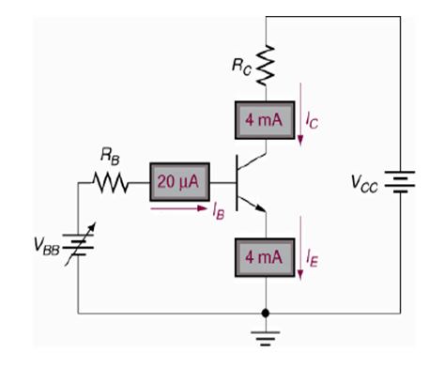
Transistor Currents & Voltages
The voltage at the collector with respect to grounded emitter is
V_{CE} = V_{CC} – V_{R(C)}
As the potential drop across R_{C} is
V_{R(C)} = I_{C}R_{C}
The voltage at the collector
V_{CE} = V_{CC} − I_{C}R_{C}
where I_{C} = β_{DC}I_{B}.
The voltage across the reverse biased collector-base junction is
V_{CB} = V_{CE} − V_{BE}

Slide 30
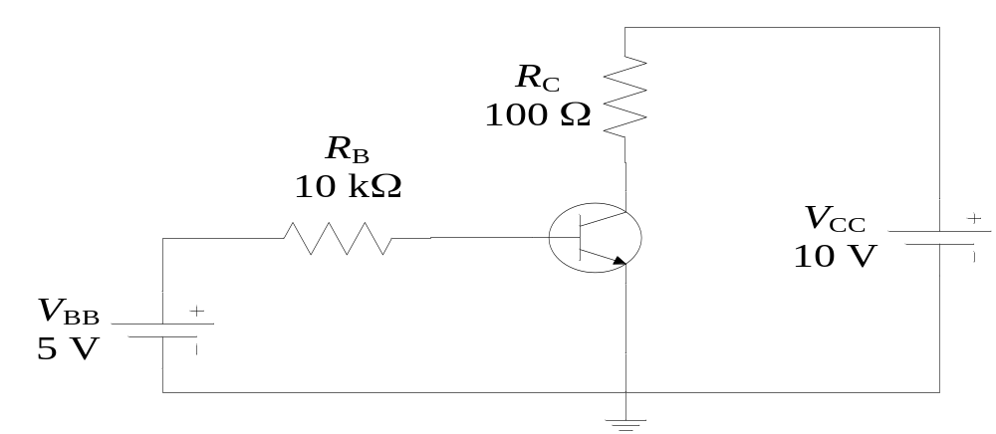
Example
Determine I_{B}, I_{C}, I_{E}, V_{BE}, V_{CE}, and V_{CB} in the following circuit. The transistor has β_{DC} = 150.

Slide 31
Solution
Known V_{BE} = 0.7 V (forward biased),
I_{B} = (V_{BB} - V_{BE}) / R_{B} = 430 μA
The collector current,
I_{C} = β_{DC}I_{B} = 64.5 mA
Kirchhoff's current law:
I_{E} = I_{C} + I_{B} = 64.9 mA
Solving for V_{CE} and V_{CB}:
V_{CE} = V_{CC} – I_{C}R_{C} = 3.55 V
V_{CB} = V_{CE} – V_{BE} = 2.85 V
The collector is at higher potential than the base (V_{CB} > 0 ⇒ V_{C} > V_{B}), the collector-base junction is reverse-biased.

Slide 32
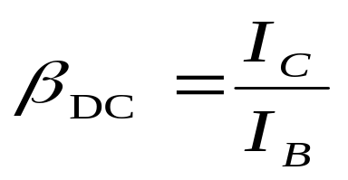
Current gain, DC Beta
The dc beta (β_{DC}) rating – ratio of dc collector current to dc base current.
It is a ratio of current values, thus it has no unit of measure.
Typical beta ratings can be as high as 300 i.e. the I_{C} can be up to 300 times the value of I_{B.}
It can be used to define other terminal currents:
I_{C} = βI_{B}
I_{E} = I_{C} + I_{B} = βI_{B} + I_{B}
I_{E} = I_{B}(β + 1)

Slide 33
DC Beta
β_{DC} is also designated by an equivalent hybrid (h) parameter:
h_{FE} = β_{DC}
Transistor data sheets do not provide β_{DC} but h_{FE}.
β_{DC} is not truly constant. It varies slightly with I_{C} and temperature.
Transistors have both dc beta ratings and ac beta ratings (which will be discussed later)

Slide 34

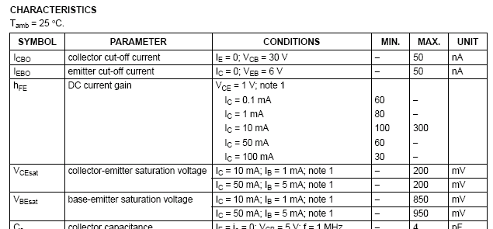
Example

Slide 35
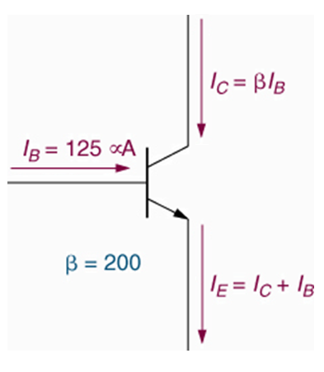
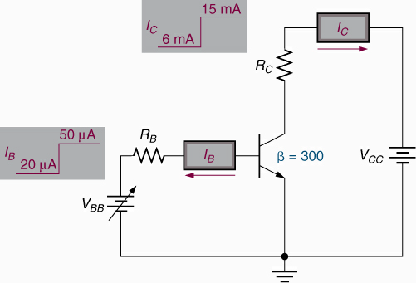
Example
Determine the values of I_{C} and I_{E} for the circuit shown.
Solution
I_{B} = 125 μA
I_{C} = βI_{B}
I_{C} = (200)(125 μA)
I_{C} = 25 mA
I_{E} is found as
I_{E} = I_{C} + I_{B}
I_{E} = 25.125 mA

Slide 36
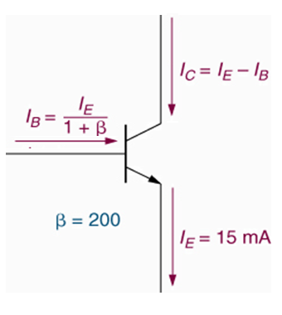
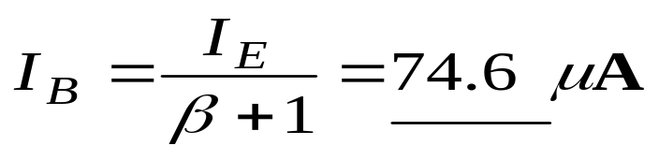
Example
Determine the values of I_{C} and I_{B} for the circuit shown.
Solution
I_{B} can be determine from
Now, I_{C} can be found as
I_{C} = I_{E} − I_{B}= 14.9 mA
or
I_{C} = βI_{B} = 14.9 mA

Slide 37
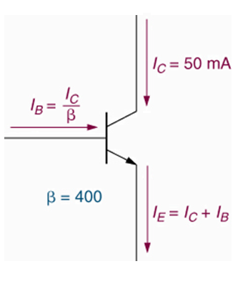
Example
Determine the values of I_{B} and I_{E} for the circuit shown.
Solution
…
The emitter current
I_{E} = I_{C} + I_{B} = 50.125 mA

Slide 38
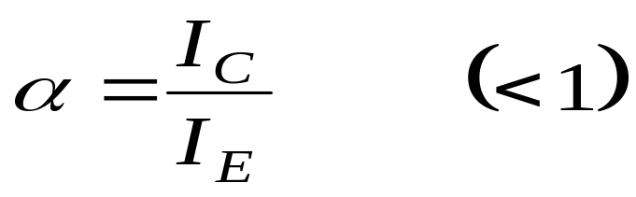
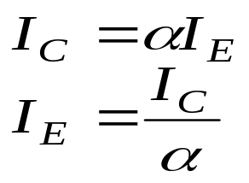
DC Alpha
dc alpha (α) rating – the ratio of collector current to emitter current.
Typical values of α_{DC} range from 0.95 to 0.99 or greater.
Like beta, it has no units.
It can be used to define other terminal currents, as follows:
I_{B} = I_{E} − I_{C} = I_{E} (1 − α)

Slide 39
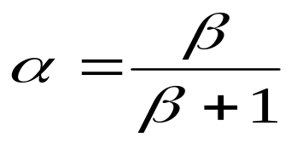
The Relationship between Alpha and Beta
The spec. sheet for a given transistor lists the value of beta for the device, but not the value of alpha as beta is used far more commonly than alpha.
Alpha can be determined using the value of beta with the following equation:

Slide 40
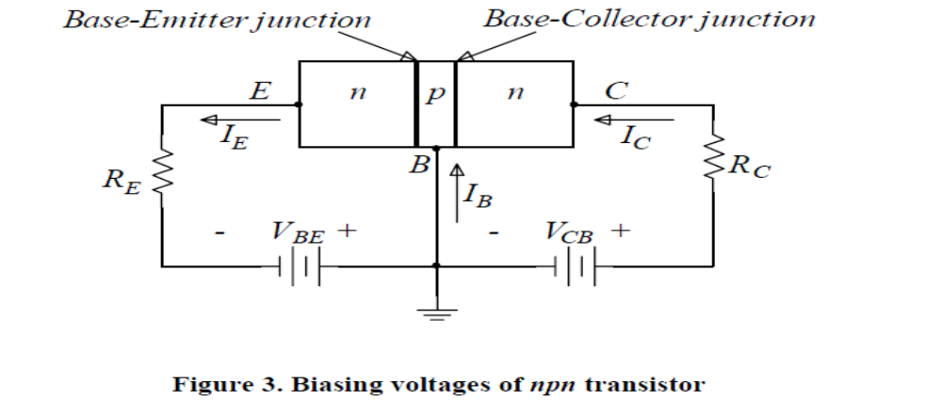
BJTs
With the voltage as shown, the Base-Emitter V_{BE} (B-E) junction is forward biased and the Base-Collector V_{BC} (B-C) junction is reverse biased.

Slide 41
Application of BJTs
Bipolar transistors are widely used in both analogue and digital circuits
They can be considered as either voltage-controlled or current-controlled devices
Their characteristics may be described by their gain or by their trans conductance
Feedback can be used to overcome problems of variability
The majority of circuits use transistors in a common-emitter configuration where the input is applied to the base and the output is taken from the collector
Common-collector circuits make good buffer amplifiers
Bipolar transistors are used in a wide range of applications

