Slide 1
Data Preprocessing

Slide 2
Why data preprocessing
Today’s real world databases are noisy, contain missing values and inconsistent due to their huge size.
A good preprocess data before data mining not only “improve the quality of mining results” but also “ease the mining process”.
There are a number a data preprocessing techniques
  Data Cleaning:- Remove noise, correct inconsistencies
  Data Integration:- Merge data from multiple sources
  Data Transformation:- Improve distance measurements
  Data Reduction:- Eliminate redundant features or instances

Slide 3
Data Cleaning
Data cleaning routines
  Missing values.
  Identify outliers.
  Correct inconsistencies.
Missing values:-
  You can note that many tuples have no recorded value for several attributes, such as country, Refund.
TID | Refund | Country | Taxable Income | Cheat
1 | Yes | USA | 125K | No
2 |  | UK | 100K | No
3 | No | Australia | 70K | No
4 |  |  | 120K | No
5 | No | NZL | 95K | Yes
6 | No | USA | 60K | No
7 | Yes | UK | 220K | No
8 | No |  | 85K | Yes
9 | No | UK |  | No
10 | No |  |  | Yes

Slide 4
Missing values Techniques
Ignore the record:-
  This is usually done when the class label is missing.
Use the attribute mean to fill in the missing value:-
  For example, take the average value of income attribute. Use this value to replace the missing value for income.
Use the attribute Median to fill in the missing value:-
  The main difference between Mean and Median is that, Median is robust to noise.
Use classification rules to fill in the missing value:-
  This can be determined with decision tree, neural network, Bayesian Modeling.

Slide 5
Missing values Techniques (cont)
K Nearest Neighbors
  KNN is a supervised learning algorithm where the missing values are replaced on the basis of nearest K neighbor. Neighbors are determined on the basis of distance measure.
  Once K neighbors are determined then we can use mean or median for missing value.
Missing value record
contains a missing value for income attribute

Slide 6
Noisy Data
Noise is a random error or variance in a measured variable.
Incorrect attribute values may due to
  faulty data collection tools
  data entry problems
  data transmission problems
Binning methods:-
  first sort data and partition into (equi-depth) bins
  then one can smooth by bin means, smooth by bin median, smooth by bin boundaries, etc.

Slide 7
Noisy Data (Binning Methods)
Sorted data for price (in dollars): 4, 8, 9, 15, 21, 21, 24, 25, 26, 28, 29, 34
* Partition into (equi-depth) bins:
- Bin 1: 4, 8, 9, 15
- Bin 2: 21, 21, 24, 25
- Bin 3: 26, 28, 29, 34
* Smoothing by bin means:
- Bin 1: 9, 9, 9, 9
- Bin 2: 23, 23, 23, 23
- Bin 3: 29, 29, 29, 29
* Smoothing by bin boundaries:
- Bin 1: 4, 4, 4, 15
- Bin 2: 21, 21, 25, 25
- Bin 3: 26, 26, 26, 34

Slide 8
Noisy Data (Clustering)
Outliers may be detected by clustering, where similar values are organized into groups or “clusters”.
Values which falls outside of the set of clusters may be considered outliers.

Slide 9
Data Integration
Data integration:
  Combines data from multiple sources into a coherent store as in data warehousing.
    Sources may include
      Databases
      Data cubes
      Flat files
Problem(1): Schema integration
  Entity identification problem: How we can sure that customer_id in one database, and cust_number in another refer to the same entity.
Problem(2): Detecting and resolving data value conflicts
  For the same entity, attribute values from different sources are different
  possible reasons: different representations, different scales, e.g., Price in dollars vs. Price in Rupees.

Slide 10
Handling Redundant Data in Data Integration
Redundant data occur often when integration of multiple databases
  The same attribute may have different names in different databases e.g. customer_id and customer_number.
  One attribute may be a “derived” attribute in another table,
Technique:
  Redundant data may be able to be detected by correlation analysis.
Advantages:
  Reduce/avoid redundancies
  Improve mining speed and quality.

Slide 11
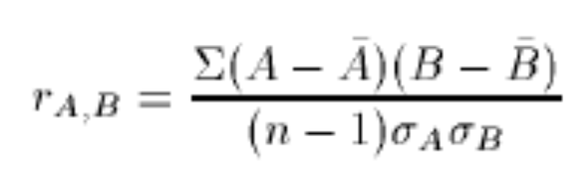
Handling Redundant Data in Data Integration
Correlation between two attributes can be checked by:-
Resulting value > 0, then A and B are positively correlated. If A increase B will also increase. A or B can be removed
Resulting value = 0, then A and B are independent.
Resulting value < 0, then A and B are negatively correlated. If the value of A increases, the value B will decreases.

Slide 12
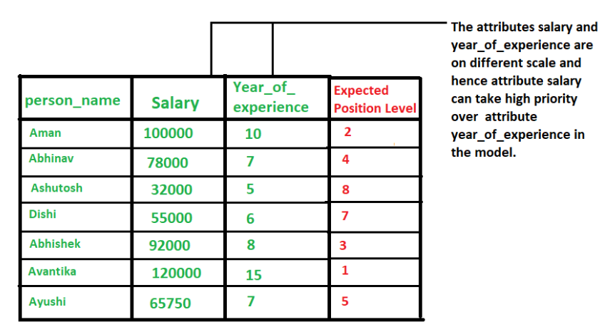
Data Transformation: Data Normalization
when multiple attributes are there but attributes have values on different scales, this may lead to poor data models while performing data mining operations. So they are normalized to bring all the attributes on the same scale.
All integer attributes are normalized, so that there values fall within a
small specified, such as 0 to 1.0
or -1.0 to 1.0.
Normalization is particularly useful for classification algorithms or distance measurements such as nearest-neighbor classification and clustering.

Slide 13

Data Normalization
min-max normalization
  Example:- Suppose that the minimum and maximum values for the attribute income are 12,000 and 98,000. By min-max normalization, a value of 73,600 for income is transformed to
        ((73,000-12,000)/(98,000-12,000)) (1.0-0) + 0 = 0.716

Slide 14
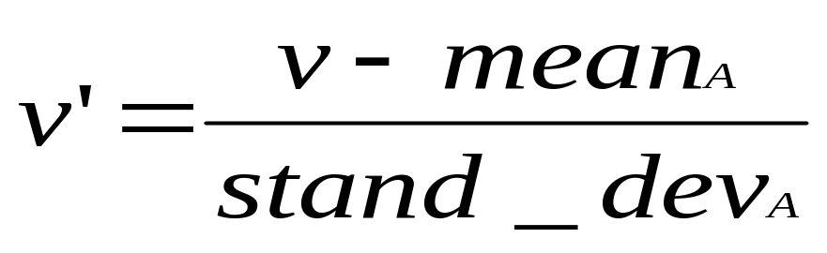
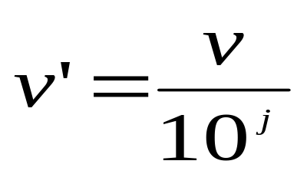

Data Normalization
z-score normalization
  This method of normalization is useful when the actual minimum and maximum of any attribute are unknown.
  Or when outliers which dominate the min-max normalization.
Decimal scaling normalization
Where j is the smallest integer such that Max(| |)<1

Slide 15
Database Reduction: Attribute or Feature Reduction
Data sets for analysis may contain hundreds of attributes or columns, many of which may be irrelevant.
Problem with including all attributes in mining process:-
  Large Processing time
  Large number of rules
  Over fitting rules become specific
For example, if we are predicting buy_computer class from Electronics sales dataset.
  Attributes like customer’s telephone number or buying date are likely to be irrelevant.
  But Attributes like age or incomes are more relevant.

Slide 16
Feature Reduction/Attribute Reduction
Feature Reduction reduces the data set size by removing irrelevant attributes.
Typically, methods of attribute subset selection are applied.
Thus there would be 2^{d} possible subsets of d attributes.
  For example if we have 3 attributes (col1, col2, col3) then total subset would be 8.
    {}, {col1}, {col2}, {col3}, {col1, col2}, {col1, col3}, {col2, col3}, {col1, col2, col3}
Approaches:-
  An exhaustive search for the optimal subset can be expensive when the total number of attributes are very large.
  Use greedy algorithms (select only the best choice).
    Step-wise forward selection.
    Step-wise backward selection.
    Combining forward selection and backward elimination.
    Decision tree induction.

