Slide 1

BAYESIAN LEARNING
Bayesian Belief Networks
Since in real world dependencies can exist between variables, hence Bayesian belief networks are used to specify joint conditional probability distributions
They allow class conditional independencies to be defined between subset of variables
They provide a graphical model of causal relationships, on which learning can be performed
These networks are also called belief networks, Bayesian networks, and probabilistic networks

Slide 2
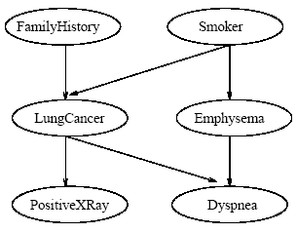
BAYESIAN LEARNING
Bayesian Belief Networks
A belief network is defined by two components
The first is a directed acyclic graph, where each node represents a attribute and each arc represents a probabilistic dependence

Slide 3
BAYESIAN LEARNING
Bayesian Belief Networks
If an arc is drawn from a node Y to a node Z, then Y is a parent of Z and Z is a descendent of Y
Each variable is conditionally independent of its non descendents in the graph, given its parents
The variables may be discrete
or continuous

Slide 4

BAYESIAN LEARNING
Bayesian Belief Networks
The second component of a belief network consists of a conditional probability table for each variable
For a variable Z, it specifies the conditional probability distribution P(Z|Parents(Z))
The conditional probability for each value of Z is listed for each possible combination of values of its parents

Slide 5

BAYESIAN LEARNING
Bayesian Belief Networks
The joint probability of any tuple (z₁, …, z_{n}) corresponding to the attributes Z₁, …, Z_{n} is computed by
Where the values P(z_{i}|Parents(Z_{i})) correspond to the entries in the CPT for z_{i}

Slide 6
BAYESIAN LEARNING
Bayesian Belief Networks
A node within the network can be selected as an output node representing a class label attribute
The structure of the network can be given by an expert

Slide 7
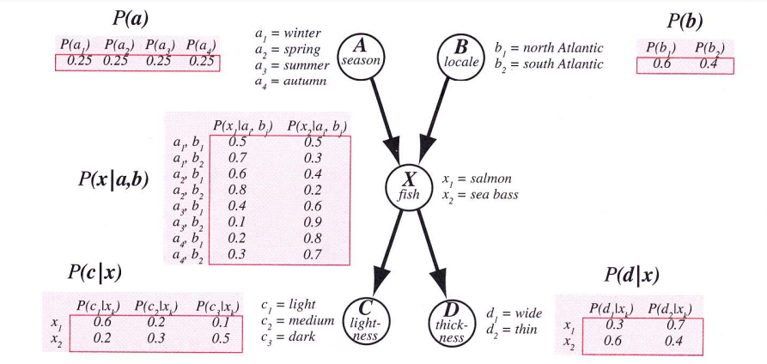
BAYESIAN LEARNING
Example: probability that a fish caught in summer, in the north Atlantic, is a sea bass, and is dark and thin:
P(a₃, b₁, x₂, c₃, d₂)
= P(a₃)P(b₁)P(x₂|a₃,b₁)P(c₃|x₂)P(d₂|x₂)
= 0.25 x 0.6 x0.4 x0.5 x0.4 = 0.012

Slide 8
BAYESIAN LEARNING
Learning Bayesian Belief Networks
The problem of learning a Bayes network is the problem of finding a network that best matches (according to some scoring metric) a training set of data
By finding a network we mean finding both the
- Structure of the net &
- the conditional probability tables (CPT) associated with each node)

Slide 9
BAYESIAN LEARNING
Learning Bayesian Belief Networks
Known Network Structure
If the structure of the network is known we only have to find the CPT
Often human experts can come up with the appropriate structure for a problem domain but not the CPT
If we have sample number of training samples, we can compute sample statistics for each node and its parents

Slide 10
BAYESIAN LEARNING
Learning Bayesian Belief Networks
Unknown Network Structure
If the network structure is not known, we must then attempt to find that structure, as well as its associated CPTs, that best fits the training data
In order to do so, we need
- a metric by which to score candidate networks
- a procedure for searching among possible structure

Slide 11
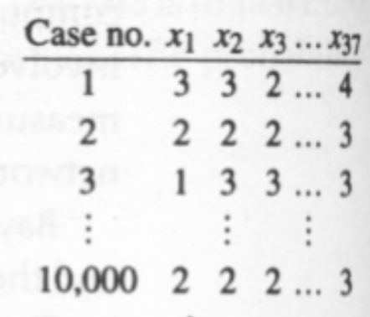

BAYESIAN LEARNING
Learning Bayesian Belief Networks

Slide 12

BAYESIAN LEARNING
Learning Bayesian Belief Networks

Slide 13
BAYESIAN LEARNING
Reference
Chapter 7 of Hans & Kamber

