Slide 1
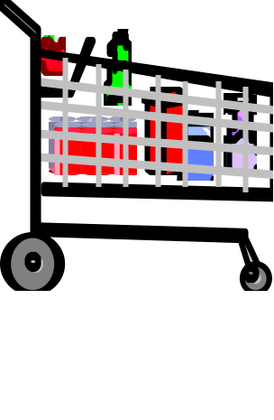
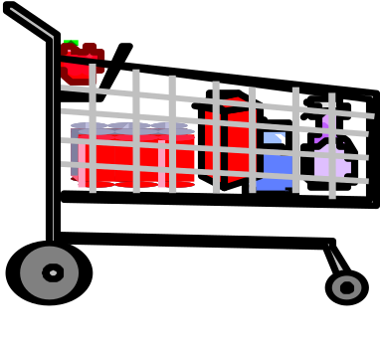
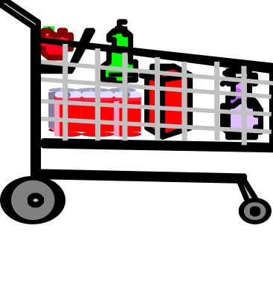
ASSOCIATION RULE MINING
Market Basket Analysis
Analysis of customer buying habits by finding associations and correlations between the different items that customers place in their "shopping basket"
Milk, eggs, sugar, bread
Eggs, sugar
Milk, eggs, cereal, bread
Customer1
Customer2
Customer3

Slide 2
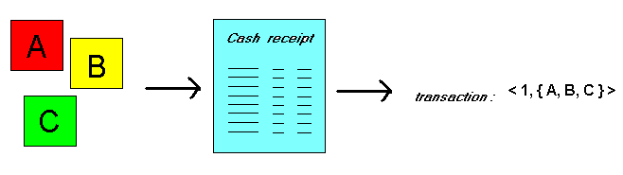
ASSOCIATION RULE MINING
Market Basket Analysis
Given: A database of customer transactions (e.g., shopping baskets), where each transaction is a set of items (e.g., products)
Find: Groups of items which are frequently purchased together

Slide 3
ASSOCIATION RULE MINING
Basic Concepts
Given database of transactions, each transaction is a list of items (purchased by a customer in a visit)
Find all rules that correlate the presence of one set of items with that of another set of items
Example: 98% of people who purchase tires and auto accessories also get automotive services done

Slide 4
ASSOCIATION RULE MINING
Extract information on purchasing behavior
  "IF buys coke and sausage, THEN also by mustard with high probability“
Actionable information: can suggest...
  New store layouts and product assortments
  Which products to put on promotion

Slide 5
ASSOCIATION RULE MINING
Useful:
"On Thursdays, super store consumers often purchase rice and meat together.“
Trivial:
"Customers who purchase maintenance agreements are very likely to purchase large appliances."
unexpected:
"When a new hardaware store opens, one of the most sold items is toilet rings."

Slide 6
ASSOCIATION RULE MINING
Association Rules: Basics
Support: denotes the frequency of the rule within transactions.
support(A ⇒ B [ s, c ]) = p(A∪B) = support ({A,B})
Confidence: denotes the percentage of transactions containing A which contain also B.
confidence(A ⇒ B [ s, c ]) = p(B|A) = p(A∪B) / p(A) = support({A,B}) / support({A})

Slide 7
ASSOCIATION RULE MINING
Association Rules: Basics
Minimum support σ :
  High ⇒ few frequent itemsets
      ⇒ few valid rules which occur very often
  Low ⇒ many valid rules which occur rarely
Minimum confidence γ :
  High ⇒ few rules, but all "almost logically true"
  Low ⇒ many rules, many of them very "uncertain"
Typical values: σ = 2 -10 %, γ = 70 - 90 %

Slide 8
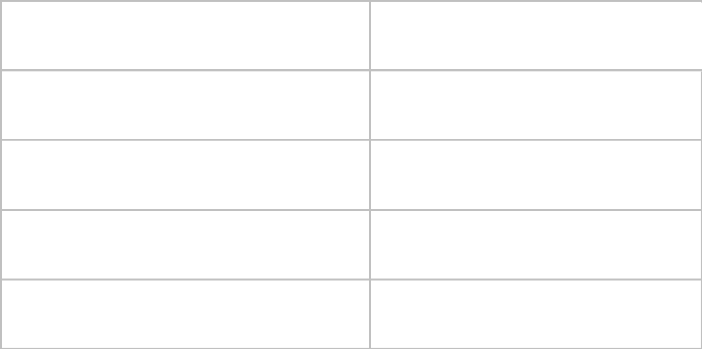
ASSOCIATION RULE MINING
Rule Measures: Support & Confidence
Let minimum support 50%, and minimum confidence 50%, we have
  A ⇒ C (50%, 66.6%)
  C ⇒ A (50%, 100%)

Slide 9
ASSOCIATION RULE MINING
Association Rules: Basics
Typical representation formats for association rules:
  rice ⇒ meat [0.5%, 60%]
  buys:rice ⇒ buys:meat [0.5%, 60%]
  "IF buys rice, THEN buys meat in 60% of the cases. rice and meat are bought together in 0.5% of the rows in the database."
Other representations (used in Han's book):
  buys(x, "rice") ⇒ buys(x, "meat") [0.5%, 60%]
  major(x, "CS") ^ takes(x, "DB") ⇒ grade(x, "A") [1%, 75%]

Slide 10
ASSOCIATION RULE MINING
Association Rules: Basics
rice ⇒ meat [0.5%, 60%]
"IF buys rice,
THEN buys meat
in 60% of the cases
in 0.5% of the rows"
2
3
4
1
Antecedent, left-hand side (LHS), body
Consequent, right-hand side (RHS), head
Support, frequency ("in how big part of the data the things in left- and right-hand sides occur together")
Confidence, strength ("if the left-hand side occurs, how likely the right-hand side occurs")

Slide 11
ASSOCIATION RULE MINING
Apriori Algorithm
Apriori algorithm finds frequent itemsets (itemsets with minimum support)
Association rules can then be generated from frequent itemsets
It consists of two steps:
- Generation of candidate itemsets
- Pruning of itemsets which are infrequent

Slide 12
ASSOCIATION RULE MINING
Apriori Algorithm: Finding frequent itemsets
It has an iterative approach known as a level-wise search
First, the set of frequent 1-itemsets is found (called L₁)
L₁ is used to find frequent 2-itemsets (L₂)
L₂ is used to find L₃, and so on…
The finding of each L requires one full scan of the database

Slide 13
ASSOCIATION RULE MINING
Apriori Algorithm: Example
Search Space of Database D
12345
1234 1235 1245 1345 2345
123 124 125 134 135 145 234 235 245 345
12 13 14 15 23 24 25 34 35 45
1 2 3 4 5

Slide 14
ASSOCIATION RULE MINING
Apriori Algorithm: Finding frequent itemsets
The efficiency of the level-wise generation of frequent itemsets is improved by an important property (called the Apriori property)
With the help of this property, the search space is reduced
Apriori Property: All non-empty subsets of a frequent itemsets must also be frequent

Slide 15
ASSOCIATION RULE MINING
Apriori Algorithm: Finding frequent itemsets
  A subset of a frequent itemset must also be a frequent itemset
    i.e., if {AB} is a frequent itemset, both {A} and {B} should be a frequent itemset
The name of the algorithm is based on the fact that the algorithm uses prior knowledge of frequent itemset properties

Slide 16
ASSOCIATION RULE MINING
Apriori Algorithm: Example of Generating Candidates
L3={abc, abd, acd, ace, bcd}
Self-joining: L3*L3
  abcd from abc and abd
  acde from acd and ace
Pruning:
  acde is removed because ade is not in L3
C4={abcd}

Slide 17



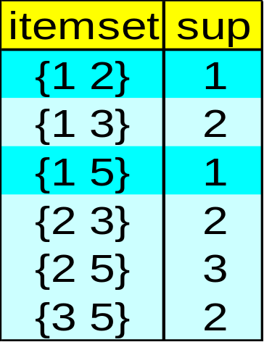




ASSOCIATION RULE MINING
Apriori Algorithm (min support =2 means 50%)
Database D
L₁
C₁
Scan D
C₂
C₂
L₂
Scan D
C₃
Scan D
L₃

Slide 18
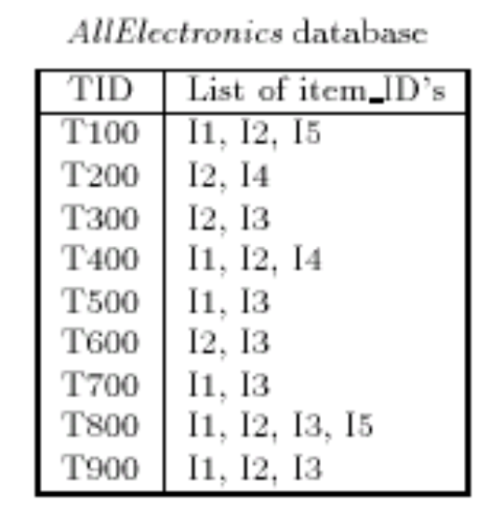
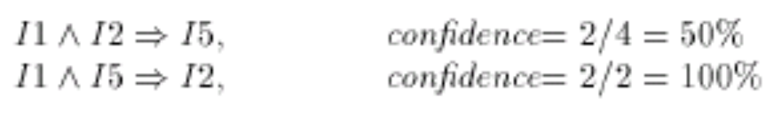
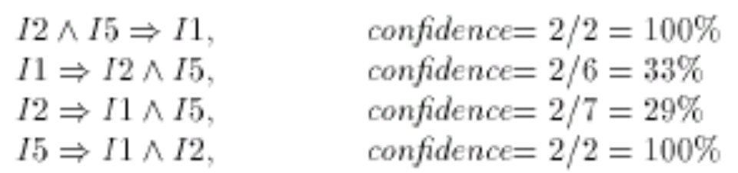
ASSOCIATION RULE MINING
Strong Rules from Frequent Itemsets
Once frequent itemsets have been found, we can
convert them into association rules
Suppose the data contains the frequent itemset {I₁, I₂, I₅}

Slide 19
ASSOCIATION RULE MINING
Reference
Chapter 6 of Hans & Kamber book

