Slide 1
ASSOCIATION RULE MINING
Dynamic Itemset Counting Algorithm
Proposed by Bin, et al. in 1997
In Apriori all itemsets are created at the beginning of a dataset scan
Once a complete scan is made, new itemsets are created and the previous ones are declared frequent or infrequent
In DIC itemsets can be created at several designated places during a dataset scan

Slide 2
ASSOCIATION RULE MINING
Dynamic Itemset Counting Algorithm
We identify certain ‘stops’ in the database
We assign numbers to each stop sequentially
Carry out certain computation at the ‘stop’ point
We then define four different structures.
  Dashed Box
  Dashed Circle
  Solid Box
  Solid Circle
Each of these structures maintain a list of itemsets.

Slide 3
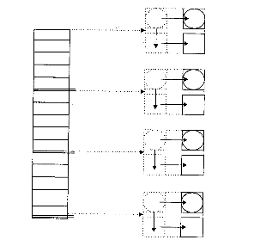
ASSOCIATION RULE MINING
Dynamic Itemset Counting Algorithm
Itemsets in the ‘dashed’ category of structures have a counter and stop number with them
The counter is to keep track of the support value of the corresponding itemset
The stop number is to keep track whether an itemset has completed a one full pass over the database

Slide 4
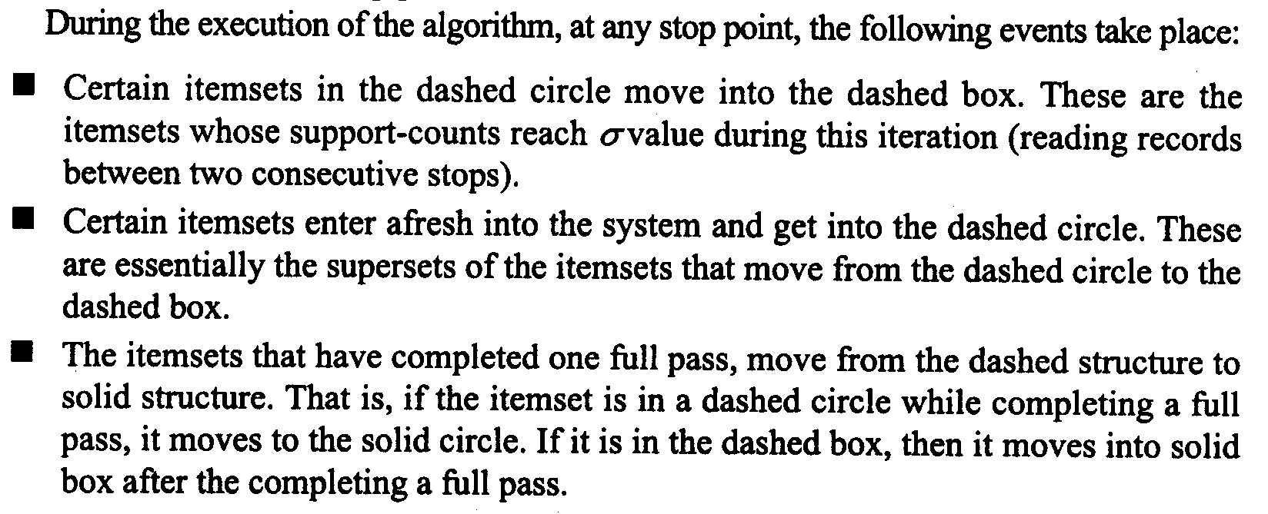
ASSOCIATION RULE MINING
Dynamic Itemset Counting Algorithm

Slide 5
ASSOCIATION RULE MINING
Dynamic Itemset Counting Algorithm: Example

Slide 6
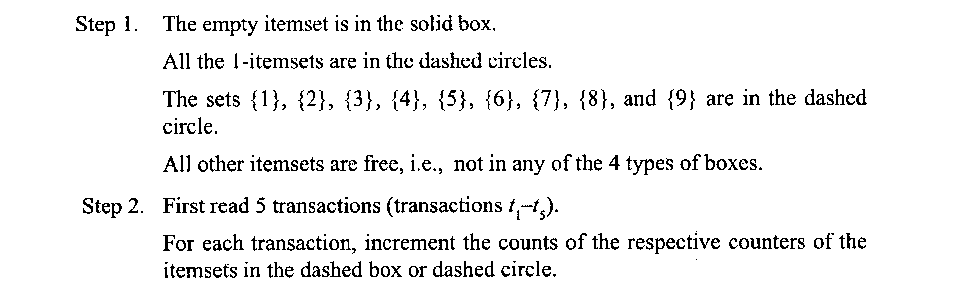
ASSOCIATION RULE MINING
Dynamic Itemset Counting Algorithm: Example

Slide 7
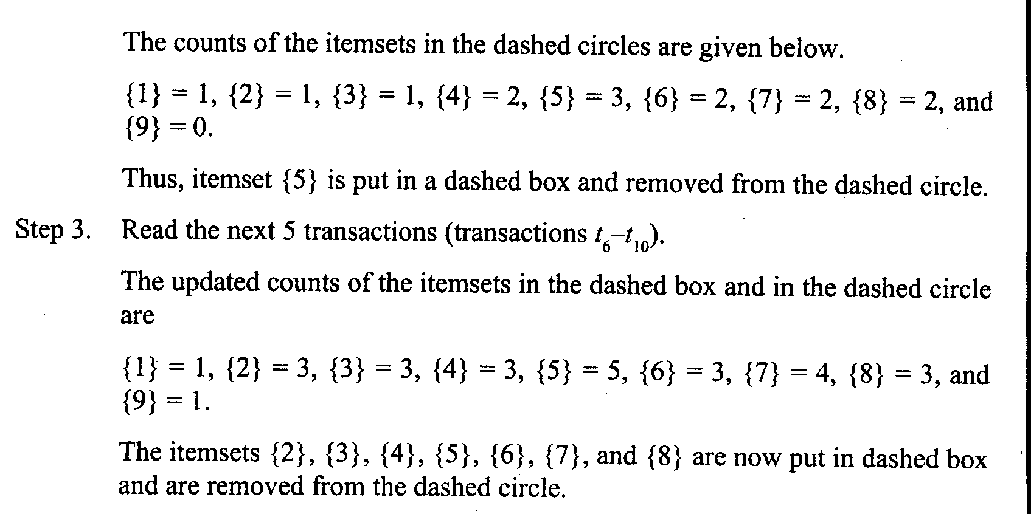
ASSOCIATION RULE MINING
Dynamic Itemset Counting Algorithm: Example

Slide 8
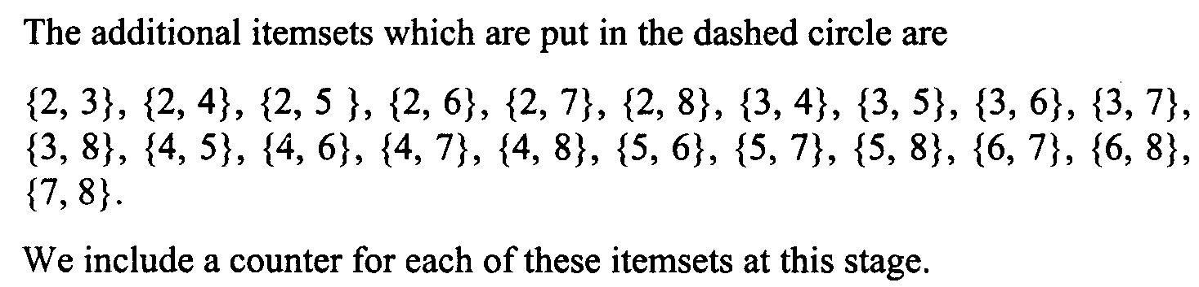
ASSOCIATION RULE MINING
Dynamic Itemset Counting Algorithm: Example

Slide 9
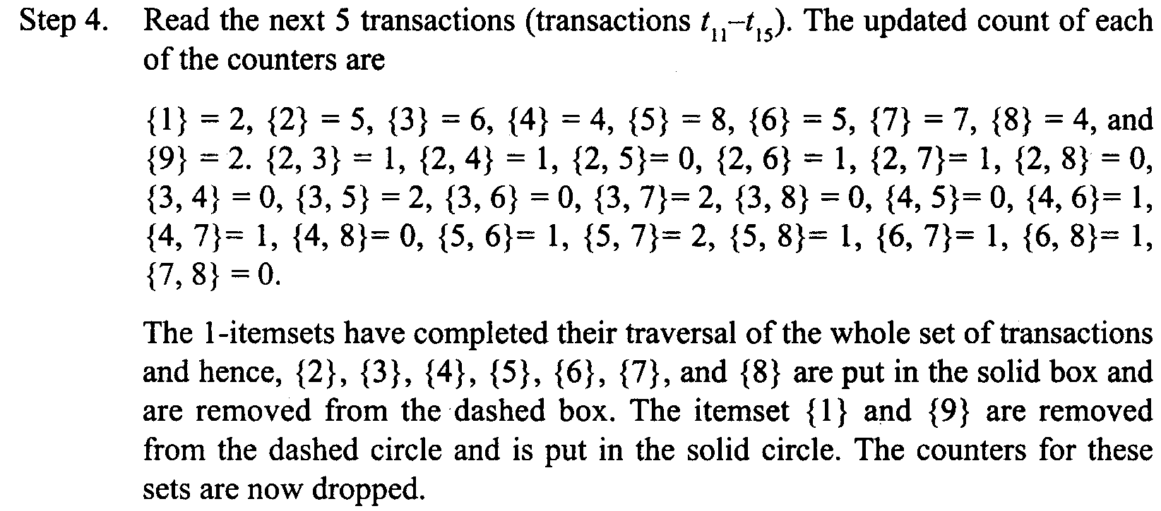
ASSOCIATION RULE MINING
Dynamic Itemset Counting Algorithm: Example

Slide 10
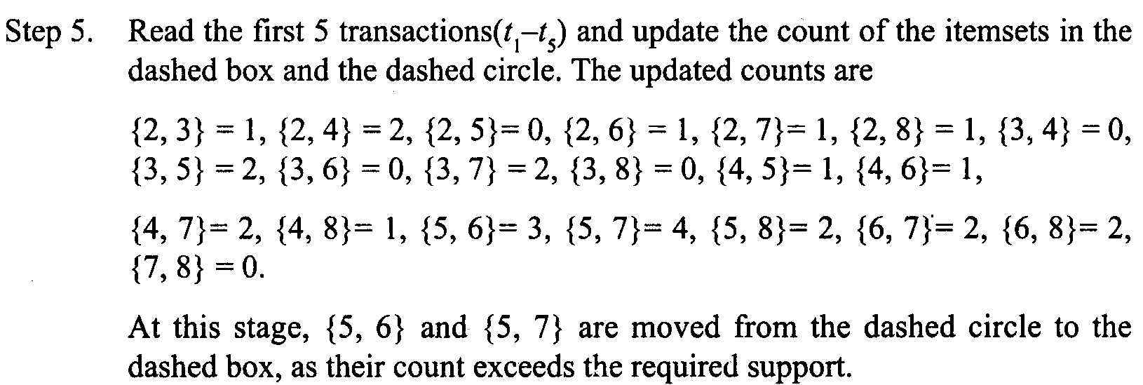
ASSOCIATION RULE MINING
Dynamic Itemset Counting Algorithm: Example

Slide 11
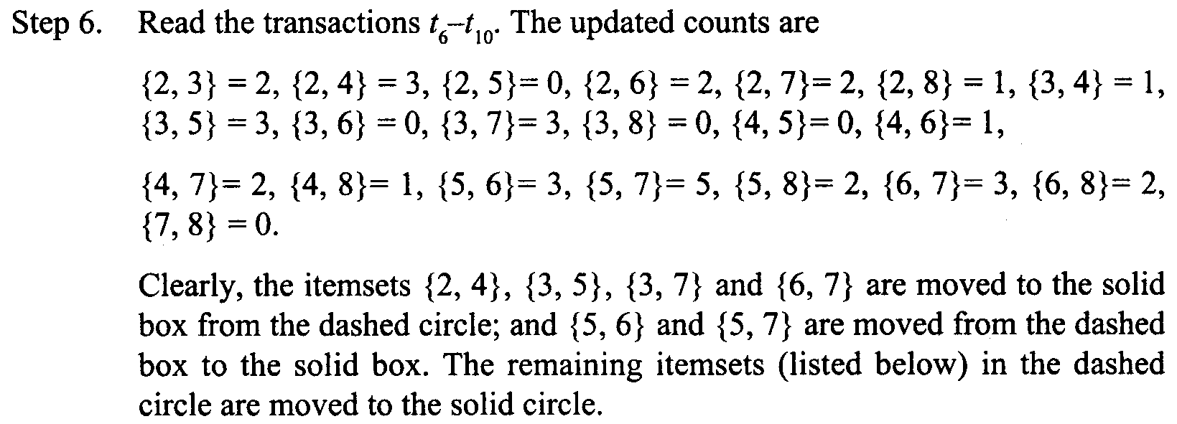
ASSOCIATION RULE MINING
Dynamic Itemset Counting Algorithm: Example

Slide 12
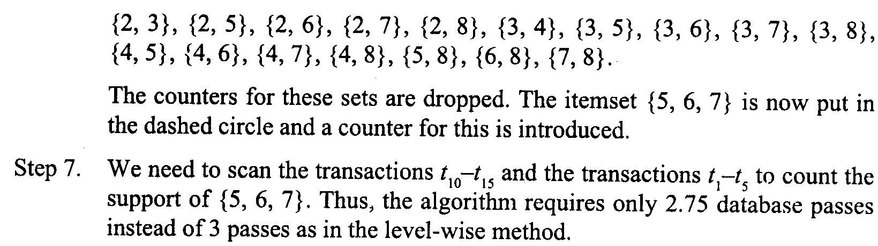
ASSOCIATION RULE MINING
Dynamic Itemset Counting Algorithm: Example

Slide 13
ASSOCIATION RULE MINING
Reference
Scan from the book
“Data Mining Techniques”
by Arun K. Pujari
placed on Course Folder

