Slide 1
Classification

Slide 2
An example application
An emergency room in a hospital measures 17 variables (e.g., blood pressure, age, etc) of newly admitted patients. A decision has to be taken whether to put the patient in an intensive-care unit. Due to the high cost of ICU, those patients who may survive less than a month are given higher priority. The problem is to predict high-risk patients and discriminate them from low-risk patients.

Slide 3
Another application
A credit card company typically receives thousands of applications for new cards. The application contains information regarding several different attributes, such as annual salary, any outstanding debts, age etc. The problem is to categorize applications into those who have good credit, bad credit, or fall into a gray area (thus requiring further human analysis).

Slide 4
Classification
Data: It has k attributes A₁, … A_{k}. Each tuple (case or example) is described by values of the attributes and a class label.
Goal: To learn rules or to build a model that can be used to predict the classes of new (or future or test) cases.
The data used for building the model is called the training data.
Notes:
Induction is different from deduction and DBMS does not not support induction;
The result of induction is higher-level information or knowledge: general statements about data
There are many approaches. Refer to the lecture notes for CS3244 available at the Co-Op.
We focus on three approaches here, other examples:
Other approaches
Instance-based learning
other neural networks
Concept learning (Version space, Focus, Aq11, …)
Genetic algorithms
Reinforcement learning

Slide 5

An example data

Slide 6
Classification
—A Two-Step Process
Model construction: describing a set of predetermined classes based on a training set. It is also called learning.
  Each tuple/sample is assumed to belong to a predefined class
  The model is represented as classification rules, decision trees, or mathematical formulae
Model usage: for classifying future test data/objects
  Estimate accuracy of the model
    The known label of test example is compared with the classified result from the model
    Accuracy rate is the % of test cases that are correctly classified by the model
  If the accuracy is acceptable, use the model to classify data tuples whose class labels are not known.

Slide 7



Classification Process (1): Model Construction
Classification
Algorithms
Training
Data
Classifier
(Model)
IF rank = ‘professor’
OR years > 6
THEN tenured = ‘yes’

Slide 8


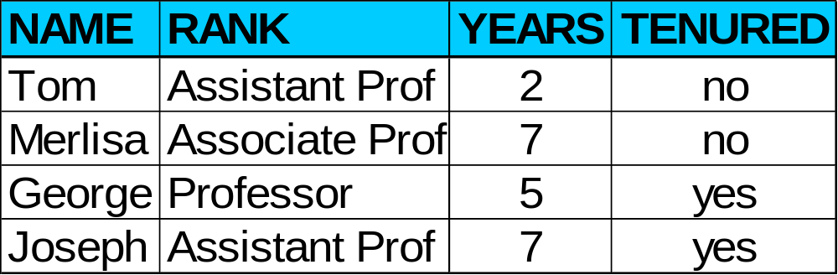

Classification Process (2): Use the Model in Prediction
Classifier
Testing
Data
Unseen Data
(Jeff, Professor, 4)
Tenured?

Slide 9
Supervised vs. Unsupervised Learning
Supervised learning: classification is seen as supervised learning from examples.
  Supervision: The training data (observations, measurements, etc.) are accompanied by labels indicating the classes of the observations/cases.
  New data is classified based on the training set
Unsupervised learning (clustering)
  The class labels of training data is unknown
  Given a set of measurements, observations, etc. with the aim of establishing the existence of classes or clusters in the data

Slide 10
Different classification techniques
There are many techniques for classification
  Decision trees
  Naïve Bayesian classifiers
  Using association rules
  Neural networks
  and many more ...

Slide 11
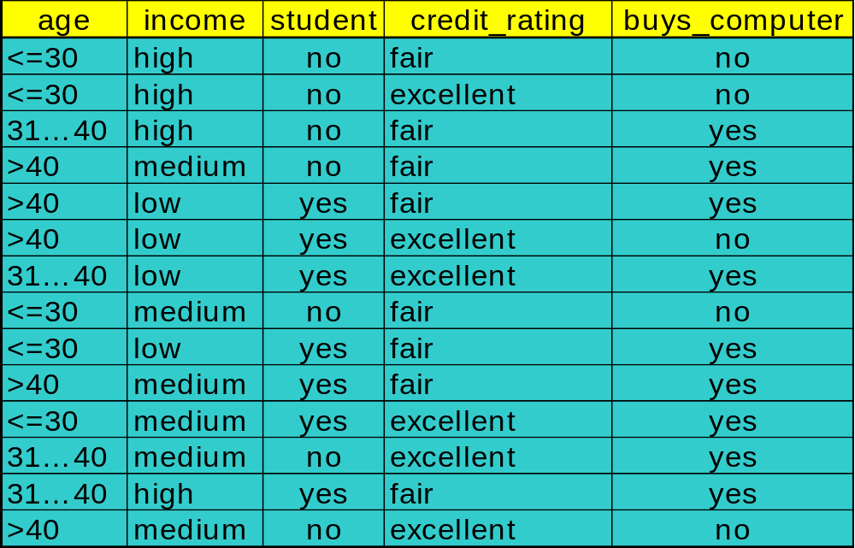
Building a decision tree: an example training dataset

Slide 12
Output: A Decision Tree for “buys_computer”
age?
<=30
overcast
>40
30..40
student?
yes
credit rating?
no
yes
excellent
fair
no
yes
no
yes

Slide 13
DECISION TREES
Decision Tree Representation
The target function can be Boolean or discrete valued
Each node corresponds to an attribute
Each branch corresponds to an attribute value
Each leaf node assigns a class

Slide 14
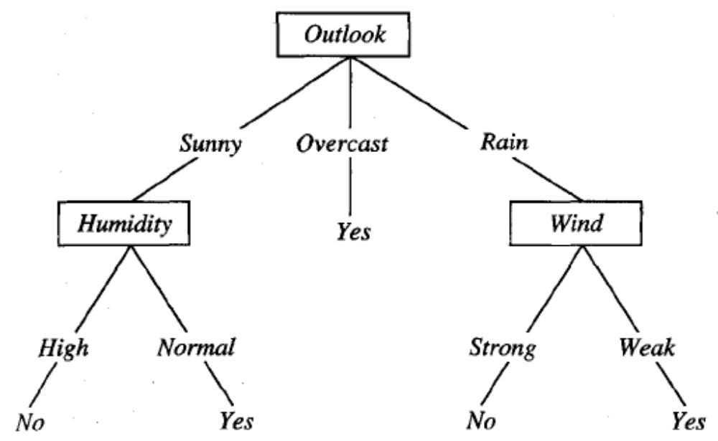
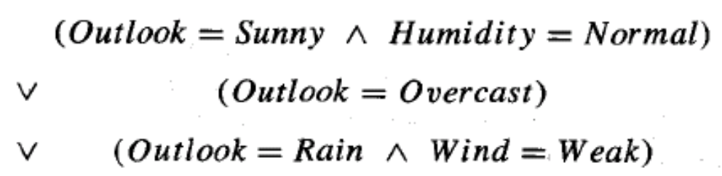
DECISION TREES
Decision Tree Representation

