Slide 1
Discretization
Discretization:
  divide the range of a continuous attribute into intervals
  Some classification algorithms only accept categorical attributes.
Experimental results indicate that with discretization
  data size can be reduced
  classification accuracy can be improved

Slide 2
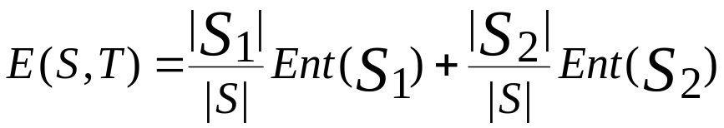

Entropy-Based Discretization
Given a set of samples S, if S is partitioned into two intervals S1 and S2 using boundary T, the entropy after partitioning is
The boundary that minimizes the entropy function over all possible boundaries is selected as a binary discretization.
The process is recursively applied to partitions obtained until some stopping criterion is met, e.g.,
Experiments show that it may reduce data size and improve classification accuracy

Slide 3

Example 1
ID | 1 | 2 | 3 | 4 | 5 | 6 | 7 | 8 | 9
Age | 21 | 22 | 24 | 25 | 27 | 27 | 27 | 35 | 41
Grade | F | F | P | F | P | P | P | P | P
Let Grade be the class attribute. Use entropy-based discretization to divide the range of ages into different discrete intervals.
There are 6 possible boundaries. They are 21.5, 23, 24.5, 26, 31, and 38.
Let us consider the boundary at T = 21.5.
  Let S1 = {21}
  S2 = {22, 24, 25, 27, 27, 27, 35, 41}
(22+24) / 2 = 23
(21+22) / 2 = 21.5

Slide 4
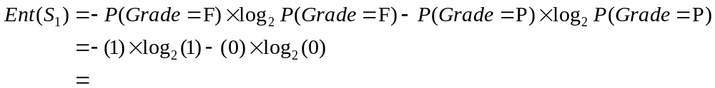

Example 1 (cont’)
ID | 1 | 2 | 3 | 4 | 5 | 6 | 7 | 8 | 9
Age | 21 | 22 | 24 | 25 | 27 | 27 | 27 | 35 | 41
Grade | F | F | P | F | P | P | P | P | P
The number of elements in S1 and S2 are:
    |S1| = 1
    |S2| = 8
The entropy of S1 is
The entropy of S2 is

Slide 5
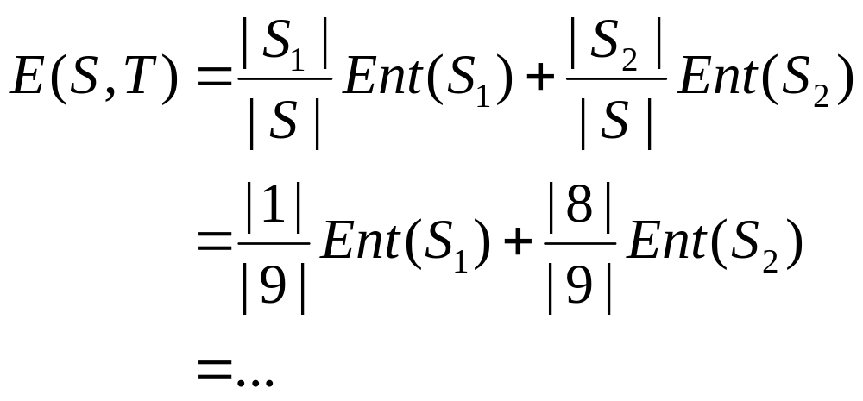
Example 1 (cont’)
Hence, the entropy after partitioning at T = 21.5 is

Slide 6
Example 1 (cont’)
The entropies after partitioning for all the boundaries are:
T = 21.5 = E(S,21.5)
T = 23 = E(S,23)
.
.
T = 38 = E(S,38)
Select the boundary with the smallest entropy
Suppose best is T = 23
Now recursively apply entropy discretization onto both partitions
ID | 1 | 2 | 3 | 4 | 5 | 6 | 7 | 8 | 9
Age | 21 | 22 | 24 | 25 | 27 | 27 | 27 | 35 | 41
Grade | F | F | P | F | P | P | P | P | P

Slide 7
Use of Association Rules:
Classification
Classification: mine a small set of rules existing in the data to form a classifier or predictor.
  It has a target attribute (on the right side): Class attribute
Association: has no fixed target, but we can fix a target.

Slide 8
Class Association Rules (CARs)
Mining rules with a fixed target
  Right-hand-side of the rules are fixed to a single attribute, which can have a number of values
  E.g., X = a, Y = d → Class = yes
  X = b → Class = no
Call such rules: class association rules

Slide 9
Mining Class Association Rules
Itemset in class association rules:
<condset, class_value>
condset: a set of items
item: attribute value pair, e.g.,
attribute1 = a
class_value: a value in class attribute

Slide 10
Classification Based on Associations (CBA)
Two steps:
Find all class association rules
  Using a modified Apriori algorithm
Build a classifier
  There can be many ways, e.g.,
    Choose a small set of rules to cover the data
Numeric attributes need to be discrertized.

Slide 11
Advantages of the CBA Model
Existing classification systems use
  Table data.
CBA can build classifiers using either
  Table form data or
  Transaction form data (sparse data)

