Slide 1
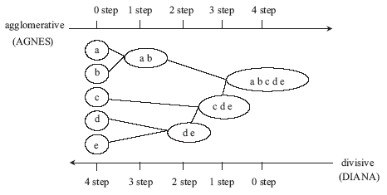
Hierarchical Clustering
They work by grouping data objects into a tree of clusters

Slide 2
Hierarchical Clustering
Agglomerative
- It is a bottom up strategy
- It first places each object in its own cluster
- Then merges these clusters into larger and larger clusters
-AGNES (Agglomerative Nesting)

Slide 3
Agglomerative
Hierarchical Clustering
Stage 1: 5 clusters
Stage 2: 3 clusters
Stage 3: 1 cluster
Merge
Merge
Stage 3: Cluster 1
Stage 2: Cluster 1
Stage 2: Cluster 2
Stage 2:
Cluster 3
Stage 1:
Cluster 1
Stage 1:
Cluster 2
Stage 1:
Cluster 3
Stage 1:
Cluster 4
Stage 1:
Cluster 5
A
B
C
D
E
Dendrogram

Slide 4
Hierarchical Clustering
The splitting and merging of clusters is based on distance measures
Four widely used distance measures are

Slide 5
Single Link
cluster similarity = similarity of two most similar members
Used by AGNES

Slide 6
Complete Link
cluster similarity = similarity of two least similar members
Notes:
I will start by motivating the work
next describe the Novel algorithm we developed
and then describe the experimental evaluation and present our results

Slide 7
Group Average
cluster similarity = average similarity of all pairs
  all pairs of all item in both cluster

Slide 8
Hierarchical Clustering
where m_{i} is the mean data object of cluster C_{i}

Slide 9
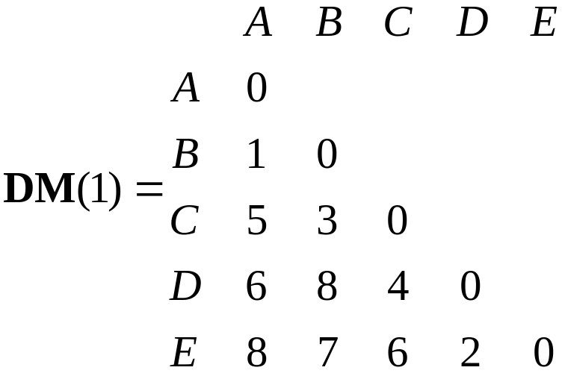
Hierarchical Clustering
Example: Let us consider five data samples: A, B, C, D, and E
Let the inter-point distances between these examples be given by the following distance matrix.

Slide 10
Hierarchical Clustering
Using the nearest neighbor measure, also known as the single linkage measure, we merge A and B to form a cluster, since they are closest.
Next we compute the distances between this cluster and the remaining examples. We can get these distances from the above distance matrix.
The values for these are as follows:
d(AB)C = min{dAC, dBC} = dBC = 3
d(AB)D = min{dAD, dBD} = dAD = 6
d(AB)E = min{dAE, dBE} = dBE = 7

Slide 11
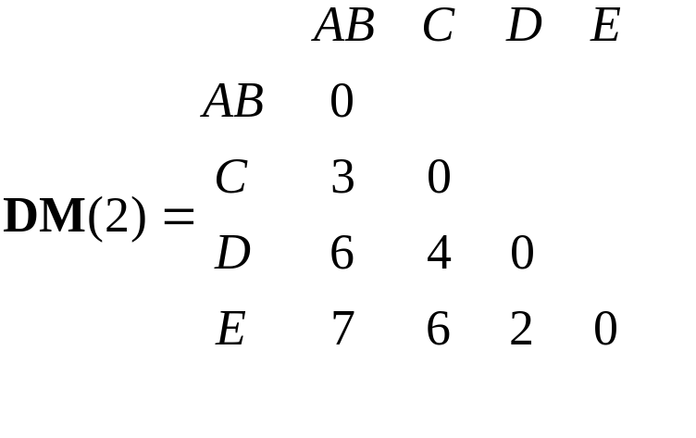
Hierarchical Clustering
Updated distance matrix
Since the smallest entry in above distance matrix is 2, examples D and E are merged to form another cluster

Slide 12
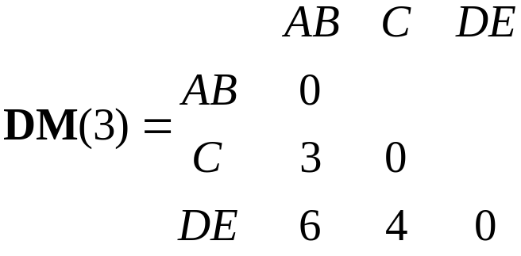
Hierarchical Clustering
Updated distance matrix
This matrix indicates that C should be merged with A and B.
At this stage we have only two clusters left that are joined to form a single cluster of five examples.

Slide 13
Hierarchical Clustering
Termination Condition
- The user can specify the desired number of clusters as a termination condition
- The quality of clusters can also be a termination condition

Slide 14
Hierarchical Clustering
How to Choose the Number of Clusters:
Lifetime Method
The lifetime of a cluster is defined as the absolute value of the difference between the dendrogram level at which it is created and the level at which it is absorbed into a larger cluster.
Using lifetime as a criterion, a user can search for cluster that have a large lifetime.

Slide 15
Hierarchical Clustering
The merge (or split) decisions are critical in these types of algorithms
Once a merging (or splitting) of two clusters is made, it cannot be undone and furthering clustering proceeds on the basis of this decision

