Slide 1

Part of Speech PowerPoint Presentation
English I Honors

Slide 2


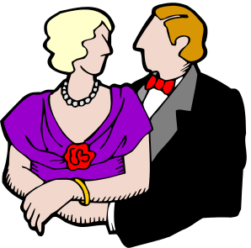




Nouns
- Definition: A word or word group that is used to name a person, place, thing, or an idea.
-Examples: Mrs. Pruett, Texas, suitcase, and freedom.

Slide 3


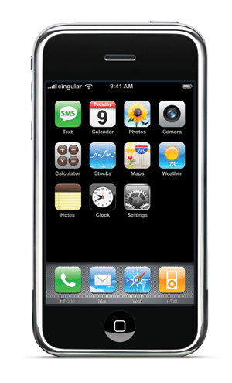
Common Nouns vs. Proper Nouns
Common Noun:
-Definition: A common noun names any one of a group or persons, places, things, or ideas and is generally not capitalized.
-Examples: Book, school, marker, computer, phone, and backpack.
Proper Noun:
-Definition: A proper noun names a particular person, place, thing, or idea, and is capitalized.
-Examples: Holt Handbook, Nesbitt Discovery Academy, Mac computer, IPhone, and Jansport backpack.

Slide 4
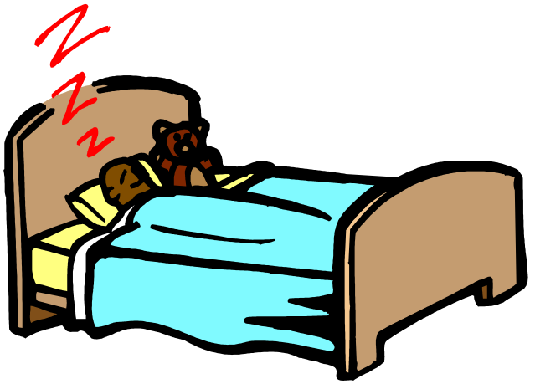

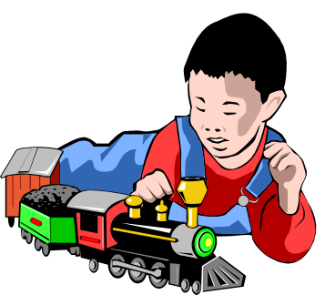
Pronouns
- Definition: A word that is used in place of one or more nouns or pronouns.
-Examples: I, they, your, our, she, we, them, he, us, him, his, their, them, and its.
He is playing with the train.
They are playing all together.
Is she sleeping in her bed?

Slide 5
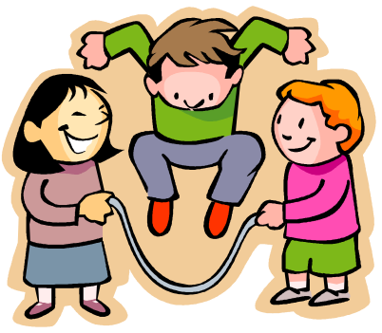


Personal Pronoun
-Definition: A personal pronoun refers to the one speaking is first person, the one spoken to is second person, or the one being spoken to is third person.
-First Person: I, me, my, mine, we, us, ours, our.
-Second person: you, yours, your.
-Third person: He, him his, she, her, hers, it, its, they, them, their, theirs.
Look, I am good at reading!
They are playing jump rope.
You click the icon to open the game.

Slide 6


Demonstrative and Interrogative Pronouns
-Demonstrative Pronouns:
-Definition: A demonstrative pronoun is used to point our a specific person, place, thing, or idea.
-Examples: This, That, These, Those.
-Interrogative Pronouns:
  -Definition: An interrogative pronoun introduces a question.
  -Examples: Who, whom, which, what, whose.
I think this is good enough.
Hmmm, who is in my class?

Slide 7

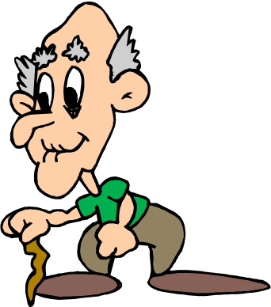

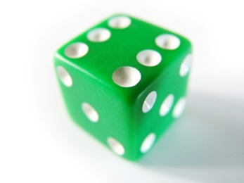
Adjective
-Definition: A word that is used to modify a noun or a pronoun.
Green Die.
Transparent ghost
Old Man
Haunted House

Slide 8

Demonstrative Adjectives and Articles
-Demonstrative Adjective:
-Definition: A demonstrative adjective is an adjective modifies a noun or pronoun.
-Example:
-Did Jenifer draw this one or that one?
-Let’s take these sandwiches and those apples on our picnic.
-Articles:
-Definition: An Indefinite Article is when they refer to any member of a group.
-Examples:
-A girl won.
-The one day sale is on Saturday.

Slide 9
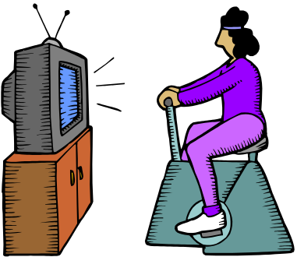
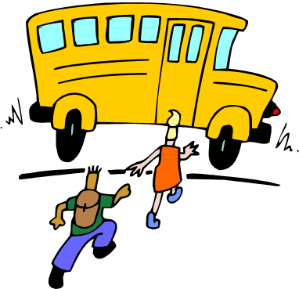

Verb
-Definition: A verb that is used to express action or a state of being.
-Example: Texting, jumping, push, doing.
Mom helps Jack do his homework.
She is exercising.
The boys get on the bus.

Slide 10


Helping Verbs
-Definition: Helping Verbs help the main verb express action or a state of being.
-Examples: can, do, has, might, should, and could.
Hey! You should put the toys in the box.
Please, can you cut the cake now?

Slide 11


Adverb
- Definition: A word that modifies a verb, an adjective, or adverb.
-Examples: There, up, here, down, tomorrow, weekly, later, and early. (Think –ly too.)
The girl is going to ride her bike up the street.
It is going to rain tomorrow and weekly from now on.

Slide 12
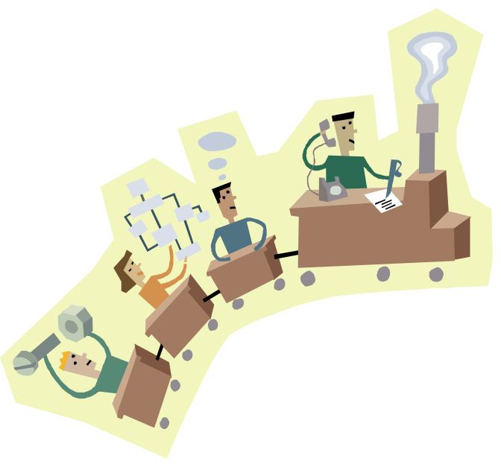

Preposition
-Definition: A word that shows the relationship of a noun or a pronoun to another word. (Remember the song!)
-Examples: Aboard, below, from, since, about, beneath, throughout, concerning, past, and without.
They are aboard the train.
This guy is from history.

Slide 13


Conjunction
-Definition: A word that joins word or words groups.
Decide whether to stay or go.
Coordinating Conjunctions:
-Examples: And, but, or nor, for yet so.
-Examples: You are supposed to walk on the street or the sidewalk.
Correlative Conjunctions:
-Examples: Both…and, Not only…but also, Whether…or.
-Example: Both Jim and Roberto were standing outside.

Slide 14
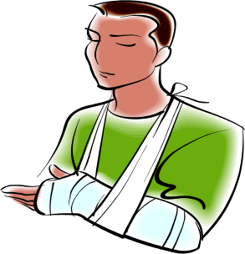
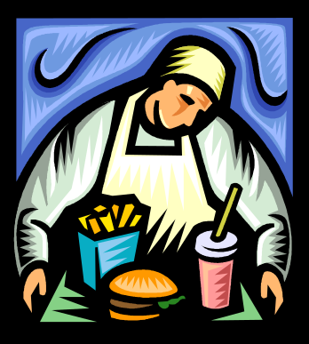

Interjection
-Definition: A word that expresses emotion.
-Definition: An interjection has no grammatical relation to the rest of the sentence.
-Examples: Crap! Wow! Yuck! Yippee! Uh-oh! Well!
WEEE! I’m Swinging!
YUCK! This is nasty!
OWW! This Hurts.

