Slide 1
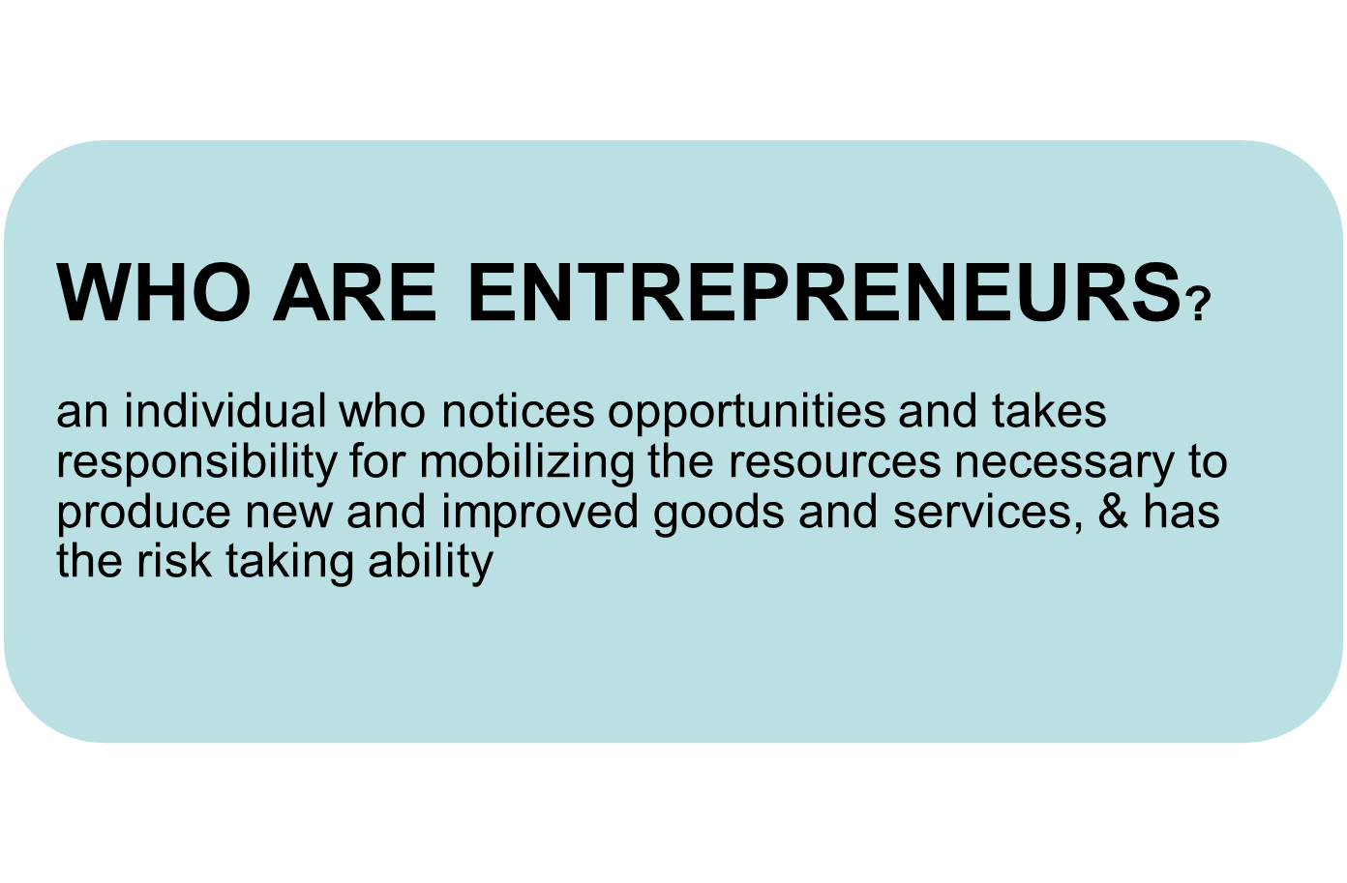


Slide 2
PERSONALITY TRAITS:
belief by individuals that their future is within their control& that external forces will have little influences
Internal locus of control
High energy level
Need to achieve
Self confidence
Awareness of passing time
Tolerance of ambiguity
Start ups requires great effort
works longer hours n hard
Quality in which people are motivated to excel & pick situations in which success is likely
set up moderately difficult goals
handle complex problems as they arise
impatient & feel sense of urgency
As if there is no tomorrow
important trait- decisions are made without clear options about which will succeed

Slide 3
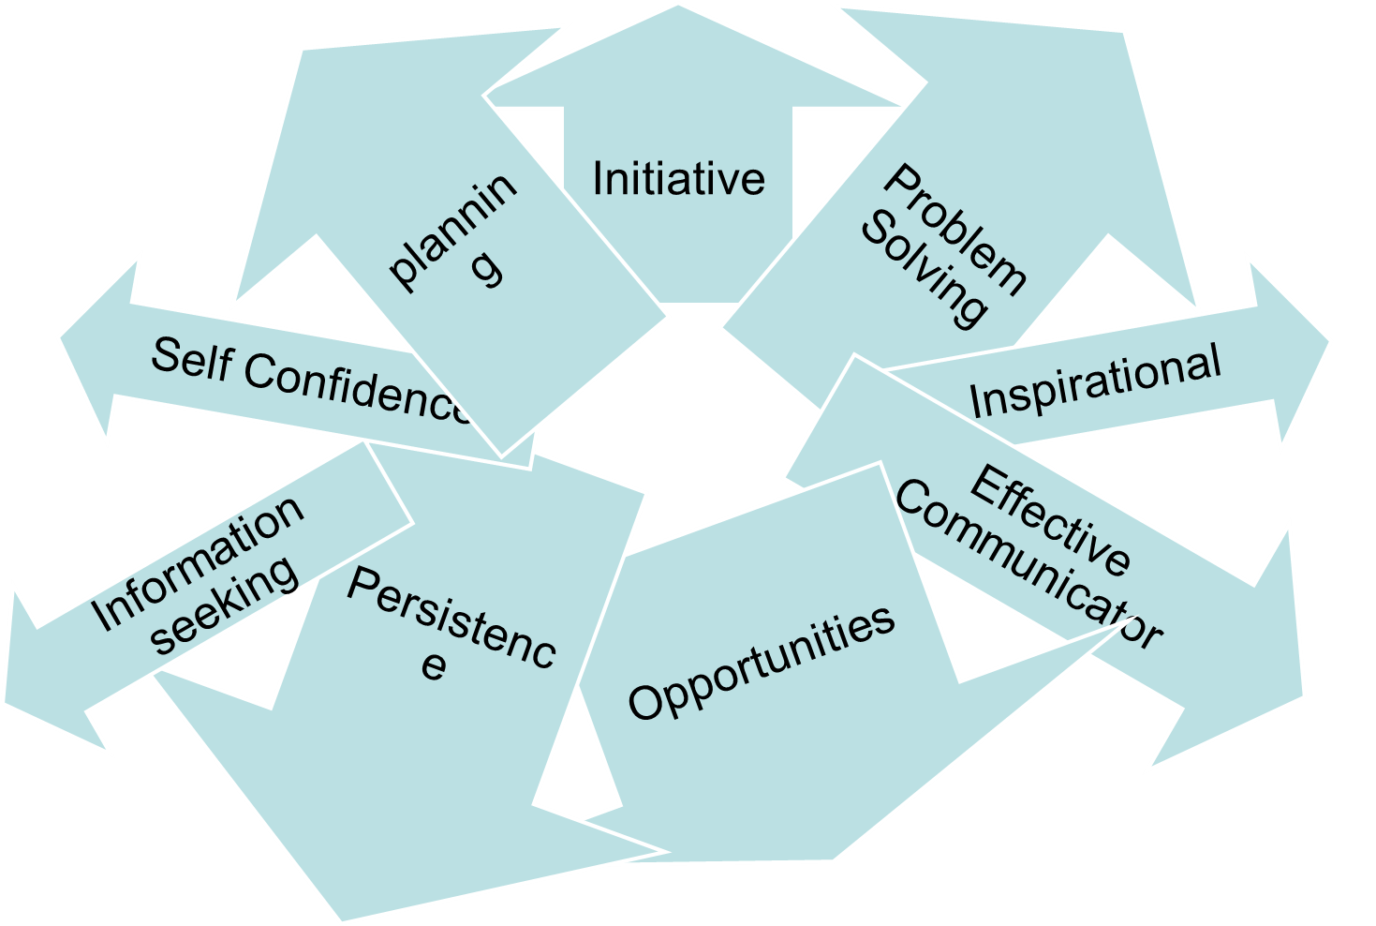
Characteristics of an Entrepreneur

Slide 4

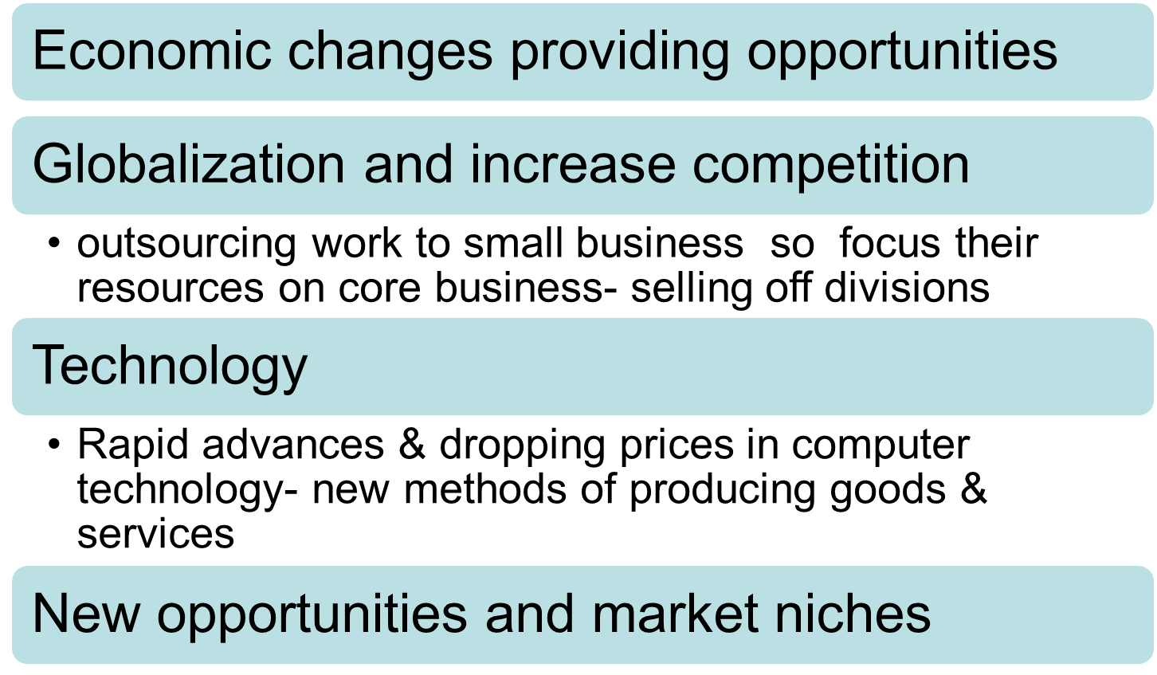

Slide 5

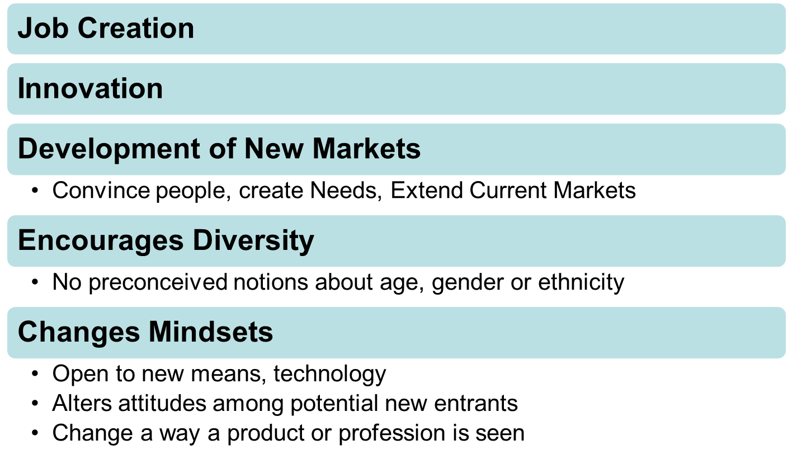

Slide 6


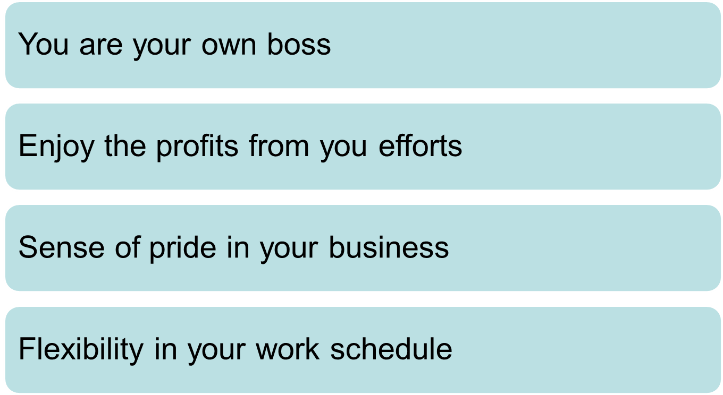

Slide 7


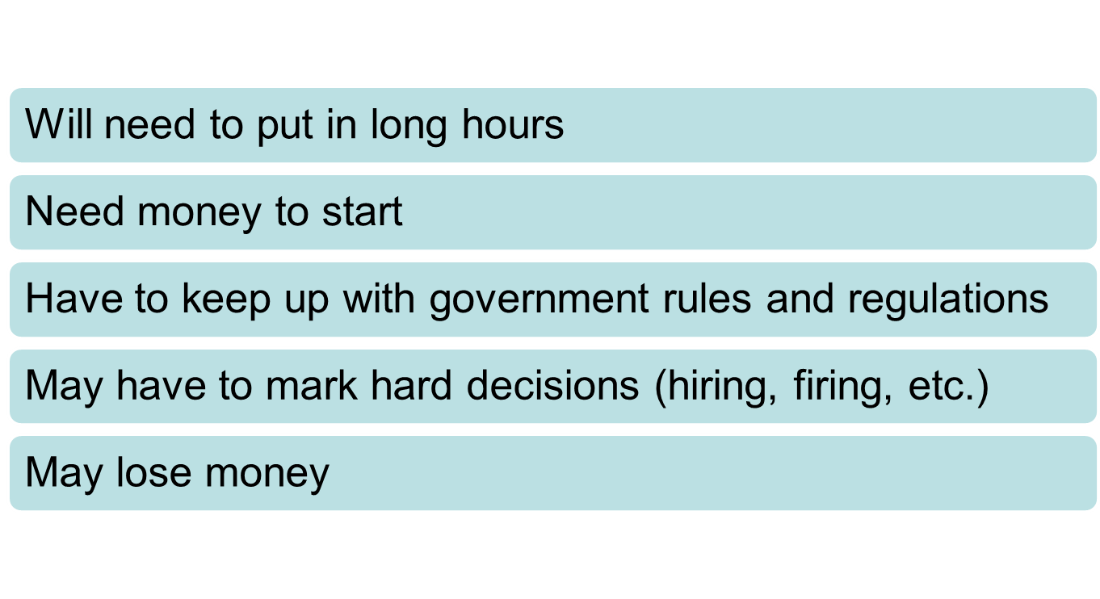

Slide 8
Task: List of Problem and their opportunities

Slide 9
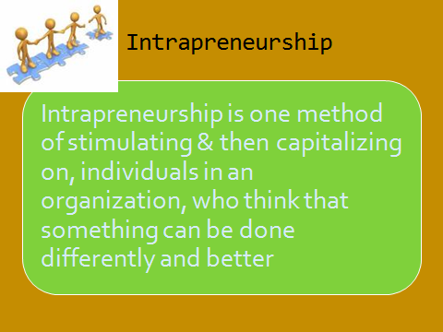

Slide 10
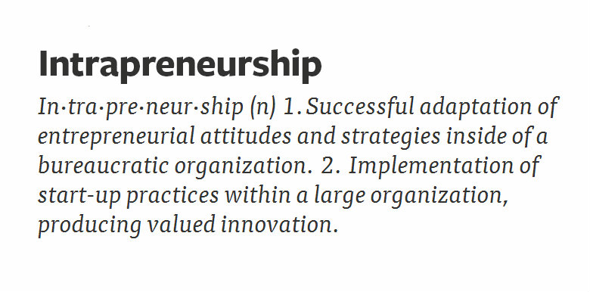
Intrapreneurship is set of rules or relaxation to give the employee in order to take new idea and new step and innovative step from the employee. If some work is going on within the company then other employee to work done by smart and innovative way.

Slide 11
