Slide 1




Slide 2
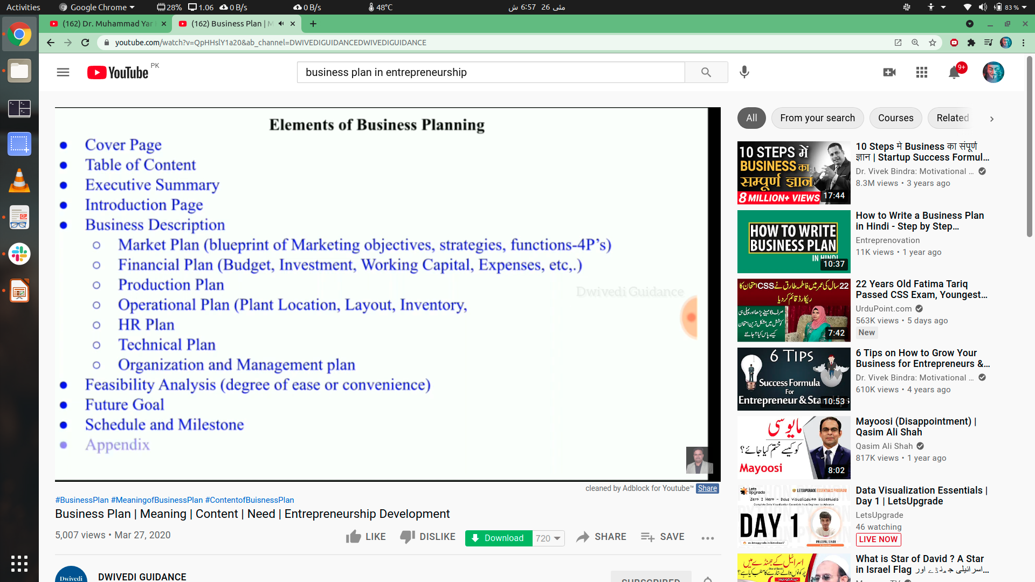

Slide 3
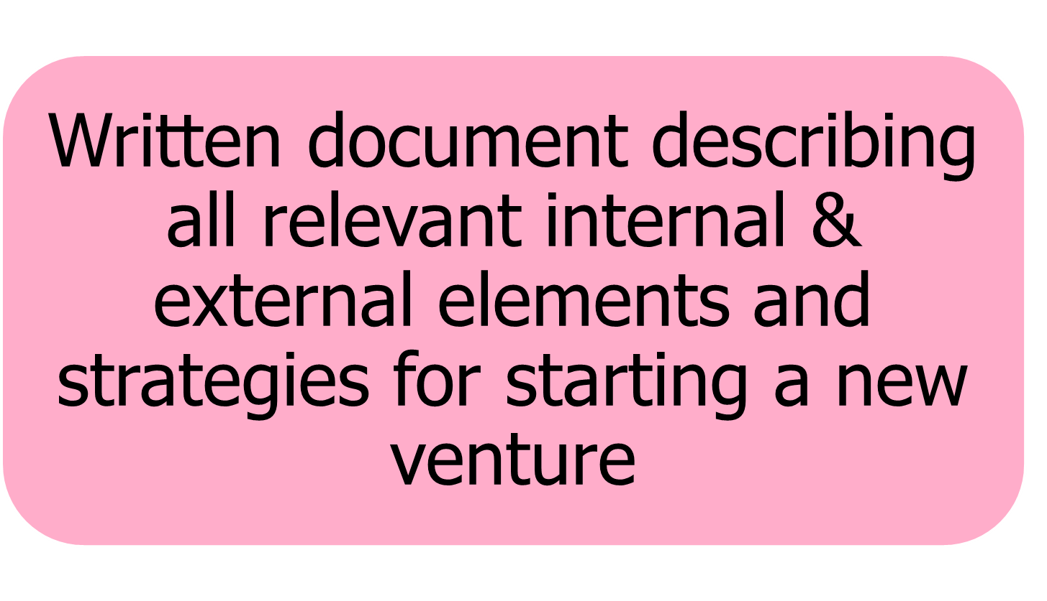
Business Plan

Slide 4
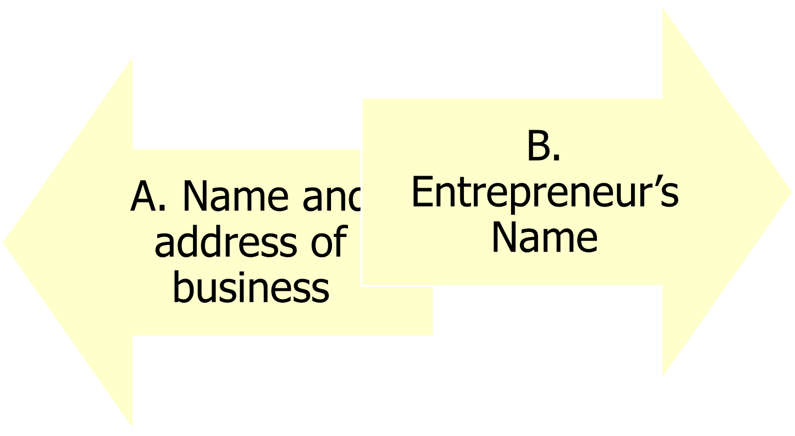
1) TITLE PAGE / COVER PAGE

Slide 5

2) EXECUTIVE SUMMARY
1.5 - 2 pages

Slide 6

3)INTRODUCTION
Components of the description are:
  Mission statement.
  Product(s) or service(s) (very briefly)
  Location and size of the business
  Profiles of the entrepreneurs

Slide 7
4) ENVIRONMNETAL & INDUSTRY ANALYSIS
Environmental analysis: assessment of external uncontrollable variables
PESTEL Analysis
Industry analysis
  Porters forces

Slide 8

PESTEL Analysis

Slide 9
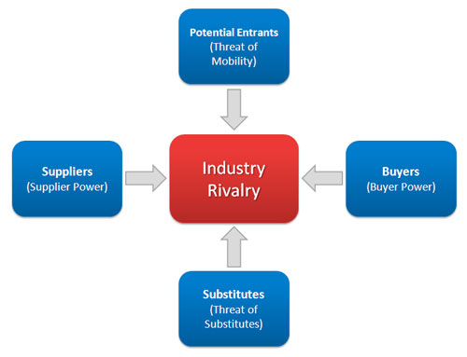
Porters six forces

Slide 10
5) PRODUCTION PLAN
Details how the product(s) will be manufactured
If product is not manufactured, this part is eliminated
Will you be responsible for all or part of the manufacturing operation? If some manufacturing is subcontracted, who will be the subcontractors? (Give names and addresses.) Why were these subcontractors selected? What are the costs of the subcontracted manufacturing? What will be the layout of the production process? (Illustrate steps if possible.) What equipment will be needed immediately for manufacturing? What raw materials will be needed for manufacturing? Who are the suppliers of new materials and what are the appropriate costs? What are the costs of manufacturing the product?

Slide 11
6) OPERATIONS PLAN /Technical
All businesses (manufacturing or non -manufacturing) should include an operations plan
If a Retail Operation or Service: From whom will merchandise be purchased? How will the inventory control system operate? What are the storage needs of the venture ? How will the goods flow to the customer? Chronologically, what are the steps involved in a business transaction?

Slide 12

7) MARKETING PLAN
Describes:
Consumer behaviour
  Marketing research
  Target market
  4 Ps(production ,price,promotion,
      place)
Potential investors regard the
marketing plan as critical to the success of the new venture.

Slide 13

8) ORGANIZATIONAL PLAN/ HR PLAN
Describes form of ownership and lines of authority and responsibility of members of new venture.
In case of a:
  Partnership:
    Terms of the partnership should be included.
  Corporation:
    Names, addresses, and resumes of the directors and officers of the corporation.
    Organization chart.

Slide 14

9) FINANCIAL PLAN
Projections of key financial data that determine economic feasibility
Two financial areas:
  Summarize the forecasted sales and the appropriate expenses for at least the first three years.
  Projected balance sheet.

Slide 15

APPENDIX / ANNEXTURES
May include:
  Letters from customers, distributors, or subcontractors.
  Secondary data or primary research data used to support plan decisions.
  Leases, contracts, or other types of agreements.
  Price lists from suppliers and competitors.

Slide 16



