Slide 1
Natural Language Processing (NLP)
Lecture 10: Word Associations
Dr. Muhammad Taimoor Khan

Slide 2
Syntagmatic Word Association
Syntagmatic: A & B have syntagmatic relation if they can be combined with each other (i.e., A & B are related contextually)
–E.g., “cat” and “sit”; “car” and “drive”
These two basic and complementary relations can be generalized to describe relations of any items in a language

Slide 3
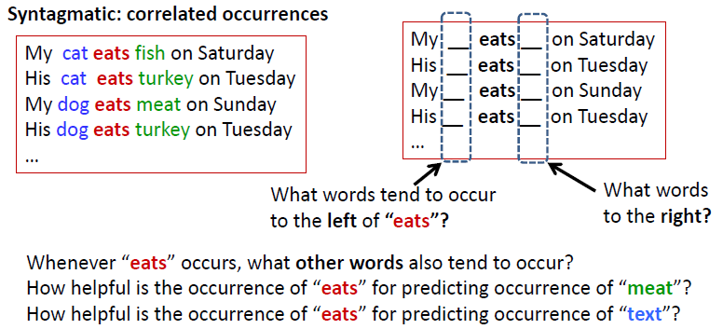
Mining word associations: Intuitions

Slide 4
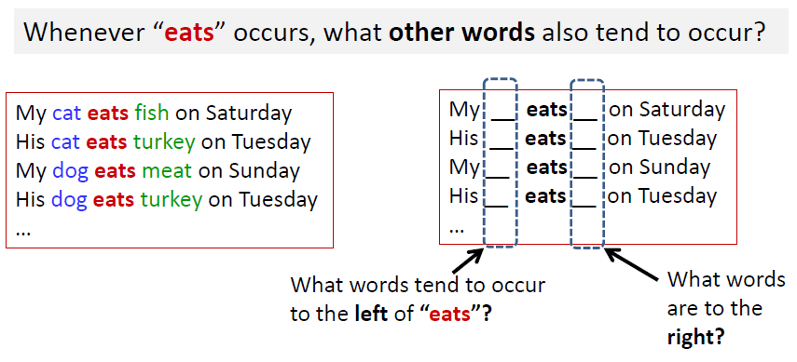
Syntagmatic Relations: Correlated Occurrences

Slide 5
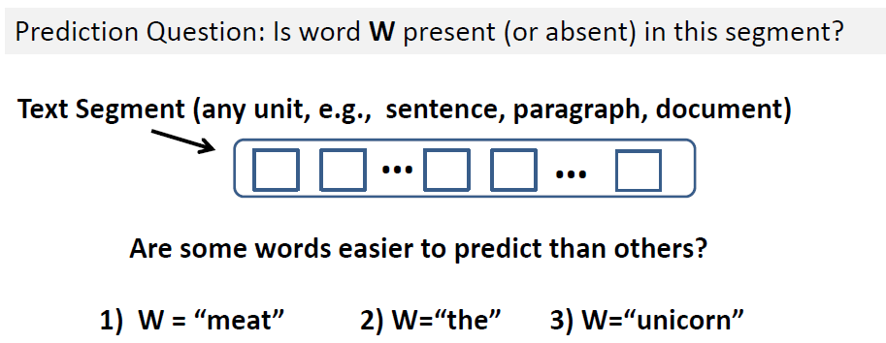
Word Prediction: Intuition

Slide 6
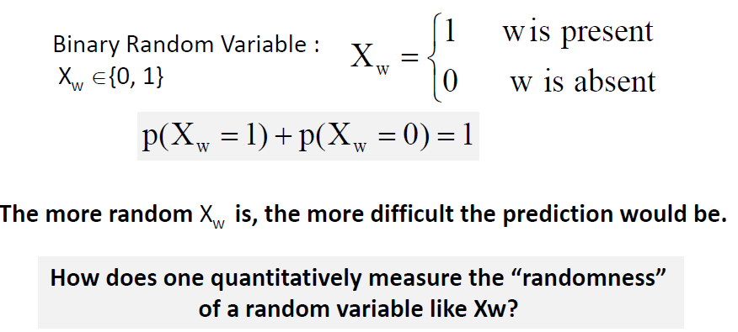
Word Prediction: Formal Definition

Slide 7
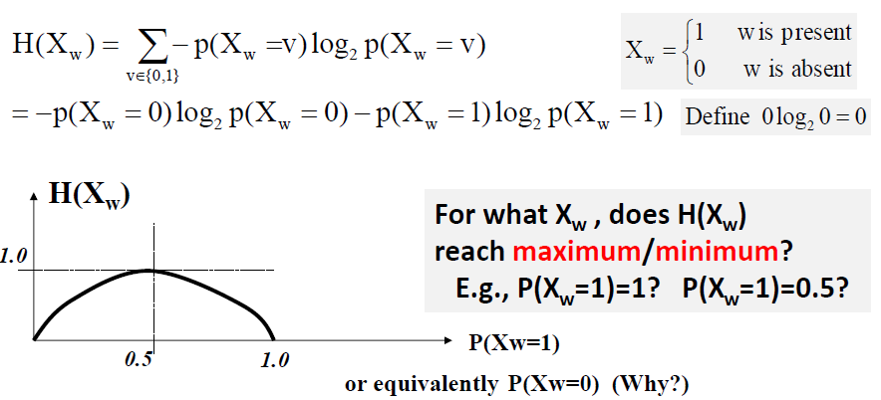
Entropy H(X) Measures Randomness of X

Slide 8
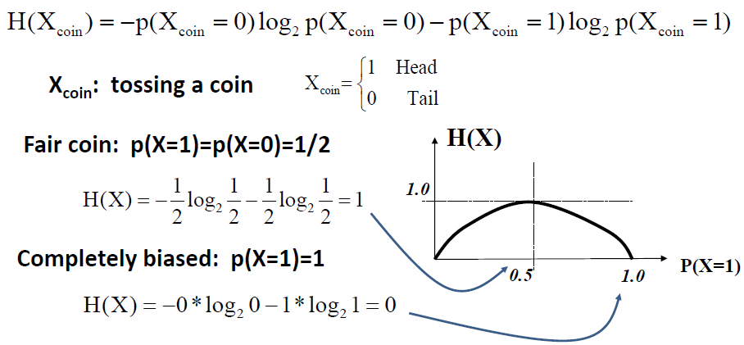
Entropy H(X): Coin Tossing

Slide 9
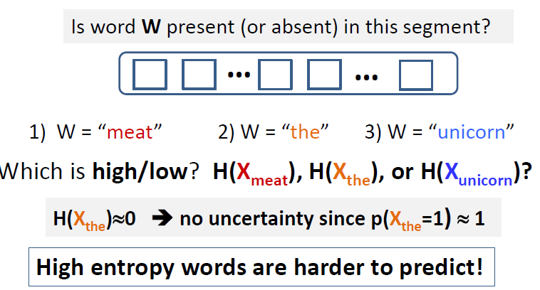
Entropy for Word Prediction

Slide 10
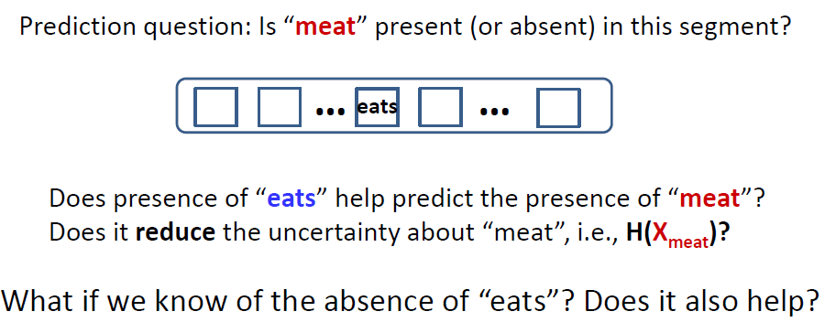
What if we know more about a text segment

Slide 11
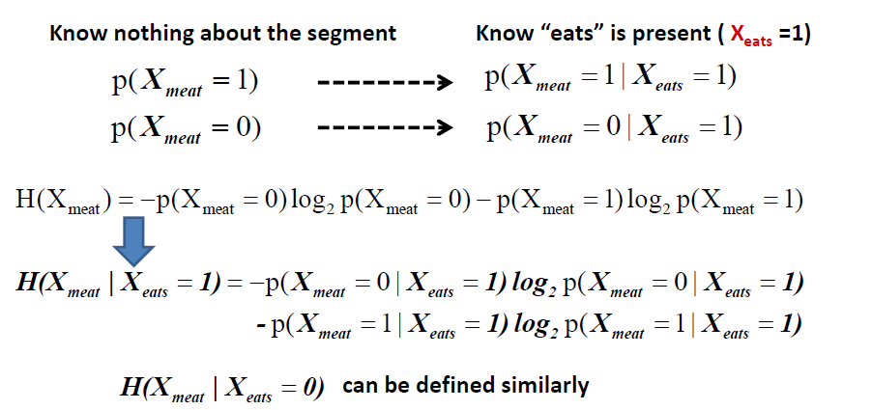
Conditional Entropy

Slide 12

In general, for any discrete random variables X and Y, we can have
$$H(X)≥H(X|Y)$$
What’s the minimum possible value for H(X|Y)?

Slide 13

Conditional Entropy to Capture Syntagmatic Relation
$$H\left(X_{meat} | X_{eats}\right)=?$$
Which is smaller? $H\left(X_{meat} | X_{the}\right)$ or $H\left(X_{meat} | X_{the}\right)$?
For which word w, does $H\left(X_{meat} | X_{w}\right)$ reach its minimum (i.e., 0)?
For which word w, does $H\left(X_{meat} | X_{w}\right)$ reach its maximum value?

Slide 14

For each word w1
For every other word w2, compute conditional entropy $H(X_{w1}|X_{w2})$
Sort all the candidate words in ascending order of $H\left(X_{w1} | X_{w2}\right)$
Take the top ranked candidate words as words that have potential syntagmatic relationship with w1.
Need to use a threshold for each w1
However, while $H\left(X_{w1} | X_{w2}\right)$ and $H\left(X_{w1} | X_{w3}\right)$ are comparable, $H\left(X_{w1} | X_{w2}\right)$ and $H\left(X_{w3} | X_{w2}\right)$ aren’t!
We may need to mine the K strongest syntagmatic relations from a collection.

Slide 15
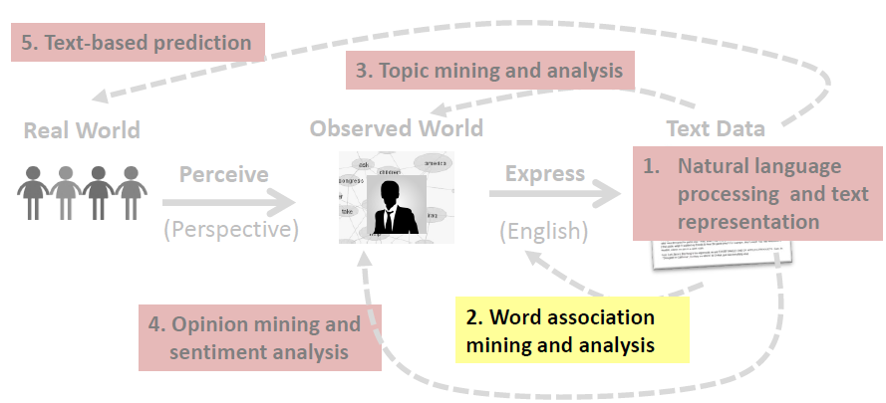
Syntagmatic relation discovery: Mutual Information

Slide 16
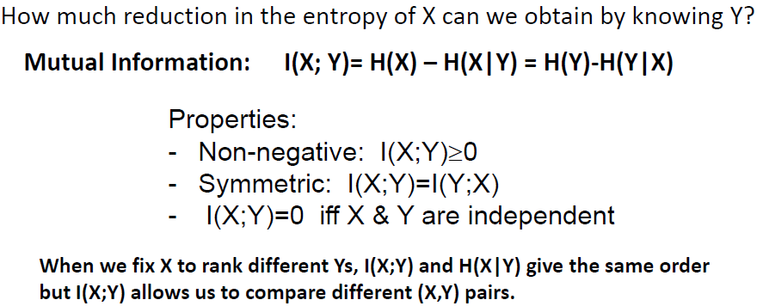
Mutual Information I(X;Y): Measuring Entropy Reduction

Slide 17
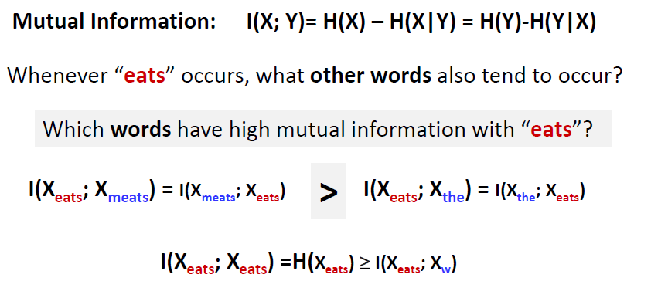
Mutual Information I(X;Y) for Syntagmatic Relation Mining

Slide 18
Summary of syntagmatic relation discovery
Syntagmatic relation can be discovered by measuring correlations between occurrences of two words.
Three concepts from Information Theory:
–Entropy H(X): measures the uncertainty of a random variable X
–Conditional entropy H(X|Y): entropy of X given we know Y
–Mutual information I(X;Y): entropy reduction of X (or Y) due to knowing Y (or X)
Mutual information provides a principled way for discovering syntagmatic relations.

