Slide 1
Natural Language Processing (NLP)
Lecture 11: Application Areas
Dr. Muhammad Taimoor Khan

Slide 2
Nature of Data
Structured
Data that can be stored as SQL database
Requires high upfront effort and are hard to modify later
Its highly organized information that uploads neatly into relational database
Its relatively easy to enter, store, query, analyze but is strictly defined in terms of field name and type
Semi-structured
Do not reside in relational database
Have some organizational properties that makes it easier to analyze
They are structured but do not confirm to a formal structure
Log files, XML, JSON

Slide 3
Nature of Data
Unstructured
May have its own internal structure but hard to comprehend
Cannot reside in a relational database
Most business interactions are unstructured that are difficult to unbox, analyze, understand and prepare for analytics
Web pages, Emails, PDF files, Word Documents
Fully Unstructured
Hard to understand having limited or no text associated
Video files, audio files and images

Slide 4
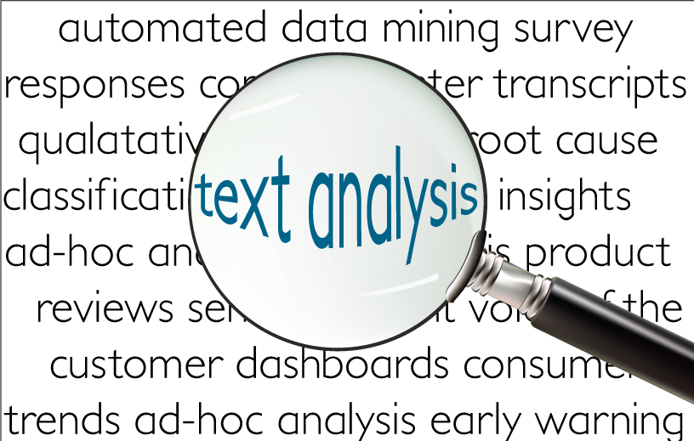
Text Mining
Deriving high quality information from text. This is usually achieved through statistical pattern learning
It’s a specific form of data mining
Comprises of NLP, IE, IR along with data mining techniques

Slide 5
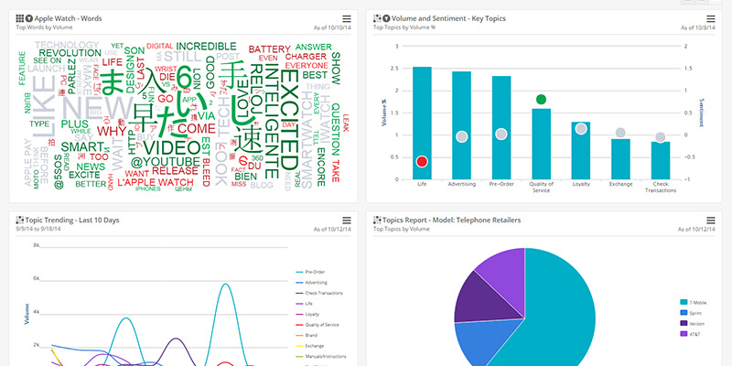
Text Analytics
Providing analysis on the basis of mined information

Slide 6
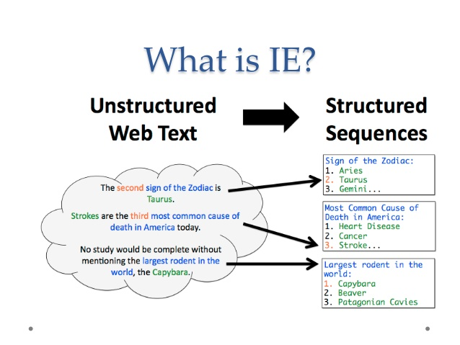
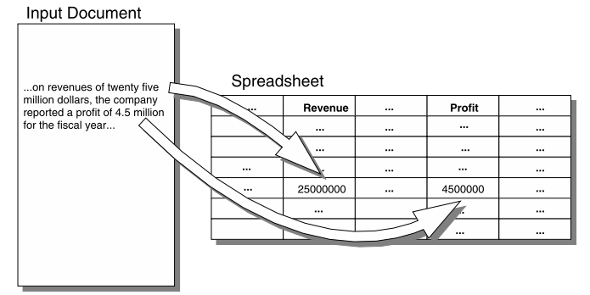
Information Extraction
The task of automatically extracting structured information from unstructured or semi-structured machine readable documents
It includes crawling, indexing, retrieving documents

Slide 7
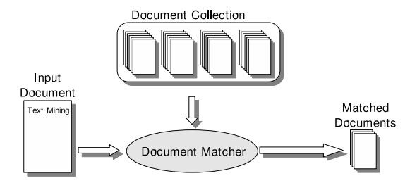
Information Retrieval
The activity of obtaining information system sources relevant to an information need (query) from a collection of information sources. Searches can be based on full text or context-based indexing
It gives effective ways to retrieve the extracted information
Its primarily based on documents Similarity

Slide 8
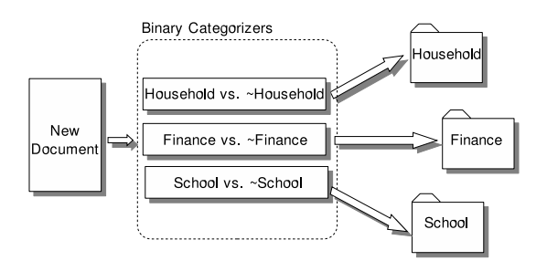
Text categorization
Classifying documents to different labels
For example predicting future stock movements based on prior experience
Analyze articles that appear prior to rise or fall in stock prices and predict for future documents

Slide 9
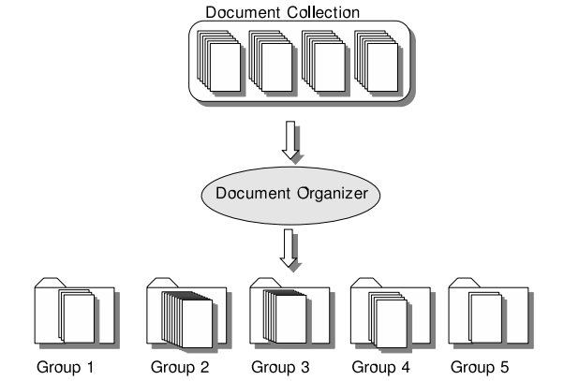
Organizing documents
Document clustering
Its not as effective as classification
It can still be very insightful
Helps to know more about customer groups
Identify groups of complaints in customer care

Slide 10
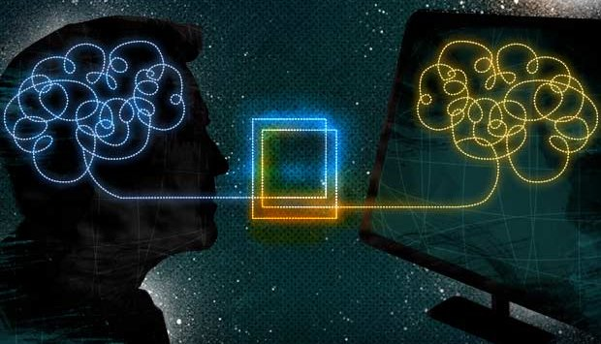
Natural Language Processing (NLP)
The use of artificial intelligence to help computers interact with humans in natural language. In particular it deals with how to program computers to process and analyze large amounts of natural language data.

Slide 11
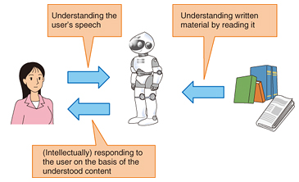
Natural Language Understanding or Interpretation (NLU / NLI)
It is a subtopic of NLP in AI that deals with machines reading comprehensions (of news papers, poetry etc.)
It understand and interprets what it reads. Therefore it empowers computers to communicate with humans in natural language.
NLU or its subtopics are AI-hard problems
Only a subset of topics as commands to robotics is achieved.

Slide 12
Knowledge-based systems
Allows to incorporate contextual knowledge into NLU systems
Speech-to-act models help household robots communicate in natural language

Slide 13
Applications

Slide 14
Undergrad Projects…
Narrow folksonomy for research groups – 2018*
Closed-domain Intelligent question-answering – 2018
Sentiment Search engine – 2018
Co-referent mention detection – 2018
Exploring hierarchy in topics using formal concept analysis – 2017
Context-aware YouTube video recommender system – 2017
Analyzing reasons for online social conflicts – 2017
Personal analytics for activities management - 2016

Slide 15
Undergrad Projects
Government policy monitoring through semi-supervised Aspect-based sentiment analysis – 2016
Lifelong machine learning for aspect extraction – 2016
(A knowledge-based readings recommender system)
Unsupervised network analysis of textual data – 2015
Contextual categorization of implicit bookmarking for revisitation – 2015
Sentiment analysis using Hadoop - 2015

Slide 16
Application Areas…
Objective text analysis
Risk management in financial and health industry
Knowledge management (deducted from heaps of information)
Cyber-crime prevention (text mining intelligence / Anti-crime application)
Customer care service
Fraud detection through claims investigation
Personality assessment (Automatic user profiling)
Contextual advertising

Slide 17
Application Areas
Business Intelligence (Data Science)
Content enrichment (enriching content by providing scalable layer to tag, organize, summarize the available content that makes it suitable for a variety of purposes)
Individual / group anomaly detection
Facts finding and verification
Aspect extraction
Named entity recognition
Text categorization / Classification / Summarization
Findability and refindability

Slide 18
Application Areas
Subjective Analysis
Opinion mining
Sentiment analysis
Aspect-based sentiment analysis
Opinion reason mining
Propaganda analysis
Bias analysis
Hate speech analysis

Slide 19
Application Areas
Information leakage
Bullying analysis
Spam opinion filtering
Opinion holder identification and analysis
Monitoring recurring events / continuous activities
Trend analysis
Danger analysis
Emotion analysis
Mood analysis (through song lyrics)

Slide 20
Application Areas
Natural Language Processing
Analysis of writing styles / ways of expression (gender analysis)
Processing conditional sentences
Processing comparative sentences
Aspects sharing opinion word / Multiple opinion words for an aspect
Subjectivity identification
Language identification (In a multi-lingual system)

Slide 21
Application Areas
Negation Handling
Grouping features synonyms
Dealing with near synonyms, antonyms, homonyms (words having same spelling or pronunciation), hyponyms (subtypes of type)
Parts-of-speech tagging
Stemming and lemmatization
Tokenization
Sarcasm detection
Object-attribute co-reference

Slide 22
Application Areas
Analyzing different source data
Discussion analysis (blogs and forums)
Product reviews with rating / Stars
Review formats with key features and general discussion
Web-page / Article analysis
Document/ Sentence / Phrase level analysis
Dealing with informal nature of social content
Analyzing transcriptions and subtitles

Slide 23
Application Areas
Natural Language Understanding / Interpreting (NLU/NLI)
IBM’s Watson
Speech to act models (robots that communicate in natural language) (SIRI)
Knowledge-based information extraction system (Systems that learn specific to a context continuously)
Extracting information in natural queries
Analysis of finance, healthcare, retail, e-commerce
Recommender systems for amazon products, energy load and sales forecasting

