Slide 1
Natural Language Processing (NLP)
Lecture 9: Word Associations
Dr. Muhammad Taimoor Khan

Slide 2
Word Associations
Words are associated with other words
Exploring these relationships can help with prediction models
Can reduce the feature set for ML techniques

Slide 3
Types of Associations
Synonyms: having similar lexical meaning (through dictionary)
Words relatedness, similarity
Antonyms: having opposite lexical meaning (through dictionary)
Homonyms: Same word (spelling) having different senses
Homophones: Words (with different spelling) having same sound

Slide 4
Basic Word Relations (Contextual)
Paradigmatic word association
Syntagmatic word association

Slide 5
Paradigmatic Word Association
A & B have paradigmatic relation if they can be substituted for each other (i.e., A & B are in the same class)
–E.g., “cat” and “dog”; “Monday” and “Tuesday”

Slide 6
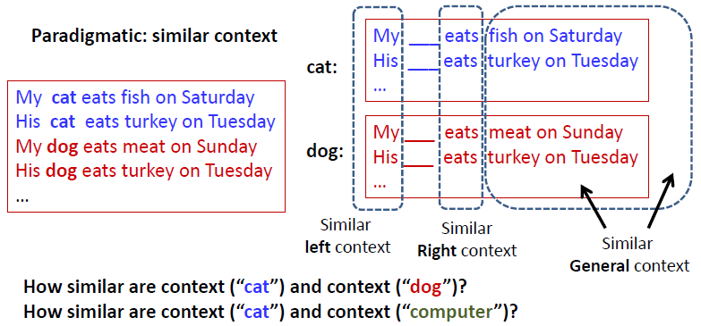
Mining word associations: Intuitions

Slide 7
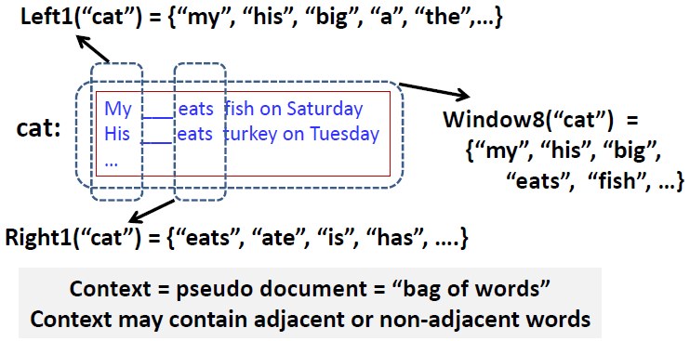
Word Context as Pseudo document

Slide 8
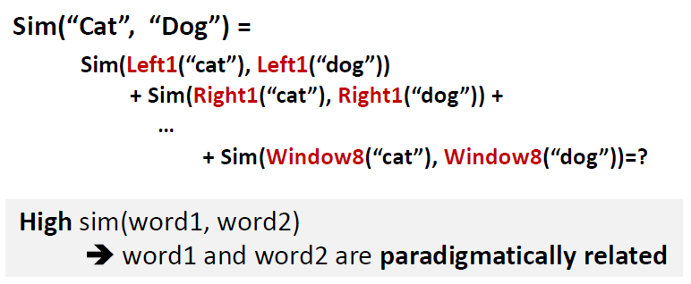
Measuring Context Similarity

Slide 9


1. Jaccard Index
Also called Jaccard Similarity Coefficient
Jaccard Distance

Slide 10
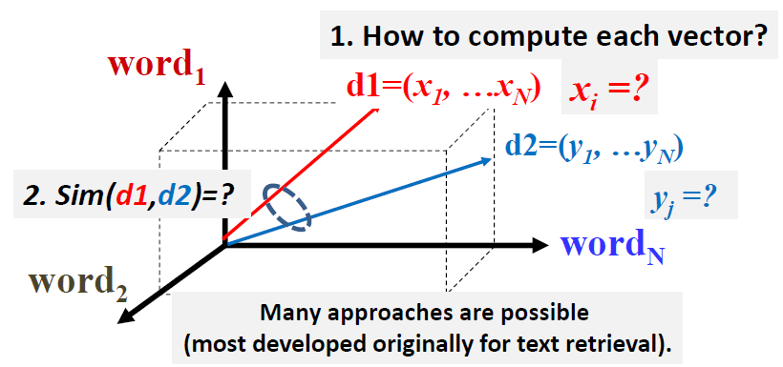
2. VSM with Normalized Frequency

Slide 11
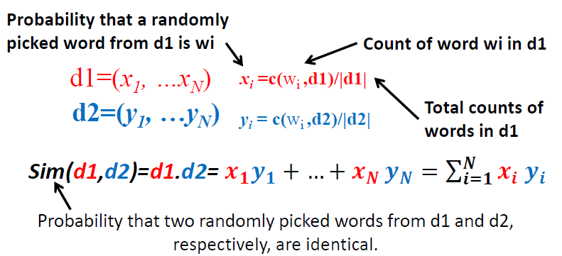
Expected Overlap of Words in Context (EOWC)

Slide 12
Would EOWC Work Well?
Intuitively, it makes sense: The more overlap the two context documents have, the higher the similarity would be.
However:
–It favors matching one frequent term very well over matching more distinct terms.
–It treats every word equally (overlap on “the” isn’t as so meaningful as overlap on “eats”).

Slide 13
Mining Word Associations: General Ideas
joint discovery of the two relations
Paradigmatically related words tend to have syntagmatic relation with the same word?
These ideas can be implemented in many different ways!

Slide 14
Improving EOWC with Retrieval Heuristics
It favors matching one frequent term very well over matching more distinct terms.
[Next Topic]
Sublinear transformation of Term Frequency (TF)
It treats every word equally (overlap on “the” isn’t as so meaningful as overlap on “eats”).
Reward matching a rare word: IDF term weighting

Slide 15
Word Association Applications
They are useful for improving accuracy of many NLP tasks
–POS tagging, parsing, entity recognition, acronym expansion
–Grammar learning
They are directly useful for many applications in text retrieval and mining
–Text retrieval (e.g., use word associations to suggest a variation of a query)
–Automatic construction of topic map for browsing: words as nodes and associations as edges
–Compare and summarize opinions (e.g., what words are most strongly associated with “battery” in positive and negative reviews about iPhone 6, respectively?)

