Slide 1
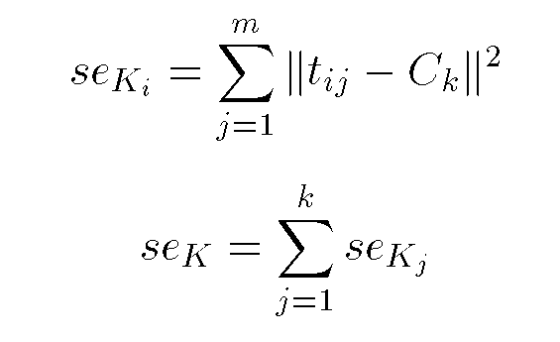
Squared Error
Internal evaluation scheme
10
9
8
7
6
5
4
3
2
1
1
2
3
4
5
6
7
8
9
10
Objective Function

