Slide 1
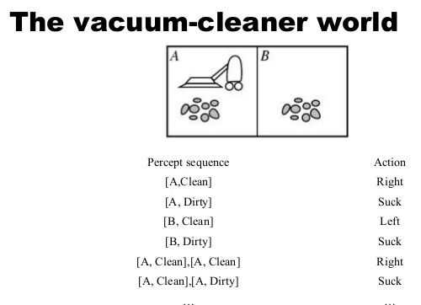
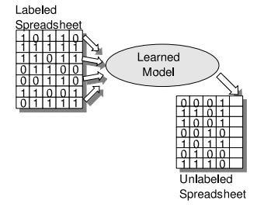
Artificial Intelligence
Deductive Learning
Machine Learning
Inductive Learning
Data Mining
Text Mining

Slide 2
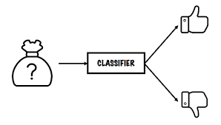
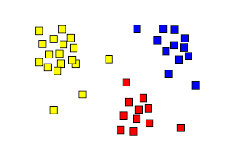
Machine Learning
Classification (Supervised Learning)
Clustering (Unsupervised Learning)

Slide 3
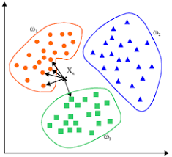
1. K-Nearest Neighbors Classifier
K-NN classifier finds k nearest neighbors from training data and vote among them
Manhattan ( distance
Euclidean shortest distance (displacement )

Slide 4
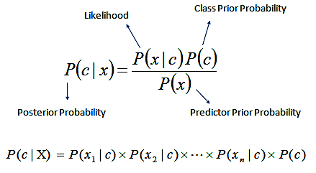
2. Naïve Bayes Classifier
$P\left(C_{i} | d\right)=\frac{P\left(d | C_{i}\right)P\left(C_{i}\right)}{P\left(d\right)}$
$P\left(C_{i} | d\right)=\frac{\prod_{j}{P\left(d_{j} | C_{i}\right)}P\left(C_{i}\right)}{P\left(d\right)}$
$P\left(C_{i} | d\right)=\frac{\sum_{j}{logP\left(d_{j} | C_{i}\right)}P\left(C_{i}\right)}{P\left(d\right)}$

Slide 5
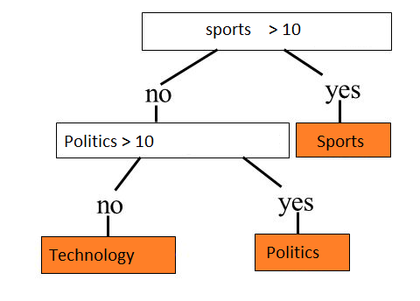
3. Decision Tree Classifier
$E\left(S\right)=\sum_{i=1}^{c}{−p_{i}}\log_{2}p_{i}$
$Gain\left(S\right)=E\left(S\right)−E\left(n_{1}\right)E\left(n_{2}\right)$

Slide 6
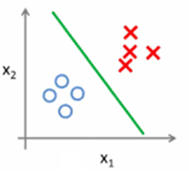
4. Linear Classifier
Draw a straight line among the two types (label) of documents
The test document is labeled based on which side of the line it lies.
w₀+w₁x₁ + w₂x₂ = b

Slide 7
Concluding Remarks
Nearest Neighbors Approaches
Probabilistic Approaches
Logic based Approaches
Weights based Approaches
Instance based vs Model based Classifiers
Parametric vs Non-parametric Classifiers

