Slide 1
Processes

Slide 2
Process
A computer program in execution on a machine is a process
More formally:
  A Sequential stream of Execution in its own address space
Feb, 2016
Operating Systems

Slide 3
Process Address Space
A list of memory locations from some min (usually 0) to some max that a process can read and write.
Contains
  the executable program
  program’s data
  Stack
  Associated with a process is a set of registers e.g. PC,SP and other information to run the program.
Feb, 2016
Operating Systems

Slide 4
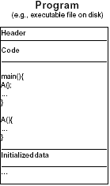
Process =? Program
Program: series of commands (e.g. C statements, assembly commands, shell commands)
Feb, 2016
Operating Systems

Slide 5
Process =? Program
Anatomy of a process
  1) More to a process than just a program
    program is part of process state
    I run dir, you run dir – same program, different processes
  2) Less to a process than a program
    A program can invoke more than one process to get the job done
    e.g. cc starts up cpp, cc1, cc2
Feb, 2016
Operating Systems

Slide 6
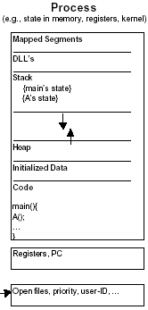
Process =? Program
Feb, 2016
Operating Systems

Slide 7
The Operating System controls the machine
gcc
gdb
User
OS Kernel
grep
diff
Application
Hard
ware
vi
date
Operating System
xterm
emacs
Hardware
netscape
Feb, 2016
Operating Systems

Slide 8
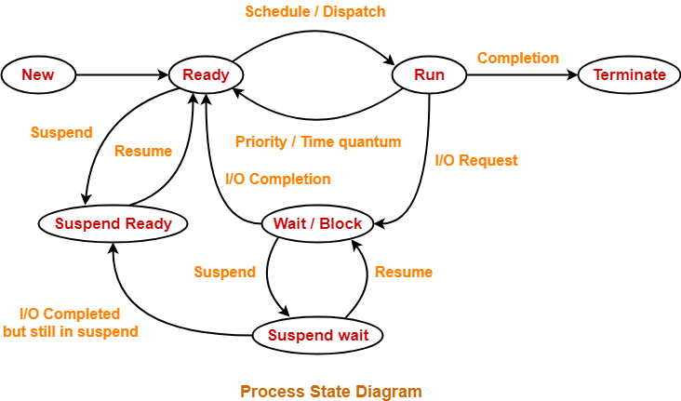

Slide 9
CPU State
CPU registers contain the current state
  1. Processor Status Word (PSW): includes bits
    Privileged or normal
    Outcome of the last arithmetic operation (zero,-ve, +ve, overflow, carry)
    Which interrupts are allowed and which are not
2. Instruction Register (IR):
    The current instruction being executed
3. Program Counter (PC):
    Address of the next instruction to be executed
4. Stack Pointer (SP):
    the address of the current stack frame, including function’s local variables and return information.
5. General purpose registers:
    used to store addresses and data values as directed by the compiler.
Feb, 2016
Operating Systems

Slide 10
Memory Contents
Only a small part of an application’s data can be stored in registers. The rest is in memory.
Typically divided into a few segments:
  Text/application code
    read-only
    might be shared by a number of processes?
  Data
    The application's predefined data structures
  Heap
    An area from which space can be allocated dynamically at runtime, using functions like new or malloc.
  Stack
    Where register values are saved
    local variables allocated
    Return Address of subroutine calls
    All the addressable memory together is called?
The process's address space.
Feb, 2016
Operating Systems

Slide 11
Environment
Contains the relationships with other entities
A process does not exist in a vacuum
It typically has connections with other entities, such as
  A terminal where the user is sitting.
  Open files
  Communication channels to other processes, possibly on other machines.
Feb, 2016
Operating Systems

Slide 12
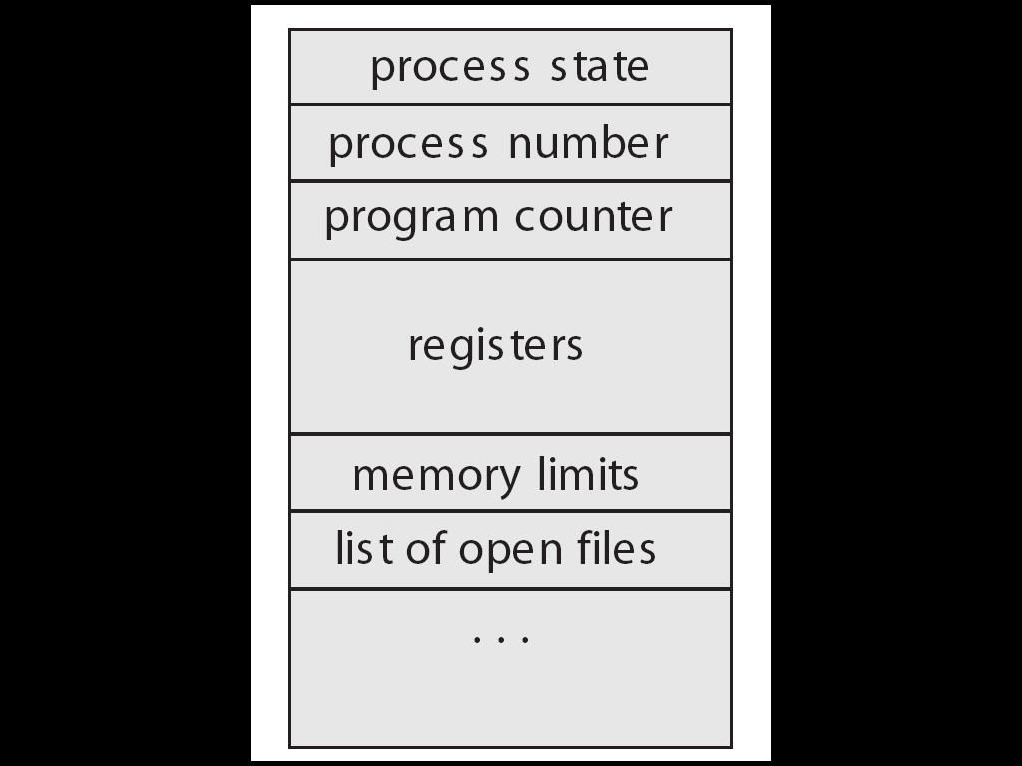
Process Control Block
The OS keeps all the data it needs about a process in the process control block (PCB)
Thus another definition of a process:
  “the entity described by a PCB”
This includes many of the data items described above, or at least pointers to where they can be found
  e.g. for the address space
Feb, 2016
Operating Systems

Slide 13
Process Identification
Process ID, a unique numeric identifier
User ID
  Who runs the process. Why?
  Used to determine what access rights the process has
Feb, 2016
Operating Systems

Slide 14
Process Control Block
OS Data Structures
Process Address Space
RAM
CPU
Kernel
User
PSW
State
Memory
Files
Accounting
Priority
User
CPU register storage
text
IR
.
PC
data
SP
heap
General Purpose Registers
stack
Feb, 2016
Operating Systems

Slide 15
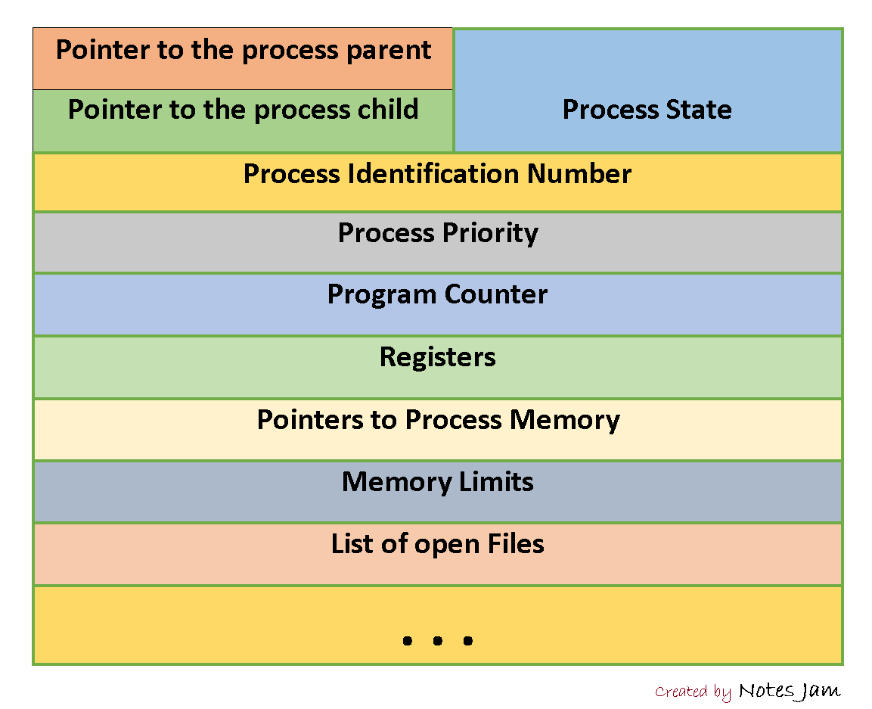

Slide 16

CPU Switch From Process to Process
Feb, 2016
Operating Systems

Slide 17
CPU Switch From Process to Process
Switching a process requires
  Saving the state of old process
  Loading the saved state of the new process
This is called Context Switch
Part of OS responsible for switching the processor among the processes is called Dispatcher
(when one process is going on and other process comes and want to be run then saving the old process and loading the new state of process is called Context Switch. All the process will done the dispatcher)
Feb, 2016
Operating Systems

Slide 18
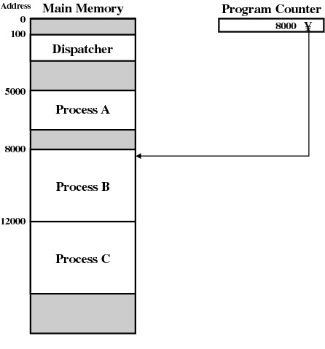
Process Example
Feb, 2016
Operating Systems

Slide 19
Process States
At any given time a process is either running or not running
Number of states
  Running
  Not Running
When the OS creates a process, the process is entered into which state?
  Not Running
Feb, 2016
Operating Systems

Slide 20
Two-state process model
Dispatch
Enter
Exit
Not
running
Running
Pause
Number of processes Running at a particular time?
Number of processes Not Running at a particular time?
Data Structure?
Processes that are Not Running at a particular time should be kept in some sort of a queue
https://www.youtube.com/watch?v=p_b7VR2MXBM&ab_channel=WorldEntertainmentbyFProduction
Feb, 2016
Operating Systems

Slide 21
Two-state process model
Processor
Queue
Enter
Dispatch
Exit
Pause
Dispatcher is now redefined:
    Moves processes to the waiting queue
    Remove completed/aborted processes
    Select the next process to run
Feb, 2016
Operating Systems

Slide 22
How process state changes1
Ready
Ready
Ready
➔ a := 1
b := a + 1
c := b + 1
read a file
a := b - c
c := c * b
b := 0
➔ a := 1
read a file
b := a + 1
c := b + 1
a := b - c
c := c * b
b := 0
➔ a := 1
b := a + 1
c := b + 1
a := b - c
c := c * b
b := 0
c := 0
Feb, 2016
Operating Systems

Slide 23
How process state changes2
Running
Ready
Ready
➔ a := 1
b := a + 1
c := b + 1
read a file
a := b - c
c := c * b
b := 0
➔ a := 1
read a file
b := a + 1
c := b + 1
a := b - c
c := c * b
b := 0
➔ a := 1
b := a + 1
c := b + 1
a := b - c
c := c * b
b := 0
c := 0
a := 1
➔ b := a + 1
c := b + 1
read a file
a := b - c
c := c * b
b := 0
a := 1
b := a + 1
➔ c := b + 1
read a file
a := b - c
c := c * b
b := 0
Timeout
Feb, 2016
Operating Systems

Slide 24
How process state changes3
Ready
Running
Ready
a := 1
b := a + 1
c := b + 1
➔ read a file
a := b - c
c := c * b
b := 0
➔ a := 1
read a file
b := a + 1
c := b + 1
a := b - c
c := c * b
b := 0
➔ a := 1
b := a + 1
c := b + 1
a := b - c
c := c * b
b := 0
c := 0
a := 1
➔ read a file
b := a + 1
c := b + 1
a := b - c
c := c * b
b := 0
I/O
Feb, 2016
Operating Systems

Slide 25
How process state changes4
Ready
Blocked
Running
a := 1
b := a + 1
c := b + 1
➔ read a file
a := b - c
c := c * b
b := 0
a := 1
➔ read a file
b := a + 1
c := b + 1
a := b - c
c := c * b
b := 0
➔ a := 1
b := a + 1
c := b + 1
a := b - c
c := c * b
b := 0
c := 0
a := 1
➔ b := a + 1
c := b + 1
a := b - c
c := c * b
b := 0
c := 0
a := 1
b := a + 1
➔ c := b + 1
a := b - c
c := c * b
b := 0
c := 0
Timeout
Feb, 2016
Operating Systems

Slide 26
How process state changes5
Running
Blocked
Ready
a := 1
b := a + 1
c := b + 1
➔ read a file
a := b - c
c := c * b
b := 0
a := 1
➔ read a file
b := a + 1
c := b + 1
a := b - c
c := c * b
b := 0
a := 1
b := a + 1
c := b + 1
➔ a := b - c
c := c * b
b := 0
c := 0
I/O
Feb, 2016
Operating Systems

Slide 27
How process state changes6
Blocked
Blocked
Running
The Next Process to Run cannot be simply selected from the front
a := 1
b := a + 1
c := b + 1
➔ read a file
a := b - c
c := c * b
b := 0
a := 1
➔ read a file
b := a + 1
c := b + 1
a := b - c
c := c * b
b := 0
a := 1
b := a + 1
c := b + 1
➔ a := b - c
c := c * b
b := 0
c := 0
Feb, 2016
Operating Systems

Slide 28
How process state changes7
Blocked
Blocked
Running
a := 1
b := a + 1
c := b + 1
➔ read a file
a := b - c
c := c * b
b := 0
a := 1
➔ read a file
b := a + 1
c := b + 1
a := b - c
c := c * b
b := 0
a := 1
b := a + 1
c := b + 1
➔ a := b - c
c := c * b
b := 0
c := 0
a := 1
b := a + 1
c := b + 1
a := b - c
➔ c := c * b
b := 0
c := 0
Suppose the Green process finishes I/O
Feb, 2016
Operating Systems

Slide 29
How process state changes8
Blocked
Ready
Running
a := 1
b := a + 1
c := b + 1
➔ read a file
a := b - c
c := c * b
b := 0
a := 1
read a file
➔ b := a + 1
c := b + 1
a := b - c
c := c * b
b := 0
a := 1
b := a + 1
c := b + 1
➔ a := b - c
c := c * b
b := 0
c := 0
a := 1
b := a + 1
c := b + 1
a := b - c
➔ c := c * b
b := 0
c := 0
a := 1
b := a + 1
c := b + 1
a := b - c
c := c * b
➔ b := 0
c := 0
Timeout
Feb, 2016
Operating Systems

Slide 30
How process state changes9
Blocked
Running
Ready
a := 1
b := a + 1
c := b + 1
➔ read a file
a := b - c
c := c * b
b := 0
a := 1
read a file
➔ b := a + 1
c := b + 1
a := b - c
c := c * b
b := 0
a := 1
b := a + 1
c := b + 1
a := b - c
c := c * b
b := 0
➔ c := 0
a := 1
read a file
b := a + 1
➔ c := b + 1
a := b - c
c := c * b
b := 0
a := 1
read a file
b := a + 1
c := b + 1
➔ a := b - c
c := c * b
b := 0
Timeout
Feb, 2016
Operating Systems

Slide 31
Problem in Two-state Process model
A process may be waiting for I/O request
A single queue for both the ready to run and waiting processes
The dispatcher cannot simply select the process at the front, it can be a busy process
In the worst case, it has to scan the whole queue to find the next process to run
Solution?
Split the Not Running state to:
  Waiting
  Ready
Feb, 2016
Operating Systems

Slide 32
Five-state Process Model
Running: currently being run
Ready: ready to run
Blocked: waiting for an event (I/O)
New: just created, not yet admitted to set of run-able processes
Exit: completed/error exit
Link for video https://www.youtube.com/watch?v=NZ1ZkZF-T1Q&ab_channel=JasonJohnson
Feb, 2016
Operating Systems

Slide 33

Five-state Process Model
Dispatch
Release
New
Admit
Ready
Running
Exit
Time-out
Event occurs
Event wait
Blocked
Feb, 2016
Operating Systems

Slide 34

Blocked Queues
Timeout
Ready queue
Processor
Admit
Dispatch
Release
Event occurs
Blocked queue/ Event queue
Event wait
Running process
Ready process
Blocked process
Further Enhancement:
A separate queue holds the
processes waiting for different event.
Feb, 2016
Operating Systems

Slide 35
Scheduling Queues
The queues are generally stored as linked lists
A queue header points to the first and the final PCB’s in the list
We extend each PCB to include a pointer field that points to the next PCB in the ready queue
Feb, 2016
Operating Systems

Slide 36


Scheduling Queues
Feb, 2016
Operating Systems

Slide 37
Schedulers
Short term Scheduler or CPU Scheduling
  Which program is to be run next
Long term Scheduler or Job Scheduler
  Which ready jobs should be brought to memory
  May need to invoke only when a process leaves the system
  Must make a careful selection
Feb, 2016
Operating Systems

Slide 38
Process Types
Most processes can be described as either I/O bound or CPU bound
I/O bound:
  Spends more of its time doing I/O than doing computations
CPU bound:
  Spends more of its time doing computations than doing I/O
If all processes are I/O bound,
  The ready queue will almost always be empty
If all processes are CPU bound,
  The I/O waiting queue will almost always be empty, devices will go unused
  System will again be unbalanced
Feb, 2016
Operating Systems

Slide 39
Process Types
Sometimes OS may swap a blocked process to disk to free up more memory
Or to improve process mix
This is called Swapping
Feb, 2016
Operating Systems

