Slide 1
William Stallings
Computer Organization and Architecture
8th Edition
Chapter 14
Instruction Level Parallelism
and Superscalar Processors

Slide 2
What is Superscalar?
Common instructions (arithmetic, load/store, conditional branch) can be initiated and executed independently
Equally applicable to RISC & CISC
In practice usually RISC
In super Scalcer system we introduced the pipeline stuctural

Slide 3
Why Superscalar?
Most operations are on scalar quantities (see RISC notes)
Improve these operations to get an overall improvement

Slide 4
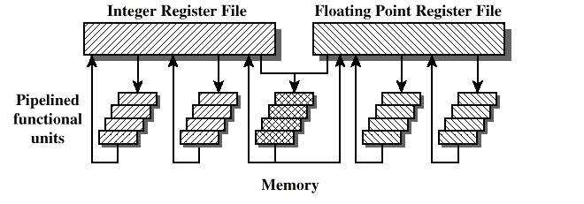
General Superscalar Organization

Slide 5
Superpipelined
Many pipeline stages need less than half a clock cycle
Double internal clock speed gets two tasks per external clock cycle
Superscalar allows parallel fetch execute
(pipeline stages less then half cycle may execute ho jati hai jis ki waja say performance bhetr ho jati hai)
In superScaler you can fetch the data parallel but its easy.for example her feth actually instruction hoti hai or her instruction ka apna PSW hota hai or us may prograam counter pc hota hai if we have one program counter how will we execute in parallel.

Slide 6
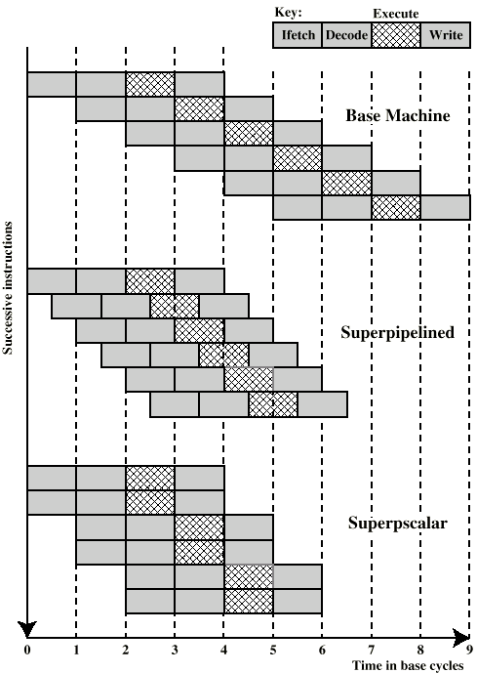
Superscalar v
Superpipeline

Slide 7
Limitations
Instruction level parallelism
Compiler based optimisation
Hardware techniques
Limited by
  True data dependency(R1 and R2 dependent on each other
  Procedural dependency(can execute instruction before the branch or after the branch)
Resource conflicts(Two or more instructions requiring access to the same resource at the same time
  Output dependency
  Antidependency
  superscalyer may parallelism limited hai at the difference stage in instruction level parallelism and compiler base and hardawre by limited by those factor shown above

Slide 8
True Data Dependency
ADD r1, r2 (r1 := r1+r2;)
MOVE r3,r1 (r3 := r1;)
Can fetch and decode second instruction in parallel with first
Can NOT execute second instruction until first is finished
Because both instruction is dependent on each other

Slide 9
Procedural Dependency
Can not execute instructions after a branch in parallel with instructions before a branch
Also, if instruction length is not fixed, instructions have to be decoded to find out how many fetches are needed
This prevents simultaneous fetches

Slide 10
Resource Conflict
Two or more instructions requiring access to the same resource at the same time
  e.g. two arithmetic instructions
Can duplicate resources
  e.g. have two arithmetic units

Slide 11
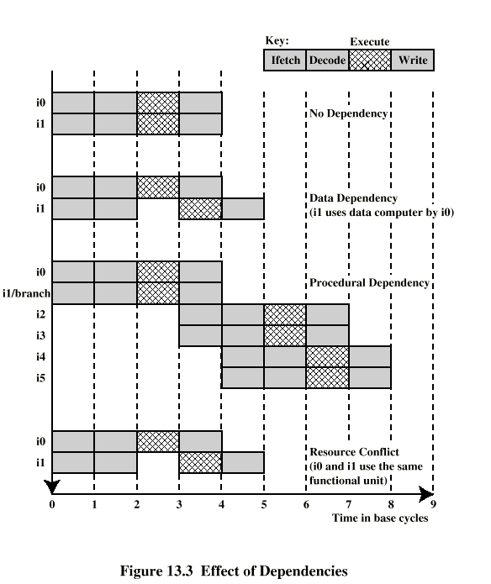
Effect of
Dependencies

Slide 12
Design Issues(TWO TYPE OF parallelism software base per and hardware base per)
Instruction level parallelism
  Instructions in a sequence are independent
  Execution can be overlapped
  Governed by data and procedural dependency
Machine Parallelism
  Ability to take advantage of instruction level parallelism
  Governed by number of parallel pipelines

Slide 13
Instruction Issue Policy at software base.
Order in which instructions are fetched
Order in which instructions are executed
Order in which instructions change registers and memory

Slide 14
In-Order Issue
In-Order Completion
Issue instructions in the order they occur
Not very efficient
May fetch >1 instruction
Instructions must stall if necessary
obviously there is no problem if the execute in order

Slide 15
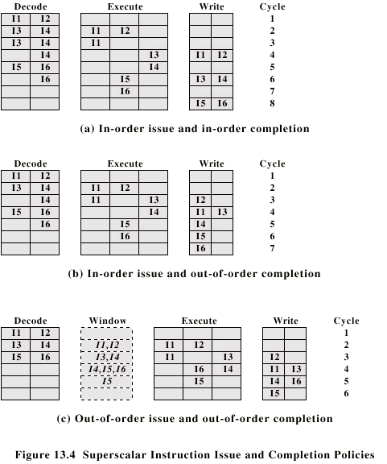
In-Order Issue In-Order Completion (Diagram)

Slide 16
In-Order Issue
Out-of-Order Completion
Output dependency
  R3:= R3 + R5; (I1)
  R4:= R3 + 1; (I2)
  R3:= R5 + 1; (I3)
  I2 depends on result of I1 - data dependency
  If I3 completes before I1, the result from I1 will be wrong - output (read-write) dependency

Slide 17
In-Order Issue Out-of-Order Completion (Diagram)

Slide 18
Out-of-Order Issue
Out-of-Order Completion
Decouple decode pipeline from execution pipeline
Can continue to fetch and decode until this pipeline is full
When a functional unit becomes available an instruction can be executed
Since instructions have been decoded, processor can look ahead

Slide 19
Out-of-Order Issue Out-of-Order Completion (Diagram)

Slide 20
Antidependency
Write-write dependency
  R3:=R3 + R5; (I1)
  R4:=R3 + 1; (I2)
  R3:=R5 + 1; (I3)
  R7:=R3 + R4; (I4)
  I3 can not complete before I2 starts as I2 needs a value in R3 and I3 changes R3

Slide 21
Reorder Buffer
Temporary storage for results
Commit to register file in program order
Thori dair k liye in ki values buffer may safe kar lyty hai then send kar dy ghy!
Likan is bhi bhetr ik solution hai hum register to rename kar dyty

Slide 22
Register Renaming
Output and antidependencies occur because register contents may not reflect the correct ordering from the program
May result in a pipeline stall
Registers allocated dynamically
  i.e. registers are not specifically named
  we rename the name 3a,3b,3c and can contain different values.

Slide 23
Register Renaming example
R3b:=R3a + R5a (I1)
R4b:=R3b + 1 (I2)
R3c:=R5a + 1 (I3)
R7b:=R3c + R4b (I4)
Without subscript refers to logical register in instruction
With subscript is hardware register allocated
Note R3a R3b R3c
Alternative: Scoreboarding
  Bookkeeping technique
  Allow instruction execution whenever not dependent on previous instructions and no structural hazards

Slide 24
Machine Parallelism
Duplication of Resources
Out of order issue
Renaming
Not worth duplication functions without register renaming
Need instruction window large enough (more than 8)

Slide 25
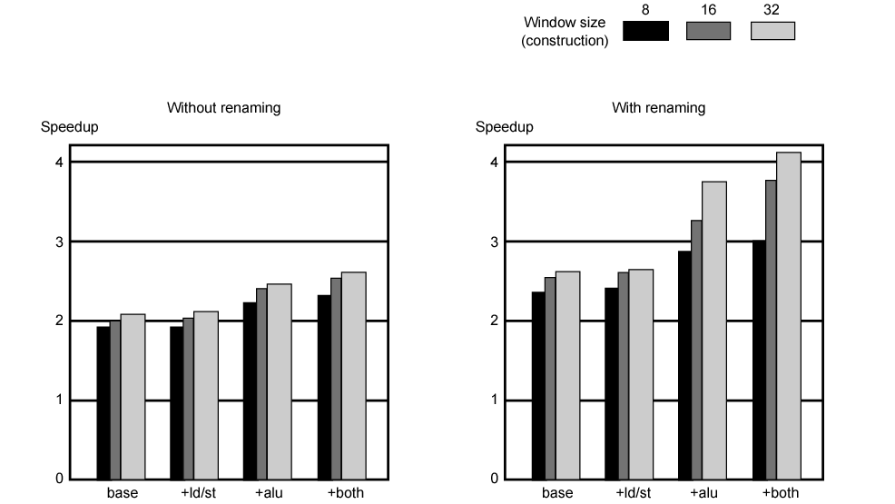
Speedups of Machine Organizations Without Procedural Dependencies

Slide 26
Branch Prediction
80486 fetches both next sequential instruction after branch and branch target instruction
Gives two cycle delay if branch taken

Slide 27
RISC - Delayed Branch
Calculate result of branch before unusable instructions pre-fetched
Always execute single instruction immediately following branch
Keeps pipeline full while fetching new instruction stream
Not as good for superscalar
  Multiple instructions need to execute in delay slot
  Instruction dependence problems
Revert to branch prediction

Slide 28
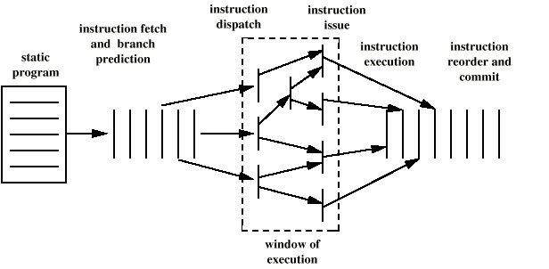
Superscalar Execution

Slide 29
Superscalar Implementation
Simultaneously fetch multiple instructions
Logic to determine true dependencies involving register values
Mechanisms to communicate these values
Mechanisms to initiate multiple instructions in parallel
Resources for parallel execution of multiple instructions
Mechanisms for committing process state in correct order

Slide 30
Pentium 4
80486 - CISC
Pentium – some superscalar components
  Two separate integer execution units
Pentium Pro – Full blown superscalar
Subsequent models refine & enhance superscalar design

Slide 31
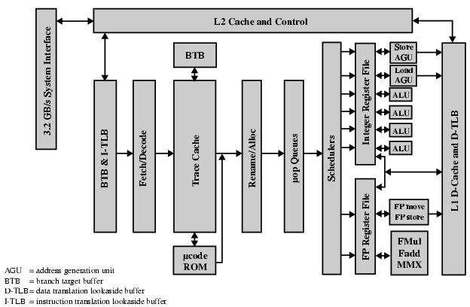
Pentium 4 Block Diagram

Slide 32
Pentium 4 Operation
Fetch instructions form memory in order of static program
Translate instruction into one or more fixed length RISC instructions (micro-operations)
Execute micro-ops on superscalar pipeline
  micro-ops may be executed out of order
Commit results of micro-ops to register set in original program flow order
Outer CISC shell with inner RISC core
Inner RISC core pipeline at least 20 stages
  Some micro-ops require multiple execution stages
    Longer pipeline
  c.f. five stage pipeline on x86 up to Pentium

Slide 33
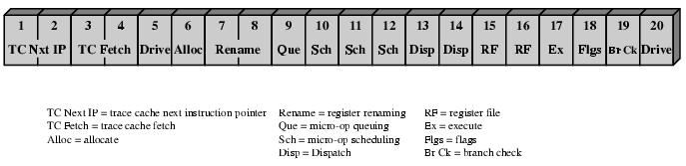
Pentium 4 Pipeline

Slide 34
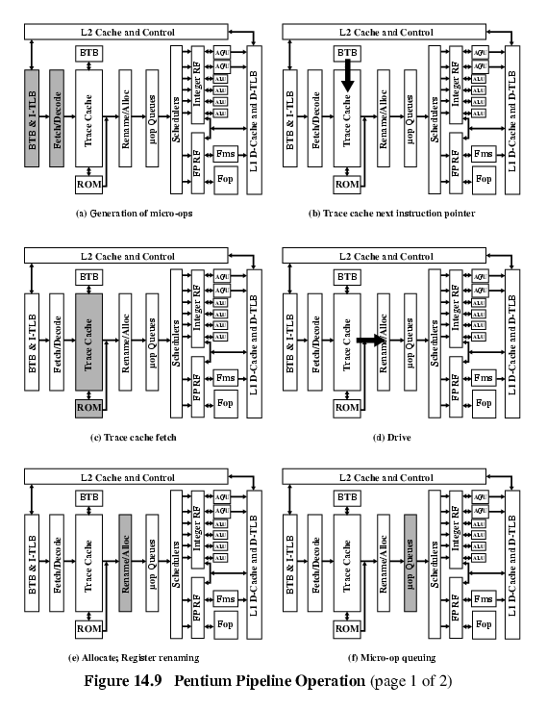
Pentium 4 Pipeline Operation (1)

Slide 35
Pentium 4 Pipeline Operation (2)

Slide 36
Pentium 4 Pipeline Operation (3)

Slide 37
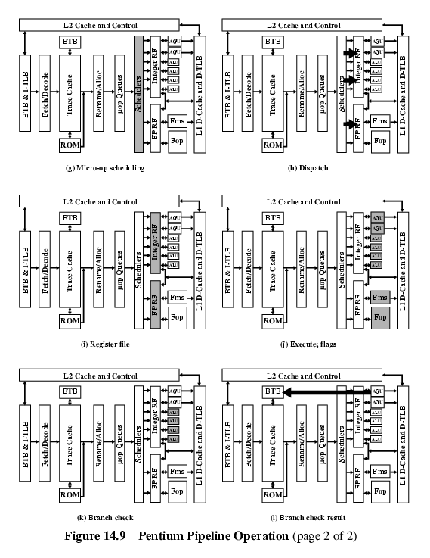
Pentium 4 Pipeline Operation (4)

Slide 38
Pentium 4 Pipeline Operation (5)

Slide 39
Pentium 4 Pipeline Operation (6)

Slide 40
ARM CORTEX-A8
ARM refers to Cortex-A8 as application processors
Embedded processor running complex operating system
  Wireless, consumer and imaging applications
  Mobile phones, set-top boxes, gaming consoles automotive navigation/entertainment systems
Three functional units
Dual, in-order-issue, 13-stage pipeline
  Keep power required to a minimum
  Out-of-order issue needs extra logic consuming extra power
Figure 14.11 shows the details of the main Cortex-A8 pipeline
Separate SIMD (single-instruction-multiple-data) unit
  10-stage pipeline

Slide 41
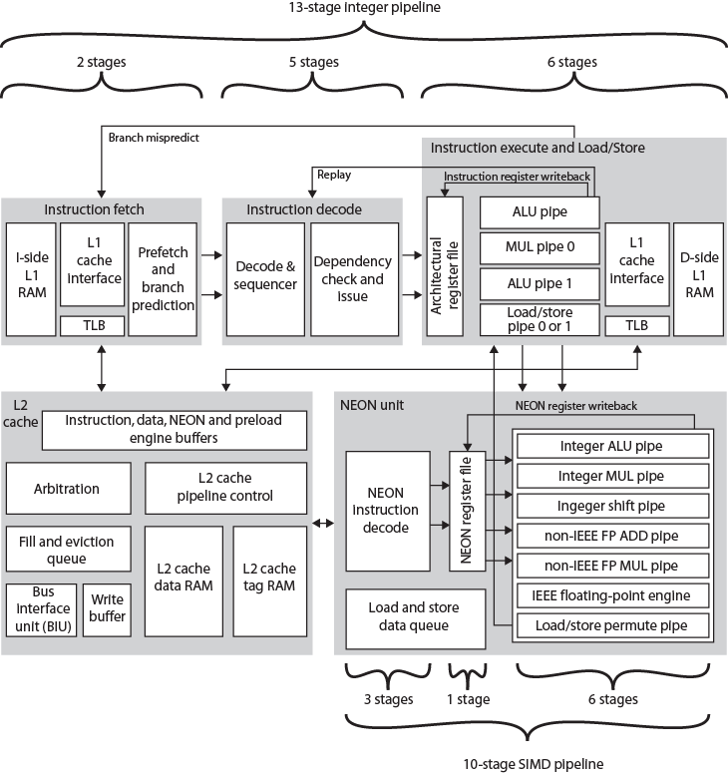
ARM
Cortex-A8
Block
Diagram

Slide 42
Instruction Fetch Unit
Predicts instruction stream
Fetches instructions from the L1 instruction cache
  Up to four instructions per cycle
Into buffer for decode pipeline
Fetch unit includes L1 instruction cache
Speculative instruction fetches
Branch or exceptional instruction cause pipeline flush
Stages:
F0 address generation unit generates virtual address
  Normally next sequentially
  Can also be branch target address
F1 Used to fetch instructions from L1 instruction cache
  In parallel fetch address used to access branch prediction arrays
F3 Instruction data are placed in instruction queue
  If branch prediction, new target address sent to address generation unit
Two-level global history branch predictor
  Branch Target Buffer (BTB) and Global History Buffer (GHB)
Return stack to predict subroutine return addresses
Can fetch and queue up to 12 instructions
Issues instructions two at a time

Slide 43
Instruction Decode Unit
Decodes and sequences all instructions
Dual pipeline structure, pipe0 and pipe1
  Two instructions can progress at a time
  Pipe0 contains older instruction in program order
  If instruction in pipe0 cannot issue, pipe1 will not issue
Instructions progress in order
Results written back to register file at end of execution pipeline
  Prevents WAR hazards
  Keeps tracking of WAW hazards and recovery from flush conditions straightforward
  Main concern of decode pipeline is prevention of RAW hazards

Slide 44
Instruction Processing Stages
D0 Thumb instructions decompressed and preliminary decode is performed
D1 Instruction decode is completed
D2 Write instruction to and read instructions from pending/replay queue
D3 Contains the instruction scheduling logic
  Scoreboard predicts register availability using static scheduling
  Hazard checking
D4 Final decode for control signals for integer execute load/store units

Slide 45
Integer Execution Unit
Two symmetric (ALU) pipelines, an address generator for load and store instructions, and multiply pipeline
Pipeline stages:
E0 Access register file
  Up to six registers for two instructions
E1 Barrel shifter if needed.
E2 ALU function
E3 If needed, completes saturation arithmetic
E4 Change in control flow prioritized and processed
E5 Results written back to register file
Multiply unit instructions routed to pipe0
  Performed in stages E1 through E3
  Multiply accumulate operation in E4

Slide 46
Load/store pipeline
Parallel to integer pipeline
E1 Memory address generated from base and index register
E2 address applied to cache arrays
E3 load, data returned and formatted
E3 store, data are formatted and ready to be written to cache
E4 Updates L2 cache, if required
E5 Results are written to register file

Slide 47
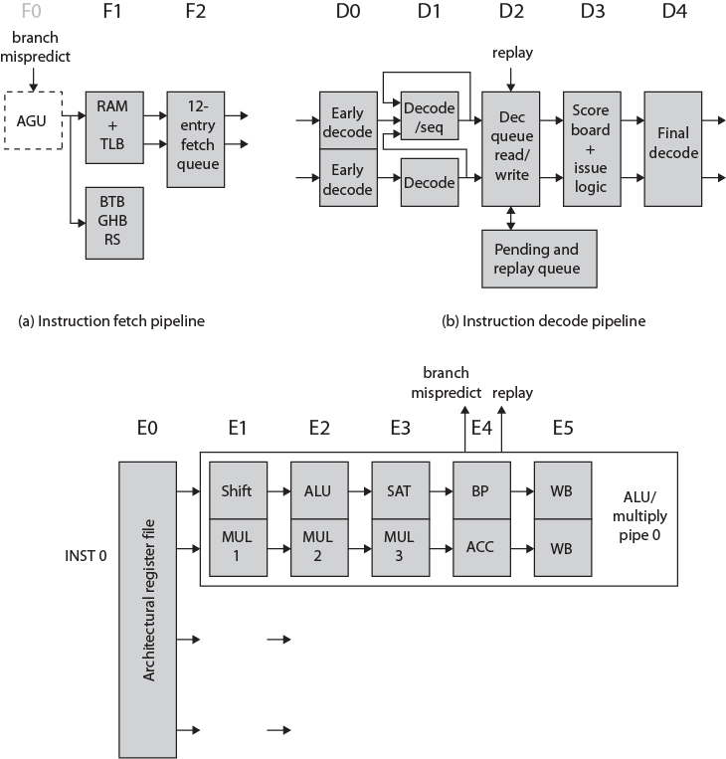
ARM
Cortex-A8
Integer
Pipeline

Slide 48
SIMD and Floating-Point Pipeline
SIMD and floating-point instructions pass through integer pipeline
Processed in separate 10-stage pipeline
  NEON unit
  Handles packed SIMD instructions
  Provides two types of floating-point support
If implemented, vector floating-point (VFP) coprocessor performs IEEE 754 floating-point operations
  If not, separate multiply and add pipelines implement floating-point operations

Slide 49
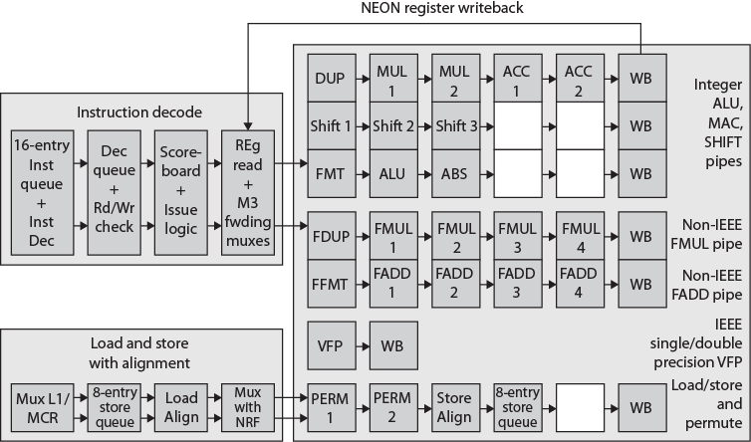
ARM Cortex-A8 NEON &
Floating Point Pipeline

Slide 50
Required Reading
Stallings chapter 14
Manufacturers web sites
IMPACT web site
  research on predicated execution

