Slide 1
Software Design and Analysis
Lecture 1

Slide 2
Prerequisite
Course:
CS309- Object Oriented Analysis and Design
CS324- Software Analysis and Design
Pre- Requisite
CS-218 Data Structures

Slide 3
Recommended Books
Craig Larman: Applying UML and patterns
Brett D. Mclaughlin, Gray Pollice & David West: Head First Object-Oriented Analysis and design

Slide 4
Evaluation Criteria
Assessment | Weightage
Sessional 1 | 15%
Sessional 2 | 15%
Quiz | 10%
Assignment | 10%
Project | 10%
Final Exam | 40%

Slide 5
Objective of OOAD
This Object-Oriented Analysis & Design course teaches students how to use object-oriented techniques to build software
The course will start with requirements gathering, use cases, UML activity diagram, sequence diagram etc. & end with implementation
In the process, you'll learn how to analyze and design classes, their relationships to each other in order to build a model of the problem domain.

Slide 6
What is Software?
More than computer programs.
The collection of programs, documentation and configuration data that ensures correct execution.
Three major types:
Generic Product: Stand alone, Sold on open market.
Customized Product: For specific customer.
Embedded Product: Built into hardware.

Slide 7
Software Development Problems
Software is not constrained by materials, or governed by physical laws, or by manufacturing process” ---- (Sommerville, Software Engineering)
Allows almost unbounded complexity:
Exponential growth of complexity w.r.t. to the size of a program: twice the size, four times the complexity;
Example: Windows XP has 40millions lines of source code (estimation).

Slide 8
Software Development Problems
Difficulty in understanding and managing the complexity causes:
Late completion:
“vaporware” that are announced but never produced
Overrunning Cost:
Denver Airport Automated Baggage System, 2 billions US dollar over budget
Unreliable
Maintenance
Etc…

Slide 9
Introduction to OOAD
The proverb “owning a hammer doesn’t make one an architect” is especially true with respect to object technology
Knowing an object language is necessary but insufficient to create object systems
Its about analyzing system requirements in terms of objects and allocating responsibilities to class objects
How would these objects collaborate with each other
classes should do what

Slide 10
Object Oriented Analysis (OOA)
It emphasizes on finding requirements and problems rather than solutions
Object oriented analysis is a process of analyzing requirements in an object-oriented paradigm
It approves some of the requirements while discards others
The requirements are represented in the form of Use cases and personas to make more sense
Based on this OOA the OOD is built

Slide 11
Use Case
Use case consists of a paragraph or so text that presents a scenario of a single system requirement
It is written in simple English that would help realize the importance of the requirement and its contribution to the over all system
There can be many use cases for a system representing its various requirements
It is not an OO activity, but it helps in the development of OOD

Slide 12
Use Case
Example
Use Case “Login to System”
The User accessing the system is asked for a username and password. On provision of the correct user name and password the user is allowed to enter the system.

Slide 13
Persona
Persona is an imaginary story in which the importance of the required system is highlighted.
It is in the form of a short story
It assumes a person with certain personal details whom the writer know
The writer explains the problems of the person in the persona with the current system and how it is lagging him behind
It also explains what the user actually wants things to be
In this way the requirements of the system are elaborated

Slide 14
Object Oriented Design (OOD)
It emphasizes on the conceptual solution in software or hardware that fulfills the requirements
It does not give any implementation details
Design ideas normally exclude low level details that are obvious to the intended customers
Ultimately designs can be implemented in code to give its true and complete realization

Slide 15
OOA vs OOD
In OOA there is an emphasis on finding and describing objects or concepts in the problem domain
For example in flight information system some of the objects are flights, planes and pilot
During OOD there is emphasis on defining software objects and how they collaborate with each other to fulfill requirements
For example a flight object may have attributes like flight duration, departure time, arrival time, source, destination etc.

Slide 16
UML
UML is a standard diagramming notation
UML is not OOAD or a method it is just a diagramming notation
It is useless to learn UML but not really know how to create an excellent OO design or evaluate and improve an existing one
To know how to design is a separate skill

Slide 17
Ways to Apply UML
Three ways to apply UML
UML as Sketch
UML as blueprint
UML as programming language
UML as sketch- Informal and incomplete diagrams (often hand sketched on whiteboards)created to explore difficult parts of the problem or solution space, exploiting the power of visual languages.

Slide 18
Ways to Apply UML
UML as blueprint - relatively detailed design diagrams used either for
reverse engineering to visualize and better understanding existing code in UML diagrams, or for
code generation(forward engineering).
If reverse engineering, a UML tool reads the source or binaries and generates (typically) UML package, class, and sequence diagrams. These "blueprints" can help the reader understand the big picture elements, structure, and collaborations.

Slide 19
Ways to Apply UML
UML as programming language - Complete executable specification of a software systemin UML. Executable code will be automatically generated but is not normally seen or modified by developers; one works only in the UML "programming language."

Slide 20
UML Perspectives
Conceptual perspective
The diagrams are interpreted as describing things in a situation of the real world or domain of interest
Specification perspective
The diagrams (using same notations) describe software abstraction or components with specifications and interfaces but no commitment to a particular implementation
Implementation perspective
Software implementation in a particular technology

Slide 21
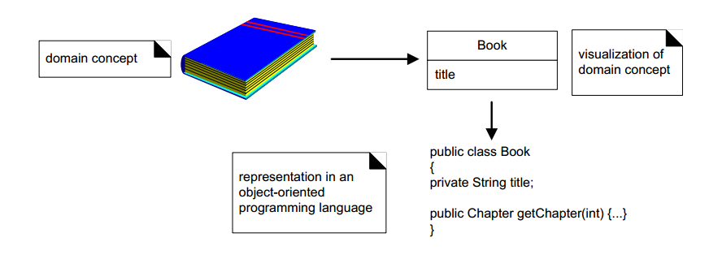

Slide 22
Famous Software Disaster
US $5 hundred million worth of payload were destroyed
Reason:
Main Navigation Computer crashes after 3 seconds.
Caused by a conversion overflow: converting floating point number to integer number.
Reuse of specification of Ariane 4 without taking into consideration the new capability.

Slide 23
Famous Software Disaster
Canada’s Therac-25 radiation therapy machine malfunctioned and delivered lethal radiation doses to patients.
Reason:
Because of a subtle bug called a race condition, a technician could accidentally configure Therac-25 so the electron beam would fire in high-power mode without the proper patient shielding.

Slide 24
EDS Child Support System
In 2004, EDS introduced a highly complex IT system to the U.K.’s Child Support Agency
Reason:
At the exact same time, the Department for Work and Pensions (DWP) decided to restructure the entire agency. The two pieces of software were completely incompatible, and irreversible errors were introduced as a result. The system somehow managed to overpay 1.9 million people, underpay another 700,000, had US$7 billion in uncollected child support payments, a backlog of 239,000 cases, 36,000 new cases “stuck” in the system, and has cost the UK taxpayers over US$1 billion to date.

Slide 25
Limitations of Non-Engineered Software
One of the problems with complex system design is that you cannot foresee the requirements at the beginning of the project.
In many cases, where you think you can start with a set of requirements that specifies the complete properties of your system, you end up with bugs, as well as erroneous and incomplete software.

Slide 26
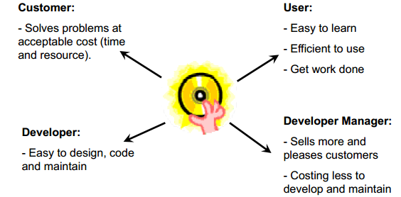
Quality of Good Software

Slide 27
Qualities of Good Software
Usability
Easy to learn and use
Efficiency
Does not waste resources such as CPU time and memory.
Dependability
Reliable, secure and safe.
Maintainability
Easily evolved (modified) to meet changing requirement.
Reusability
Parts can be reused, with minor or no modification.

Slide 28
Software Engineering Myths
A general statement of objectives is sufficient to begin writing programs - we can fill in the details later.
Poor Up-front definition is the major cause of failed software efforts.
If we get behind schedule we can add more , we can add more programmers and catch up.
Brooks Law: “Adding people to a late project makes it later.”

Slide 29
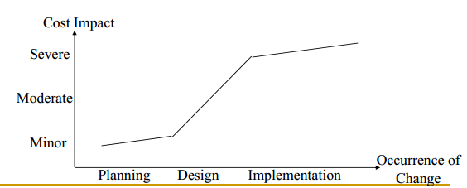
Project requirements continually change, but change can be easily accommodated because software is flexible.

Slide 30
