Slide 1
Software Process Models
Lecture 2

Slide 2
Software Process Models
The set of activities and associated results that produce a software product.
Four fundamental process activities
Software Specification
Software Development
Software Validation
Software Evolution
Organized differently by different Software process models having different levels of detail

Slide 3
1. Software Specifications
Customers and Software Engineers define the software to be produced and the constraints on its operations. Typical Stages are,
Feasibility Study:
Is it possible with the current technologies + within budget?
Domain Analysis:
What is the background for the software?
Requirements Gathering and Analysis:
What is it that the user wants?
Requirements Specification:
Formal documentation on User and System requirements.
Requirements Validation:
Check for realism consistency and completeness , consistency, and completeness.

Slide 4
2. Software Development
Consists of Design and Programming
System Analyst design the software and decide how the requirement can be implemented.
Programmers write code to translate the high level design into a real code in a chosen programming language

Slide 5
3. Software Validation
Software Engineer (or dedicated tester) and Customer:
Check the software to ensure it meets the customers’ requirements.
Typical Stages:
Component Testing: Independent testing of individual components in subsystem.
System Testing: Testing of integrated components.
Acceptance Testing: Tested with customer supplied data. Final test before operation.
Interactive activity that feedback to previous stages: E.g., an error in component testing triggers re-coding.

Slide 6
4. Software Evolution
Customers and Software Engineers:
Define changing requirements.
Modify the software system to adapt.
Typical Work: Update the system for minor new requirements, e.g., changing the telephone number from 7 digits to 8 digits, changing the date representation (the Millennium Bug).

Slide 7
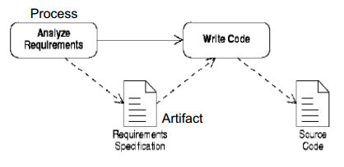
Simple Software Process
In the simplest cases, code is written directly from some statements of requirements.

Slide 8
Two processes:
Analyze requirements’
‘Write code’
Two artifacts:
‘Requirements specification’
‘Source code’
‘Requirements specification’ can be written as:
an informal outline or
a highly detailed description.

Slide 9
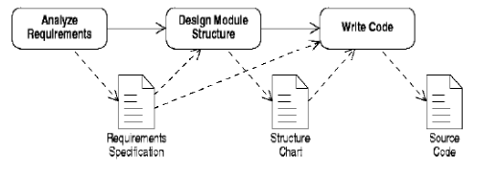
A more Complex Software Process
It is better to design before you code.
On larger projects, intermediate pieces of documentation are produced.

Slide 10
One new process:
‘Design module structure’ - splitting the program into modules and subroutine
One new artifact:
‘Structure chart’ – is based on the information contained in the ‘requirements specification’
Both the ‘requirements specification’ and the ‘structure chart’ are used when writing the final code.

Slide 11
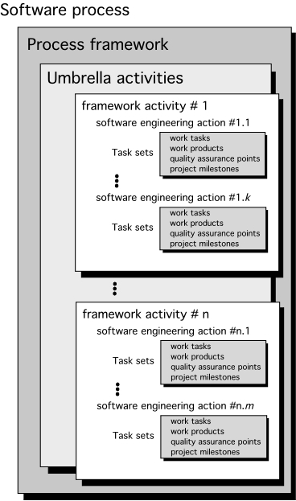

Slide 12
Identifying a Task Set
A task set defines the actual work to be done to accomplish the objectives of a software engineering action.
A list of the task to be accomplished
A list of the work products to be produced
A list of the quality assurance filters to be applied

Slide 13
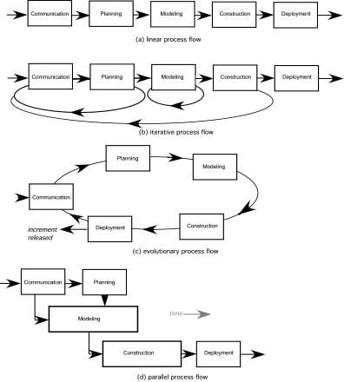

Slide 14
Phases of Software Process Model
Requirements phase
Specification phase
Design phase
Implementation phase
Integration phase
Maintenance phase
Retirement

Slide 15
Waterfall Model
Requirement
Definition
System and
Software Design
Implementation
and Unit Testing
Integration and
System Testing
Operation and
Maintenance

Slide 16
Requirement
Definition
Waterfall Model
System and
Software Design
Implementation
and Unit Testing
Integration and
System Testing
Operation and
Maintenance

Slide 17
Rapid
Prototyping
Rapid Prototyping Model
Requirement
Definition
System and
Software Design
Implementation
and Unit Testing
Integration and
System Testing
Operation and
Maintenance

Slide 18
Build and Fix Model
Build first
version
Modify until
client is satisfied
Maintenance
phase
Development
Maintenance
Retirement

Slide 19
Incremental Model
Requirements phase
Verify
Specification phase
Verify
Architectural design
Verify
For each build:
Perform detailed design, implementation and integration,
test, deliver to client
Maintenance phase
Development
Retirement
Maintenance

Slide 20
Incremental Model (cont.)
Build 1
Specification
Design
Implementation, integration
Deliver to client
Build 2
Specification
Design
Implementation, integration
Deliver to client
Build 3
Specification
Design
Implementation, integration
Deliver to client
Build n
Specification
Design
Implementation, integration
Deliver to client
Specification team
Design team
Implementation, integration team

Slide 21
Simplified Spiral Model
Risk Analysis
If risks cannot be resolved, project is immediately terminated
Rapid Prototype
Specification
Design
Implementation
Verify
Integration

Slide 22
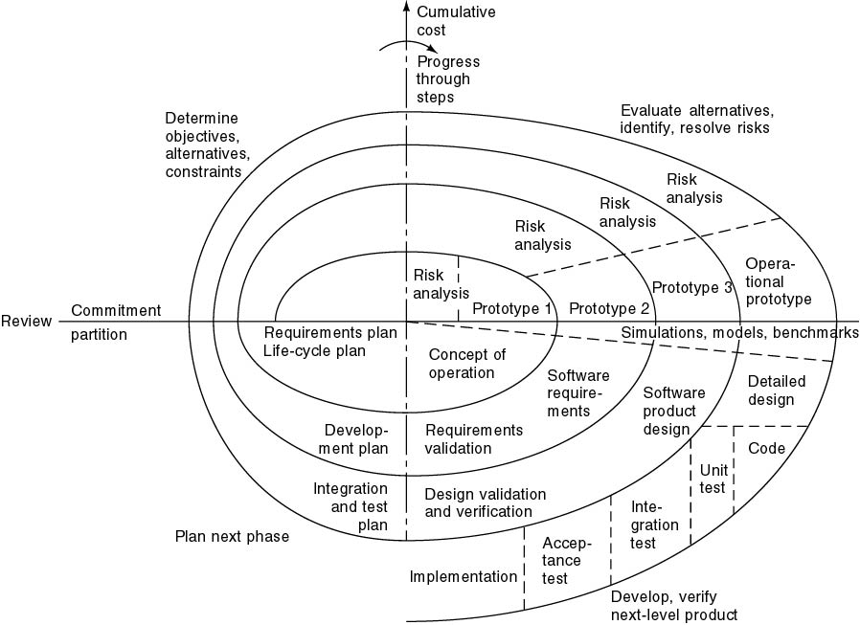
Full Spiral Model
Angular dimension (progress)
Radial dimension (cost)

Slide 23
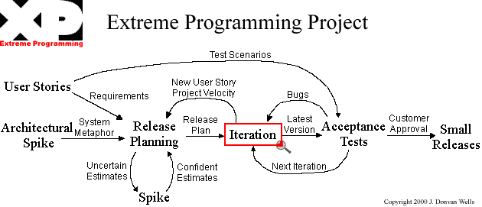
Extreme Programming

Slide 24
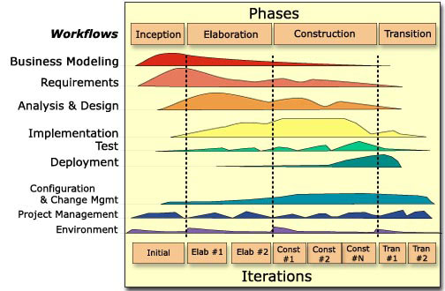
Unified Process
(This image is from P. Krutchen’s paper)

Slide 25
What are the UP Phases?
Inception:
Approximate vision, business case, scope, estimates
Elaboration:
Refined vision, core implemented iteratively, attack high risks, most requirements identified
Construction:
Fill in the details through iteration
Transition:
Beta tests and deployment

Slide 26
UP Model

Slide 27
Documentation Phase?
There is NO documentation phase
Every phase must be fully documented before starting the next phase
Postponed documentation may never be completed
The responsible individual may leave
The product is constantly changing—we need the documentation to do this
The design (for example) will be modified during development, but the original designers may not be available to document it

Slide 28
Phase | Documents | QA
Requirement Definition | Rapid prototype, or Requirements document | Rapid prototype Reviews
Functional Specification | Specification document (specifications) Software Product Management Plan | Traceability FS Review
Design | Architectural Design Detailed Design | Traceability Review
Coding | Source code Test cases | Traceability Review Testing
Integration | Source code Test cases | Integration testing Acceptance testing
Maintenance | Change record Regression test cases | Regression testing

Slide 29
Traceability matrix
Requirement ID | Use Case ID | UID | Class/ function | Test Case ID

