Slide 1
Group meeting · 2026-10-28 · plan only, nothing executed
all-the-data / bio-box
Gene-neighbourhood, domain and ncRNA context across public prokaryote, phage and plasmid assemblies, built in gated stages from 14 genomes upward.
Current host: wilkcomp02 (CPU only). Target: rented bare metal (Hetzner). Source docs: STAGES.md, PLAN.md v3, 00-spec.md v3, DEPLOYMENT v3, planning/*, audits/critique_4–8, SYNTHESIS_2.
1 / 51
Notes:
One sentence: we are asking to start the preflight, not to build the planet. Everything shown is a plan; numbers are labelled measured, derived, or estimate.

Slide 2
Bottom line: approve a 2–3 week preflight, then S0 on 14 genomes. No large compute until S0 has measured real rates.
What we ask today
What we are not asking for
Sign off the first-10 questions (the lab's, not the engine's)
Send a written footprint request to the pod owner: threads, scratch growth to ~2 TB, multi-week runs, wilkcomp03 GPU, a second account
Name a data engineer and a bioinformatician (may be one person, ~60%)
Accept kill criteria K1–K6
Budget a one-week Hetzner rehearsal after S2 (quote pending)
No planetary build, no Logan, no GPU training
No public service: localhost + SSH tunnel only
No custom indexes until a measured SLO fails
Exit of S0: pipeline reproduces curated annotations on 14 reference genomes; every unit rate measured on Haswell; the size model is refit from data instead of guesses.
2 / 51
Notes:
Lead with the ask. The deck afterwards explains why the ask is this small: v2 numbers did not survive arithmetic.

Slide 3
Existing tools each cover one slice. The new part is narrow: sub-ORF tapes with ncRNA, mobility-aware statistics, and raw sequence lineage in one queryable store.
Slice | Already covered by | Plan
Neighbourhood viewing for one query | webFlaGs, GCsnap2, EFI-GNT, IMG/VR | Baseline for Q1/Q5; reuse, don't rebuild
Genomic-context language models | gLM2 + OMG corpus + Gaia (Tatta Bio), Evo 2, Bacformer | gLM deferred; gLM2 is the baseline
Dark families with context | FESNov (2024), Pavlopoulos 2023, Durairaj 2023 | Cite; compare family sets
Structure for dark proteins | Foldseek, AFDB / ESMAtlas30, ProstT5 | Transfer at ≥90% ID only; ProstT5 on GPU later
Pangenome co-occurrence | Coinfinder, STRING neighbourhood channel | External baselines in B-EXT
Planetary sequence search | Logan-Search, MetaGraph | Logan last, compute-to-data on AWS
MGE / defense calls | geNomad, CheckV, DefenseFinder, PADLOC | Run as tools; system calls stored as sidecars
PRIOR-ART.md v3
3 / 51

Slide 4
Five independent audits rewrote the v2 plan: its scale numbers, dedup, statistics and benchmarks did not survive arithmetic.
v2 claim | Finding
40.8 TB Logan, 68 h | Hundreds of TB; 40.8 TB at 400 MB/s is 28 h anyway
2.5×10⁹ contigs, 3.6×10⁹ slots | 1.44 slots/contig, impossible under the ≥2-feature gate
POPCNT ≤ 6 = 95% ANI | ≈99.3% ANI; 95% is E[popcnt] ≈ 22
Syncmer hash "90% invariant" | Jaccard ≈ 0.21 at 90% AA ID
LLR_func primary metric | Not a likelihood ratio (P_obs undefined)
Recall 48/50 known systems | Circular: DefenseFinder/PADLOC models are inputs
"0% / 100%" criteria | 0/200 still allows ≈1.5% (95% UB)
4.7-day build | Withdrawn; replaced by a measured capacity model
Bioinformatics
20 findings
Data science
17 findings
Architecture
16 findings + roadmap
Database
20 findings
Data quality
19 findings + golden set
Synthesis
28 decisions, D-01..D-28
Each auditor first rewrote its own brief: what a top professional would add, rawest material, methods, outside proof.
audits/critique_4..8, audits/SYNTHESIS_2.md
4 / 51

Slide 5
Six rules make the build accretable instead of a one-shot planetary run.
1 · Stage = one release
One data increment, one capability, one science question, one gate, release rS<k>.<n>.
2 · Shards, not genomes
500–2,000 genomes per job; idempotent, content-addressed, pausable by STOP file.
3 · Layers have update rules
Append-only L0/L1/L3 coords; L2 incremental with crosswalk; L4 recomputed; L5 only if needed.
4 · Nothing discarded
Every contig incl. dedup members stays retrievable. Dedup changes counting weights only.
5 · Accretion is proven
Incremental build of stage k must hash-equal a from-scratch build of 0..k.
6 · Measure, then predict
Each stage writes unit rates to sizing.yaml; a stage missing its estimate by >2× stops for review.
Every number in the docs is labelled measured (stage, date), derived (formula) or estimate ±40%.
5 / 51

Slide 6
PART 1
Data layers
What is stored, how it changes, and how any slot traces back to raw sequence.
6 / 51

Slide 7
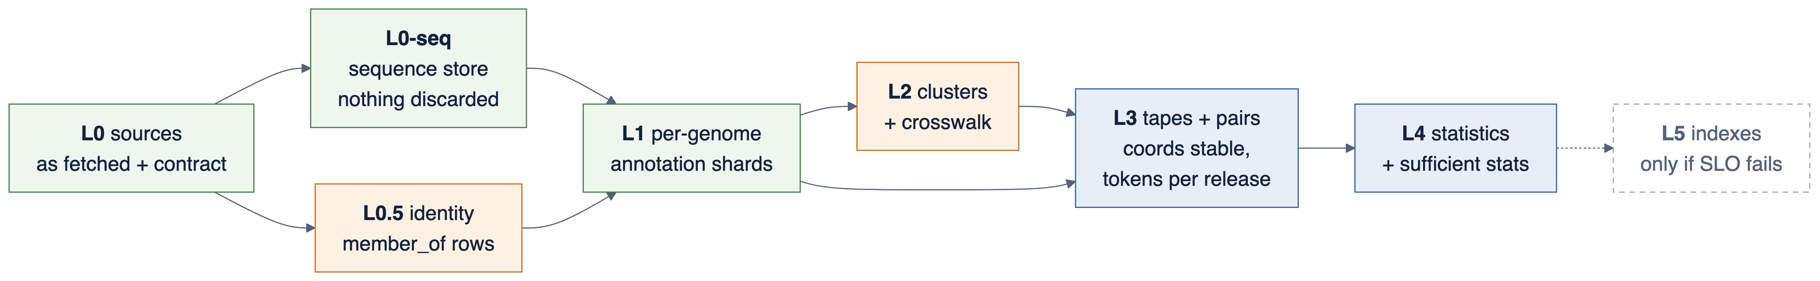
Seven layers, each reading only from below. A bug in statistics never forces re-running annotation.
append-only
incremental + crosswalk
recomputed per release
optional
Layer | Recompute trigger | Truth key
L0 / L0-seq | never; new source release = new snapshot | sha256 per object; BLAKE3-128 per sequence
L1 annotation | tool or reference-DB bump → new annot_version | (genome_uid, annot_version)
L2 clusters | >20% new sequences, parameter change, or drift test fails | cluster_uid + id_history
L4 statistics | any change below; deltas flagged stale | stats_release_id
planning/data_layer_and_tests.md §1
7 / 51

Slide 8
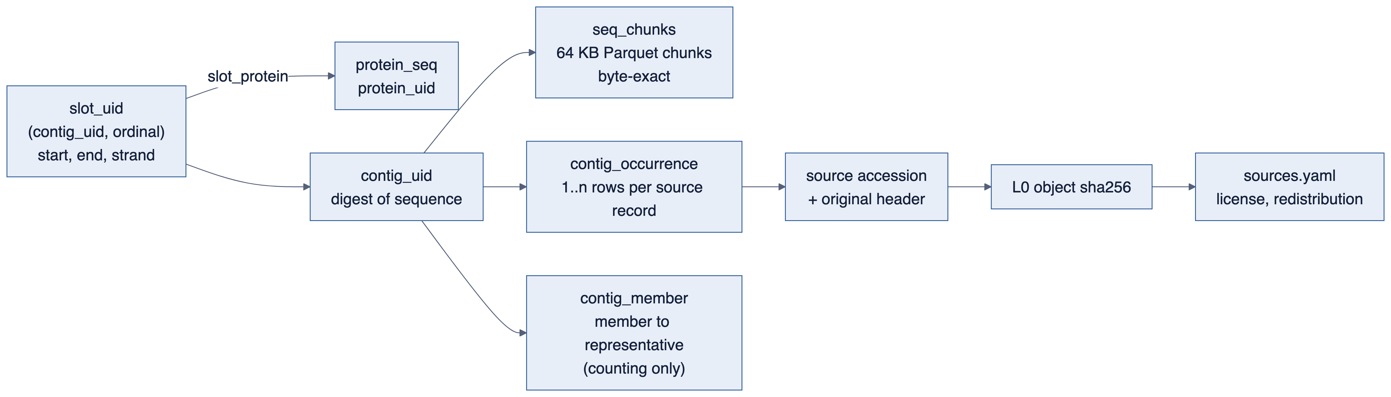
Raw sequences stay available to every project: each slot resolves to bases and to the source record it came from.
Stored
Every source contig byte-exact (64 KB Parquet chunks), incl. dedup members and screening rejects. Proteins incl. Sec/Pyl/frameshift reconstructions. IGRs as coordinates.
Retrieved
bio-box seq get|extract|lineage; DuckDB macros seq_slice, seq_get; bgzip + .fai generated on demand.
Exceptions
Human / vertebrate-host contigs: digest + reason code only. Non-redistributable sources ship as fetch recipes.
PLAN §4.0 · data_layer_and_tests §2A · tests R-01..R-09, K-13
8 / 51

Slide 9
Two kinds of ID: content-derived UIDs that never change, and dense integers that live inside one release.
ID | Definition | Lifetime
contig_uid | BLAKE3-128(uppercase sequence) | forever
protein_uid | BLAKE3-128(AA sequence) | forever
raw_digest | sha256(exact source bytes) | forever
cluster_uid | BLAKE3-128(members at creation, params) | until split/merge
token_uid | (level, library, accession, version) | forever
dense_contig_id | release-local uint64 | one release only
Why it matters
v2 keyed sidecars by dense IDs, so every rebuild silently re-pointed them at the wrong rows.
id_history
Per release transition: same / split / merged / retired. Sidecars declare key_type and key_release; registration refuses mismatches.
128-bit UIDs: collision risk negligible at 10¹² items. 64-bit would reach ≈1 collision near 6×10⁹, which S7 could reach.
9 / 51

Slide 10
PART 2
Pipeline and statistics
Per-genome work fans out; global steps are explicit barriers.
10 / 51

Slide 11
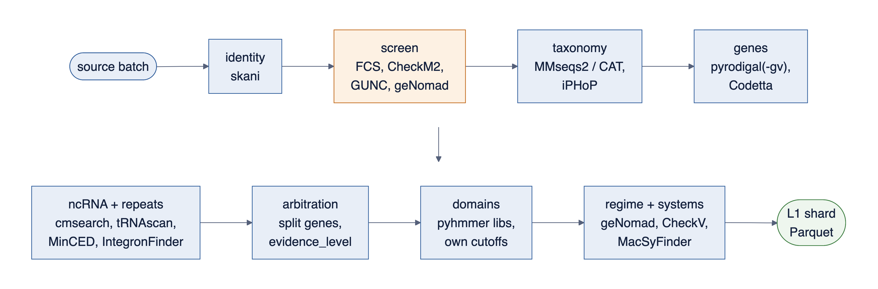
Per-genome annotation is embarrassingly parallel and fixes v2's biology errors with off-the-shelf tools.
Genetic code per genome (Codetta); pyrodigal-gv for phages. Code 25 = SR1/BD1-5, not "all CPR"
smORFs are candidates until a cluster appears in ≥3 orders with RNAcode or dN/dS < 0.5
Split-gene merges need a slippery motif, Sec/Pyl machinery or an intron call; else CANDIDATE_INDEL
cmsearch with Infernal's own filters; riboswitch pocket subtype per member, not per IGR90 rep
Each HMM library keeps its own curated cutoffs; HMMER Z fixed per release
Mobility regime from geNomad, CheckV, IntegronFinder, ISEScan, not ±15-ORF rules
PLAN §2.3, §3 · D-04, D-06..D-11
11 / 51

Slide 12
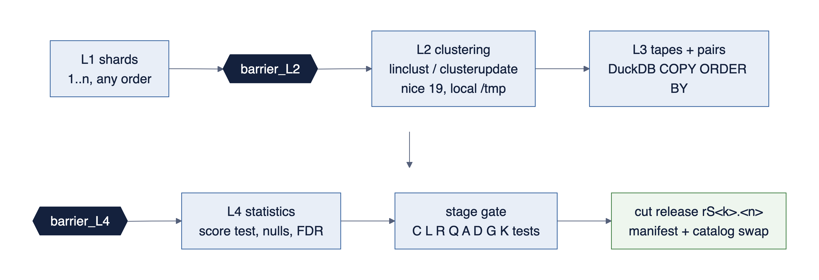
Global steps run only on complete inputs; every stage ends in a gate and an atomic release cut.
Dedup is deterministic
Two-pass sort-merge; ≥1,024-bit containment sketch; skani verifies. Same inputs in any order give the same representatives.
Clusters update
mmseqs clusterupdate (≥18-8cc5c); full recluster at >20% growth, with crosswalk.
Release cut
Manifest written, catalog regenerated, current.json swapped by rename.
12 / 51

Slide 13
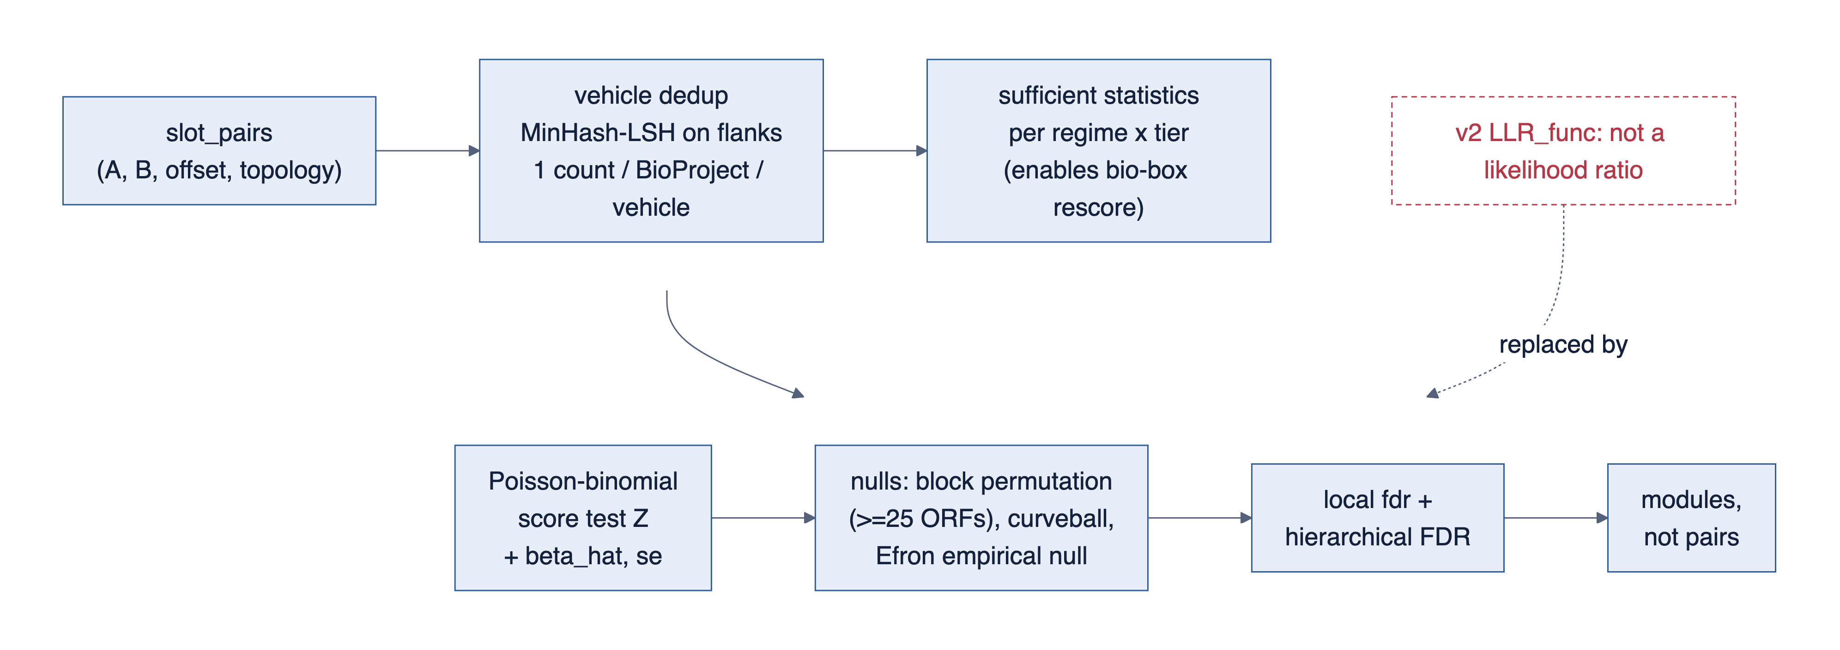
Coupling is ranked by a score test with proper nulls and FDR; parameters can be changed later without the base build.
Geometry, entropy and vehicle terms are separate columns, never ad-hoc subtractions
powered and min_detectable_count columns: absence of signal is reported as absence of power where true
Tier 2: replicon-matched geometry test (a 12-ORF plasmid makes co-presence uninformative)
Weights fitted on split gold sets into params.yaml, not chosen to clear the benchmark
Per-pair sufficient statistics stored, so bio-box rescore recomputes Z and FDR
Gene-tree homoplasy on demand for top-N pairs only
PLAN §4.3 · D-13, D-14 · critique_5
13 / 51

Slide 14
PART 3
Container composition and runtime
One lockfile, two images, one data pack, same commands on the pod and on Hetzner.
14 / 51

Slide 15
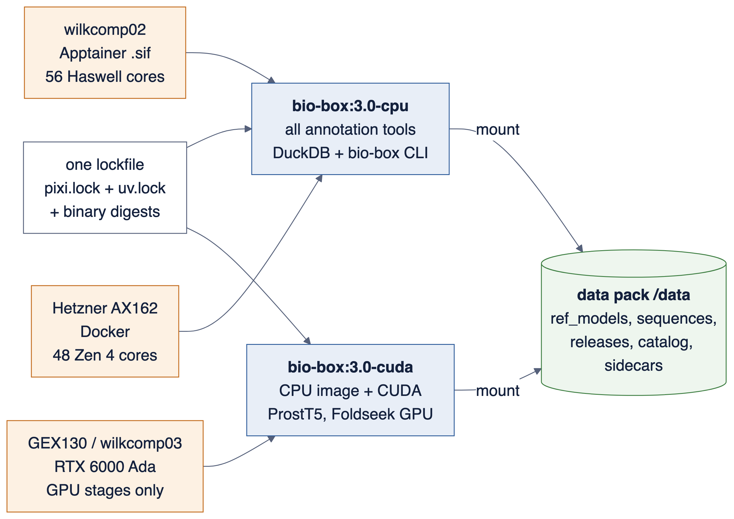
Software and data ship separately: images hold tools, the data pack holds everything that changes with a release.
Weights, HMM/CM libraries and Foldseek DBs live in the data pack, never in image layers. Image digest is recorded in every release manifest.
DEPLOYMENT-AND-MALLEABILITY.md §1–2 · D-26
15 / 51

Slide 16
The CPU image bundles about 25 established tools; the custom code is the glue, the data layer and the tests.
Function | Tools (pinned in pixi.lock / uv.lock) | Where results go
Identity, QC, screen | skani, FCS-adaptor, FCS-GX*, CheckM2, GUNC | L0.5, quarantine, ledger
Taxonomy | MMseqs2 taxonomy / CAT (GTDB R226), iPHoP | L1 tax_* columns
Genes | pyrodigal, pyrodigal-gv, Codetta | L1 genes, protein_seq
ncRNA, repeats | Infernal 1.1.5 cmsearch, tRNAscan-SE 2, Aragorn, MinCED, TransTermHP, IntegronFinder 2 | L1 ncrna
Domains | pyhmmer / HMMER 3.4 (Pfam, NCBIfam, PHROGs, arCOG), cath-resolve-hits; COG via eggNOG | L1 domains
Mobility, systems | geNomad, CheckV, ISEScan, MacSyFinder (DefenseFinder, CONJScan, TXSScan), PADLOC | L1 regime; sidecars
Clustering, structure | MMseqs2 ≥18 (AVX2), Foldseek CPU; ProstT5 in the CUDA image | L2; fold_source
Trees | FAMSA, VeryFastTree (top-N pairs) | on demand
Data, API | DuckDB (pinned), Snakemake, bio-box CLI / run-step / serve / doctor | L3–L4, catalog
*FCS-GX needs ~470 GB in RAM (verify) against a 200 GB cgroup: route decided in preflight (skip for NCBI-screened sources, rented box, or exception).
16 / 51

Slide 17
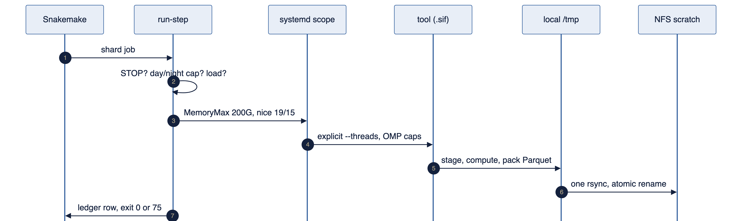
On wilkcomp02 every job goes through one wrapper that enforces the house rules, so the watchdog never fires.
Threads 40 day / 56 night, physical cores only
Memory systemd-run MemoryMax=200G
Priority nice 19 monolithic, 15 fan-out; watchdog renices a PID past ~369 CPU-min
Disk stage on local /tmp, one rsync back; no NFS dir >1,000 files
Pause STOP file → exit 75, resumable
Network serve on 127.0.0.1 via SSH tunnel
Ledger in / kept / rejected, peak RSS, CPU-s, versions per job
Lesson defense-finder -w 1 drove load to 67: thread env vars always set
Ported from homology_pod.sh and the fragment-defense pod scripts.
17 / 51

Slide 18
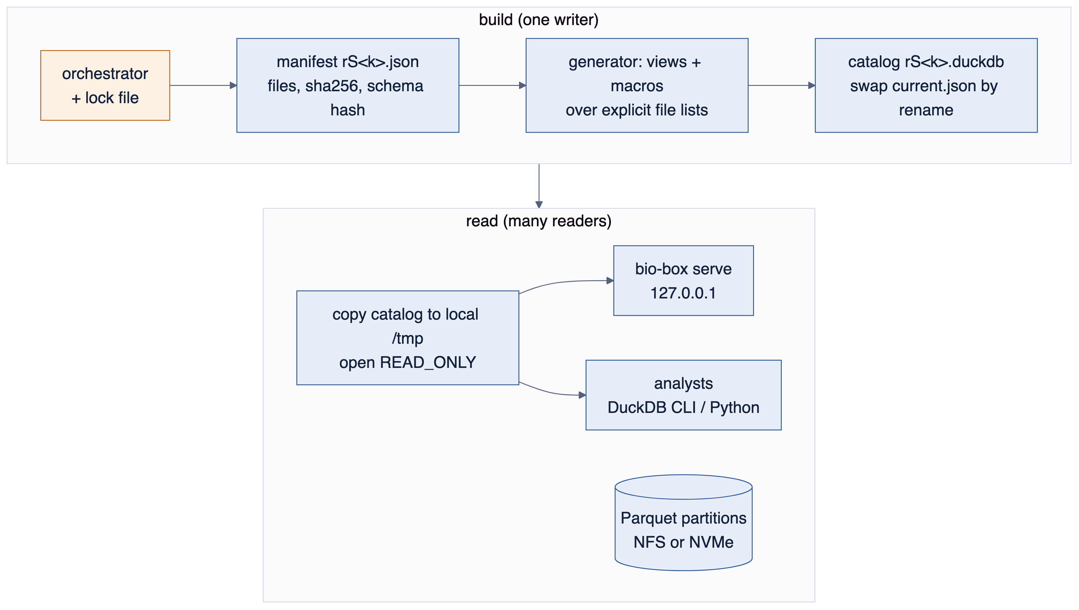
DuckDB is the query engine, used read-only. One writer builds a manifest; readers open a generated catalog from local disk.
Why not a shared read-write catalog
DuckDB allows one read-write process or many read-only ones, and warns about database files on network storage. v2 had serve, append and sidecar registration all writing.
DuckDB tests K-01..K-13 (every stage, every new host)
Version pin · memory_limit spills inside the cgroup · temp_directory local · thread cap · partition and row-group pruning (EXPLAIN ANALYZE) · LIST cost · 1–16 read-only clients · second writer fails fast · NFS vs local · sort determinism · sequence-store format bake-off.
DuckLake v1.0 evaluated at S2 against four pass criteria; adopted only if it beats the generated catalog.
18 / 51

Slide 19
PART 4
Tests and gates
A stage is done when outside truth agrees, not when the job exits 0.
19 / 51

Slide 20
Seven gates apply to every stage; failing any one stops the next stage.
# | Gate | Check | Tests
1 | Ledger balances | n_in = kept + merged + Σ rejected_by_reason, vs source manifest | L-01..03
2 | Determinism | shuffled input order, other thread counts, kill-resume: identical hashes | D-01..05
3 | Accretion equivalence | incremental = from scratch (L0/L1/L3 hash; L2 via crosswalk, ARI ≥ 0.99) | A-01..07
4 | Oracle agreement | every query class equals a brute-force scan, incl. window-edge pairs | Q1–Q8
5 | Golden regression | codes, starts, introns, frameshifts, operons, riboswitches vs curated truth | G-01..05, B-G
6 | Sequence round trip | digest = source checksum; 10k random slices = samtools faidx | R-01..09
7 | SLOs | p50/p95, warm and cold, 8 clients, hub/mid/tail tokens | §1.2 table
Plus schema contracts C-01..C-09 on every table: keys unique, foreign keys resolve, list lengths equal, coordinates in bounds, enums mapped to Sequence Ontology.
20 / 51

Slide 21
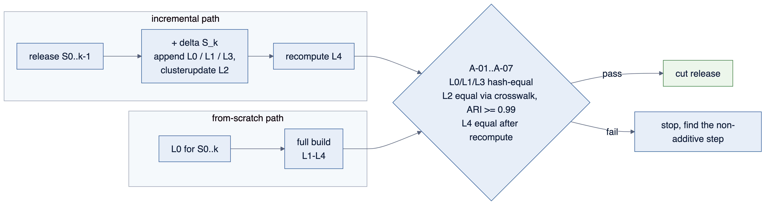
Accretion is proven, not assumed: the incremental path and the rebuild path must agree before a release is cut.
Additive counts merge across epochs.
Medians, entropies, Z and q-values never "add"; they are flagged stale until recompute.
Token remap is merge-only; splits go through a new release.
21 / 51

Slide 22
Latency targets are per query class and measured on the host, replacing v2's 4 ms claims.
Class | Example | Served by | Warm p50 / p95 | Cold p95
Q1 count | loci with A and B within ±k ORFs | slot_pairs | 0.5 / 2 s | 10 s
Q2 neighbourhoods | fetch 1,000 contig tapes | contig_tapes | 0.3 / 1 s | 5 s
Q3 anchor profile | partners of A by Z | pair_stats | 0.1 / 0.5 s | 3 s
Q4 drill-down | loci of (A, B) with geometry | slot_pairs | 0.5 / 2 s | 10 s
Q5 pathway hole | core(A)&core(B)&~pan(C)&masks | pangenome planes | 0.2 / 1 s | 5 s
Q6 co-transmission | top-k X for C | transition edges | 1 / 5 s | 20 s
Q7 sequence slice | (uid, start, end, strand) | sequence store | 0.05 / 0.2 s | 1 s
Q8 ad-hoc SQL | analytics | DuckDB read-only | no SLO; memory-capped, cancellable
A miss is fixed by an L5 index (Roaring slot-level bitmaps, offset index) or a revised target with a written reason. Hub anchors are 6–12 GB, not 5–80 MB.
22 / 51

Slide 23
PART 5
Stage cards
Smallest data first. Each stage adds one capability and answers one question.
23 / 51

Slide 24
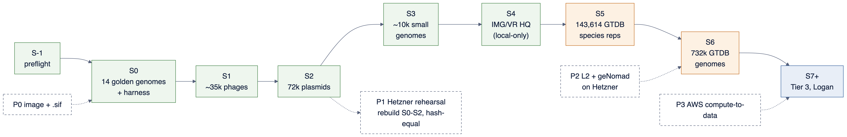
Eight stages after preflight; wilkcomp02 carries S0–S5, rented hardware takes over global work from S6.
Stage | Adds | n | Gbp | Core-h (est.) | Seq store | Host
S0 | golden set + CAMI subset | ~14 | 0.05 | 100–1.5k | 0.03 GB | pod
S1 | INPHARED phages | 30–40k | ~2 | 250–2.5k | 0.9 GB | pod
S2 | PLSDB plasmids | 72,360 | 5–7 | 0.8–6k | 2.8 GB | pod
S3 | GTDB reps <2 Mbp | 9–12k | 10–13 | 1–10k | 5.2 GB | pod
S4 | IMG/VR HQ vOTUs | 0.23M | ~12 | 4.5–17k | 5.5–19 GB | pod local-only
S5 | all GTDB species reps | 143,614 | 400–450 | 20–80k | 207 GB | borderline
S6 | all GTDB genomes | 732,475 | 2.7–3.1k | 60k–1.6M | +1.34 TB | split
S7+ | AllTheBacteria, SPIRE, Logan | millions | Tbp–Pbp | — | — | Hetzner / AWS
Estimates: planning/sources_and_sizing.md; pod ≈ 800 core-h/day; all rates unmeasured until S0
24 / 51

Slide 25
STAGE CARD · S−1 · 2–3 WEEKS · NO DATA, NO COMPUTE
Preflight closes the gaps that would stall S0–S3: questions, approvals, IDs, reference DBs, repo and CI.
Governance
First-10 questions signed off, each with a baseline tool
Roles, time boxes, kill criteria K1–K6
Footprint request to pod owner; reply filed
Decisions (ADRs)
BLAKE3-128 UIDs, dense IDs per release
FCS-GX route; human-data rule
Upgrade policy: bumps only at stage boundaries
L0 kept durable; code license and name check
Infrastructure
Git repo, CI with a 3-genome micro-S0 fixture
Image by digest; .sif on the pod; bio-box doctor
run-step ported, kill-resume incl. wiped /tmp
Data
golden.yaml pinned (SR1, Lak, Obelisk)
refdb.yaml: version, sha256, size, RAM, license
sources.yaml for S0–S3; costs.md quotes
planning/preflight_gaps.md §7
25 / 51

Slide 26
STAGE CARD · S0 · ~4 WEEKS
S0 runs the full stack on 14 reference genomes and freezes the decisions that are expensive to change later.
Adds
MG1655, B. subtilis 168, T4, λ, M. genitalium, SR1, Lak phage, M. acetivorans, H. volcanii, S. acidocaldarius, H37Rv, B. theta, SF370, an Obelisk; CAMI II subset; spike-in panel.
Capability
Every layer at toy scale; read-only catalog; run-step, ledger, doctor. ADRs: schema v1, badge layout, enums → SO terms, sequence-store format (K-13).
Science check
Gene starts vs EcoCyc/SubtiWiki; operons vs RegulonDB; T4 introns stitched; λ gpG-T merged; code 4 and 25 detected; leaderless starts in Haloferax; production Infernal recall ≥0.98 of full Rfam.
Gate
All seven gates at full oracle scale; K-01..K-13. Measures R_pyro, r_pfam, s_cm, geNomad rate, MMseqs2 RSS/tmp, bytes/bp. If S5 >150 days predicted: re-plan before S1.
n ~14 + subset
Gbp 0.05
core-h 100–1,500
disk <20 GB
release rS0.1
26 / 51

Slide 27
STAGE CARD · S1 · ~2 WEEKS
S1 adds ~35k complete phages: first real pair tables, first clusters, first accretion-equivalence test.
Adds
INPHARED complete phage genomes (count read from *_data.tsv at freeze). Open sequences; INPHARED scripts AGPL, called as a tool, not vendored.
Capability
pyrodigal-gv codes 11/15; PHROGs; intron/HEG and frameshift stitching at scale; viral regime; first slot_pairs and pair_stats; clusterupdate exercised.
Science check
Lysis cassettes, Acr–Aca loci and the tail-chaperone frameshift rank as top modules with defense annotations held out. Lab Q1 (retron RT neighbourhoods with FASTA) answered.
Gate
Everything in S0 plus A-01..A-07: S0→S1 incremental equals S0+S1 from scratch. First scaling-fit point. Cross-check against fragment-defense phage DefenseFinder/PADLOC runs.
n 30–40k
Gbp 1.7–2.2
core-h 250–2,500
seq store 0.9 GB
release rS1.1
27 / 51

Slide 28
STAGE CARD · S2 · 2–3 WEEKS · THEN P1 REHEARSAL
S2 adds 72k plasmids and is the first real test of passenger versus coupling.
Adds
PLSDB 2024_05_31_v2 (72,360). Redistribution terms not stated: check before any pack.
Capability
Backbone vs cargo; CONJScan and IntegronFinder sidecars; vehicle clustering on real MGEs; replicon-matched geometry test. Decisions: DuckLake, LIST vs exploded tapes, offset index.
Science check
parAB, ccdAB, hok/sok rank; blaTEM–tnpA does not. First pre-registered, hash-committed slice of the B5 trap panel; FPR with exact-binomial CI. Lab Q4 answered.
Gate
Everything in S1; data-layer decisions recorded as ADRs; 2-point scaling fit. K4 kill review if trap FPR upper bound >10%.
n 72,360
Gbp 5–7
core-h 800–6,000
seq store 2.8 GB
release rS2.1
28 / 51

Slide 29
STAGE CARD · S3 · ~3 WEEKS
S3 adds ~10k small genomes, where genetic codes, reduced pathways and taxonomy get hard.
Adds
GTDB R226 species reps under 2 Mbp: Patescibacteria, DPANN, Mycoplasmatota, endosymbionts, selected by genome_size.
Capability
Codetta at scale; taxonomy with confidence feeding tax_order_id; first tree-ordered presence bitmaps and transition edges on the R226 tree; smORF promotion.
Science check
Buchnera-type pathway losses called as losses, not holes; code reassignments in BD1-5/SR1 detected. Lab Q3 and Q10 answered.
Gate
Everything in S2 on a stratified sample. The 3-point scaling fit decides whether S5's global steps run on the pod or on Hetzner.
n 9–12k
Gbp 10–13
core-h 1k–10k
seq store 5.2 GB
release rS3.1
29 / 51

Slide 30
STAGE CARD · S4 · ~3 WEEKS · LOCAL-ONLY
S4 adds uncultivated viruses; their sequences never leave the lab because of JGI policy.
Adds
IMG/VR v4 HQ vOTU reps (231,408), optionally IMG/PR (~0.7M). Rows flagged redistributable = false; packs carry fetch recipes.
Capability
Host predictions with confidence; provirus boundaries; spacer–protospacer links; L2 drift test (incremental vs full recluster ARI).
Science check
Anti-defense hotspots and counter-defense modules rank above prophage moron–structural passengers (prophage slice of the trap panel, with CI).
Gate
Everything in S3, plus drift test and license-flag test: no non-redistributable UID in any exportable pack.
n 0.23M (+0.7M)
Gbp ~12 (+10–30)
core-h 4.5k–17k
seq store 5.5–19 GB
release rS4.1
30 / 51

Slide 31
STAGE CARD · S5 · 6–14 WEEKS · BORDERLINE ON THE POD
S5 adds all 143,614 GTDB species reps: the first tree-wide answers and the first honest benchmark.
Adds
GTDB R226 species representatives (127 GB tarball, 400–450 Gbp).
Capability
Full token dictionary; tree-wide dispersion; core plane over species reps; L5 decision per query class. Becomes the lite edition.
Science check
B1 temporal holdout: dictionary frozen at a 2013 snapshot, scored on systems published later, Wilson CI. STRING and Coinfinder baselines. First hash-timestamped prospective prediction file.
Envelope
MMseqs2 ≈160 GB vs 200 GB cap; /tmp peak 0.5–0.9 TB vs 940 GB; 25–100 days. Mitigate: exact dedup first, per-phylum linclust + clusterupdate, short HMMER shards; else move L2 to Hetzner.
n 143,614
Gbp 400–450
core-h 20k–80k
seq store 207 GB
release rS5.1 = lite
31 / 51

Slide 32
STAGE CARD · S6 · SPLIT ACROSS HOSTS
S6 adds all 732k GTDB genomes for pangenome planes; per-genome work stays on the pod, global work moves to rented metal.
Adds
588,861 non-representative members; RefSeq Complete Genome flag from assembly_summary_refseq.txt.
Capability
Three-valued pangenome planes with shrinkage; closed-or-multi-strain mask; strain-level vehicle dedup. Becomes the core edition.
Science check
Missing-step search with quality masks recovers ThyA/ThyX, MetE/MetH, FolB/PTPS-III with CIs. B3 fragmentation test under its pre-registered false-hole bound.
Split
Pod: per-genome L1, sequence store, per-species planes. Hetzner (P2): global L2 clustering, geNomad on new members. Results return as L2 Parquet with crosswalk; cross-host hash equality (D-05).
n 732,475
Gbp 2.7–3.1k
core-h 60k–1.6M
seq store +1.34 TB
release rS6.1 = core
32 / 51

Slide 33
STAGE CARD · S7+ · OFF THE POD BY DESIGN
S7 adds metagenomic and SRA-derived contigs in order of cost, and stops when novelty per Tbp falls below a preset threshold.
1 · AllTheBacteria
2.44M isolate assemblies, MIT. Identity resolution against S0–S6 first: most overlap GTDB.
2 · SPIRE, GlobDB extras
Unbinned and MAG contigs; CheckM2, GUNC, FCS-GX on every MAG/SAG.
3 · Logan, last
AWS us-east-1, compute-to-data. Runs preselected by SRA metadata and STAT. Only L1 Parquet and kept sequences leave AWS.
Gate at every substage: identity resolution, screening, and a rarefaction check: novel NR50 clusters per Tbp above the preset threshold, else stop. Cost per novel cluster within budget (P3).
33 / 51

Slide 34
The pod runs out on memory and local disk at S5 and on CPU-years at S6; each limit has a planned response.
Limit | First stage that strains it | Planned response
200 GB memory cgroup | S5 (MMseqs2 ≈160 GB) | Exact dedup first; per-phylum linclust; written exception; else L2 to Hetzner
~940 GB local /tmp | S5 (0.5–0.9 TB peak) | --split-memory-limit; shard-wise passes; clear tmp between passes
Watchdog, ~369 CPU-min per PID | every MMseqs2 run from S1 | nice 19 from launch; HMMER/Infernal in short shard processes
Shared NFS, 10 GbE | S6 (~2 TB through NFS) | one throttled stream; off-hours bulk sync
Scratch not backed up | S0 for L0; S6 for the sequence store | L0 second copy on /stor/work; object storage from S5
FCS-GX ~470 GB DB (verify) | S0 / S3 | skip for NCBI-screened sources, rented box, or one-night exception
geNomad CPU-years | S6 | Hetzner; reuse IMG/VR- and GTDB-shipped calls
34 / 51

Slide 35
Rapid deployment is rehearsed early on small data, and measured from bare rental to first correct query.
Step | When | What
P0 | S0 | one OCI image → .sif (pod), Docker (Hetzner); doctor probe; ref DBs as L0
P1 | after S2 | rent one AX-class box; bootstrap; pull image by digest and rS2.1 pack; rebuild S0–S2 from manifests
P2 | S5/S6 | Hetzner runs L2 and geNomad; object storage is the system of record
P3 | S7 | AWS compute-to-data for Logan; Hetzner serves planetary
P1 pass criteria
Hash equality across hosts on L0/L1/L3, L2 via crosswalk; K-tests re-run; time from rental to first oracle-checked query under 2 h for S0–S2.
Timed breakdown
OS bootstrap · image pull · pack download at 1 and 10 Gbps · catalog open · first query.
Facts corrected
AX162: EPYC 9454P, 48 cores, 2×1.92 TB base. GEX130: 128 GB RAM. 1 Gbps default; 10 G add-on.
35 / 51

Slide 36
Editions are cuts of stage releases, not designed top-down.
Edition | Stages | Size (estimate) | Download 1 / 10 Gbps | Notes
lite | S0–S5 | ~0.3–1.0 TB | 40 min–2.2 h / 4–13 min | IMG/VR as statistics only; v2's 85 GB withdrawn
core | S0–S6 | ~4–6 TB | 9–13 h / 53–80 min | multi-strain planes and masks
planetary | S0–S7+ | unknown until S7 rarefaction | — | built and served on Hetzner
Every edition carries its stages' sequence store. Non-redistributable sources (IMG/VR, ISfinder, JGI data) ship as fetch recipes; GSA-Human is never ingested.
36 / 51

Slide 37
PART 6
Risks, kill criteria, first questions
Pre-mortem: it is April 2027 and S0–S3 stalled. Why?
37 / 51

Slide 38
The likeliest failure is building plumbing nobody asked for; the pre-mortem's top gaps are about users and approvals, not code.
# | Gap | Closes with | Blocks
1 | No signed-off first questions | First-10 list, two of them in S1/S3 gates | S0
2 | No repo, CI, image pipeline | Repo + micro-S0 fixture in CI | S0
3 | 10 cross-doc contradictions | Resolved 2026-10-28; doc-lint in CI | S0
4 | FCS-GX ~470 GB vs 200 GB cap | ADR: skip / rent / exception | S0
5 | Pod footprint not requested | Written request to the pod owner | S0
6 | L0 only on unbacked scratch | L0 durable: second copy | S0
7 | Reference DBs not pinned | refdb.yaml filled and frozen | S0
9 | Pod GPU (wilkcomp03) ignored | Ask in footprint request | S3
15 | Bus factor 1, account not shareable | Second account, RUNBOOK, cookbook | S1
16 | Human-derived contigs in quarantine | Digest + reason only | S0
planning/preflight_gaps.md (22 gaps)
38 / 51

Slide 39
Six kill criteria say when to stop, so the project cannot drift on sunk cost.
ID | Trigger | Action
K1 | S0 rates predict S5 >150 days on the pod and no Hetzner budget | Stop at S4; ship lite without S5
K2 | Golden gene-calling or ncRNA targets fail after two fixes | Adopt PGAP/Bakta outputs for Tier 1
K3 | By end of S4, no first-10 question beats its baseline | Stop building; keep sequence store + L1 as a lab resource
K4 | S2 trap FPR 95% UB >10% | Ship as a retrieval tool only
K5 | Accretion equivalence fails by S2 | Rebuild L2 per release; re-budget
K6 | Pod footprint withdrawn | Move to P1 host early
Any time box overrun by 50% triggers a kill review.
39 / 51

Slide 40
Draft first-10 questions, tied to the lab's defense, retron and repair work; each has a baseline to beat.
# | Question | First answerable | Baseline
Q1 | Every ±10-gene neighbourhood of a retron RT, with raw FASTA | S1 | webFlaGs, GCsnap2
Q2 | Phage genes near anti-defense genes beyond passenger expectation | S1 | manual DefenseFinder/PADLOC
Q3 | Uncharacterized conserved neighbours of RecBCD/AddAB across orders | S3 | STRING
Q4 | Plasmid pairs: coupled modules vs AMR–transposon passengers | S2 | Coinfinder
Q5 | Export a subfamily with neighbourhoods, sequences, taxonomy | S1 | EFI-GNT
Q6 | Strain-variable defense cassettes and their vehicles | S6 | per-genome PADLOC
Q7 | Reduced genomes: pathway lost vs holed with replacement | S3 | GapMind
Q8 | Riboswitch subtypes upstream of a transporter family | S3 | Rfam + manual
Q9 | Intron/HEG insertions in phage core genes, by lineage | S1 | manual
Q10 | Tree-ordered distribution of a module with closed-genome support | S3 | AnnoTree
Draft for PI sign-off. Q1/Q4 join the S1/S2 gates; Q3/Q10 join S3.
40 / 51

Slide 41
About six months to the lite edition at ~60% of one person, if S0 rates hold.
Phase | Time box | Ends with
S−1 preflight | 2–3 weeks | checklist green
S0 | 4 weeks | rS0.1, sizing refit, ADRs frozen
S1 | 2 weeks | rS1.1, Q1 answered
S2 | 2–3 weeks | rS2.1, Q4 answered, data-layer decisions
P1 | 1 week | cross-host hash equality, timed deploy
S3 | 3 weeks | rS3.1, Q3/Q10, S5 go/no-go
S4 | 3 weeks | rS4.1
S5 | 6–14 weeks (CPU-bound) | rS5.1, B1 with CI, lite
Estimate. Revised after S0 measures real rates; 50% overrun of any box triggers kill review.
41 / 51

Slide 42
Decisions needed this month
From the PI
Rank or replace the first-10 questions
Approve the footprint request text
Name owners (engineer, bioinformatician, independent curator)
FCS-GX route
Accept K1–K6
OK to get Hetzner quotes for P1
From the pod owner and facility
Scratch growth to ~2 TB; multi-week runs at nice 19
Possible overnight memory exception at S5
wilkcomp03 GPU by arrangement
Second account for a postdoc
/tmp cleanup policy on reboot
42 / 51
Notes:
Close on the asks. Everything else in the deck is supporting detail.

Slide 43
UPDATE
Update, 12 November 2026
Since this deck (2026-10-28): what is built, what a search gives, the decisions taken, and what comes next.
planning/tasks/STATUS.md (handoff 2026-11-12 10:30 CST; merged cards) · planning/DECISIONS.md DEC-24 to DEC-29
43 / 51
Notes:
These five slides come only from planning/tasks/STATUS.md (the handoff of 2026-11-12 10:30 CST and the table of merged cards) and from planning/DECISIONS.md rows DEC-24 to DEC-29. Every number carries the label those files give it; where they give none, the number is a count. The slides before this section are the 2026-10-28 deck, unchanged.

Slide 44
95 cards are merged and real releases verify on the pod; the 50 Gbp release rM.1 has its clusters but stopped at the token step.
Built and verified
plan/task-cards: 95 cards merged; last green ci and cross-host at 3ff6bc4 (2026-11-12)
main has pull requests 1 and 2 (87 cards) and is behind
First real build-stage run (C-10): 1,947 phages and 250 prokaryotes, two releases, both verify
Releases rN.1a, rN.1b, rN.1, rN.2, rN.3 all verify (C-19)
Search pack of rN.1: 5.51 GB, built at 750 MiB peak (measured, W-16)
Data root holds stages S1 and P1 to P6, on local disk, not yet copied to /stor
The 50 Gbp build (unit r50-driver)
Stages P3 to P6 ingested and gene-called
rM.1 published its clustering at 10:53 CST: 45,815,843 proteins, 31,183,876 NR90 and 8,192,065 NR50 clusters (measured)
rM.1.tokens failed at 10:57: DuckDB out of memory in the slot join (card B-46)
Relaunched with SKIP_RM1=1: Pfam scan of P3 to P6 to about midday Saturday (estimate), then rM.2 once B-46 is merged
planning/tasks/STATUS.md: handoff 2026-11-12 10:30 CST; merged cards C-10, C-19, W-16
44 / 51
Notes:
What exists on 12 November. The 10 Gbp-era releases rN.1a to rN.3 all verify; the 50 Gbp release rM.1 has clusters but no tokens yet, because the token step ran out of memory (card B-46). The driver carries on with the Pfam scan meanwhile. Note the data root is on local disk that a reboot clears.

Slide 45
A search runs end to end on a real release: one command gives hits, sequences and neighbour summaries, and the worker peak fell from 26.27 GiB to 1.78 GiB.
What a user runs and gets
The trial search on rN.1 (measured, wilkcomp02)
bio-box search hmm --hmm FILE --release R --bits 30 --neighbors 5 --positive ACCESSION:START-END --out DIR (W-07)
Recipe, hit table, FASTA, neighbour summary, per-locus tables, and a README.txt naming every column (W-07, W-20)
0-based half-open coordinates; strand +1/-1 in every exported file (W-20)
bio-box releases, seq --protein UID, seq --contig ACC:START-END, read-only bio-box sql FILE (W-23)
 | Before W-19 | After W-19 | After W-21
Worker peak | 26.27 GiB | 1.34 GiB | 1.78 GiB
Wall time | 534 s | 294 s | 244.6 s
Proteins found | 1,957 | 1,957 | 1,957
W-21 ran on a loaded pod; its peak rose 33% over W-19, cause not fully established. Also measured on rN.1: partners_of with 3,509 anchors 12.35 s before, 0.52 s after (B-38). Not yet: no tiering step exists (W-20).
planning/tasks/STATUS.md merged cards W-07, W-19, W-20, W-21, W-23, B-38
45 / 51
Notes:
The search path that the deck promised now runs on a real release. W-19 made the search stream its target, which took the worker from 26.27 GiB to 1.34 GiB with byte-identical output; W-21 added read-ahead, faster but 33% more memory. Every number here is measured on wilkcomp02 and comes from the merged-cards table.

Slide 46
Six decisions since 10 November: each release clusters from scratch under its own CPU cap, and a contig may belong to several genomes.
Row | Date | Decision | Basis, as labelled in DECISIONS.md
DEC-24 | 2026-11-10 | Each release clusters all its proteins from scratch; mmseqs clusterupdate is not used | Our side of clustering peaks at about 1 GB at 2.05 M proteins (measured); about 36 h per release at 95 M proteins (derived)
DEC-25 | 2026-11-10 | Clustering is exempt from the 300 CPU-minute rule until it is split, under its own cap | 10,620,684 proteins used 2,195.9 CPU-minutes in one process (measured)
DEC-26 | 2026-11-11 | A contig shared by stages belongs to the stage that stored it first | 4 of 54,265 contigs of the 50 Gbp set are shared across stages (measured)
DEC-27 | 2026-11-11 | A contig may belong to several genomes (amends DEC-26); repeated records are no longer dropped | The input script had removed 6,818 of 34,076 INPHARED records from stage S1 (measured)
DEC-28 | 2026-11-11 | ncRNA: 588 curated Rfam 15.1 models on intergenic regions, with clan competition | Full Rfam 1,910 CPU-hours per 10 Gbp; this set 247 at 99.4% of hits (derived from per-model CPU, measured)
DEC-29 | 2026-11-12 | A clustering call that cannot be split under the budget runs as one process, under clustering's cap | Starts at about 74 M proteins (NR90 step) and 108 M (NR50 step 0) (derived)
DEC-24 replaces the incremental clusterupdate path shown earlier in this deck. All six were decided by the PI.
planning/DECISIONS.md rows DEC-24 to DEC-29
46 / 51
Notes:
Two of these change what the deck said: clusters are no longer updated incrementally (DEC-24), and genome membership is many-to-many (DEC-27). DEC-25 and DEC-29 are the CPU-budget exemptions that from-scratch clustering needs on the pod. DEC-28 cut the ncRNA scan from full Rfam to a curated set.

Slide 47
Next: fix the token step (B-46) so rM.2 can be built, copy the data root to permanent storage, then add huge phages and PLSDB.
Next, in order
Agents running
C-21b genome membership view; W-22 one pack directory per host; C-23 run records name their code; B-45 unsplittable clustering call as one process (DEC-29).
B-46 first: it blocks rM.2. Merge C-21b, W-22, C-23, B-45 as they report; then C-21c, C-16, W-24, W-15
When rM.2 is built and verified: copy the data root to /stor (one rsync, atomic rename); clear obsolete scratch
C-24 (stage H1, huge phages) after the Pfam scan of P3 to P6; B-42 after B-45; then PLSDB (no card yet; needs C-21b and C-21c)
A pull request bringing main up to plan/task-cards; runbook and pod_pytest.sh on the new image
Finish measurement 0-08a (Rfam sample scan); S2C phase 2 (card C-25) waits for the PI
On the pod
Pfam scan of P3 to P6, to about midday Saturday (estimate). Rfam sample scan 0-08a: 16 shards done at 10:12 CST. The data root is on local disk, which a reboot clears.
planning/tasks/STATUS.md: handoff 2026-11-12 10:30 CST, "Agents running", "On the pod now", "Next, in order"
47 / 51
Notes:
The order matters: B-46 unblocks rM.2, and only a verified rM.2 justifies the copy to /stor. Huge phages (H1) and PLSDB come after; PLSDB needs the genome-membership cards C-21b and C-21c first. Items waiting for the PI are listed in STATUS.md under "Open items for the PI".

Slide 48
APPENDIX
Reference material
48 / 51

Slide 49
Appendix A · Audit findings to decisions
Decision | Topic | From
D-02 | One sizing model; labels on every number | BX-01, AR-02, DB-01, DQ-09, DS-03
D-04 | Identity resolution, screening, deterministic dedup | BX-15/18, DQ-01..03, DB-04, AR-03, DS-02
D-06 | Explicit contig taxonomy with confidence | BX-03, DQ-04
D-07..D-11 | Gene calling, ncRNA, domains, structure, regimes | BX-04..13
D-13 | Score test, permutation nulls, hierarchical FDR, rescore | DS-01, DS-06..08, DS-12, DS-14
D-17 | Parquet + DuckDB first; indexes only on SLO failure | AR-06, DB-02..08
D-19..D-21 | Stable IDs, staleness contract, read-only catalog | AR-04/05/11, DB-10..12, DQ-13
D-23 | Per-source license contracts; fetch recipes | AR-13, DQ-05
D-24 | Temporal holdout, CIs, simulation, pre-registration | DS-04/10/11/16, DQ-10, BX-20
D-27 | Staged accretion | all five audits
49 / 51

Slide 50
Appendix B · Source and license blockers
Source | Stage | Terms | Handling
GTDB R226 | S3, S5, S6 | CC BY-SA (verify) | attribution file per release
INPHARED | S1 | INSDC sequences; scripts AGPL | call as tool, do not vendor
PLSDB | S2 | no license stated | derived tables only until checked
IMG/VR, IMG/PR | S4 | JGI data policy | local-only; fetch recipes
ISfinder | — | no download without authorization | bring your own data
Logan | S7 | no license; NIH GDS policy | preselect runs; human screen
GSA-Human | never | controlled access | do not ingest
AllTheBacteria | S7 | MIT | public packs OK
50 / 51

Slide 51
Appendix C · Where things live
File | Authoritative for
STAGES.md | stage numbering, cards, portability track, editions
planning/preflight_gaps.md | pre-mortem, contradictions, first-10, refdb list, roles, kill criteria, checklist
planning/data_layer_and_tests.md | layers, IDs, sequence store, layout, catalog, all test IDs, orchestration
planning/sources_and_sizing.md | sources, versions, unit-rate formulas, envelope
PLAN.md v3 | pipeline, schema, statistics, benchmarks
00-spec.md v3 | scope and 14 invariants
DEPLOYMENT-AND-MALLEABILITY.md v3 | hosts, images, malleability contract, security, licensing
audits/SYNTHESIS_2.md | decision record D-01..D-28
Diagrams: presentations/diagrams/*.mmd, rendered by presentations/render.sh (mermaid-cli 11.12).
51 / 51

