Slide 1

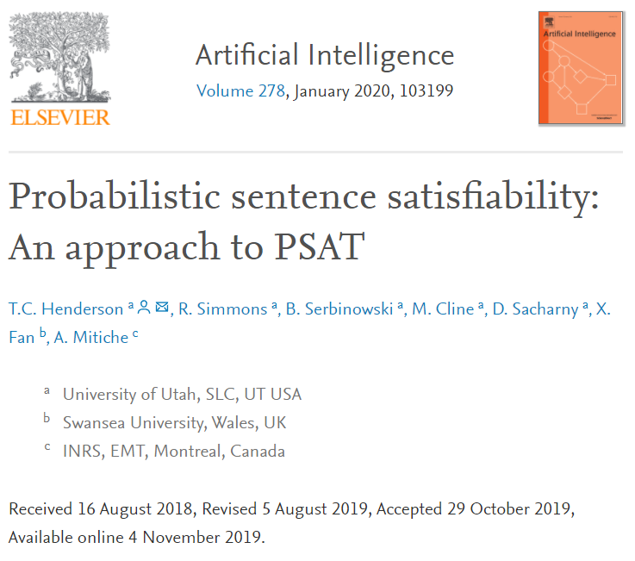

Probabilistic Sentence Satisfiability: An Approach to PSAT
T.C. Henderson, R. Simmons, B. Serbinowski, M. Cline, D. Sacharny, X.Fan, A. Mitiche

Slide 2
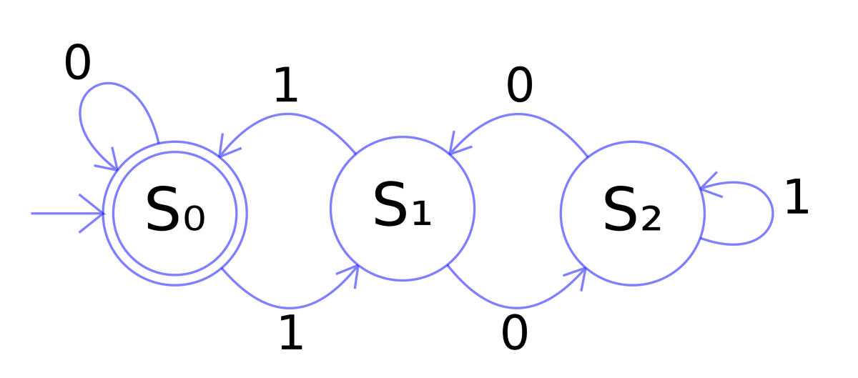
In the Context of Formal Specification
A potential way to study probabilistic systems, e.g., probabilistic automata (PA)
Core ideas of this work:
Solving (a version of) PSAT with optimization
Considering “local” constraints
Independence assumption

Slide 3
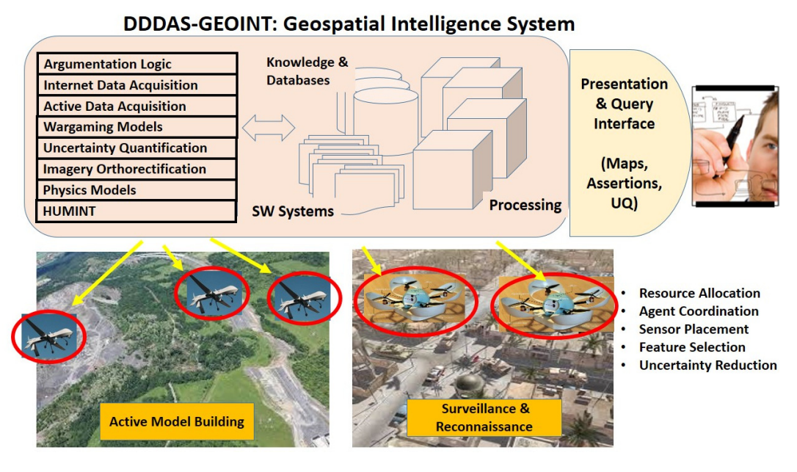
An Engineering Problem
BRECCIA: Geospatial Intelligence System
Multi-source information fusion problem
  Different sensor sources have different uncertainty measures
Decision making in such systems, e.g., where to send the drone?

Slide 4
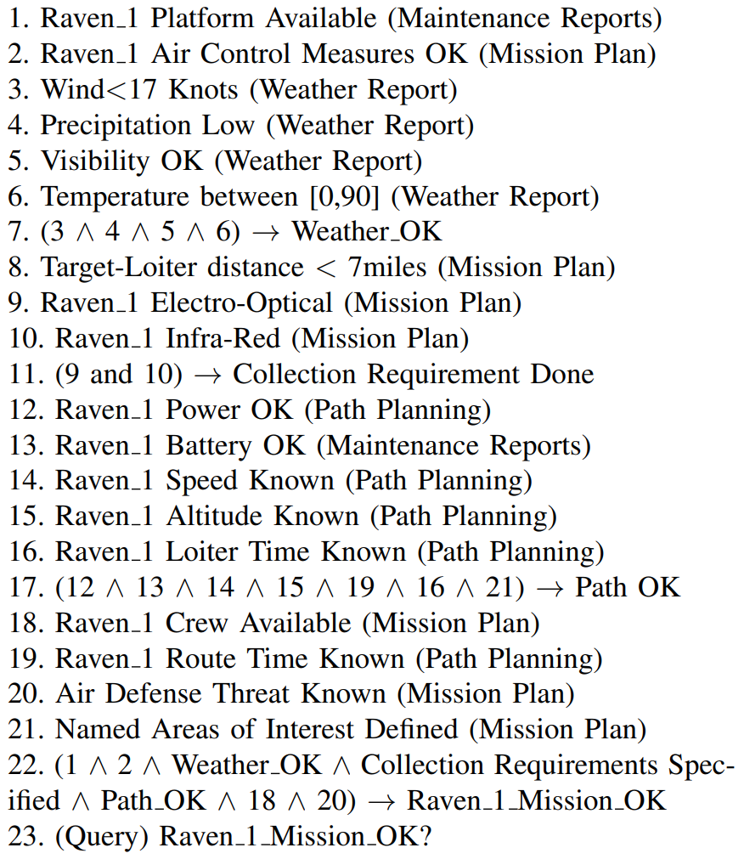
Reasoning with Knowledge-bases
Consider a simple propositional logic representation
Each sentence has an associated probability
The sources of information, i.e., which BRECCIA component produced them, are given in parentheses

Slide 5


Abstraction
Knowledge bases are expressed in Conjunctive Normal Form
Each sentence (disjunction) in a knowledge base has an associated probability
Question: How to compute the probability of an individual literal in the knowledge base?
E.g., given knowledge base K
From P(C_{i}), we want to compute P(L_{i,j})

Slide 6
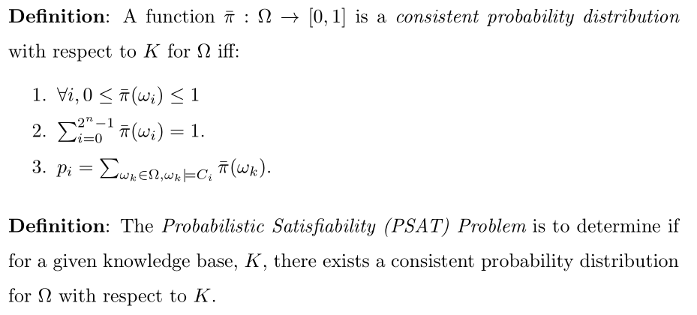
Does solution exist?
A solution exists if the KB is probabilistic satisfiable.

Slide 7
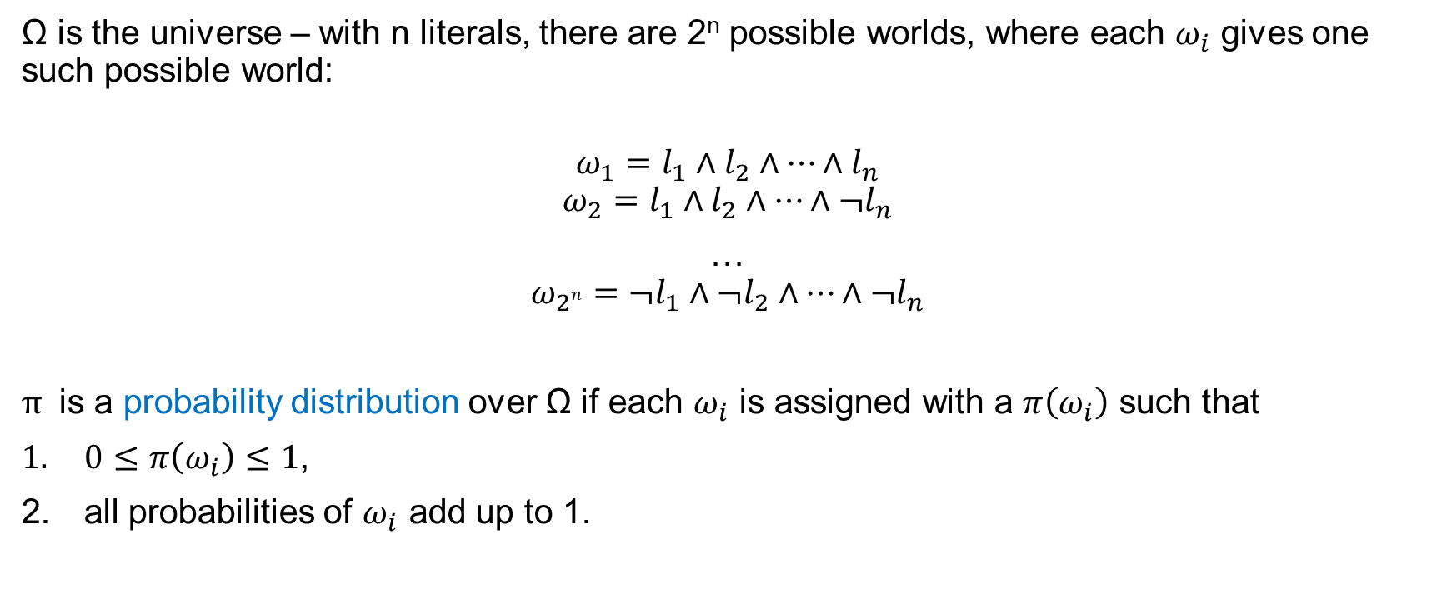
Ω (part 1)
Ω is the universe – with n literals, there are 2^{n} possible worlds, where each $ω_{i}$ gives one such possible world:
$$ω_{1}=l_{1}∧l_{2}∧…∧l_{n}$$
$$ω_{2}=l_{1}∧l_{2}∧…∧¬l_{n}$$
…
$$ω_{2n}=¬l_{1}∧¬l_{2}∧…∧¬l_{n}$$
$π$ is a probability distribution over Ω if each $ω_{i}$ is assigned with a $π\left(ω_{i}\right)$ such that
$0≤π\left(ω_{i}\right)≤1$,
all probabilities of $ω_{i}$ add up to 1.

Slide 8

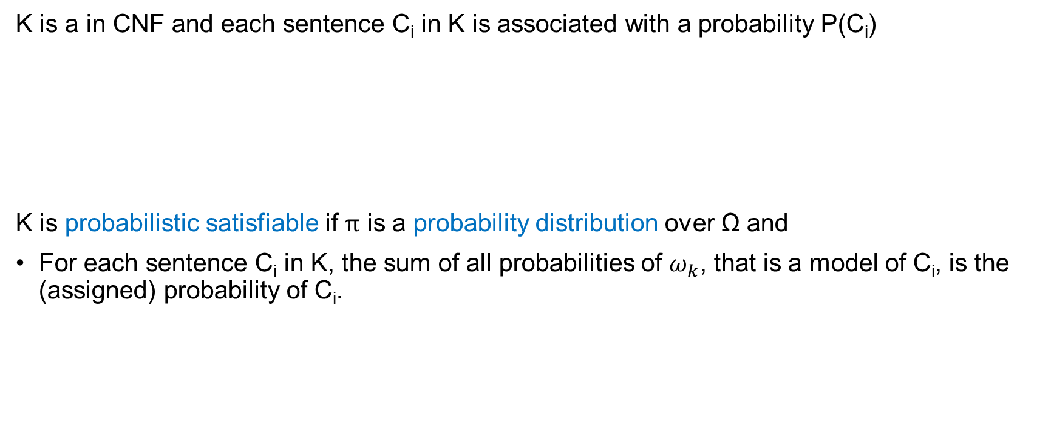
Ω (part 2)
K is a in CNF and each sentence C_{i} in K is associated with a probability P(C_{i})
K is probabilistic satisfiable if $π$ is a probability distribution over Ω and
For each sentence C_{i} in K, the sum of all probabilities of $ω_{k}$, that is a model of C_{i}, is the (assigned) probability of C_{i}.

Slide 9
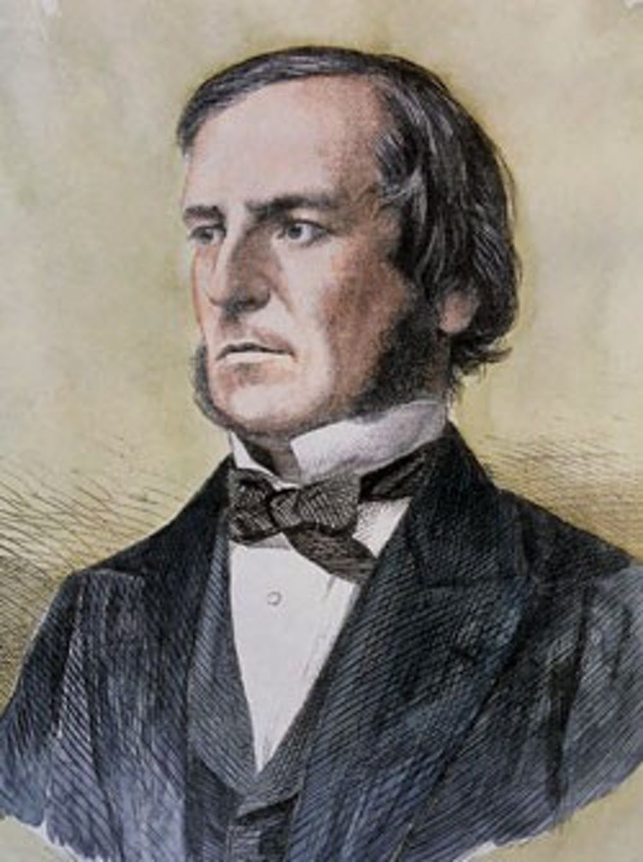
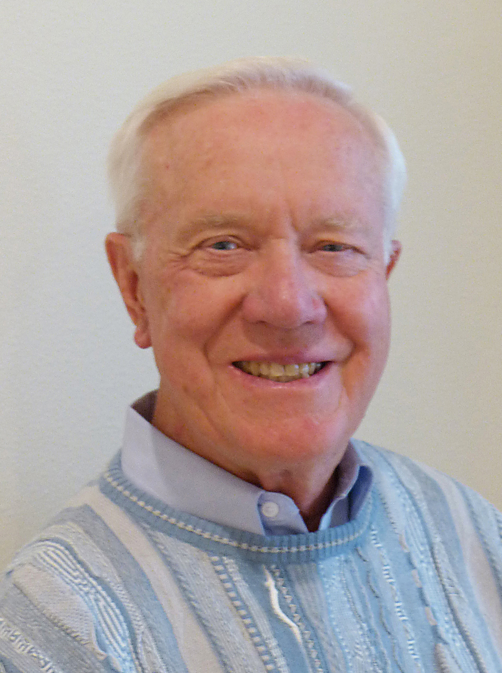
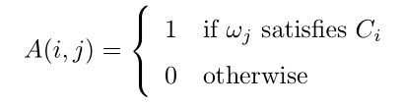
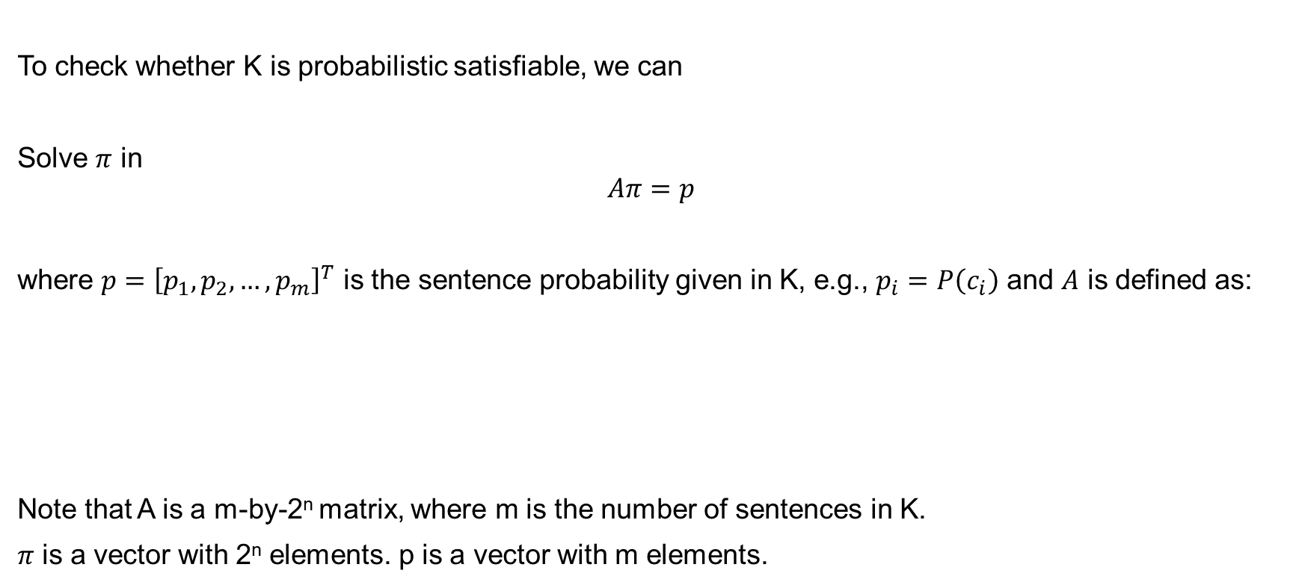
Compute the probability distribution $π$ (Boole & Nilsson)
To check whether K is probabilistic satisfiable, we can
Solve $π$ in
$$Aπ=p$$
where $p={\left[p_{1},p_{2},…, p_{m}\right]}^{T}$ is the sentence probability given in K, e.g., $p_{i}=P\left(c_{i}\right)$ and $A$ is defined as:
Note that A is a m-by-2^{n} matrix, where m is the number of sentences in K.
$π$ is a vector with 2^{n} elements. p is a vector with m elements.

Slide 10
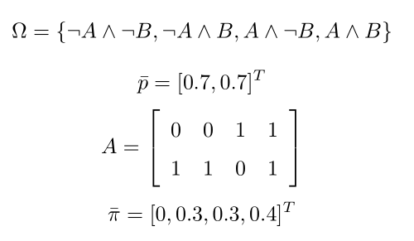



Example
$$Aπ=p$$
K = A[0.7] ∧ (¬A ∨ B)[0.7]
$¬A∧¬B$ is not a model of $A$
$¬A∧¬B$ is a model of $¬A∨B$

Slide 11

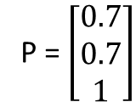
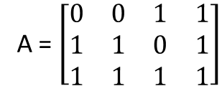
Example
$$Aπ=p$$
K = A[0.7] ∧ (¬A ∨ B)[0.7]
A = $\left[\begin{matrix}0 & 0 & 1 & 1 \\ 1 & 1 & 0 & 1 \\ 1 & 1 & 1 & 1\end{matrix}\right]$
P = $\left[\begin{matrix}0.7 \\ 0.7 \\ 1\end{matrix}\right]$
(An extra row of 1’s is added to A as is an extra row with 1 to the p vector so as to force the sum of the elements of π to be 1.)

Slide 12
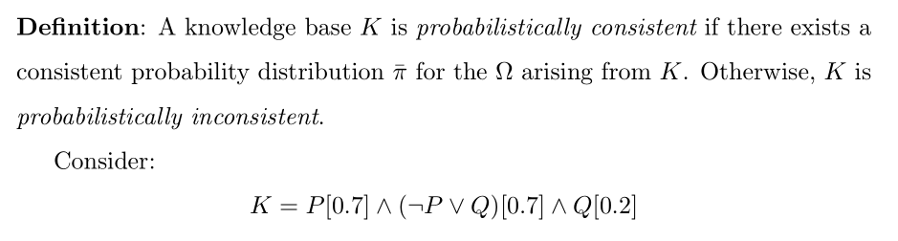
Another Example (an inconsistent one)
How to see that K is probabilistically inconsistent?

Slide 13
Another Example (an inconsistent one)
How to see that K is probabilistically inconsistent?
From P[0.7] we know ~P[0.3].
Then, Prob(~P v Q) <= 0.3 + 0.2 = 0.5
However, we are also given: (~P v Q) [0.7], this gives inconsistency.

Slide 14
Problem with Boole & Nilsson
Complexity – for a KB with n literals, we need to solve a (linear) system with 2^{n} unknowns
Can we do better?
  In general, no, unless P = NP. (PSAT has been shown to be NP-complete.)
  In special cases, including the one shown in this work – assuming independence between variables and focus only on “local” constraints, to a point, – we can.
Main idea:
  Consider each sentence as a set of constraints and solve for literal probabilities (and potentially some extra terms) directly.
  Roughly, we reduce complexity from O(2^{n}) to O(2^{k}), where k is the length of the longest clauses.
  “Fixed-Parameter Tractable”

Slide 15
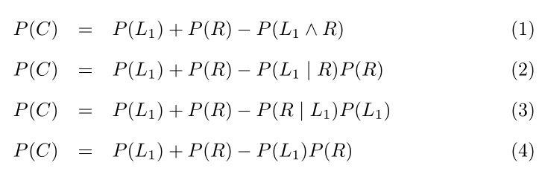
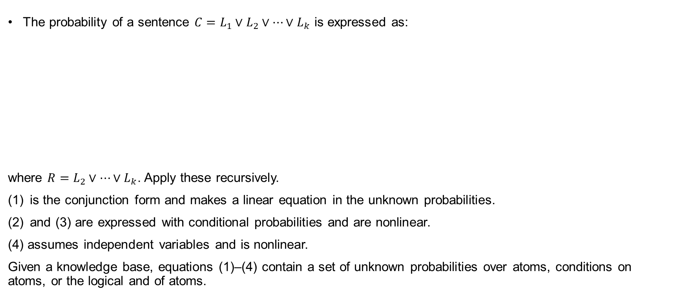
Our approach
The probability of a sentence $C=L_{1}∨L_{2}∨…∨L_{k}$ is expressed as:
where $R=L_{2}∨…∨L_{k}$. Apply these recursively.
is the conjunction form and makes a linear equation in the unknown probabilities.
and (3) are expressed with conditional probabilities and are nonlinear.
(4) assumes independent variables and is nonlinear.
Given a knowledge base, equations (1)–(4) contain a set of unknown probabilities over atoms, conditions on atoms, or the logical and of atoms.

Slide 16
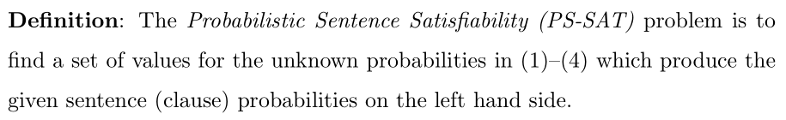
Our approach
But why do we care about such solutions? – P(L_{i})

Slide 17
A closer Look
We know that:
P(A v B) = P(A) + P(B) – P(A ^ B)
We like terms such as P(A) and P(B) – they are the answers we are after in general.
We introduce three constraints on P(A ^ B):
P(A ^ B) = P(A|B)P(B)
P(A ^ B) = P(B|A)P(A)
P(A ^ B) = P(A)P(B)
1 & 2 are from the definition of conditional probability;
3 is the independence assumption.
Replace B with R = L₂ v L₃ … v L_{k}, we have the four equations.

Slide 18

Our approach
1. Convert K to a system of nonlinear equations expressing the clause probabilities in terms of one of Equations (1) to (4).
2. Solve numerically, constraining each unknown to be in the [0,1] interval.

Slide 19

Example (with Independent Variables)
KB is:
K = A[0.7] ∧ (¬A ∨ B)[0.7]
System from constraint is:
0.7 = P(A)
0.7 = P(~A) + P(B) – P(~A)*P(B)
1 = P(A) + P(~A)
1 = P(B) + P(~B)
Solve for P(A) and P(B):
P(A) = 0.7
P(B) = 0.571

Slide 20
What do we compute?
If variables are independent, and our approach finds a solution, then the solution is a PSAT solutions.
We are solving non-linear systems, whether a solution can be found also depends on other things, such the initial condition used in search.
On the negative side, our approach cannot be used to rule out the existence of PSAT solutions, when we don’t find a solution, due to the use of numerical solvers.

Slide 21
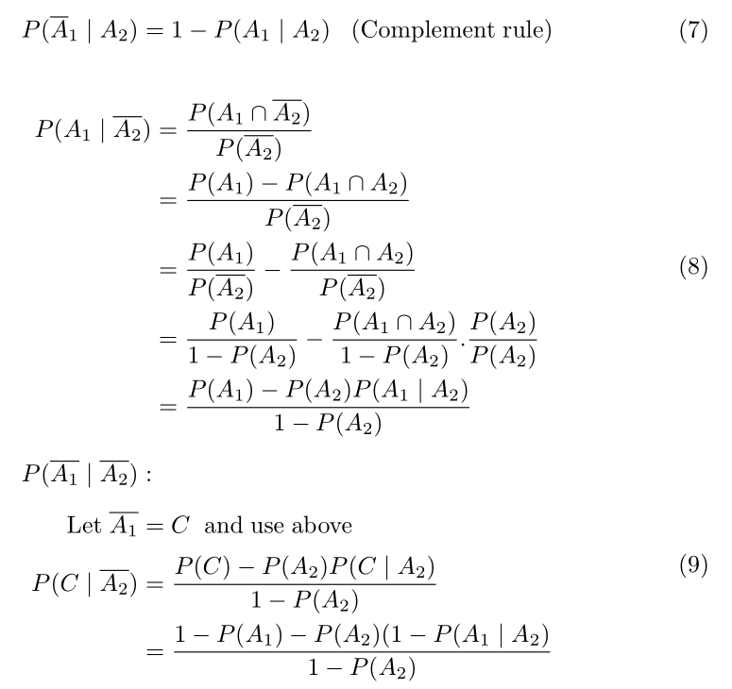
For non-independent variables
The paper gives a few more constraints to consider, all derived from probability rules. But same idea in general.

Slide 22
In summary
To solve PS-SAT, we solve a system of nonlinear equations derived directly from the meaning of the probability of the logical sentences.
The experiments reported here show that solving these systems is possible and not overly complex, and the number of variables and sentences used in our experiments is beyond the current state-of-the-art on directly solving PSAT.
In future, explore suitable applications.

