Slide 1
Poison Ivy Website Idea

Slide 2
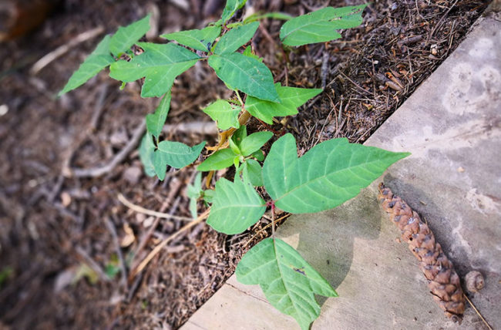
Is this poison ivy?
Definitely
No way!

Slide 3
YES IT IS!
Some kind of reaction to if you got it right or not
Running score of users correct and wrong answers
Definitely
No way!

