Slide 1
590PR Final Project Presentation
—— NBA Western Conference Champion Prediction
Group Member: Mengyuan Li, Yushuo Fan, Ruoqiao Zhang, Xiang Chen

Slide 2
Contents
Background
Data Collection
Class
Random Variables & MC Simulation

Slide 3
590PR Final Project Presentation
—— NBA Western Conference Champion Prediction
Part 1 —— Object and NBA Competition System

Slide 4

NBA: National Basketball Association
30 Teams, 2 Conferences (Eastern and Western)
The last two winning teams of each conference compete for conference champions
The champions of each conference compete for the NBA champion
Regular Season: 82 games per team
Playoffs: Top 8 teams from each conference

Slide 5
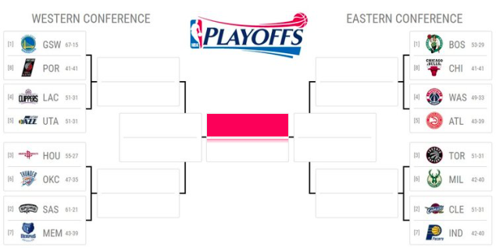

Slide 6
590PR Final Project Presentation
—— NBA Western Conference Champion Prediction
Part 2 —— Data Collection

Slide 7
Two Periods to collect data
Final Eight Teams
1 vs 7
Latest two games
Team A vs Team B (latest 2)
Team A vs Team C (latest 2)
……
Important
Each game
Until Apr-26th, 2018 (yesterday)
Regular Season:
Playoffs:

Slide 8
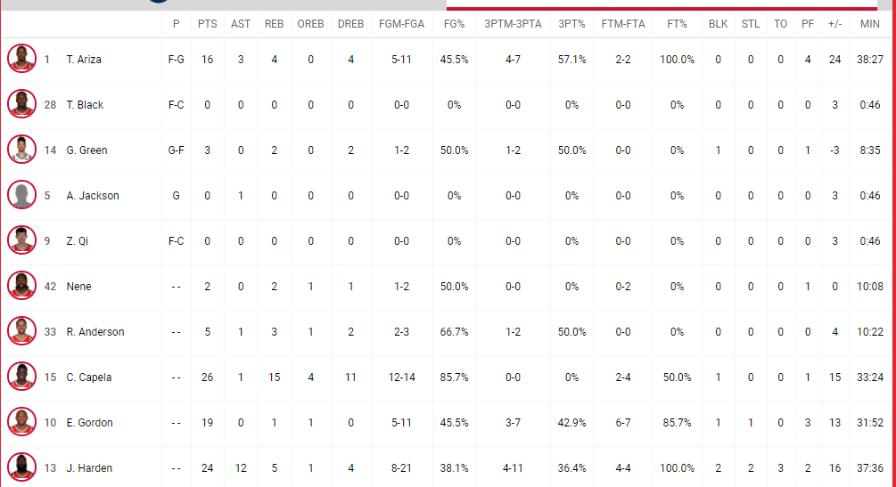
Data Source
NBA Website
Team Website
Team Schedule

Slide 9
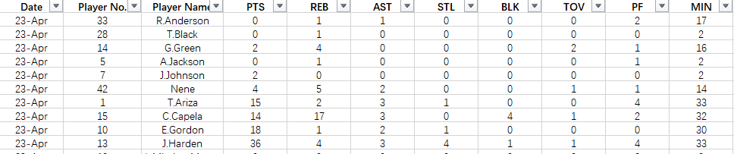
How to use the data
Positive Weighting
Negative Weighting
Playing Time

Slide 10
590PR Final Project Presentation
—— NBA Western Conference Champion Prediction
Part 3 —— Class

Slide 11
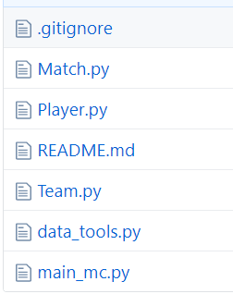
Class Description
Match.py, Player.py, Team.py:
Three classes we design for the simulation
data_tools.py:
Process csv files of player data
main_mc.py:
The file of Monte Carlo process, import the modules above to run the program

Slide 12
590PR Final Project Presentation
—— NBA Western Conference Champion Prediction
Part 4 —— Random Variables and MC Simulation

Slide 13
Player Performance Score: X_player
Player Performance
Data X
X = [feature1, feature2, …]
X_player = w1 * feature1 + w2 * feature2....
w: weights we assign subjectively based on experience,
where sum(w) = 1
Performance Score
Calculator
X_player ~ N (E(X_player), D(X_player))
Normal distribution:
In general, a player’s performance in a match fluctuates around his average level and rarely reaches extreme values.
X_player

Slide 14
Team Performance Score: X_team
X_team = X_player1 + X_player2 + X_player3 + X_player4 + X_player5
Assume players are independent of each other
X_team ~ N (E(sum(X_players)), D(sum(X_players))
In the simulation, the team who has a higher performance score wins the match

Slide 15
Choice of Players: D_team
Only 5 players will be chosen to play for their team
The longer a player plays in recent matches, the higher the probability that he will be chosen to play the upcoming match.
Discrete distribution
Player
player1
player2
...
P = sum(player’s playing time) /sum(team’s playing time)
Probability of being chosen
P1
P2
...

Slide 16
Monte Carlo Simulation
For a single Match and each team
Decide D_team (choose 5 players with certain probability)
Calculate distribution of X_team based on X_players
Randomly choose a value from the distribution of X_team
The Team with higher performance score wins

Slide 17
Monte Carlo Simulation
Decide battle teams according to the NBA rules and find the final champion
Simuluate the process above n times, calculate the winning probability for each team, P = (winning times) / n

Slide 18
Thanks!

