Slide 1
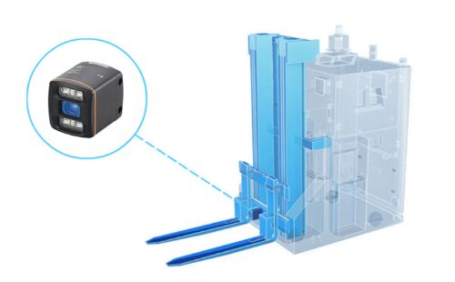
Z
camera
X
Y

Slide 2
camera
5cm
origin

