Slide 1
Greedy vs Dynamic Programming Approach
Comparing the methods
Knapsack problem
Greedy algorithms for 0/1 knapsack
An approximation algorithm for 0/1 knapsack
Optimal greedy algorithm for knapsack with fractions
A dynamic programming algorithm for 0/1 knapsack

Slide 2
Greedy Approach VS Dynamic Programming (DP)
Greedy and Dynamic Programming are methods for solving optimization problems.
Greedy algorithms are usually more efficient than DP solutions.
However, often you need to use dynamic programming since the optimal solution cannot be guaranteed by a greedy algorithm.
DP provides efficient solutions for some problems for which a brute force approach would be very slow.
To use Dynamic Programming we need only show that the principle of optimality applies to the problem.

Slide 3
The 0/1 Knapsack problem
Given a knapsack with weight W > 0.
A set S of n items with weights w_{i} >0 and
benefits b_{i}> 0 for i = 1,…,n.
S = { (item₁, w₁, b₁ ), (item₂, w₂, b₂ ) ,
. . . , ( item_{n,} w_{n}, b_{n} ) }
Find a subset of the items which does not exceed the weight W of the knapsack and maximizes the benefit.

Slide 4
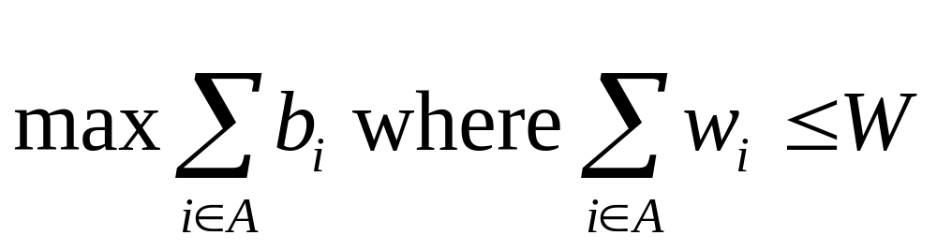
0/1 Knapsack problem
Determine a subset A of { 1, 2, …, n } that satisfies the following:
In 0/1 knapsack a specific item is either selected or not

Slide 5
Variations of the Knapsack problem
Fractions are allowed. This applies to items such as:
  bread, for which taking half a loaf makes sense
  gold dust
No fractions.
  0/1 (1 brown pants, 1 green shirt…)
  Allows putting many items of same type in knapsack
    5 pairs of socks
    10 gold bricks
  More than one knapsack, etc.
First 0/1 knapsack problem will be covered then the Fractional knapsack problem.

Slide 6
Brute force!
Generate all 2^{n} subsets
Discard all subsets whose sum of the weights exceed W (not feasible)
Select the maximum total benefit of the remaining (feasible) subsets
What is the run time?
O(n 2^{n}), Omega(2^{n})
Lets try the obvious greedy strategy .

Slide 7
Example with “brute force”
S = { ( item₁ , 5, $70 ), (item₂ ,10, $90 ), ( item₃, 25, $140 ) } , W=25
Subsets:
1. {}
2. { ( item₁ , 5, $70 ) } Profit=$70
3. { (item₂ ,10, $90 ) } Profit=$90
4. { ( item₃, 25, $140 ) } Profit=$140
5. { ( item₁ , 5, $70 ), (item₂ ,10, $90 )}. Profit=$160 ****
6. { (item₂ ,10, $90 ), ( item₃, 25, $140 ) } exceeds W
7. { ( item₁ , 5, $70 ), ( item₃, 25, $140 ) } exceeds W
8. { ( item₁ , 5, $70 ), (item₂ ,10, $90 ), ( item₃, 25, $140 ) } exceeds W

Slide 8
Greedy 1: Selection criteria: Maximum beneficial item.
Counter Example:
S = { ( item₁ , 5, $70 ), (item₂ ,10, $90 ), ( item₃, 25, $140 ) }
$140
10 lb
W = 25lb
$90
$140
$70
5 lb
25 lb
$70
25 lb
10 lb
$90
5 lb
10 lb
item₁
item₂
item₃
Knapsack
Greedy
Solution
=$140
Optimal
Solution
=$160

Slide 9
Greedy 2: Selection criteria: Minimum weight item
Counter Example:
S = { ( item₁ , 5, $150 ), (item₂ ,10, $60 ), ( item₃, 20, $140 ) }
5 lb
$140
W =
30lb
$140
20 lb
$60
$60
20 lb
10 lb
$150
10 lb
$150
5 lb
$150
5 lb
5 lb
item₁
item₂
item₃
Knapsack
Greedy
Solution
=$210
Optimal
Solution
=$290

Slide 10
Greedy 3: Selection criteria: Maximum weight item
Counter Example:
S = { ( item₁ , 5, $150 ), (item₂ ,10, $60 ), ( item₃, 20, $140 ) }
5 lb
10 lb
$60
$140
W =
30lb
$140
20 lb
$60
20 lb
$150
10 lb
20 lb
$140
$150
5 lb
5 lb
item₁
item₂
item₃
Knapsack
Greedy
Solution
Optimal
Solution
=$200
=$290

Slide 11
Greedy 4: Selection criteria: Maximum benefit per unit item Counter Example
S = { ( item₁ , 5, $50 ), ( item₂, 20, $140 ) (item₃ ,10, $60 ), }
5 lb
B/W: $7
$140
W =
30lb
$140
20 lb
$140
B/W 2: $6
20 lb
B/W 1: $10
$60
20 lb
$50
10 lb
$60
10 lb
$50
5 lb
5 lb
item₁
item₂
item₃
Knapsack
Greedy
Solution
=$190
Optimal
Solution
=$200
What is the asymptotic runtime of this algorithm?

Slide 12
Approximation algorithms
Approximation algorithms attempt to evaluate how far away from the optimum OPT, are the solutions solAlg provided by an algorithm in the worst case
Many criteria are used. We use OPT/solAlg for maximization, and attempt to establish OPT/solAlg<=K where K is a constant (solAlg/OPT for minimization)
The following slides show that the “best” greedy algorithm for 0/1 knapsack, greedy 4 does not satisfy OPT/solAlg<=K
Often greedy4 gives an optimal solutions, but for some problem instances the ratio can become very large
A small modification of greedy4, however, guarantees, that OPT/alg<=2
This is a big improvement.
There are better approximation algorithms for knapsack

Slide 13
Approximation algorithms
Use greedy 4: select the items with maximum benefit per unit.
  Implement by Sorting S by benefit per unit.
Example where greedy4 provides a very poor solution:
  Assume a 0/1 knapsack problem with n=2
  very large W.
  S={ ( item1, 1, $2 ), ( item 2, W, $1.5W ) }.
The solution to greedy4 has a benefit of $2
An optimal solution has a benefit of $1.5W.
If we want the best investment and we have W=10,000 dollars. We should choose the 2nd one with a profit of $15,000, and not the first with a profit of $2.

Slide 14
Approximation Continued
Let BOpt denote the optimal benefit for the 0/1 knapsack problem
Let BGreedy4 be the benefit calculated by greedy4.
  For last example BOpt / BGreedy4 = $1.5W / 2
  Note: W can be arbitrarily large
We would like to find a better algorithm Alg such that
BOpt / Alg ≤ K where K is a small constant and is independent of the problem instance.

Slide 15
A Better Approximation Algorithm
Let maxB = max{ b_{i}| i =1, …, n }
The approximation algorithm selects, either the solution to Greedy4, or only the item with benefit MaxB depending on max{ BGreedy4, maxB }.
Let APP = max{ BGreedy4, maxB }
What is the asymptotic runtime of this algorithm?
It can be shown that with this modification the ratio BOpt/ APP ≤ 2 (Optimal benefit at most twice that of APP)

Slide 16
An Optimal Greedy Algorithm for Knapsack with Fractions (KWF)
In this problem a fraction of any item may be chosen
The following algorithm provides the optimal benefit:
The greedy algorithm uses the maximum benefit per unit selection criteria
  1. Sort items in decreasing b_{i} / w_{i}.
  2. Add items to knapsack (starting at the first) until there are no more items, or the next item to be added exceeds W.
  3. If knapsack is not yet full, fill knapsack with a fraction of next unselected item.

Slide 17
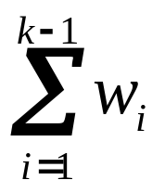
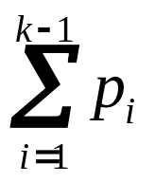
KWF
Let k be the index of the last item included in the knapsack. We may be able to include the whole or only a fraction of item k
Without item k totweight =
profitKWF =
+ min{(W - totweight),w_{k} } X (p_{k} / w_{k} )
min{(W - totweight),w_{k} }, means that we either take the whole of item k when the knapsack can include the item without violating the constraint, or we fill the knapsack by a fraction of item

Slide 18
Example of applying the optimal greedy algorithm for Fractional Knapsack Problem
S = { ( item₁ , 5, $50 ), ( item₂, 20, $140 ) (item₃ ,10, $60 ), }
B/W: $7
5 lb
5/10 * $60 = $30
$140
30lb
Max
Optimal
benefit $220
Solution:
items 1and 2
and 1/2 of
item 3
$140
B/W 2: $6
20 lb
B/W 1: $10
$60
20 lb
$50
10 lb
$50
5 lb
5 lb
item₁
item₂
item₃
Knapsack
Greedy
Solution
=
Optimal
Solution

Slide 19
Example of applying the optimal greedy algorithm for Fractional Knapsack Problem
W=30
S = { ( item1 , 5, $50 ), (item2 ,20, $140 ), ( item3, 10, $60 ) }
Note: items are already sorted by benefit/weight
Applying the algorithm:
Current weight in knapsack=0, Current benefit=0.
Can item 1 fit? 0+5<30 so select it. Current benefit=0+50
Can item 2 fit? 5+20<30, so select. Current benefit =50+140=190
Can item 3 fit? 25+10>30. No.
We can add 5 to knapsack (30-25).
So select 5/10=0.5 of item 3.
Current benefit=190+30=220

Slide 20
Greedy Algorithm for Knapsack with fractions
To show that the greedy algorithm finds the optimal profit for the fractional Knapsack problem you need to prove there is no solution with a higher profit (see text)
Notice there may be more than one optimal solution

Slide 21
Principle of Optimality for 0/1 Knapsack problem
Theorem: 0/1 knapsack satisfies the principle of optimality
Proof: Assume that item_{i} is in the most beneficial subset that weighs at most W. If we remove item_{i} from the subset the remaining subset must be the most beneficial subset weighing at most W - w_{i} of the n -1 remaining items after excluding item_{i}.
If the remaining subset after excluding item_{i} was not the most beneficial one weighing at most W - w_{i} of the n -1 remaining items, we could find a better solution for this problem and improve the optimal solution. This is impossible.

Slide 22
Dynamic Programming Approach
Given a knapsack problem with n items and knapsack weight of W.
We will first compute the maximum benefit, and then determine the subset.
To use dynamic programming we solve smaller problems and use the optimal solutions of these problems to find the solution to larger ones.

Slide 23
Dynamic Programming Approach
What are the smaller problem?
  Assume a subproblem in which the set of items is restricted to {1,…, i } where i ≤ n, and the weight of the knapsack is w, where 0≤ w ≤ W.
  Let B [i, w] denote the maximum benefit achieved for this problem.
  Our goal is to compute the maximum benefit of the original problem B[n, W]
  We solve the original problem by computing B[i, w] for i = 0, 1,…, n and for w = 0,1,…,W.
  We need to specify the solution to a larger problem in terms of a smaller one

Slide 24
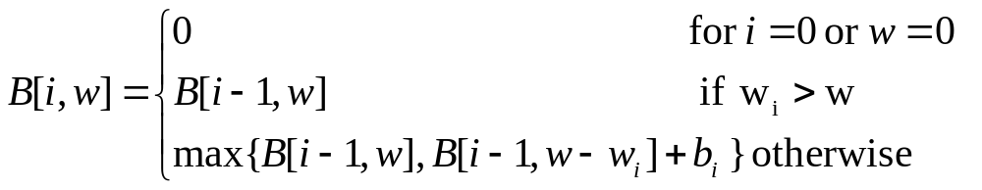
Recursive formula for the “smaller” 0/1Knapsack Problem
Using only item₁ to item_{i} and knapsack weight at most w
3 cases:
1. There are no items in the knapsack, or the weight of the knapsack is 0 - the benefit is 0
2. The weight of item_{i} exceeds the weight w of the knapsack - item_{i} cannot be included in the knapsack and the maximum benefit is B[i-1, w]
3. Otherwise, the benefit is the maximum achieved by either not including item_{i} ( i.e., B[i-1, w]),
or by including item_{i} (i.e., B[i-1, w-w_{i}]+b_{i})

Slide 25
Pseudo-code:0/1 Knapsack
(n+1)*(W+1) Matrix
Input: {w₁ ,w₂, . . . w_{n} }, W , {b₁ ,b₂, . . . b_{n} }
Output: B[n, W],
for w ← 0 to W do // row 0
B[0,w] ← 0
for k ← 1 to n do // rows 1 to n
B[k, 0] ← 0 // element in column 0
for w ← 1 to W do // elements in columns 1 to W
if (w_{k} ≤ w) and (B[k-1, w- w_{k} ] + b_{k} > B[k-1, w])
then B[k, w] ← B[k-1, w- w_{k} ] + b_{k}
else B[k, w] ← B[k-1, w]

Slide 26
Example:
W = 30, S = { ( i₁ , 5, $50 ), (i₂ ,10, $60 ), ( i₃, 20, $140 ) }
Weight: 0 1 2 3 … 30
MaxProfit { } 0 0 0 0 … 0
Weight: 0 1 2 3 4 5 … 30
MaxProfit { } 0 0 0 0 0 0 … 0
MaxProfit{i₁} 0 0 0 0 0 50 … 50

Slide 27
Example continued
W = 30, S = { ( i₁ , 5, $50 ), (i₂ ,10, $60 ), ( i₃, 20, $140 ) }
Weight: 0 ... 4 5 … 9 10 … 14 15 ... 30
MaxProfit { } 0 ... 0 0 … 0 0 … 0 0 … 0
MaxProfit{i₁} 0 ... 0 50 … 50 50 ... 50 50 … 50
MaxProfit{i₁, i₂} 0 … 0 50 … 50 60 … 60 110 … 110
B[2,10] = max { B[1,10], B[1,10-10] + b₂ }
= 60
B[2,15] = max { B[1,15], B[1,15-10] + b₂ }
= max {50, 50+60}
= 110

Slide 28
Example continued
W = 30, S = { ( i₁ , 5, $50 ), (i₂ ,10, $60 ), ( i₃, 20, $140 ) }
Wt: 0...4 5 … 9 10…14 15… 19 20… 24 25…29 30
MaxP{ } 0...0 0 … 0 0 …0 0 … 0 0…0 0… 0 0
MaxP{i₁} 0...0 50…50 50…50 50… 50 50…50 50…50 50
MaxP{i₁, i₂} 0…0 50…50 60…60 110...110 110… 110 ... 110
MaxP{i₁,i₂,i₃} 0…0 50…50 60…60 110...110 140…140 190…190 200
B[3,20] = max { B[2,20], B[2,20-20] + b₃ }
= 140
B[3,25] = max { B[2,25], B[2,25-20] + 140 }
= max {110, 50+140}
= 190
B[3,30] = max { B[2,30], B[2,30-20] + 140 }
= 200

Slide 29
Analysis
It is straightforward to fill in the array using the expression on the previous slide. SO What is the size of the array??
The array is the (number of items+1) ∗ (W+1).
So the algorithm will run in Θ( n W ). It appears to be linear BUT the weight is not a function of only the number of items. What if W= n ! ? Then this algorithm is worst than the brute force method. One can show algorithms for 0/1 knapsack with worst case time complexity of O(min ( 2^{n}, n W )) (N169)
No one has ever found a 0/1 knapsack algorithm whose worst case time is better than exponential AND no one has proven that such an algorithm is not possible.

Slide 30
Pseudo-code
Using (W +1) *2 matrix
Knapsack01(W, w_{1,} ... w_{n} , b₁ ...b_{n} )
Note: Calculating B[k,w] depends only on
B[k-1,w] or B[k-1, w- w_{k} ]. B[n,W] = B[0,W] or B[1, W] depending on whether n is even or odd.
B ← 0 // Initialize W by 2 matrix
for k ← 1 to n do
for w ← 1 to W do // w is not w_{i}
if (w_{k} ≤ w) and (B[mod(k,2), w- w_{k} ] + b_{k}
> B[mod(k,2), w ]) then
B[w,mod(k+1, 2) ] ←
B[mod(k+1,2), w- w_{k} ] + b_{k}

