Slide 1
Escrow In Etherium
Sean Brody
Jordan Seres
Max Tatiefo
Adam Weiner

Slide 2
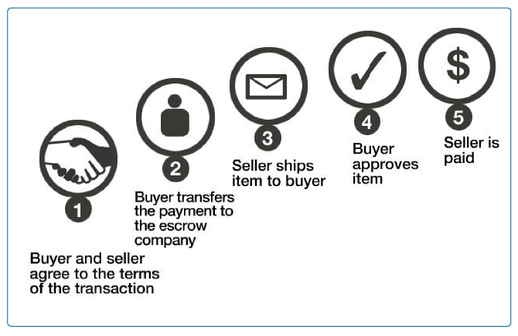
What is an Escrow
A contractual arrangement in which a third party receives and disburses money or documents
Transacting parties govern moderating rules

Slide 3
Our implementation
Using the escrow as a middle man, sender can set up contract for a recipient to complete
Upon completion recipient gets money, the escrow keeps 5%
Only recipient confirms results, but ideally contract creator should also confirm
Did not include a timeout system for contracts

Slide 4
Code Explanation And Demo

