Slide 1
Mortality Trends in Cardiovascular Diseases:
A 9-Year Analysis of Heart Disease and Stroke in the United States (2010-2019)
By: Lauren Carter, Isaac Fonseca, Sandeep Singh and Warren Simmons
Notes:
1
Warren

Slide 2
Analysis Report of Heart Disease
This report presents an analysis of mortality rates for heart disease and stroke. The data set contains the data of 9
years ranging from 2010 to 2019 from several counties in the United States of America. The purpose of this
report is to explore trends, patterns and outliers in mortality rates across different causes of death, demographic
groups, and years. The data set has different features such as age group, sex, location, state, county, mortality rate,
confLow, confHigh, and year. The data set contains information on mortality rates for different causes of death that
may including; All Heart Disease, All Stroke, Heart Failure, Coronary Heart Disease, and Cardiovascular Disease.
Notes:
2
Warren

Slide 3
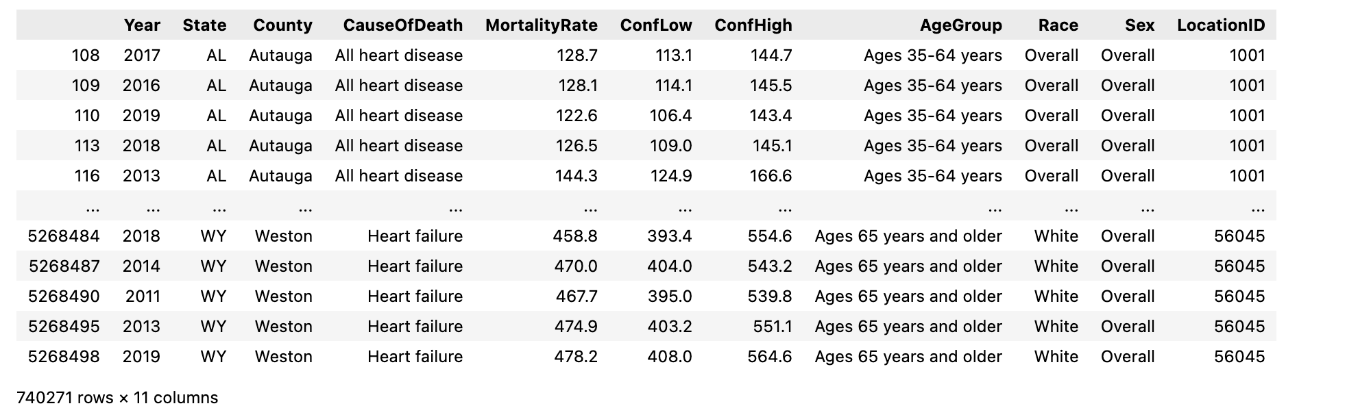
Cleaning Procedures
Handling Missing Data:
Rows with missing values in key columns (e.g., mortality rate) were removed.
Dropping Unnecessary Columns:
Columns without valuable information or with identical values across all rows were dropped.
Outlier Removal:
Extreme outliers in mortality rates were removed to improve data reliability, reducing the dataset from 5.77 million rows to 740,271 rows.
Data Refinement:
Columns were renamed for clarity, and data was restricted to the years 2010-2019.
Notes:
Data Collection:
• The dataset used in this analysis includes mortality data from various U.S. counties, spanning the years 2010 to 2019.
• The dataset includes variables such as age group, sex, state, county, cause of death (e.g., heart disease, stroke), mortality rate, and confidence intervals.
Data Cleanup Process:
1. Missing Values:
• Initial checks revealed missing data in critical columns such as Data_Value, Confidence_limit_Low, and Confidence_limit_High.
• Rows with missing critical data were dropped to ensure data quality.
2. Dropping Unnecessary Columns:
• Columns with missing or non-informative values (e.g., Data_Value_Footnote, DataSource) were dropped.
• Columns where all values were identical across rows (e.g., GeographicLevel, Class) were also removed to reduce redundancy.
3. Data Type Conversion:
• The Year column was converted to numeric format, and rows with invalid years were dropped.
• Remaining data was filtered to include only records from 2010-2019.
4. Outlier Removal:
• Outliers in the MortalityRate column were identified and removed, using the 1st and 99th percentiles to filter extreme values.
5. Column Renaming:
• For better clarity, key columns were renamed (e.g., LocationAbbr to State, Data_Value to MortalityRate).

Slide 4
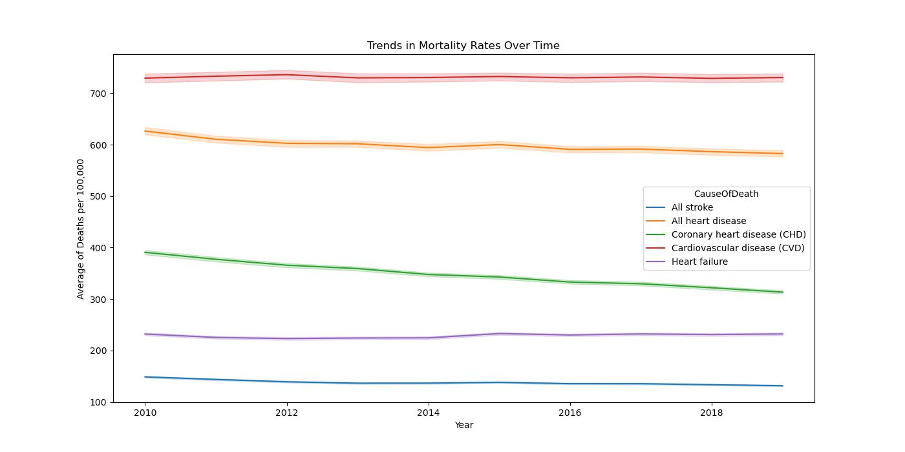
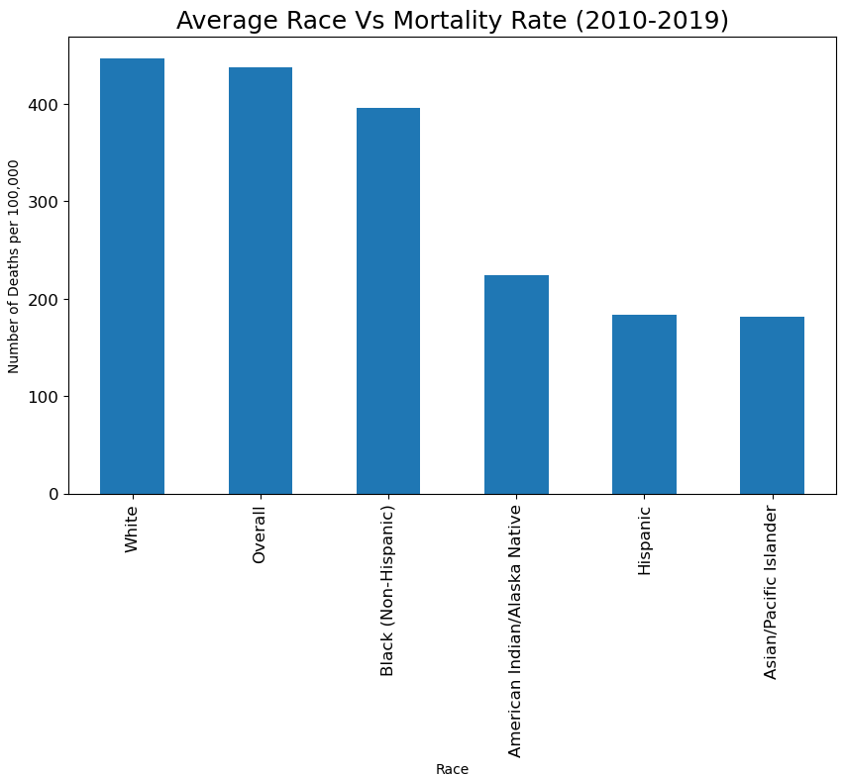
Data Exploration: Overall Trends and Race 2010-2019
Notes:
1- The mortality rate was measured on all causes for over a period of 10 years. The first graph shows the trends of the mortality rate from year 2010 to 2019. The main key findings shows that there were only 2 causes that had a major decline over the years and it includes CHD and All heart diseases. This decline shows how practitioners were able to provide remedies of these diseases and reduced the mortality rate. However, CVD and Heart failure didn’t show any improvement and CVD remained the top cause of higher mortality rate among the humans. All heart disease is at the second number while all stroke causes the minimum deaths throughout this period.
3- So this is the graph that separately plots the comparison between different races and their corresponding mortality rates.
In here, like before, the white has the highest mortality rate while overall is at the second position and native Asians or pacific islanders have the lowest mortality rate. Hispanic is also very close to the Asians. Now there could be several reasons for all these differences such as diet, health routines, etc. As white people have different diet and activities while Asians have different diet and activities, these factors could be considered as why white has the highest mortality rate and Asians have the lowest mortality rate.
Sandeep

Slide 5
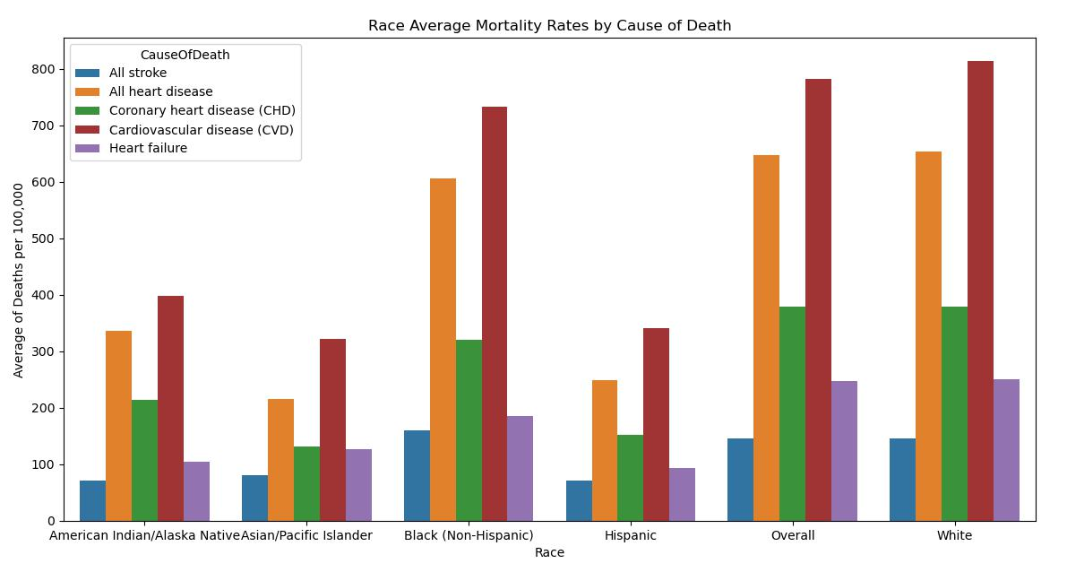
Data Exploration: Race and Cause of Death 2010-2019
Notes:
2-In the second plot, we compared the mortality rate considering the factors like race and the cause. The trends shows clearly that CVD has the higher mortality rate in all races. While all heart disease remained at the second position. However if we try to compare it based on race then white has the highest mortality rate in almost all causes of death while native Asians or pacific islander have the lowest mortality rate for all causes.
Sandeep

Slide 6
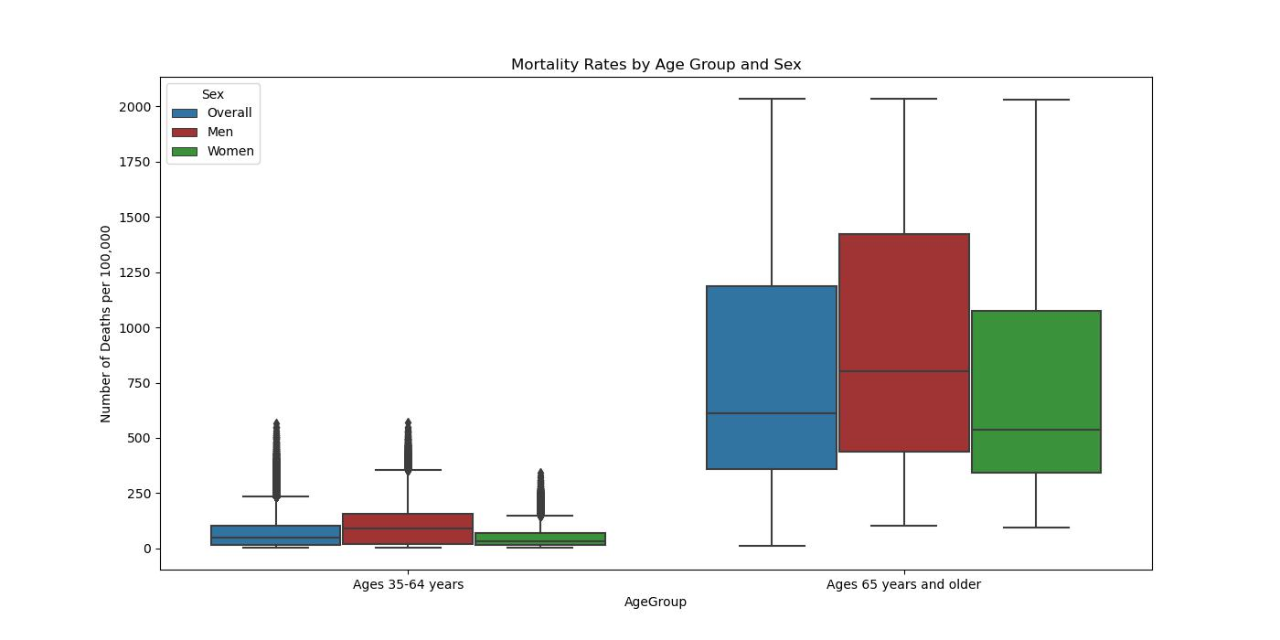
Data Exploration Analysis Ages Group
Men tend to develop heart disease at a younger age compared to women
Women generally develop heart disease later in life, often after menopause when estrogen levels decline.
Men are more likely to have higher rates of risk factors such as high blood pressure, high cholesterol, and smoking, which contribute to the development of heart disease.
Lauren
Notes:
6
Isaac
Understanding these differences is crucial for developing targeted prevention and treatment strategies for both men and women.
Men are more likely to engage in behaviors that increase the risk of heart disease, such as smoking, heavy alcohol consumption, and poor diet

Slide 7
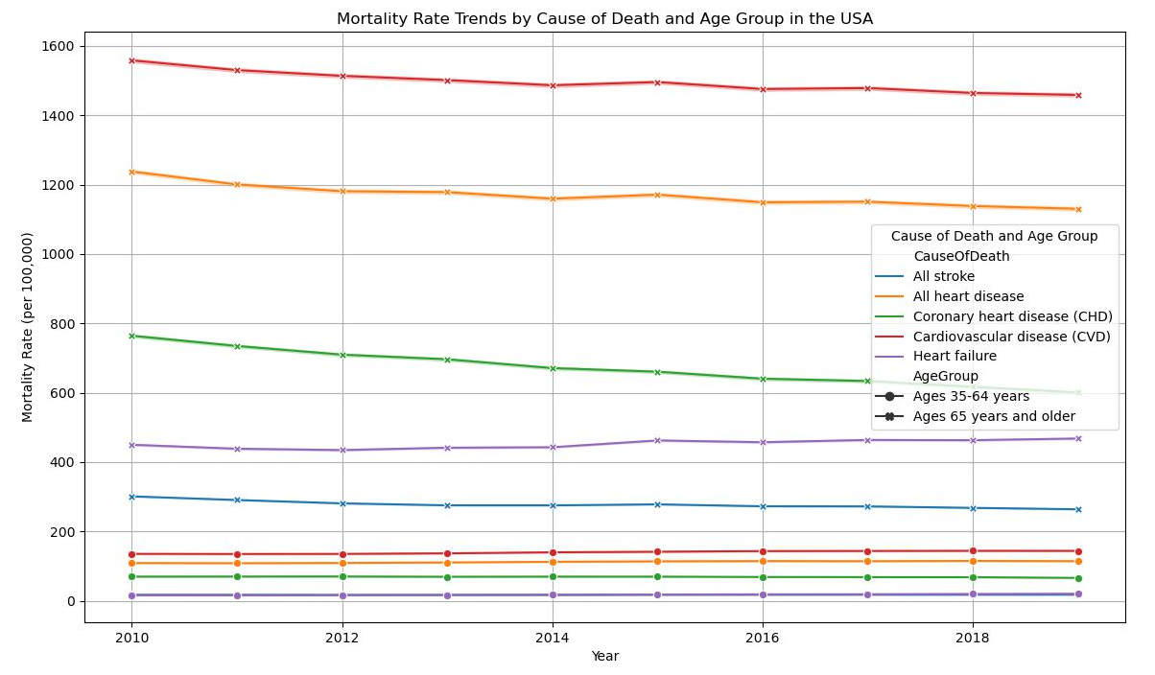
Data Exploration Analysis Ages Group
Mortality Rates: Cardiovascular diseases (CVD) have the highest mortality rates, followed by all heart diseases and coronary heart disease (CHD).
Age Trends: CVD trends are higher in the age group 65 years and older compared to those aged 35-64 years.
Heart Failure: There is a slight increase in heart failure trends.
Notes:
7
Isaac
These observations are crucial for understanding the impact of cardiovascular diseases across different age groups.

Slide 8
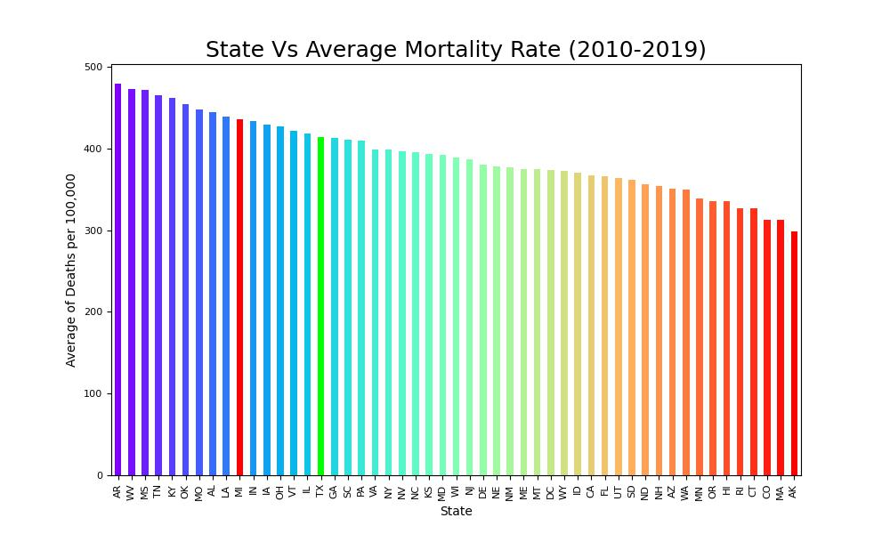
Data Exploration Analysis Group 5 Trends in Mortality Rates Texas Vs Michigan
Lauren
Notes:
8
Lauren

Slide 9
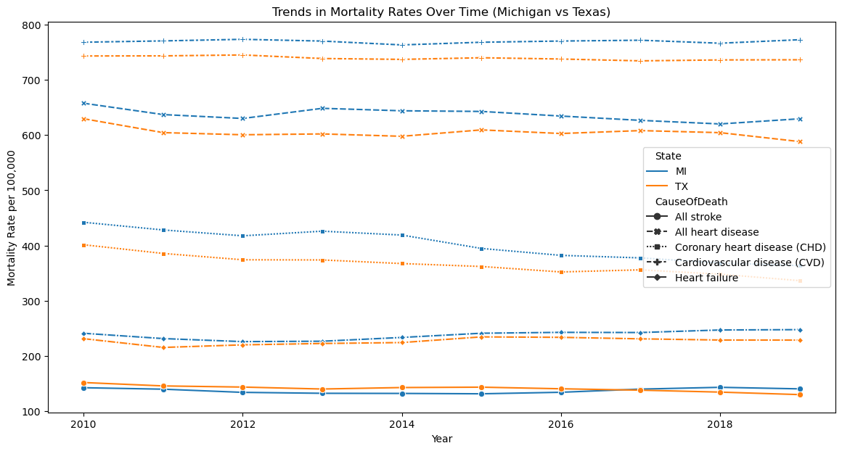
Trends in Mortality Rates Texas VS. Michigan

Slide 10
Executive Summary
Analysis Report of Heart Disease
Historical trend: Heart disease can be traced back to ancient Egypt long before modern medicine could help the civilization. Even with today's advances in heart care, heart disease remains the leading cause of death in the United States (Baystate Health, 2024).
Current trend: The age-adjusted prevalence of heart disease in men decreased from 8.3% in 2009 to 7.2% in 2018. In 2019, 7.0% of men reported having heart disease. The age-adjusted prevalence of heart disease in women decreased from 4.6% in 2009 to 4.1% in 2018. In 2019, 4.2% of women reported having heart disease (CDC, 2024).
Conclusion: The trend analysis of mortality rates for heart disease, stroke, and related conditions reveals an overall decline in mortality rates for most conditions, with significant variability.
Gender differences show a higher mortality rates for men compared to women, with notable declines for both groups. While other conditions show positive trends, the overall category of Cardiovascular Disease, remains a major health concern in the future. For example, in the United States, the age-standardized death rate from cardiovascular diseases was over 500 per 100,000 people in 1950 and declined to less than 150 in 2020. This represents a reduction of almost three-quarters. The dramatic decline in smoking has played a significant role in this reduction (Dattani et al., 2023).
Future Plans: If we have more time available, we can look at time series analysis, through machine learning we can explore Algorithms that are being used to analyze data from electronic health records, imaging, wearables, and sensors to generate personalized risk assessments (Javaid et al., 2022)
Notes:
10
Lauren

Slide 11
References
Dattani, S., Samborska, V., Ritchie, H., & Roser, M. (2023, December 28). Cardiovascular diseases. Our World in Data. https://ourworldindata.org/cardiovascular-diseases#:~:text=In%20the%20United%20States%2C%20for,significant%20role%20in%20this%20reduction
Heart disease prevalence - health, United States. (2024). https://www.cdc.gov/nchs/hus/topics/heart-disease-prevalence.htm#:~:text=The%20age%2Dadjusted%20prevalence%20of%20heart%20disease%20in%20men%20decreased,women%20reported%20having%20heart%20disease
History of Heart Disease: Ancient Egypt to Cutting Edge Surgery. (2024, June 25). Baystate Health. https://www.baystatehealth.org/articles/history-of-heart-disease
Javaid, A., Zghyer, F., Kim, C., Spaulding, E. M., Isakadze, N., Ding, J., Kargillis, D., Gao, Y., Rahman, F., Brown, D. E., Saria, S., Martin, S. S., Kramer, C. M., Blumenthal, R. S., & Marvel, F. A. (2022). Medicine 2032: The future of cardiovascular disease prevention with machine learning and digital health technology. American Journal of Preventive Cardiology, 12, 100379. https://doi.org/10.1016/j.ajpc.2022.100379
Rates and trends in heart disease and stroke mortality among US adults (35+) by county, age group, Race/Ethnicity, and sex – 2000-2019 | Data | Centers for Disease Control and Prevention. (2022, February 18). https://data.cdc.gov/Heart-Disease-Stroke-Prevention/Rates-and-Trends-in-Heart-Disease-and-Stroke-Morta/7b9s-s8ck/about_data
The heart disease gender gap. (2022, Sept 01). https://www.health.harvard.edu/heart-health/the-heart-disease-gender-gap

