Slide 1
Credit card fraud
Team 3:
Cody Lerch, Debasis Pradhan, Elena Gehle, Isaac Fonseca, and Warren Simmons
https://www.linkedin.com/pulse/3-types-credit-card-frauds-how-mitigate-them-2023-mark-taylor/

Slide 2
Project Overview
Data scaled and split into two separate CSVs, train and test.
Each of us ran one of the following models:
Logistic Regression
SVM
KNN
Decision Tree
Random Forest
XGBoost
Each model ran one default, one oversample(SMOTE & SMOTEENN), and one under sample (RUS)
The best performing model then underwent hyperparameter tuning (Gridsearch)
We then took our best performing model and compared
Finally, we selected the best model and applied it to the testing data

Slide 3
Analysis report of credit card fraud
Summary
This project presents an analysis of credit card fraud to apply an ML model for binary data (0 and 1) .
The data used for this project comes from a competition provided by Kaggle. It has been cleaned and scaled, with variables hidden to protect customers' PII.
All transactions are from Europe.
The median fraudulent charge in the data provided by Kaggle averages $254, compared to a non-fraudulent average amount of $250.
This data, collected over a 48-hour timeframe, shows an imbalance with 99.83% non-fraudulent transactions (Class 0) versus 0.17% fraudulent ones (Class 1)

Slide 4
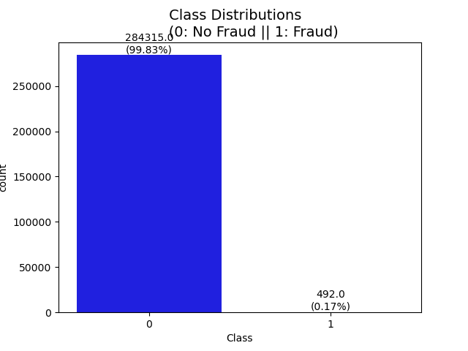
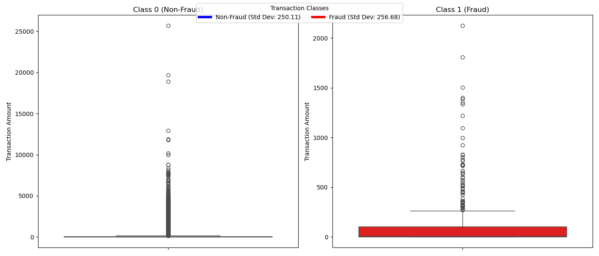
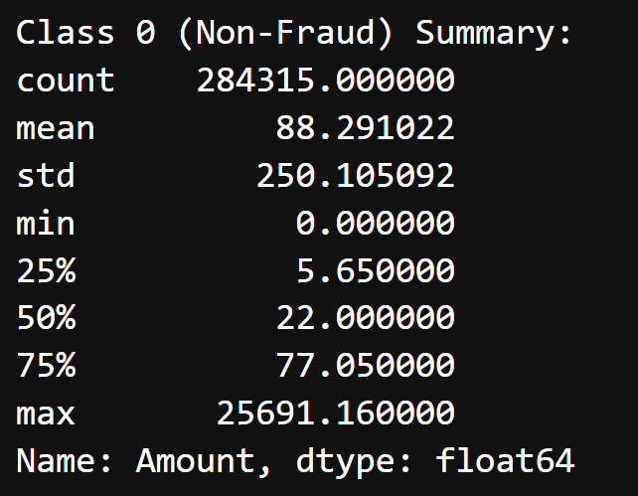
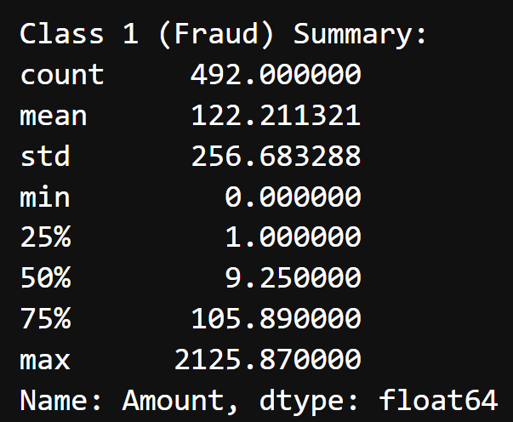
Cleaning & EDA
Standard deviation Class “1” closer to the normal transaction Class “0”
Higher Imbalance data

Slide 5
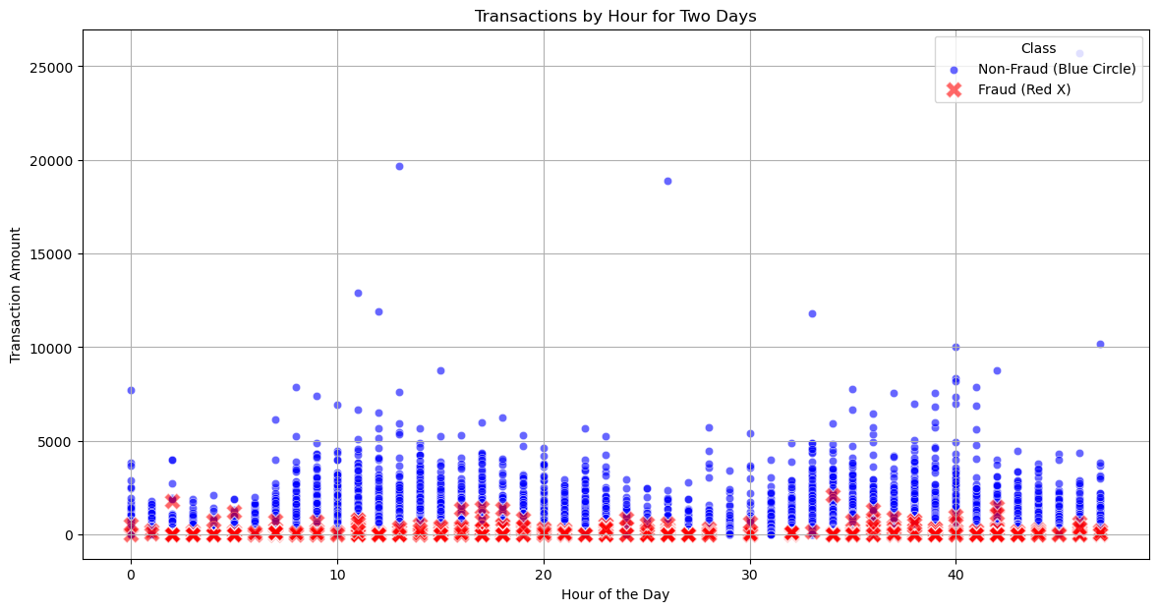
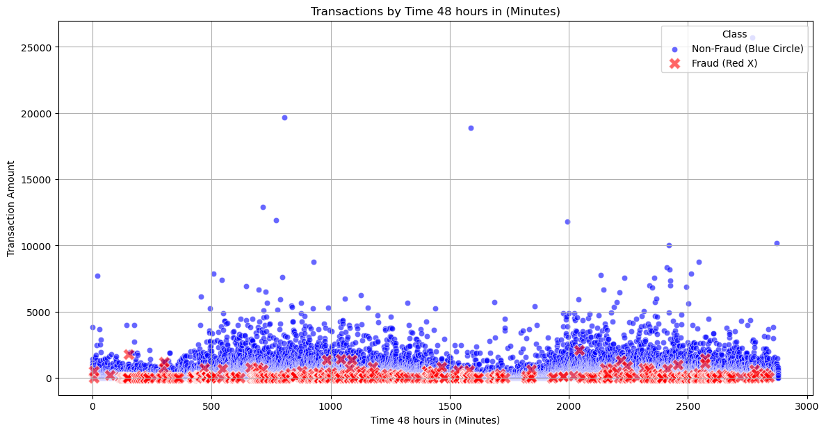
scatter plot by hour and minute

Slide 6
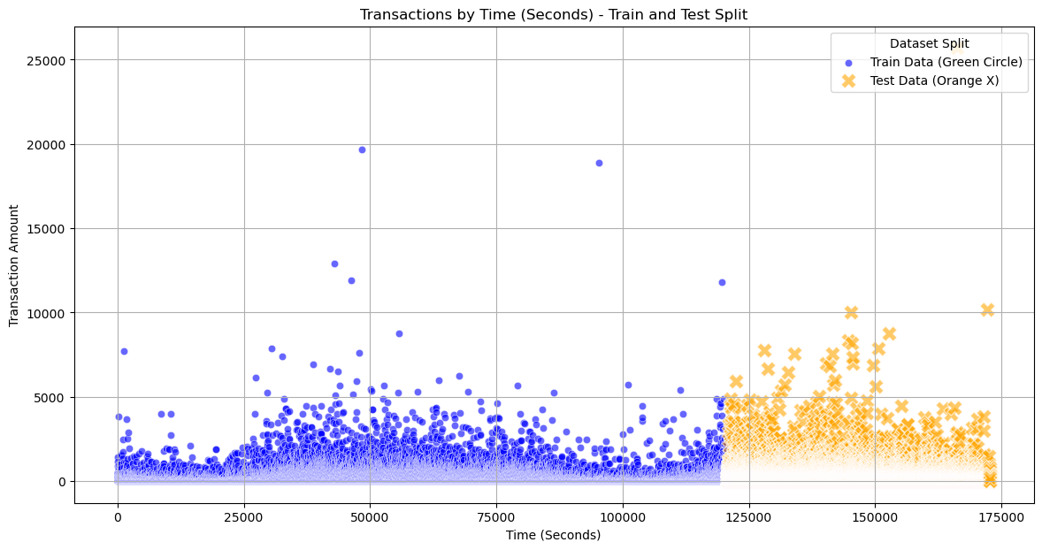
train and test split

Slide 7
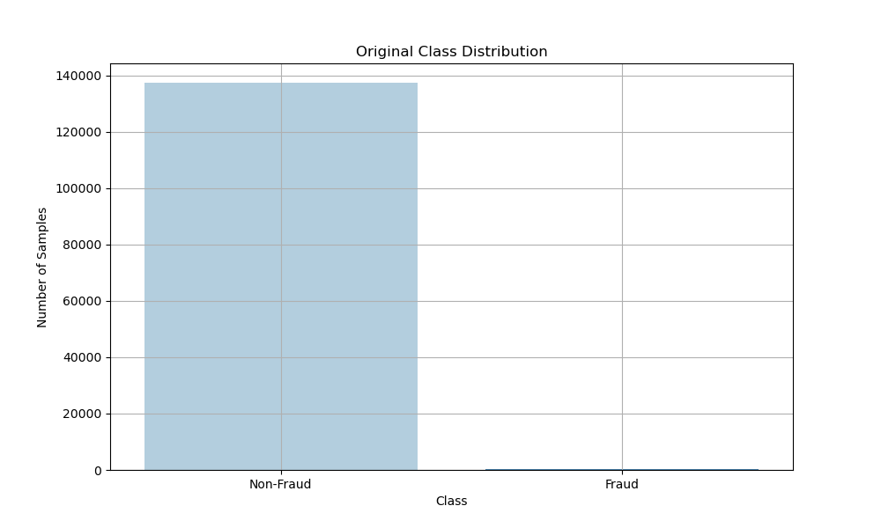
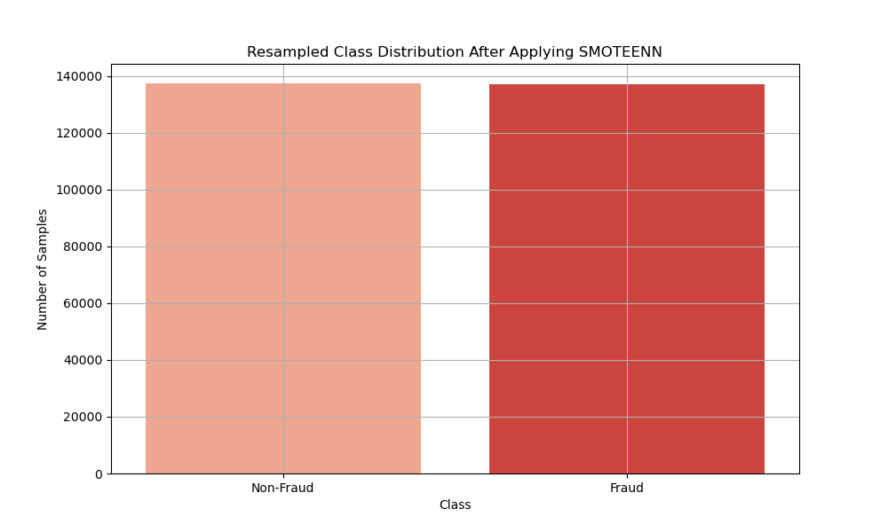
SMOTEENN (SMOTE + Edited Nearest Neighbors)
Notes:
SMOTEENN with XGBoost:
Balances the dataset and removes noisy samples.
Can lead to cleaner training data and better model performance.
More computationally intensive, but can yield better results with proper tuning.
SMOTEENN (SMOTE + Edited Nearest Neighbors)
SMOTEENN combines SMOTE with Edited Nearest Neighbors (ENN). It works by:
Applying SMOTE to generate synthetic samples for the minority class.
Using ENN to remove noisy samples from both the majority and minority classes.
Pros:
Balances the dataset by generating synthetic samples and removing noisy samples.
Can improve model performance by reducing noise and providing cleaner training data.
Cons:
More computationally intensive than SMOTE alone.
May remove useful samples if not carefully tuned.

Slide 8
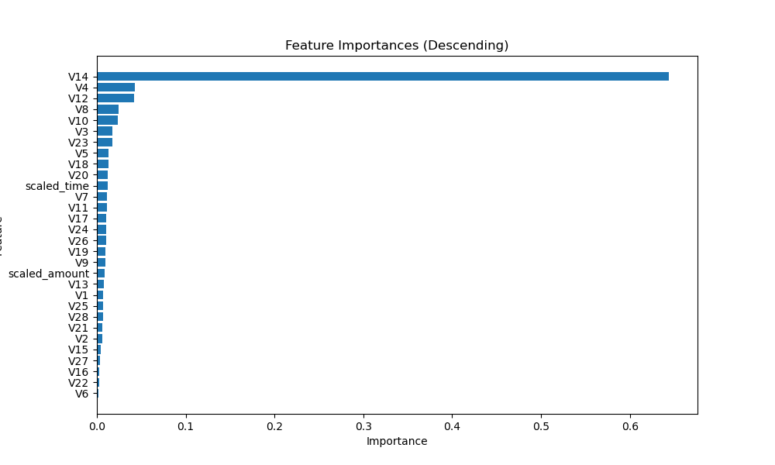
FEATURES IMPORTANCES

Slide 9
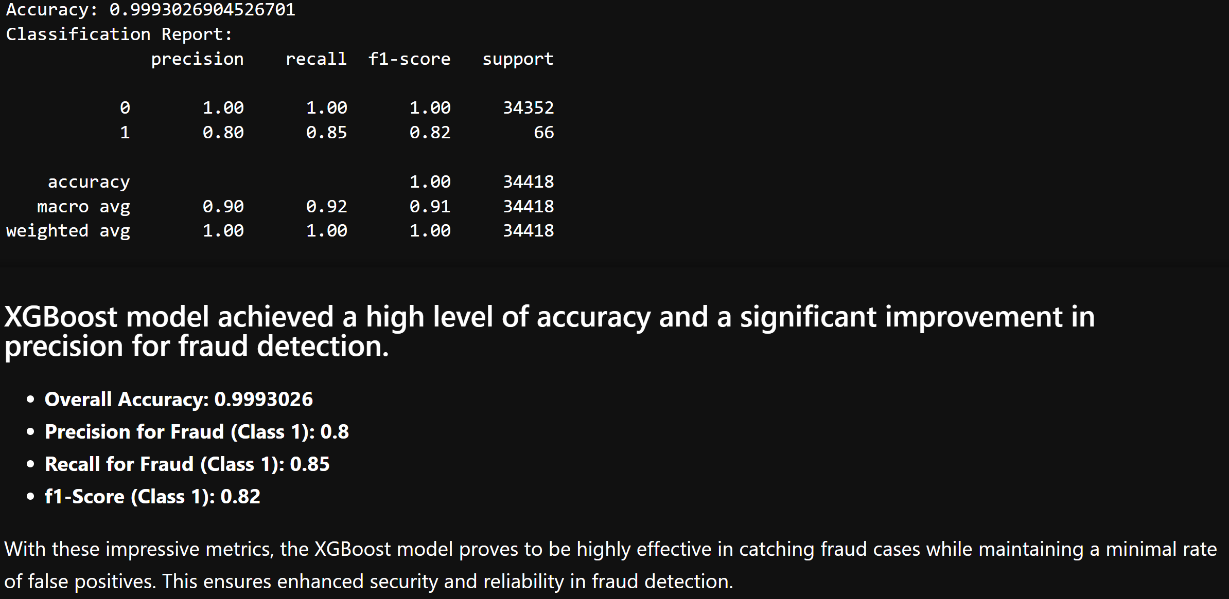
Predictive Models XGB Training data

Slide 10
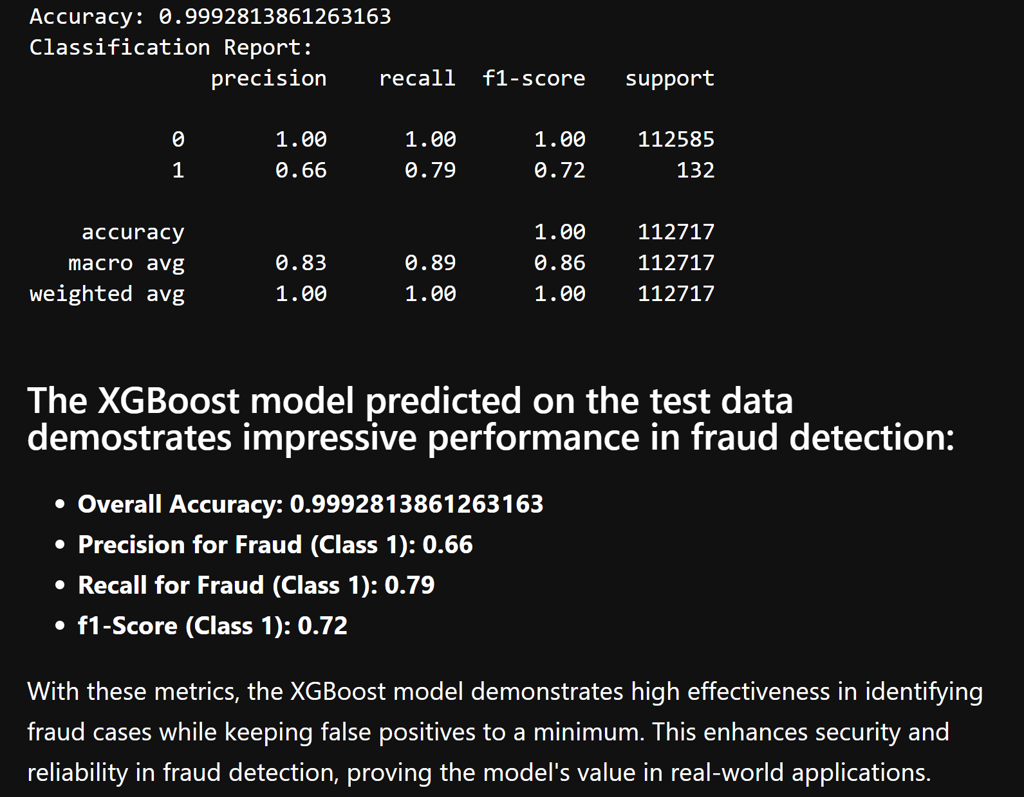
Predictive Models XGB Test data

Slide 11
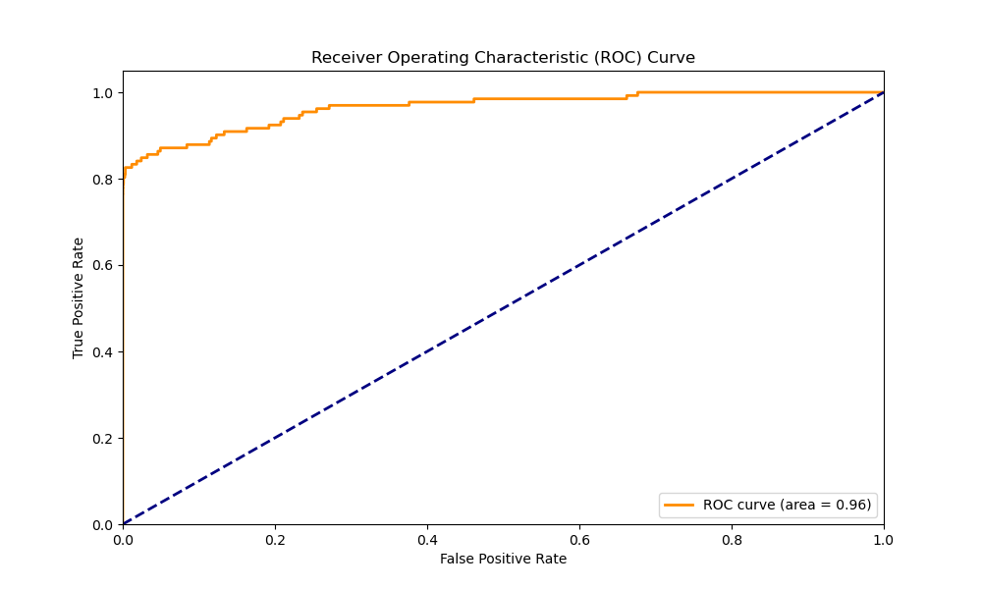
Predictive Models XGB Test data

Slide 12

Conclusion
Further research: If we had more time, we would investigate the two periods of time within the 48 hours that had no fraudulent activity. Analyzing more data than just the 48 hour period used for this dataset could give further insights as to whether there is a pattern of time that fraudulent charges tend to follow.

Slide 13
references
1). Gabriel Preda (2024) Credit Card Fraud Detection Predictive Models. https://www.kaggle.com/code/gpreda/credit-card-fraud-detection-predictive-models
2). Brett Cruz(2024, Jul 26) 52 Million Americans Experienced Credit Card Fraud Last Year. Securiety.org
3). RandomForrestClassifier, http://scikit-learn.org/stable/modules/generated/sklearn.ensemble.RandomForestClassifier.html

