Slide 1
Credit card fraud
Team 3:
Cody Lerch, Debasis Pradhan, Elena Gehle, Isaac Fonseca, and Warren Simmons
https://www.linkedin.com/pulse/3-types-credit-card-frauds-how-mitigate-them-2023-mark-taylor/

Slide 2
Analysis report of credit card fraud
Summary
This project presents an analysis of credit card fraud to apply an ML model for binary data (0 and 1) .
The data used for this project comes from a competition provided by Kaggle. It has been cleaned and scaled, with variables hidden to protect customers' PII.
All transactions are from Europe.
The median fraudulent charge in the data provided by Kaggle averages $254, compared to a non-fraudulent average amount of $250.
This data, collected over a 48-hour timeframe, shows an imbalance with 99.83% non-fraudulent transactions (Class 0) versus 0.17% fraudulent ones (Class 1)
Research Question

Slide 3
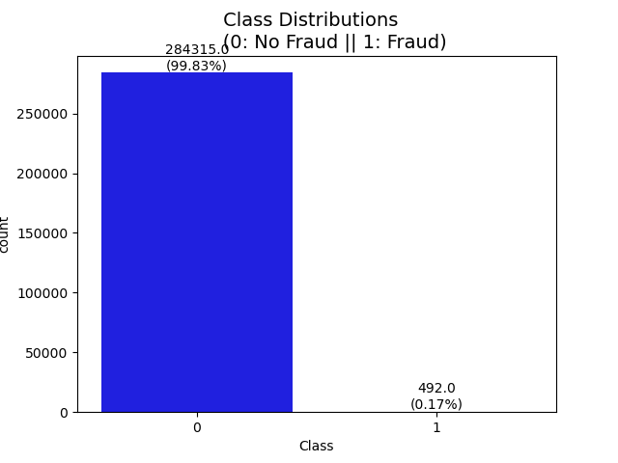
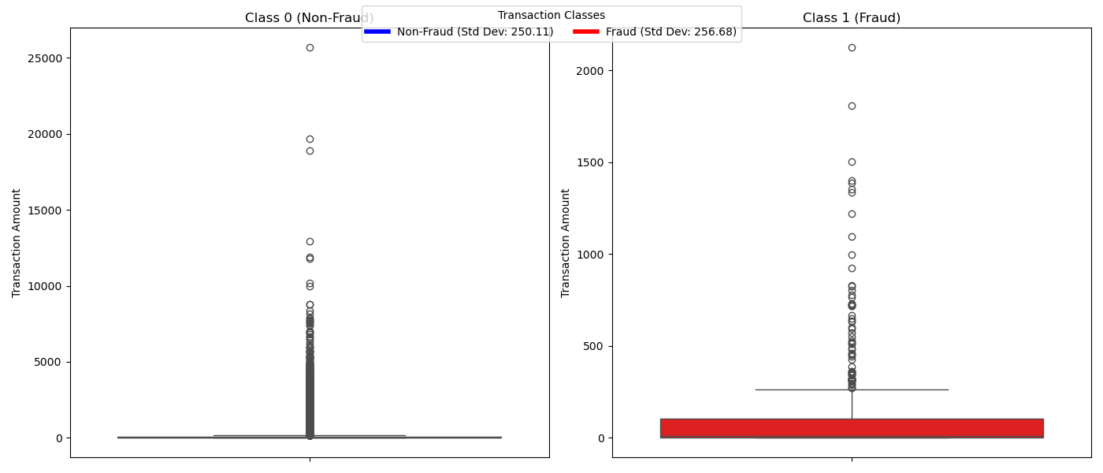
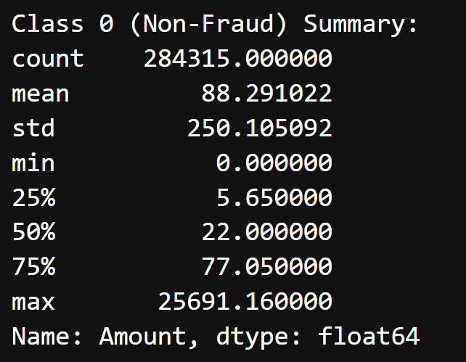
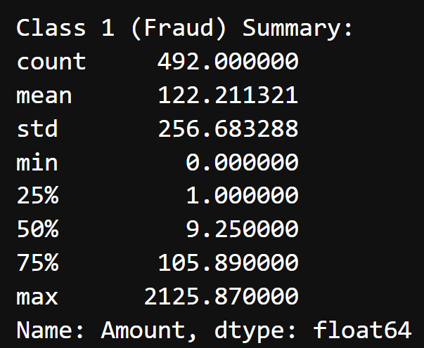
Cleaning & EDA
Standard deviation Class “1” closer to the normal transaction Class “0”
Higher Imbalance data

Slide 4
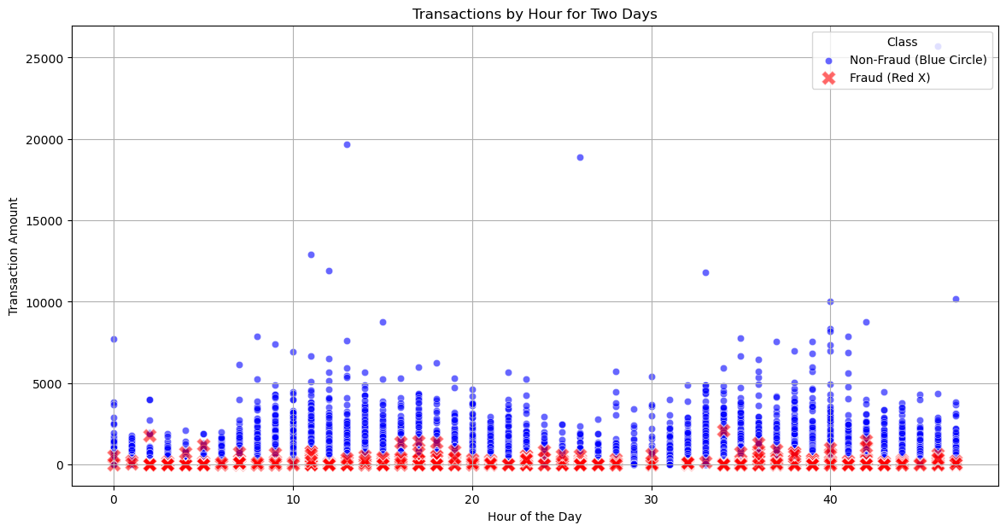
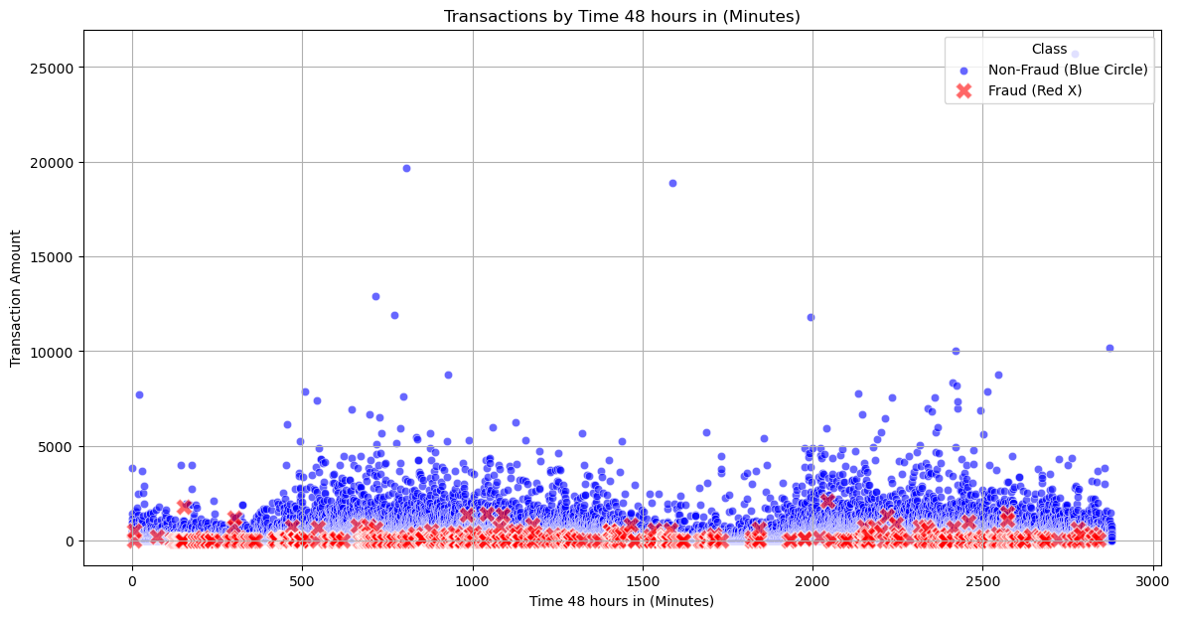
scatter plot by hour and minute

Slide 5
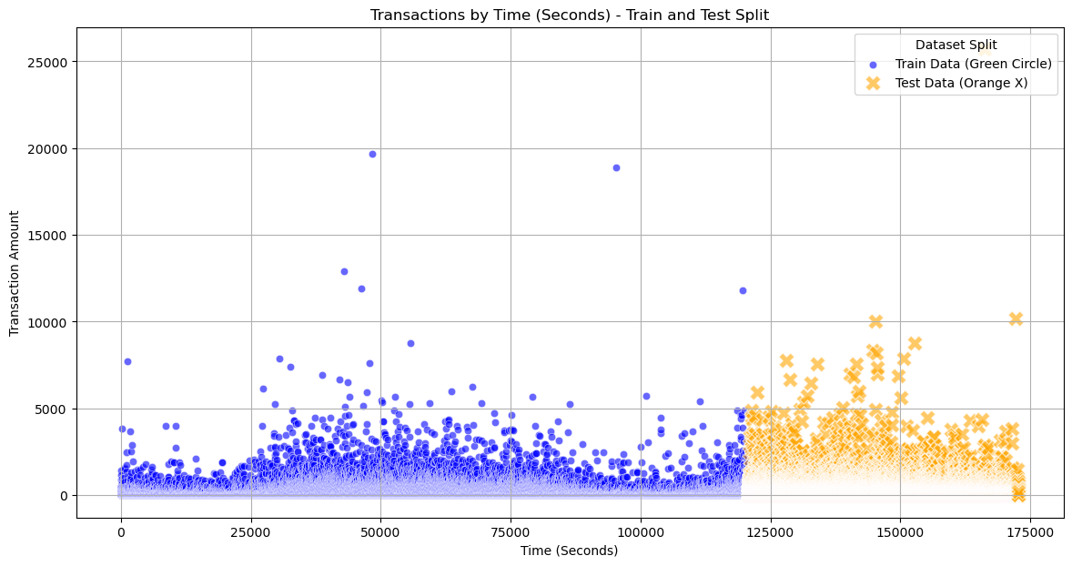
train and test split

Slide 6
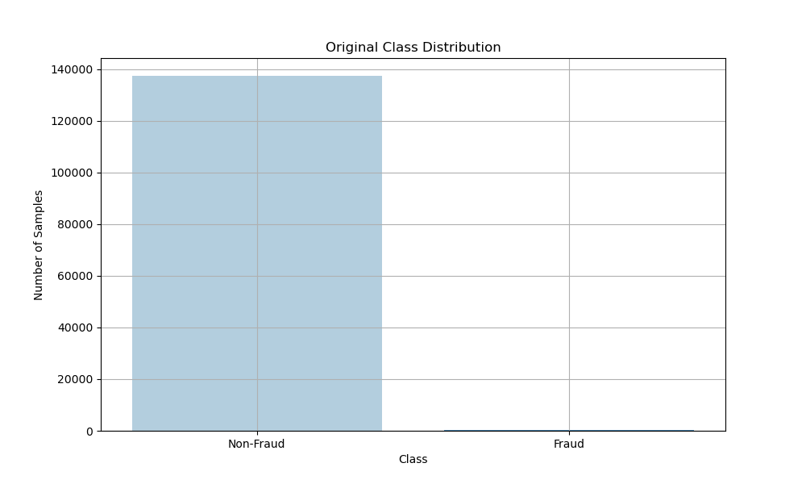
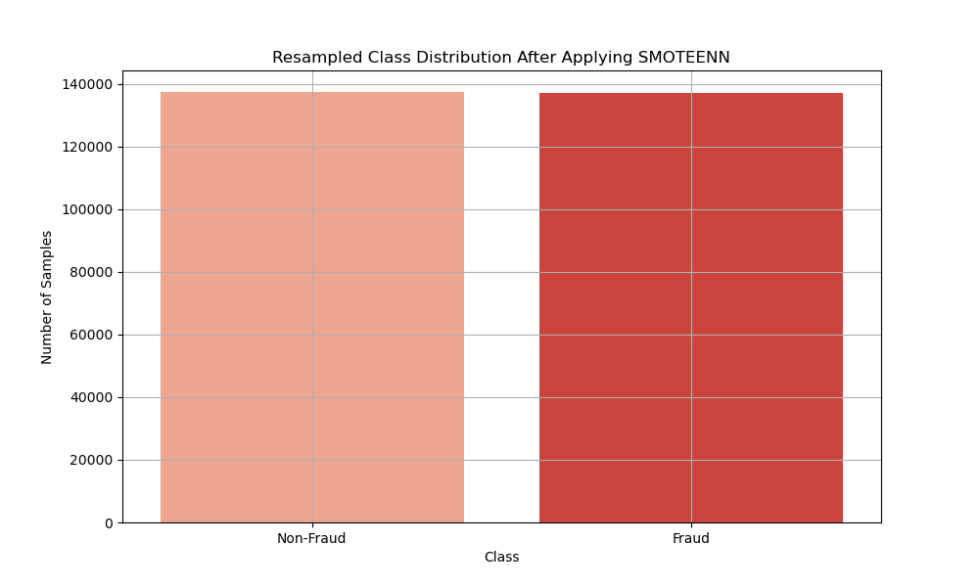
SMOTEENN (SMOTE + Edited Nearest Neighbors)
Notes:
SMOTEENN (SMOTE + Edited Nearest Neighbors)
SMOTEENN combines SMOTE with Edited Nearest Neighbors (ENN). It works by:
Applying SMOTE to generate synthetic samples for the minority class.
Using ENN to remove noisy samples from both the majority and minority classes.
Pros:
Balances the dataset by generating synthetic samples and removing noisy samples.
Can improve model performance by reducing noise and providing cleaner training data.
Cons:
More computationally intensive than SMOTE alone.
May remove useful samples if not carefully tuned.

Slide 7
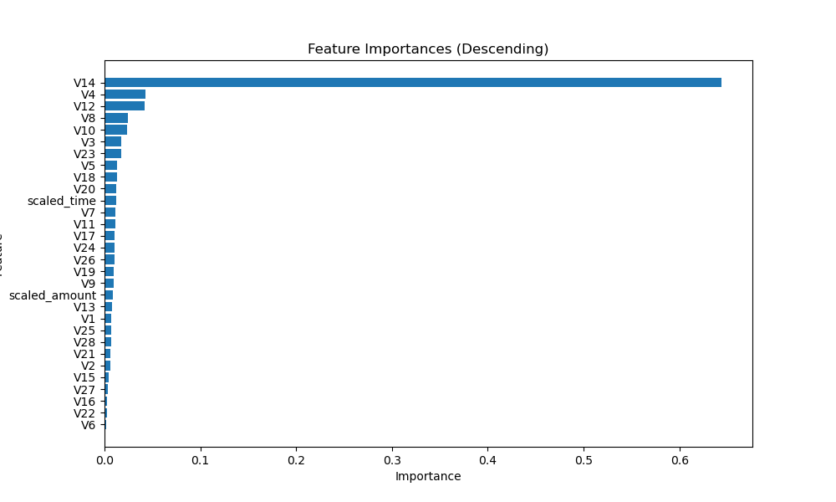
FUTURES IMPORTANCES

Slide 8
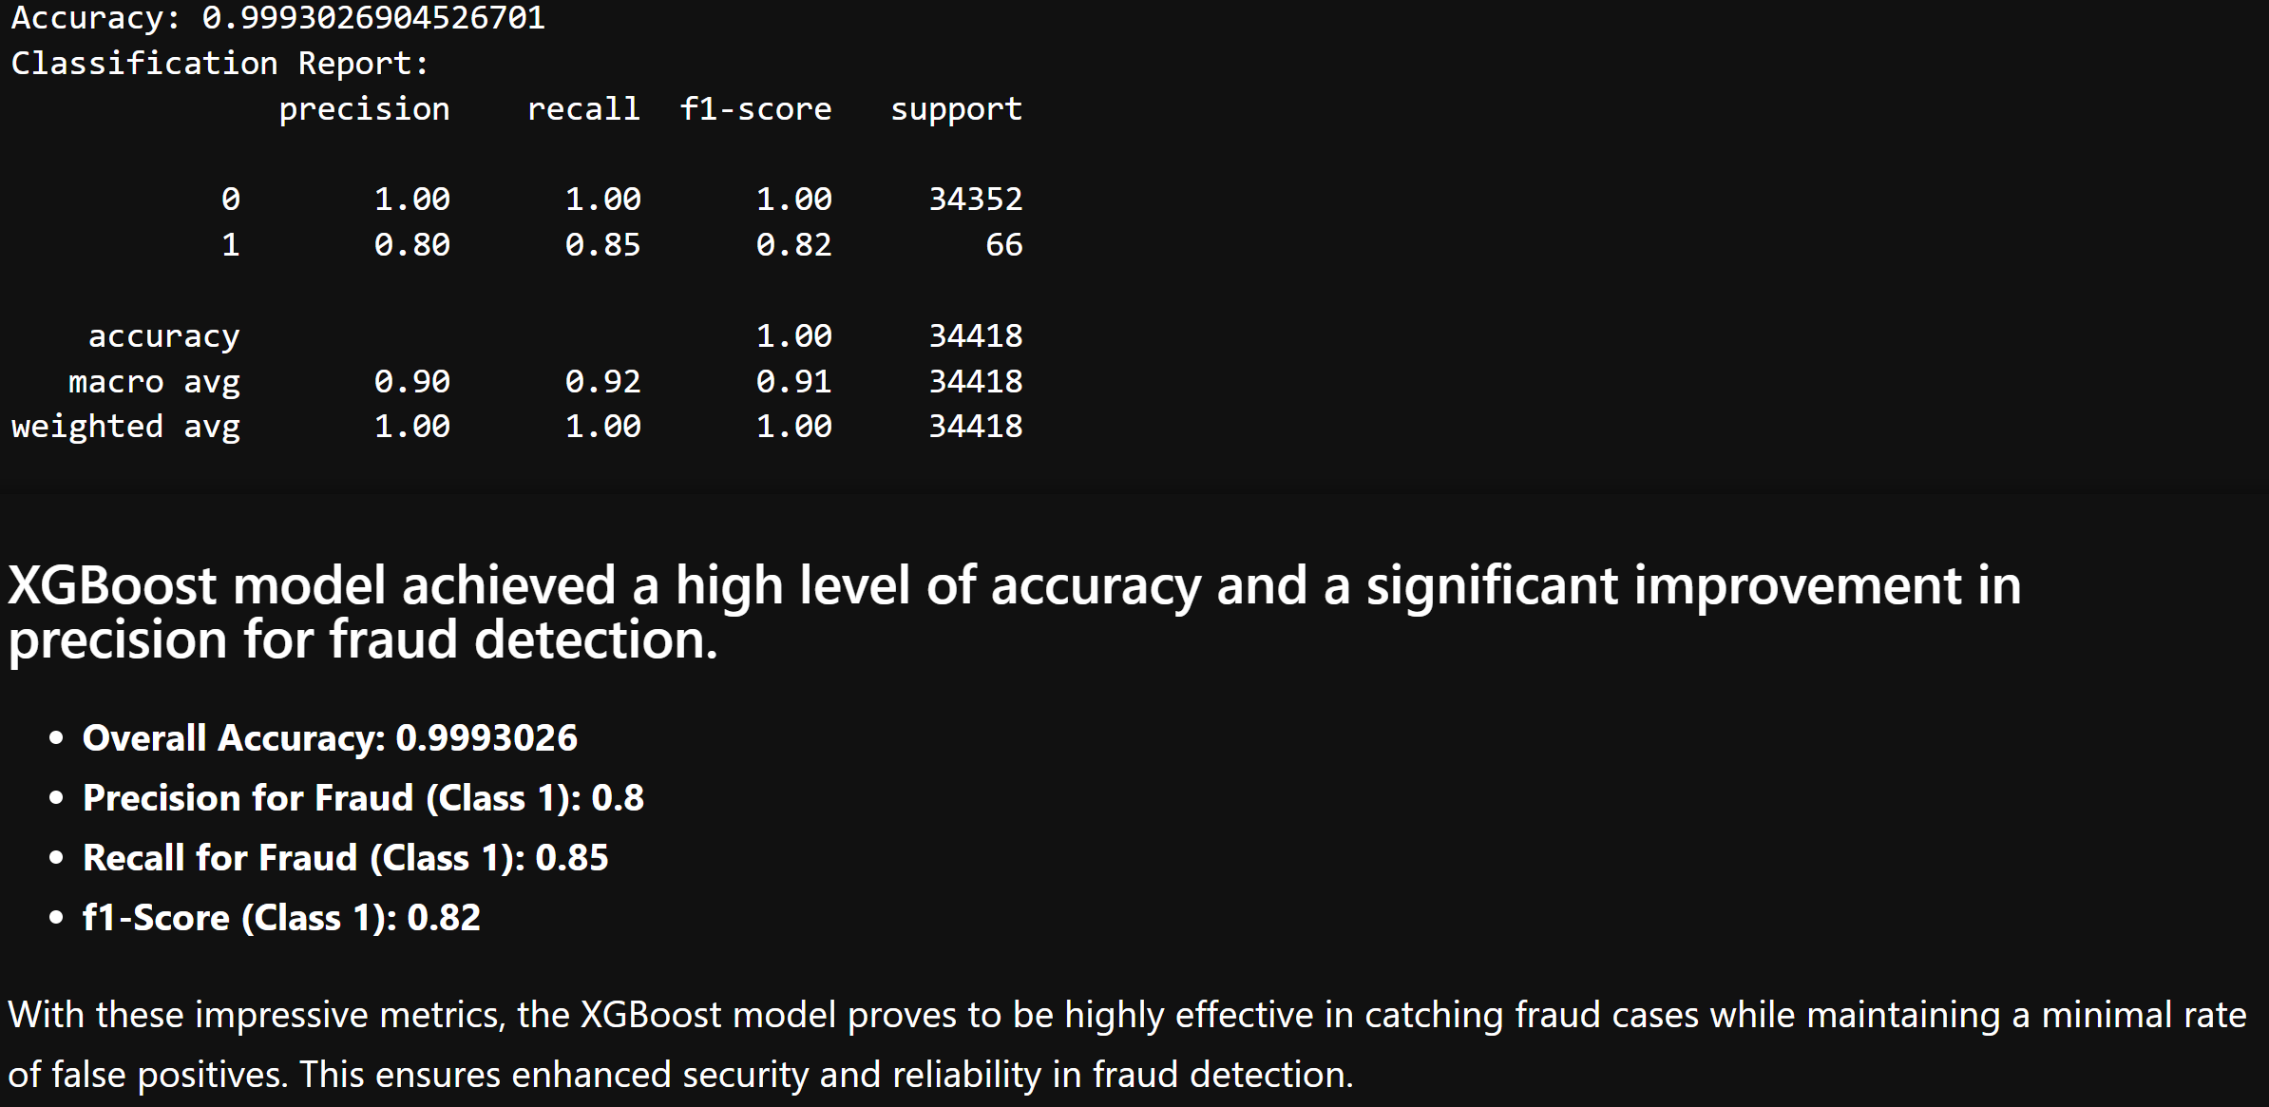
Predictive Models XGB Training data
Notes:
SMOTEENN with XGBoost:
Balances the dataset and removes noisy samples.
Can lead to cleaner training data and better model performance.
More computationally intensive, but can yield better results with proper tuning.

Slide 9
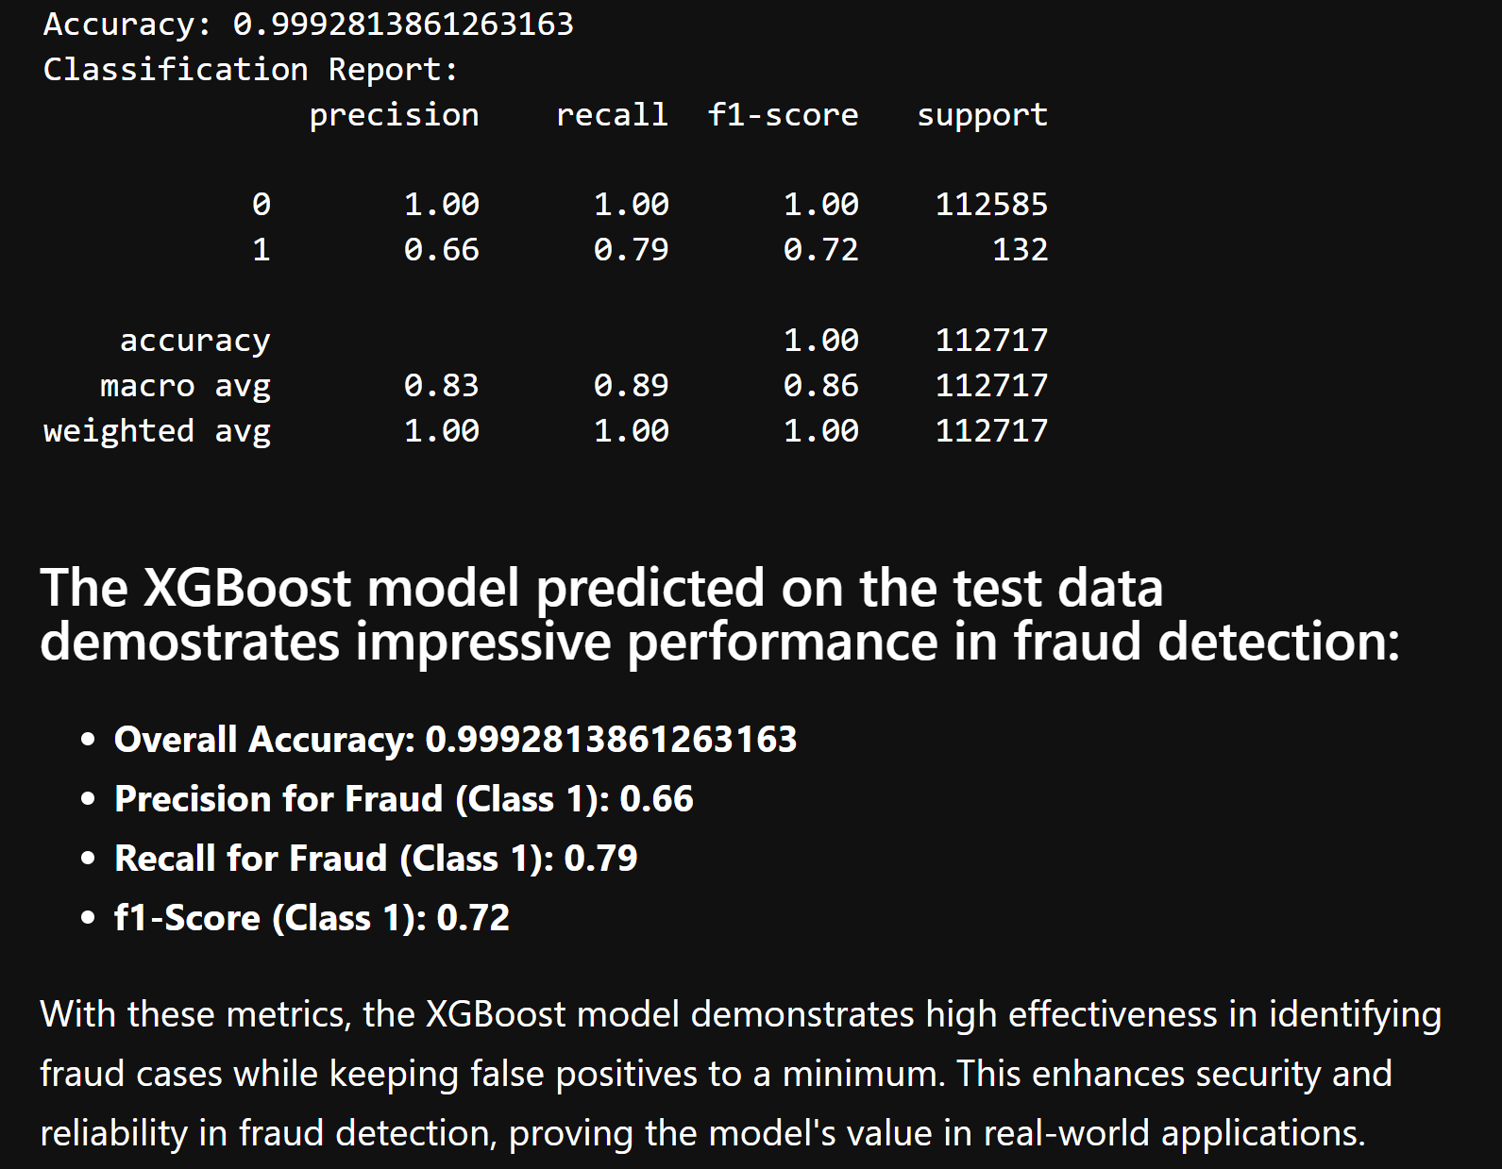
Predictive Models XGB Test data

Slide 10
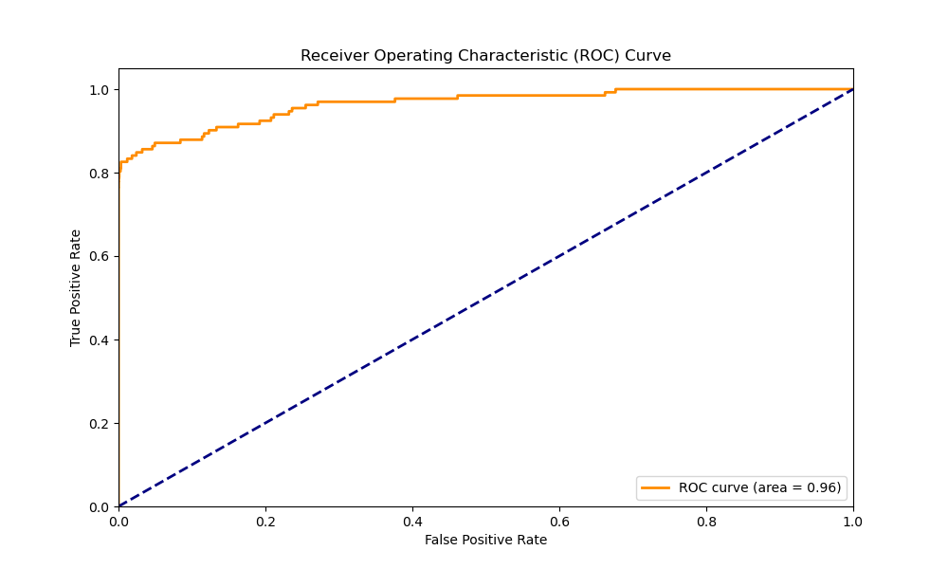
Predictive Models XGB Test data

Slide 11
Executive Summary

Slide 12
references
1). Gabriel Preda (2024) Credit Card Fraud Detection Predictive Models. https://www.kaggle.com/code/gpreda/credit-card-fraud-detection-predictive-models
2). Brett Cruz(2024, Jul 26) 52 Million Americans Experienced Credit Card Fraud Last Year. Securiety.org
3). RandomForrestClassifier, http://scikit-learn.org/stable/modules/generated/sklearn.ensemble.RandomForestClassifier.html

