Slide 1
Credit card fraud
Team 3:
Cody Lerch, Debasis Pradhan, Elena Gehle, Isaac Fonseca, and Warren Simmons
https://www.linkedin.com/pulse/3-types-credit-card-frauds-how-mitigate-them-2023-mark-taylor/

Slide 2
Analysis report of credit card fraud
Summary
This project presents an analysis of credit card fraud to apply an ML model for binary data (0 and 1) .
The data used for this project comes from a competition provided by Kaggle. It has been cleaned and scaled, with variables hidden to protect customers' PII.
All transactions are from Europe.
The median fraudulent charge in the data provided by Kaggle averages $254, compared to a non-fraudulent average amount of $250.
This data, collected over a 48-hour timeframe, shows an imbalance with 99.83% non-fraudulent transactions (Class 0) versus 0.17% fraudulent ones (Class 1)
Research Question

Slide 3
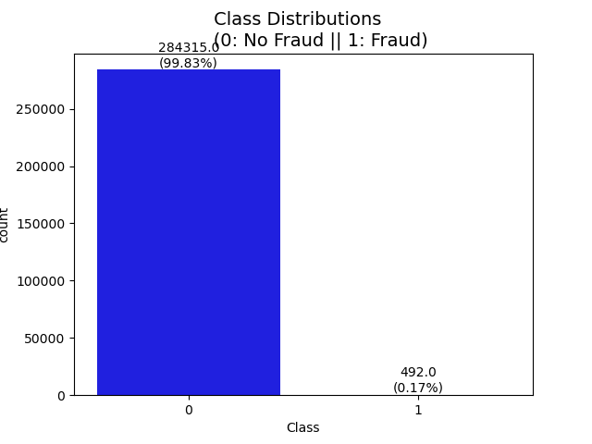
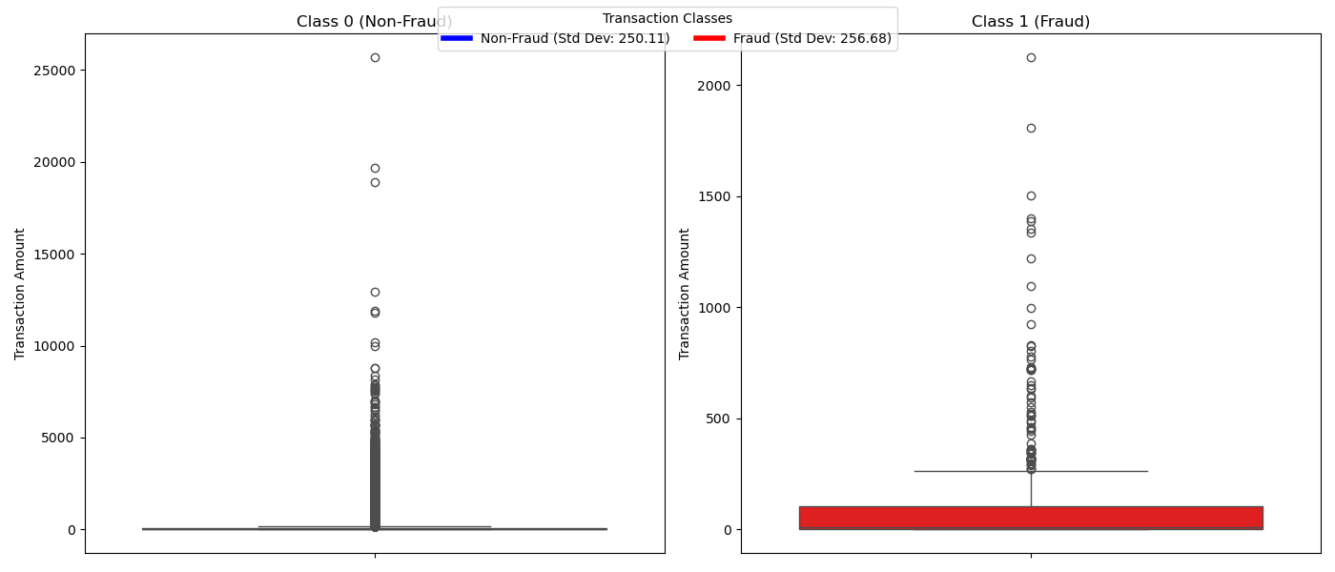
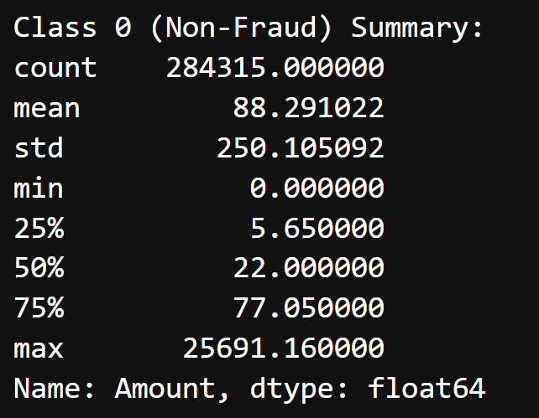
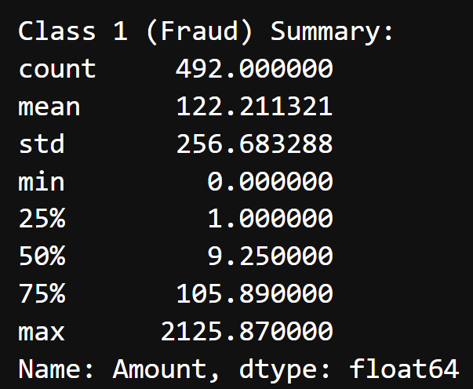
Cleaning & EDA
Standard deviation Class “1” closer to the normal transaction Class “0”
Higher Imbalance data

Slide 4
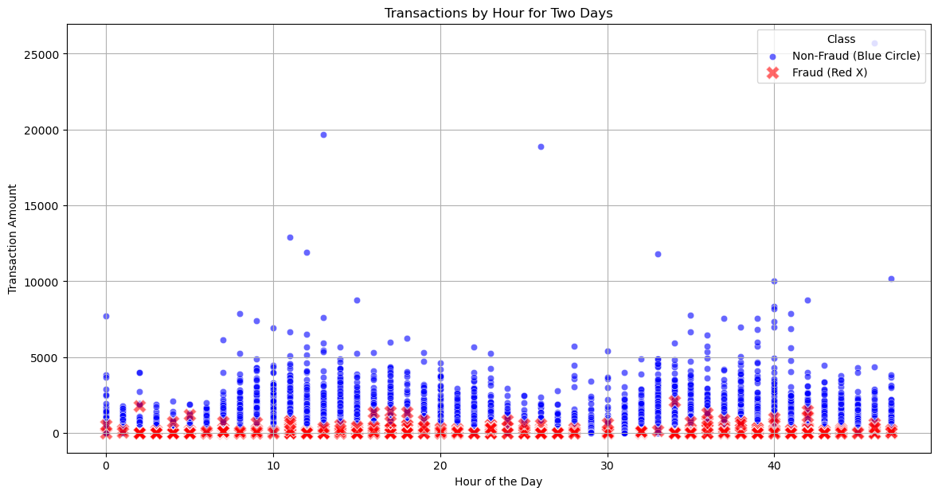
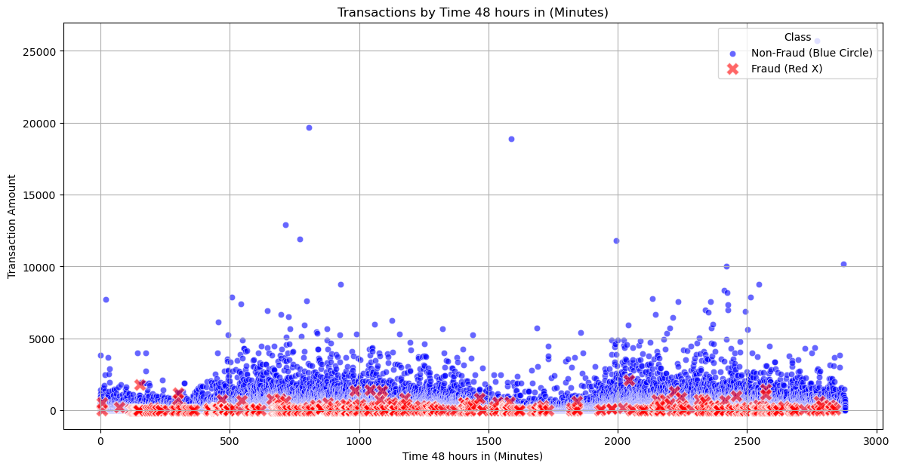
scatter plot by hour and minute

Slide 5
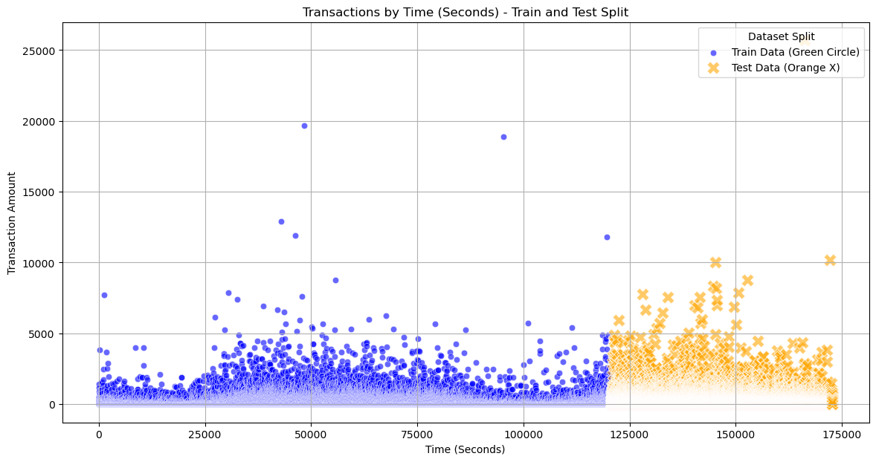
train and test split

Slide 6
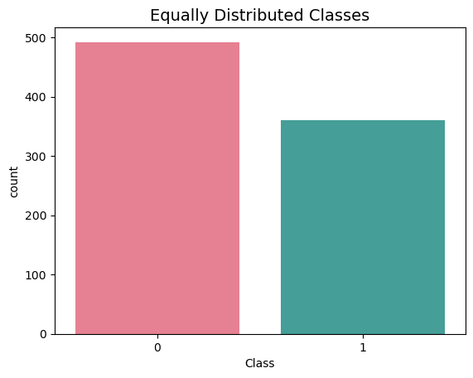
distribution of sub sample classes Add Smote SMOteenn
0 0.577465
1 0.422535

Slide 7
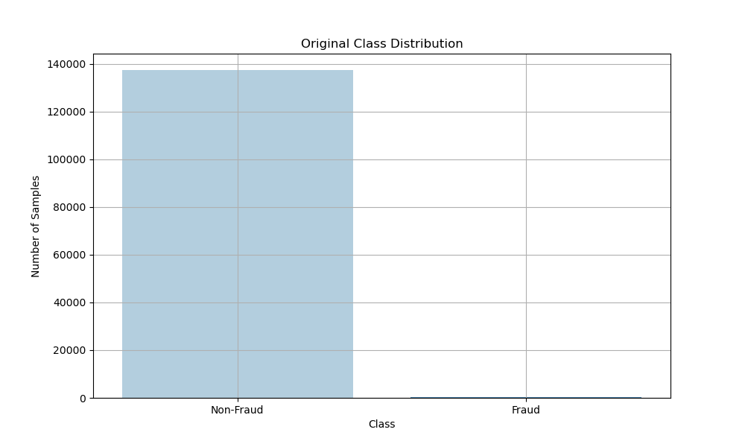
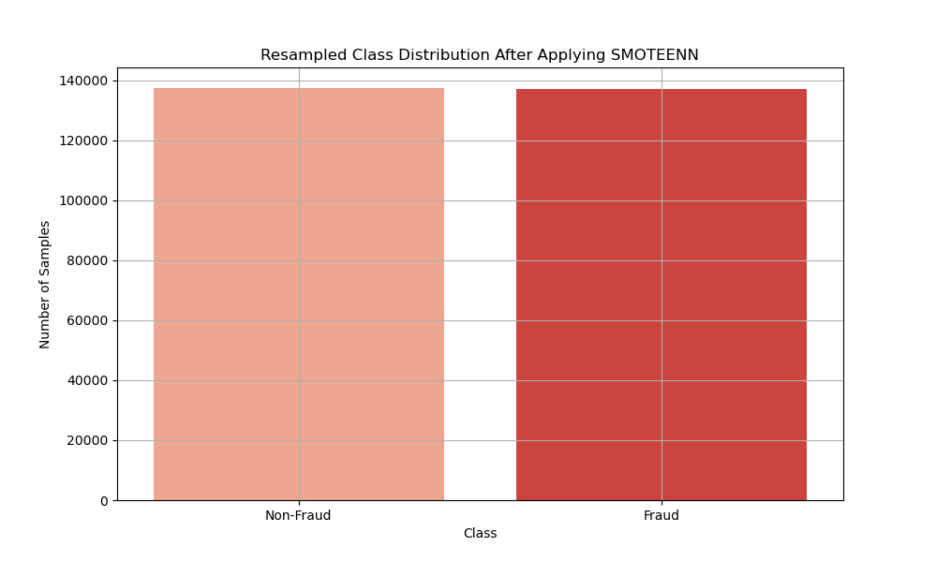
SMOTEENN (SMOTE + Edited Nearest Neighbors)

Slide 8
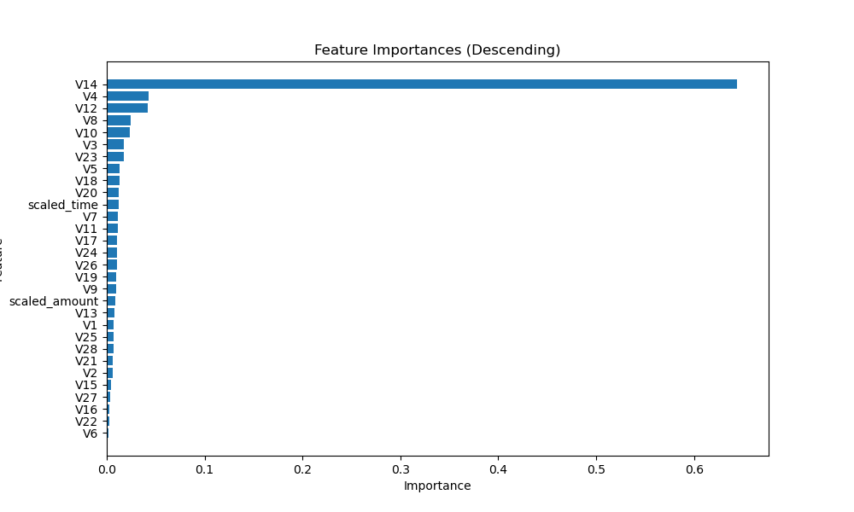
FUTURES IMPORTANCES

Slide 9
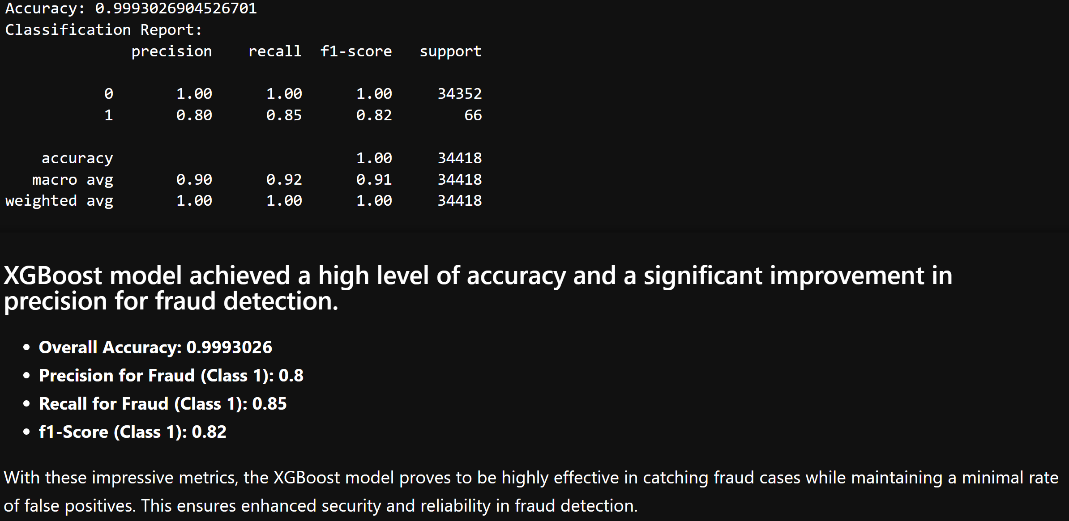
Predictive Models XGB Training data

Slide 10
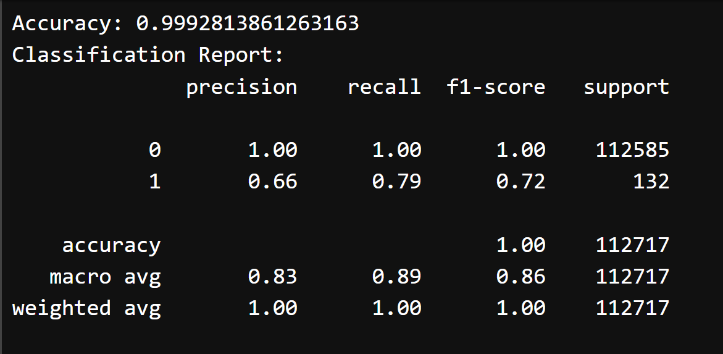
Predictive Models XGB Test data

Slide 11
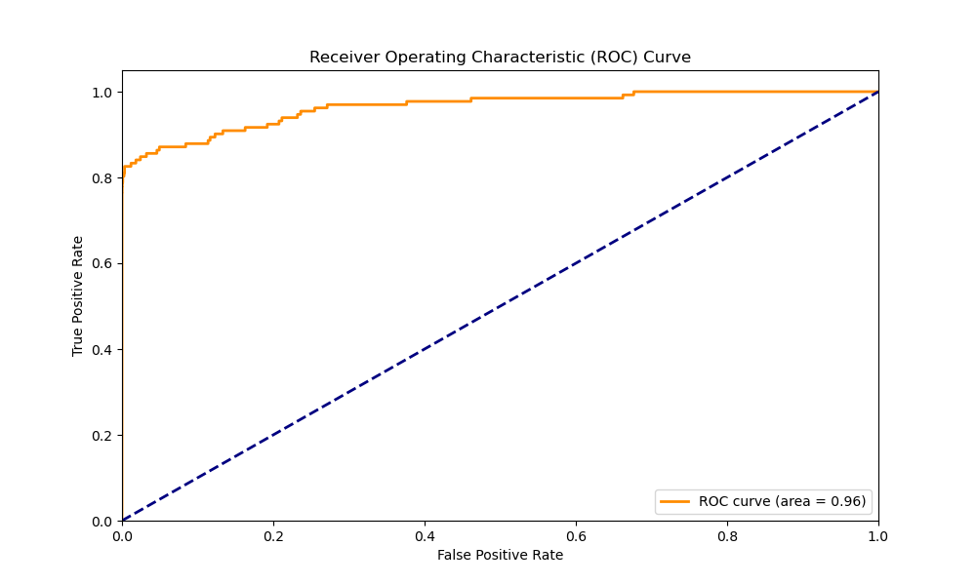
Predictive Models XGB Test data

Slide 12
Executive Summary

Slide 13
references
1). Gabriel Preda (2024) Credit Card Fraud Detection Predictive Models. https://www.kaggle.com/code/gpreda/credit-card-fraud-detection-predictive-models
2). Brett Cruz(2024, Jul 26) 52 Million Americans Experienced Credit Card Fraud Last Year. Securiety.org
3). RandomForrestClassifier, http://scikit-learn.org/stable/modules/generated/sklearn.ensemble.RandomForestClassifier.html

