Slide 1
Credit card fraud
Team 3:
Cody Lerch, Debasis Pradhan, Elena Gehle, Isaac Fonseca, and Warren Simmons
https://www.linkedin.com/pulse/3-types-credit-card-frauds-how-mitigate-them-2023-mark-taylor/

Slide 2
Project Overview
Data scaled and split into two separate CSVs, train and test.
Each of us ran one of the following models:
Logistic Regression
SVM
KNN
Decision Tree
Random Forest
XGBoost
For each model we ran one default model, one using over sampling (SMOTE & SMOTEENN), and one using under sampling (RUS)
Each model with the best performing results then underwent hyperparameter tuning (Gridsearch)
We then took our best performing models and compared
Finally, we selected the best model and applied it to the testing data

Slide 3
Analysis report of credit card fraud
Summary
This project presents an analysis of credit card fraud to apply an ML model for binary data (0 and 1) .
The data used for this project comes from a competition provided by Kaggle. It has been cleaned and scaled, with variables hidden to protect customers' PII.
All transactions are from Europe.
The median fraudulent charge in the data provided by Kaggle averages $254, compared to a non-fraudulent average amount of $250.
This data, collected over a 48-hour timeframe, shows an imbalance with 99.83% non-fraudulent transactions (Class 0) versus 0.17% fraudulent ones (Class 1)

Slide 4
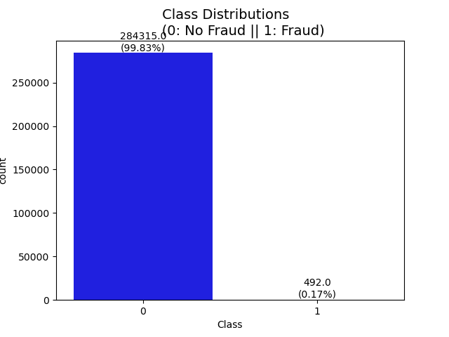
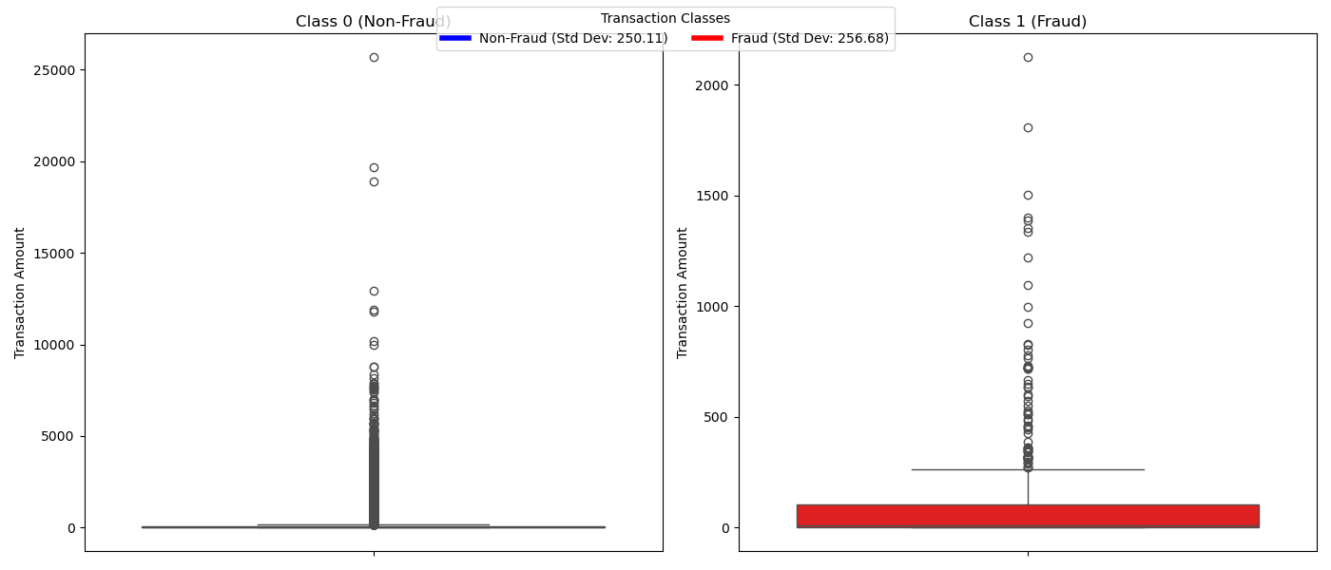
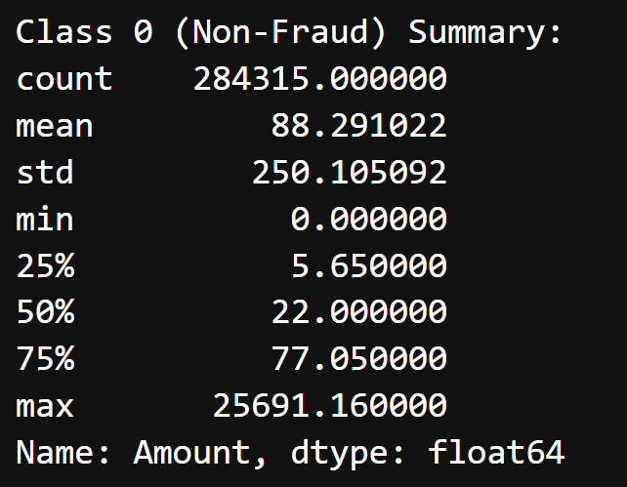
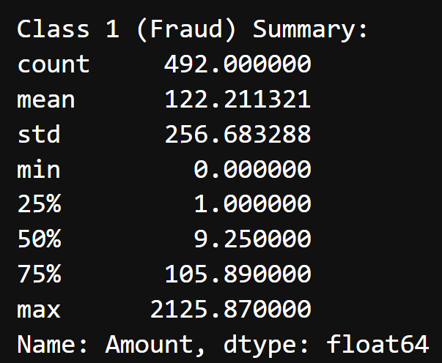
Cleaning & EDA
Standard deviation Class “1” closer to the normal transaction Class “0”
Higher Imbalance data

Slide 5
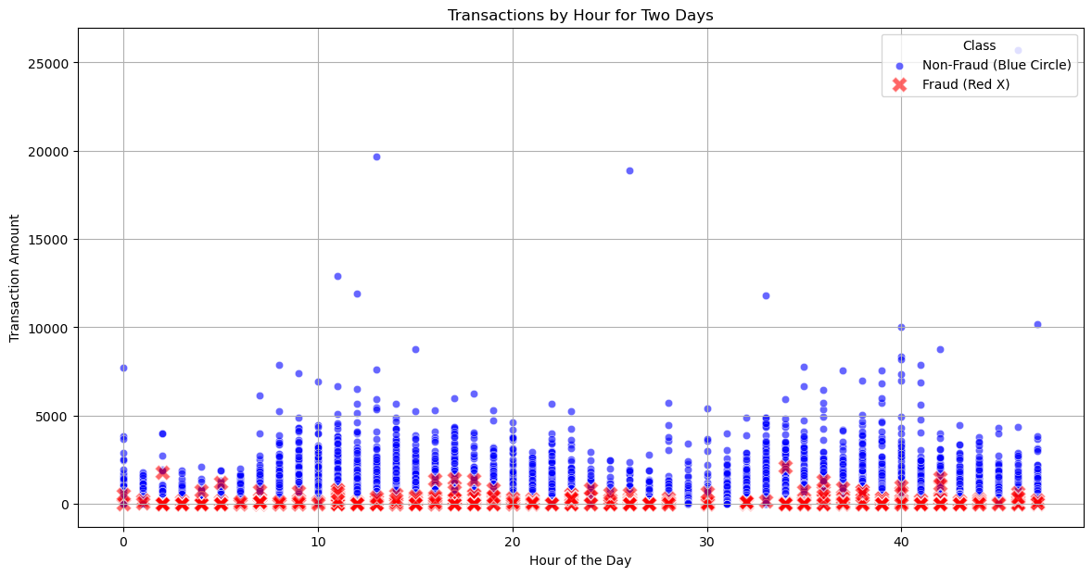
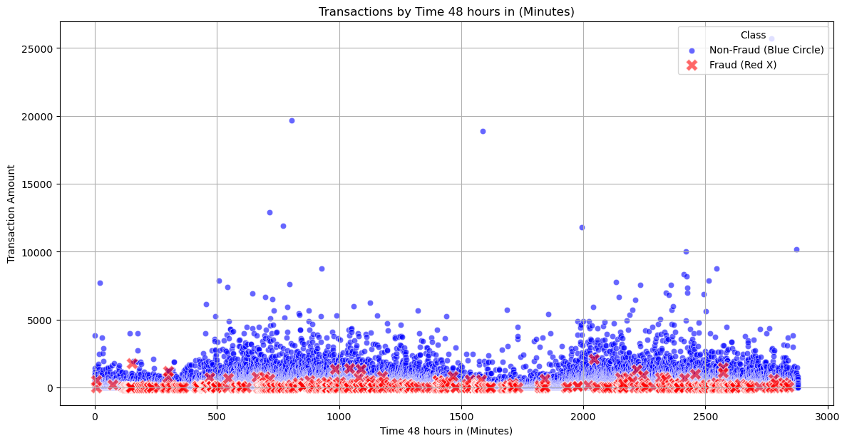
scatter plot by hour and minute

Slide 6
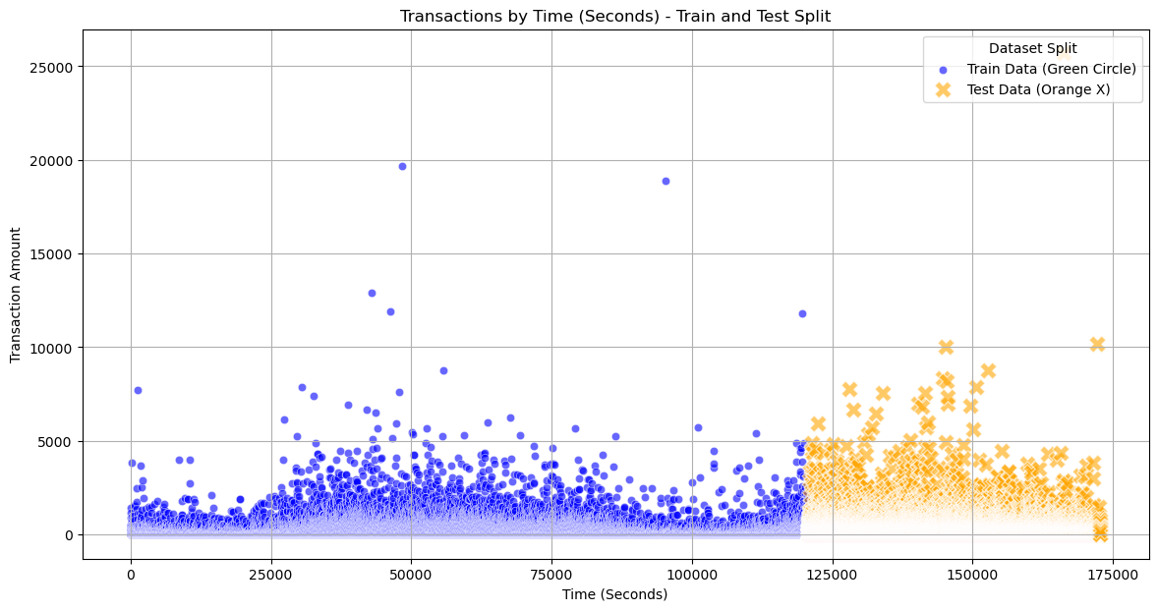
train and test split

Slide 7
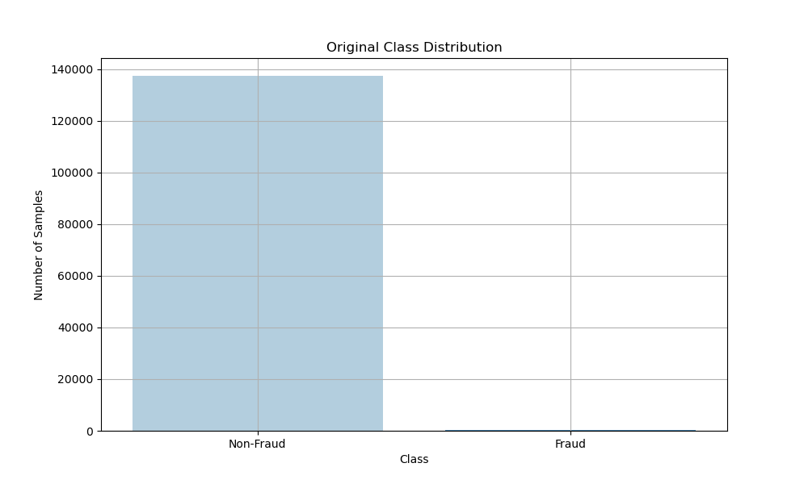
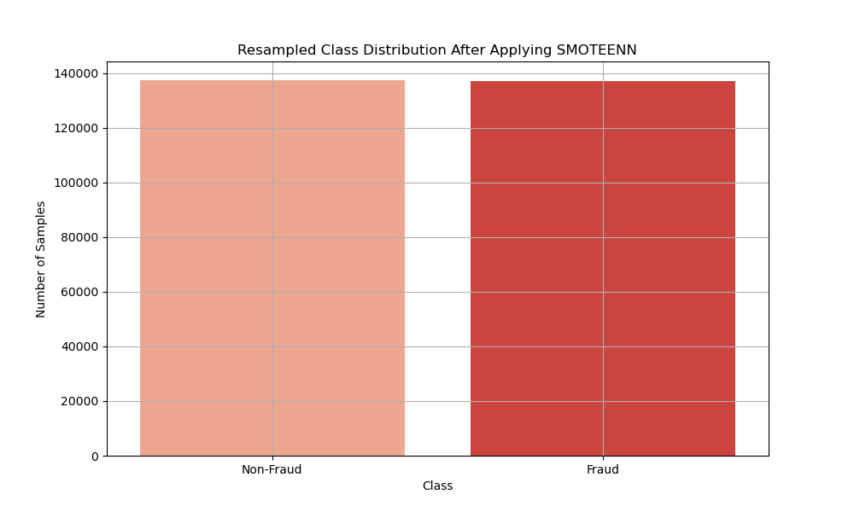
SMOTEENN (SMOTE + Edited Nearest Neighbors)
Notes:
SMOTEENN with XGBoost:
Balances the dataset and removes noisy samples.
Can lead to cleaner training data and better model performance.
More computationally intensive, but can yield better results with proper tuning.
SMOTEENN (SMOTE + Edited Nearest Neighbors)
SMOTEENN combines SMOTE with Edited Nearest Neighbors (ENN). It works by:
Applying SMOTE to generate synthetic samples for the minority class.
Using ENN to remove noisy samples from both the majority and minority classes.
Pros:
Balances the dataset by generating synthetic samples and removing noisy samples.
Can improve model performance by reducing noise and providing cleaner training data.
Cons:
More computationally intensive than SMOTE alone.
May remove useful samples if not carefully tuned.

Slide 8
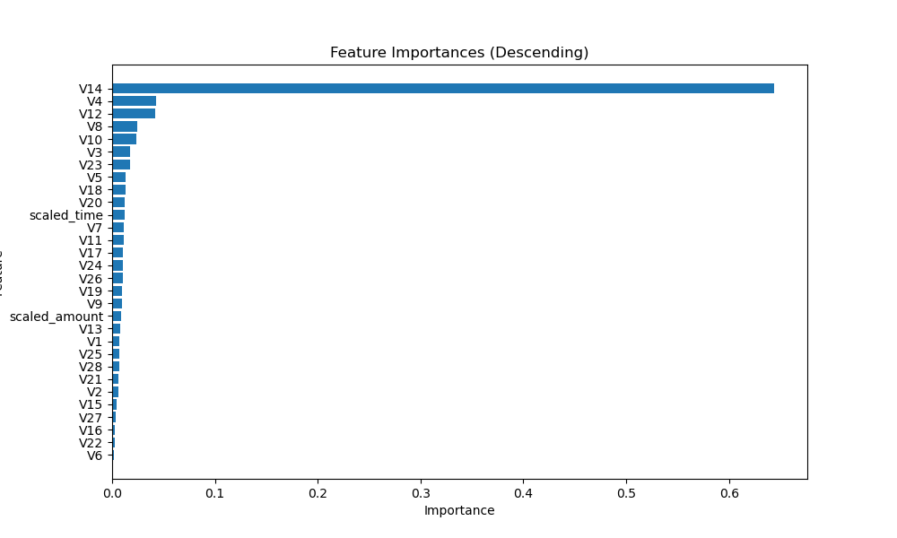
FEATURES IMPORTANCES

Slide 9
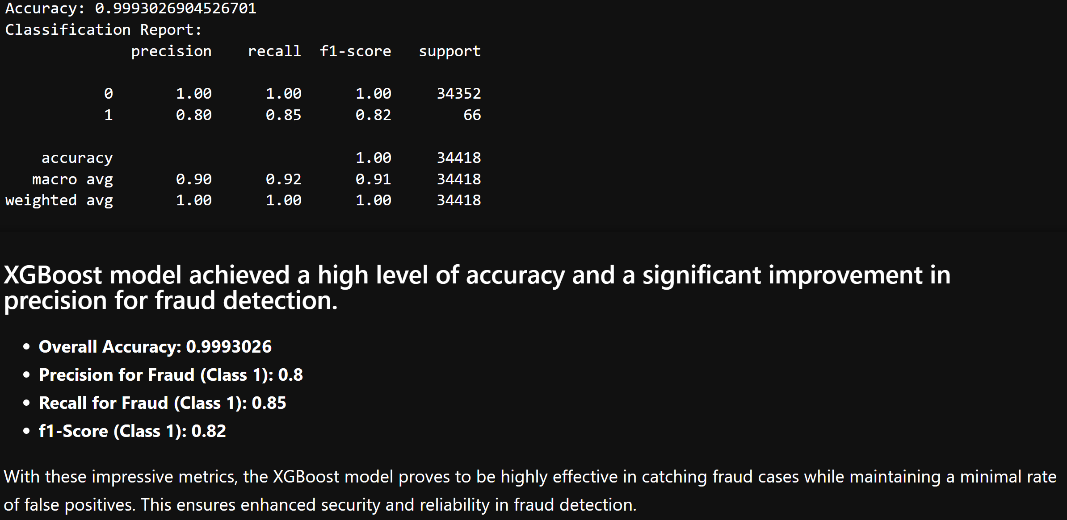
Predictive Models XGB Training data
Load and prepare Data
Split Data into Training and Validation Set
Save and Deploy Model (Production Line)
Apply Data Balancing (SMOTE/SMOTEENN
Train XGBoost Model
Evaluate Model on Validation Set
Optimize Hyperparameters
Evaluate Model on Test Set
Notes:
The XGBoost (Extreme Gradient Boosting) model is like the overachiever of the machine learning world. It's designed to be fast, efficient, and accurate, often outperforming other models in terms of speed and predictive power.
XGBoost is built on the gradient boosting framework. This means it builds models sequentially, with each new model attempting to correct the errors of its predecessors.
Decision Trees: The primary building blocks of XGBoost are decision trees. Each tree is built based on the residual errors from the previous trees, improving the overall model accuracy over time.Objective Function:XGBoost optimizes an objective function, which is a combination of a loss function (to measure prediction error) and a regularization term (to control model complexity and prevent overfitting).Regularization:XGBoost includes regularization parameters to prevent overfitting.
These parameters control the complexity of the model, ensuring it generalizes well to new data.Handling Missing Values:XGBoost has built-in handling for missing values, making it robust for real-world datasets where missing data is common.Feature Importance:After training, XGBoost can provide insights into feature importance, helping to understand which features are most influential in making predictions.
Parallel Processing:One of XGBoost's standout features is its ability to perform parallel processing, making it extremely efficient and faster than many other models.In summary, XGBoost is a powerful and flexible model that excels in predictive accuracy and efficiency, making it a popular choice for many machine learning tasks.

Slide 10
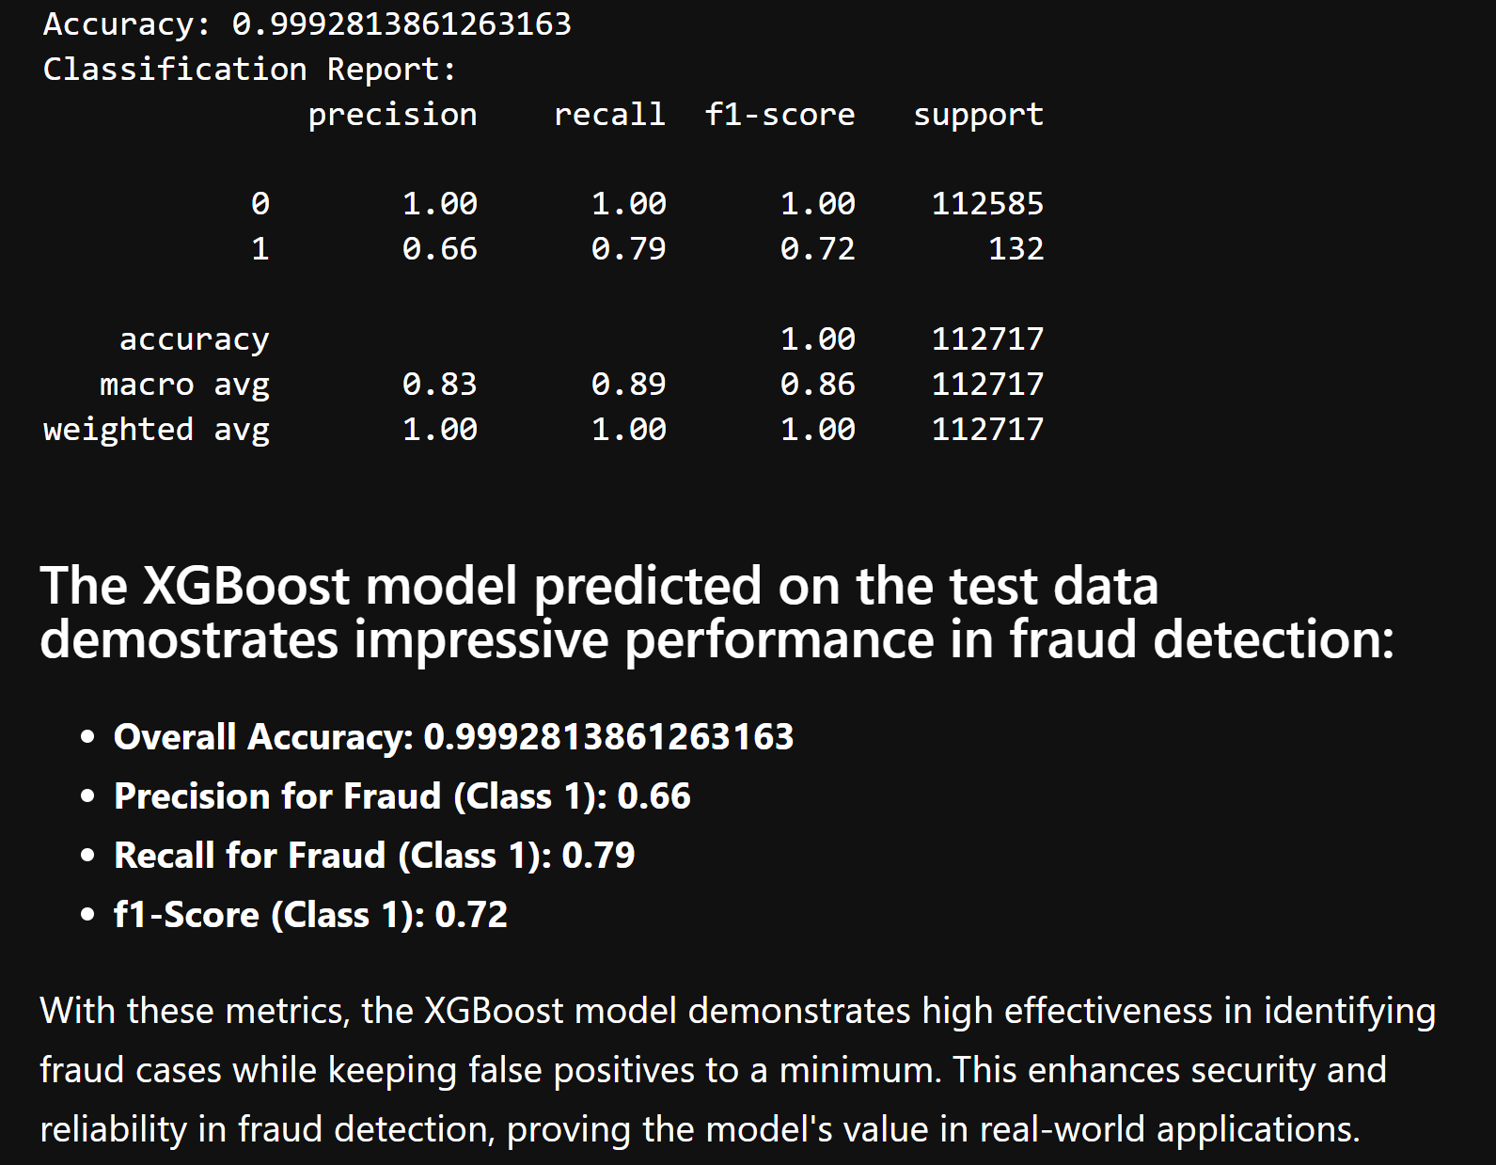
Predictive Models XGB Test data
Notes:
Summary
The model is adept at correctly identifying a significant portion of actual fraud cases (recall of 0.79).
Precision at 0.66 implies that the model is somewhat cautious in flagging transactions as fraud to minimize false positives.
The F1-score of 0.72 suggests a reasonable trade-off between precision and recall, making the model robust in practical scenarios where detecting fraud is critical.

Slide 11
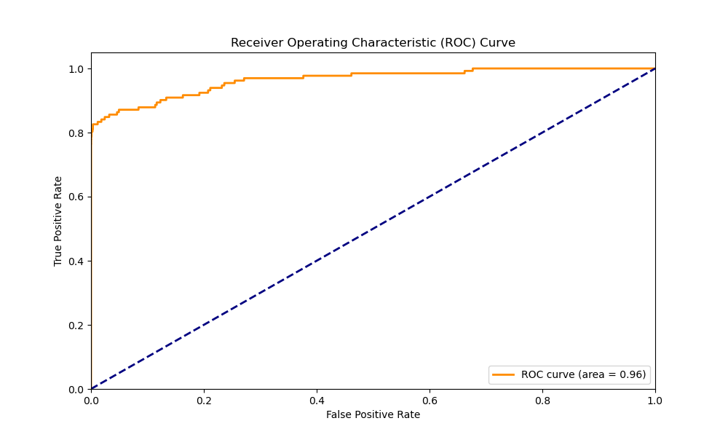
Predictive Models XGB Test data

Slide 12
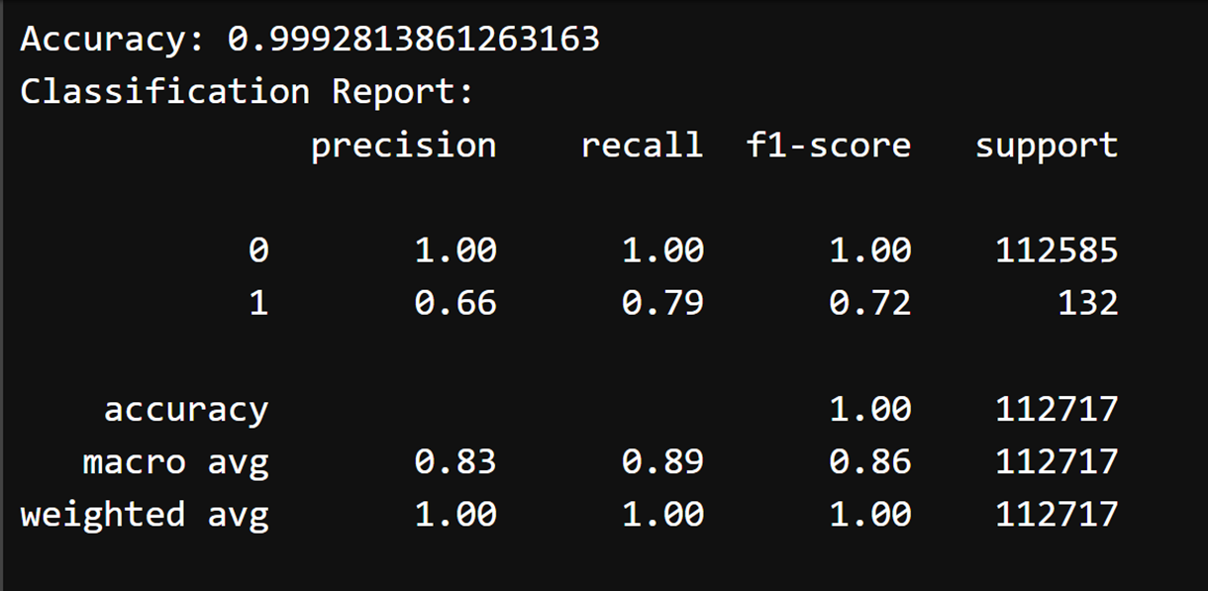
Conclusion
Severely imbalanced data
Oversampling gave us the best results
Detecting fraud was more important than identifying nonfraud and Recall held more importance than precision
While our Random Forest model performed well, our XGBoost model had better recall and slightly better precision

Slide 13

Further Research
If we had more time, we would investigate the two periods of time within the 48 hours that had no fraudulent activity. Analyzing more data than just the 48 hour period used for this dataset could give further insights as to whether there is a pattern of time that fraudulent charges tend to follow.

Slide 14
references
https://www.kaggle.com/datasets/mlg-ulb/creditcardfraud
Gabriel Preda (2024) Credit Card Fraud Detection Predictive Models. https://www.kaggle.com/code/gpreda/credit-card-fraud-detection-predictive-models
Brett Cruz(2024, Jul 26) 52 Million Americans Experienced Credit Card Fraud Last Year. Securiety.org
RandomForrestClassifier, http://scikit-learn.org/stable/modules/generated/sklearn.ensemble.RandomForestClassifier.html

