Slide 1
Understanding Git's Architecture
Ingram Monk
Local Web developer, for small family business advertising properties for sale in France
Have been using Git for 3-4 years
Have yet to start using it well!
Have realised that to use it well, I need to understand how it works, not just how to use it
Please interject with your questions – no matter how silly you think they may be – I can guarantee I have already asked myself them!

Slide 2
Contents
Why use Git?
What is Git?
Git's architecture

Slide 3
Why use Git?
Have you ever edited a file and then afterwards wished you had not made the changes, only to be too late to undo them all?
Would you like to be able to share your work with others and keep track of who did what?
Would you like to be able to make different versions of the same file to test different ideas?
Would you like to be able to back up your work without needing to remember to use a separate backup system?

Slide 4
What is Git?
A Distributed Version Control System (DVCS)
What is Version Control?
A logical way to organise and control revisions to documents
A safe mechanism for users to collaborate on the same work without overwriting each other's changes
A simple way to revert to previous versions of documents, in cases where you have messed up!
What does Distributed mean?
Everybody has a working copy of the codebase on their local machine, as opposed to a reference copy of the codebase
No requirement to share a common network
No central server / repository
I.e. decentralized and peer-to-peer

Slide 5
Why is Distributed a good approach?
No need for network access to central server – good for remote working (conversely; don't lose your laptop!)
Each user has a complete repository on their machine. Allows them to do private work without treading on each other's toes and without the need to seek permission to make changes – a faster way to work
No single point of failure, as with a central server. Likewise each copy of the repository functions as a remote backup of codebase
Quicker operations, as no network latency
Allows simple forking of projects for the inevitable design disagreements inherent in FOSS software!

Slide 6
Git's architecture
This is often the last thing learned about, but in fact should be the first thing to be learnt
Understanding how Git organises its files takes the voodoo out using Git
It also helps you understand what is going on, so that you don't panic if you think you have lost your work, or believe you have overwritten it
* you may well have have done this of course!
*

Slide 7
Git's architecture – Terminology
Repository – a collection of commits detailing the project and its history
Working Tree – a directory (and all its sub-directories and files) which has a Repository associated with it (the .git folder under the root of the project)
Commit – a snapshot of your Working Tree at a particular point in time
The Index – a staging area into which you register the code changes that you wish to commit.

Slide 8
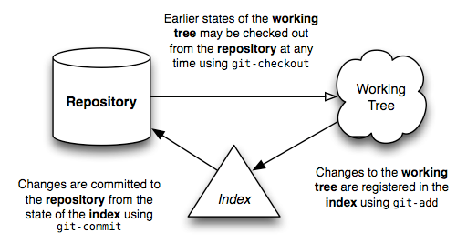
Basic work flow
© https://jwiegley.github.io/git-from-the-bottom-up/

Slide 9
Directory content tracking 1
What it does *not* do
Git does not store a copy of all of the Working Tree files with each commit
Nor does it store a list of difference patches for an incremental replaying of project history
It also does not store the files in a directory / file structure that is representative of your Working Tree

Slide 10
Directory content tracking 2
What it does do
Git stores all files it tracks in leaf nodes called blobs (equivalent of filesystem inodes / files)
Git records the structure of the nodes within the Repository in a tree (equivalent of directory entries)
A tree can contain both blobs and trees. This is how it can build up the directory structure of your Working Tree
The final object type is the commit itself

Slide 11
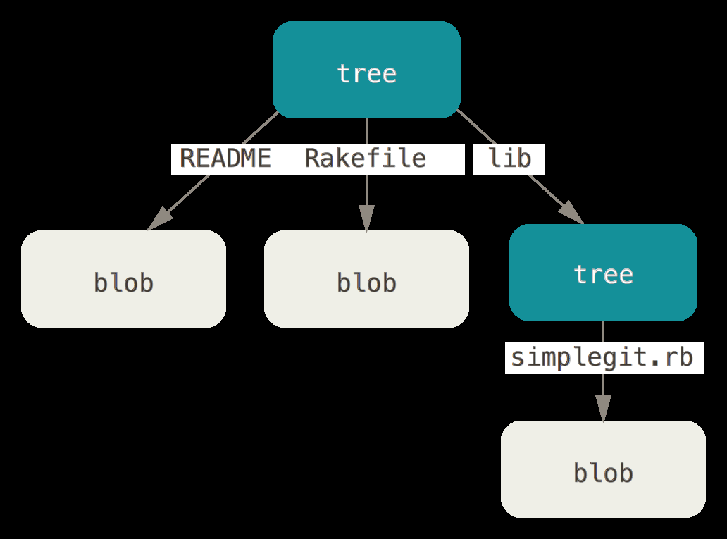
Representation of filesystem in Git
1 sub-directory
3 files
/lib/simplegit.rb
/Rakefile
/README
© http://git-scm.com/book/en/v2/Git-Internals-Git-Objects

Slide 12
Object naming & metadata
Blobs, trees & commits are named using the SHA-1 algorithm, giving a 40 character name:
a5bce3fd2565d8f458555a0c6f42d0504a848bd5
Thankfully we can refer to these by the first 6-7 characters, e.g. a5bce3
Blob names are composed of a hash of the file size and contents, but not the filename
This ensures that the blob will represent the file content regardless of any other file metadata

Slide 13
Blob objects
Unlike a filesystem, data in Git is immutable (i.e. it cannot change)
If the file being tracked is changed, then a new blob is written when the file is re-added to the Index, unless...
there is a blob that already contains that exact file contents, in which case the Index will reference this instead
This provides a very compact way of storage, as only files which have been changed are stored afresh as a new blob

Slide 14
Tree objects
Are written recursively from the Index on commit
Each tree contains references to other sub-trees as well as the blobs at this directory level
A tree also contains the metadata about the blobs and trees contained within:
  Mode (file permissions – 0644, 0700 etc.)
  Type (blob / tree)
  Filename

Slide 15
Commit objects
Store pointers to the snapshot of the Working Tree you staged in the Index to commit (i.e. the root tree)
Also store pointers to the parent commit(s) (from second commit onwards)
Also stores metadata about the commit:
  Author name + email
  Committer name + email
  Timestamp of commit
  Commit message written when making commit

Slide 16
Putting it all together
Now we have a commit, we can introspect into it, to find the SHA-1 id of the root tree
We can then look at this root tree to find the blobs and trees it contains
We can then iterate through all the sub-trees to see the blobs and trees they contain
This gives us a complete snapshot of the Working Tree at the time the commit was made

Slide 17
That's a lot of work to do!
Thankfully Git will do all of this for us
There are many GUI tools on the market as well to help with this, although I find they confuse me more than they help
Using GitHub will allow us to view the commits individually to see the changes that have been made
It will also let us view the full snapshot of the repo at the point in time of the commit we are looking at

Slide 18
But that's not all by a long way
There are numerous further concepts to learn to get a full understanding of Git's architecture, but for the moment the most important are branches and HEAD
Branches allow us to make parallel Working Trees, which do not interfere with each other, and do not require a change of working environment
This means we can easily diverge from the main line of development without messing up the code in the main line

Slide 19
Branches
Branches are user-namable, movable pointers to commits
You can choose to name them, rather than have to use the 40 character SHA-1 id
The branch pointer will move on automatically with each commit made on the branch, so that it points to the last commit made – this tip is more correctly known as the branch head
By default the first branch is called master, but you are free to change this if you wish

Slide 20
HEAD (capitalised)
At first this is one of the most mystifying things about Git
It is actually so simple, it doesn't really make sense!
It is just a pointer to the branch head (lower case) that you are currently working on
Detached HEAD rightfully sounds bad, and can lead to danger, but it is just a case of HEAD pointing to a specific commit and not a branch head – we will cover this in a later session

Slide 21
To be continued...
Further resources:
https://jwiegley.github.io/git-from-the-bottom-up/
http://git-scm.com/book/en/v2/Git-Internals-Plumbing-and-Porcelain
If you wish to ask me any questions whatsoever, please email:
ingram.monk@gmail.com

