Slide 1
Understanding Git and
Using GitHub
Ingram Monk
Local Web developer, for small family business advertising properties for sale in France
Have been using Git for 3-4 years
Have yet to start using it well
Have realised that to use it well, I need to understand how it works, not just how to use it
Please interject with your questions – no matter how silly you think they may be – I can guarantee I have already asked myself them!

Slide 2
Understanding Git and
Using GitHub
Why use Git?
What is Git?
Git's architecture
Using Git
Using GitHub

Slide 3
Why use Git?
Have you ever edited a file and then afterwards wished you had not made the changes, only to be too late to undo them all?
Would you like to be able to share your work with others and keep track of who did what?
Would you like to be able to make different versions of the same file to test different ideas?
Would you like to be able to back up your work without needing to remember to use a separate backup system?

Slide 4
What is Git?
A Distributed Version Control System (DVCS)
What is Version Control?
A logical way to organise and control revisions to documents
A safe mechanism for users to collaborate on the same work without overwriting each other's changes
A simple way to revert to previous versions of documents, in cases where you have messed up!
What does Distributed mean?
Everybody has a working copy of the codebase on their local machine, as opposed to a reference copy of the codebase
No requirement to share a common network
No central server / repository
I.e. decentralized and peer-to-peer

Slide 5
Why is Distributed a good approach?
No need for network access to central server – good for remote working (conversely; don't lose your laptop!)
Each user has a complete repository on their machine. Allows them to do private work without treading on each other's toes and without the need to seek permission to make changes – a faster way to work
No single point of failure, as with a central server. Likewise each copy of the repository functions as a remote backup of codebase
Quicker operations, as no network latency
Allows simple forking of projects for the inevitable design disagreements inherent in FOSS software!

Slide 6
Installing Git
If you have a linux / OSX machine it is likely to be pre-installed. If not, or even if it is, it is best to download the latest stable version:
RHEL / CentOS / Fedora - $ sudo yum install git
or
Debian / Ubuntu - $ sudo apt-get install git
or
Windows - https://msysgit.github.io/ - includes Git Bash CLI emulator – far better than Github for Windows
or
Mac – visit http://git-scm.com/download/mac - I remember it being a world of pain upgrading, for some forgotten reason

Slide 7
Getting a Git Repository
2 ways to get a Git repository:
Initialise a repository in an existing directory
(the top directory of your project):
  $ git init
Clone an existing repository:
  $ git clone [repository_url]

Slide 8
Git's architecture
This is often the last thing learned about, but in fact should be the first thing to be learnt
Understanding how Git organises its files takes the voodoo out using Git
It also helps you understand what is going on, so that you don't panic if you think you have lost your work, or believe you have overwritten it
* you may well have have done this of course!
*

Slide 9
Git's architecture – Terminology
Repository – a collection of commits detailing the project and its history
Working Tree – a directory (and all its sub-directories and files) which has a Repository associated with it (the .git folder under the root of the project)
Commit – a snapshot of your working tree at a particular point in time
The Index – a staging area into which you register the code changes that you wish to commit.

Slide 10
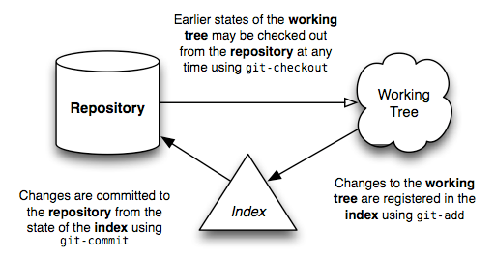
Basic work flow
© https://jwiegley.github.io/git-from-the-bottom-up/

Slide 11
Directory content tracking 1
Git does not store a copy of all of the Working Tree files with each commit
Nor does it store a list of difference patches for an incremental replaying of history
It also does not store the files in directory / file structure that is representative of your Working Tree

Slide 12
Directory content tracking 2
Git stores all files it tracks in leaf nodes called blobs (equivalent of filesystem inodes)
Git records the structure of the nodes within the repository in a tree (equivalent of directory entries)
A tree can contain both blobs and trees. This is how it can build up the directory structure of your Working Tree.

Slide 13
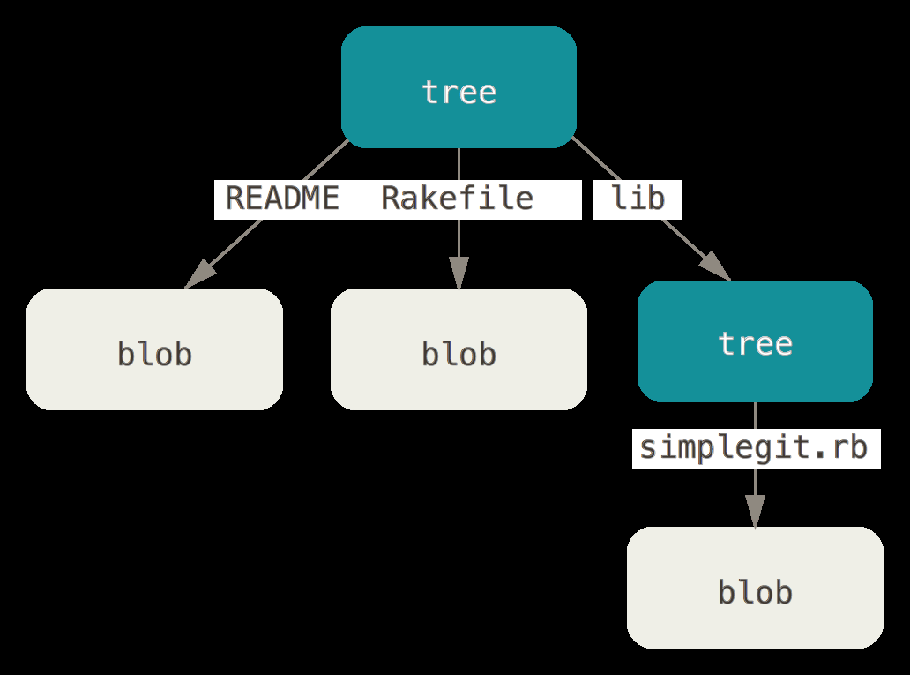
Representation of filesystem in Git
1 sub-directory
3 files
/lib/simplegit.rb
/Rakefile
/README

Slide 14
Object Naming & Metadata
Both blobs and trees are named using the SHA1 algorithm
Blob names are composed of a hash of the file size and contents, but not the filename
This ensures that the blob will represent the file content regardless of any other file metadata
Metadata about the blob is stored in the tree

Slide 15
Commit Objects
Unlike a filesystem, data in Git is immutable (i.e. it cannot change)
If the file being tracked is changed, then a new blob is written when the file is re-added to the Index, unless...
there is a blob that already contains that exact file contents, in which case the index will reference this instead
This provides a very compact way of storage, as only files which have been changed are stored afresh as a new blob

