Slide 1


Slide 2
Intro to Nancy
Lightweight

Slide 3
Intro to Nancy
Lightweight
Low Ceremony

Slide 4
Intro to Nancy
Lightweight
Low Ceremony
Open Source

Slide 5
Intro to Nancy
Lightweight
Low Ceremony
Open Source
Run anywhere

Slide 6
Super Duper Happy Path (SDHP)
“Just works”

Slide 7
Super Duper Happy Path (SDHP)
“Just works”
Easily customizable

Slide 8
Super Duper Happy Path (SDHP)
“Just works”
Easily Customizable
Low Ceremony

Slide 9
Super Duper Happy Path (SDHP)
“Just works”
Easily Customizable
Low Ceremony
Low Friction

Slide 10
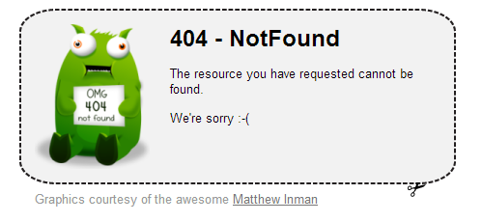
Conventions
Static Files in /Content
Default Error Page

Slide 11
Modules
Inherit from NancyModule

Slide 12
Modules
Inherit from NancyModule
Declare anywhere

Slide 13
Modules
Inherit from NancyModule
Declare anywhere
Module Paths

Slide 14
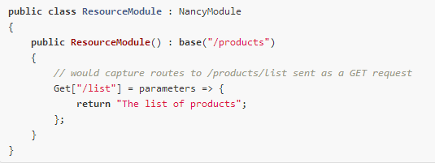
Modules
Inherit from NancyModule
Declare anywhere
Module Paths

Slide 15
Routing
Literals (/some/literal/segments)

Slide 16
Routing
Literals /some/literal/segments
Capture Segments /{name}

Slide 17
Routing
Literals /some/literal/segments
Capture Segments /{name}
Optional Capture /{name?}

Slide 18
Routing
Literals /some/literal/segments
Capture Segments /{name}
Optional Capture /{name?}
Optional w/ Default /{name?none}

Slide 19
Routing
Literals /some/literal/segments
Capture Segments /{name}
Optional Capture /{name?}
Optional w/ Default /{name?none}
Regex /(?<age>[/d]{1,2})

Slide 20
Routing
Literals /some/literal/segments
Capture Segments /{name}
Optional Capture /{name?}
Optional w/ Default /{name?none}
Regex /(?<age>[/d]{1,2})
Greedy /{name*}

Slide 21
Routing
Literals /some/literal/segments
Capture Segments /{name}
Optional Capture /{name?}
Optional w/ Default /{name?none}
Regex /(?<age>[/d]{1,2})
Greedy /{name*}
Greedy Regex /^(?<name>[a-z]{3,10}(?:/{1})(?<action>[a-z]{5,10}))$

Slide 22
Routing
Literals /some/literal/segments
Capture Segments /{name}
Optional Capture /{name?}
Optional w/ Default /{name?none}
Regex /(?<age>[/d]{1,2})
Greedy /{name*}
Greedy Regex /^(?<name>[a-z]{3,10}(?:/{1})(?<action>[a-z]{5,10}))$
Multiple Capture /{filename}.{extension}

Slide 23
Route Collisions?
/{category}
/products

Slide 24
Route Scoring
Literals 10000
Capture Segments 1000
Optional Capture 1000
Optional w/ Default 1000
Regex 1000
Greedy 0
Greedy Regex 100
Multiple Capture 100

Slide 25
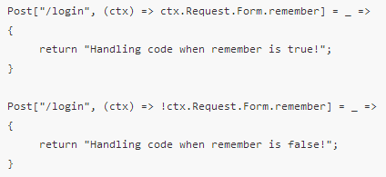
Conditionals

Slide 26
Constraints

Slide 27
Constraints
int
decimal
guid
bool
alpha
datetime
datetime(format)
min(#)
max(#)
range(min, max)
minlength(#)
maxlength(#)
length(min, max)

Slide 28
Constraints
int
decimal
guid
bool
alpha
datetime
datetime(format)
min(#)
max(#)
range(min, max)
minlength(#)
maxlength(#)
length(min, max)
Your Custom Constraint Here

Slide 29
Actions
Return any model and the result is determined through Content Negotiation

Slide 30
Actions
Return any model and the result is determined through Content Negotiation
Response object

Slide 31
Actions
Return any model and the result is determined through Content Negotiation
Response object
Int
HttpStatusCode
String
Action<stream>

Slide 32

Actions
Return any model and the result is determined through Content Negotiation
Response object
Int
HttpStatusCode
String
Action<stream>
Return a View

Slide 33
Super Simple View Engine
Variables
Hello @Model.Name, your age is @Model.User.Age

Slide 34
Super Simple View Engine
Variables
Hello @Model.Name, your age is @Model.User.Age
Iterators
@Each.Users
Hello @Current.Name!
@EndEach

Slide 35
Super Simple View Engine
Variables
Hello @Model.Name, your age is @Model.User.Age
Iterators
@Each.Users
Hello @Current.Name!
@EndEach
Conditionals
@If … @EndIf
@IfNot … @EndIf
HasCollection

Slide 36
Super Simple View Engine
Html Encoding - @!

Slide 37
Super Simple View Engine
Html Encoding - @!
Partial Views
@Partial[‘mypartialview.sshtml’]
@Partial[‘mypartialview.sshtml’, Model.User]

Slide 38
Super Simple View Engine
Html Encoding - @!
Partial Views
@Partial[‘mypartialview.sshtml’]
@Partial[‘mypartialview.sshtml’, Model.User]
Master Pages and Sections
@Master[‘name’]
@Section[‘name’] … @EndSection

Slide 39
Super Simple View Engine
Html Encoding - @!
Partial Views
@Partial[‘mypartialview.sshtml’]
@Partial[‘mypartialview.sshtml’, Model.User]
Master Pages and Sections
@Master[‘name’]
@Section[‘name’] … @EndSection
@AntiForgeryToken
@Path[‘relativepath’]

Slide 40
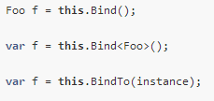
Model Binding

Slide 41
Model Binding

Slide 42
Bootstrapper
TinyIoC (https://github.com/grumpydev/TinyIoC)
AutoRegister
Check NuGet for Alternatives
Autofac
Ninject
StructureMap
Unity
Windsor

Slide 43
Authorization
Basic
Forms
Stateless

Slide 44
Authorization
IUserIdentity – this.Context.CurrentUser
Extension Methods
RequiresAuthentication
RequiresClaims
RequiresAnyClaim
RequiresValidatedClaims
RequiresHttps

Slide 45
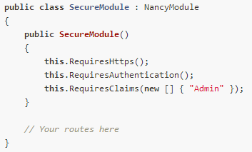
Authorization

Slide 46

Pipelines

Slide 47

Pipelines

Slide 48

Pipelines

Slide 49
Hosting
ASP.NET (IIS)

Slide 50
Hosting
ASP.NET (IIS)
Azure

Slide 51
Hosting
ASP.NET (IIS)
Azure
OWIN

Slide 52
Hosting
ASP.NET (IIS)
Azure
OWIN
Self Hosting

