Slide 1
Lung Cancer Detection
Gnana Deepak Madduri
Ifrat Zaman
Shubham Pawar

Slide 2
Agenda
Introduction
Project Objective
Data
Libraries
Models
Application
Conclusion
References

Slide 3
Introduction
Why Lung Cancer? It is estimated that 1 in every 16 people will suffer from lung cancer in their lifetime. An estimated 236,740 people will be diagnosed with lung cancer in 2022 in the U.S.
Cause? Smoking is responsible for 80% of cases. Other risk factors that contribute are secondhand smoke, asbestos, air pollution, and automobile exhaust, etc.

Slide 4
Project Objective
Lung cancer prediction based on different factors affecting the cause of lung cancer - smoking, chronic diseases, fatigue, allergy, alcohol consumption, etc., along with the symptoms of coughing, chest pain, shortness of breath, and swallowing difficulties
Investigate different ML models to achieve best accuracy
After the evaluation of models, we will select out best model for use in application
Use the ML model to build an application that predicts lung cancer

Slide 5
Data
There are a total of 309 instances in this structured dataset. Each instance has a value for each of the attributes mentioned below.
The best feature of this dataset is that it contains no missing values. Therefore, the veracity of data is high and analysis outputs will be accurate and useful.
The dataset has the following attributes: Gender (M/F), Age, Smoking, Yellow Fingers, Anxiety, Peer Pressure, Chronic Disease, Fatigue, Allergy, Wheezing, Alcohol, Coughing, Shortness of Breath, Swallowing Difficulty, Chest pain, Lung Cancer. (YES/NO).
NO = 1 & YES = 2

Slide 6
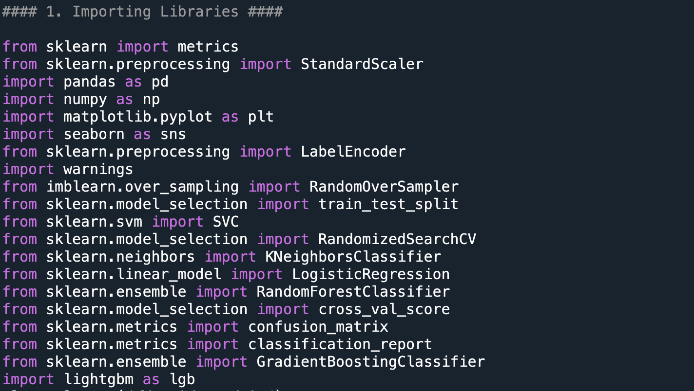
Libraries
Imblearn library
Extension of sklearn
Provides tools to deal with imbalanced classes
Lightgbm library
Light Gradient Boosting Model
Gradient boosting framework that uses tree based learning algorithm

Slide 7
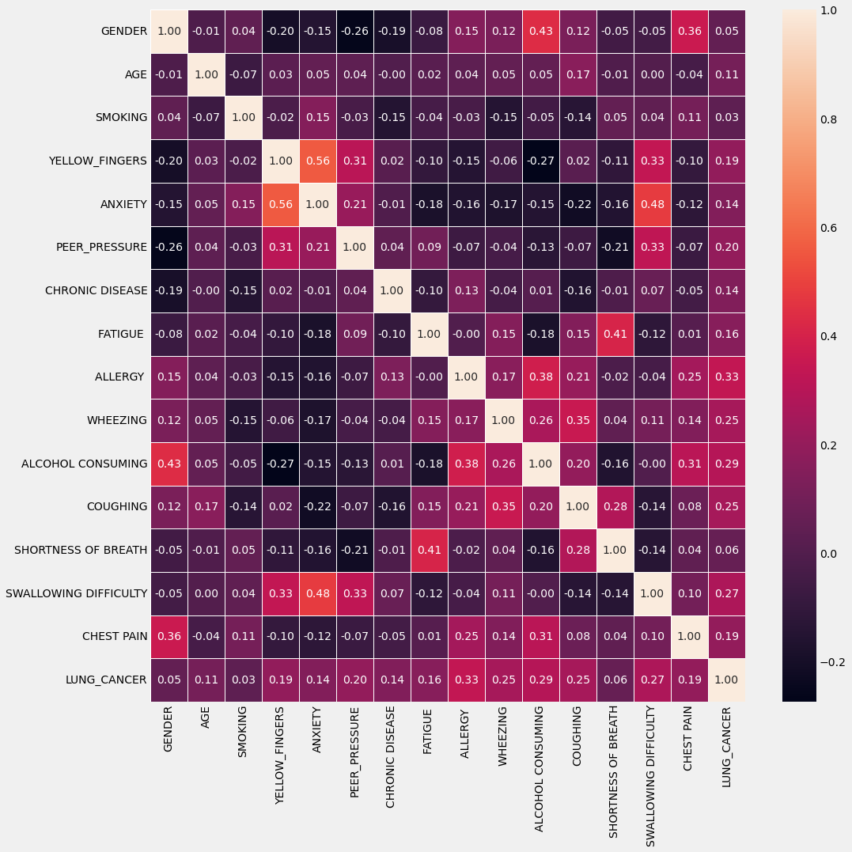
Data Cleansing & Exploration
No missing values in the dataset
Duplicate rows deleted
Encoding categorical columns
Male = 1 & Female = 0
Yes = 1 & No = 0
Heatmap indicated multicollinearity

Slide 8
Models
KNN Classifier
Support Vector Machine
Logistic Regression
Random Forest Classifier
Gradient Boosting Classifier
LGBM Classifier

Slide 9
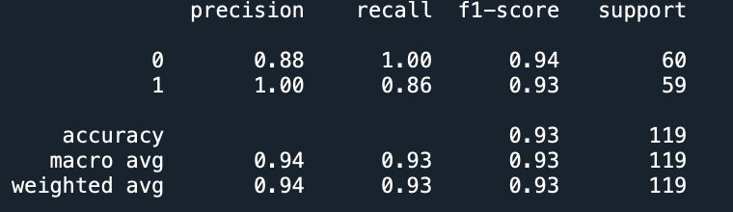
KNN Classifier
Easy to understand and implement
Good for non-linear data
Sensitivity: 86%

Slide 10
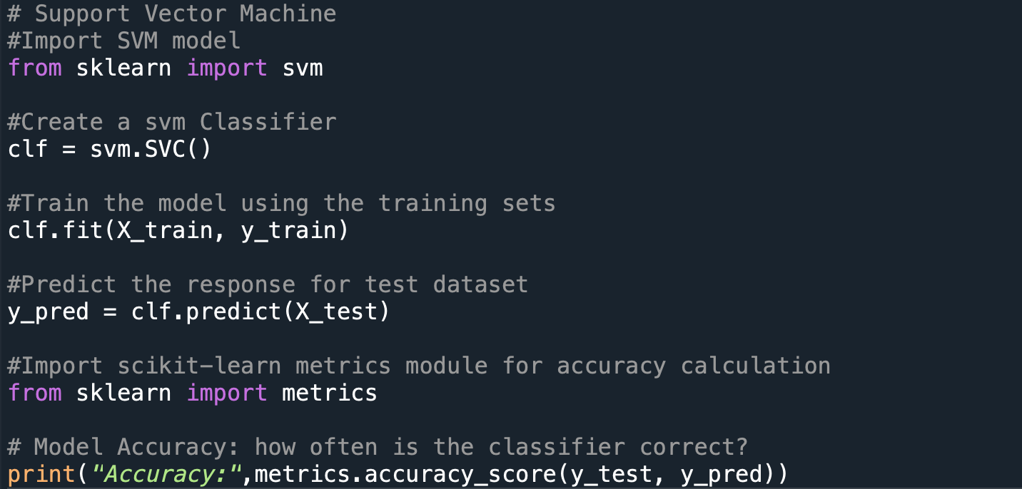
Support Vector Machine
Effective in high dimensional dataset
Memory efficient
Easy to code
Sensitivity: 98%

Slide 11
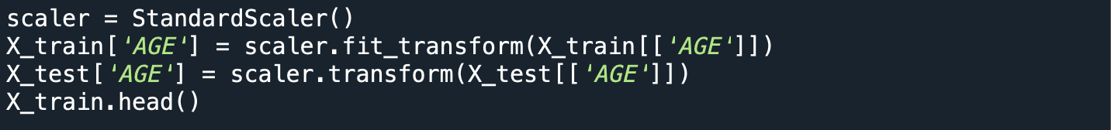
Application
Scaling variable “AGE”
Easier to train ML models
Computing user input “age” manually using scalar fit transformation

Slide 12
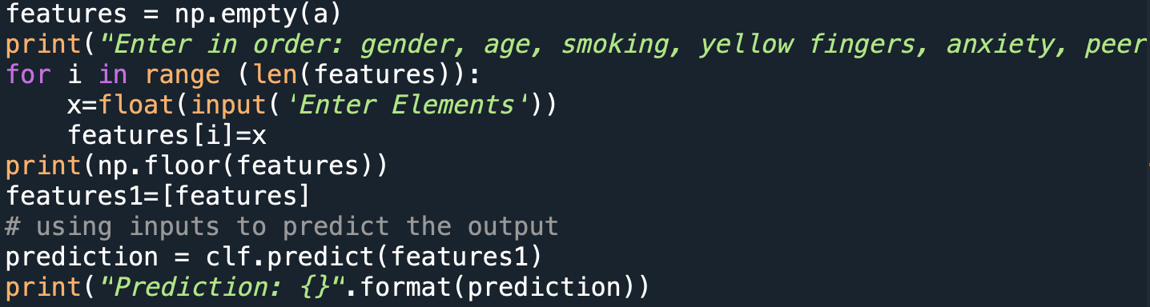
Application

Slide 13
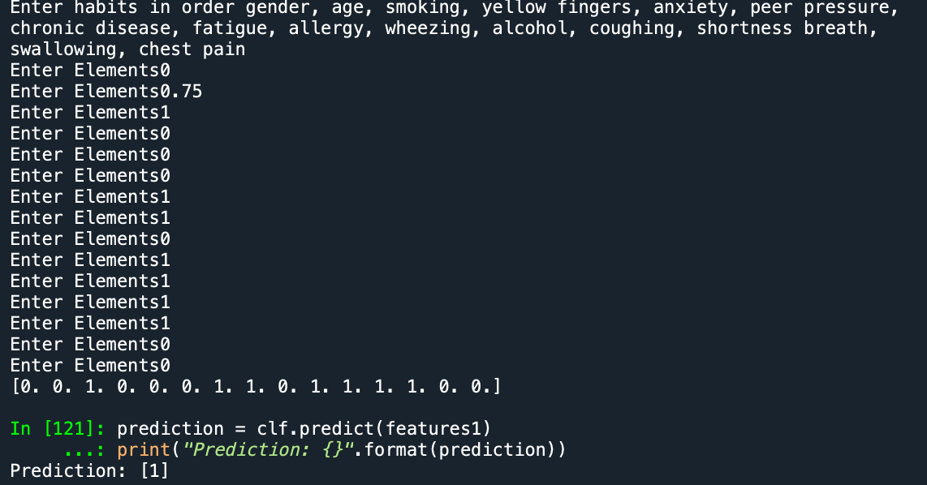
Application Example

Slide 14
Conclusion
Support Vector Machine performs best
Application outputs are accurate to 93%
Application SVM model had different training set of data
Possibly because of the random nature of sampling train and test data

Slide 15
References
[1] M. A. Bhat, “Lung cancer,” Kaggle, 01-Oct-2021. [Online]. Available: https://www.kaggle.com/datasets/mysarahmadbhat/lung-cancer. [Accessed: 05-Nov-2022].
[2] “Sklearn.preprocessing.StandardScaler,” scikit. [Online]. Available: https://scikit-learn.org/stable/modules/generated/sklearn.preprocessing.StandardScaler.html. [Accessed: 01-Dec-2022].
[3] A. Joby, “What is K-nearest neighbor? an ML algorithm to classify data,” Learn Hub. [Online]. Available: https://learn.g2.com/k-nearest-neighbor. [Accessed: 01-Dec-2022].
[4] “1.4. Support Vector Machines,” scikit. [Online]. Available: https://scikit-learn.org/stable/modules/svm.html. [Accessed: 01-Dec-2022].

Slide 16


