Slide 1



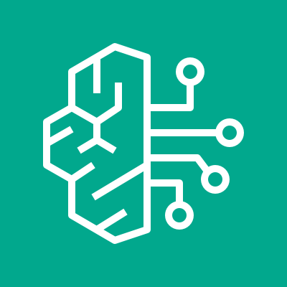
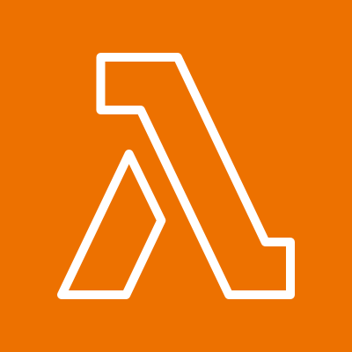
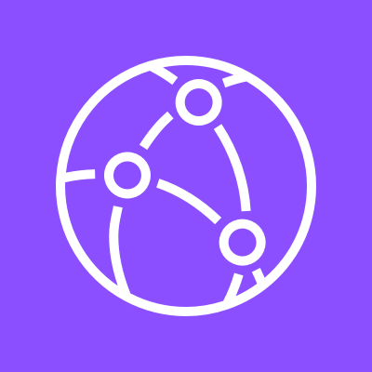



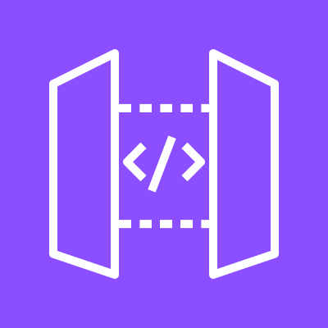
Zero Day Librarian on Amazon Bedrock AgentCore + CockroachDB Cloud
Four Bedrock AgentCore agents (ingest, governance, supervisor, remediation) ingest CVE intelligence, evaluate policy, recall prior incidents via CockroachDB's distributed vector index, and apply governance-approved remediations. A Next.js dashboard behind CloudFront reads the same CockroachDB Cloud system of record.
Analysts & Feeds
AWS Cloud
CockroachDB Cloud
Bedrock AgentCore
Tool Compute
Dashboard Delivery
2
1
Security / SOC Analyst
CockroachDB Cloud (zdl_db) Distributed vector index
AgentCore Runtime 4 agents
zdl-tools-handler 6 tool contracts
Amazon CloudFront
NVD / Advisory CVE Feeds
AgentCore Gateway + Memory
AWS Secrets Manager
Amazon S3 (static export)
Foundation Models (Bedrock Mantle)
Amazon API Gateway
API handler (FastAPI)

