Slide 1

Algorithms and Data Structures
Unit 4 – Elementary Data Structures II

Slide 2
Outline
Linked lists
Singly linked lists
Exercise
Doubly linked lists
Exercise

Slide 3
Linked lists

Slide 4
Disadvantages of dynamic arrays
Python’s list class is highly optimized
It is a great choice for storage, but it has some disadvantages:
The length typically does not correspond to the actual number of elements
Amortized complexity may not be acceptable is some systems
Insertion and deletions at interior positions are expensive
We introduce a new data structure: linked list
As an alternative to dynamic arrays, this data structure solves these problems

Slide 5
Linked lists
A linked list is a distributed representation of a collection of elements
It relies on a lightweight object called node
For every element a linked list allocates one node
Each node maintains a reference to its element
Additionally, each node keeps one or more references to neighboring nodes
With this principle, a linear order of the sequence is maintained
Elements of a linked list can not be accessed by a numeric index

Slide 6
Singly linked lists

Slide 7






Singly linked lists
A singly linked list is a collection of nodes that form a linear sequence
Each node stores
a reference to an element
a reference to the next node
‘Vienna‘
‘Austria‘
-10
$$None$$
$$element$$
$$next$$
$$element$$
$$next$$
$$element$$
$$next$$

Slide 8







Head and tail
The first node is called the head
The last node is called the tail
‘Vienna‘
‘Austria‘
-10
$$None$$
$$element$$
$$next$$
$$element$$
$$next$$
$$element$$
$$next$$
$$Head$$
$$Tail$$

Slide 9




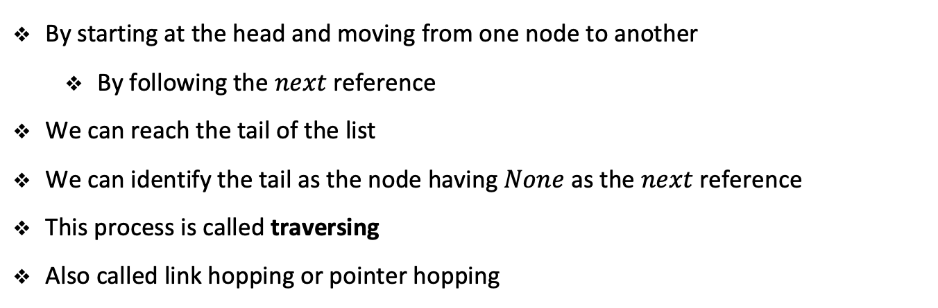




Traversing the list
‘Vienna‘
‘Austria‘
-10
$$None$$
$$element$$
$$next$$
$$element$$
$$next$$
$$element$$
$$next$$
$$Head$$
$$Tail$$
By starting at the head and moving from one node to another
By following the $next$ reference
We can reach the tail of the list
We can identify the tail as the node having $None$ as the $next$ reference
This process is called traversing
Also called link hopping or pointer hopping

Slide 10
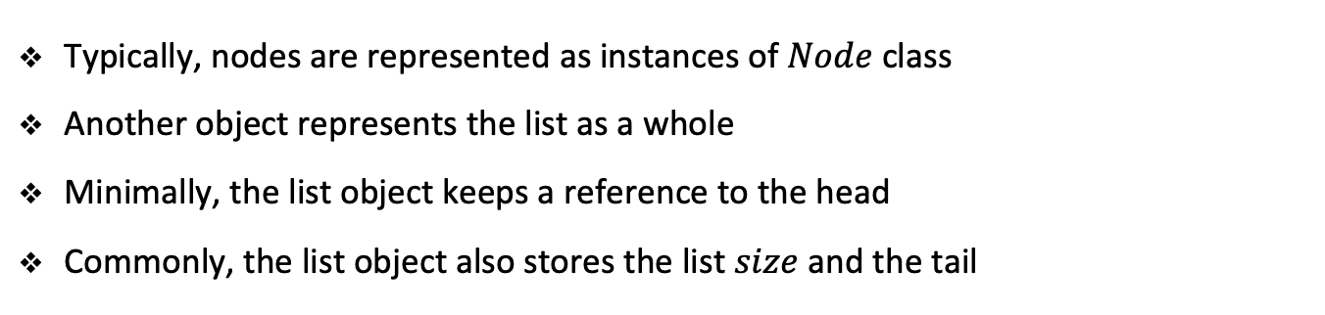
Representing singly linked lists
‘Vienna‘
‘Austria‘
-10
$$None$$
$$element$$
$$next$$
$$element$$
$$next$$
$$element$$
$$next$$
$$Head$$
$$Tail$$
Typically, nodes are represented as instances of $Node$ class
Another object represents the list as a whole
Minimally, the list object keeps a reference to the head
Commonly, the list object also stores the list $size$ and the tail

Slide 11
Singly linked lists in python
class SinglyLinkedList:
class _Node:
def __init__(self, element):
self._element = element
self._next = None
def __init__(self):
self._head = None
self._tail = None
self._size = 0

Slide 12





















Inserting an element at the head of the singly linked list
‘Vienna‘
‘Austria‘
-10
$$None$$
$$element$$
$$next$$
$$element$$
$$next$$
$$element$$
$$next$$
$$Head$$
$$Tail$$
‘Europe‘
‘Vienna‘
‘Austria‘
-10
$$None$$
$$element$$
$$next$$
$$element$$
$$next$$
$$element$$
$$next$$
$$element$$
$$next$$
$$New$$
$$Head$$
$$Tail$$

Slide 13
Singly linked lists in python
def add_first(self, element):
new = self._Node(element)
new._next = self._head
self._head = new
if self._size == 0:
self._tail = new
self._size += 1

Slide 14




















Inserting an element at the tail of the singly linked list
‘Vienna‘
‘Austria‘
-10
$$None$$
$$element$$
$$next$$
$$element$$
$$next$$
$$element$$
$$next$$
$$Head$$
$$Tail$$
‘Vienna‘
‘Austria‘
-10
‘Europe‘
$$element$$
$$next$$
$$element$$
$$next$$
$$element$$
$$next$$
$$element$$
$$next$$
$$Head$$
$$Tail$$
$$New$$
$$Tail$$

Slide 15
Singly linked lists in python
def add_last(self, element):
new = self._Node(element)
new._next = None
if self._size > 0:
self._tail._next = new
else:
self._head = new
self._tail = new
self._size += 1

Slide 16






Removing an element from the singly linked list
‘Europe‘
‘Vienna‘
‘Austria‘
-10
$$None$$
$$element$$
$$next$$
$$element$$
$$next$$
$$element$$
$$next$$
$$element$$
$$next$$
$$Head$$
$$Tail$$
‘Vienna‘
‘Austria‘
-10
$$None$$
$$element$$
$$next$$
$$element$$
$$next$$
$$element$$
$$next$$
$$Head$$
$$Tail$$

Slide 17
Singly linked lists in python
def remove_first(self):
if self._size == 0:
raise Empty('Singly linked list is empty')
self._head = self._head._next
self._size -= 1
Notebook example

Slide 18
Exercise

Slide 19
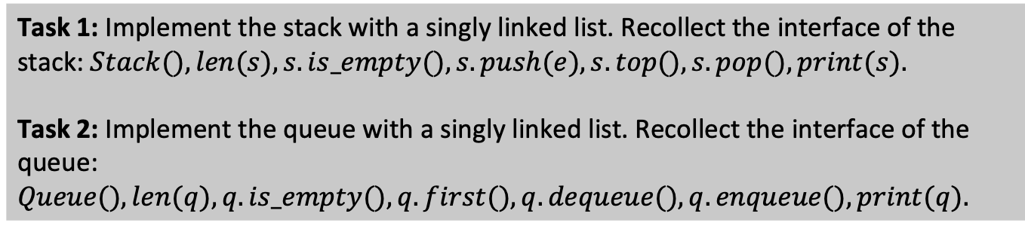
Student task
Task 1: Implement the stack with a singly linked list. Recollect the interface of the stack: $Stack(), len(s), s.is_empty(), s.push(e), s.top(), s.pop(), print(s).$
Task 2: Implement the queue with a singly linked list. Recollect the interface of the queue: $Queue(), len(q), q.is_empty(), q.first(), q.dequeue(), q.enqueue(), print(q).$

Slide 20
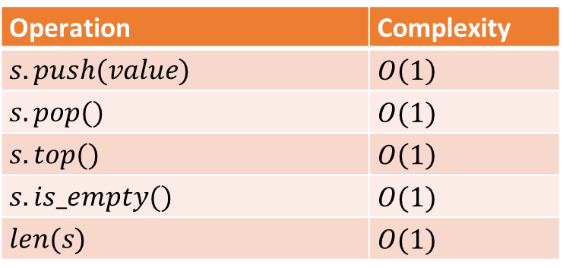
Complexity of list-based stacks
Operation | Complexity
$$s.push(value)$$ | $$O\left(1\right)$$
$$s.pop()$$ | $$O(1)$$
$$s.top()$$ | $$O\left(1\right)$$
$$s.is_empty()$$ | $$O(1)$$
$$len(s)$$ | $$O(1)$$

Slide 21
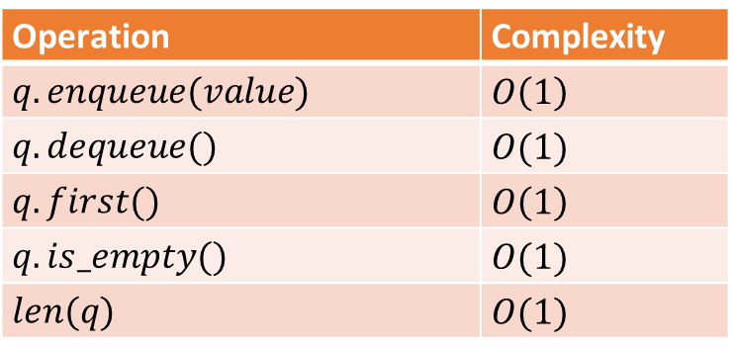
Complexity of list-based queues
Operation | Complexity
$$q.enqueue(value)$$ | $$O\left(1\right)$$
$$q.dequeue()$$ | $$O(1)$$
$$q.first()$$ | $$O\left(1\right)$$
$$q.is_empty()$$ | $$O(1)$$
$$len(q)$$ | $$O(1)$$

Slide 22
Doubly linked lists

Slide 23
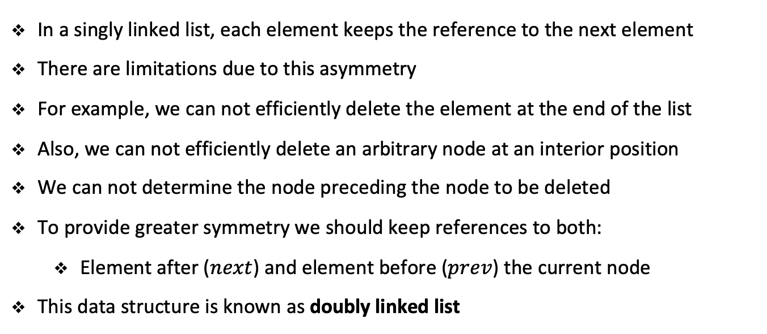
Doubly linked lists
In a singly linked list, each element keeps the reference to the next element
There are limitations due to this asymmetry
For example, we can not efficiently delete the element at the end of the list
Also, we can not efficiently delete an arbitrary node at an interior position
We can not determine the node preceding the node to be deleted
To provide greater symmetry we should keep references to both:
Element after ($next$) and element before ($prev$) the current node
This data structure is known as doubly linked list

Slide 24
Header and trailer sentinels
In order to avoid some special case when operating at the boundaries
We add two special nodes at both ends of the list:
Header at the beginning of the list
Trailer at the end of the list
These dummy nodes are known as sentinels (guards)
They do not store elements of the primary sequence
For an empty list:
Header’s next points to the trailer
Trailer’s prev points to the header
For a nonempty list:
Header’s next points to a node containing the first real element
Trailer’s prev points to the last element of the sequence

Slide 25






Doubly linked lists with sentinels
A doubly linked list keeping three elements
Vienna, Austria, -10
‘Vienna‘
‘Austria‘
-10
$$Header$$
$$Trailer$$
$$next$$
$$prev$$
$$elem$$
$$next$$
$$prev$$
$$elem$$
$$next$$
$$prev$$
$$elem$$
$$next$$
$$prev$$

Slide 26
Advantage of sentinels
We could implement the doubly linked list without sentinels
However, using sentinels simplifies the operation logic
Header and trailer nodes never change
All insert operations are treated the same:
A new node is always placed between a pair of existing nodes
All delete operations are also treated the same:
Every node that we want to delete has neighbors on each side

Slide 27








Inserting with doubly linked lists
‘Vienna‘
‘Austria‘
-10
$$Header$$
$$Trailer$$
$$next$$
$$prev$$
$$elem$$
$$next$$
$$prev$$
$$elem$$
$$next$$
$$prev$$
$$elem$$
$$next$$
$$prev$$
True
‘Vienna‘
‘Austria‘
-10
$$Header$$
$$Trailer$$
$$next$$
$$prev$$
$$elem$$
$$next$$
$$prev$$
$$elem$$
$$next$$
$$prev$$
$$elem$$
$$next$$
$$prev$$
$$elem$$
$$next$$
$$prev$$

Slide 28



Deleting with doubly linked lists
True
‘Vienna‘
‘Austria‘
-10
$$Header$$
$$Trailer$$
$$next$$
$$prev$$
$$elem$$
$$next$$
$$prev$$
$$elem$$
$$next$$
$$prev$$
$$elem$$
$$next$$
$$prev$$
$$elem$$
$$next$$
$$prev$$
‘Vienna‘
‘Austria‘
-10
$$Header$$
$$Trailer$$
$$next$$
$$prev$$
$$elem$$
$$next$$
$$prev$$
$$elem$$
$$next$$
$$prev$$
$$elem$$
$$next$$
$$prev$$

Slide 29
Exercise

Slide 30
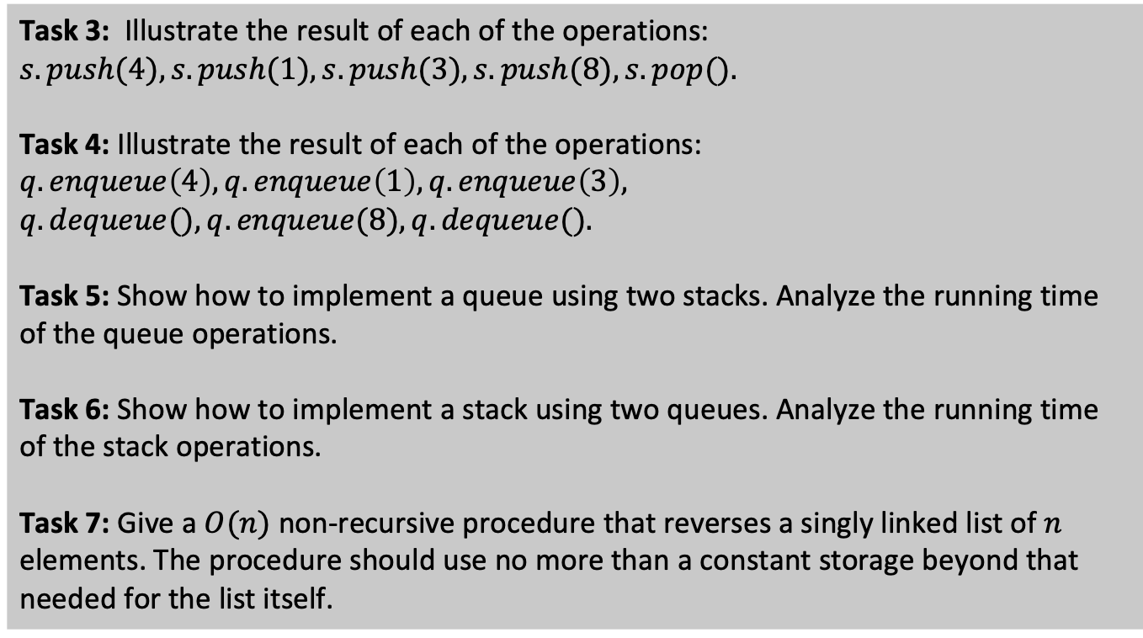
Student task
Task 3: Illustrate the result of each of the operations: $s.push(4), s.push(1), s.push(3), s.push(8), s.pop().$
Task 4: Illustrate the result of each of the operations: $q.enqueue\left(4\right), q.enqueue\left(1\right), q.enqueue\left(3\right),$
$$q.dequeue(), q.enqueue(8), q.dequeue().$$
Task 5: Show how to implement a queue using two stacks. Analyze the running time of the queue operations.
Task 6: Show how to implement a stack using two queues. Analyze the running time of the stack operations.
Task 7: Give a $O(n)$ non-recursive procedure that reverses a singly linked list of $n$ elements. The procedure should use no more than a constant storage beyond that needed for the list itself.

Slide 31
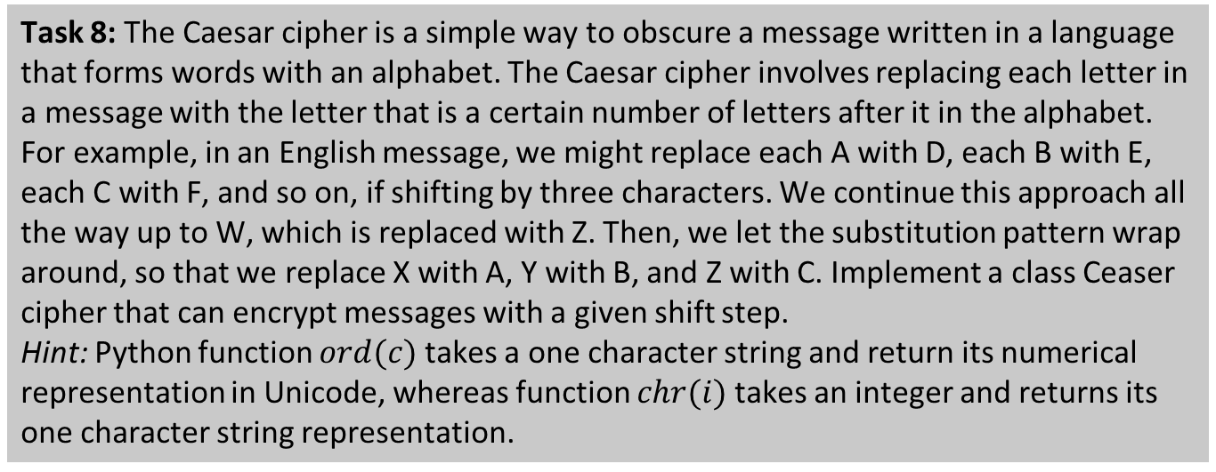
Student task
Task 8: The Caesar cipher is a simple way to obscure a message written in a language that forms words with an alphabet. The Caesar cipher involves replacing each letter in a message with the letter that is a certain number of letters after it in the alphabet. For example, in an English message, we might replace each A with D, each B with E, each C with F, and so on, if shifting by three characters. We continue this approach all the way up to W, which is replaced with Z. Then, we let the substitution pattern wrap around, so that we replace X with A, Y with B, and Z with C. Implement a class Ceaser cipher that can encrypt messages with a given shift step.
Hint: Python function $ord(c)$ takes a one character string and return its numerical representation in Unicode, whereas function $chr(i)$ takes an integer and returns its one character string representation.

Slide 32
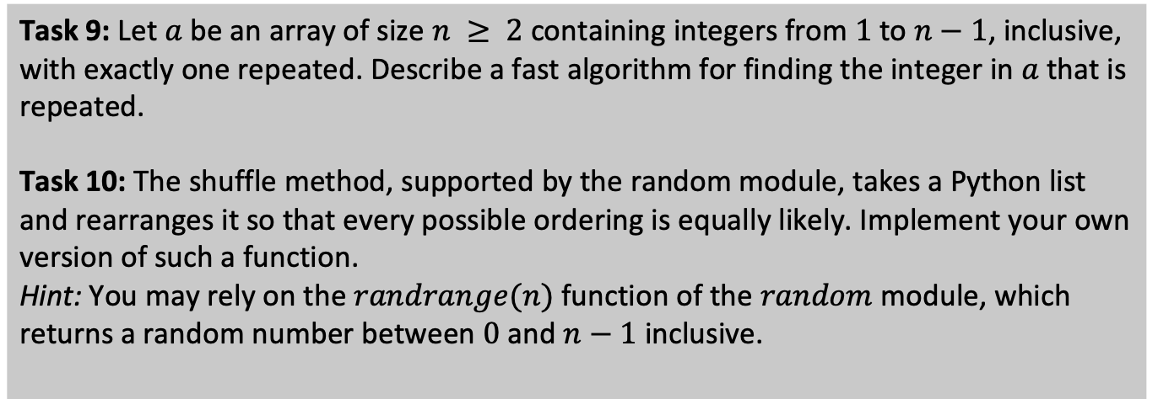
Student task
Task 9: Let $a$ be an array of size $n ≥ 2$containing integers from $1$to $n−1$, inclusive,
with exactly one repeated. Describe a fast algorithm for finding the integer in $a$ that is repeated.
Task 10: The shuffle method, supported by the random module, takes a Python list and rearranges it so that every possible ordering is equally likely. Implement your own version of such a function.
Hint: You may rely on the $randrange(n)$function of the $random$ module, which returns a random number between $0$ and $n−1$inclusive.

Slide 33
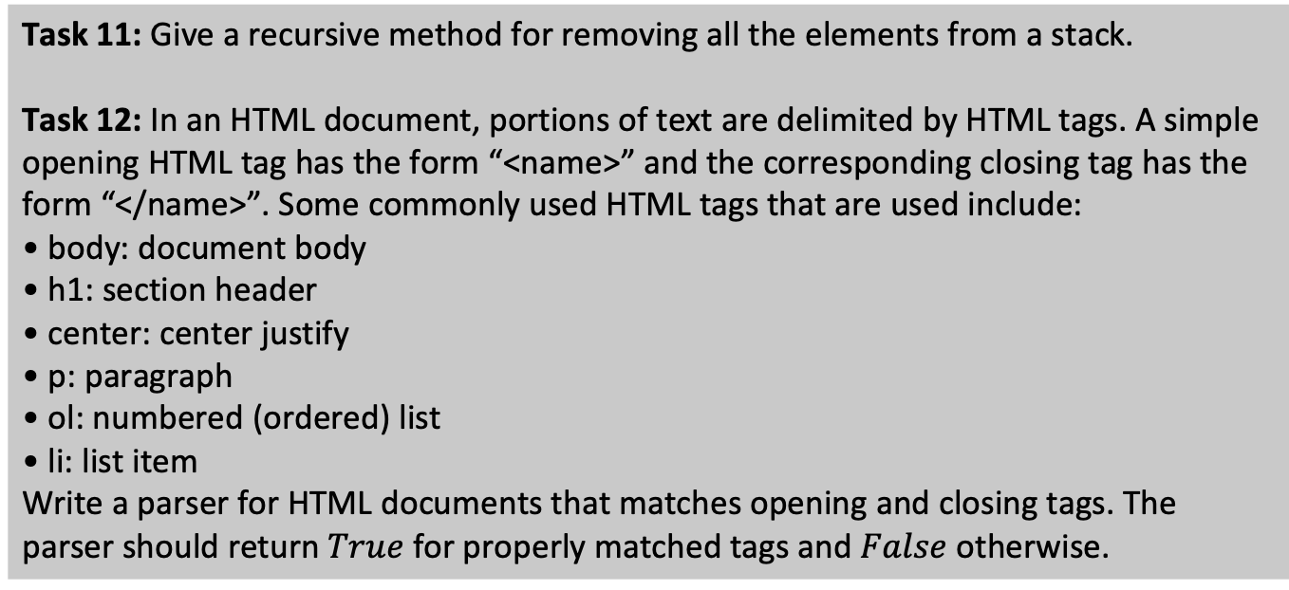
Student task
Task 11: Give a recursive method for removing all the elements from a stack.
Task 12: In an HTML document, portions of text are delimited by HTML tags. A simple
opening HTML tag has the form “<name>” and the corresponding closing tag has the form “</name>”. Some commonly used HTML tags that are used include:
• body: document body
• h1: section header
• center: center justify
• p: paragraph
• ol: numbered (ordered) list
• li: list item
Write a parser for HTML documents that matches opening and closing tags. The parser should return $True$ for properly matched tags and $False$ otherwise.

Slide 34
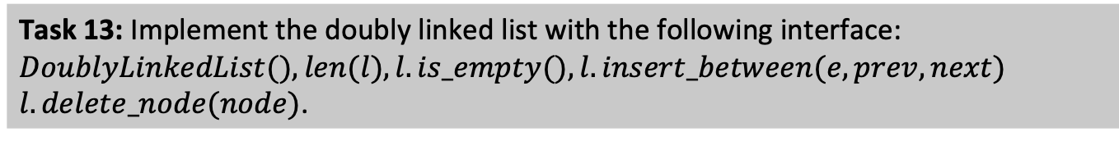
Student task
Task 13: Implement the doubly linked list with the following interface: $DoublyLinkedList(), len(l), l.is_empty(), l.insert_between(e, prev, next)$
$l.delete_node(node)$.

