Slide 1

Algorithms and Data Structures
Unit 2 – Quicksort and Randomized Algorithms

Slide 2
Outline
Quicksort
Partitioning
Exercise
Complexity of quicksort
Exercise
Exercise: Hoare’s partitioning
Average case complexity
Exercise
Randomized quicksort
Exercise
Exercise

Slide 3
Quicksort

Slide 4
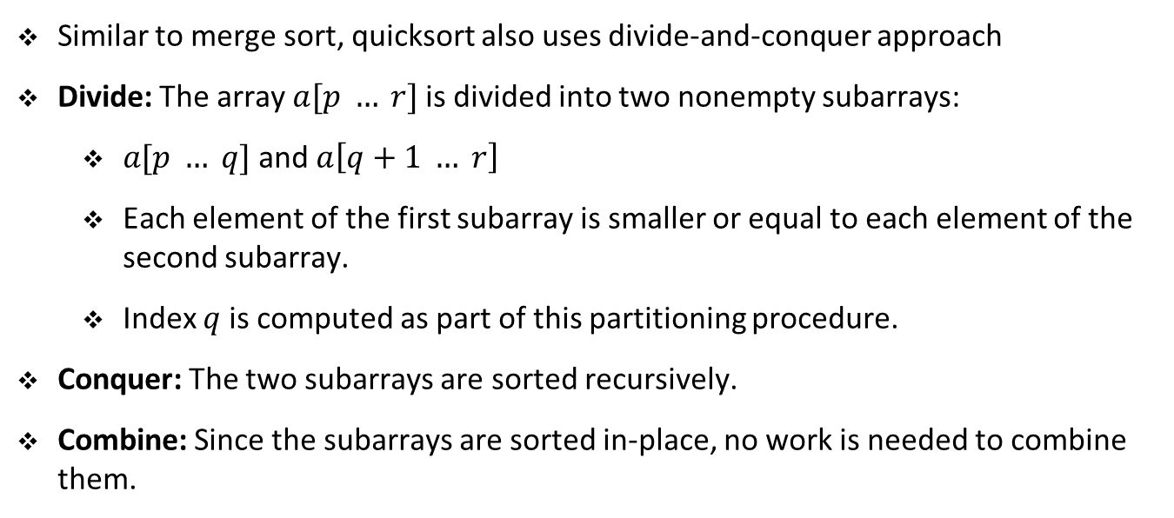
Quicksort
Similar to merge sort, quicksort also uses divide-and-conquer approach
Divide: The array $a[p … r]$is divided into two nonempty subarrays:
$a[p … q]$and $a\left[q+1 … r\right]$
Each element of the first subarray is smaller or equal to each element of the second subarray.
Index $q$ is computed as part of this partitioning procedure.
Conquer: The two subarrays are sorted recursively.
Combine: Since the subarrays are sorted in-place, no work is needed to combine them.
Remark 1: Quicksort sorts in-place, i.e., it does not copy elements into new lists. Merge sort does not sort in-place as it copies the elements of the two sublists while combining/merging. Hence, quicksort generally occupies less memory than merge sort.

Slide 5
Quicksort
def quicksort(a, p, r):
if p < r:
q = partition(a, p, r) # partition around the pivot
# q is index of pivot element
quicksort(a, p, q - 1) # sort the low side
quicksort(a, q + 1, r) # sort the high side

Slide 6
Partitioning

Slide 7
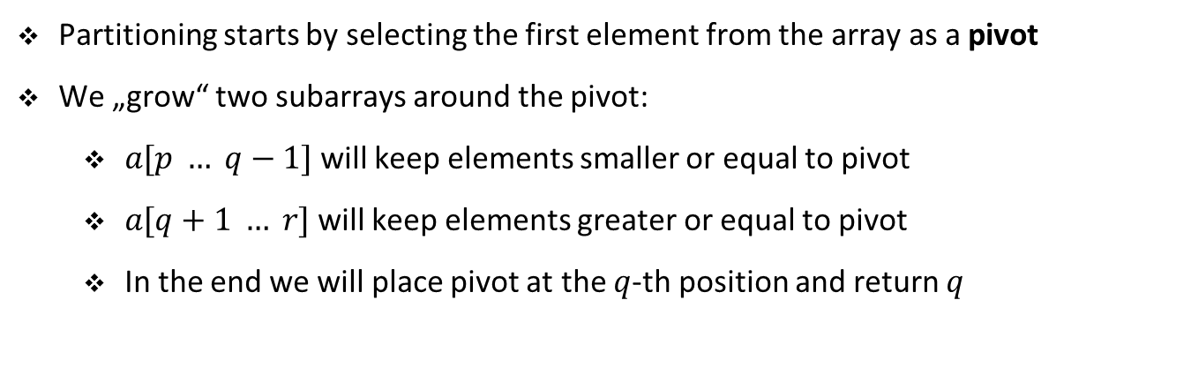
Partitioning the array
Partitioning starts by selecting the first element from the array as a pivot
We „grow“ two subarrays around the pivot:
$a[p … q−1]$will keep elements smaller or equal to pivot
$a[q+1 … r]$will keep elements greater or equal to pivot
In the end we will place pivot at the $q$-th position and return $q$

Slide 8
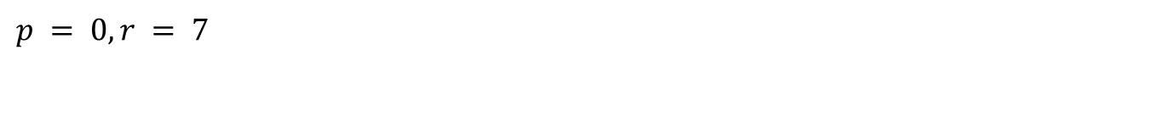
Partitioning the array
$$p = 0, r = 7$$
0 | 1 | 2 | 3 | 4 | 5 | 6 | 7
5 | 3 | 2 | 6 | 4 | 1 | 3 | 7

Slide 9
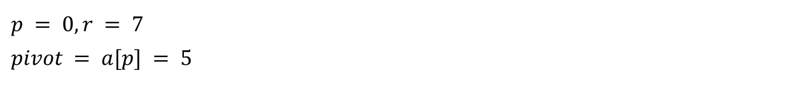
Partitioning the array
$$p = 0, r = 7$$
$$pivot = a[p] = 5$$
0 | 1 | 2 | 3 | 4 | 5 | 6 | 7
5 | 3 | 2 | 6 | 4 | 1 | 3 | 7

Slide 10

Partitioning the array
$$p = 0, r = 7$$
$$pivot = a[p] = 5$$
0 | 1 | 2 | 3 | 4 | 5 | 6 | 7
$$step = 0$$
5 | 3 | 2 | 6 | 4 | 1 | 3 | 7
i
j
Notes:
We need two pointer i and j.
i runs from the end to the beginning
I denotes the boundary between the lower and upper part. In the end, it is the position of the pivot element.

Slide 11

Partitioning the array
$$p = 0, r = 7$$
$$pivot = a[p] = 5$$
0 | 1 | 2 | 3 | 4 | 5 | 6 | 7
$$step = 1$$
5 | 3 | 2 | 6 | 4 | 1 | 3 | 7
i
j

Slide 12

Partitioning the array
$$p = 0, r = 7$$
$$pivot = a[p] = 5$$
0 | 1 | 2 | 3 | 4 | 5 | 6 | 7
$$step = 2$$
5 | 3 | 2 | 6 | 4 | 1 | 3 | 7
i
j

Slide 13

Partitioning the array
$$p = 0, r = 7$$
$$pivot = a[p] = 5$$
0 | 1 | 2 | 3 | 4 | 5 | 6 | 7
$$step = 3$$
5 | 3 | 2 | 6 | 4 | 1 | 3 | 7
i
j

Slide 14

Partitioning the array
$$p = 0, r = 7$$
$$pivot = a[p] = 5$$
0 | 1 | 2 | 3 | 4 | 5 | 6 | 7
$$step = 4$$
5 | 3 | 2 | 6 | 4 | 1 | 3 | 7
i
j

Slide 15

Partitioning the array
$$p = 0, r = 7$$
$$pivot = a[p] = 5$$
0 | 1 | 2 | 3 | 4 | 5 | 6 | 7
$$step = 5$$
5 | 3 | 2 | 6 | 4 | 1 | 3 | 7
i
j

Slide 16
Partitioning the array
$$p = 0, r = 7$$
$$pivot = a[p] = 5$$
0 | 1 | 2 | 3 | 4 | 5 | 6 | 7
$$step = 5$$
5 | 3 | 2 | 6 | 4 | 1 | 3 | 7
i
j

Slide 17
Partitioning the array
$$p = 0, r = 7$$
$$pivot = a[p] = 5$$
0 | 1 | 2 | 3 | 4 | 5 | 6 | 7
$$step = 5$$
5 | 3 | 2 | 3 | 4 | 1 | 6 | 7
i
j

Slide 18

Partitioning the array
$$p = 0, r = 7$$
$$pivot = a[p] = 5$$
0 | 1 | 2 | 3 | 4 | 5 | 6 | 7
$$step = 6$$
5 | 3 | 2 | 3 | 4 | 1 | 6 | 7
i
j

Slide 19

Partitioning the array
$$p = 0, r = 7$$
$$pivot = a[p] = 5$$
0 | 1 | 2 | 3 | 4 | 5 | 6 | 7
$$step = 7$$
5 | 3 | 2 | 3 | 4 | 1 | 6 | 7
i
j

Slide 20

Partitioning the array
$$p = 0, r = 7$$
$$pivot = a[p] = 5$$
0 | 1 | 2 | 3 | 4 | 5 | 6 | 7
$$Final step$$
5 | 3 | 2 | 3 | 4 | 1 | 6 | 7
j

Slide 21
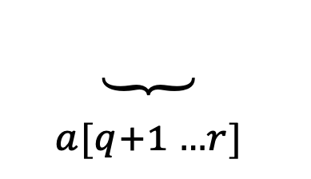

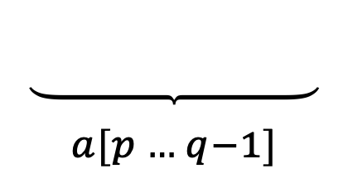
Partitioning the array
$$p = 0, r = 7$$
$$pivot = a[p] = 5$$
0 | 1 | 2 | 3 | 4 | 5 | 6 | 7
$$return j as q$$
1 | 3 | 2 | 3 | 4 | 5 | 6 | 7
$$\underset{\begin{aligned} \\ a[p … q−1]\end{aligned}}{\underbrace{ }}$$
$$\underset{\begin{aligned} \\ a[q+1 …r]\end{aligned}}{\underbrace{ }}$$
q = j

Slide 22



4 regions during execution
$$p = 0, r = 7$$
$$pivot = a[p] = 5$$
$$pivot$$
unknown
$$x≤pivot$$
$$x>pivot$$
0 | 1 | 2 | 3 | 4 | 5 | 6 | 7
$$step = 4$$
5 | 3 | 2 | 6 | 4 | 1 | 3 | 7
i
j

Slide 23
Quicksort: Partition
def partition(a, p, r):
pivot = a[p] # the pivot element
j = r # index of first known element greater than pivot
for i in range(r, p, -1):
if a[i] > pivot:
if i < j:
a[i], a[j] = a[j], a[i]
j -= 1
if p < j:
a[p], a[j] = a[j], a[p] # put pivot in place
return j

Slide 24
Exercise

Slide 25
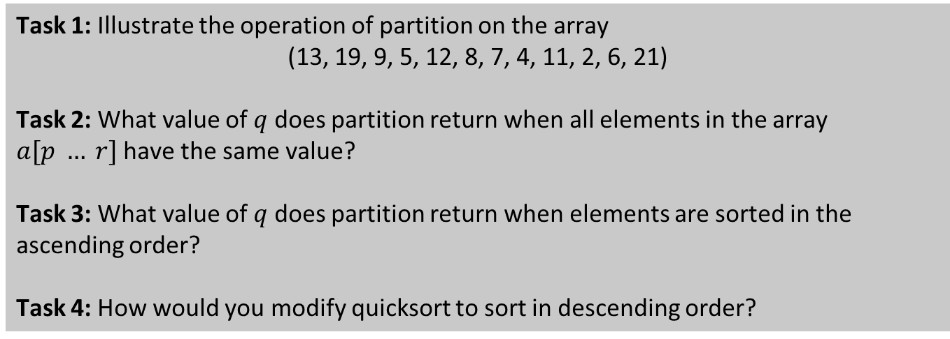
Student task
Task 1: Illustrate the operation of partition on the array
(13, 19, 9, 5, 12, 8, 7, 4, 11, 2, 6, 21)
Task 2: What value of $q$ does partition return when all elements in the array $a[p … r]$have the same value?
Task 3: What value of $q$ does partition return when elements are sorted in the ascending order?
Task 4: How would you modify quicksort to sort in descending order?

Slide 26
Complexity of quicksort

Slide 27
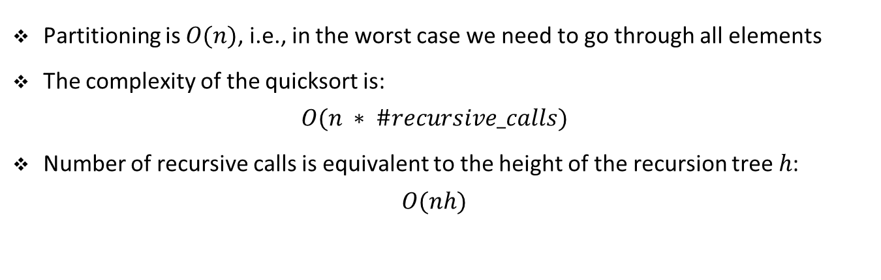
Complexity of quicksort
Partitioning is $O(n)$, i.e., in the worst case we need to go through all elements
The complexity of the quicksort is:
$$O(n ∗ \#recursive_calls)$$
Number of recursive calls is equivalent to the height of the recursion tree $h$:
$$O(nh)$$

Slide 28





















Recursion tree
$$h$$
$$n$$
$$n$$
$$n_{21}$$
$$n_{22}$$
$$n$$
$$n_{31}$$
$$n_{32}$$
$$n_{33}$$
$$n_{34}$$
$$n$$
$$n_{41}$$
$$n_{42}$$
$$n_{43}$$
$$n$$
$$. . .$$
$$≤n$$
$$n_{h1}$$
$$n_{h2}$$
$$2$$
$$O(nh)$$

Slide 29


















Recursion tree: best case
$$log n$$
$$n$$
$$n$$
$$n/2$$
$$n/2$$
$$n$$
$$n/4$$
$$n/4$$
$$n/4$$
$$n/4$$
$$n$$
$$. . .$$
$$n$$
$$. . .$$
$$. . .$$
$$. . .$$
$$. . .$$
$$1$$
$$1$$
$$1$$
$$1$$
$$n$$
$$O(n\log{n})$$

Slide 30
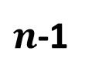











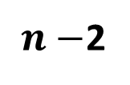
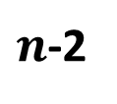
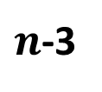




Recursion tree: worst case
$$n$$
$$n$$
$$n$$
$$1$$
$n$-1
$$n$$
$$1$$
$n$-2
$$n−1$$
$$1$$
$n$-3
$n−$2
$$. . .$$
$$1$$
$$O(n^{2})$$
$$1$$
$$2$$
$$3$$
$$1$$
$$1$$
$$2$$

Slide 31
Exercise

Slide 32
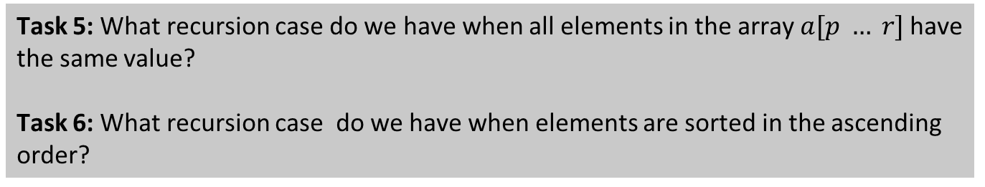
Student task
Task 5: What recursion case do we have when all elements in the array $a[p … r]$have the same value?
Task 6: What recursion case do we have when elements are sorted in the ascending order?

Slide 33
Exercise: Hoare’s partitioning

Slide 34
Student task
Task 7: What we used so far for quicksort is a so-called Lomuto‘s partitioning scheme. This scheme is a bit more intuitive than the original Hoare‘s partitioning scheme, which is typically slightly faster on a certain kind of input. Here is the python implementation of the Hoare‘s partitioning scheme.
def partition(a, p, r):
pivot = a[p]
i = p - 1
j = r + 1
while True:
j -= 1
i += 1
while a[j] > pivot:
j -= 1
while a[i] < pivot:
i += 1
if i >= j:
return j
a[i], a[j] = a[j], a[i]

Slide 35
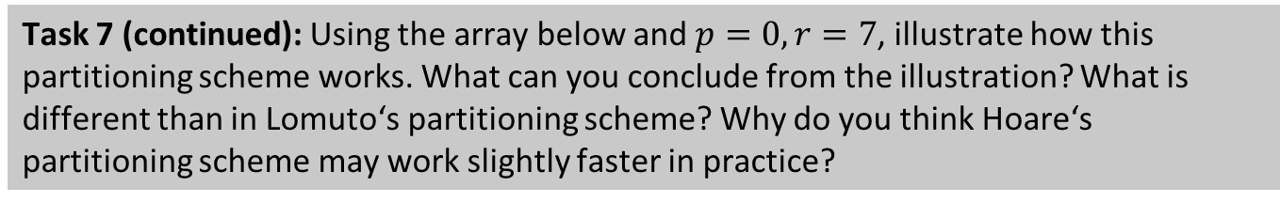
Student task
Task 7 (continued): Using the array below and $p=0, r=7$, illustrate how this partitioning scheme works. What can you conclude from the illustration? What is different than in Lomuto‘s partitioning scheme? Why do you think Hoare‘s partitioning scheme may work slightly faster in practice?
0 | 1 | 2 | 3 | 4 | 5 | 6 | 7
5 | 3 | 2 | 6 | 4 | 1 | 3 | 7
Task 8: When using Hoare‘s partitioning scheme we need to slightly modify our implementation of the quicksort.
def quicksort(a, p, r):
if p < r:
q = partition(a, p, r)
quicksort(a, p, q)
quicksort(a, q + 1, r)

Slide 36
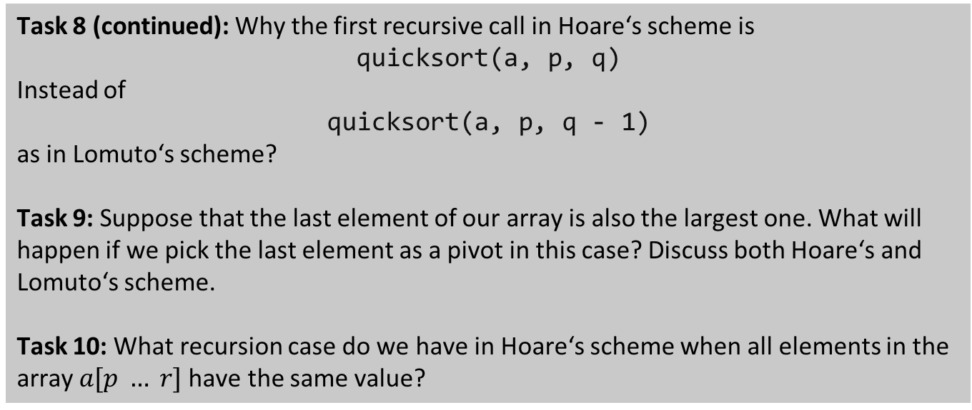
Student task
Task 8 (continued): Why the first recursive call in Hoare‘s scheme is
quicksort(a, p, q)
Instead of
quicksort(a, p, q - 1)
as in Lomuto‘s scheme?
Task 9: Suppose that the last element of our array is also the largest one. What will happen if we pick the last element as a pivot in this case? Discuss both Hoare‘s and Lomuto‘s scheme.
Task 10: What recursion case do we have in Hoare‘s scheme when all elements in the array $a[p … r]$have the same value?
Notebook example

Slide 37
Average case complexity

Slide 38
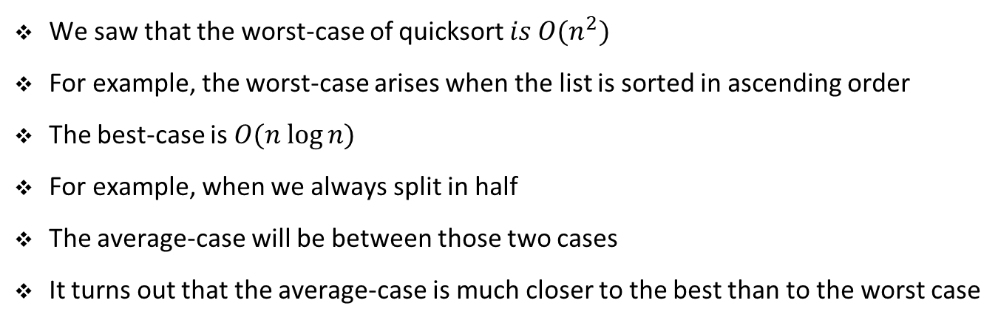
Average case
We saw that the worst-case of quicksort $is O(n^{2})$
For example, the worst-case arises when the list is sorted in ascending order
The best-case is $O(n log⁡n)$
For example, when we always split in half
The average-case will be between those two cases
It turns out that the average-case is much closer to the best than to the worst case

Slide 39
Balanced vs. unbalanced partitioning
Balanced partitioning is a partitioning s.t. the two sublists are of similar sizes
For example, 47% and 53% split is balanced
In unbalanced partitioning the two sublists differ substantially in their sizes
For example, 10% and 90% split is unbalanced
Let us investigate the recursion tree for an unbalanced split

Slide 40




















Recursion tree: unbalanced partitioning, 9-to-1 split
$$log_{10}n$$
$$n$$
$$n$$
$$\frac{n}{10}$$
$$\frac{9n}{10}$$
$$n$$
$$\frac{n}{100}$$
$$\frac{9n}{100}$$
$$\frac{9n}{100}$$
$$\frac{81n}{100}$$
$$n$$
$$. . .$$
$$\frac{81n}{1000}$$
$$\frac{729n}{1000}$$
$$n$$
$$1$$
$$. . .$$
$$. . .$$
$$log_{10/9}n$$
$$≤n$$
$$1$$
$$≤n$$
$$O(n\log{n})$$

Slide 41
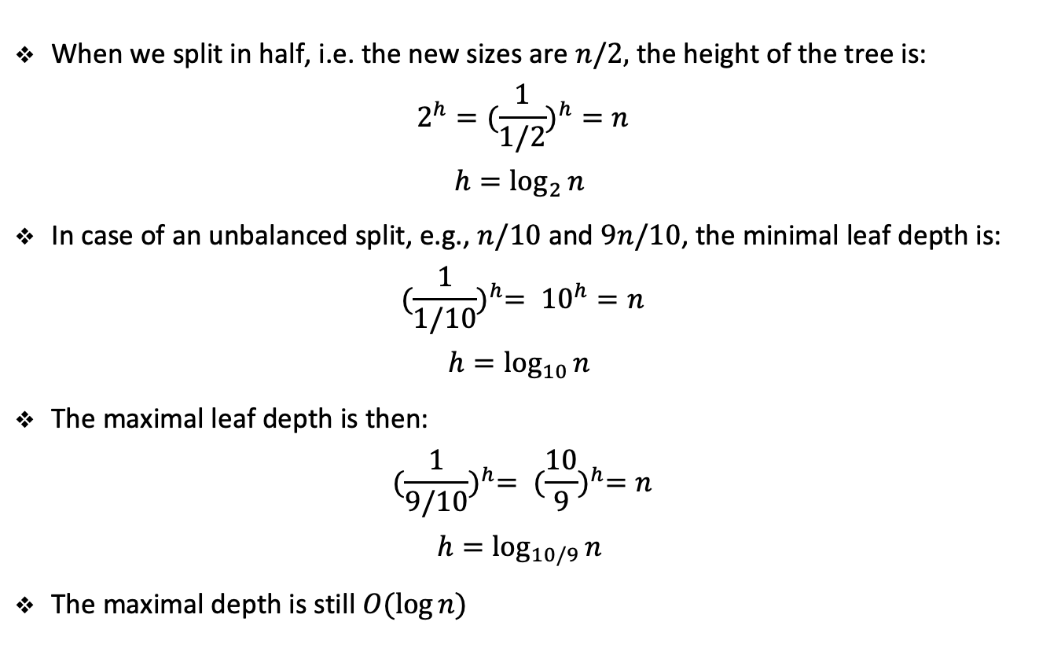
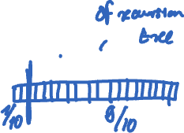
Unbalanced partitioning, 9-to-1 split
When we split in half, i.e. the new sizes are $n/2,$ the height of the tree is:
$${2^{h}=(\frac{1}{1/2})}^{h}=n$$
$$h=\log_{2}{n }$$
In case of an unbalanced split, e.g., $n/10$and $9n/10$, the minimal leaf depth is:
$${(\frac{1}{1/10})}^{h}= {10}^{h}=n$$
$$h=\log_{10}{n }$$
The maximal leaf depth is then:
$${(\frac{1}{9/10})}^{h}= {(\frac{10}{9})}^{h}=n$$
$$h=\log_{10/9}{n }$$
The maximal depth is still $O(\log{n})$

Slide 42
Exercise

Slide 43
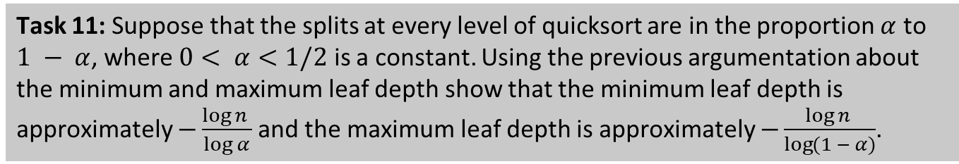
Student task
Task 11: Suppose that the splits at every level of quicksort are in the proportion $α$ to $1 − α$, where $0< α<1/2$ is a constant. Using the previous argumentation about the minimum and maximum leaf depth show that the minimum leaf depth is approximately $−\frac{\log{n }}{\log{α}}$ and the maximum leaf depth is approximately $−\frac{\log{n }}{\log{(1 − α)}}$.

Slide 44
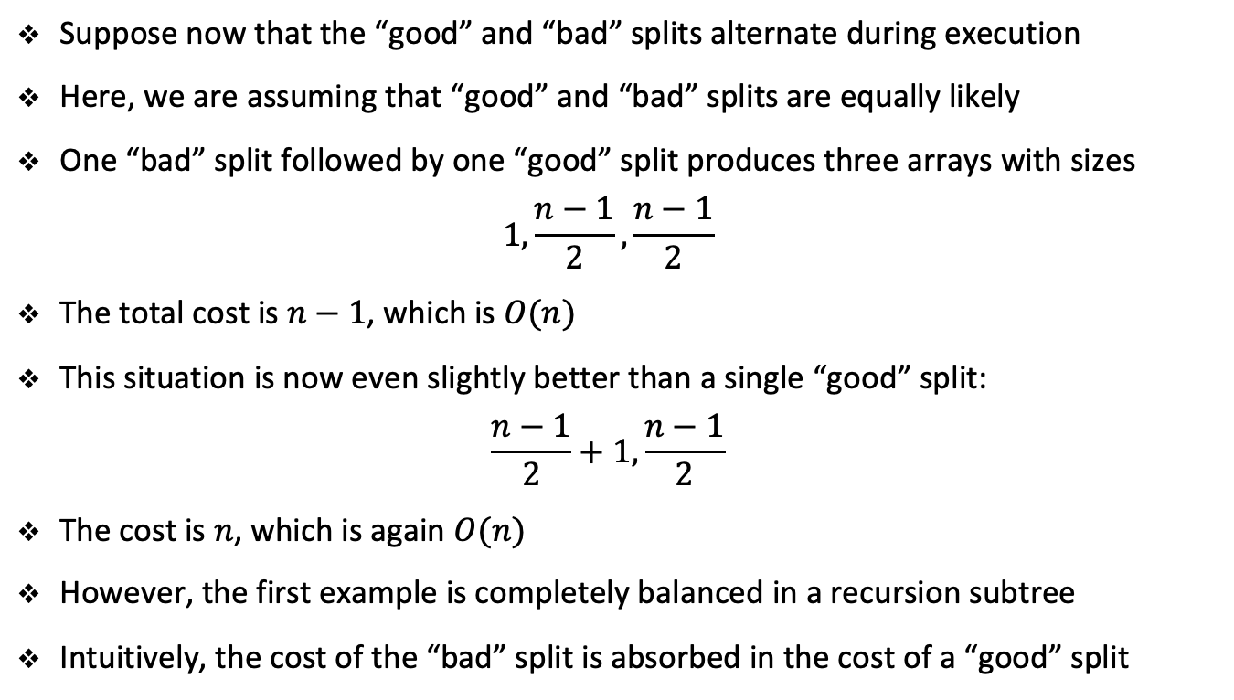
Average case
Suppose now that the “good” and “bad” splits alternate during execution
Here, we are assuming that “good” and “bad” splits are equally likely
One “bad” split followed by one “good” split produces three arrays with sizes
$$1,\frac{n−1}{2},\frac{n−1}{2}$$
The total cost is $n−1$, which is $O(n)$
This situation is now even slightly better than a single “good” split:
$$\frac{n−1}{2}+1,\frac{n−1}{2}$$
The cost is $n$, which is again $O(n)$
However, the first example is completely balanced in a recursion subtree
Intuitively, the cost of the “bad” split is absorbed in the cost of a “good” split
Notes:
O(n) for the partition/split operation

Slide 45
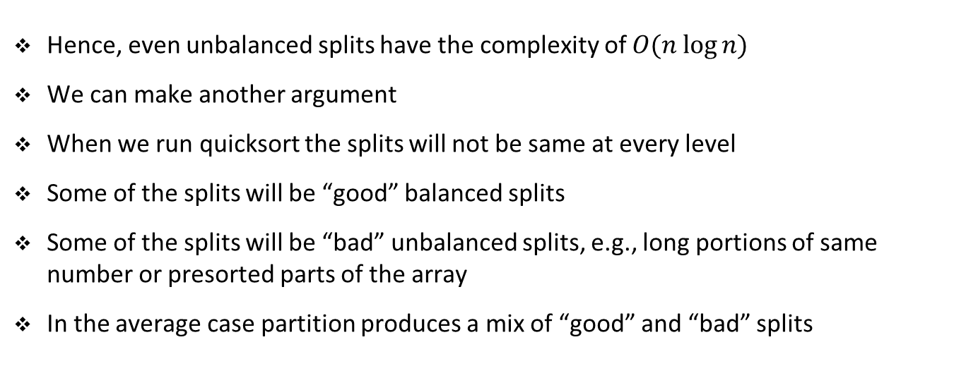
Average case
Hence, even unbalanced splits have the complexity of $O(n log⁡n)$
We can make another argument
When we run quicksort the splits will not be same at every level
Some of the splits will be “good” balanced splits
Some of the splits will be “bad” unbalanced splits, e.g., long portions of same number or presorted parts of the array
In the average case partition produces a mix of “good” and “bad” splits
Remark 2: Important assumption that we are making: all permutations are equally likely. Some of these permutations will produce “good” splits and some will produce “bad” splits.
Notes:
Don’t forget, the first or last element is the pivot element. Permtations create different pivot elements.

Slide 46
Randomized quicksort

Slide 47
Randomized quicksort
In real situations, we can not expect that all permutations are equally likely
In many applications, we will have larger presorted parts of the array
For example, transaction data sorted for each day combined in monthly data
In these cases we can use a randomized algorithm to impose a distribution
There are two basic possibilities to have a randomized quicksort:
Before sorting we randomly permute the input array
We randomly select the pivot when partitioning
See Notebook example

Slide 48
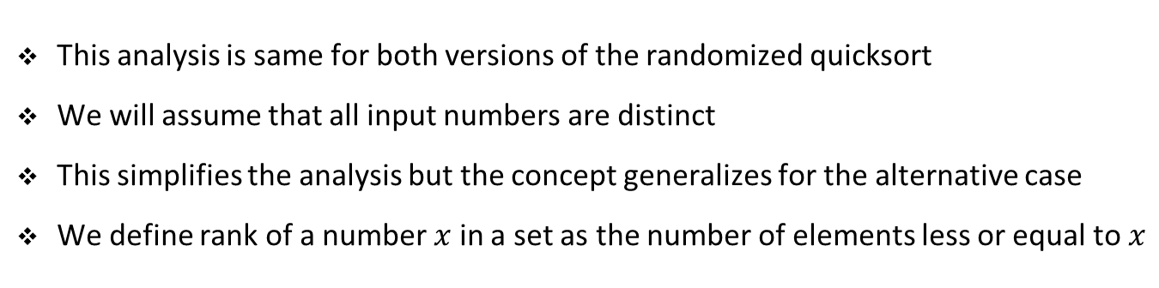
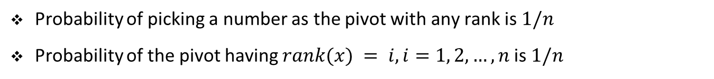
Analysis of randomized quicksort
This analysis is same for both versions of the randomized quicksort
We will assume that all input numbers are distinct
This simplifies the analysis but the concept generalizes for the alternative case
We define rank of a number $x$ in a set as the number of elements less or equal to $x$
Number
2 | 4 | 5 | 7 | 14 | 25 | 36 | 77
Rank
1 | 2 | 3 | 4 | 5 | 6 | 7 | 8
Probability of picking a number as the pivot with any rank is $1/n$
Probability of the pivot having $rank(x) = i, i=1, 2, …, n$is $1/n$

Slide 49
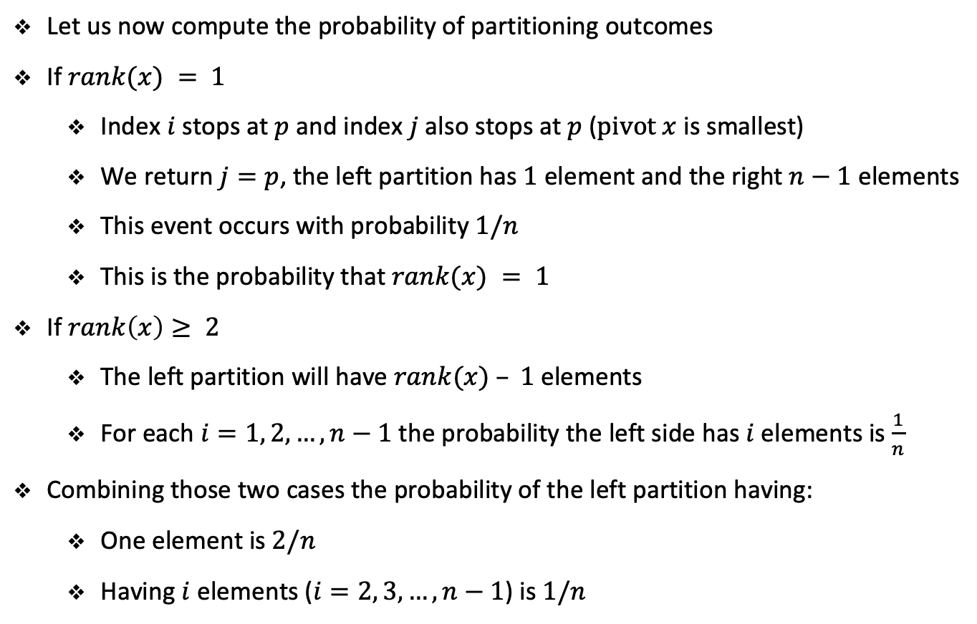
Analysis of randomized quicksort
Let us now compute the probability of partitioning outcomes
If $rank(x) = 1$
Index $i$ stops at $p$ and index $j$also stops at $p$ ($pivot x$ is smallest)
We return $j=p$, the left partition has $1$ element and the right $n−1$ elements
This event occurs with probability $1/n$
This is the probability that $rank(x) = 1$
If $rank\left(x\right)≥ 2$
The left partition will have $rank(x) – 1$elements
For each $i=1, 2, …, n−1$the probability the left side has $i$ elements is $\frac{1}{n}$
Combining those two cases the probability of the left partition having:
One element is $2/n$
Having $i$ elements ($i=2, 3, …, n−1$) is $1/n$

Slide 50
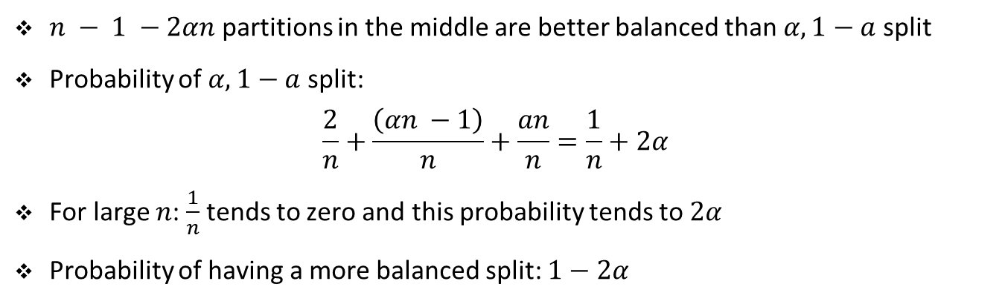
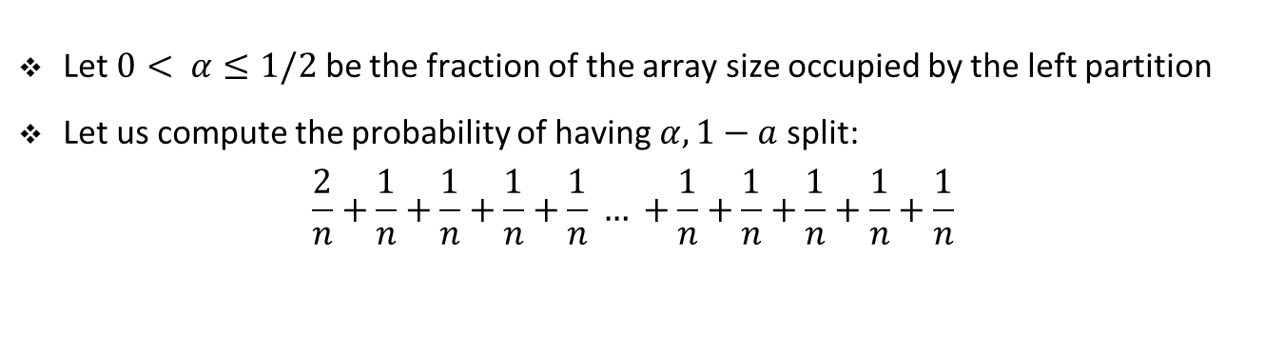
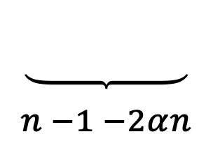
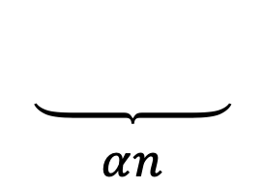

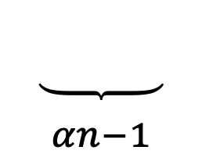
Analysis of randomized quicksort
Let $0< α≤1/2$ be the fraction of the array size occupied by the left partition
Let us compute the probability of having $α, 1−a$ split:
$$\frac{2}{n}+\frac{1}{n}+\frac{1}{n}+\frac{1}{n}+\frac{1}{n} … +\frac{1}{n}+\frac{1}{n}+\frac{1}{n}+\frac{1}{n}+\frac{1}{n}$$
$$\underset{\begin{aligned} \\ αn−1\end{aligned}}{\underbrace{ }}$$
$$\underset{\begin{aligned} \\ n −1 −2αn\end{aligned}}{\underbrace{ }}$$
$$\underset{\begin{aligned} \\ αn\end{aligned}}{\underbrace{ }}$$
$$1$$
$n − 1 −2αn$ partitions in the middle are better balanced than $α, 1−a$ split
Probability of $α, 1−a$ split:
$$\frac{2}{n}+\frac{\left(αn −1\right)}{n}+\frac{an}{n}=\frac{1}{n}+2α$$
For large $n$: $\frac{1}{n}$ tends to zero and this probability tends to $2α$
Probability of having a more balanced split: $1−2α$
Notes:
$n − 1 −2αn$ partitions in the middle are better balanced than $α, 1−a$ split: that is, the probability or split is somewhere in the middle. Task 13 gives the probability that splits are between first and third quartile.

Slide 51
Exercise

Slide 52
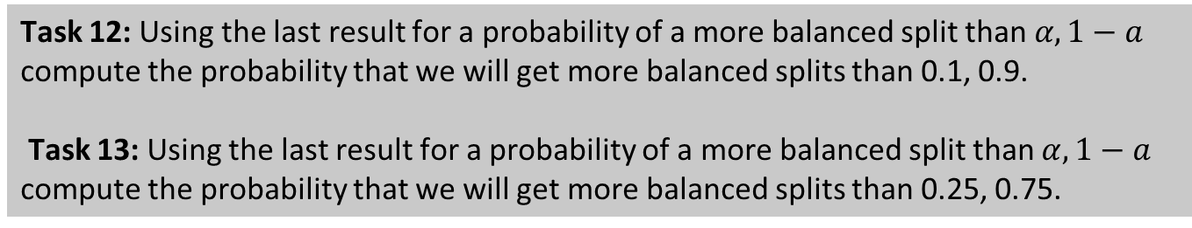
Student task
Task 12: Using the last result for a probability of a more balanced split than $α, 1−a$ compute the probability that we will get more balanced splits than 0.1, 0.9.
Task 13: Using the last result for a probability of a more balanced split than $α, 1−a$ compute the probability that we will get more balanced splits than 0.25, 0.75.

Slide 53
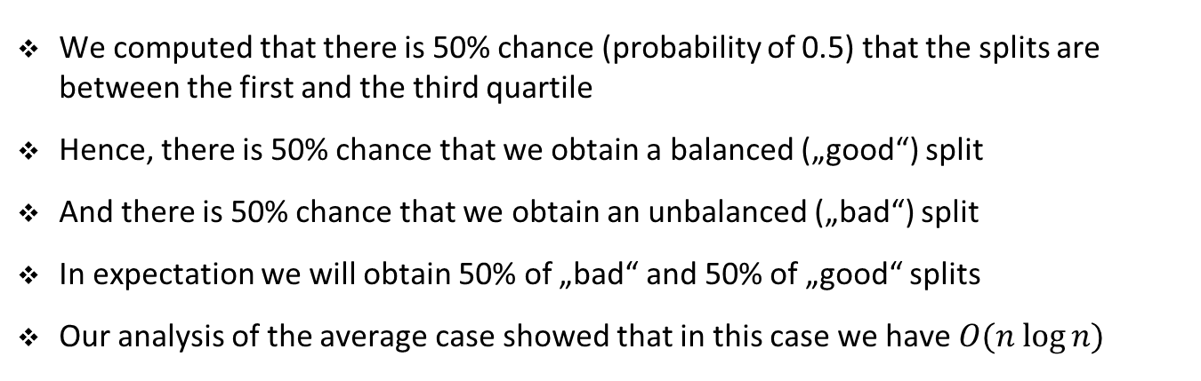
Analysis of randomized quicksort
We computed that there is 50% chance (probability of 0.5) that the splits are between the first and the third quartile
Hence, there is 50% chance that we obtain a balanced („good“) split
And there is 50% chance that we obtain an unbalanced („bad“) split
In expectation we will obtain 50% of „bad“ and 50% of „good“ splits
Our analysis of the average case showed that in this case we have $O(n log⁡n)$

Slide 54
Exercise

Slide 55
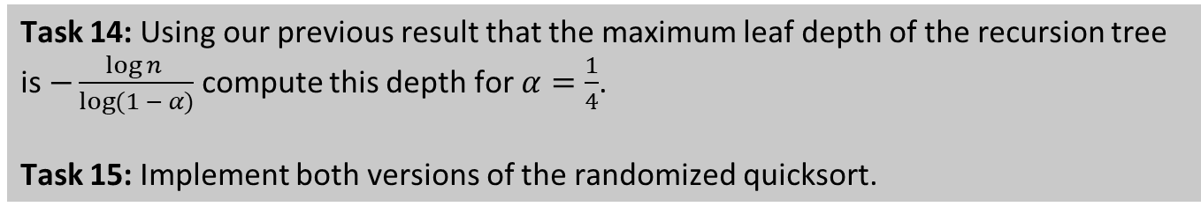
Student task
Task 14: Using our previous result that the maximum leaf depth of the recursion tree is $−\frac{\log{n }}{\log{(1 − α)}}$ compute this depth for $α=\frac{1}{4}$.
Task 15: Implement both versions of the randomized quicksort.

