Slide 1

Algorithms and Data Structures
Unit 8 – Graphs I & II

Slide 2
Outline
Representation of graphs
Graph traversal
Minimum spanning trees

Slide 3
Representation of graphs

Slide 4
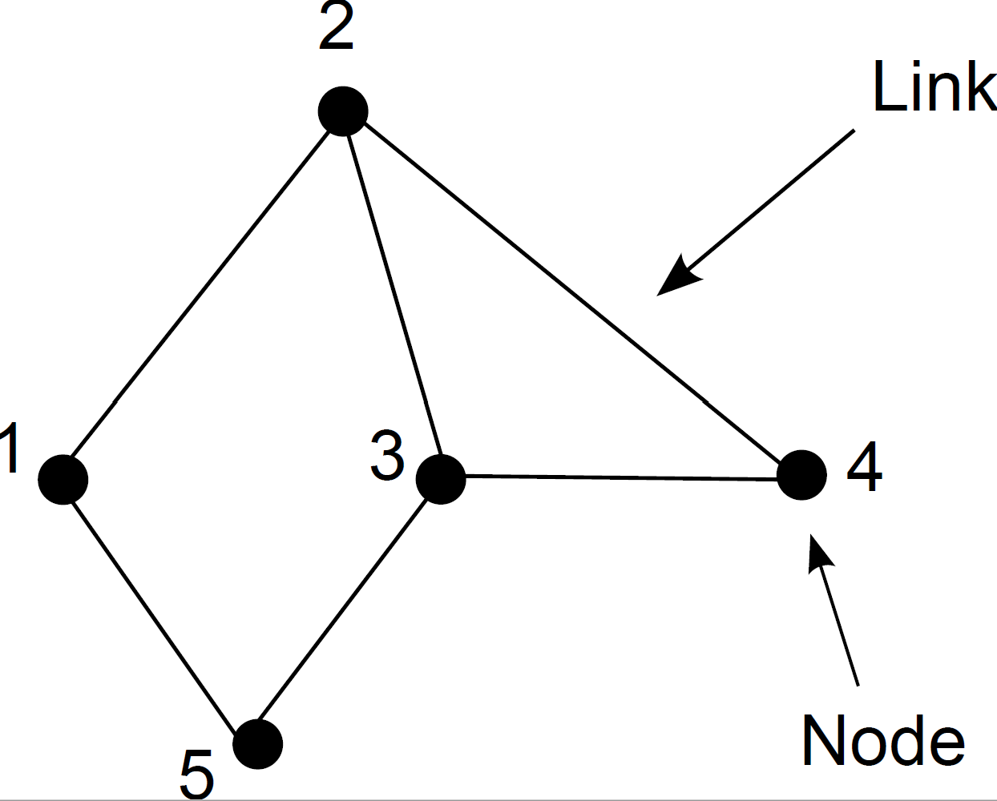
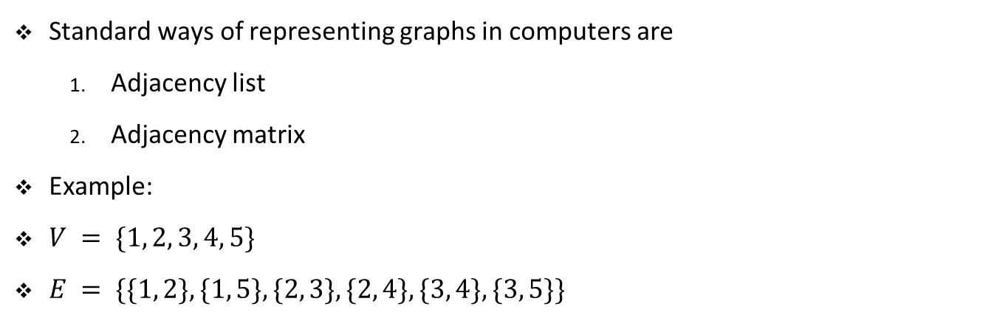
Graph representations
Standard ways of representing graphs in computers are
Adjacency list
Adjacency matrix
Example:
$V = \{1, 2, 3, 4, 5\}$
$E = \{\{1, 2\}, \{1, 5\}, \{2, 3\}, \{2, 4\}, \{3, 4\}, \{3, 5\}\}$

Slide 5
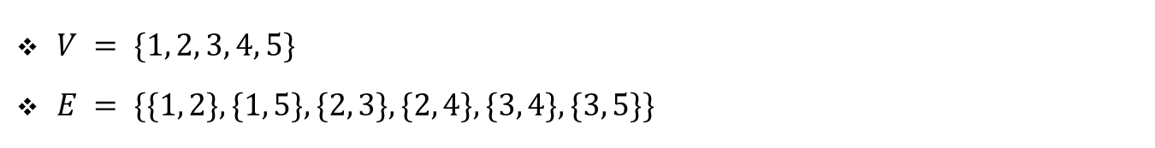
Adjacency list
$V = \{1, 2, 3, 4, 5\}$
$E = \{\{1, 2\}, \{1, 5\}, \{2, 3\}, \{2, 4\}, \{3, 4\}, \{3, 5\}\}$
1 | 2 | 5
2 | 1 | 3 | 4
3 | 2 | 4 | 5
4 | 2 | 3
5 | 1 | 3

Slide 6


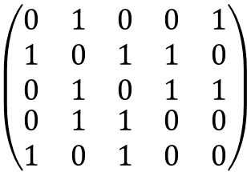
Adjacency matrix
$V = \{1, 2, 3, 4, 5\}$
$E = \{\{1, 2\}, \{1, 5\}, \{2, 3\}, \{2, 4\}, \{3, 4\}, \{3, 5\}\}$
$$\begin{matrix}1 & \begin{matrix}2 & 3 & 4\end{matrix} & 5\end{matrix}$$
$$\begin{matrix}1 \\ \begin{matrix}2 \\ 3 \\ 4\end{matrix} \\ 5\end{matrix}$$
$$\left(\begin{matrix}\begin{matrix}0 & 1 & 0 \\ 1 & 0 & 1 \\ 0 & 1 & 0\end{matrix} & \begin{matrix}0 & 1 \\ 1 & 0 \\ 1 & 1\end{matrix} \\ \begin{matrix}0 & 1 & 1 \\ 1 & 0 & 1\end{matrix} & \begin{matrix}0 & 0 \\ 0 & 0\end{matrix}\end{matrix}\right)$$

Slide 7
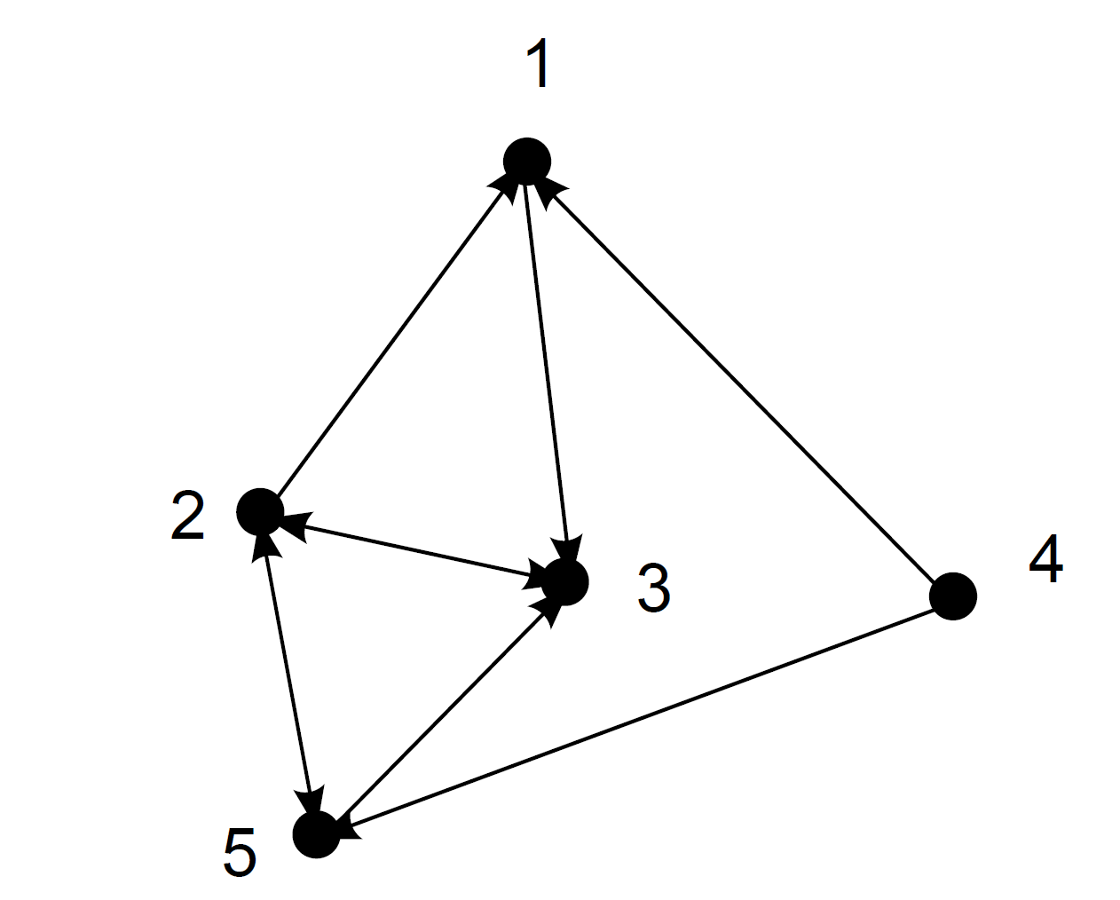
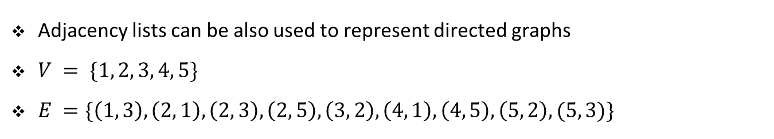
Adjacency list
Adjacency lists can be also used to represent directed graphs
$V = \{1, 2, 3, 4, 5\}$
$E =\{\left(1, 3\right), \left(2, 1\right), \left(2, 3\right), \left(2, 5\right), \left(3, 2\right), \left(4, 1\right), \left(4, 5\right), \left(5, 2\right), (5, 3)\}$
1 | 3
2 | 1 | 3 | 5
3 | 2
4 | 1 | 5
5 | 2 | 3

Slide 8

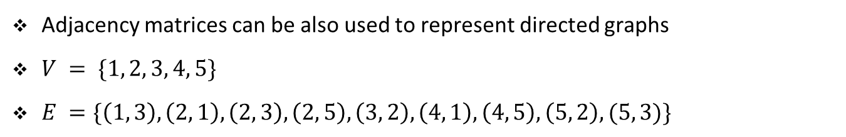
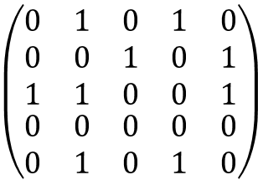
Adjacency matrix
Adjacency matrices can be also used to represent directed graphs
$V = \{1, 2, 3, 4, 5\}$
$E =\{\left(1, 3\right), \left(2, 1\right), \left(2, 3\right), \left(2, 5\right), \left(3, 2\right), \left(4, 1\right), \left(4, 5\right), \left(5, 2\right), (5, 3)\}$
$$\begin{matrix}1 & \begin{matrix}2 & 3 & 4\end{matrix} & 5\end{matrix}$$
$$\begin{matrix}1 \\ \begin{matrix}2 \\ 3 \\ 4\end{matrix} \\ 5\end{matrix}$$
$$\left(\begin{matrix}\begin{matrix}0 & 1 & 0 \\ 0 & 0 & 1 \\ 1 & 1 & 0\end{matrix} & \begin{matrix}1 & 0 \\ 0 & 1 \\ 0 & 1\end{matrix} \\ \begin{matrix}0 & 0 & 0 \\ 0 & 1 & 0\end{matrix} & \begin{matrix}0 & 0 \\ 1 & 0\end{matrix}\end{matrix}\right)$$
We set $A_{ij}=1$ if node j points to node i

Slide 9
Exercise

Slide 10
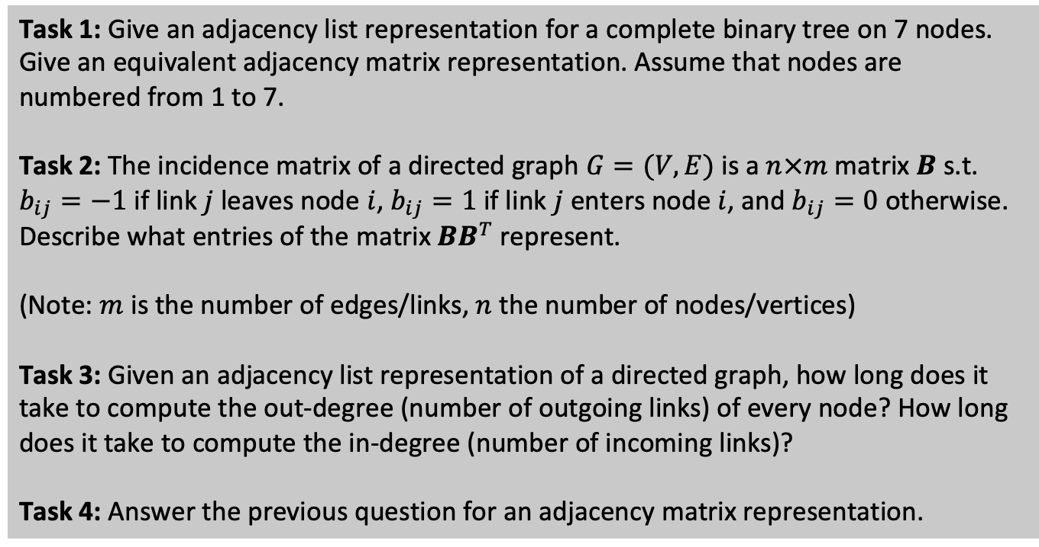
Student task
Task 1: Give an adjacency list representation for a complete binary tree on 7 nodes. Give an equivalent adjacency matrix representation. Assume that nodes are numbered from 1 to 7.
Task 2: The incidence matrix of a directed graph $G=(V,E)$is a $n×m$ matrix $B$ s.t. $b_{ij}=−1$if link$j$ leaves node $i$, $b_{ij}=1$if link $j$ enters node$i$, and $b_{ij}=0$otherwise. Describe what entries of the matrix $BB^{T}$ represent.
(Note: $m$ is the number of edges/links, $n$ the number of nodes/vertices)
Task 3: Given an adjacency list representation of a directed graph, how long does it take to compute the out-degree (number of outgoing links) of every node? How long does it take to compute the in-degree (number of incoming links)?
Task 4: Answer the previous question for an adjacency matrix representation.

Slide 11
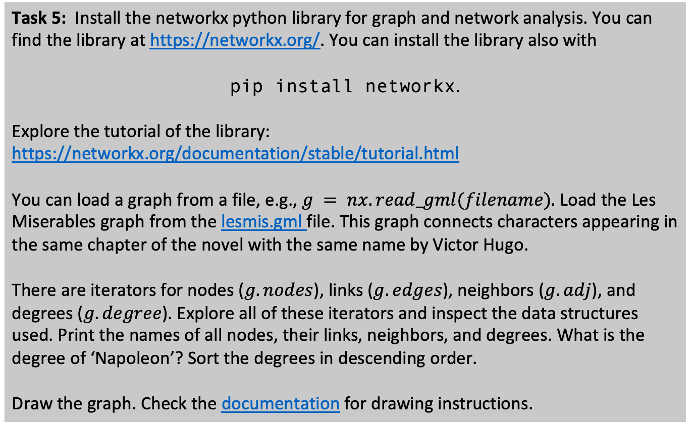
Student task
Task 5: Install the networkx python library for graph and network analysis. You can find the library at https://networkx.org/. You can install the library also with
pip install networkx.
Explore the tutorial of the library: https://networkx.org/documentation/stable/tutorial.html
You can load a graph from a file, e.g., $g = nx.read_gml(filename).$ Load the Les Miserables graph from the lesmis.gml file. This graph connects characters appearing in the same chapter of the novel with the same name by Victor Hugo.
There are iterators for nodes ($g.nodes$), links ($g.edges$), neighbors ($g.adj$), and degrees ($g.degree$). Explore all of these iterators and inspect the data structures used. Print the names of all nodes, their links, neighbors, and degrees. What is the degree of ‘Napoleon’? Sort the degrees in descending order.
Draw the graph. Check the documentation for drawing instructions.

Slide 12
Graph traversal

Slide 13
Graph search algorithms
Traversing/searching a graph
Commonly, we are given a source node s
We want to explore graph starting from s and find all other nodes reachable from s
Search algorithms are basic graph algorithms
Many other graph algorithms use ideas from those basic search algorithms
We will learn about two graph search/traversal algorithms
Breadth-first search
Depth-first search

Slide 14
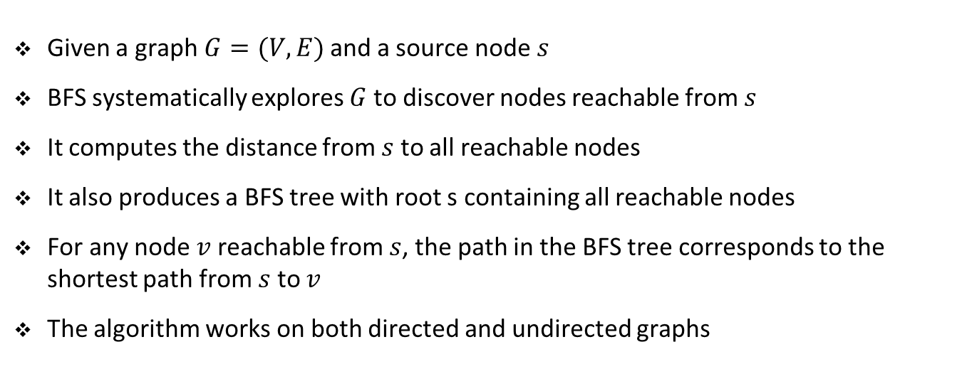
Breadth-first search (BFS)
Given a graph $G=(V,E)$and a source node $s$
BFS systematically explores $G$ to discover nodes reachable from $s$
It computes the distance from $s$ to all reachable nodes
It also produces a BFS tree with root s containing all reachable nodes
For any node $v$ reachable from $s$, the path in the BFS tree corresponds to the shortest path from $s$ to $v$
The algorithm works on both directed and undirected graphs

Slide 15
Breadth-first search (BFS)
BFS discovers nodes uniformly across the breadth of already discovered nodes
It discovers first all nodes at distance k from s before discovering any node at distance k+1
BFS keeps track of progress by coloring nodes as white, grey, or black
White nodes are nodes not yet reached
Grey nodes are discovered nodes but their neighbors are not completely examined
Black nodes are discovered and their neighbors have been completely examined

Slide 16
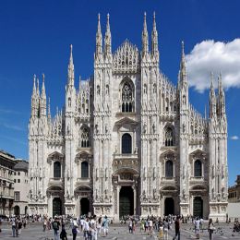
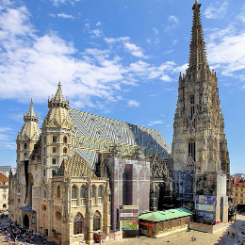
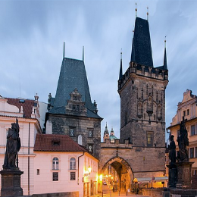
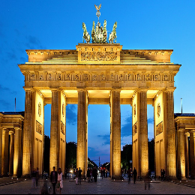

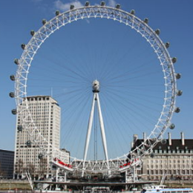

BFS
Milan
Vienna
Prague
Berlin
Paris
London
Copenhagen

Slide 17
BFS
Milan
Vienna
Prague
Vienna
Berlin
Paris
London
Copenhagen

Slide 18
BFS
Milan
Vienna
Prague
0
Berlin
Paris
London
Copenhagen

Slide 19
BFS
Milan
Vienna
Prague
1
0
1
Milan
Prague
Berlin
1
Berlin
Paris
London
Copenhagen

Slide 20
BFS
Milan
Vienna
Prague
1
0
1
Milan
Prague
Berlin
1
Berlin
Paris
London
Copenhagen

Slide 21
BFS
Milan
Vienna
Prague
1
0
1
Prague
Berlin
1
Berlin
Paris
London
Copenhagen

Slide 22
BFS
Milan
Vienna
Prague
1
0
1
Prague
Berlin
1
Berlin
Paris
London
Copenhagen

Slide 23
BFS
Milan
Vienna
Prague
1
0
1
Prague
Berlin
1
Berlin
Paris
London
Copenhagen

Slide 24
BFS
Milan
Vienna
Prague
1
0
1
Berlin
1
Berlin
Paris
London
Copenhagen

Slide 25
BFS
Milan
Vienna
Prague
1
0
1
Berlin
Copenhagen
1
Berlin
Paris
London
2
Copenhagen

Slide 26
BFS
Milan
Vienna
Prague
1
0
1
Berlin
Copenhagen
1
Berlin
Paris
London
2
Copenhagen

Slide 27
BFS
Milan
Vienna
Prague
1
0
1
Copenhagen
1
Berlin
Paris
London
2
Copenhagen

Slide 28
BFS
Milan
Vienna
Prague
1
0
1
Copenhagen
Paris
1
Berlin
Paris
London
2
2
Copenhagen

Slide 29
BFS
Milan
Vienna
Prague
1
0
1
Copenhagen
Paris
1
Berlin
Paris
London
2
2
Copenhagen

Slide 30
BFS
Milan
Vienna
Prague
1
0
1
Paris
1
Berlin
Paris
London
2
2
Copenhagen

Slide 31
BFS
Milan
Vienna
Prague
1
0
1
Paris
1
Berlin
Paris
London
2
2
Copenhagen

Slide 32
BFS
Milan
Vienna
Prague
1
0
1
1
Berlin
Paris
London
2
2
Copenhagen

Slide 33
BFS
Milan
Vienna
Prague
1
0
1
London
1
Berlin
Paris
London
2
2
3
Copenhagen

Slide 34
BFS
Milan
Vienna
Prague
1
0
1
London
1
Berlin
Paris
London
2
2
3
Copenhagen

Slide 35
BFS
Milan
Vienna
Prague
1
0
1
1
Berlin
Paris
London
2
2
3
Copenhagen

Slide 36
BFS
Milan
Vienna
Prague
1
0
1
1
Berlin
Paris
London
2
2
3
Copenhagen

Slide 37
BFS
Vienna
Milan
Berlin
Prague
Distance 1
Paris
Copenhagen
Distance 2
…
…
…
…

Slide 38
BFS
def BFS(g, s):
q = Queue()
q.enqueue(s)
color = {}
d = {}
parent = {}
for node in g.nodes:
color[node] = 'white'
d[node] = float('inf')
parent[node] = None
color[s] = 'grey'
d[s] = 0
while not q.is_empty():
u = q.dequeue()
for v in g.adj[u]:
if color[v] == 'white':
color[v] = 'grey'
d[v] = d[u] + 1
parent[v] = u
q.enqueue(v)
return d, parent
Notebook example

Slide 39
Exercise

Slide 40
Student task
Task 6: Explore the documentation of the networkx library related to BFS. Load the Les Miserables graph. Compute the BFS tree using this function from node ‘Napoleon’. Compute the distances from node ‘Myriel’ using this function.
Draw the BFS tree starting at ‘Napoleon’.

Slide 41
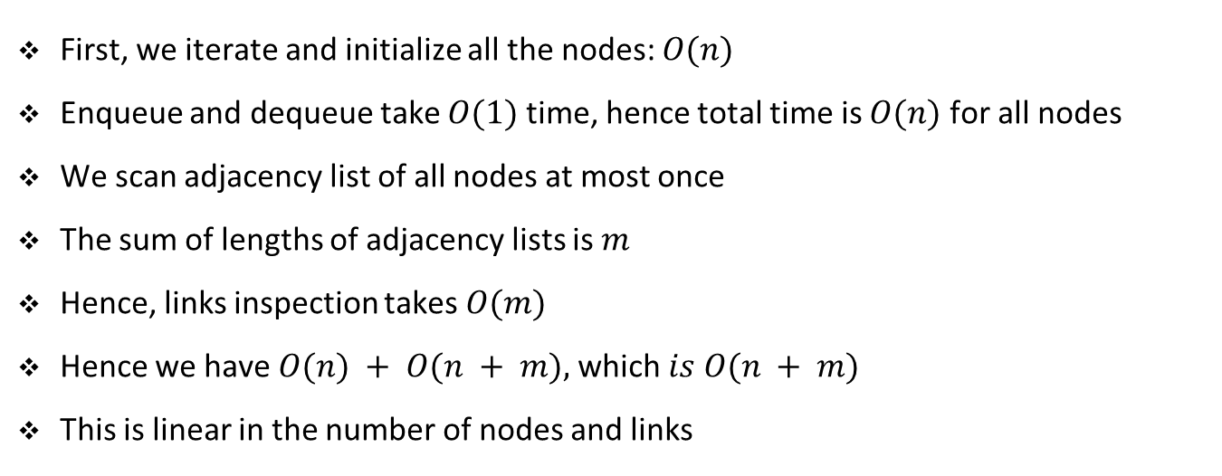
Complexity of BFS
First, we iterate and initialize all the nodes: $O(n)$
Enqueue and dequeue take $O(1)$ time, hence total time is $O(n)$ for all nodes
We scan adjacency list of all nodes at most once
The sum of lengths of adjacency lists is $m$
Hence, links inspection takes $O(m)$
Hence we have $O(n) + O(n + m),$which $is O(n + m)$
This is linear in the number of nodes and links

Slide 42
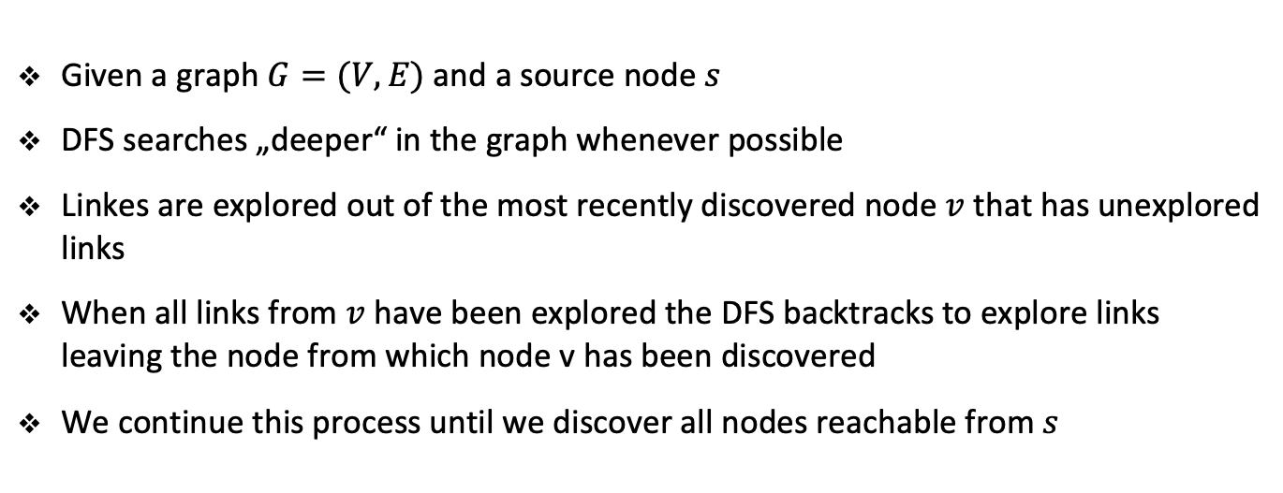
Depth-first search (DFS)
Given a graph $G=(V,E)$and a source node $s$
DFS searches „deeper“ in the graph whenever possible
Linkes are explored out of the most recently discovered node $v$ that has unexplored links
When all links from $v$ have been explored the DFS backtracks to explore links leaving the node from which node v has been discovered
We continue this process until we discover all nodes reachable from $s$

Slide 43
Depth-first search (DFS)
As with BFS whenever a node v is discovered we keep track of its parent
Similar to BFS, we color nodes as we progress trough the search
All nodes start white, turn grey when they are discovered
They are blackened when the exploration of their neighbors is finished

Slide 44
DFS
Milan
Vienna
Prague
Berlin
Paris
London
Copenhagen

Slide 45
DFS
Milan
Vienna
Prague
Berlin
Paris
London
Copenhagen

Slide 46
DFS
Milan
Vienna
Prague
Berlin
Paris
London
Copenhagen

Slide 47
DFS
Milan
Vienna
Prague
Berlin
Paris
London
Copenhagen

Slide 48
DFS
Milan
Vienna
Prague
Berlin
Paris
London
Copenhagen

Slide 49
DFS
Milan
Vienna
Prague
Berlin
Paris
London
Copenhagen

Slide 50
DFS
Milan
Vienna
Prague
Berlin
Paris
London
Copenhagen

Slide 51
DFS
Milan
Vienna
Prague
Berlin
Paris
London
Copenhagen

Slide 52
DFS
Milan
Vienna
Prague
Berlin
Paris
London
Copenhagen

Slide 53
DFS
def DFS(g, s):
visited = {}
parent = {}
for node in g.nodes:
visited[node] = False
parent[node] = None
return DFS_traversal(g, s, visited, parent)
def DFS_traversal(g, u, visited, parent):
visited[u] = True
for v in g.adj[u]:
if not visited[v]:
parent[v] = u
DFS_traversal(g, v, visited, parent)
return visited, parent
Notebook example

Slide 54
Exercise

Slide 55
Student task
Task 7: Explore the documentation of the networkx library related to DFS. Load the Les Miserables graph. Compute the DFS tree using this function from node ‘Napoleon’. Draw the DFS tree starting at ‘Napoleon.
Task 8: DFS can be easily extended to discover all the connected components of a graph. What is the main idea of such an extension? Implement this extension and test it on a simple graph with two components.

Slide 56
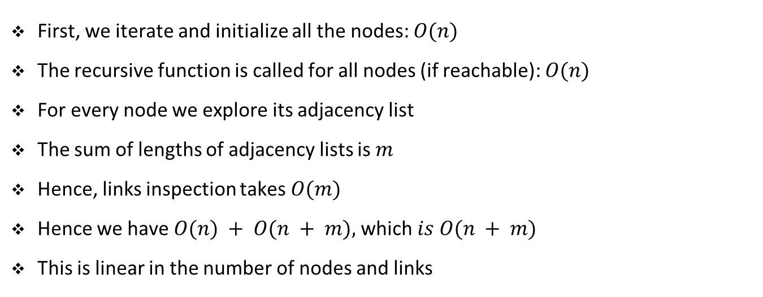
Complexity of DFS
First, we iterate and initialize all the nodes: $O(n)$
The recursive function is called for all nodes (if reachable): $O(n)$
For every node we explore its adjacency list
The sum of lengths of adjacency lists is $m$
Hence, links inspection takes $O(m)$
Hence we have $O(n) + O(n + m),$which $is O(n + m)$
This is linear in the number of nodes and links

Slide 57
Minimum spanning trees

Slide 58
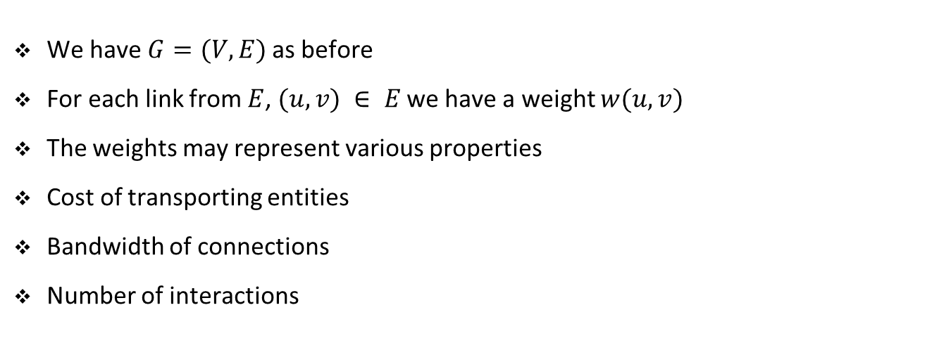
Weighted graphs
We have $G=(V,E)$as before
For each link from $E$, $(u, v) ∈ E$we have a weight $w(u, v)$
The weights may represent various properties
Cost of transporting entities
Bandwidth of connections
Number of interactions

Slide 59






















Weighted graph
$$8$$
$$7$$
$$b$$
$$c$$
$$d$$
$$4$$
$$2$$
$$9$$
$$4$$
$$14$$
$$a$$
$$11$$
$$i$$
$$e$$
$$7$$
$$8$$
$$10$$
$$h$$
$$g$$
$$f$$
$$1$$
$$2$$

Slide 60
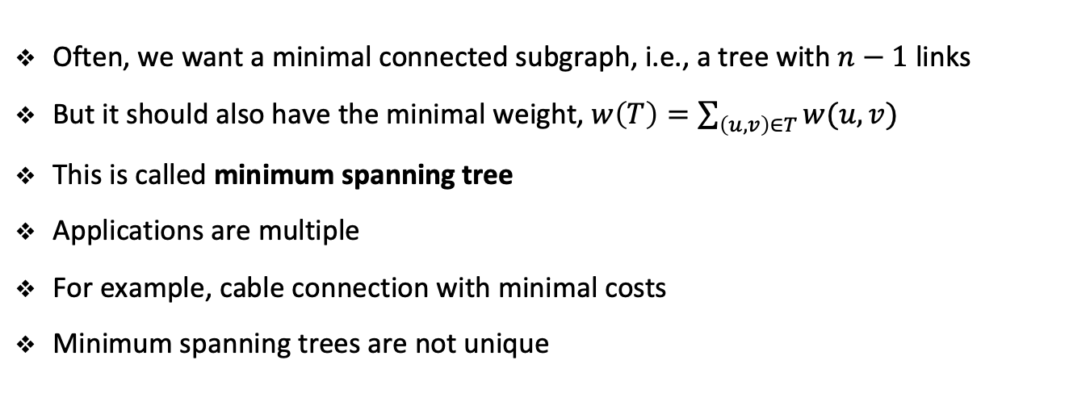
Weighted graphs
Often, we want a minimal connected subgraph, i.e., a tree with $n−1$ links
But it should also have the minimal weight,$w\left(T\right)=\sum_{\left(u, v\right)∈T}{w(u, v)}$
This is called minimum spanning tree
Applications are multiple
For example, cable connection with minimal costs
Minimum spanning trees are not unique

Slide 61

Minimum spanning tree
$$8$$
$$7$$
$$b$$
$$c$$
$$d$$
$$4$$
$$2$$
$$9$$
$$4$$
$$14$$
$$a$$
$$11$$
$$i$$
$$e$$
$$7$$
$$8$$
$$10$$
$$h$$
$$g$$
$$f$$
$$1$$
$$2$$
$$w\left(T\right)=37$$

Slide 62
Minimum spanning tree
$$8$$
$$7$$
$$b$$
$$c$$
$$d$$
$$4$$
$$2$$
$$9$$
$$4$$
$$14$$
$$a$$
$$11$$
$$i$$
$$e$$
$$7$$
$$8$$
$$10$$
$$h$$
$$g$$
$$f$$
$$1$$
$$2$$
$$w\left(T\right)=37$$

Slide 63
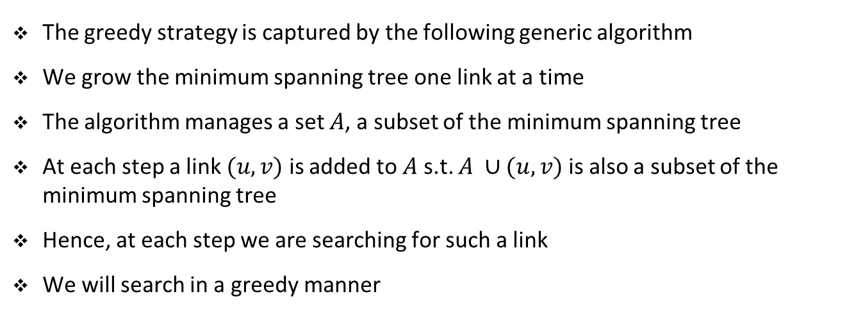
Greedy algorithm for minimum spanning tree
The greedy strategy is captured by the following generic algorithm
We grow the minimum spanning tree one link at a time
The algorithm manages a set $A$, a subset of the minimum spanning tree
At each step a link $(u, v)$ is added to $A$ s.t. $A ∪(u, v)$is also a subset of the minimum spanning tree
Hence, at each step we are searching for such a link
We will search in a greedy manner

Slide 64
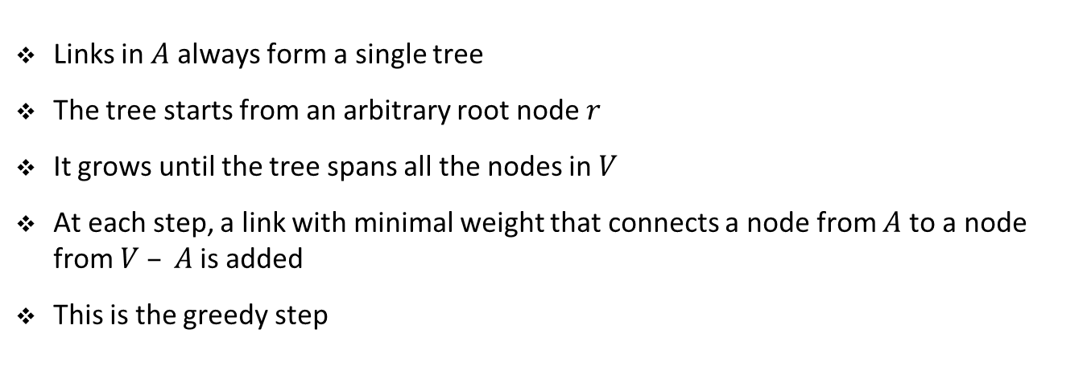
Prim’s greedy algorithm for minimum spanning tree
Links in $A$ always form a single tree
The tree starts from an arbitrary root node $r$
It grows until the tree spans all the nodes in $V$
At each step, a link with minimal weight that connects a node from $A$ to a node from $V – A$is added
This is the greedy step

Slide 65
Prim’s algorithm
$$8$$
$$7$$
$$b$$
$$c$$
$$d$$
$$4$$
$$2$$
$$9$$
$$4$$
$$14$$
$$a$$
$$11$$
$$i$$
$$e$$
$$7$$
$$8$$
$$10$$
$$h$$
$$g$$
$$f$$
$$1$$
$$2$$

Slide 66
Prim’s algorithm
$$8$$
$$7$$
$$b$$
$$c$$
$$d$$
$$4$$
$$2$$
$$9$$
$$4$$
$$14$$
$$a$$
$$11$$
$$i$$
$$e$$
$$7$$
$$8$$
$$10$$
$$h$$
$$g$$
$$f$$
$$1$$
$$2$$

Slide 67
Prim’s algorithm
$$8$$
$$7$$
$$b$$
$$c$$
$$d$$
$$4$$
$$2$$
$$9$$
$$4$$
$$14$$
$$a$$
$$11$$
$$i$$
$$e$$
$$7$$
$$8$$
$$10$$
$$h$$
$$g$$
$$f$$
$$1$$
$$2$$

Slide 68
Prim’s algorithm
$$8$$
$$7$$
$$b$$
$$c$$
$$d$$
$$4$$
$$2$$
$$9$$
$$4$$
$$14$$
$$a$$
$$11$$
$$i$$
$$e$$
$$7$$
$$8$$
$$10$$
$$h$$
$$g$$
$$f$$
$$1$$
$$2$$

Slide 69
Prim’s algorithm
$$8$$
$$7$$
$$b$$
$$c$$
$$d$$
$$4$$
$$2$$
$$9$$
$$4$$
$$14$$
$$a$$
$$11$$
$$i$$
$$e$$
$$7$$
$$8$$
$$10$$
$$h$$
$$g$$
$$f$$
$$1$$
$$2$$

Slide 70
Prim’s algorithm
$$8$$
$$7$$
$$b$$
$$c$$
$$d$$
$$4$$
$$2$$
$$9$$
$$4$$
$$14$$
$$a$$
$$11$$
$$i$$
$$e$$
$$7$$
$$8$$
$$10$$
$$h$$
$$g$$
$$f$$
$$1$$
$$2$$

Slide 71
Prim’s algorithm
$$8$$
$$7$$
$$b$$
$$c$$
$$d$$
$$4$$
$$2$$
$$9$$
$$4$$
$$14$$
$$a$$
$$11$$
$$i$$
$$e$$
$$7$$
$$8$$
$$10$$
$$h$$
$$g$$
$$f$$
$$1$$
$$2$$

Slide 72
Prim’s algorithm
$$8$$
$$7$$
$$b$$
$$c$$
$$d$$
$$4$$
$$2$$
$$9$$
$$4$$
$$14$$
$$a$$
$$11$$
$$i$$
$$e$$
$$7$$
$$8$$
$$10$$
$$h$$
$$g$$
$$f$$
$$1$$
$$2$$

Slide 73
Prim’s algorithm
$$8$$
$$7$$
$$b$$
$$c$$
$$d$$
$$4$$
$$2$$
$$9$$
$$4$$
$$14$$
$$a$$
$$11$$
$$i$$
$$e$$
$$7$$
$$8$$
$$10$$
$$h$$
$$g$$
$$f$$
$$1$$
$$2$$

Slide 74
Exercise

Slide 75
Student task
Task 9: Explore the documentation of the networkx library related to spanning trees. Load the Star Wars graph. This graph is stored in a different format. Use this command to load it:
nx.read_weighted_edgelist('starwars.csv', delimiter=',')
This graph stores characters from the Episode IV of Star Wars and how often they interacted with each other in the movie. Compute the minimum spanning tree as well as the maximum spanning tree of the graph. Explore its properties and draw both trees.

Slide 76
Single-source shortest paths

Slide 77
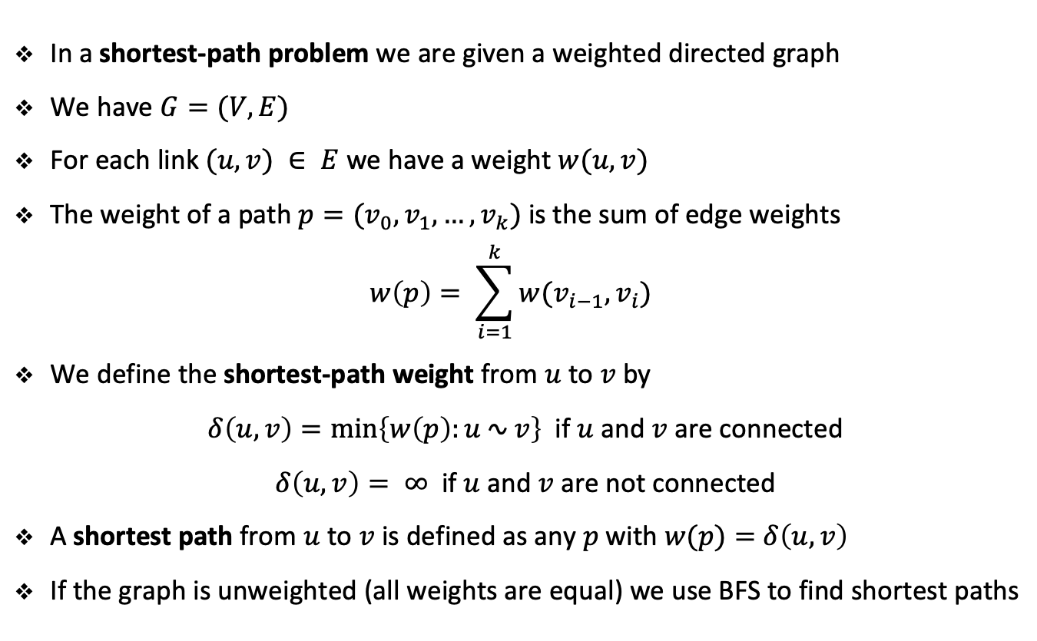
Single-source shortest paths
In a shortest-path problem we are given a weighted directed graph
We have $G=(V,E)$
For each link $(u, v) ∈ E$we have a weight $w(u, v)$
The weight of a path $p=(v_{0}, v_{1}, …, v_{k})$is the sum of edge weights
$$w\left(p\right)= \sum_{i=1}^{k}{w(v_{i−1}, v_{i})}$$
We define the shortest-path weight from $u$ to $v$ by
$δ\left(u, v\right)=\min\left\{w\left(p\right):u ∿ v\right\}$ if $u$ and $v$ are connected
$δ\left(u, v\right)= ∞$ if $u$and $v$are not connected
A shortest path from $u$ to $v$ is defined as any $p$ with $w(p)=$ $δ\left(u, v\right)$
If the graph is unweighted (all weights are equal) we use BFS to find shortest paths

Slide 78




















Non-uniqueness of shortest paths
$$b$$
$$c$$
$$6$$
$$3$$
$$9$$
$$3$$
$$2$$
$$1$$
$$a$$
$$0$$
$$4$$
$$2$$
$$7$$
$$5$$
$$3$$
$$5$$
$$11$$
$$6$$
$$d$$
$$e$$

Slide 79
Non-uniqueness of shortest paths
$$b$$
$$c$$
$$6$$
$$3$$
$$9$$
$$3$$
$$2$$
$$1$$
$$a$$
$$0$$
$$4$$
$$2$$
$$7$$
$$5$$
$$3$$
$$5$$
$$11$$
$$6$$
$$d$$
$$e$$

Slide 80
Non-uniqueness of shortest paths
$$b$$
$$c$$
$$6$$
$$3$$
$$9$$
$$3$$
$$2$$
$$1$$
$$a$$
$$0$$
$$4$$
$$2$$
$$7$$
$$5$$
$$3$$
$$5$$
$$11$$
$$6$$
$$d$$
$$e$$

Slide 81
Exercise

Slide 82








































Student task
Task 10: Give two shortest-path trees for the graph from the previous example other than the two shown.
$$b$$
$$c$$
$$b$$
$$c$$
$$6$$
$$6$$
$$3$$
$$9$$
$$3$$
$$9$$
$$3$$
$$3$$
$$2$$
$$1$$
$$2$$
$$1$$
$$a$$
$$0$$
$$4$$
$$a$$
$$0$$
$$4$$
$$2$$
$$7$$
$$2$$
$$7$$
$$5$$
$$3$$
$$5$$
$$3$$
$$5$$
$$11$$
$$5$$
$$11$$
$$6$$
$$6$$
$$d$$
$$e$$
$$d$$
$$e$$

Slide 83
Variants
We will focus on single-source shortest path problem
Many other problems can be solved with the algorithms for this problems
Variants include:
Single-destination shortest path
By reversing the direction of every link
Single-pair shortest path problem
If we solve single-source problem this problem is also solved
All-pairs shortest path
Run a single-source algorithm from every node
There are more efficient algorithms for this problem though

Slide 84
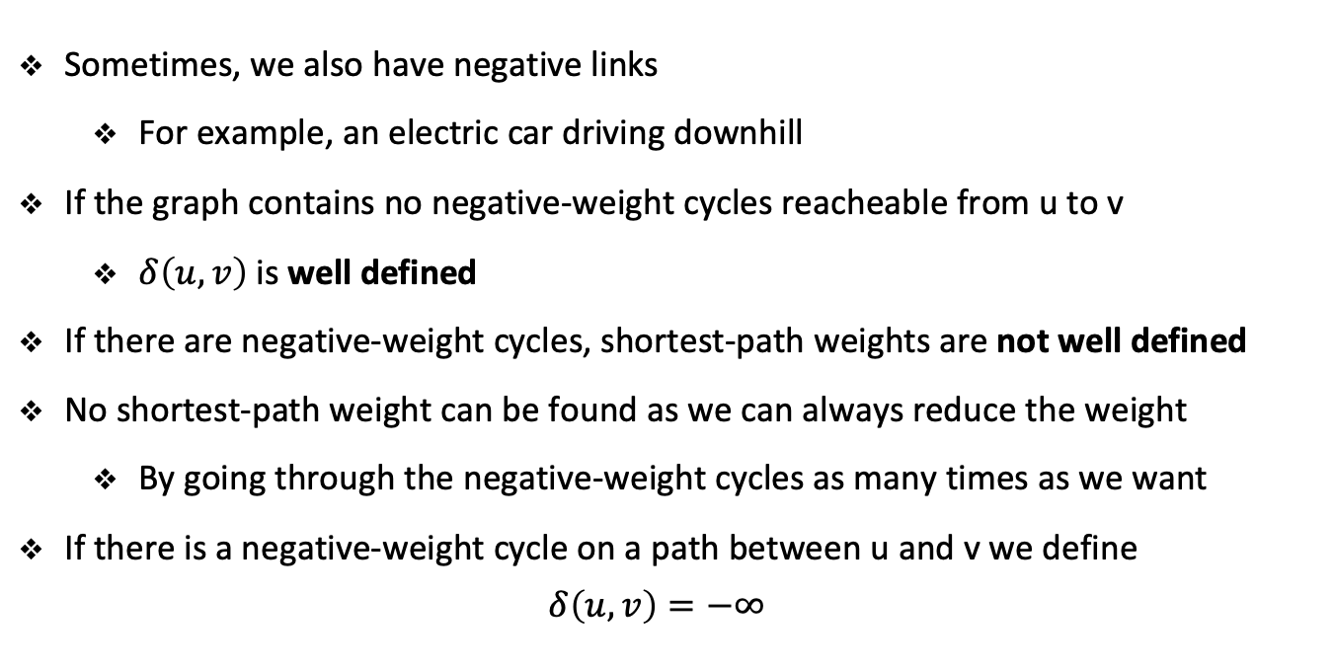
Negative links
Sometimes, we also have negative links
For example, an electric car driving downhill
If the graph contains no negative-weight cycles reacheable from u to v
$δ\left(u, v\right)$ is well defined
If there are negative-weight cycles, shortest-path weights are not well defined
No shortest-path weight can be found as we can always reduce the weight
By going through the negative-weight cycles as many times as we want
If there is a negative-weight cycle on a path between u and v we define
$$δ\left(u, v\right)=−∞$$

Slide 85

Negative links
$$8$$
$$7$$
$$b$$
$$c$$
$$d$$
$$4$$
$$2$$
$$9$$
$$4$$
$$14$$
$$a$$
$$11$$
$$i$$
$$e$$
$$7$$
$$−12$$
$$8$$
$$10$$
$$h$$
$$g$$
$$f$$
$$1$$
$$2$$
Which shortest-path from $a$ is well-defined?
Only $a$ to $b$

Slide 86
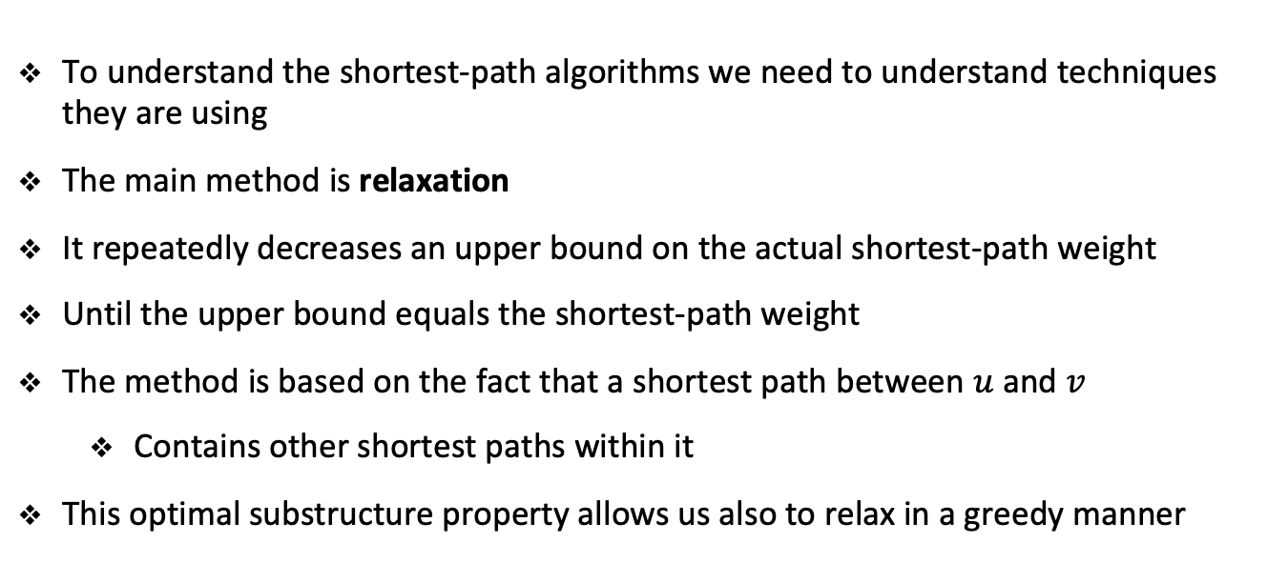
Relaxation
To understand the shortest-path algorithms we need to understand techniques they are using
The main method is relaxation
It repeatedly decreases an upper bound on the actual shortest-path weight
Until the upper bound equals the shortest-path weight
The method is based on the fact that a shortest path between $u$ and $v$
Contains other shortest paths within it
This optimal substructure property allows us also to relax in a greedy manner

Slide 87
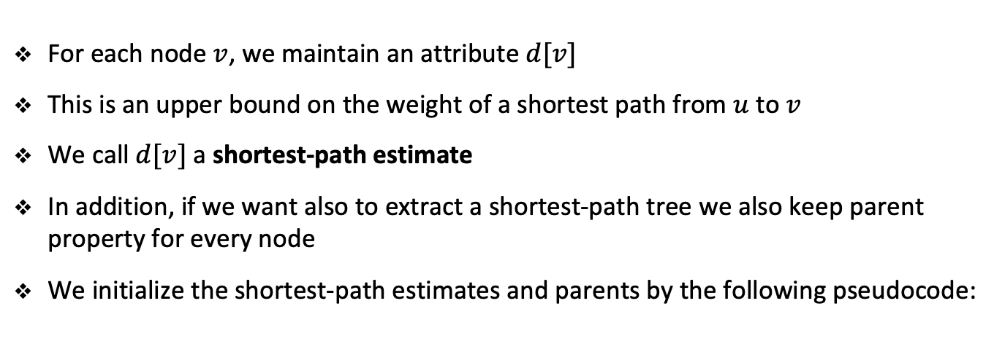
Relaxation
For each node $v$, we maintain an attribute $d[v]$
This is an upper bound on the weight of a shortest path from $u$ to $v$
We call $d[v]$ a shortest-path estimate
In addition, if we want also to extract a shortest-path tree we also keep parent property for every node
We initialize the shortest-path estimates and parents by the following pseudocode:
initialize_single_source(g, s):
for v in g.nodes:
d[v] = float(‘inf’)
parent[v] = None
d[s] = 0

Slide 88
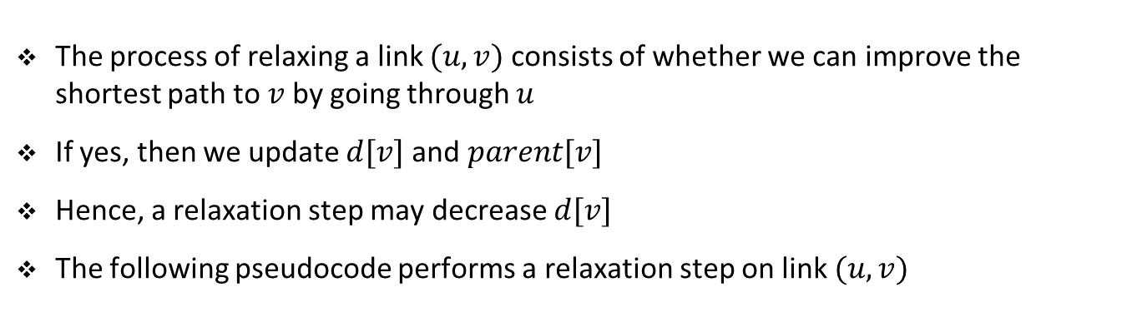
Relaxation
The process of relaxing a link $(u,v)$consists of whether we can improve the shortest path to $v$ by going through $u$
If yes, then we update $d[v]$and $parent[v]$
Hence, a relaxation step may decrease $d[v]$
The following pseudocode performs a relaxation step on link $(u,v)$
relax(u, v, w):
if d[v] > d[u] + w(u,v):
d[v] = d[u] + w(u,v)
parent[v] = u

Slide 89










Example of relaxation
$$u$$
$$v$$
$$2$$
Before relaxation
$$5$$
$$9$$
$$u$$
$$v$$
$$2$$
After relaxation
$$5$$
$$7$$

Slide 90


Example of relaxation
$$u$$
$$v$$
$$2$$
Before relaxation
$$5$$
$$6$$
$$u$$
$$v$$
$$2$$
After relaxation
$$5$$
$$6$$

Slide 91
Shortest-path algorithms
There are several shortest-path algorithms
Typically, shortest-path algorithms call first initialize_single_source
Then they repeatedly call the relax method
Moreover, relaxation is the only means by which shortest-path estimates and parents change
The algorithms just differ in:
How many times they relax each link
The order in which they relax links

Slide 92
Dijkstra’s algorithm

Slide 93
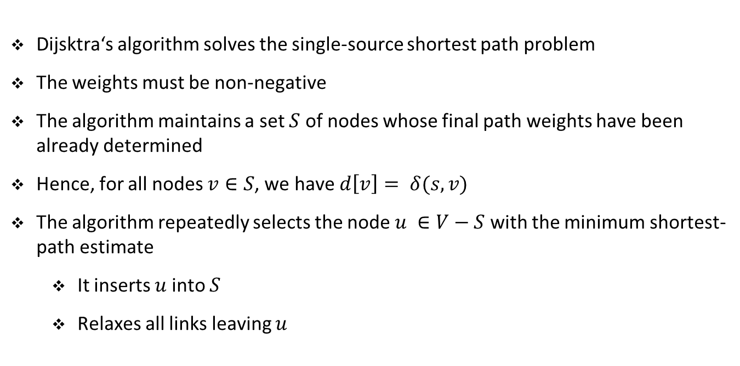
Dijkstra’s algorithm
Dijsktra‘s algorithm solves the single-source shortest path problem
The weights must be non-negative
The algorithm maintains a set $S$ of nodes whose final path weights have been already determined
Hence, for all nodes $v∈S$, we have $d\left[v\right]= δ(s, v)$
The algorithm repeatedly selects the node $u ∈V−S$ with the minimum shortest-path estimate
It inserts $u$into $S$
Relaxes all links leaving $u$

Slide 94
Pseudocode for Dijkstra’s algorithm
dijkstra(g, w, s)
initialize_single_source(g, s)
S = set()
q.enqueue(g.nodes)
while not q.is_empty():
u = q.extract_min()
S = S.union(u)
for v in g.adj[u]:
relax(u, v, w)

Slide 95











Dijkstra’s algorithm
$$b$$
$$c$$
$$1$$
$$∞$$
$$∞$$
$$10$$
$$2$$
$$3$$
$$a$$
$$0$$
$$9$$
$$4$$
$$6$$
$$5$$
$$7$$
$$∞$$
$$∞$$
2
$$d$$
$$e$$

Slide 96
Dijkstra’s algorithm
$$b$$
$$c$$
$$1$$
$$∞$$
$$∞$$
$$10$$
$$2$$
$$3$$
$$a$$
$$0$$
$$9$$
$$4$$
$$6$$
$$5$$
$$7$$
$$∞$$
$$∞$$
2
$$d$$
$$e$$

Slide 97

Dijkstra’s algorithm
$$b$$
$$c$$
$$1$$
$$10$$
$$∞$$
$$10$$
$$2$$
$$3$$
$$a$$
$$0$$
$$9$$
$$4$$
$$6$$
$$5$$
$$7$$
$$5$$
$$∞$$
2
$$d$$
$$e$$

Slide 98

Dijkstra’s algorithm
$$b$$
$$c$$
$$1$$
$$10$$
$$∞$$
$$10$$
$$2$$
$$3$$
$$a$$
$$0$$
$$9$$
$$4$$
$$6$$
$$5$$
$$7$$
$$5$$
$$∞$$
2
$$d$$
$$e$$

Slide 99



Dijkstra’s algorithm
$$b$$
$$c$$
$$1$$
$$8$$
$$14$$
$$10$$
$$2$$
$$3$$
$$a$$
$$0$$
$$9$$
$$4$$
$$6$$
$$5$$
$$7$$
$$5$$
$$7$$
2
$$d$$
$$e$$

Slide 100

Dijkstra’s algorithm
$$b$$
$$c$$
$$1$$
$$8$$
$$14$$
$$10$$
$$2$$
$$3$$
$$a$$
$$0$$
$$9$$
$$4$$
$$6$$
$$5$$
$$7$$
$$5$$
$$7$$
2
$$d$$
$$e$$

Slide 101

Dijkstra’s algorithm
$$b$$
$$c$$
$$1$$
$$8$$
$$13$$
$$10$$
$$2$$
$$3$$
$$a$$
$$0$$
$$9$$
$$4$$
$$6$$
$$5$$
$$7$$
$$5$$
$$7$$
2
$$d$$
$$e$$

Slide 102

Dijkstra’s algorithm
$$b$$
$$c$$
$$1$$
$$8$$
$$13$$
$$10$$
$$2$$
$$3$$
$$a$$
$$0$$
$$9$$
$$4$$
$$6$$
$$5$$
$$7$$
$$5$$
$$7$$
2
$$d$$
$$e$$

Slide 103
Dijkstra’s algorithm
$$b$$
$$c$$
$$1$$
$$8$$
$$9$$
$$10$$
$$2$$
$$3$$
$$a$$
$$0$$
$$9$$
$$4$$
$$6$$
$$5$$
$$7$$
$$5$$
$$7$$
2
$$d$$
$$e$$

Slide 104

Dijkstra’s algorithm
$$b$$
$$c$$
$$1$$
$$8$$
$$9$$
$$10$$
$$2$$
$$3$$
$$a$$
$$0$$
$$9$$
$$4$$
$$6$$
$$5$$
$$7$$
$$5$$
$$7$$
2
$$d$$
$$e$$

Slide 105

Dijkstra’s algorithm
$$b$$
$$c$$
$$1$$
$$8$$
$$9$$
$$10$$
$$2$$
$$3$$
$$a$$
$$0$$
$$9$$
$$4$$
$$6$$
$$5$$
$$7$$
$$5$$
$$7$$
2
$$d$$
$$e$$

Slide 106
Dijkstra’s algorithm
$$b$$
$$c$$
$$1$$
$$8$$
$$9$$
$$10$$
$$2$$
$$3$$
$$a$$
$$0$$
$$9$$
$$4$$
$$6$$
$$5$$
$$7$$
$$5$$
$$7$$
2
$$d$$
$$e$$

Slide 107
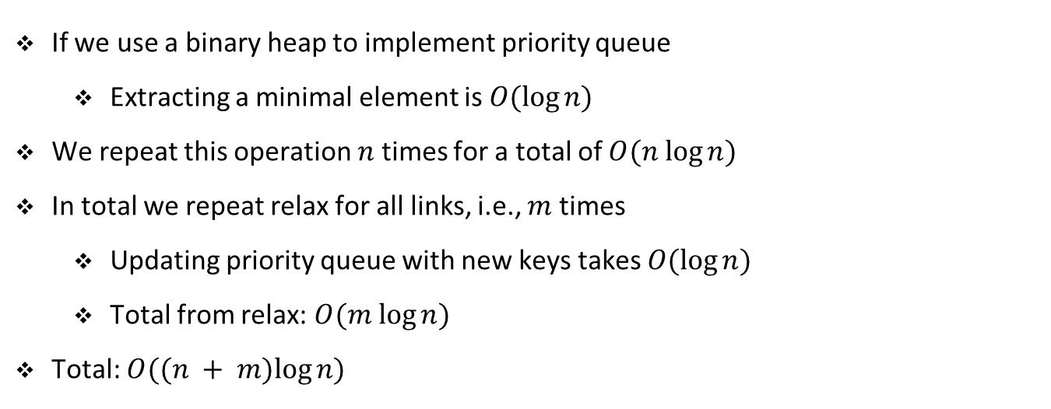
Complexity of Dijkstra’s algorithm
If we use a binary heap to implement priority queue
Extracting a minimal element is $O(log⁡n)$
We repeat this operation $n$ times for a total of $O(n log⁡n)$
In total we repeat relax for all links, i.e., $m$ times
Updating priority queue with new keys takes $O(log⁡n)$
Total from relax: $O(m log⁡n)$
Total: $O((n + m)log⁡n)$

Slide 108
Exercise

Slide 109















Student task
Task 11: Run Dijkstra‘s algorithm on the graph below first using node $a$ and then node $e$ as the source node.
$$6$$
$$b$$
$$c$$
$$3$$
$$2$$
$$1$$
$$a$$
$$4$$
$$2$$
$$7$$
$$5$$
$$3$$
$$d$$
$$e$$
$$6$$

Slide 110
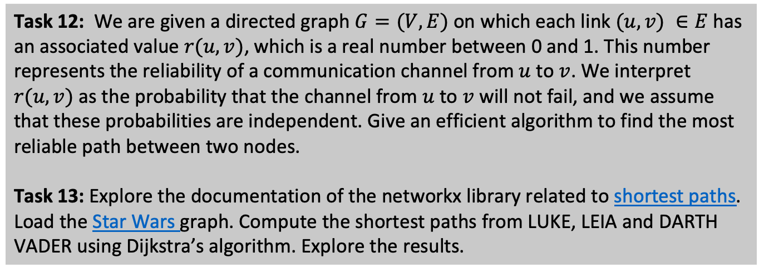
Student task
Task 12: We are given a directed graph $G=(V, E)$on which each link $(u,v) ∈E$has an associated value $r(u,v)$, which is a real number between 0 and 1. This number represents the reliability of a communication channel from $u$ to $v$. We interpret $r(u,v)$ as the probability that the channel from $u$ to $v$ will not fail, and we assume that these probabilities are independent. Give an efficient algorithm to find the most reliable path between two nodes.
Task 13: Explore the documentation of the networkx library related to shortest paths. Load the Star Wars graph. Compute the shortest paths from LUKE, LEIA and DARTH VADER using Dijkstra’s algorithm. Explore the results.

Slide 111
Bellman-Ford algorithm

Slide 112
Bellman-Ford algorithm
The Bellman-Ford algorithm solves the single-source shortest path problem
The weights can also be negative
The algorithm returns a Boolean value indicating whether or not there is a negative-weight cycle
If there is no such cycle the algorithm computes the shortest paths and their weights

Slide 113
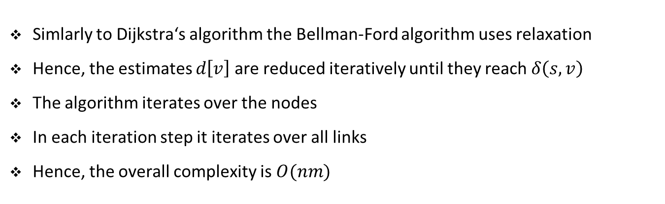
Bellman-Ford algorithm
Simlarly to Dijkstra‘s algorithm the Bellman-Ford algorithm uses relaxation
Hence, the estimates $d\left[v\right]$ are reduced iteratively until they reach $δ\left(s, v\right)$
The algorithm iterates over the nodes
In each iteration step it iterates over all links
Hence, the overall complexity is $O(nm)$

Slide 114
Pseudocode for the Bellman-Ford algorithm
bellman-ford(g, w, s)
initialize_single_source(g, s)
# Relax all edges n-1 times
for i in range(0, n-1):
for l in g.edges:
relax(l.u, l.v, w)
# Check for negative cycles
for l in g.edges:
if d[l.v] > d[l.u] + w(u, v)
return False
return True

Slide 115










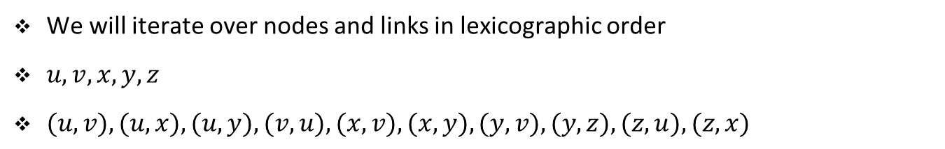





Bellman-Ford algorithm
$$u$$
$$5$$
$$v$$
$$∞$$
$$−2$$
$$∞$$
$$6$$
$$−4$$
$$8$$
$$z$$
$$0$$
$$7$$
$$−3$$
$$2$$
$$7$$
$$∞$$
$$∞$$
$$9$$
$$x$$
$$y$$
We will iterate over nodes and links in lexicographic order
$u, v, x, y, z$
$(u,v), (u,x), (u,y), (v, u), (x, v), (x, y), (y, v), (y, z), (z, u), (z, x)$

Slide 116


Bellman-Ford algorithm: First pass over links
$$u$$
$$5$$
$$v$$
$$6$$
$$−2$$
$$∞$$
$$6$$
$$−4$$
$$8$$
$$z$$
$$0$$
$$7$$
$$−3$$
$$2$$
$$7$$
$$7$$
$$∞$$
$$9$$
$$x$$
$$y$$
We will iterate over nodes and links in lexicographic order
$u, v, x, y, z$
$(u,v), (u,x), (u,y), (v, u), (x, v), (x, y), (y, v), (y, z), (z, u), (z, x)$

Slide 117


Bellman-Ford algorithm: Second pass over links
$$u$$
$$5$$
$$v$$
$$6$$
$$−2$$
$$11$$
$$6$$
$$−4$$
$$8$$
$$z$$
$$0$$
$$7$$
$$−3$$
$$2$$
$$7$$
$$7$$
$$2$$
$$9$$
$$x$$
$$y$$
We will iterate over nodes and links in lexicographic order
$u, v, x, y, z$
$(u,v), (u,x), (u,y), (v, u), (x, v), (x, y), (y, v), (y, z), (z, u), (z, x)$

Slide 118
Bellman-Ford algorithm: Second pass over links
$$u$$
$$5$$
$$v$$
$$6$$
$$−2$$
4
$$6$$
$$−4$$
$$8$$
$$z$$
$$0$$
$$7$$
$$−3$$
$$2$$
$$7$$
$$7$$
$$2$$
$$9$$
$$x$$
$$y$$
We will iterate over nodes and links in lexicographic order
$u, v, x, y, z$
$(u,v), (u,x), (u,y), (v, u), (x, v), (x, y), (y, v), (y, z), (z, u), (z, x)$

Slide 119

Bellman-Ford algorithm: Third pass over links
$$u$$
$$5$$
$$v$$
$$2$$
$$−2$$
4
$$6$$
$$−4$$
$$8$$
$$z$$
$$0$$
$$7$$
$$−3$$
$$2$$
$$7$$
$$7$$
$$2$$
$$9$$
$$x$$
$$y$$
We will iterate over nodes and links in lexicographic order
$u, v, x, y, z$
$(u,v), (u,x), (u,y), (v, u), (x, v), (x, y), (y, v), (y, z), (z, u), (z, x)$

Slide 120

Bellman-Ford algorithm: Fourth pass over links
$$u$$
$$5$$
$$v$$
$$2$$
$$−2$$
4
$$6$$
$$−4$$
$$8$$
$$z$$
$$0$$
$$7$$
$$−3$$
$$2$$
$$7$$
$$7$$
$$−2$$
$$9$$
$$x$$
$$y$$
We will iterate over nodes and links in lexicographic order
$u, v, x, y, z$
$(u,v), (u,x), (u,y), (v, u), (x, v), (x, y), (y, v), (y, z), (z, u), (z, x)$

Slide 121
Exercise

Slide 122



















Student task
Task 14: Run the Bellman-Ford algorithm on the graph below using node $y$ as the source node. Relax links in lexicographic order.
$$u$$
$$v$$
$$5$$
$$∞$$
$$−2$$
$$∞$$
$$6$$
$$−4$$
$$8$$
$$z$$
$$∞$$
$$7$$
$$−3$$
$$2$$
$$7$$
$$∞$$
0
$$9$$
$$x$$
$$y$$

Slide 123
Student task
Task 15: Explore the documentation of the networkx library related to shortest paths. Load the Star Wars graph. Compute the shortest paths from LUKE, LEIA and DARTH VADER using the Bellman-Ford algorithm. Explore the results.

