Slide 1

Algorithms and Data Structures
Unit 6 – Trees

Slide 2
Outline
Graphs
Exercise
Trees
Exercise
Exercise
Binary search trees
Exercise
Exercise

Slide 3
Graphs

Slide 4
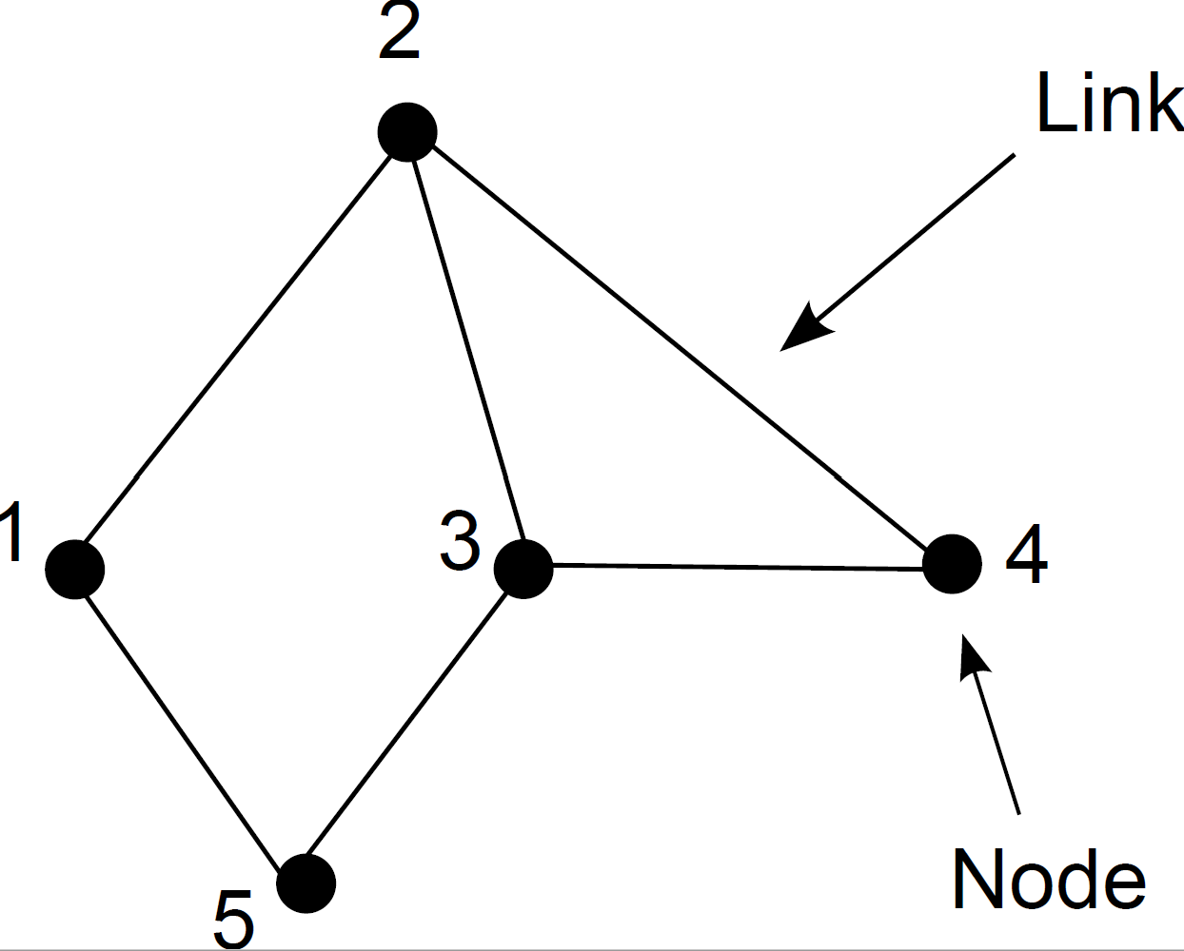
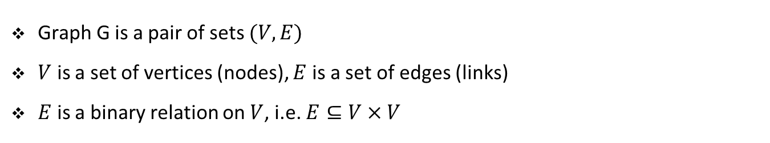
Graphs
Graph G is a pair of sets $(V, E)$
$V$ is a set of vertices (nodes), $E$ is a set of edges (links)
$E$ is a binary relation on $V$, i.e. $E⊆V×V$

Slide 5
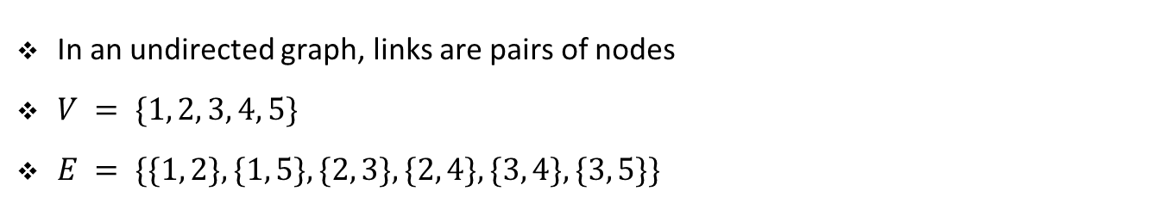
Undirected graphs
In an undirected graph, links are pairs of nodes
$V = \{1, 2, 3, 4, 5\}$
$E = \{\{1, 2\}, \{1, 5\}, \{2, 3\}, \{2, 4\}, \{3, 4\}, \{3, 5\}\}$

Slide 6
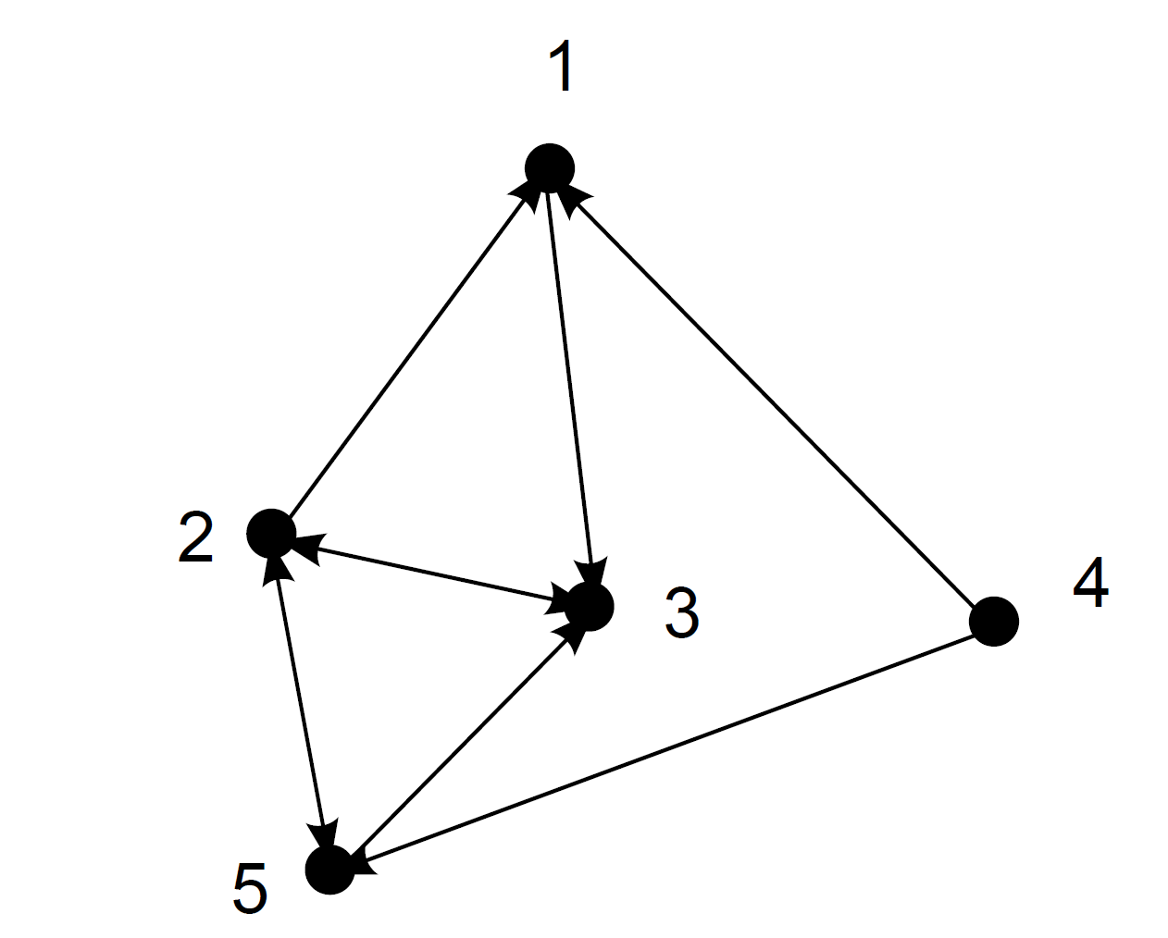
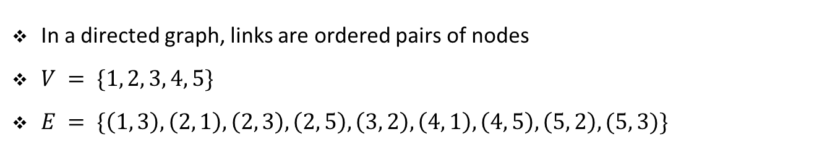
Directed graphs
In a directed graph, links are ordered pairs of nodes
$V = \{1, 2, 3, 4, 5\}$
$E = \{\left(1, 3\right), \left(2, 1\right), \left(2, 3\right), \left(2, 5\right), \left(3, 2\right), \left(4, 1\right), \left(4, 5\right), \left(5, 2\right), (5, 3)\}$

Slide 7
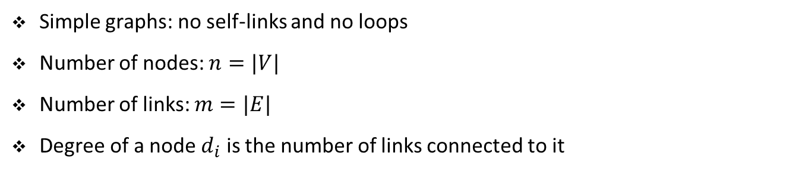
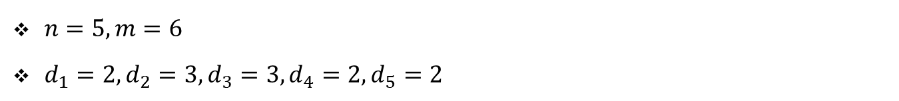
Some further notation
Simple graphs: no self-links and no loops
Number of nodes: $n=|V|$
Number of links: $m=|E|$
Degree of a node $d_{i}$ is the number of links connected to it
$n=5, m=6$
$d_{1}=2, d_{2}=3, d_{3}=3, d_{4}=2, d_{5}=2$

Slide 8
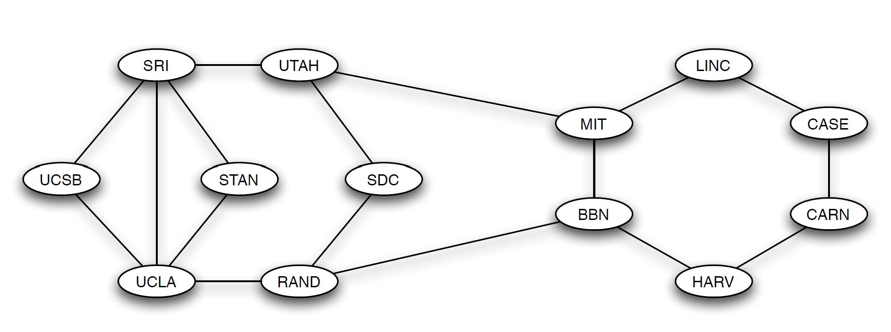
Paths
Often things travel across the links of a graph
For example, data packets travel over the Internet
Path: a sequence of nodes such that each consecutive pair is connected by a link
(MIT, BBN, RAND, UCLA) is a path in the early Internet graph
(CASE, LINC, MIT, UTAH, SRI, UCSB) is also a path
(LINC, BBN, HARV, CARN) is not a path

Slide 9
Paths
We can repeat nodes in a path
(SRI, STAN, UCLA, SRI, UTAH, MIT) is a path
SRI is repeated
If a path does not include repeated nodes: simple path

Slide 10
Cycles
An important kind of nonsimple paths is a cycle
Cycle: a path with at least three links, in which the first and the last node are same
(SRI, STAN, UCLA, SRI) is a cycle
In the early Internet: every node is a part of a cycle to make it robust to failure

Slide 11
Path length
Important property of paths: their length
Path length: the number of links in a path
(MIT, BBN, RAND, UCL) has length 3
(MIT, UTAH) has length of 1
#nodes - 1

Slide 12
Distance
Distance: the length of the shortest path between two nodes
LINC and SRI have distance 3
UTAH and RAND have distance 2
UTAH and SRI have distance 1

Slide 13
Connectivity
Important property: can we reach every node from every other node by a path
If that is the case, we say that the graph is connected
Otherwise, the graph is not connected
The early Internet is a connected graph

Slide 14
Exercise

Slide 15
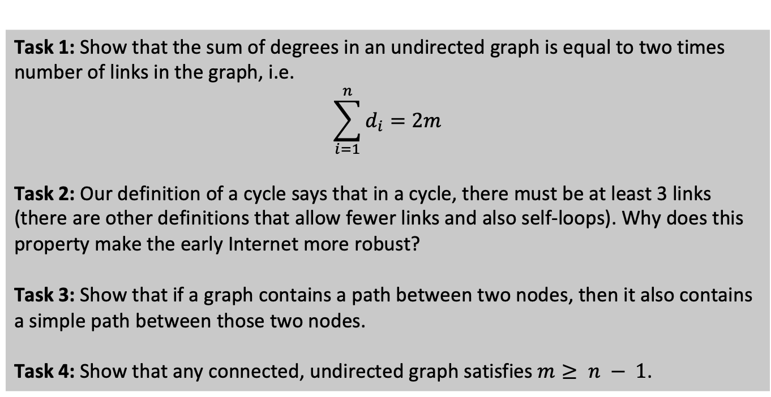
Student task
Task 1: Show that the sum of degrees in an undirected graph is equal to two times number of links in the graph, i.e.
$$\sum_{i=1}^{n}{d_{i}}=2m$$
Task 2: Our definition of a cycle says that in a cycle, there must be at least 3 links (there are other definitions that allow fewer links and also self-loops). Why does this property make the early Internet more robust?
Task 3: Show that if a graph contains a path between two nodes, then it also contains a simple path between those two nodes.
Task 4: Show that any connected, undirected graph satisfies $m≥ n − 1$.

Slide 16
Trees

Slide 17
Trees
A tree is a connected, acyclic, undirected graph
If an undirected graph is acyclic but disconnected we call it a forest
Can you classify these three graphs?

Slide 18
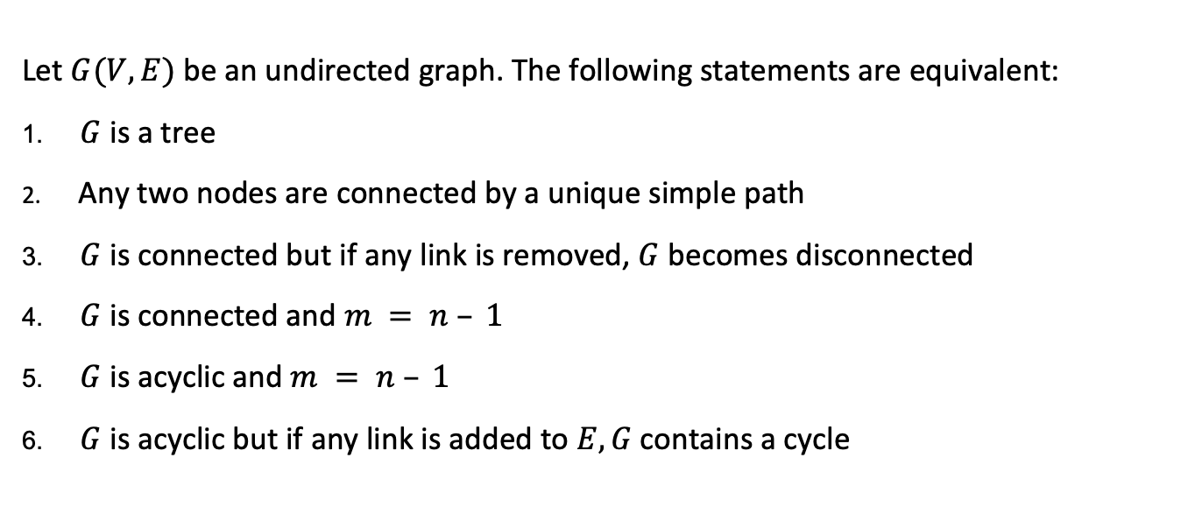
Properties of trees
Let $G(V, E)$be an undirected graph. The following statements are equivalent:
$G$ is a tree
Any two nodes are connected by a unique simple path
$G$ is connected but if any link is removed, $G$ becomes disconnected
$G$ is connected and $m = n – 1$
$G$ is acyclic and $m = n – 1$
$G$ is acyclic but if any link is added to $E, G$contains a cycle

Slide 19
Exercise

Slide 20
Student task
Task 5: Show that (1) ⇒ (2), (2) ⇒ (3), (3) ⇒ (4), (4) ⇒ (5), (5) ⇒ (6), and (6) ⇒ (1).

Slide 21










Rooted trees
A rooted tree is a tree in which one node (root) is distinguished from the others
7
Depth 0
$$3$$
$$10$$
$$4$$
Depth 1
$$8$$
$$12$$
$$11$$
$$2$$
Depth 2
$$6$$
$$5$$
$$1$$
Depth 3

Slide 22


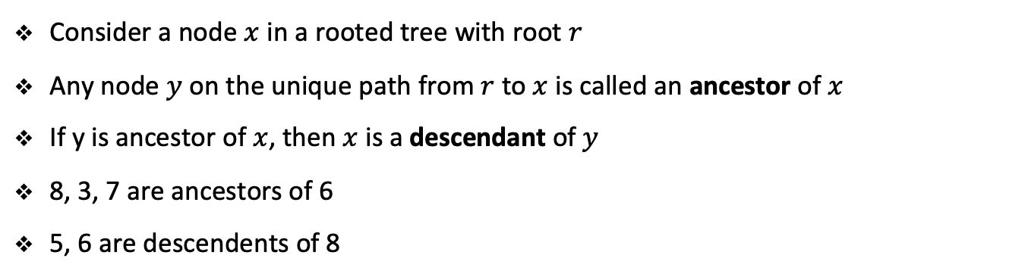








Rooted trees
Consider a node $x$ in a rooted tree with root $r$
Any node $y$ on the unique path from $r$ to $x$ is called an ancestor of $x$
If y is ancestor of $x$, then $x$ is a descendant of $y$
8, 3, 7 are ancestors of 6
5, 6 are descendents of 8
7
Depth 0
$$3$$
$$10$$
$$4$$
Depth 1
$$8$$
$$12$$
$$11$$
$$2$$
Depth 2
$$6$$
$$5$$
$$1$$
Depth 3

Slide 23










Rooted trees
Direct ancestors and descendants are called parents and children, respectively
Siblings have the same parent
A node with no children is called leaf
A nonleaf node is called an internal node
7
Depth 0
$$3$$
$$10$$
$$4$$
Depth 1
$$8$$
$$12$$
$$11$$
$$2$$
Depth 2
$$6$$
$$5$$
$$1$$
Depth 3

Slide 24




Binary trees
A binary tree defined (recursively) on a set of finite nodes either:
Contains no nodes, or
Consists of three types of nodes:
A root node
A binary tree called the left subtree
A binary tree called the right subtree
7
Depth 0
$$3$$
$$4$$
Depth 1
$$8$$
$$12$$
$$11$$
$$2$$
Depth 2
$$6$$
$$5$$
$$1$$
Depth 3

Slide 25












Complete binary trees
Complete binary tree: all leaves have the same depth
In addition, all internal nodes have degree 2
If not completely filled then we go level by level
7
Depth 0
$$3$$
$$4$$
Depth 1
$$8$$
$$12$$
$$11$$
$$2$$
Depth 2
$$6$$
$$5$$
$$1$$
$$9$$
$$10$$
$$13$$
$$14$$
$$15$$
Depth 3

Slide 26
Exercise

Slide 27
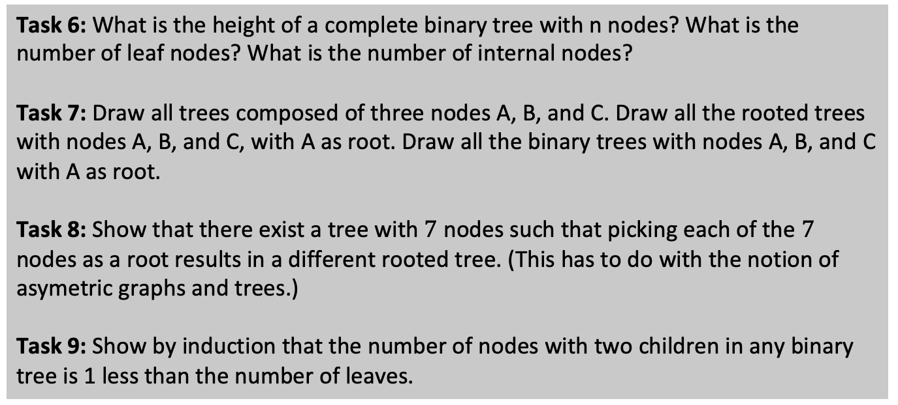
Student task
Task 6: What is the height of a complete binary tree with n nodes? What is the number of leaf nodes? What is the number of internal nodes?
Task 7: Draw all trees composed of three nodes A, B, and C. Draw all the rooted trees with nodes A, B, and C, with A as root. Draw all the binary trees with nodes A, B, and C with A as root.
Task 8: Show that there exist a tree with$7$ nodes such that picking each of the $7$ nodes as a root results in a different rooted tree. (This has to do with the notion of asymetric graphs and trees.)
Task 9: Show by induction that the number of nodes with two children in any binary tree is 1 less than the number of leaves.

Slide 28
Binary search trees

Slide 29
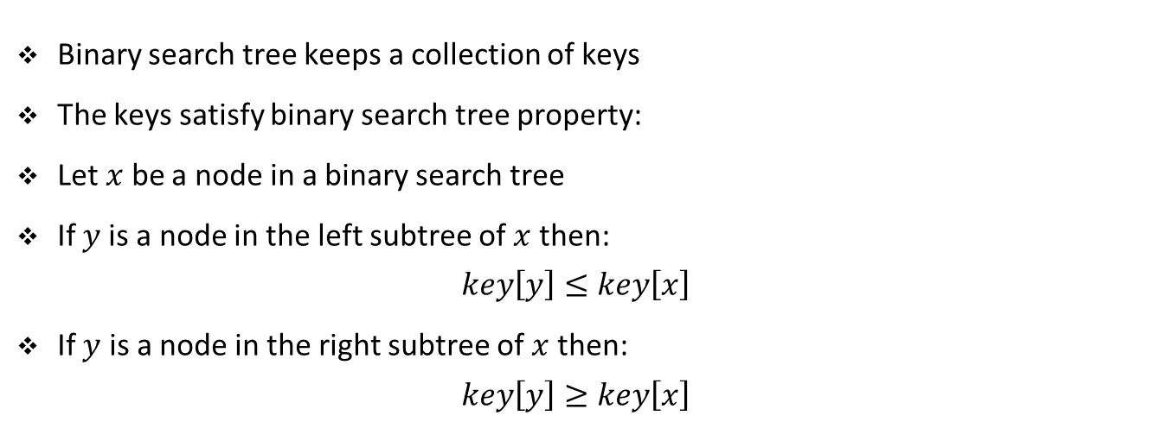
Binary search trees
Binary search tree keeps a collection of keys
The keys satisfy binary search tree property:
Let $x$ be a node in a binary search tree
If $y$is a node in the left subtree of $x$ then:
$$key\left[y\right]≤key\left[x\right]$$
If $y$ is a node in the right subtree of $x$ then:
$$key\left[y\right]≥key\left[x\right]$$

Slide 30





Binary search trees
5
$$3$$
$$7$$
$$2$$
$$5$$
$$8$$

Slide 31




Binary search trees
2
3
$$7$$
$$5$$
$$8$$
$$5$$

Slide 32
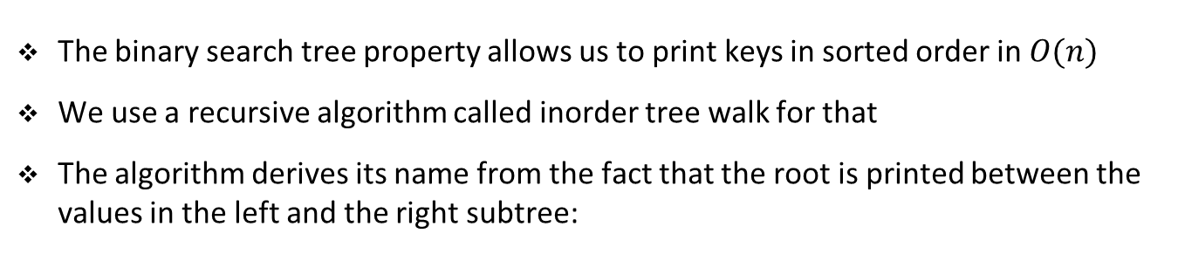
Inorder tree walk
The binary search tree property allows us to print keys in sorted order in $O(n)$
We use a recursive algorithm called inorder tree walk for that
The algorithm derives its name from the fact that the root is printed between the values in the left and the right subtree:
def _inorder_walk(self, node):
result = ''
if node:
result += self._inorder_walk(node._left)
result += str(node._element) + ' '
result += self._inorder_walk(node._right)
return result
Notebook example

Slide 33
Exercise

Slide 34
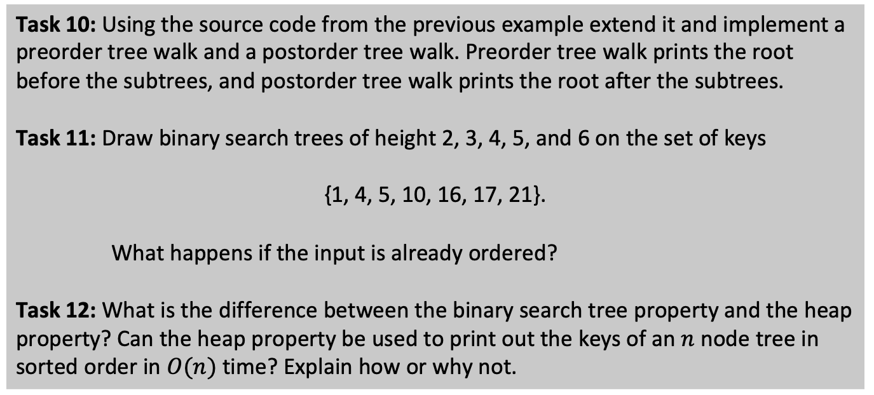
Student task
Task 10: Using the source code from the previous example extend it and implement a preorder tree walk and a postorder tree walk. Preorder tree walk prints the root before the subtrees, and postorder tree walk prints the root after the subtrees.
Task 11: Draw binary search trees of height 2, 3, 4, 5, and 6 on the set of keys
{1, 4, 5, 10, 16, 17, 21}.
What happens if the input is already ordered?
Task 12: What is the difference between the binary search tree property and the heap property? Can the heap property be used to print out the keys of an$n$node tree in sorted order in $O(n)$ time? Explain how or why not.

Slide 35
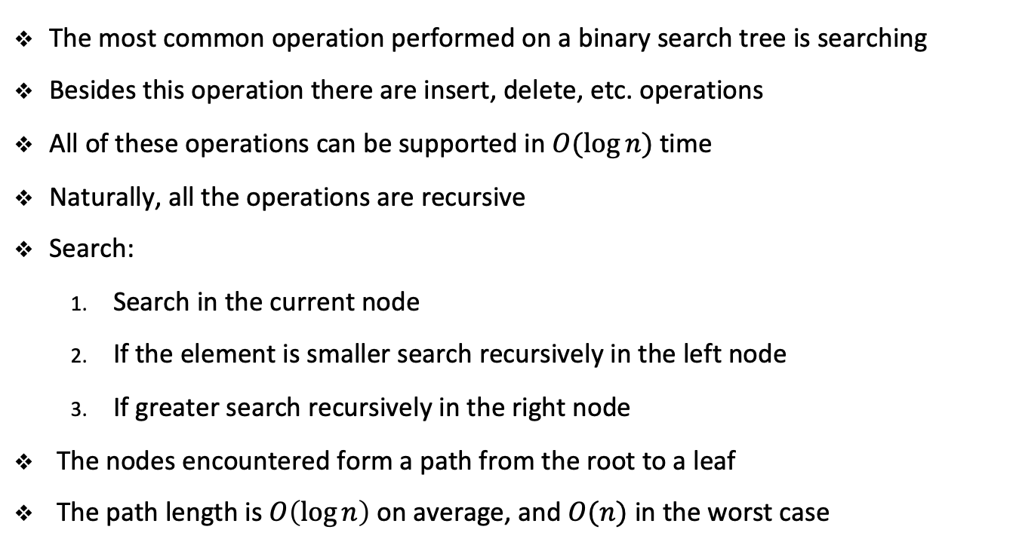
Querying binary search trees
The most common operation performed on a binary search tree is searching
Besides this operation there are insert, delete, etc. operations
All of these operations can be supported in $O(\log{n})$time
Naturally, all the operations are recursive
Search:
Search in the current node
If the element is smaller search recursively in the left node
If greater search recursively in the right node
The nodes encountered form a path from the root to a leaf
The path length is $O\left(\log{n}\right)$ on average, and $O(n)$ in the worst case

Slide 36

Inserting elements into binary search trees
def insert(self, element):
self._insert_element(self._root, element)
def _insert_element(self, node, element):
if element < node._element:
if node._left:
self._insert_element(node._left, element)
else:
node._left = self._Node(element)
self._size += 1
else:
if node._right:
self._insert_element(node._right, element)
else:
node._right = self._Node(element)
self._size += 1
Again, the nodes encountered form a path from the root to a leaf
Again, the path length is $O\left(\log{n}\right)$ on average, and $O(n)$ in the worst case

Slide 37

Finding min/max in binary search trees
def minimum(self):
return self._minimum_walk(self._root)._element
def _minimum_walk(self, node):
if node._left:
return self._minimum_walk(node._left)
else:
return node
Again, the nodes encountered form a path from the root to a leaf
Again, the path length is $O\left(\log{n}\right)$ on average, and $O(n)$ in the worst case

Slide 38
Finding min/max in binary search trees
def maximum(self):
return self._maximum_walk(self._root)._element
def _maximum_walk(self, node):
if node._right:
return self._maximum_walk(node._right)
else:
return node
Again, the nodes encountered form a path from the root to a leaf
Again, the path length is $O\left(\log{n}\right)$ on average, and $O(n)$ in the worst case

Slide 39
Exercise

Slide 40
Student task
Task 13: Implement the search method for binary search trees using the source code of the previous example.
Task 14: Implement the delete method for binary search trees.
Hint: As always use a recursive procedure. You will need to distuingish between the cases depending how many children the node that we want to delete has.

