Slide 1

Algorithms and Data Structures
Unit 5 – Hash Tables

Slide 2
Outline
Maps and dictionaries
Exercise
Hash tables
Hash functions
Exercise
Exercise
Collision handling schemes
Exercise
Complexity
Exercise

Slide 3
Maps and dictionaries

Slide 4
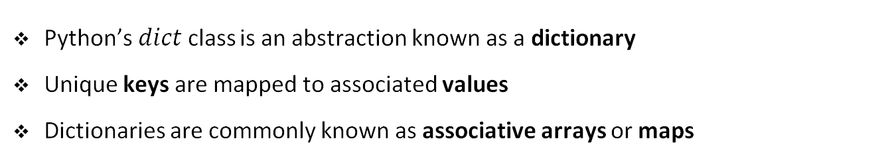
Python’s dictionaries and maps
Python’s$dict$class is an abstraction known as a dictionary
Unique keys are mapped to associated values
Dictionaries are commonly known as associative arrays or maps
Yuan
Euro
Dollar
Lira
Rupee
Turkey | Spain | Greece | China | USA | India

Slide 5
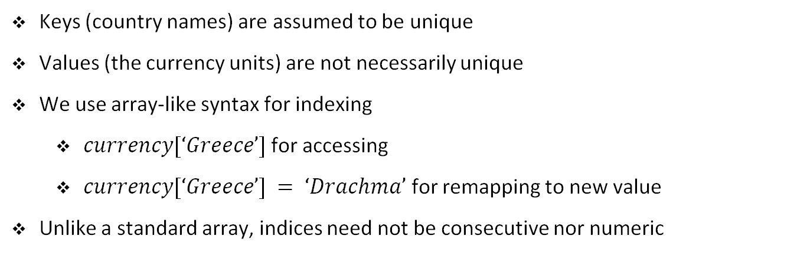
Python’s dictionaries and maps
Yuan
Euro
Dollar
Lira
Rupee
Turkey | Spain | Greece | China | USA | India
Keys (country names) are assumed to be unique
Values (the currency units) are not necessarily unique
We use array-like syntax for indexing
$currency[‘Greece’]$for accessing
$currency[‘Greece’] = ‘Drachma’$ for remapping to new value
Unlike a standard array, indices need not be consecutive nor numeric

Slide 6
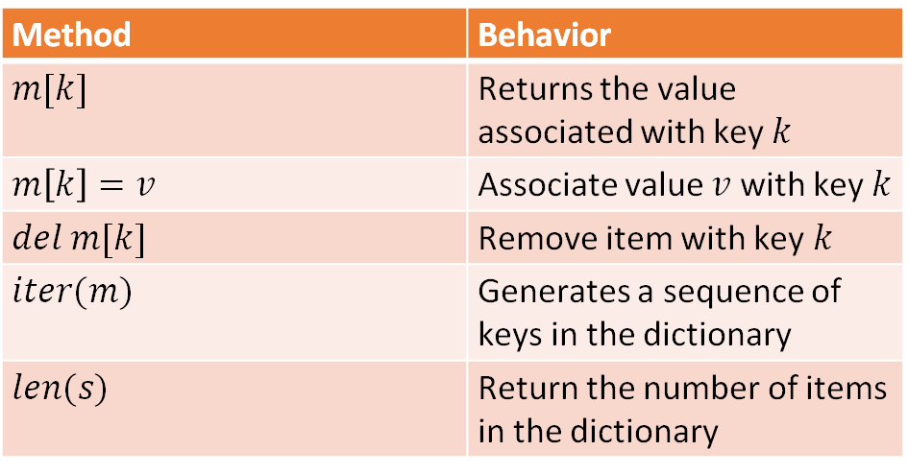
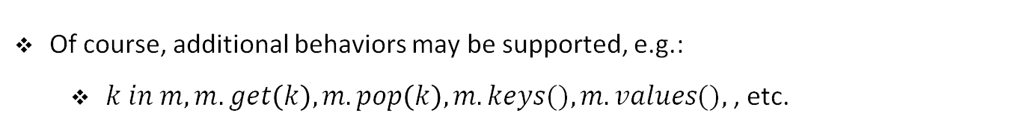
Basic map/dictionary interface
Method | Behavior
$$m[k]$$ | Returns the value associated with key $k$
$$m\left[k\right]=v$$ | Associate value $v$ with key $k$
$$del m[k]$$ | Remove item with key $k$
$$iter(m)$$ | Generates a sequence of keys in the dictionary
$$len(s)$$ | Return the number of items in the dictionary
Of course, additional behaviors may be supported, e.g.:
$k in m, m.get\left(k\right), m.pop\left(k\right), m.keys(), m.values(),$, etc.

Slide 7
Exercise

Slide 8
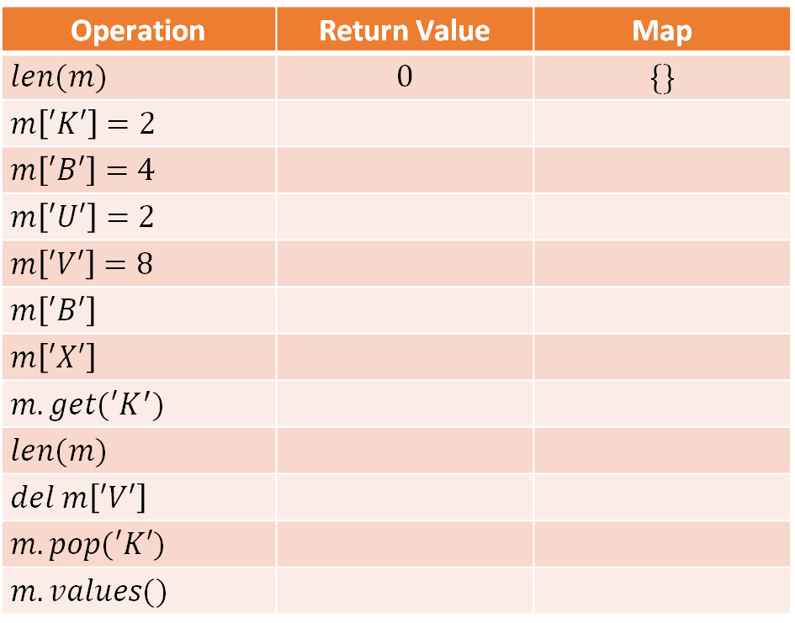
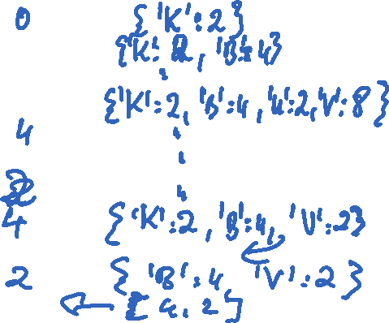
Student task
Task 1: Show the effect of the following operations on an initially empty map storing items with single-character keys and integer values. Use Python syntax to describe the map contents.
Operation | Return Value | Map
$$len(m)$$ | $$0$$ | $$\{\}$$
$$m\left[′K′\right]=2$$
$$m\left[′B′\right]=4$$
$$m\left[′U′\right]=2$$
$$m\left[′V′\right]=8$$
$$m\left[′B′\right]$$
$$m\left[′X′\right]$$
$$m.get(′K^{′})$$
$$len(m)$$
$$del m\left[′V′\right]$$
$$m.pop(′K′)$$
$$m.values()$$

Slide 9
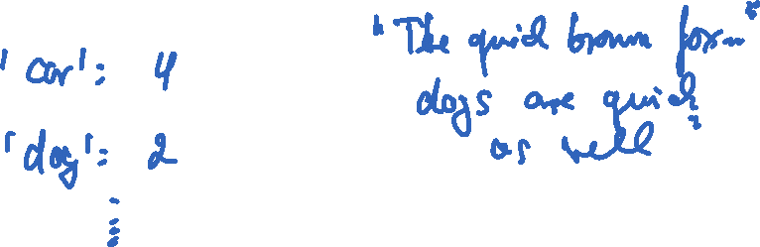
Student task
Task 2: Implement a function that counts the number of occurrances of words in a document. Use a dictionary as a data structure here. Use words as keys and word counts as values. The document is passed as a string to the function. The words are delimited with whitespaces.

Slide 10
Hash tables

Slide 11
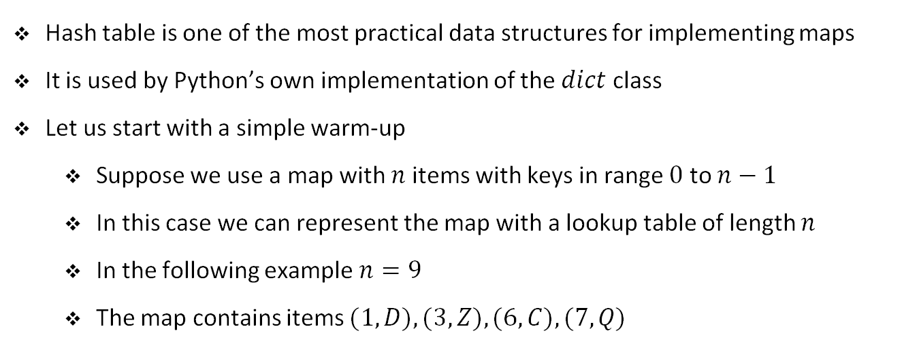

Hash tables
Hash table is one of the most practical data structures for implementing maps
It is used by Python’s own implementation of the $dict$ class
Let us start with a simple warm-up
Suppose we use a map with $n$ items with keys in range $0$ to $n−1$
In this case we can represent the map with a lookup table of length $n$
In the following example $n=9$
The map contains items $(1, D), (3, Z), (6, C), (7, Q)$
0 | 1 | 2 | 3 | 4 | 5 | 6 | 7 | 8
 | D |  | Z |  |  | C | Q
We store the values associated with the keys at corresponding indices
All basic map operations can be implemented in $O(1)$ worst-case

Slide 12
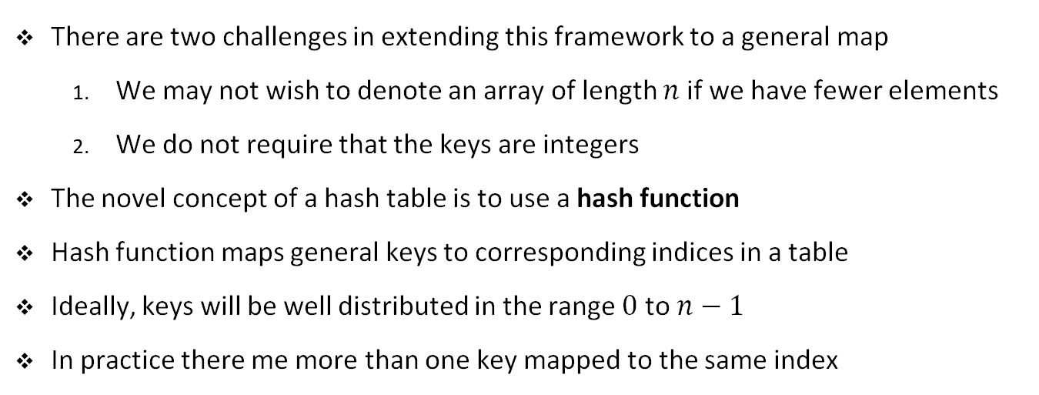
Hash tables
There are two challenges in extending this framework to a general map
We may not wish to denote an array of length $n$ if we have fewer elements
We do not require that the keys are integers
The novel concept of a hash table is to use a hash function
Hash function maps general keys to corresponding indices in a table
Ideally, keys will be well distributed in the range $0$ to $n−1$
In practice there me more than one key mapped to the same index
0 | 1 | 2 | 3 | 4 | 5 | 6 | 7 | 8
(1,D)
(25,C)
(3, F)
(14, Z)
(6,A)
(39, C)
(7,Q)
Bucket
Array

Slide 13
Hash functions

Slide 14
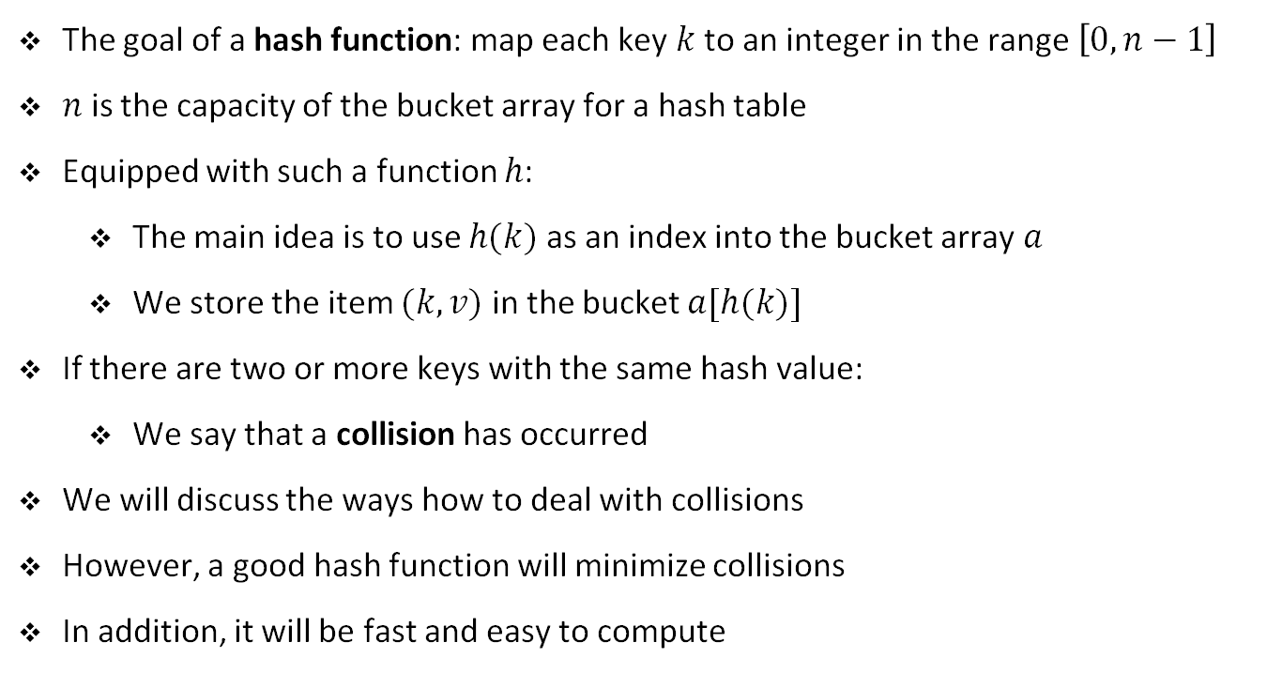
Hash functions
The goal of a hash function: map each key $k$ to an integer in the range $\left[0, n−1\right]$
$n$ is the capacity of the bucket array for a hash table
Equipped with such a function $h$:
The main idea is to use $h(k)$ as an index into the bucket array $a$
We store the item $(k,v)$ in the bucket $a[h(k)]$
If there are two or more keys with the same hash value:
We say that a collision has occurred
We will discuss the ways how to deal with collisions
However, a good hash function will minimize collisions
In addition, it will be fast and easy to compute

Slide 15
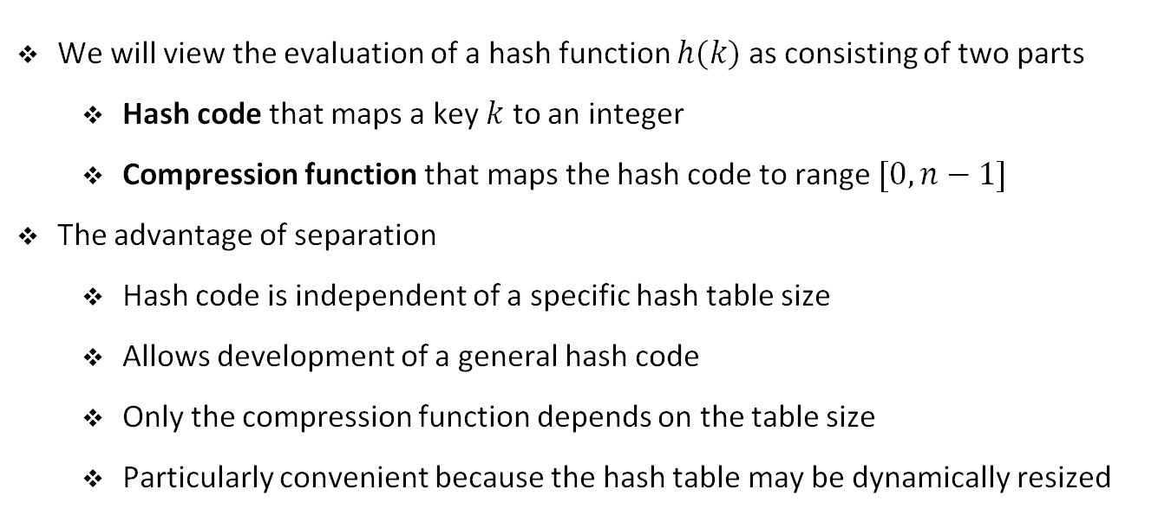
Hash functions
We will view the evaluation of a hash function $h(k)$ as consisting of two parts
Hash code that maps a key $k$ to an integer
Compression function that maps the hash code to range $[0, n−1]$
The advantage of separation
Hash code is independent of a specific hash table size
Allows development of a general hash code
Only the compression function depends on the table size
Particularly convenient because the hash table may be dynamically resized

Slide 16
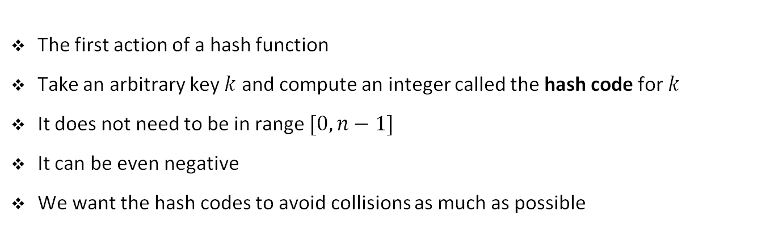
Hash codes
The first action of a hash function
Take an arbitrary key $k$ and compute an integer called the hash code for $k$
It does not need to be in range $[0, n−1]$
It can be even negative
We want the hash codes to avoid collisions as much as possible

Slide 17
Bit representations as integers
The simplest hash code for any data type:
Integer interpretation of its bits
For example, the hash code for key 314 is simply 314
The hash code for a float 3.14 is the representation of its bits as an integer:
1078523331
This is the bit representation of a 32 bit float data type
However, if the hash codes are shorter, e.g., 16 bits we need to cut 16 bits
For example, we could use only higher- or lower-order 16 bits

Slide 18
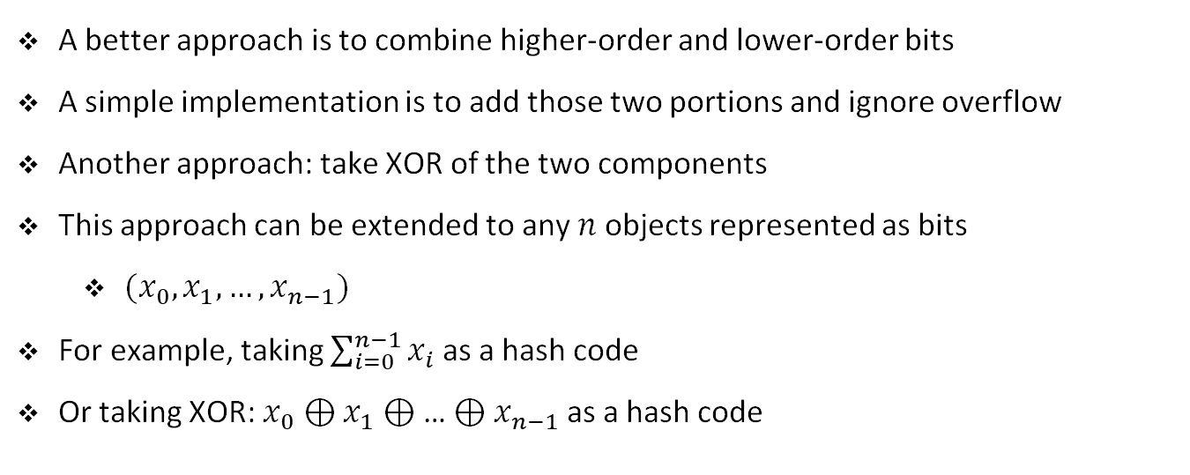
Bit representations as integers
A better approach is to combine higher-order and lower-order bits
A simple implementation is to add those two portions and ignore overflow
Another approach: take XOR of the two components
This approach can be extended to any $n$ objects represented as bits
$(x_{0},x_{1}, …,x_{n−1})$
For example, taking $\sum_{i=0}^{n−1}{x_{i} }$as a hash code
Or taking XOR: $x_{0}⊕x_{1}$ $⊕$… $⊕x_{n−1}$as a hash code

Slide 19
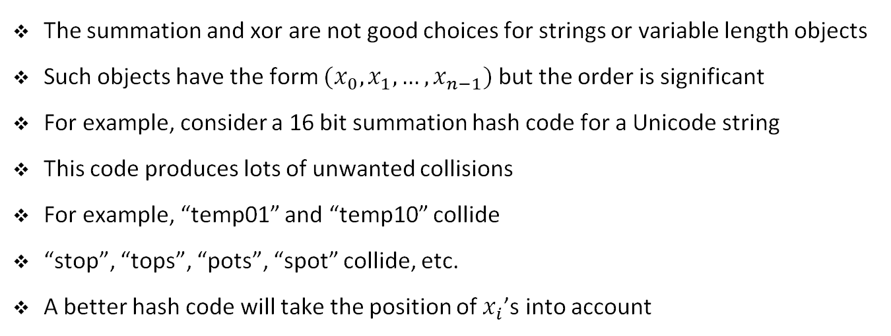
Polynomial hash codes
The summation and xor are not good choices for strings or variable length objects
Such objects have the form $(x_{0},x_{1}, …,x_{n−1})$ but the order is significant
For example, consider a 16 bit summation hash code for a Unicode string
This code produces lots of unwanted collisions
For example, “temp01” and “temp10” collide
“stop”, “tops”, “pots”, “spot” collide, etc.
A better hash code will take the position of $x_{i}$’s into account

Slide 20
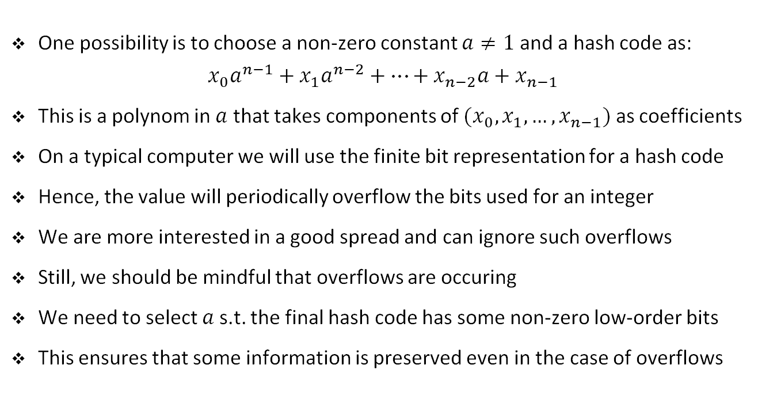
Polynomial hash codes
One possibility is to choose a non-zero constant $a≠1$ and a hash code as:
$$x_{0}a^{n−1}+x_{1}a^{n−2}+…+x_{n−2}a+x_{n−1}$$
This is a polynom in $a$ that takes components of $(x_{0},x_{1}, …,x_{n−1})$ as coefficients
On a typical computer we will use the finite bit representation for a hash code
Hence, the value will periodically overflow the bits used for an integer
We are more interested in a good spread and can ignore such overflows
Still, we should be mindful that overflows are occuring
We need to select $a$s.t. the final hash code has some non-zero low-order bits
This ensures that some information is preserved even in the case of overflows

Slide 21
Cyclic-shift hash codes
We can replace multiplication by a with a cyclic shift of a partial sum
For example, a 5-bit cyclic shift of the 32-bit value 00111101100101101010100010101000 is achieved by taking leftmost 5 bits and placing those on the rightmost side of the representation: 10110010110101010001010100000111
Arithmetically, this has little meaning but it accomplishes variation of the bits
In Python, a cyclic shift can be accomplished by the bitwise operators << and >>
We need to take care of truncating results to 32-bit integers

Slide 22
Cyclic-shift hash codes
We can replace multiplication by a with a cyclic shift of a partial sum
For example, a 5-bit cyclic shift of the 32-bit value 00111101100101101010100010101000 is achieved by taking leftmost 5 bits and placing those on the rightmost side of the representation: 10110010110101010001010100000111
Arithmetically, this has little meaning but it accomplishes variation of the bits
In Python, a cyclic shift can be accomplished by the bitwise operators << and >>
We need to take care of truncating results to 32-bit integers

Slide 23
Python example
def cyclic_shift_hash(word, shift):
hash_code = 0
for c in word:
hash_code = ((hash_code << shift) |
(hash_code >> (32 - shift))) & 0xFFFFFFFF
hash_code = (hash_code + ord(c)) & 0xFFFFFFFF
return hash_code

Slide 24
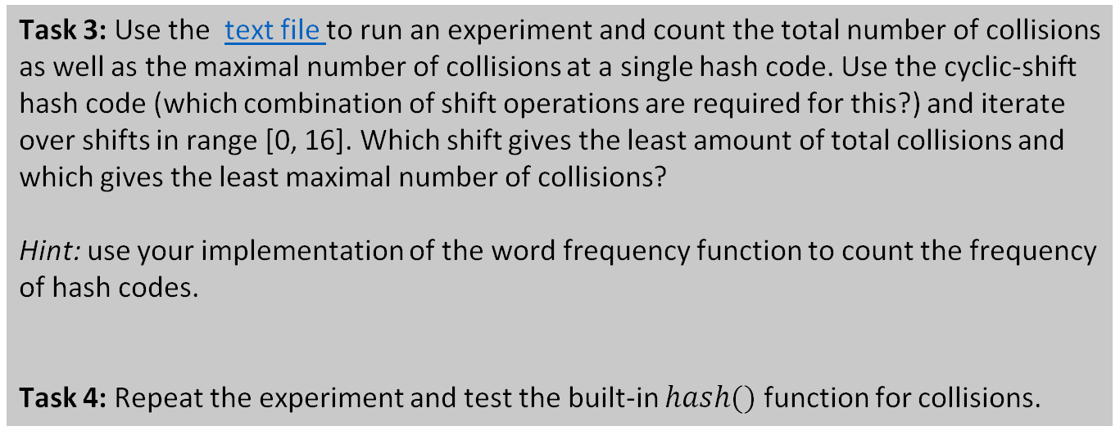
Student task
Task 3: Use the text file to run an experiment and count the total number of collisions as well as the maximal number of collisions at a single hash code. Use the cyclic-shift hash code (which combination of shift operations are required for this?) and iterate over shifts in range [0, 16]. Which shift gives the least amount of total collisions and which gives the least maximal number of collisions?
Hint: use your implementation of the word frequency function to count the frequency of hash codes.
Task 4: Repeat the experiment and test the built-in $hash()$ function for collisions.

Slide 25
Cyclic shift in Python
def cyclic_shift_hash(word, shift):
hash_code = 0
for c in word:
hash_code = ((hash_code << shift) | (hash_code >> (32 - shift))) & 0xFFFFFFFF
hash_code = (hash_code + ord(c)) & 0xFFFFFFFF
return hash_code

Slide 26
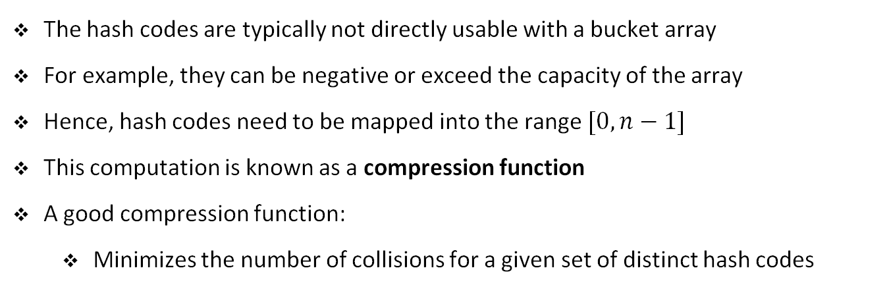
Compression functions
The hash codes are typically not directly usable with a bucket array
For example, they can be negative or exceed the capacity of the array
Hence, hash codes need to be mapped into the range $[0, n−1]$
This computation is known as a compression function
A good compression function:
Minimizes the number of collisions for a given set of distinct hash codes

Slide 27
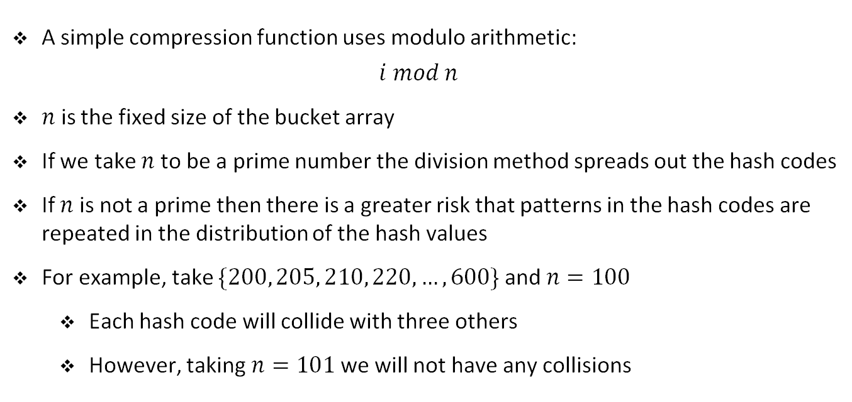
The division method
A simple compression function uses modulo arithmetic:
$$i mod n$$
$n$ is the fixed size of the bucket array
If we take $n$ to be a prime number the division method spreads out the hash codes
If $n$ is not a prime then there is a greater risk that patterns in the hash codes are repeated in the distribution of the hash values
For example, take $\{200, 205, 210, 220, …, 600\}$and $n=100$
Each hash code will collide with three others
However, taking $n=101$we will not have any collisions

Slide 28
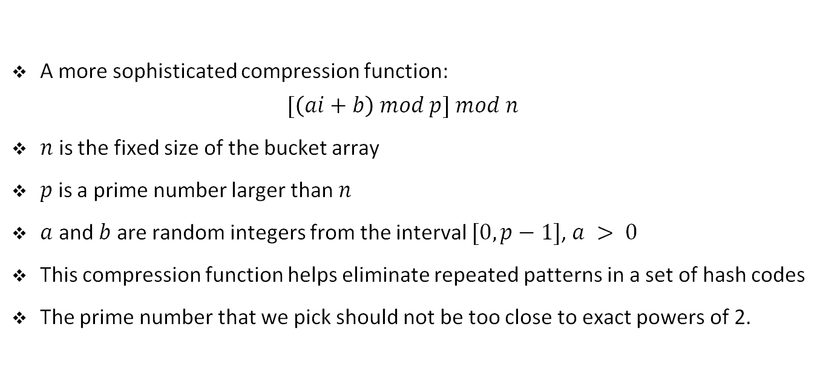
The multiply and divide method
A more sophisticated compression function:
$$[\left(ai+b\right) mod p] mod n$$
$n$ is the fixed size of the bucket array
$p$ is a prime number larger than $n$
$a$ and $b$ are random integers from the interval $[0, p−1]$, $a > 0$
This compression function helps eliminate repeated patterns in a set of hash codes
The prime number that we pick should not be too close to exact powers of 2.

Slide 29
Exercise

Slide 30
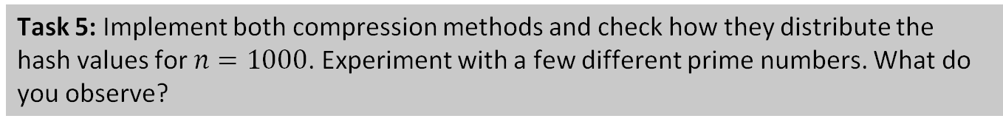
Student task
Task 5: Implement both compression methods and check how they distribute the hash values for $n=1000$. Experiment with a few different prime numbers. What do you observe?

Slide 31
Collision handling schemes

Slide 32
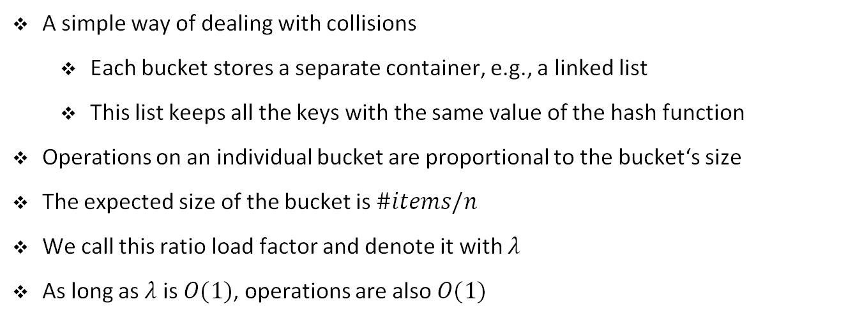
Separate chaining
A simple way of dealing with collisions
Each bucket stores a separate container, e.g., a linked list
This list keeps all the keys with the same value of the hash function
Operations on an individual bucket are proportional to the bucket‘s size
The expected size of the bucket is $\#items/n$
We call this ratio load factor and denote it with $λ$
As long as $λ$ is $O(1)$, operations are also $O(1)$
0 | 1 | 2 | 3 | 4 | 5 | 6 | 7 | 8
(1,D)
(25,C)
(3, F)
(14, Z)
(6,A)
(39, C)
(7,Q)
Bucket
Array

Slide 33
Open addressing
Disadvantage of separate chaining
It requires an auxiliary data structure
Alternatively, we could try to store each item in a new table slot
There are several variants of this approach called open addressing
Open addressing requires that the load factor is always at most 1

Slide 34
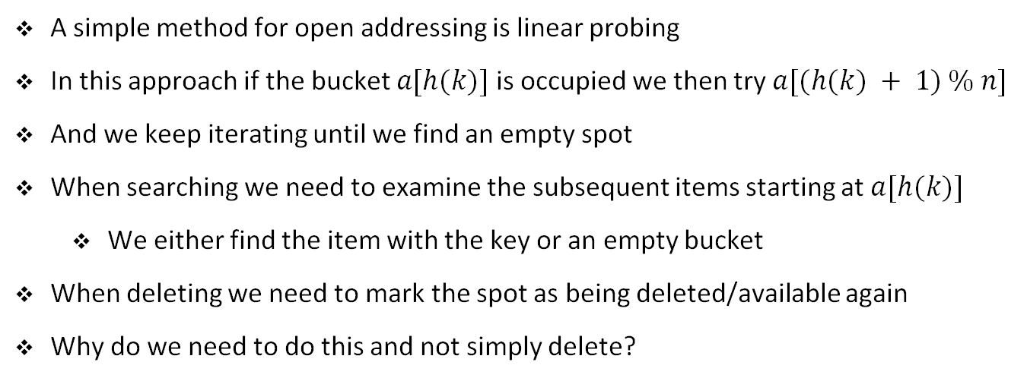
Linear probing
A simple method for open addressing is linear probing
In this approach if the bucket $a[h(k)]$is occupied we then try $a[(h(k) + 1) \% n]$
And we keep iterating until we find an empty spot
When searching we need to examine the subsequent items starting at $a[h(k)]$
We either find the item with the key or an empty bucket
When deleting we need to mark the spot as being deleted/available again
Why do we need to do this and not simply delete?

Slide 35
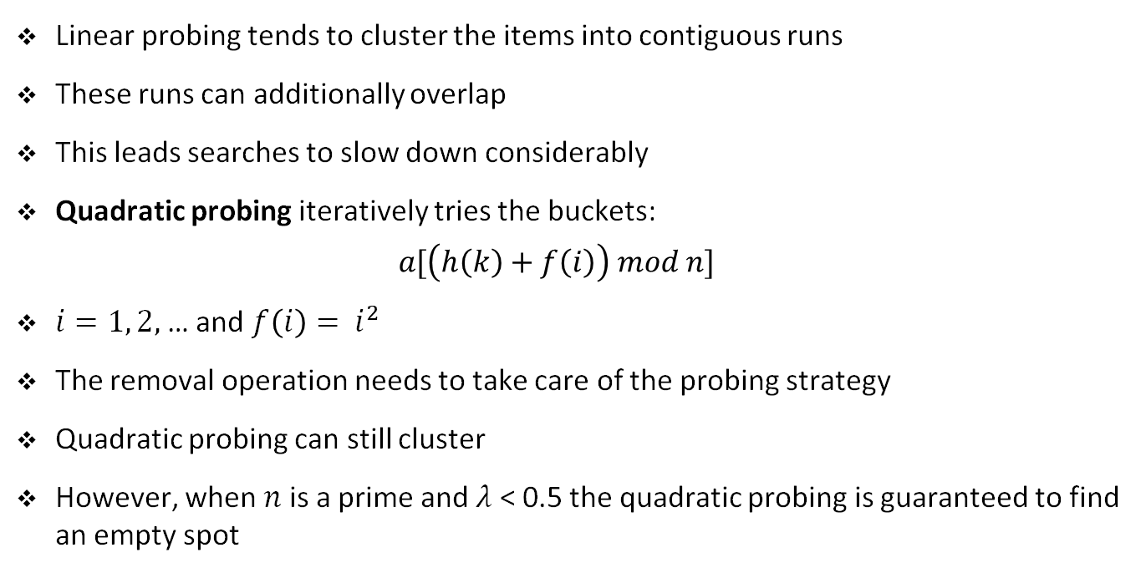
Quadratic probing
Linear probing tends to cluster the items into contiguous runs
These runs can additionally overlap
This leads searches to slow down considerably
Quadratic probing iteratively tries the buckets:
$$a[\left(h\left(k\right)+f\left(i\right)\right) mod n]$$
$i=1, 2,$… and $f\left(i\right)= i^{2}$
The removal operation needs to take care of the probing strategy
Quadratic probing can still cluster
However, when $n$ is a prime and $λ$ < 0.5 the quadratic probing is guaranteed to find an empty spot

Slide 36
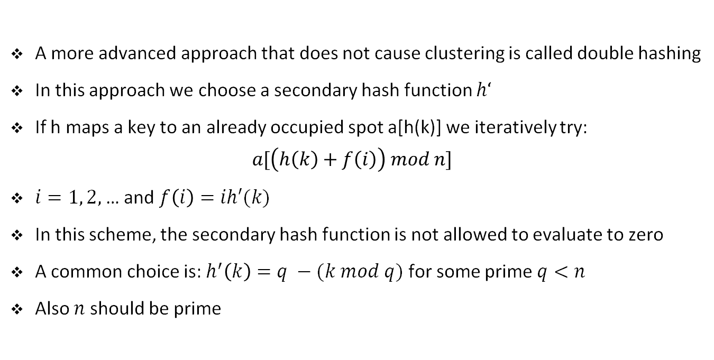
Double hashing
A more advanced approach that does not cause clustering is called double hashing
In this approach we choose a secondary hash function $h‘$
If h maps a key to an already occupied spot a[h(k)] we iteratively try:
$$a[\left(h\left(k\right)+f\left(i\right)\right) mod n]$$
$i=1, 2,$… and $f\left(i\right)=ih′(k)$
In this scheme, the secondary hash function is not allowed to evaluate to zero
A common choice is: $h^{′}\left(k\right)=q −(k mod q)$ for some prime $q<n$
Also $n$ should be prime

Slide 37
Exercise

Slide 38
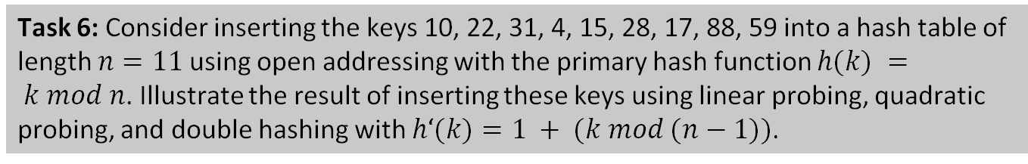
Student task
Task 6: Consider inserting the keys 10, 22, 31, 4, 15, 28, 17, 88, 59 into a hash table of length $n=11$using open addressing with the primary hash function $h(k) = k mod n$. Illustrate the result of inserting these keys using linear probing, quadratic probing, and double hashing with $h‘(k)=1 + (k mod (n−1))$.

Slide 39
Complexity

Slide 40
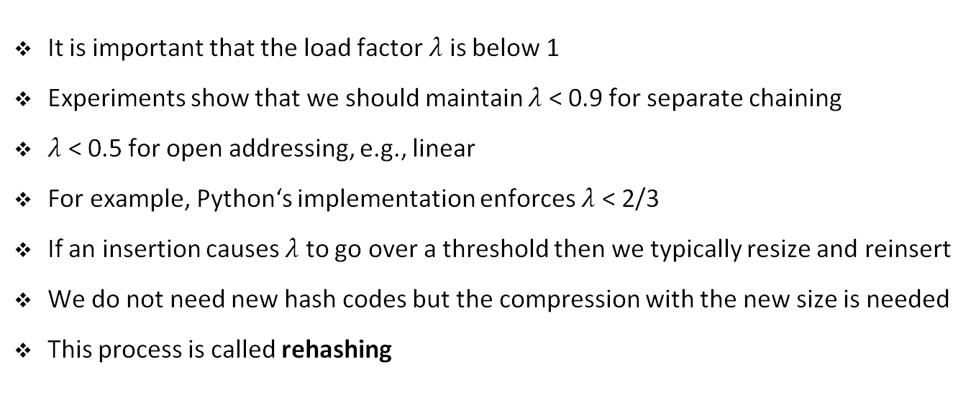
Load factors and rehashing
It is important that the load factor $λ$is below 1
Experiments show that we should maintain $λ$ < 0.9 for separate chaining
$λ$ < 0.5 for open addressing, e.g., linear
For example, Python‘s implementation enforces $λ$ < 2/3
If an insertion causes $λ$ to go over a threshold then we typically resize and reinsert
We do not need new hash codes but the compression with the new size is needed
This process is called rehashing

Slide 41
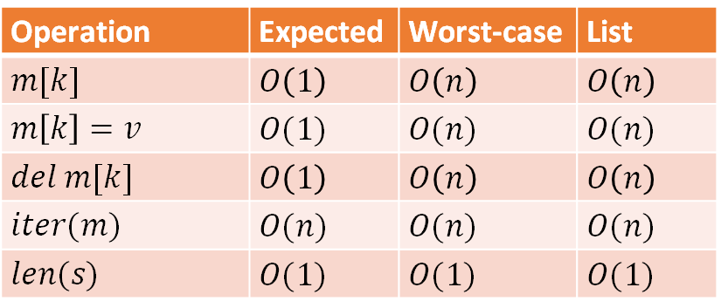
Complexity of hash tables
Operation | Expected | Worst-case | List
$$m[k]$$ | $$O\left(1\right)$$ | $$O\left(n\right)$$ | $$O\left(n\right)$$
$$m\left[k\right]=v$$ | $$O(1)$$ | $$O(n)$$ | $$O(n)$$
$$del m[k]$$ | $$O\left(1\right)$$ | $$O\left(n\right)$$ | $$O\left(n\right)$$
$$iter(m)$$ | $$O(n)$$ | $$O(n)$$ | $$O(n)$$
$$len(s)$$ | $$O(1)$$ | $$O(1)$$ | $$O(1)$$

Slide 42
Exercise

Slide 43
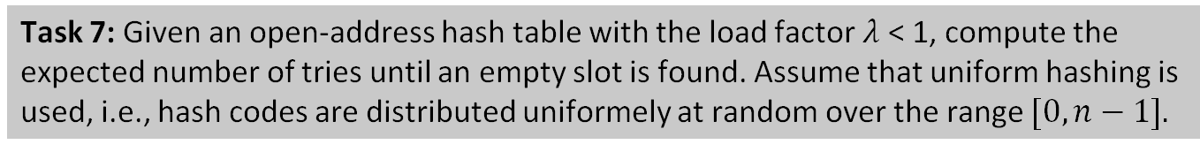
Student task
Task 7: Given an open-address hash table with the load factor $λ$ < 1, compute the expected number of tries until an empty slot is found. Assume that uniform hashing is used, i.e., hash codes are distributed uniformely at random over the range $[0, n−1].$

