Slide 1

Algorithms and Data Structures
Unit 3 – Elementary Data Structures I

Slide 2
Outline
Low-level arrays
Referential arrays
Dynamic arrays and amortization
Exercise
Python’s lists revisited
Exercise
Stacks
Exercise
Exercise
Queues
Exercise
Exercise

Slide 3
Low-level arrays

Slide 4
Representation of low-level arrays in memory
The primary computer memory is composed of bits
Bits are grouped together in larger units
Typically, groups have 8 bits, i.e., bytes
To keep track of what information is stored in what byte, the computer uses memory addresses
In effect, each byte is associated with a unique address
… | 2145 | 2146 | 2147 | 2148 | 2149 | 2150 | 2151 | 2152 | …
… | 5 | 3 | 2 | 6 | 4 | 1 | 3 | 7 | …

Slide 5
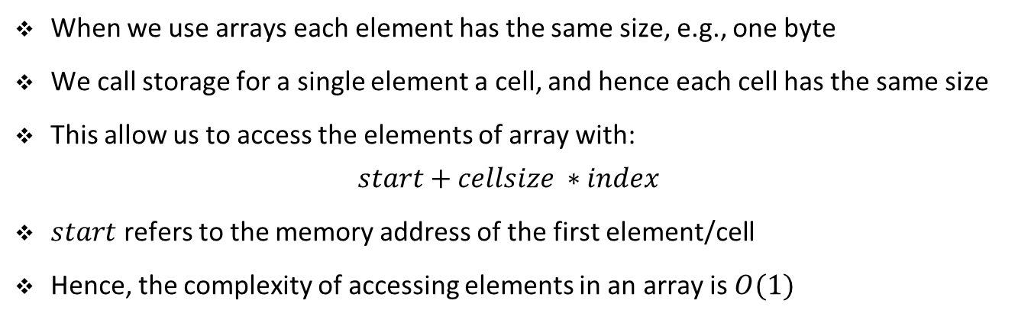
Representation of low-level arrays in memory
We store groups of related variables one after another in a contiguous portion of memory
Such groups are called arrays
For example, string “SAMPLE” may be stored like this:
… | 2145 | 2146 | 2147 | 2148 | 2149 | 2150 | 2151 | 2152 | …
… |  | S | A | M | P | L | E |  | …
 |  | 0 | 1 | 2 | 3 | 4 | 5
When we use arrays each element has the same size, e.g., one byte
We call storage for a single element a cell, and hence each cell has the same size
This allow us to access the elements of array with:
$$start+cellsize ∗index$$
$start$ refers to the memory address of the first element/cell
Hence, the complexity of accessing elements in an array is $O(1)$

Slide 6
Referential arrays

Slide 7
Referential arrays
For collection of elements which may differ in their sizes we cannot use arrays
For example, python’s lists or tuples can have elements of different types
In this case, we use referential arrays
Referential arrays keep addresses to elements
As all addresses are equal in size (e.g., 8 bytes) they are stored in arrays
The elements themselves are stored elsewhere
True
‘Vienna‘
5.12
‘Austria‘
3
-10
… | 2145 | 2146 | 2147 | 2148 | 2149 | 2150 | 2151 | 2152 | …
… |  |  |  |  |  |  |  |  | …
 |  | 0 | 1 | 2 | 3 | 4 | 5

Slide 8
Referential arrays
The fact that lists or tuples are referential arrays leads to important consequences
A single list may include multiple references to the same element
A single object may be an element in more than one list
For example, when we compute a list slice the result is a new list
But the new list has references to the same elements as the original list

Slide 9
Referential arrays
$$list[2:5]$$
… | 3242 | 3243 | 3244 | …
… |  |  |  | …
 | 0 | 1 | 2
True
‘Vienna‘
5.12
‘Austria‘
3
-10
… | 2145 | 2146 | 2147 | 2148 | 2149 | 2150 | 2151 | 2152 | …
… |  |  |  |  |  |  |  |  | …
 |  | 0 | 1 | 2 | 3 | 4 | 5

Slide 10


Referential arrays
$$list1.extend(list2)$$
… | 3242 | 3243 | 3244 | …
$$list2$$
… |  |  |  | …
 | 0 | 1 | 2
True
‘Vienna‘
5.12
‘Austria‘
3
-10
… | 2145 | 2146 | 2147 | 2148 | 2149 | 2150 | 2151 | 2152 | …
$$list1$$
… |  |  |  |  |  |  |  |  | …
 |  | 0 | 1 | 2 | 3 | 4 | 5

Slide 11
Dynamic arrays and amortization

Slide 12
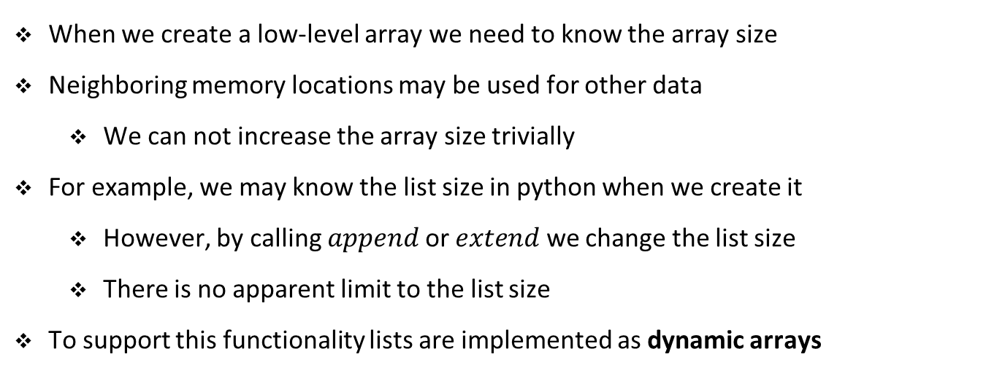
Dynamic arrays
When we create a low-level array we need to know the array size
Neighboring memory locations may be used for other data
We can not increase the array size trivially
For example, we may know the list size in python when we create it
However, by calling $append$ or $extend$ we change the list size
There is no apparent limit to the list size
To support this functionality lists are implemented as dynamic arrays

Slide 13
Dynamic arrays
Typically, the underlying array has a greater capacity then the current list length
Hence, when a user creates a list with five elements
The system reserves an underlying array for storing more than five objects
For example, eight or ten objects
If we keep adding elements to the list we will exhaust the capacity eventually
In that case, the system reserves an even larger array
First, the elements from the list are copied from the old into the new array
The old array is no longer needed

Slide 14
Dynamic arrays: experiment in python
import sys
data = []
n = 100
old_size = 0
for i in range(n):
print(f'Length: {len(data)},'
f'Size in bytes: {sys.getsizeof(data)},'
f'Size in bytes: {sys.getsizeof(data) - old_size}')
old_size = sys.getsizeof(data)
data.append(1)
Notebook example

Slide 15
Dynamic arrays: experiment in python
Empty list requires already 56 bytes
Adding the first element increases the size to 88 bytes
32 bytes difference
The experiment was done on a 64-bit machine
8 bytes are needed for storing one address
Hence, python increases the size of the list to keep references of four objects
Adding the fifth object increases the size by another 32 bytes
Adding the ninth object increases the size by 64 bytes (8 references)
This size increase repeats until the 40th element, then we have increase for 96 bytes
This progression continues for longer lists

Slide 16
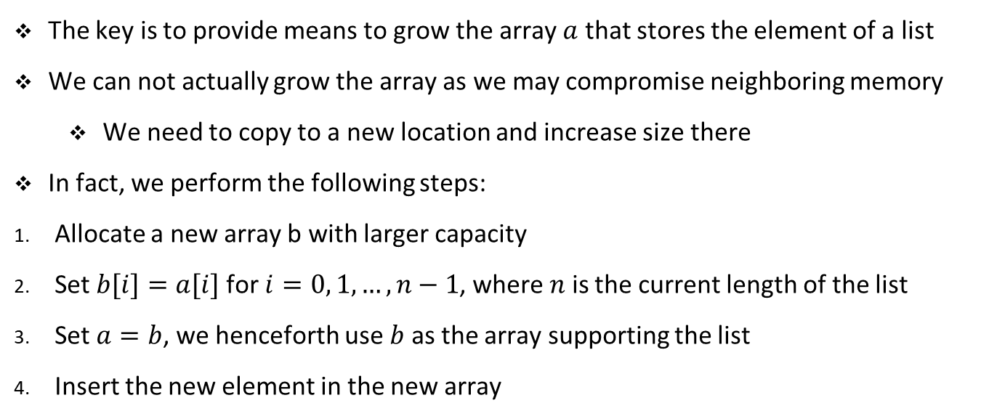
Implementing dynamic arrays
The key is to provide means to grow the array $a$ that stores the element of a list
We can not actually grow the array as we may compromise neighboring memory
We need to copy to a new location and increase size there
In fact, we perform the following steps:
Allocate a new array b with larger capacity
Set $b[i]=a[i]$for $i=0, 1, …, n−1$, where $n$ is the current length of the list
Set $a=b$, we henceforth use $b$ as the array supporting the list
Insert the new element in the new array

Slide 17

Implementing dynamic arrays
$$a.append(True)$$
3242 | 3243
a
0 | 1
3
5.12
True
2146 | 2147 | 2148 | 2149 | 2150 | 2151 | 2152
$$b$$
0 | 1 | 2

Slide 18
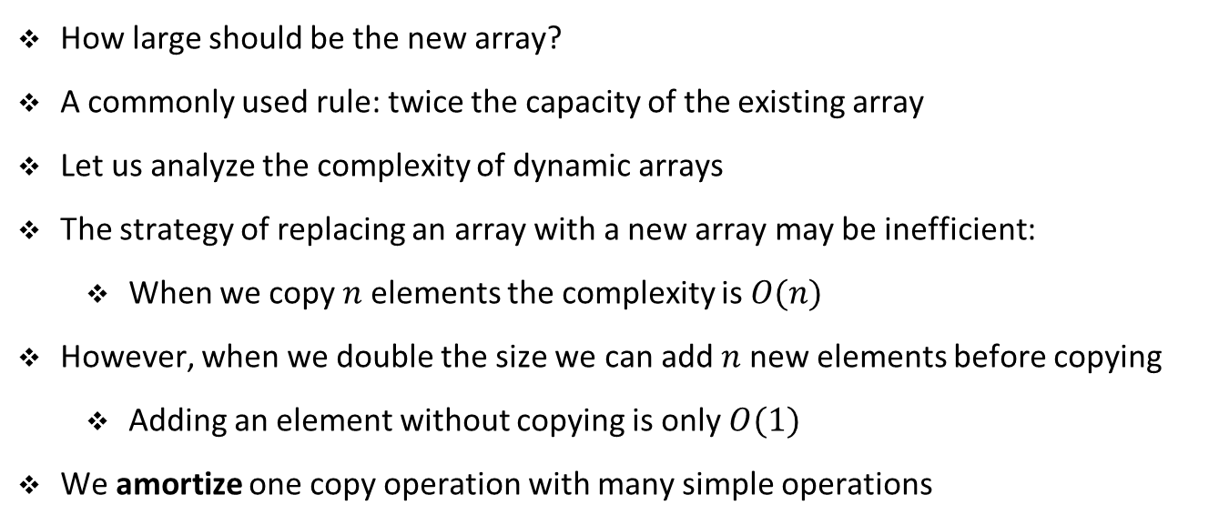
Growing dynamic arrays
How large should be the new array?
A commonly used rule: twice the capacity of the existing array
Let us analyze the complexity of dynamic arrays
The strategy of replacing an array with a new array may be inefficient:
When we copy $n$ elements the complexity is $O(n)$
However, when we double the size we can add $n$ new elements before copying
Adding an element without copying is only $O(1)$
We amortize one copy operation with many simple operations

Slide 19
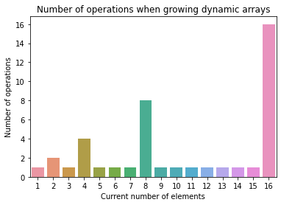
Growing dynamic arrays

Slide 20
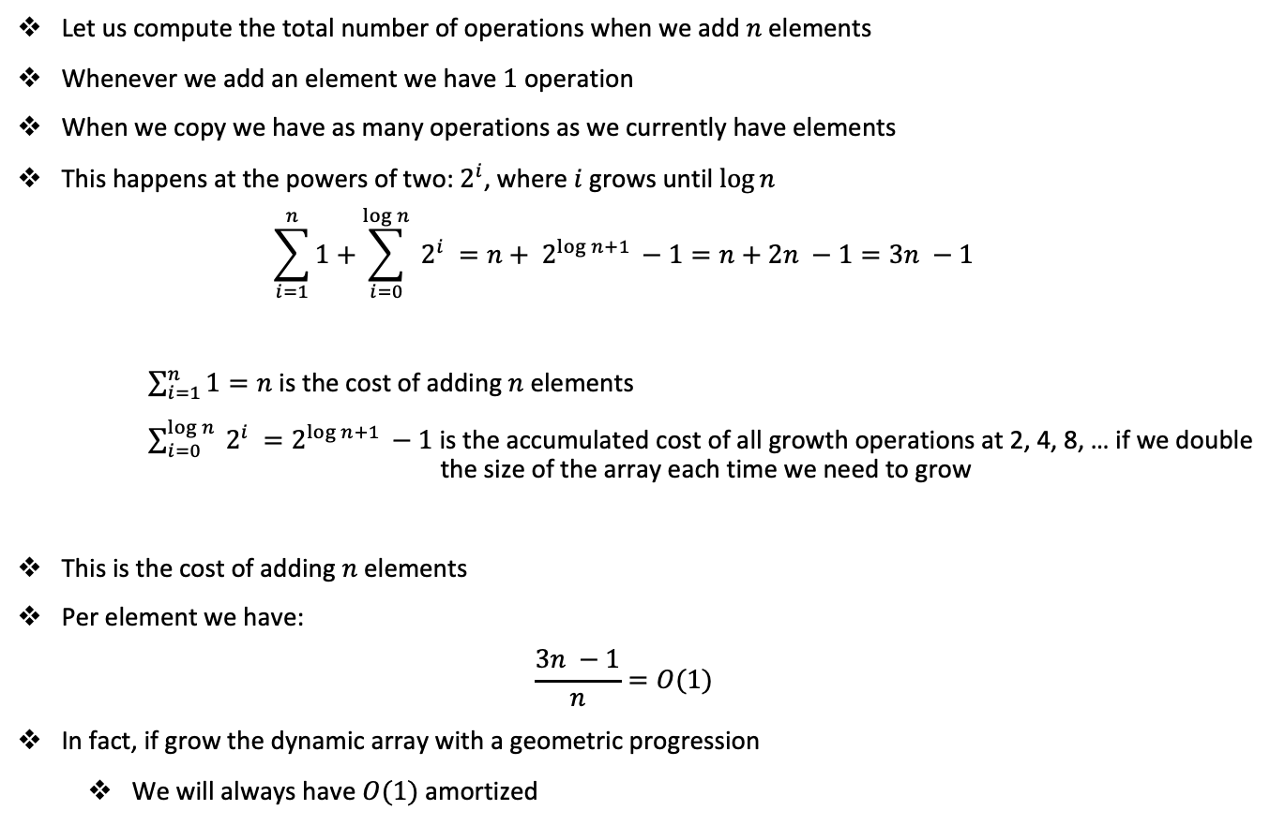
Growing dynamic arrays
Let us compute the total number of operations when we add $n$ elements
Whenever we add an element we have $1$ operation
When we copy we have as many operations as we currently have elements
This happens at the powers of two: $2^{i}$, where $i$ grows until $\log{n}$
$$\sum_{i=1}^{n}{1}+\sum_{i=0}^{\log{n}}{ 2^{i} }=n+ 2^{\log{n+1} }−1=n+2n −1=3n −1$$
$\sum_{i=1}^{n}{1=n}$ is the cost of adding $n$ elements $\sum_{i=0}^{\log{n}}{ 2^{i} }=2^{\log{n+1} }−1$ is the accumulated cost of all growth operations at 2, 4, 8, … if we double the size of the array each time we need to grow
This is the cost of adding $n$ elements
Per element we have:
$$\frac{3n −1}{n}=O(1)$$
In fact, if grow the dynamic array with a geometric progression
We will always have $O(1)$ amortized
Notes:
See also geometric series and partial geometric sum.

Slide 21
Exercise

Slide 22
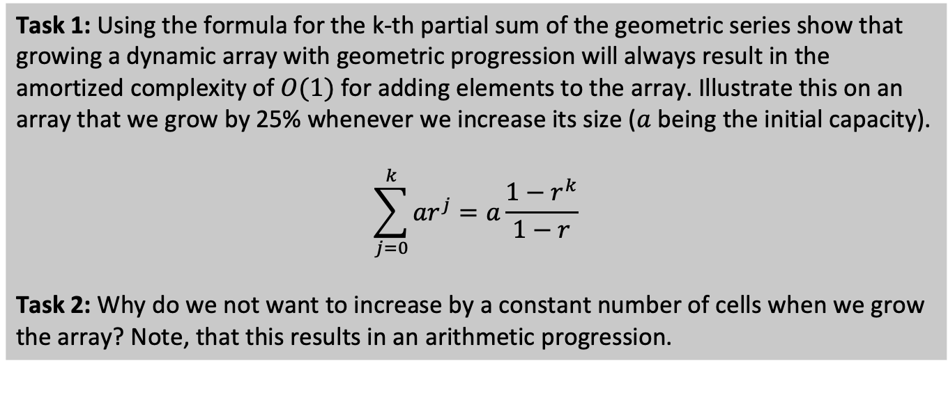
Student task
Task 1: Using the formula for the k-th partial sum of the geometric series show that growing a dynamic array with geometric progression will always result in the amortized complexity of $O(1)$ for adding elements to the array. Illustrate this on an array that we grow by 25% whenever we increase its size ($a$ being the initial capacity).
$$\sum_{j=0}^{k}{{ar}^{j}}=a\frac{1−r^{k}}{1−r}$$
Task 2: Why do we not want to increase by a constant number of cells when we grow the array? Note, that this results in an arithmetic progression.

Slide 23
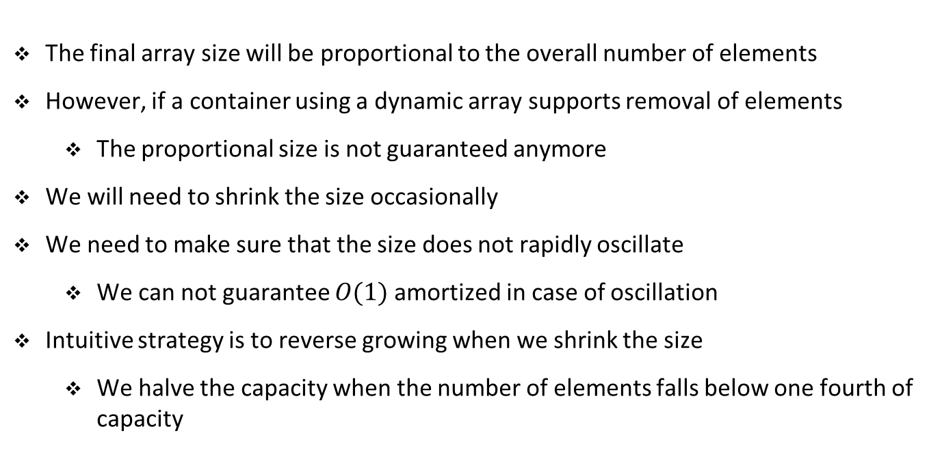
Shrinking dynamic arrays
The final array size will be proportional to the overall number of elements
However, if a container using a dynamic array supports removal of elements
The proportional size is not guaranteed anymore
We will need to shrink the size occasionally
We need to make sure that the size does not rapidly oscillate
We can not guarantee $O(1)$ amortized in case of oscillation
Intuitive strategy is to reverse growing when we shrink the size
We halve the capacity when the number of elements falls below one fourth of capacity

Slide 24
Python’s lists revisited

Slide 25
Python lists are implemented as dynamic arrays
Let us check amortized costs of adding elements to a python list
def append_cost(n=100):
data = []
for i in range(n):
data.append(None)
ns = [1, 10, 100, 1000, 10000, 100000, 1000000]
results = []
for n in ns:
print(n)
time = np.array(timeit.repeat('append_cost(n)', globals=globals(), number=1, repeat=30))
time /= n
results.append([n, np.mean(time), np.std(time, ddof=1)])
Notebook example

Slide 26
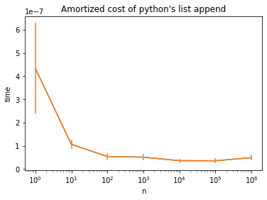
Python lists are implemented as dynamic arrays

Slide 27
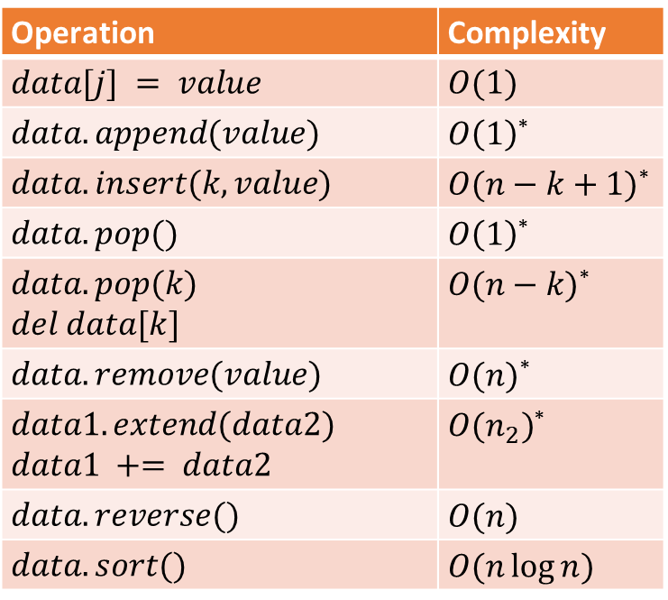
Python lists are implemented as dynamic arrays
Operation | Complexity
$$data[j] = value$$ | $$O(1)$$
$$data.append(value)$$ | $O\left(1\right)$*
$$data.insert(k, value)$$ | $O(n−k+1)$*
$$data.pop()$$ | $O\left(1\right)$*
$$data.pop(k)$$ $$del data[k]$$ | $O(n−k)$*
$$data.remove(value)$$ | $O(n)$*
$$data1.extend(data2)$$ $$data1 += data2$$ | $O(n_{2})$*
$$data.reverse()$$ | $$O(n)$$
$$data.sort()$$ | $$O(n\log{n})$$
* amortized

Slide 28
Exercise

Slide 29
Student task
Task 3: Using the previous code for measuring the time of append operation as a template, measure the time of inserting the element at the first, middle, and the last position in the list. Repeat the experiment for the lists of size 1, 10, 100, 1000, 10000, 100000. Store the results and plot them at the end of the experiment. Use a logarithmic scale for the list size.
Task 4: Repeat the previous example but use the pop operation for removing the elements instead of insert operation.

Slide 30
Stacks

Slide 31
Stacks
A stack is a collection of objects following the last-in, first-out (LIFO) principle
Users can insert objects into a stack at any time
But you can only access or remove the most recently inserted object
The most recently added object remains at the top of the stack
The fundamental operations are pushing and popping onto/from the top
For example, browser history is implemented as a stack
Every Web page that you visit is pushed onto the stack
When you click the back button the last visited page is popped from the stack

Slide 32

Stacks
7
$$s.push(7)$$

Slide 33

Stacks
9
7
$$s.push(9)$$

Slide 34

Stacks
4
9
7
$$s.push(4)$$

Slide 35

Stacks
9
7
$$s.pop()$$
$$return:4$$

Slide 36

Stacks
6
9
7
$$s.push(6)$$

Slide 37

Stacks
8
6
9
7
$$s.push(8)$$

Slide 38

Stacks
6
9
7
$$s.pop()$$
$$return: 8$$

Slide 39
Exercise

Slide 40
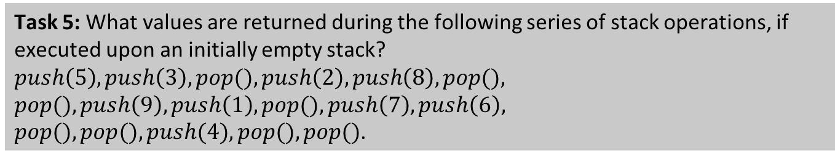
Student task
Task 5: What values are returned during the following series of stack operations, if executed upon an initially empty stack? $push\left(5\right), push\left(3\right), pop(), push\left(2\right), push\left(8\right), pop(),$
$$pop(), push\left(9\right), push\left(1\right), pop(), push\left(7\right), push\left(6\right),$$
$pop(), pop(), push(4), pop(), pop()$.

Slide 41
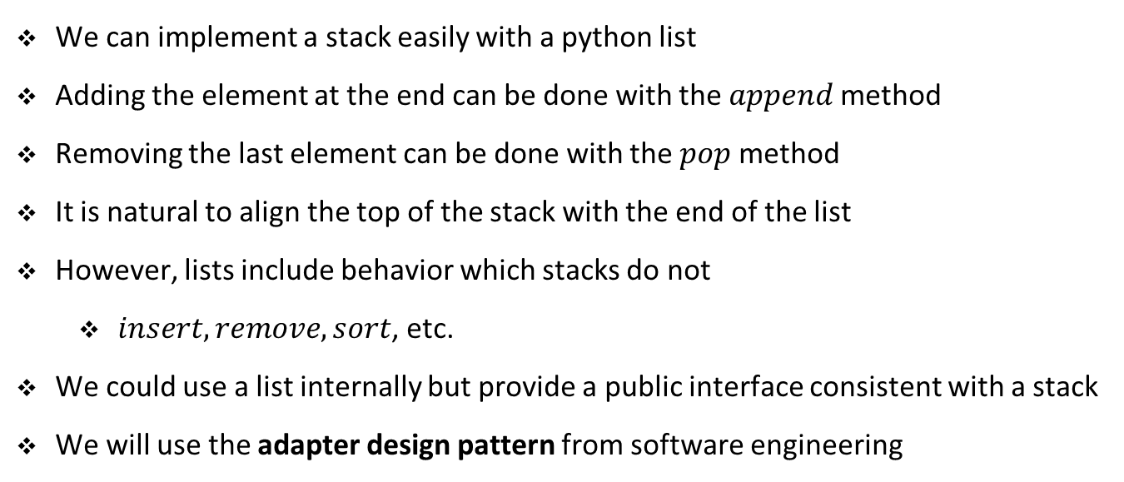
Implementing stacks
We can implement a stack easily with a python list
Adding the element at the end can be done with the $append$ method
Removing the last element can be done with the $pop$ method
It is natural to align the top of the stack with the end of the list
However, lists include behavior which stacks do not
$insert, remove, sort$, etc.
We could use a list internally but provide a public interface consistent with a stack
We will use the adapter design pattern from software engineering

Slide 42
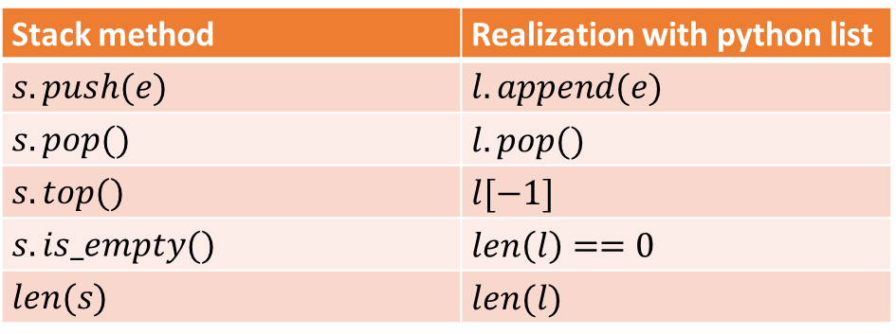
Adapting lists to represent stacks
Stack method | Realization with python list
$$s.push(e)$$ | $$l.append(e)$$
$$s.pop()$$ | $$l.pop()$$
$$s.top()$$ | $$l[−1]$$
$$s.is_empty()$$ | $$len\left(l\right)==0$$
$$len(s)$$ | $$len(l)$$
All other list‘s behavior we will hide from outside by indicating that the list is private
Recollect: encapsulation and information hiding from OO programming

Slide 43
Adapting lists to represent stacks
class StackEmpty(Exception):
pass
class Stack:
def __init__(self):
self._data = []
def __len__(self):
return len(self._data)
def is_empty(self):
return len(self._data) == 0
def push(self, e):
self._data.append(e)

Slide 44
Adapting lists to represent stacks
def top(self):
if self.is_empty():
raise StackEmpty('Stack is empty')
return self._data[-1]
def pop(self):
if self.is_empty():
raise StackEmpty('Stack is empty')
return self._data.pop()
def __str__(self):
return f'{self._data}'
Notebook example

Slide 45
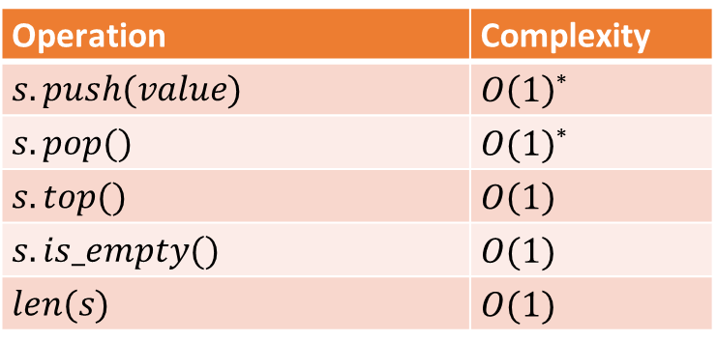
Complexity of array-based stacks
Operation | Complexity
$$s.push(value)$$ | $O\left(1\right)$*
$$s.pop()$$ | $O(1)$*
$$s.top()$$ | $$O\left(1\right)$$
$$s.is_empty()$$ | $$O(1)$$
$$len(s)$$ | $$O(1)$$
* amortized

Slide 46
Exercise

Slide 47
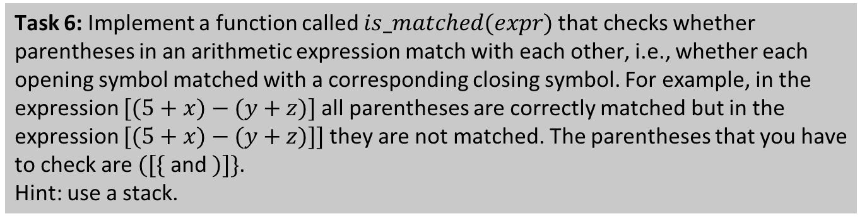
Student task
Task 6: Implement a function called $is_matched(expr)$that checks whether parentheses in an arithmetic expression match with each other, i.e., whether each opening symbol matched with a corresponding closing symbol. For example, in the expression $[(5+x)−(y+z)]$all parentheses are correctly matched but in the expression $[(5+x)−(y+z)]]$they are not matched. The parentheses that you have to check are $([\{$ and $)]\}$.
Hint: use a stack.

Slide 48
Queues

Slide 49
Queues
Another fundamental data structure is the queue
Collection of objects, inserted/removed following first-in, first-out (FIFO) principle
Elements can be inserted at any time
The element that in in the queue the longest is removed first
Elements are inserted at the back but removed from the front
For example, people waiting in line in the bank, post office, at the counter, etc.
For example, Web server responding to the requests
Fundamental operations are enqueue and dequeue
The enqueue operation adds an element at the back of the queue
The dequeue operation removes and returns the element from the front

Slide 50

Queues
7
$$q.enqueue(7)$$

Slide 51

Queues
7
9
$$q.enqueue(9)$$

Slide 52

Queues
7
9
4
$$q.enqueue(4)$$

Slide 53

Queues
9
4
$$q.dequeue()$$
$$return:7$$

Slide 54

Queues
9
4
6
$$q.enqueue(6)$$

Slide 55

Queues
9
4
6
8
$$q.enqueue(8)$$

Slide 56

Queues
4
6
8
$$q.dequeue()$$
$$return:9$$

Slide 57
Exercise

Slide 58
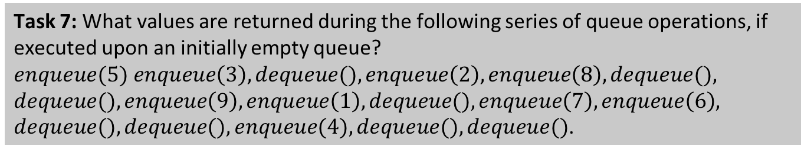
Student task
Task 7: What values are returned during the following series of queue operations, if executed upon an initially empty queue? $enqueue(5) enqueue\left(3\right), dequeue(), enqueue\left(2\right), enqueue\left(8\right), dequeue(),$
$$dequeue(), enqueue\left(9\right), enqueue\left(1\right), dequeue(), enqueue\left(7\right), enqueue\left(6\right),$$
$dequeue(), dequeue(), enqueue(4),dequeue(), dequeue()$.

Slide 59
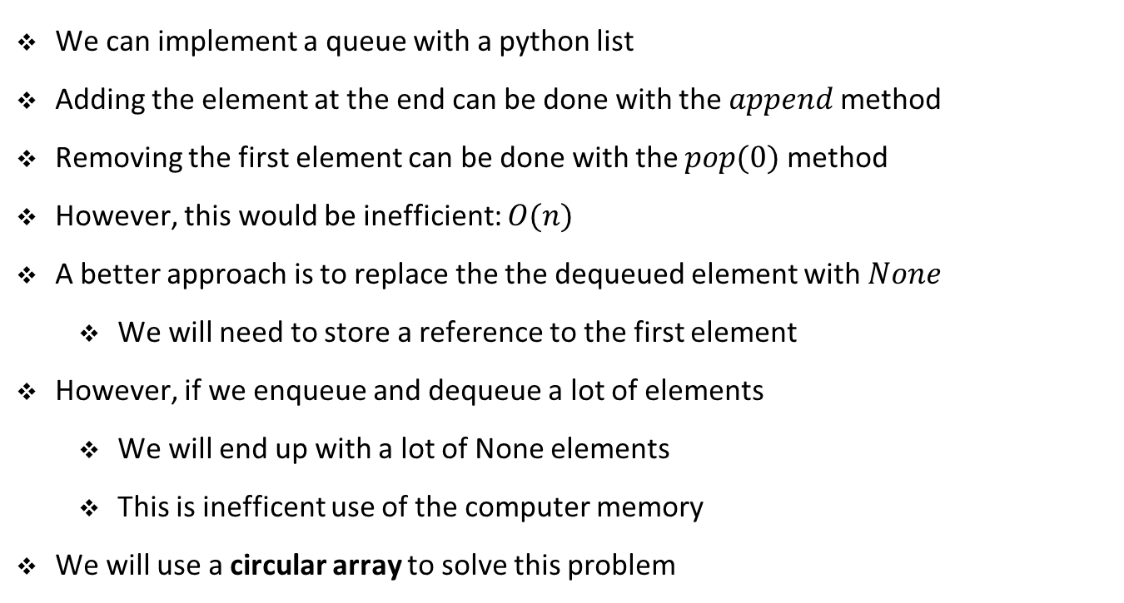

Implementing queues
We can implement a queue with a python list
Adding the element at the end can be done with the $append$ method
Removing the first element can be done with the $pop(0)$ method
However, this would be inefficient: $O(n)$
A better approach is to replace the the dequeued element with $None$
We will need to store a reference to the first element
However, if we enqueue and dequeue a lot of elements
We will end up with a lot of None elements
This is inefficent use of the computer memory
We will use a circular array to solve this problem
12 | 7 | None | None | 10 | 5 | 6
$$first$$

Slide 60
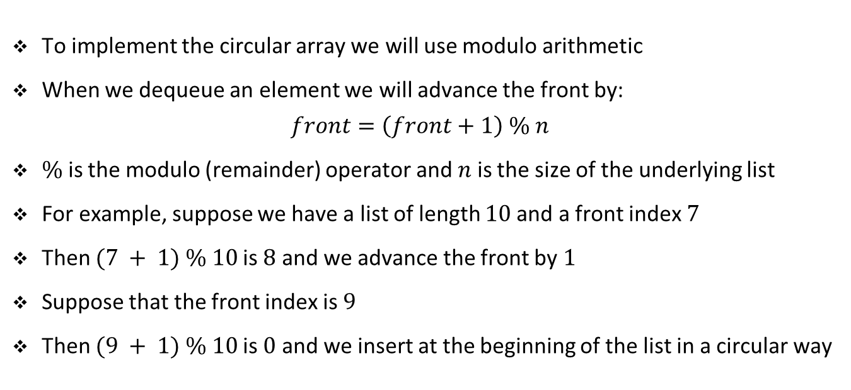
Implementing queues
To implement the circular array we will use modulo arithmetic
When we dequeue an element we will advance the front by:
$$front=\left(front+1\right) \% n$$
$\%$ is the modulo (remainder) operator and $n$ is the size of the underlying list
For example, suppose we have a list of length $10$and a front index $7$
Then $(7 + 1) \% 10$is $8$ and we advance the front by $1$
Suppose that the front index is $9$
Then $(9 + 1) \% 10$is $0$ and we insert at the beginning of the list in a circular way

Slide 61
Adapting lists to represent queues
class Queue:
DEFAULT_CAPACITY = 10
def __init__(self):
self._data = [None] * Queue.DEFAULT_CAPACITY
self._size = 0
self._front = 0
def __len__(self):
return self._size
def is_empty(self):
return self._size == 0
def first(self):
if self.is_empty():
raise Empty('Queue is empty')
return self._data[self._front]

Slide 62
Adapting lists to represent queues
def dequeue(self):
e = self.first()
self._data[self._front] = None
self._front = (self._front + 1) % len(self._data)
self._size -= 1
return e
def enqueue(self, e):
if self._size == len(self._data):
self._resize(2 * len(self._data))
back = (self._front + self._size) % len(self._data)
self._data[back] = e
self._size += 1

Slide 63
Adapting lists to represent queues
def _resize(self, capacity):
old = self._data
self._data = [None] * capacity
i = self._front
for j in range(self._size):
self._data[j] = old[i]
i = (i + 1) % len(old)
self._front = 0
def __str__(self):
return f'{self._data}'
Notebook example

Slide 64
Exercise

Slide 65
Student task
Task 8: Explain the resize method. Why do we move the front to 0 when we copy the arrays?
Task 9: Where we would add the code for shrinking the list if we dequeue too many elements? How that code may look like?

Slide 66
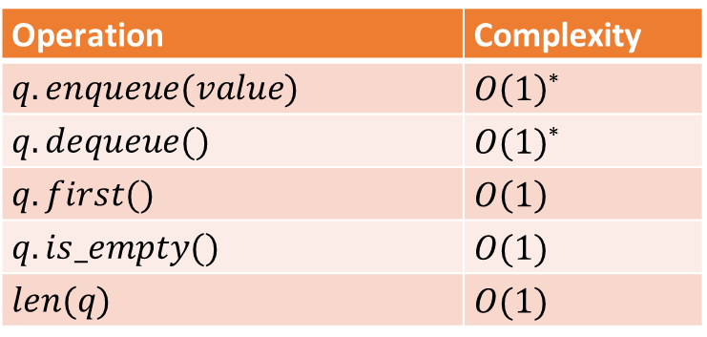
Complexity of array-based queues
Operation | Complexity
$$q.enqueue(value)$$ | $O\left(1\right)$*
$$q.dequeue()$$ | $O(1)$*
$$q.first()$$ | $$O\left(1\right)$$
$$q.is_empty()$$ | $$O(1)$$
$$len(q)$$ | $$O(1)$$
* amortized

Slide 67
Exercise

Slide 68
Student task
Task 10: Postfix notation is an unambiguous way of writing an arithmetic expression without parentheses. It is defined so that if “(exp1)op(exp2)” is a normal, fully parenthesized expression whose operation is op, the postfix version of this is “pexp1 pexp2 op”, where pexp1 is the postfix version of exp1 and pexp2 is the postfix version of exp2. The postfix version of a single number or variable is just that number or variable. For example, the postfix version of “((5+2) ∗ (8−3))/4” is “5 2 + 8 3 − ∗ 4 /”. Write a python program for evaluating expressions in postfix notation. Which data structure are you going to use?
Task 11: Suppose we buy 100 shares at €20 each on day 1, 20 shares at €24 on day 2, 200 shares at €36 on day 3, and then sell 150 shares on day 4 at €30 each. Then applying the FIFO protocol means that of the 150 shares sold, 100 were bought on day 1, 20 were bought on day 2, and 30 were bought on day 3. The capital gain in this case would therefore be 100 · 10 + 20 · 6 + 30 · (−6), or €940. Write a program that takes as input a sequence of transactions of the form “buy x share(s) at y each” or “sell x share(s) at y each,” assuming that the transactions occur on consecutive days and the values x and y are integers. Given this input sequence, the output should be the total capital gain (or loss) for the entire sequence, using the FIFO protocol to identify shares. Which data structure you are going to use?

