Slide 1

Algorithms and Data Structures
Unit 7 – Greedy Algorithms

Slide 2
Outline
Optimization problems
Greedy method
Activity selection
Exercise
Huffman codes
Exercise
Constructing Huffman codes
Exercise

Slide 3
Optimization problems

Slide 4
Optimization problems
In optimization problems we seek to find an optimal solution to a given problem
Typically, the problem has many possible solutions
Each solution has a value, we wish to find a solution with a minimal/maximal value
For example, we discussed the line fitting problem
We wanted to fit a line that minimizes the error in approximating a set of data

Slide 5
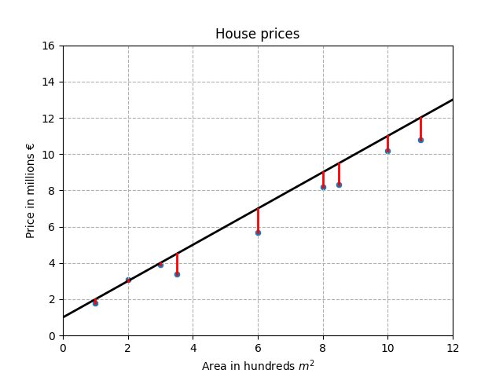
Example: fitting a line to data
Sum of squared errors

Slide 6
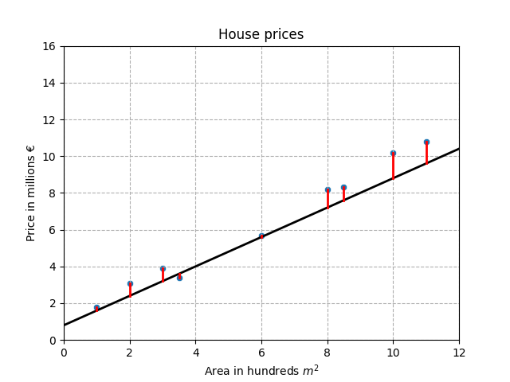
Example: fitting a line to data
Sum of squared errors

Slide 7
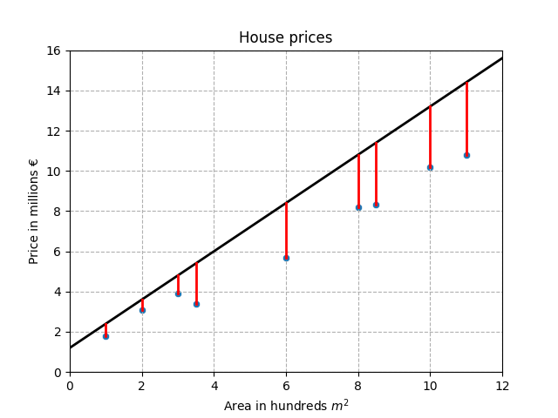
Example: fitting a line to data
Sum of squared errors

Slide 8
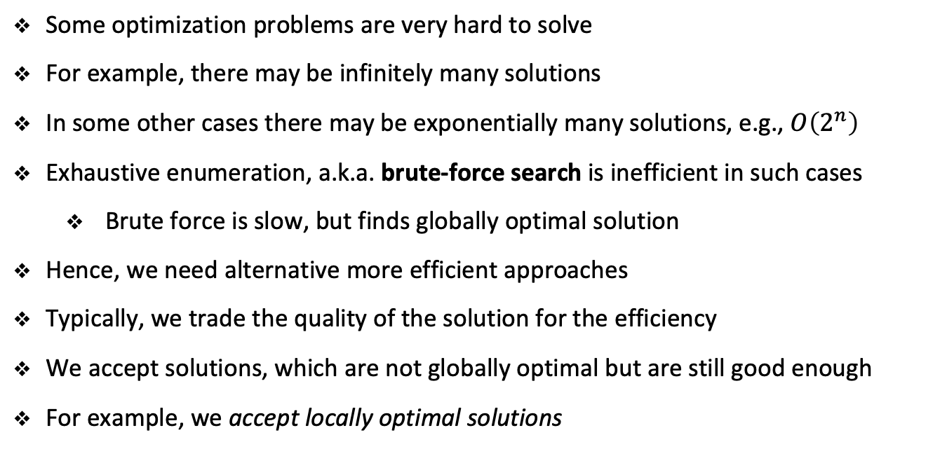
Optimization problems
Some optimization problems are very hard to solve
For example, there may be infinitely many solutions
In some other cases there may be exponentially many solutions, e.g., $O\left(2^{n}\right)$
Exhaustive enumeration, a.k.a. brute-force search is inefficient in such cases
Brute force is slow, but finds globally optimal solution
Hence, we need alternative more efficient approaches
Typically, we trade the quality of the solution for the efficiency
We accept solutions, which are not globally optimal but are still good enough
For example, we accept locally optimal solutions

Slide 9
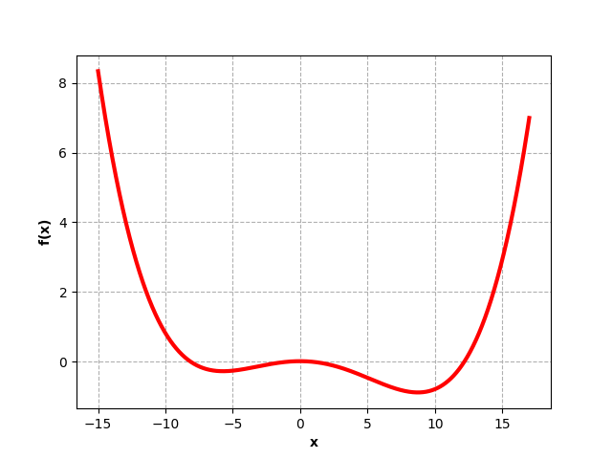



Global vs. local minimum
$${f(x}_{min})$$
$$x_{min}^{∗}$$
$$x_{min}$$

Slide 10
Greedy method

Slide 11
Greedy method
Greedy algorithms are a very efficient choice on solving optimization problems
A greedy algorithm always makes a choice that looks best at the moment
It makes a locally optimal choice
The hope is that such choices will also lead to a globally optimal solution
This does not always happen
However, locally optimal solutions found by greedy algorithms are typically of very good quality
Hence, greedy algorithms represent a good balance between efficiency and solution quality

Slide 12
Activity Selection Problem

Slide 13
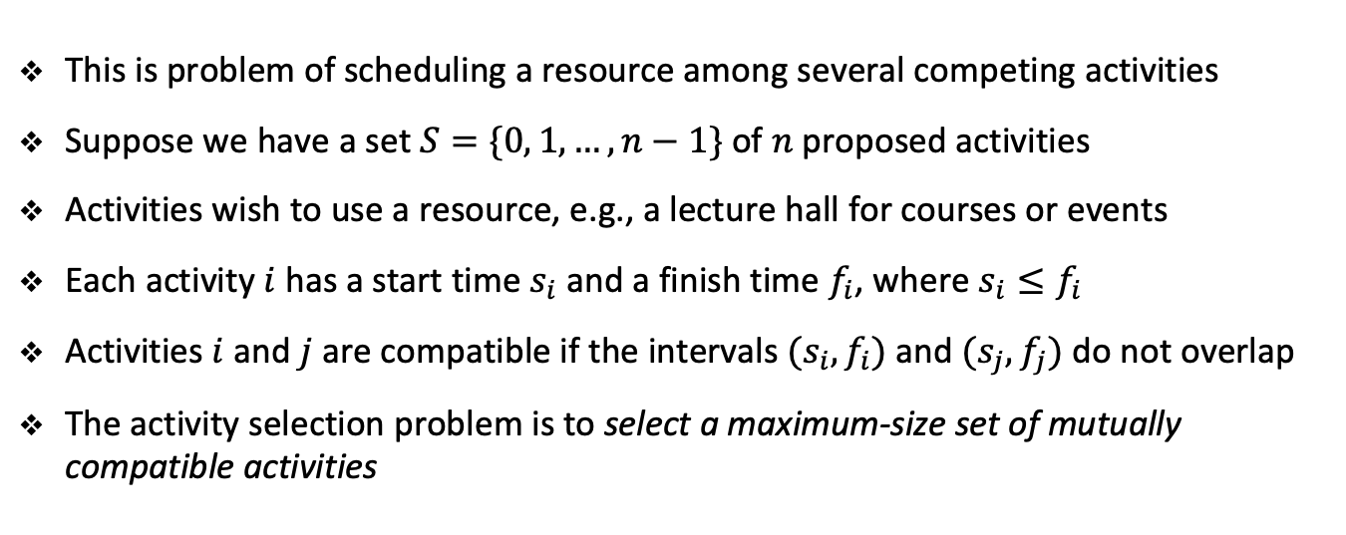
Activity selection problem
This is problem of scheduling a resource among several competing activities
Suppose we have a set $S=\{0, 1, …, n−1\}$of $n$ proposed activities
Activities wish to use a resource, e.g., a lecture hall for courses or events
Each activity $i$ has a start time $s_{i}$ and a finish time $f_{i}$, where $s_{i}≤f_{i}$
Activities $i$ and $j$ are compatible if the intervals $(s_{i}, f_{i})$and $(s_{j}, f_{j})$do not overlap
The activity selection problem is to select a maximum-size set of mutually compatible activities

Slide 14
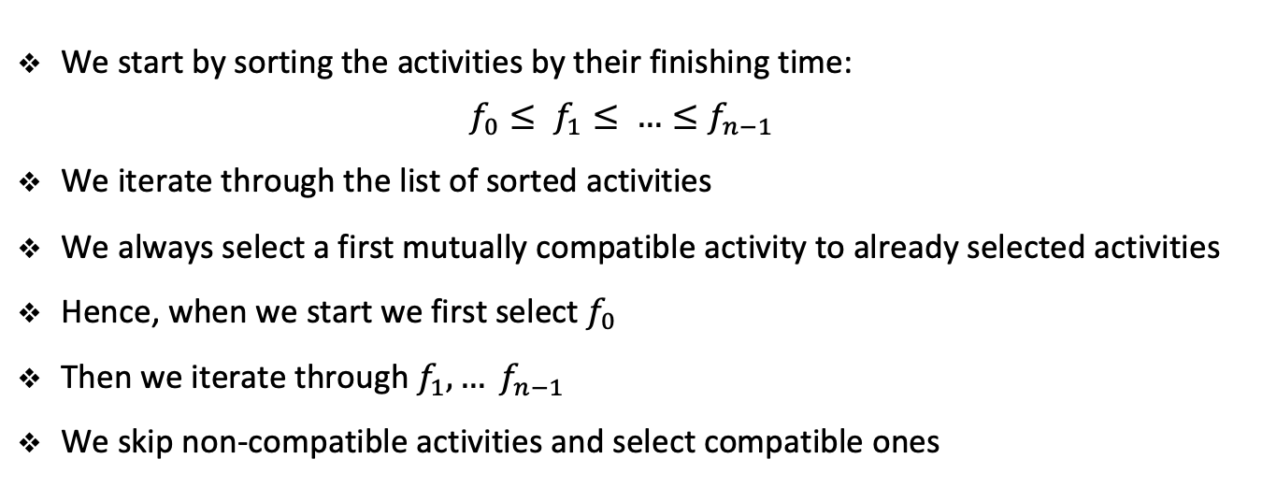
Activity selection problem
We start by sorting the activities by their finishing time:
$$f_{0}≤ f_{1}≤ …≤f_{n−1}$$
We iterate through the list of sorted activities
We always select a first mutually compatible activity to already selected activities
Hence, when we start we first select $f_{0}$
Then we iterate through $f_{1}, … f_{n−1}$
We skip non-compatible activities and select compatible ones

Slide 15
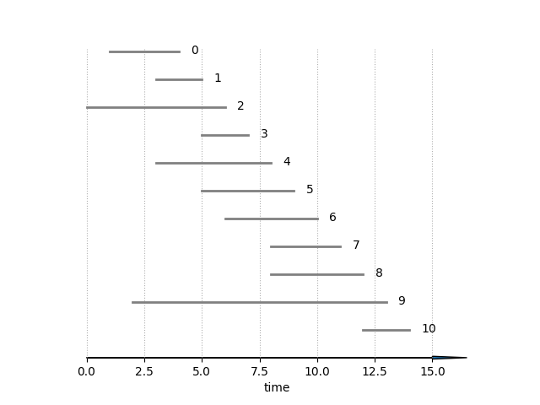
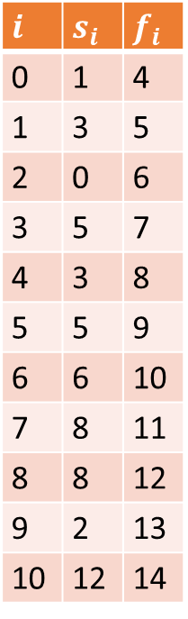
Activity selection
$$i$$ | $$s_{i}$$ | $$f_{i}$$
0 | 1 | 4
1 | 3 | 5
2 | 0 | 6
3 | 5 | 7
4 | 3 | 8
5 | 5 | 9
6 | 6 | 10
7 | 8 | 11
8 | 8 | 12
9 | 2 | 13
10 | 12 | 14

Slide 16
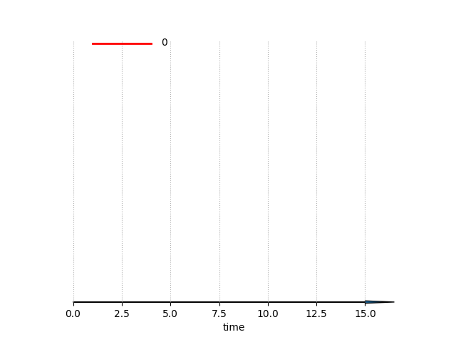
Activity selection
$$i$$ | $$s_{i}$$ | $$f_{i}$$
0 | 1 | 4
1 | 3 | 5
2 | 0 | 6
3 | 5 | 7
4 | 3 | 8
5 | 5 | 9
6 | 6 | 10
7 | 8 | 11
8 | 8 | 12
9 | 2 | 13
10 | 12 | 14

Slide 17
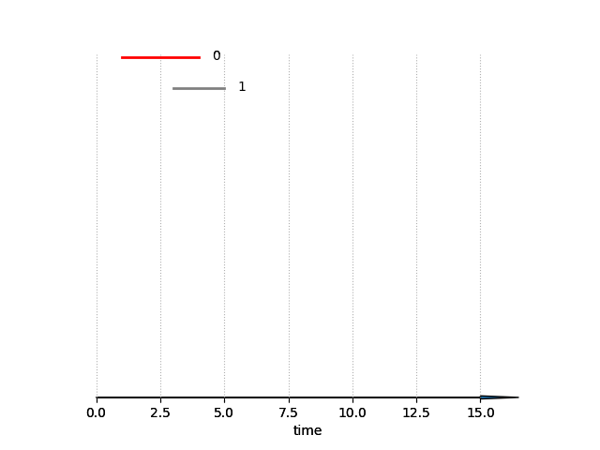
Activity selection
$$i$$ | $$s_{i}$$ | $$f_{i}$$
0 | 1 | 4
1 | 3 | 5
2 | 0 | 6
3 | 5 | 7
4 | 3 | 8
5 | 5 | 9
6 | 6 | 10
7 | 8 | 11
8 | 8 | 12
9 | 2 | 13
10 | 12 | 14

Slide 18
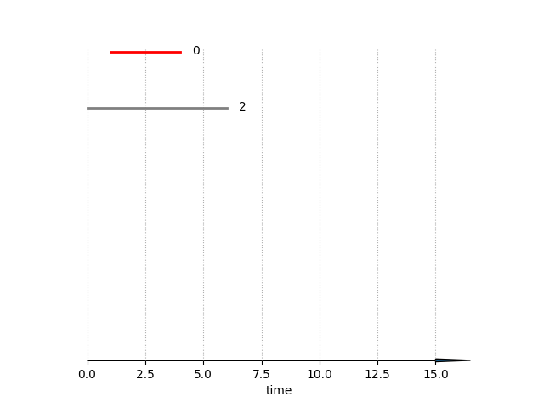
Activity selection
$$i$$ | $$s_{i}$$ | $$f_{i}$$
0 | 1 | 4
1 | 3 | 5
2 | 0 | 6
3 | 5 | 7
4 | 3 | 8
5 | 5 | 9
6 | 6 | 10
7 | 8 | 11
8 | 8 | 12
9 | 2 | 13
10 | 12 | 14

Slide 19
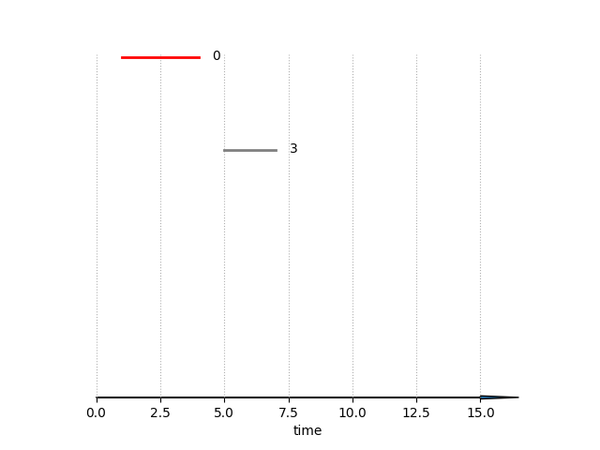
Activity selection
$$i$$ | $$s_{i}$$ | $$f_{i}$$
0 | 1 | 4
1 | 3 | 5
2 | 0 | 6
3 | 5 | 7
4 | 3 | 8
5 | 5 | 9
6 | 6 | 10
7 | 8 | 11
8 | 8 | 12
9 | 2 | 13
10 | 12 | 14

Slide 20
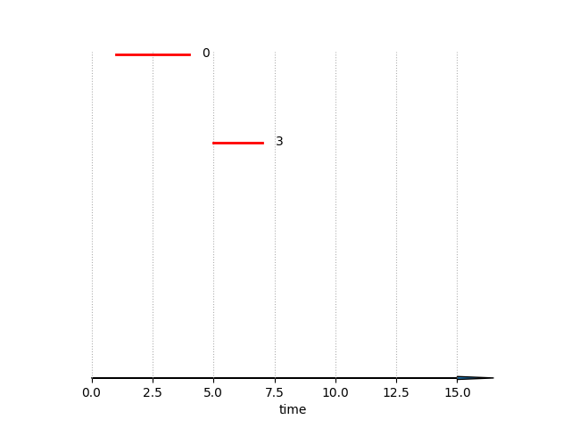
Activity selection
$$i$$ | $$s_{i}$$ | $$f_{i}$$
0 | 1 | 4
1 | 3 | 5
2 | 0 | 6
3 | 5 | 7
4 | 3 | 8
5 | 5 | 9
6 | 6 | 10
7 | 8 | 11
8 | 8 | 12
9 | 2 | 13
10 | 12 | 14

Slide 21
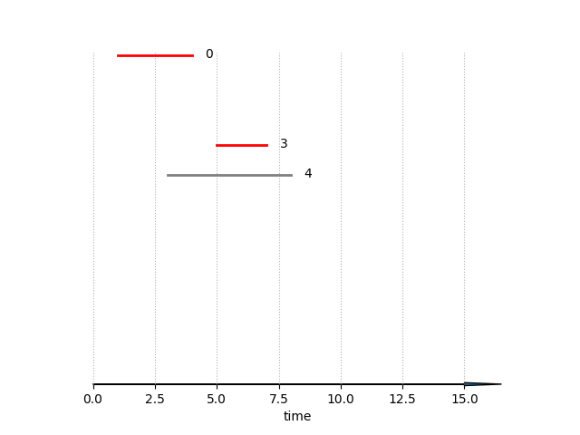
Activity selection
$$i$$ | $$s_{i}$$ | $$f_{i}$$
0 | 1 | 4
1 | 3 | 5
2 | 0 | 6
3 | 5 | 7
4 | 3 | 8
5 | 5 | 9
6 | 6 | 10
7 | 8 | 11
8 | 8 | 12
9 | 2 | 13
10 | 12 | 14

Slide 22
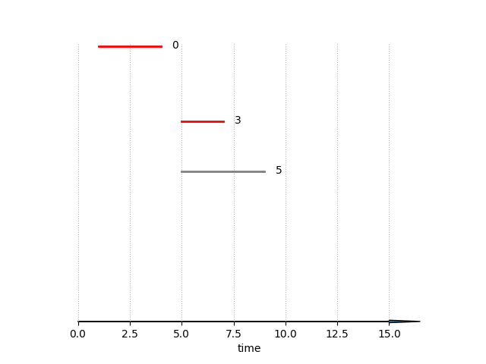
Activity selection
$$i$$ | $$s_{i}$$ | $$f_{i}$$
0 | 1 | 4
1 | 3 | 5
2 | 0 | 6
3 | 5 | 7
4 | 3 | 8
5 | 5 | 9
6 | 6 | 10
7 | 8 | 11
8 | 8 | 12
9 | 2 | 13
10 | 12 | 14

Slide 23
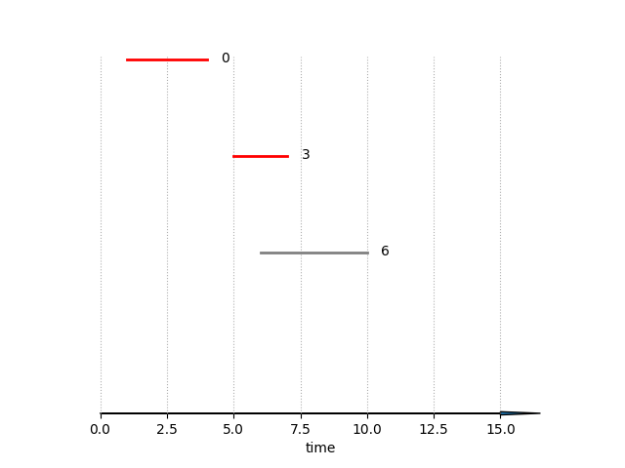
Activity selection
$$i$$ | $$s_{i}$$ | $$f_{i}$$
0 | 1 | 4
1 | 3 | 5
2 | 0 | 6
3 | 5 | 7
4 | 3 | 8
5 | 5 | 9
6 | 6 | 10
7 | 8 | 11
8 | 8 | 12
9 | 2 | 13
10 | 12 | 14

Slide 24
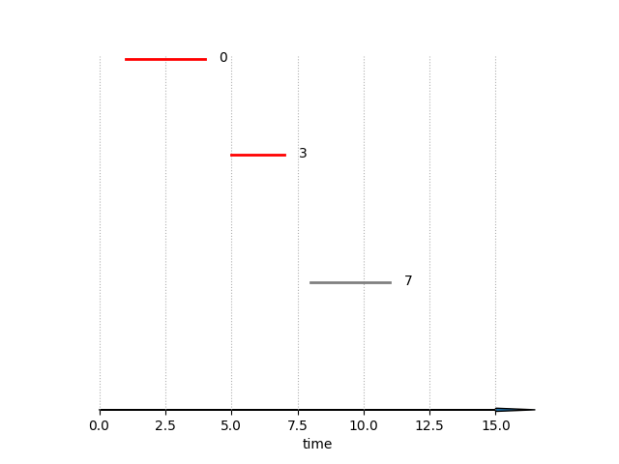
Activity selection
$$i$$ | $$s_{i}$$ | $$f_{i}$$
0 | 1 | 4
1 | 3 | 5
2 | 0 | 6
3 | 5 | 7
4 | 3 | 8
5 | 5 | 9
6 | 6 | 10
7 | 8 | 11
8 | 8 | 12
9 | 2 | 13
10 | 12 | 14

Slide 25
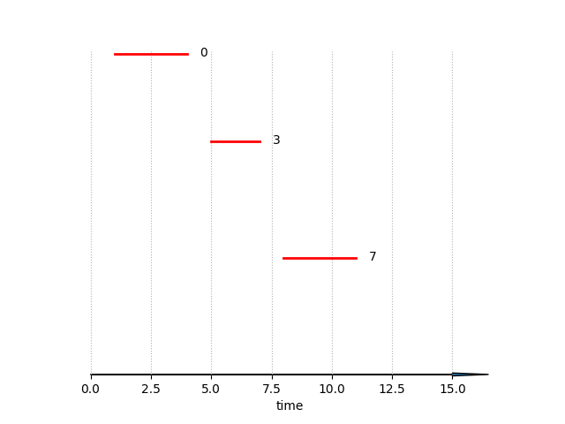
Activity selection
$$i$$ | $$s_{i}$$ | $$f_{i}$$
0 | 1 | 4
1 | 3 | 5
2 | 0 | 6
3 | 5 | 7
4 | 3 | 8
5 | 5 | 9
6 | 6 | 10
7 | 8 | 11
8 | 8 | 12
9 | 2 | 13
10 | 12 | 14

Slide 26
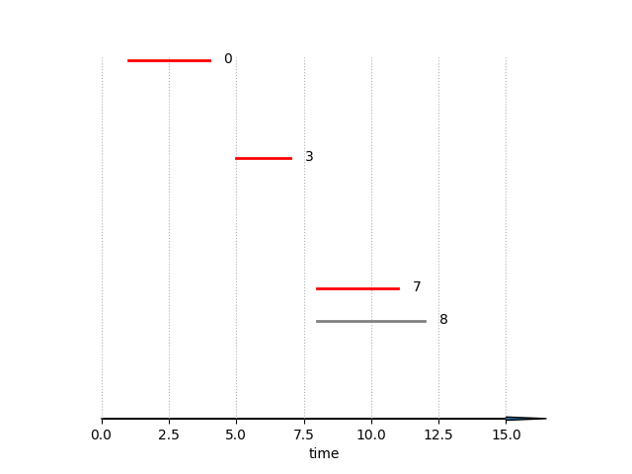
Activity selection
$$i$$ | $$s_{i}$$ | $$f_{i}$$
0 | 1 | 4
1 | 3 | 5
2 | 0 | 6
3 | 5 | 7
4 | 3 | 8
5 | 5 | 9
6 | 6 | 10
7 | 8 | 11
8 | 8 | 12
9 | 2 | 13
10 | 12 | 14

Slide 27
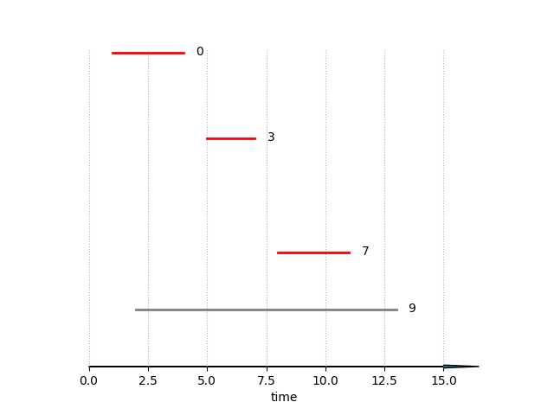
Activity selection
$$i$$ | $$s_{i}$$ | $$f_{i}$$
0 | 1 | 4
1 | 3 | 5
2 | 0 | 6
3 | 5 | 7
4 | 3 | 8
5 | 5 | 9
6 | 6 | 10
7 | 8 | 11
8 | 8 | 12
9 | 2 | 13
10 | 12 | 14

Slide 28
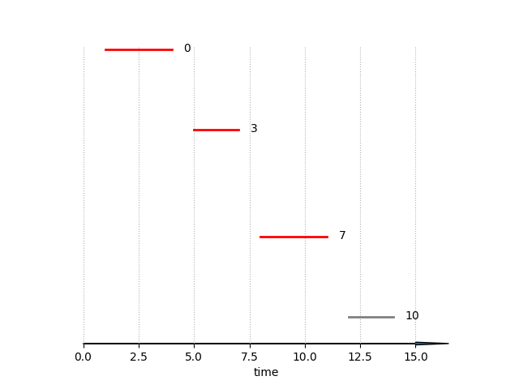
Activity selection
$$i$$ | $$s_{i}$$ | $$f_{i}$$
0 | 1 | 4
1 | 3 | 5
2 | 0 | 6
3 | 5 | 7
4 | 3 | 8
5 | 5 | 9
6 | 6 | 10
7 | 8 | 11
8 | 8 | 12
9 | 2 | 13
10 | 12 | 14

Slide 29
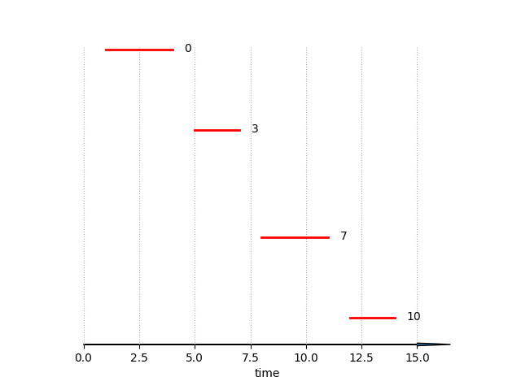
Activity selection
$$i$$ | $$s_{i}$$ | $$f_{i}$$
0 | 1 | 4
1 | 3 | 5
2 | 0 | 6
3 | 5 | 7
4 | 3 | 8
5 | 5 | 9
6 | 6 | 10
7 | 8 | 11
8 | 8 | 12
9 | 2 | 13
10 | 12 | 14

Slide 30
Activity selection
def select(activities):
activities.sort(key = lambda x: x[1])
result = [activities[0]]
indices = [0]
j = 0
for i in range(1, len(activities)):
if activities[i][0] >= activities[j][1]:
result.append(activities[i])
indices.append(i)
j = i
return result, indices
Notebook example

Slide 31
Activity selection problem
The activity picked next is always the one with the earliest legal finishing time
The activity picked is thus a “greedy” choice
It leaves as much opportunity (time) as possible for the remaining activities
We (locally) optimize the amount of unscheduled time remaining
It turns out that this algorithm also finds a global optimum

Slide 32
Exercise

Slide 33
Student task
Task 1: Show that our activity selection greedy algorithm produces solutions of (globally) maximum size for the activity selection problem.
Task 2: Suppose that we have a set of activities to schedule among a large number of lecture halls. We wish to schedule all the activities using as few lecture halls as possible. Give an efficient greedy algorithm to determine which activity should use which lecture hall.
Task 3: Interval-graph coloring problem. An interval (intersection) graph is an undirected graph constructed from a set of intervals on the real line. Each interval is a node in the graph and two nodes are connected to each other by a link if their intervals intersect with each other. In the graph coloring problem we want to color every node of the graph so that no two connected nodes are given the same color. Can you relate this problem to the problem from Task 2?

Slide 34
Huffman codes

Slide 35
Data compression
Huffman codes are a widely used technique for compressing data
Typically, they are used for text compression
They achieve savings of 20% to 90%
Huffman codes are created by a greedy Huffman algorithm
The algorithm uses a table of character occurrence frequencies
The table is used to build an optimal binary code for each character

Slide 36
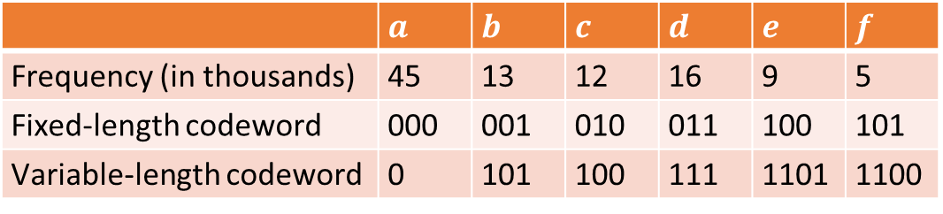
Occurrence frequencies
Suppose we have a 100,000 character data in a file that we want to compress
Characters are Unicode encoded with 2 bytes per character
Hence, uncompressed file is 200KB in size
We observe that there are only six different characters appearing in the file
The table gives their occurrence frequencies
 | $$a$$ | $$b$$ | $$c$$ | $$d$$ | $$e$$ | $$f$$
Frequency (in thousands) | 45 | 13 | 12 | 16 | 9 | 5
Fixed-length codeword | 000 | 001 | 010 | 011 | 100 | 101
Variable-length codeword | 0 | 101 | 100 | 111 | 1101 | 1100
If we use a fixed-length code, we need three bits to represent six characters
A variable-length code can give frequent characters shorter codewords

Slide 37
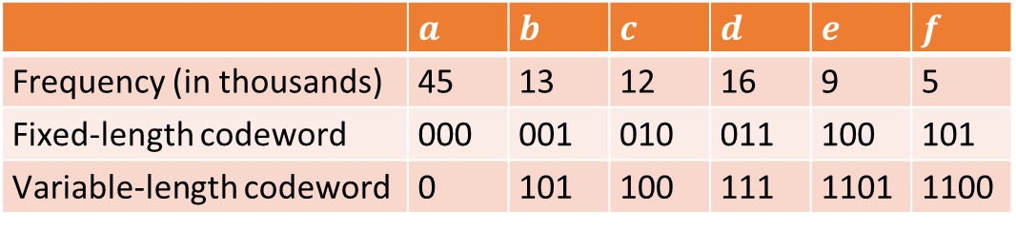
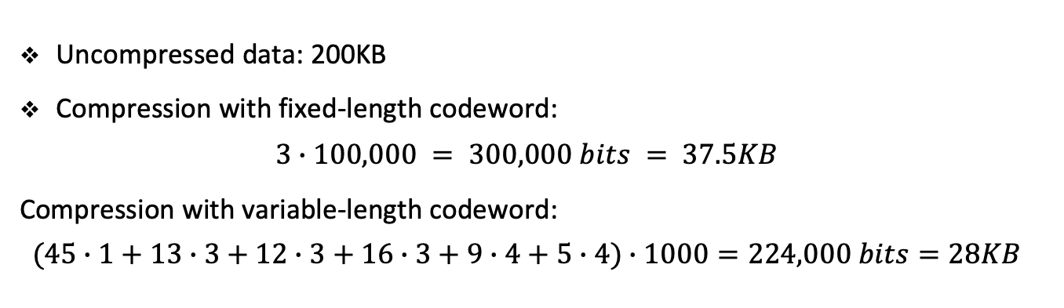
Occurrence frequencies
 | $$a$$ | $$b$$ | $$c$$ | $$d$$ | $$e$$ | $$f$$
Frequency (in thousands) | 45 | 13 | 12 | 16 | 9 | 5
Fixed-length codeword | 000 | 001 | 010 | 011 | 100 | 101
Variable-length codeword | 0 | 101 | 100 | 111 | 1101 | 1100
Uncompressed data: 200KB
Compression with fixed-length codeword:
$$3∙100,000 = 300,000 bits = 37.5KB$$
Compression with variable-length codeword:
$$(45∙1+13∙3+12∙3+16∙3+9∙4+5∙4)∙1000=224,000 bits=28KB$$

Slide 38
Prefix codes
We consider here only codes in which no codeword is prefix of another codeword
Such codes are called prefix codes
Prefix codes simplify encoding (compression) and decoding (decompression)
Encoding is simply concatenating the codewords for single characters
Decoding is also fairly simple since no codeword is a prefix of any other:
We identify the initial codeword
Translate it back to the original character
Remove it from the encoded file
Then we repeat the process for the remainder of the encoded file

Slide 39
Exercise

Slide 40
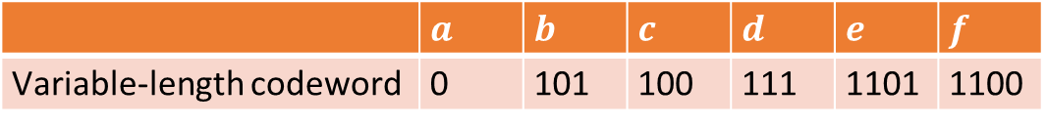
Student task
Task 4: Using the codes from the previous example encode the string ‘abc’. Then decode the string ‘00101110100’.
Why should we not encode ‘c’ simply with ‘10’? Check this by decoding above string again with ’10’ as the code for ‘c’.
 | $$a$$ | $$b$$ | $$c$$ | $$d$$ | $$e$$ | $$f$$
Variable-length codeword | 0 | 101 | 100 | 111 | 1101 | 1100

Slide 41
Codeword representation
The decoding process needs an efficient representation of the codewords
Used to find the initial codeword
We will use a binary tree with characters stored as leaves
We interpret the codeword as a path from the root to a character
We encode the left child as 0 and the right child as 1
Each leaf is labeled with a character and its occurrence frequency
Each internal node is labeled with the sum of weights of the leaves in the subtree

Slide 42



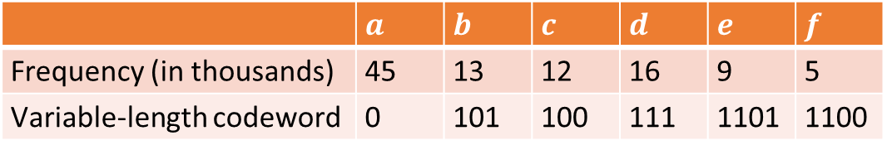







Codeword construction
 | $$a$$ | $$b$$ | $$c$$ | $$d$$ | $$e$$ | $$f$$
Frequency (in thousands) | 45 | 13 | 12 | 16 | 9 | 5
Variable-length codeword | 0 | 101 | 100 | 111 | 1101 | 1100
100
0
1
$$a:45$$
$$55$$
0
1
$$25$$
$$30$$
0
1
0
1
$$c:12$$
$$b:13$$
$$14$$
$$d:16$$
0
1
$$f:5$$
$$e:9$$

Slide 43
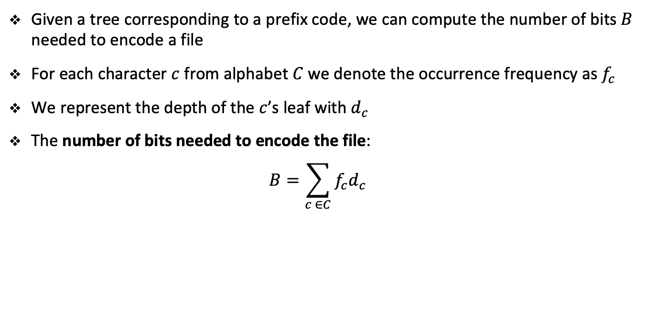
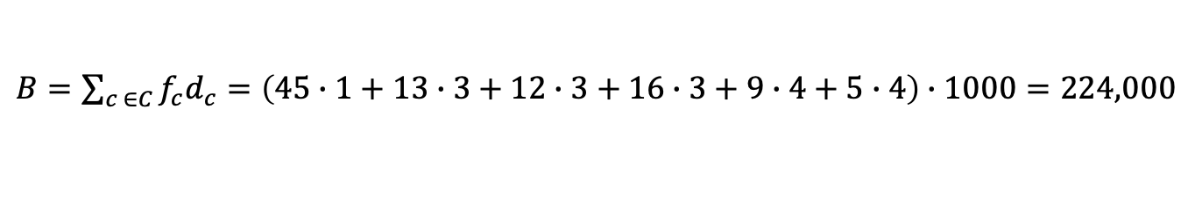
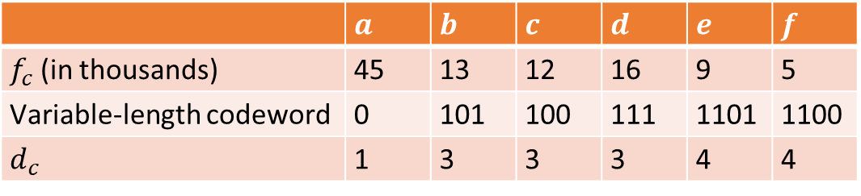
Number of bits
Given a tree corresponding to a prefix code, we can compute the number of bits $B$ needed to encode a file
For each character $c$ from alphabet $C$ we denote the occurrence frequency as $f_{c}$
We represent the depth of the $c$’s leaf with $d_{c}$
The number of bits needed to encode the file:
$$B=\sum_{c ∈C}{f_{c}d_{c}}$$
 | $$a$$ | $$b$$ | $$c$$ | $$d$$ | $$e$$ | $$f$$
$f_{c}$(in thousands) | 45 | 13 | 12 | 16 | 9 | 5
Variable-length codeword | 0 | 101 | 100 | 111 | 1101 | 1100
$$d_{c}$$ | 1 | 3 | 3 | 3 | 4 | 4
$B=\sum_{c ∈C}{f_{c}d_{c}}=\left(45∙1+13∙3+12∙3+16∙3+9∙4+5∙4\right)∙1000=224,000$

Slide 44
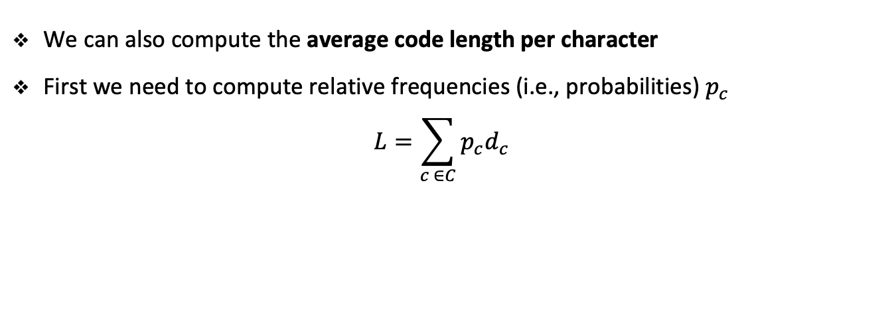
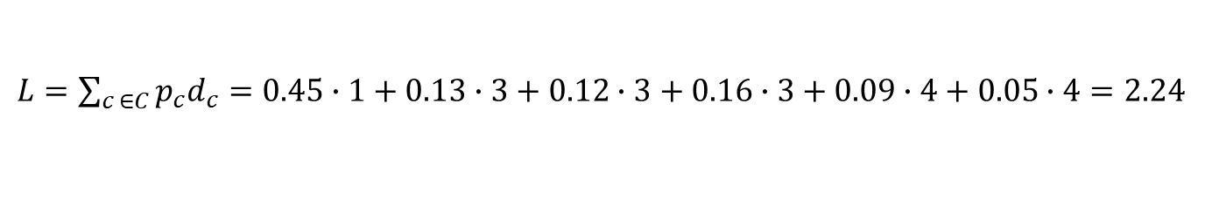
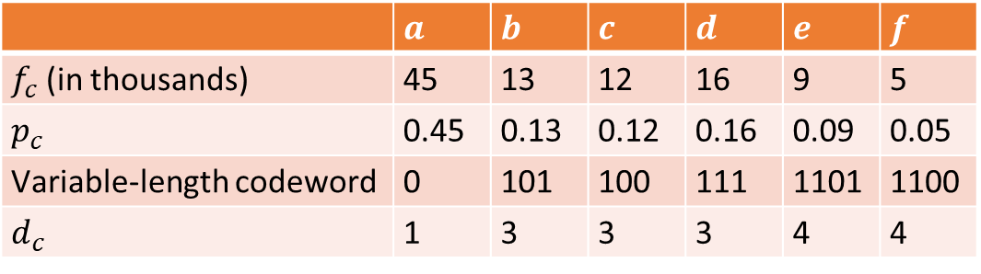
Average code length
We can also compute the average code length per character
First we need to compute relative frequencies (i.e., probabilities) $p_{c}$
$$L=\sum_{c ∈C}{p_{c}d_{c}}$$
 | $$a$$ | $$b$$ | $$c$$ | $$d$$ | $$e$$ | $$f$$
$f_{c}$(in thousands) | 45 | 13 | 12 | 16 | 9 | 5
$$p_{c}$$ | 0.45 | 0.13 | 0.12 | 0.16 | 0.09 | 0.05
Variable-length codeword | 0 | 101 | 100 | 111 | 1101 | 1100
$$d_{c}$$ | 1 | 3 | 3 | 3 | 4 | 4
$L=\sum_{c ∈C}{p_{c}d_{c}}=0.45∙1+0.13∙3+0.12∙3+0.16∙3+0.09∙4+0.05∙4=2.24$

Slide 45
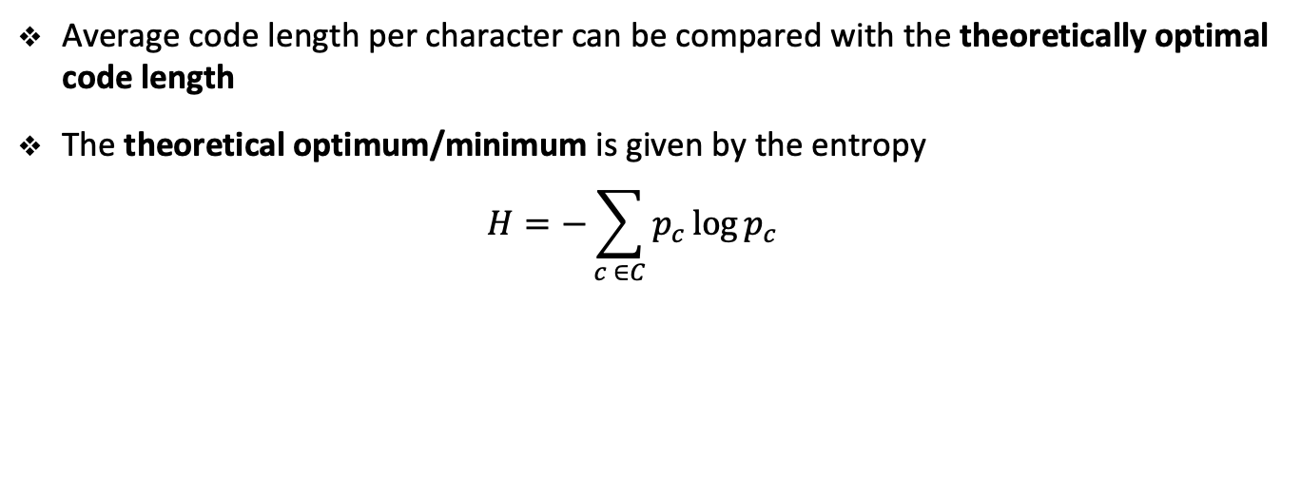
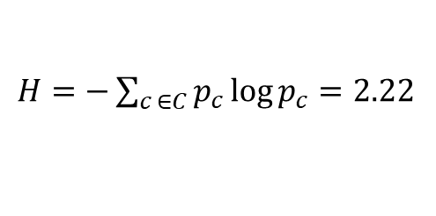
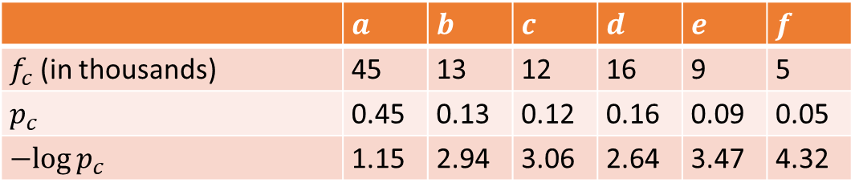
Optimal code length
Average code length per character can be compared with the theoretically optimal code length
The theoretical optimum/minimum is given by the entropy
$$H=−\sum_{c ∈C}{p_{c}\log{p_{c}}}$$
 | $$a$$ | $$b$$ | $$c$$ | $$d$$ | $$e$$ | $$f$$
$f_{c}$(in thousands) | 45 | 13 | 12 | 16 | 9 | 5
$$p_{c}$$ | 0.45 | 0.13 | 0.12 | 0.16 | 0.09 | 0.05
$$−log{p_{c}}$$ | 1.15 | 2.94 | 3.06 | 2.64 | 3.47 | 4.32
$H=−\sum_{c ∈C}{p_{c}\log{p_{c}}}=2.22$

Slide 46
Constructing Huffman codes
Notes:
Log base 2

Slide 47
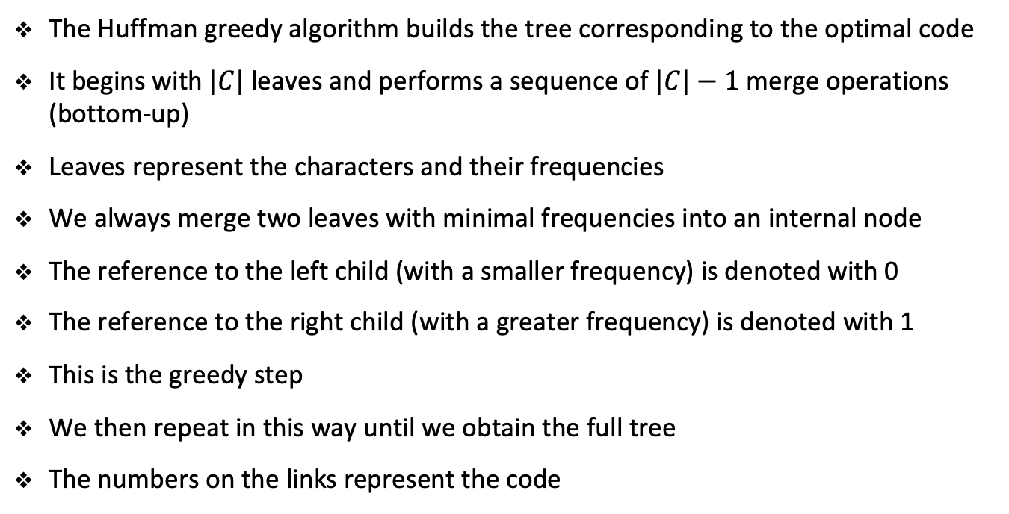
Greedy algorithm for Huffman codes
The Huffman greedy algorithm builds the tree corresponding to the optimal code
It begins with$|C|$leaves and performs a sequence of $|C|−1$merge operations (bottom-up)
Leaves represent the characters and their frequencies
We always merge two leaves with minimal frequencies into an internal node
The reference to the left child (with a smaller frequency) is denoted with 0
The reference to the right child (with a greater frequency) is denoted with 1
This is the greedy step
We then repeat in this way until we obtain the full tree
The numbers on the links represent the code

Slide 48






Greedy algorithm for Huffman codes
 | $$a$$ | $$b$$ | $$c$$ | $$d$$ | $$e$$ | $$f$$
Frequency (in thousands) | 45 | 13 | 12 | 16 | 9 | 5
Variable-length codeword | 0 | 101 | 100 | 111 | 1101 | 1100
100
1
$$55$$
1
0
0
$$30$$
0
1
$$25$$
$$14$$
0
1
0
1
$$a:45$$
$$c:12$$
$$b:13$$
$$f:5$$
$$e:9$$
$$d:16$$

Slide 49
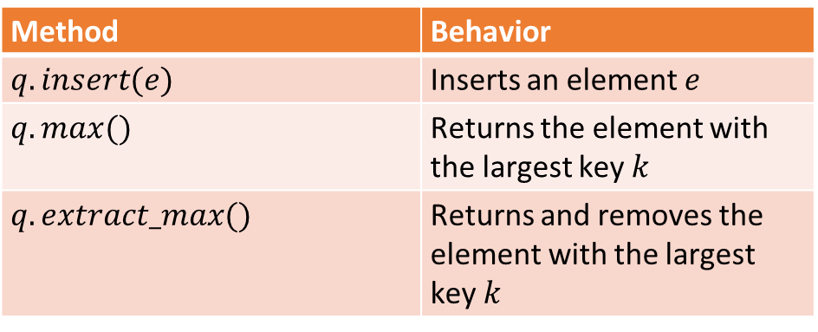
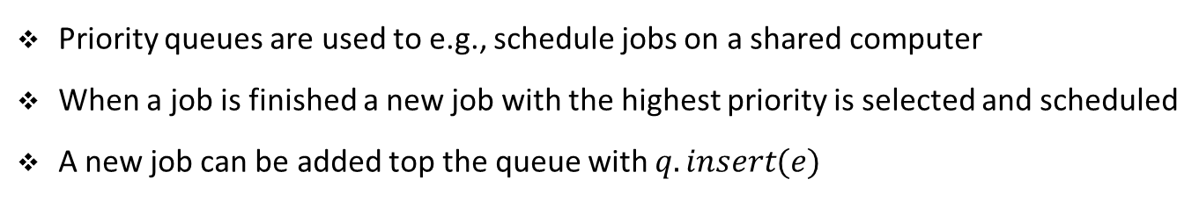
Priority queue
To implement the Huffman greedy algorithm, we need a priority queue
A priority queue is a data structure that maintains a set of elements with keys
It has the following interface
Method | Behavior
$$q.insert(e)$$ | Inserts an element $e$
$$q.max()$$ | Returns the element with the largest key $k$
$$q.extract_max()$$ | Returns and removes the element with the largest key $k$
Priority queues are used to e.g., schedule jobs on a shared computer
When a job is finished a new job with the highest priority is selected and scheduled
A new job can be added top the queue with $q.insert(e)$

Slide 50
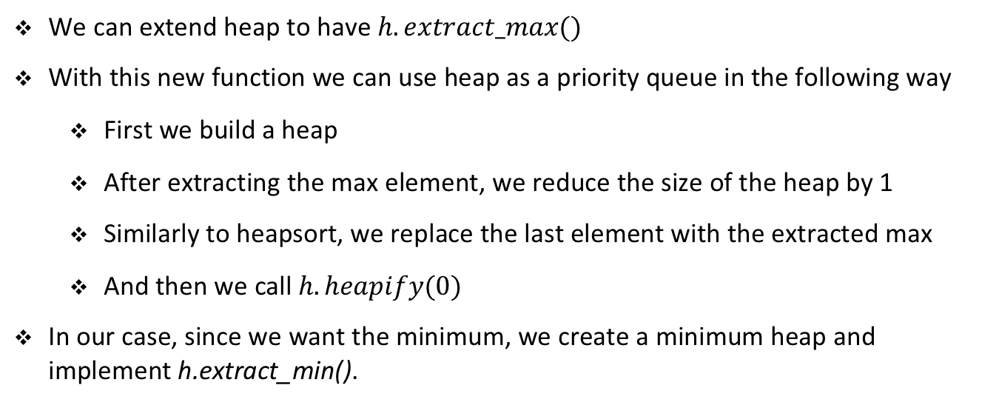
Implementing priority queues with heaps
We can extend heap to have $h.extract_max()$
With this new function we can use heap as a priority queue in the following way
First we build a heap
After extracting the max element, we reduce the size of the heap by 1
Similarly to heapsort, we replace the last element with the extracted max
And then we call $h.heapify(0)$
In our case, since we want the minimum, we create a minimum heap and implement h.extract_min().

Slide 51
Priority queue
def extract_min(self):
result = self.a[0]
self.a[0] = self.a[self.size - 1]
self.size -= 1
self.heapify(0)
return result
def insert(self, e):
self.size += 1
if len(self.a) < self.size:
self.a.append(e)
else:
self.a[self.size] = e
i = self.size - 1
while i > 0 and self.a[Heap.parent(i)] > e:
self.a[i] = self.a[Heap.parent(i)]
i = Heap.parent(i)
self.a[i] = e
Notebook example

Slide 52
Exercise

Slide 53
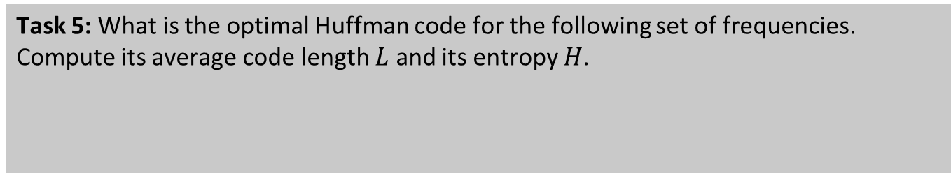
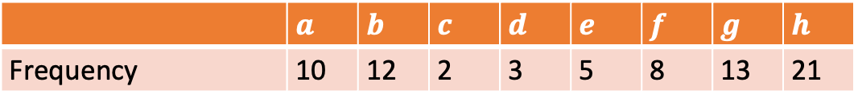
Student task
Task 5: What is the optimal Huffman code for the following set of frequencies. Compute its average code length $L$ and its entropy $H$.
 | $$a$$ | $$b$$ | $$c$$ | $$d$$ | $$e$$ | $$f$$ | $$g$$ | $$h$$
Frequency | 10 | 12 | 2 | 3 | 5 | 8 | 13 | 21

